Slide 1

Basic Electricity
Prepared by Tom Lawton, TESCO
For Mid-South Annual Meter School
May 3, 2022
10:00 AM
Group 1

Slide 2
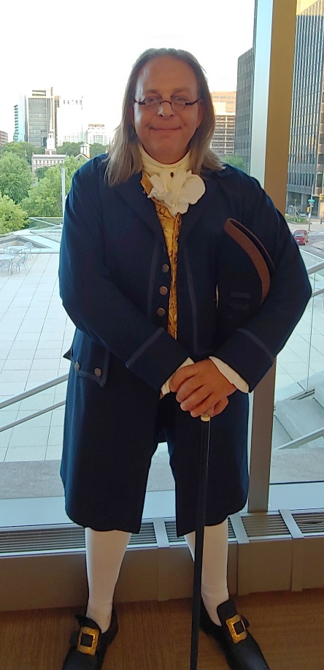
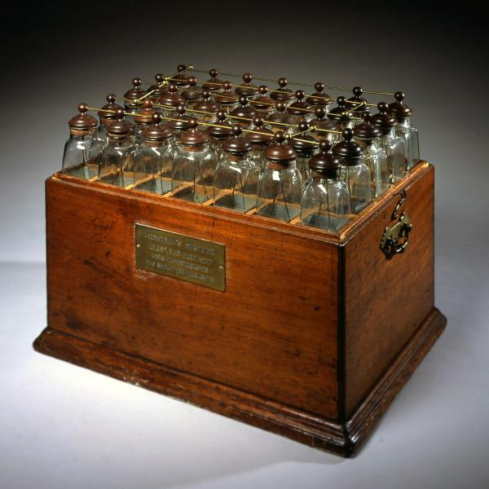
Franklin’s Electric “Battery” circa 1760
Actually his “battery” was actually
a collection of Leyden jars which were an early capacitor
Franklin called them a battery, using the military term for weapons functioning together.
Using this he designed an electric motor that could move at 12 to 15 rpm’s and thought this would be perfect for powering a rotisserie.
Ben Franklin’s “Battery,” on display at the American Philosophical Society, Philadelphia, PA
Ben Franklin at TESCO’s Users Group with Independence Hall in the background, Philadelphia, PA

Slide 3
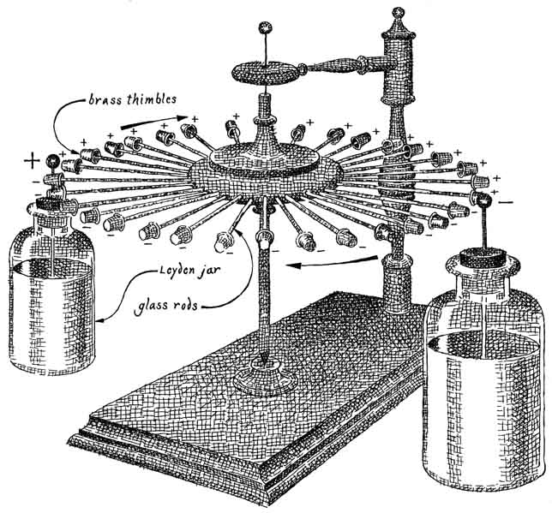
Voltaic Piles and Electric Motors
Franklin felt that his electric motor was not powerful enough to compete with water wheels or steam engines that were just coming on the scene.
The publication where he introduced this concept was eagerly seized upon by the world and cemented Franklin’s International reputation. But not for the battery . For the lightening rod.
In 1799 the Italian Alessandro Volta invented the first actual battery which were initially called “piles”.

Slide 4
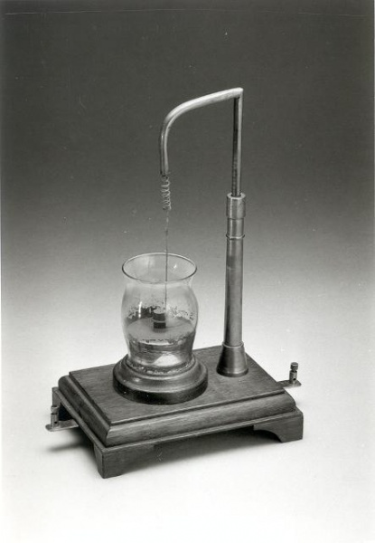
Michael Faraday
By 1831 British Physicist Michael Faraday discovers the principle of electromagnetism and goes on to discover electromagnetic induction and hydroelectricity among other things.
By 1832 he builds the first electric motor, the first generator and the first transformer

Slide 5
A Little History
1800 Volta
  First electric battery
1802
  Electric Arc Lamp invented
1830-31 Faraday and Henry
  Changing magnetic field can induce an electric current. Build first very crude electric motors in lab.
1832 Pixii
  First crude generation of an AC current.
1856 Siemens
  First really practical electric motor
1860s Varley, Siemens and Wheatstone
  Each develop electric dynamos (DC Generators).

Slide 6
Electricity Starts to Take Off
1870s
  First electric railroad and street lights in Berlin (DC).
1879 Edison
  Incandescent light bulb
1880
  First electric elevator (DC).
1885-88 Thomson, Ferraris, Tesla
  Each develop AC electric induction motors.
  Tesla is granted a US patent for induction motor in 1888.
1890 Dolivo-Dobrovolsky
  First three phase generator, motor and transformer

Slide 7
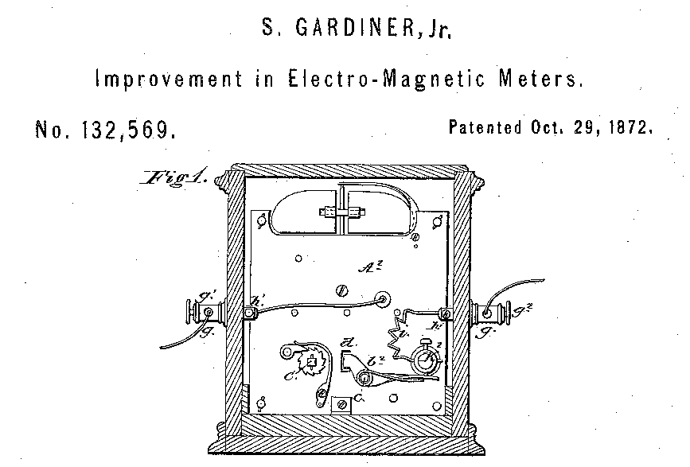
First Meters
1872 - Samuel Gardiner takes out the first known patent on an electric meter. This was a DC lamp-hour meter that was a clock with an electromagnet that started and stopped the mechanism.
1878 - J.B. Fuller takes out a patent on an AC lamp-hour meter that was a clock operated by an armature that vibrated between two coils.
Image from original patent for Samuel Gardiner’s electric meter.

Slide 8
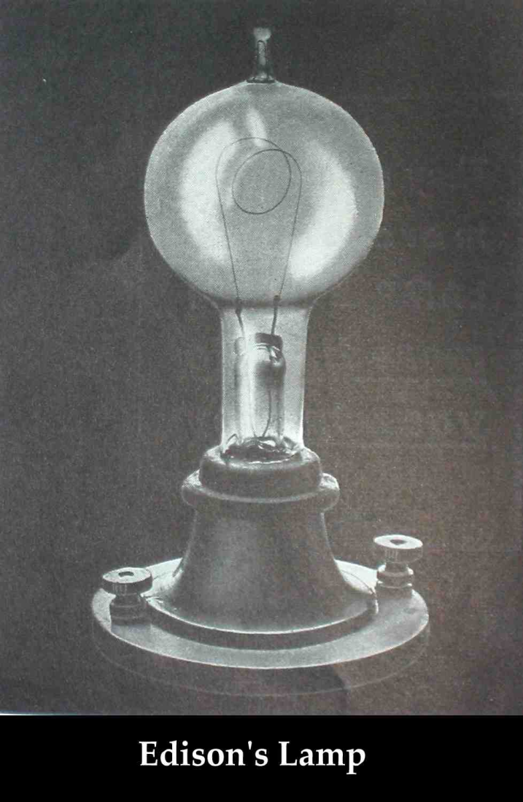
1880: Edison Illuminating Company Formed
September 4, 1882: First central power plant-Pearl Street Station in lower Manhattan
One generator produced power for 800 electric light bulbs.
In 14 months, Pearl Street Station had 508 subscribers and 12,732 bulbs.

Slide 9
AC vs DC
Direct Current (DC) – an electric current that flows in one direction.(IEEE100)
Alternating Current (AC) – an electric current that reverses direction at regularly recurring intervals of time. (IEEE100)

Slide 10
AC vs DC
Edison and Westinghouse
  Edison favored DC power distribution, Westinghouse championed AC distribution.
  The first US commercial electric systems were Edison’s DC systems.
First AC system was in 1893 in Redlands, CA. Developed by Almirian Decker it used 10,000 volt, three phase primary distribution.

Slide 11
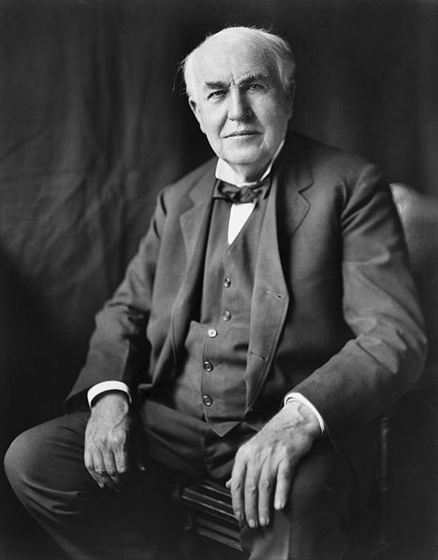
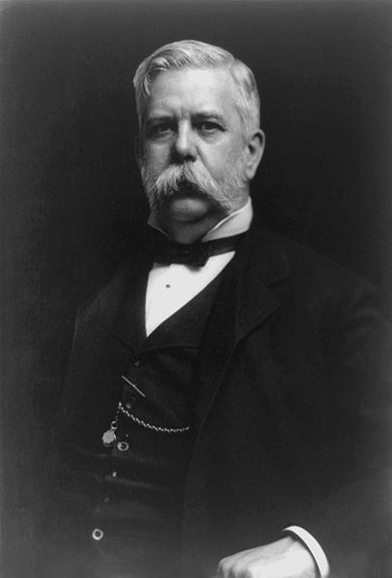
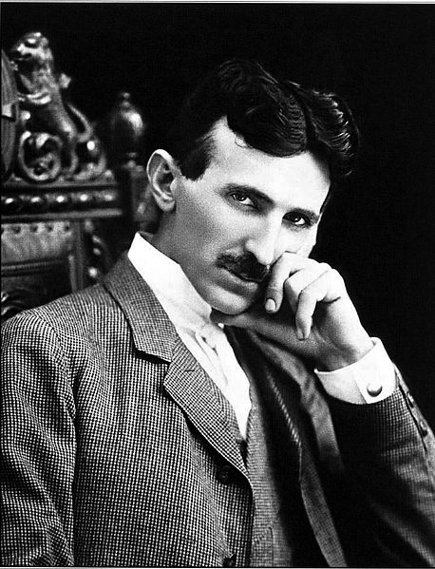
War of the Currents
Thomas Edison
George Westinghouse
Nikola Tesla

Slide 12
Thomas Edison - 1889
"Fooling around with alternating current is just a waste of time. Nobody will use it, ever."
- Thomas Edison, 1889

Slide 13
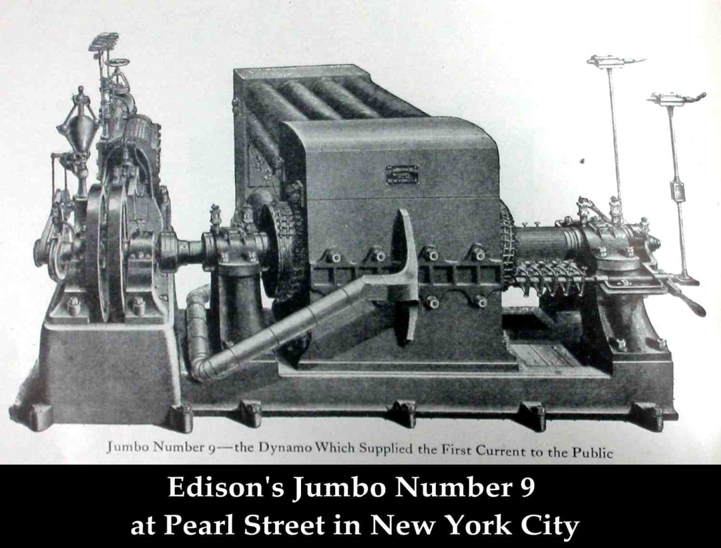
The Problem with Direct Current
High losses required generators to be near the loads – maximum of one mile without huge conductors
Difficult to change voltages for transmission with DC

Slide 14
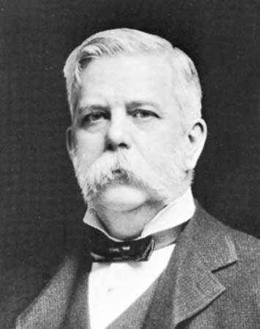
Westinghouse
1884 – George Westinghouse establishes the Union Switch & Signal Co. in Pittsburgh, PA
Buys the U.S. rights to a transformer patented in Europe
The company reorganizes as the Westinghouse Electric and Manufacturing Company
William Stanley joins the company as the chief electrical engineer and Oliver B. Shallenberger resigns as an officer in the U.S. Navy to work under him as the chief electrician.
George Westinghouse

Slide 15
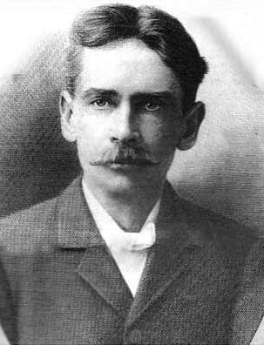
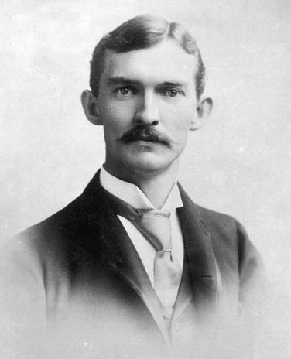
AC Starts to Win
Stanley and Schallenberger: They refine the transformer design and in 1886 Stanley demonstrates the first complete system of high voltage AC transmissions including generators, transformers, and high voltage transmission lines.
AC had none of the issues of DC (voltage drop in long lines and a lack of an easy way to increase or decrease the voltage). However there was no meter that could accurately record the usage of electricity on AC circuits.
William Stanley, Jr.
Oliver Schallenberger

Slide 16
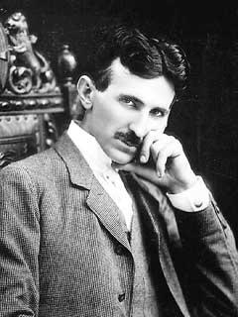
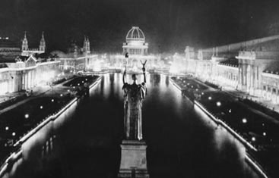
1888: A Young Serb Named Никола Тесла
(Nicola Tesla) Meets George Westinghouse
Nicola Tesla, "The Wizard of The West"
1893: World’s Fair Chicago lighted by Westinghouse / Tesla
1888: Westinghouse, American entrepreneur and engineer meets Tesla
1882: Induction Motor

Slide 17
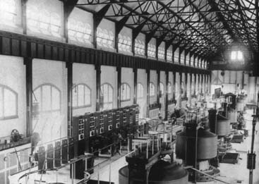
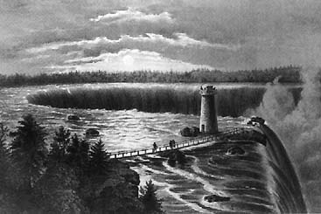
1893: Westinghouse Awarded the Contract for Powerhouse at Niagara Falls
Edward Dean Adams power station at Niagara, with ten 5,000-horsepower Tesla/Westinghouse AC generators — the culmination of Tesla's dream.
(Courtesy Smithsonian Institution)

Slide 18
AC Theory - History
By 1900 AC power systems had won the battle for power distribution.
  Transformers allowed more efficient distribution of power over large areas.
  AC motors were cheaper and easier to build.
  AC electric generators were easier to build.

Slide 19
AC Circuits
An AC circuit has three general characteristics
  Voltage
  Frequency
  Phase
In the US, the household value is 120 Volts with other common voltages being 208, 240, 277 and 480 Volts. The frequency is 60 Hertz (cycles per second).

Slide 20
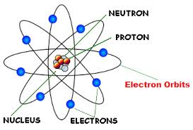
Some Background
The Atom
  All matter is made up of atoms.
  Atoms are composed of three particles
    Protons – with a positive charge
    Electrons – with a negative charge
    Neutrons – with no charge
Each atom has the same number of protons and electrons. That number is called the atomic number of the atom and determines the element.
For example: If the atomic number is 8 as shown in the figure to the left the element is Oxygen (O).

Slide 21
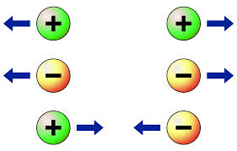
Some Background
Charge
  Opposite charges attract each other.
  That is what holds the electrons of an atom to the protons of the nucleus.
  Like charges repel each other.

Slide 22

Man “Discovers” Electricity
Static Electricity
  Awareness of a “strange force” goes back to the beginning of recorded history. Early man realized that rubbing a piece of amber with an animal skin imparted some mystical property to the amber.
    It would attract hair and small bits of debris.
    We get the same effect when we rub a balloon on a fur or cloth

Slide 23
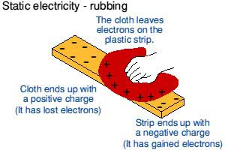
Man “Discovers” Electricity
Static Electricity
  What is this strange force? It “Static” electricity.
    Rubbing the cloth across an insulator causes electrons to move from one object to the other. This leaves one object with more electrons than it should have and the other with less. The cloth has less so it becomes positively charged.

Slide 24
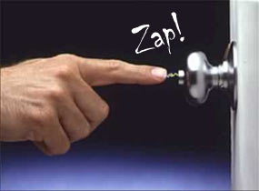
“Dynamic” Electricity
Current – Electrons flowing from one place to another
  If one object has a negative charge and another has a positive charge Electrons will flow from the negative to the positive if they are connected

Slide 25
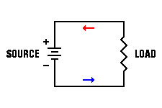
Practical Electricity
Direct Current – DC
  In our “zap” electrons briefly travelled from the negative object to the positive object.
    Until the excess electrons ran out the current flowed.
    Once they ran out the current stopped.
  A battery is a device that continuously supplies electrons through a chemical reaction.
    Hook the positive side of a battery through a load to the negative side and electrons will flow.
    This is a current (a flow of electrons)
    Since it goes in only one direction it is called DIRECT CURRENT

Slide 26

Practical Electricity
Direct Current – DC
  Sources of direct current include
    Batteries – electrons are supplied by a chemical reaction
    Thermocouples – electrons are supplied by heat
    Photovoltaic cells – electrons are supplied by light
    Electronic Power Supplies – Generally transform AC electricity to DC electricity because electronic devices run off of DC electricity
  There always has to be some form of energy to produce the electrons for the current
  Modern electronic devices all run off of DC electricity

Slide 27
DC Electricity
Basic Concepts
  Current – The flow of electrons
    The general convention is that a POSITIVE current is a current that flows from the positive terminal of the source to the negative terminal of the source
    Why – Electrons actually flow the other direction?
      Scientists made up the conventions long before they discovered electrons, they got it backwards and we still use the convention today.
  Voltage – A measure of the potential difference between two points
    Voltage is to current, as the pressure in a pipe is to the water
    The higher the voltage (potential difference), the easier it is for current to flow
  Impedance – Something which resists the flow of current.
    Resistor – The most common and simplest impedance
    Capacitor – An impedance which stores the electrons as they try to flow through
      Energy is stored in an electric field
    Inductor – An impedance which resists the change in current flowing through the device
      Energy is stored in a magnetic field

Slide 28
Basic Concepts: Electricity and Water
Comparing Electricity to Water flowing from a hose
  Voltage is the equivalent of the pressure in the hose
  Current is water flowing through a hose (coulombs/sec vs gal/sec). The water in a system is the “charge” (coulombs)
  Impedance(Resistance) is the size of the hose. The nozzle would provide a change in resistance.
  Power is how fast water flows from a pipe (gallons per minute vs kilowatts). Power is a rate of energy consumption

Slide 29
Basic Electrical Units
Charge – Coulombs
  “Q” – 1 coulomb = 6.2415 x10¹⁸ electron charges
Current – Amperes
  “I or A” – 1 ampere = 1 coulomb per second of charge flow
Voltage – Volt
  “V or E” – The potential difference required to do 1 joule of work
Impedance – Resistance - Ohm
  “R” – Resistance
  Ohm’s Law - V = IR
  One volt applied across one ohm results in 1 ampere of current.

Slide 30
Basic Electrical Laws
Ohms Law
  Voltage = Current times Resistance
  V = I X R
  THE MOST USEFUL AND THE MOST FUNDAMENTAL OF THE ELECTRICAL LAWS

Slide 31
Basic Electrical Units
Power – Watt
  A rate of energy consumption. A measure of work performed.
  For DC electricity = product of voltage and current
Energy – For Electricity – Watt-Hours (DC ONLY – AC IS MORE COMPLICATED)
  The energy when one ampere flows with a potential of one volt for one hour

Slide 32
Basic Electrical Laws
Ohms Law Examples
  If V = 20 volts and I = 5 amperes what is the resistance?
    R = V / I = 20 / 5 = 4 ohms
  If R = 20 ohms and V = 120 volts what is the current?
    I = V / R = 120 / 20 = 6 amps
  If I = 10 amperes and R = 24 ohms what is the voltage?
    V = I x R = 10 x 24 = 240 volts
  Problem: If V = 240 volts and R = 6 ohms what is the current?
    I = V / R = 240 / 6 = 40 amps

Slide 33
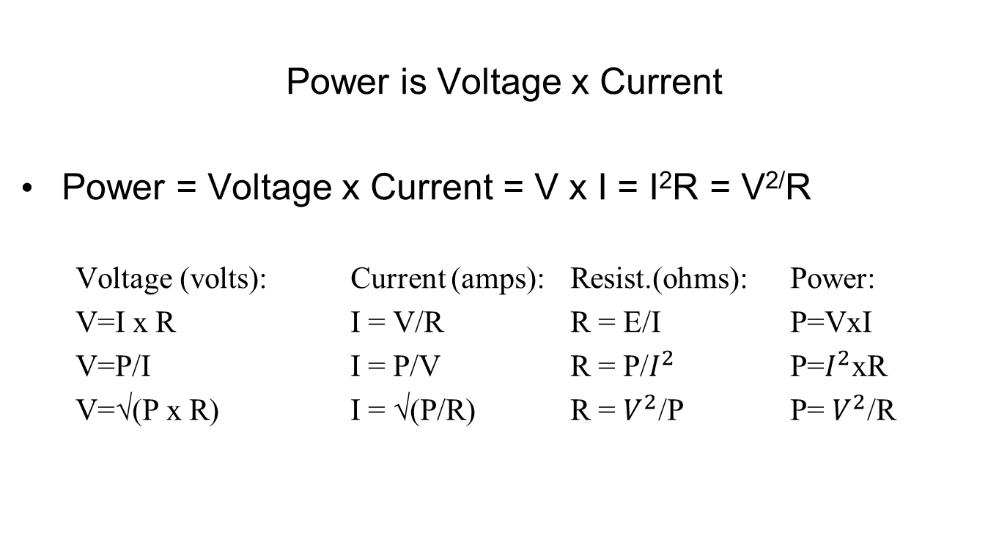
Basic Electrical Laws

Slide 34
Basic Electrical Laws
Power = Voltage x Current = V x I = I²R = V^{2/}R
  If V = 20 volts and I = 8 amperes what is the power?
    P = V x I = 20 x 8 = 160 watts
  If R = 5 ohms and V = 120 volts what is the power?
    P = V^{2/}R = 120 x 120 / 5 = 2880 watts
  If I = 10 amperes and R = 20 ohms what is the power?
    P = I²R = 10 x 10 x 20 = 2000 watts
    1 kilowatt (kW) = 1,000 watts
    1 megawatt (MW) = 1,000,000 watts

Slide 35
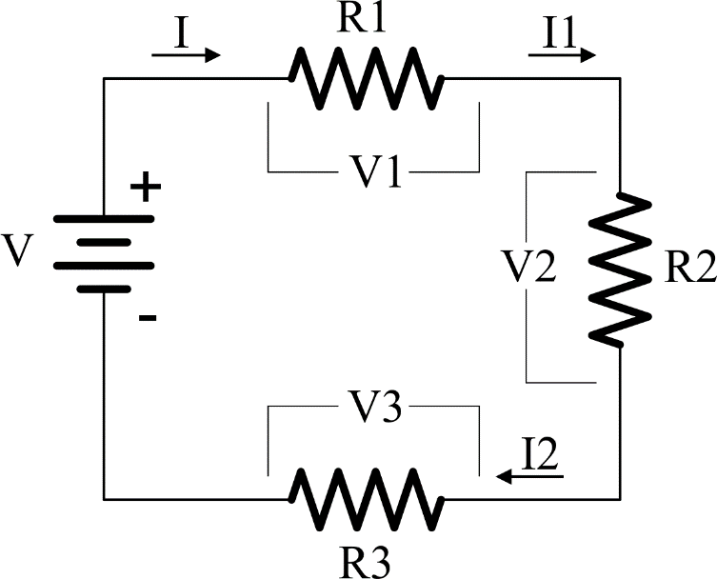
Basic Electrical Laws
Kirchoff’s Voltage Law (KVL)
The sum of the voltages around a circuit loop is zero.
  V = V1 + V2 + V3 = I * (R1 + R2 + R3) = I1 * R1 + I2 * R2 + I3 * R3
  I = I1 = I2 = I3
Resistors in series add

Slide 36
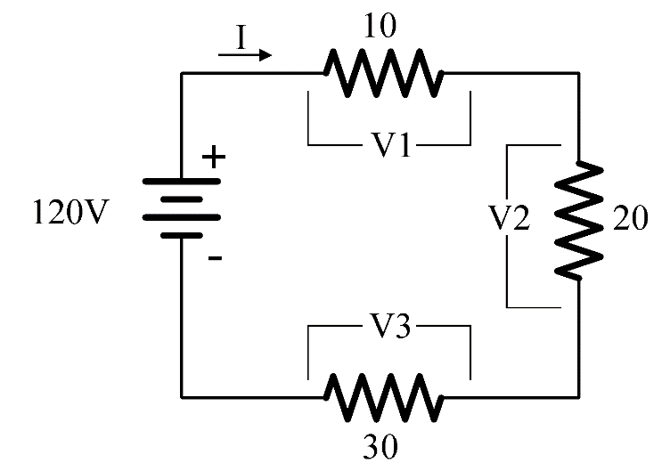
Basic Electrical Laws
Kirchoff’s Voltage Law (KVL) – PROBLEM #1
  I = V / R = V / (R1 + R2 + R3) = 120/(10+20+30) = 2 amperes
  V1 = I*R1 = 2 *10 = 20 volts
  V2 = I*R2 = 2 *20 = 40 volts
  V3 = I*R3 = 2 *30 = 60 volts
What is the current in the circuit?
What are V1, V2, V3?

Slide 37
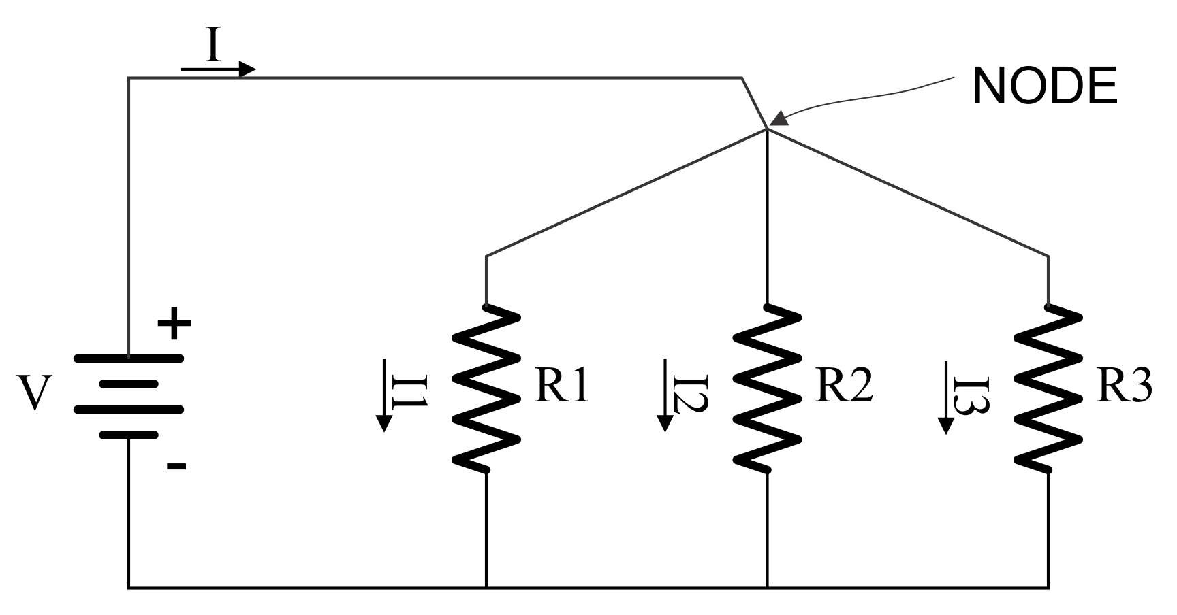
Basic Electrical Laws
Kirchoff’s Current Law (KCL)
The sum of the currents at a node in a circuit is zero.
  I = I1 + I2 + I3
  If Loads are placed in parallel they sum up.
  So does power
  P = V x I = V x I1 + V x I2 + V x I3

Slide 38
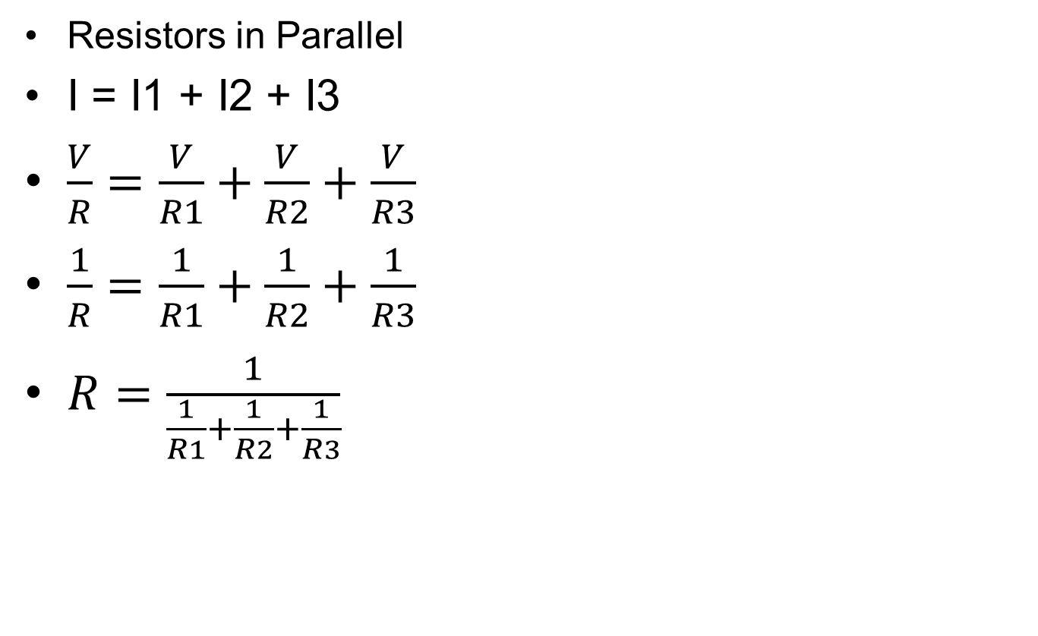

Basic Electrical Laws

Slide 39
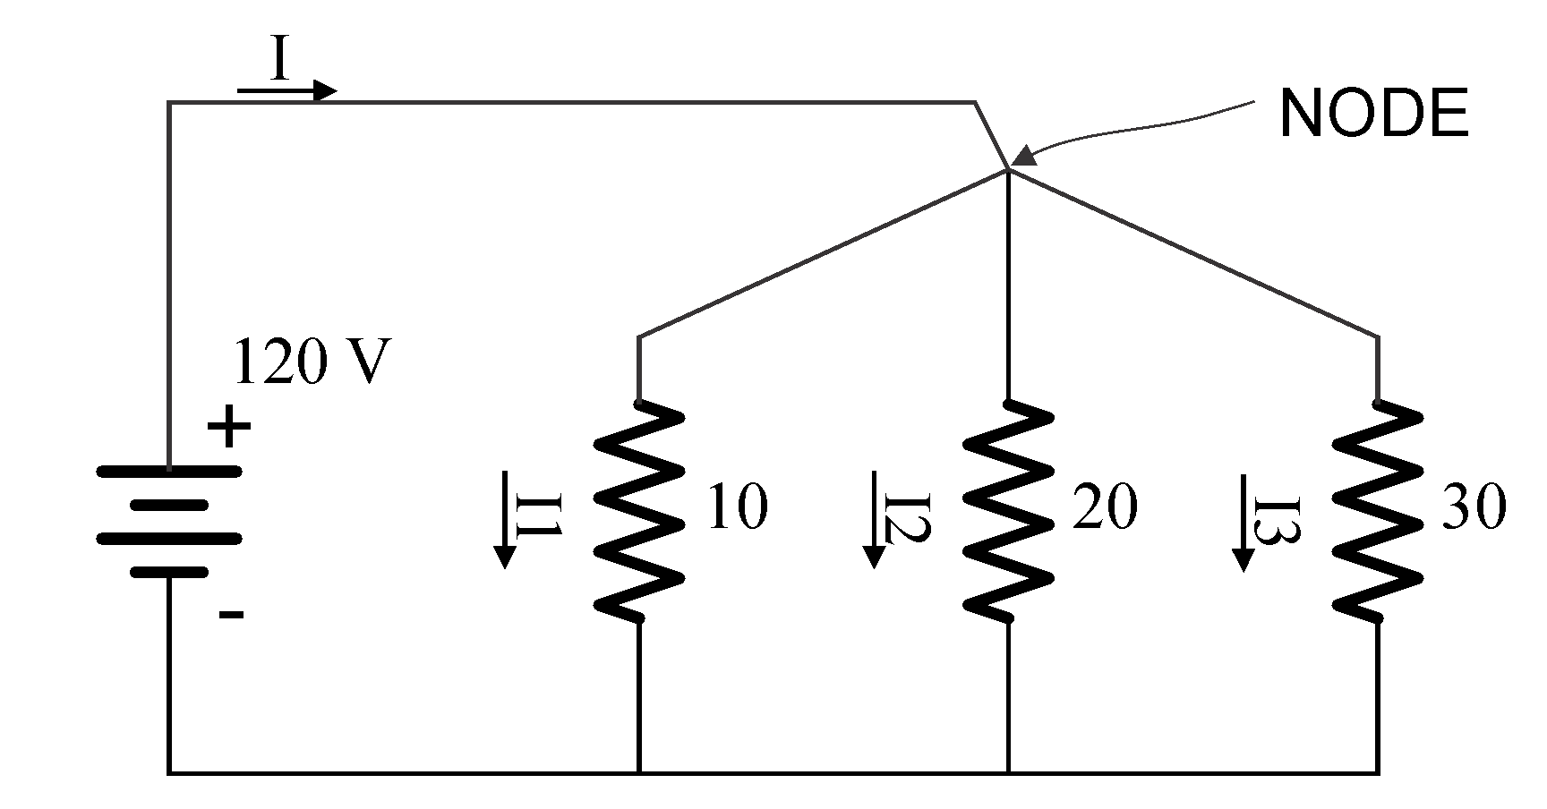
Basic Electrical Laws
Compute
I1, I2, I3
I
R (parallel resistance of R1, R2, R3)
  I1 = 120/10 = 12A, I2=120/20=6A, I3=120/30= 4A
  I = 12 + 6 + 4 =22A
  R = V/I = 120 / 22 = 5.4545 ohms

Slide 40
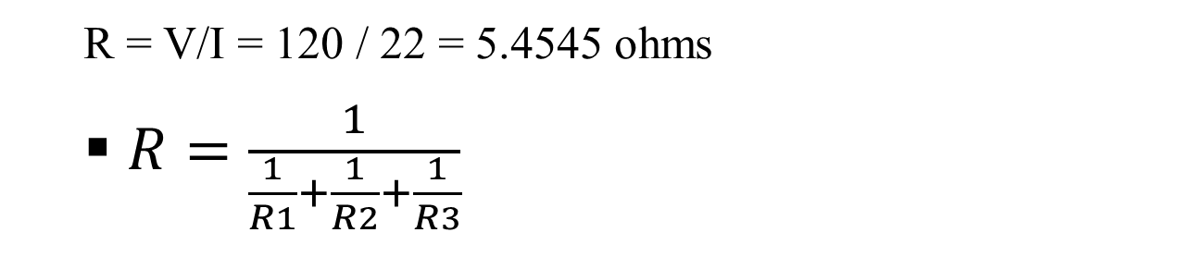
Basic Electrical Laws
Compute
I1, I2, I3
I
R (parallel resistance of R1, R2, R3)

Slide 41

Basic Electrical Laws
Compute
R1, R2, R3
I
R (parallel resistance of R1, R2, R3)
  I = 10 + 20 + 5 =35A
  R = V/I = 240 / 35 = 6.857 ohms

Slide 42
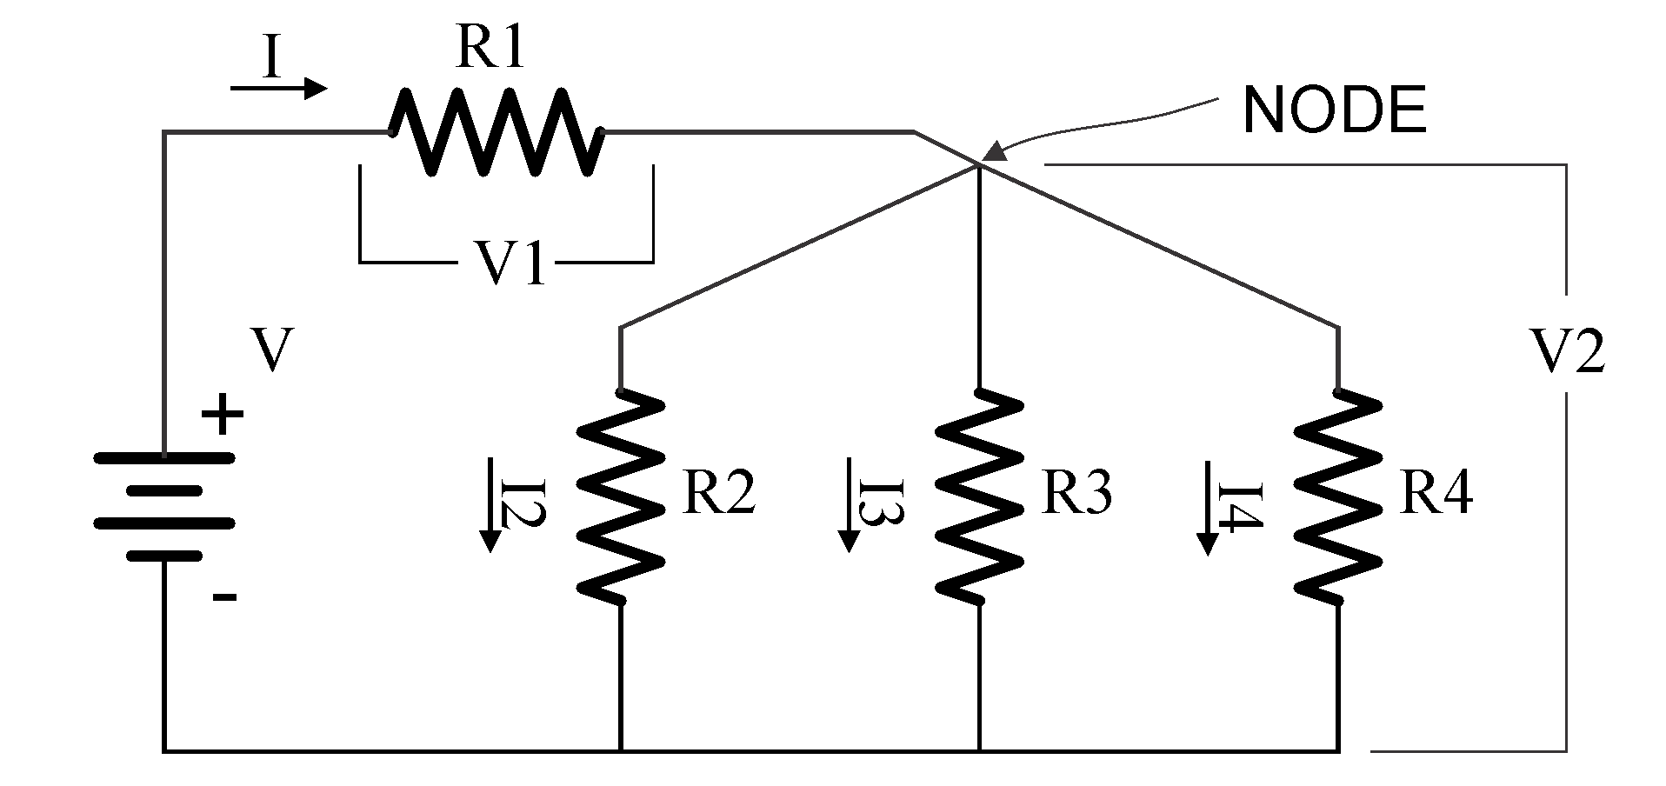
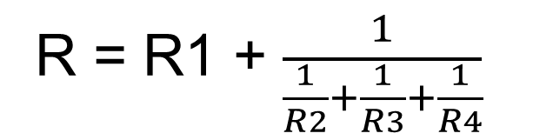
Basic Electrical Laws
More complex circuits
  V = V1 + V2
  I = I1 + I2 + I3

Slide 43

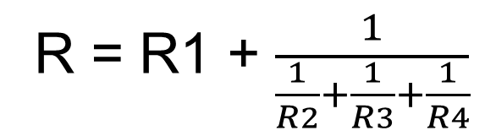
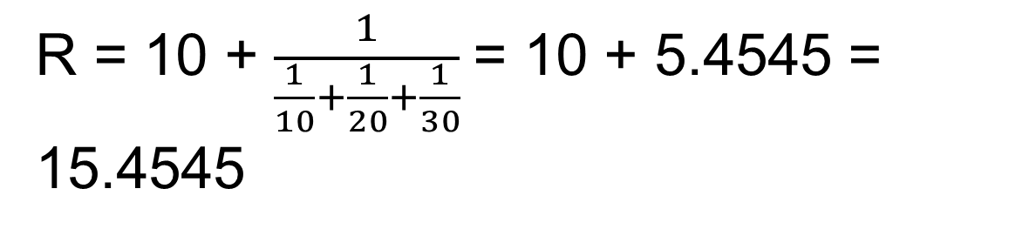
Basic Electrical Laws
More complex circuits

Slide 44
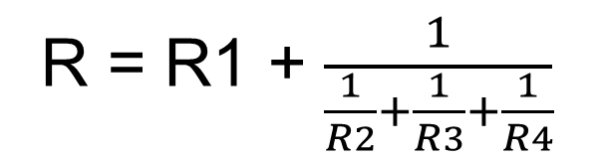
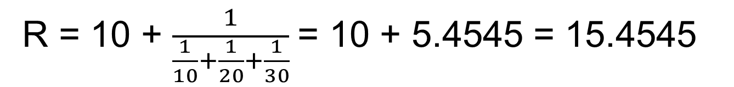
Basic Electrical Laws
More complex circuits

Slide 45
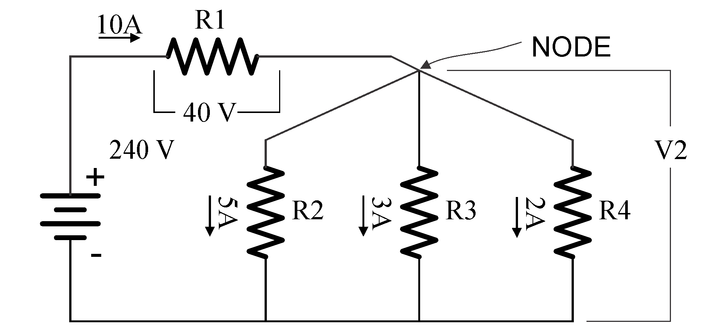
Basic Electrical Laws
More complex circuits
Compute
V2
R1, R2, R3, R4
Total Power
V2 = 240 – 40 = 200 volts
R1 = 40/10 = 4, R2 = 200/5 = 40,
R3 = 200/3 = 66.667, R4 = 200/2 = 100

Slide 46
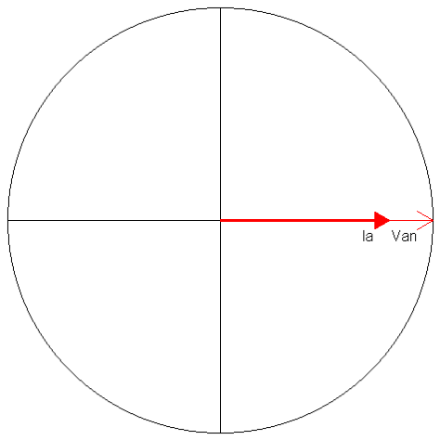
Basic AC Theory Power – The Simple View
E = Voltage (rms)
I = Current (rms)
PF = Power Factor
Power = Watts = E x I x PF
Power is sometimes
referred to as Demand
Sinusoidal
Waveforms
Only
NO
Harmonics
For a 120 Volt service drawing
13 Amps at Unity (1.0) PF,
how much power is being drawn?
Power = 120 x 13 x 1.0 = 1560 Watts

Slide 47
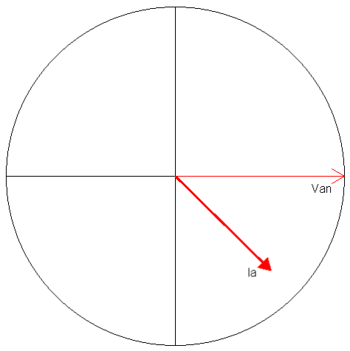
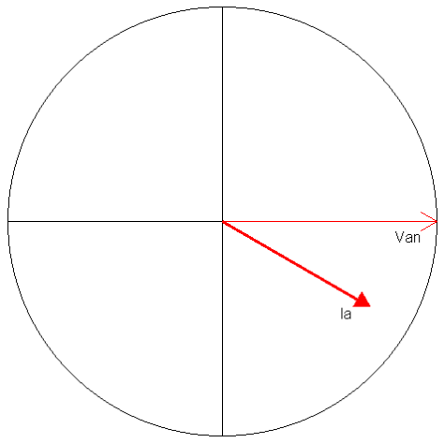
Basic Meter Math Power – The Simple View
For a 120 Volt service drawing
13 Amps at 0.866 PF,
how much power is being drawn?
Power = 120 x 13 x 0.866 = 1351 Watts
For a 480 Volt service drawing
156 Amps at 0.712 PF,
how much power is being drawn?
Power = 480 x 156 x 0.712 = 53,315 Watts

Slide 48
Basic AC Theory Power – The Simple View
In the previous example we had:
Power = 480 x 156 x 0.712 = 53,315 Watts
Normally we don’t talk about Watts, we speak in Kilowatts
1000 Watts = 1 Kilowatt = 1 kW
Watts / 1000 = Kilowatts
For a 480 Volt service drawing
156 Amps at Unity (0.712) PF,
how many Kilowatts are being drawn?
Power = 480 x 156 x 0.712 / 1000 = 53.315 kW

Slide 49
Basic AC Theory Energy – What We Sell
If power is how fast water flows from a pipe,
then energy is how much water we have in a bucket
after the water has been flowing for a specified time.
Energy = Power x Time
1 kW for 1 Hour = 1 Kilowatt-Hour = 1 kWh
Energy (Wh) = E x I x PF x T
where T = time in hours
Energy (kW) = (E x I x PF / 1000) x T

Slide 50
Basic Meter Math Energy – What We Sell
For a 120 Volt service drawing 45 Amps at a Power Factor of 0.9 for 1 day,
how much Energy (kWh) has been used?
Energy = (120 x 45 x 0.9 / 1000) x 24 = 116.64 kWh
For a 240 Volt service drawing 60 Amps at a Power Factor of 1.0 for 5.5 hours,
how much Energy (kWh) has been used?
Energy = (240 x 60 x 1.0 / 1000) x 5.5 = 79.2 kWh

Slide 51
Basic Meter Math Energy – What We Sell
For a 120 Volt service drawing 20 Amps at a Power Factor of 0.8 from 8:00AM to 6:00PM,
and 1 Amp at PF=1.0 from 6:00PM to 8:00AM
how much Energy (kWh) has been used?
8:00AM to 6:00PM = 10 hours
6:00PM to 8:00AM = 14 hours
Energy = (120 x 20 x 0.8 / 1000) x 10 = 19.2 kWh
Energy = (120 x 1 x 1 / 1000) x 14 = 1.68 kWh
Energy = 19.2 kWh + 1.68 kWh = 20.88 kWh

Slide 52
Basic AC Theory What is VA?
Power was measured in Watts. Power does useful work. The power that does useful work is referred to as
“Active Power.”
VA is measured in Volt-Amperes. It is the capacity required to deliver the Power. It is also referred to as the “Apparent Power.”
Power Factor = Active Power / Apparent Power
VA = E x I
PF = W/VA

Slide 53
Basic Meter Math Power – VA
For a 120 Volt service drawing 13 Amps at 0.866 PF
How much power is being drawn?
Power = 120 x 13 x 0.866 = 1351 Watts
How many VA are being drawn?
VA = 120 x 13 = 1560 Volt-Amperes

Slide 54
Basic Meter Math Power – VA
For a 480 Volt service drawing 156 Amps at 0.712 PF
How much power is being drawn?
Power = 480 x 156 x 0.712 = 53,315 Watts
How many VA are being drawn?
VA = 480 x 156 = 74,880 Volt-Amperes

Slide 55
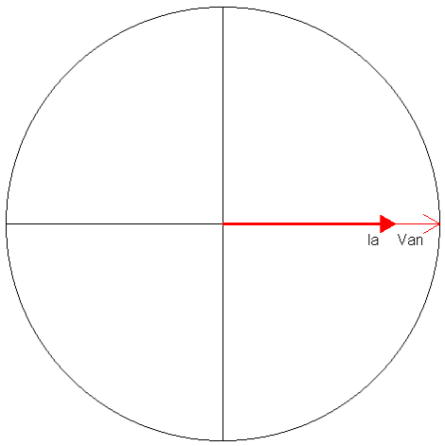
Basic Meter Math Power – VA
For a 120 Volt service drawing 60 Amps at 1.00 PF
How much power is being drawn?
Power = 120 x 60 x 1.00 = 7,200 Watts
How many VA are being drawn?
VA = 120 x 60 = 7,200 Volt Amperes

Slide 56
Basic AC Theory Sinusoidal Waveforms
Peak Value
RMS Value

Slide 57
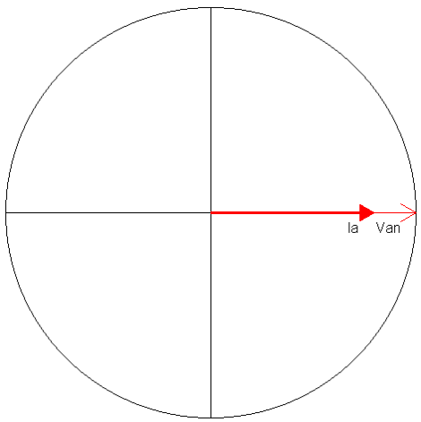
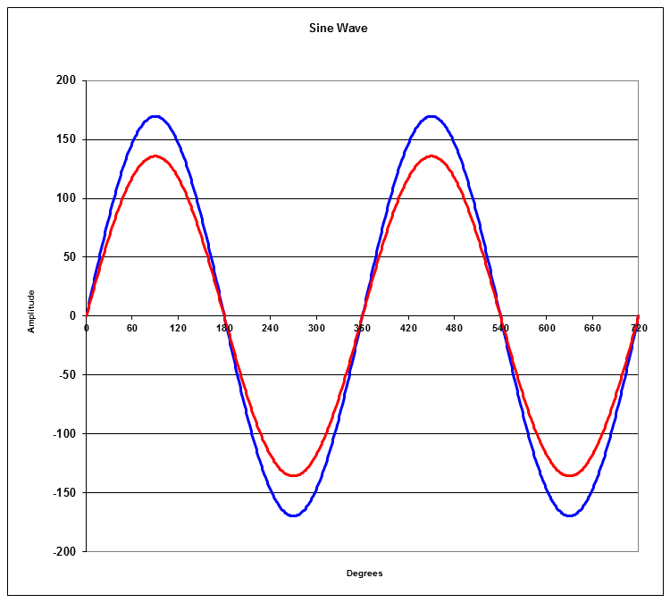
Basic AC Theory Power Factor = 1.0

Slide 58
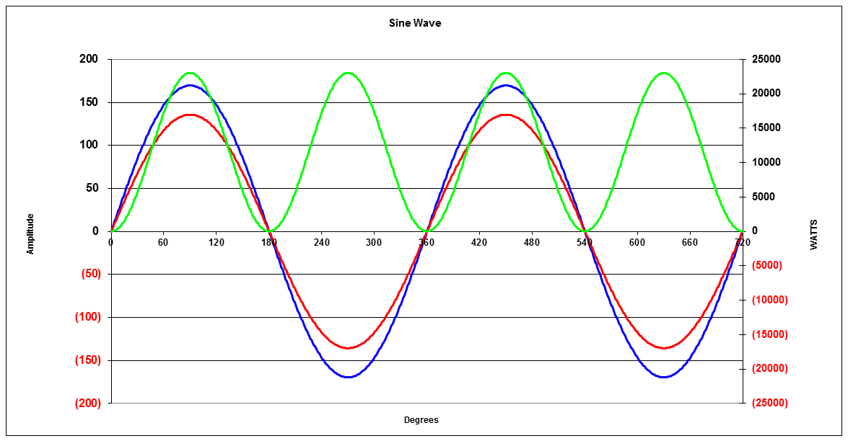
Basic AC Theory Instantaneous Power
Average Power
P = 11520 Watts
Power is a “rate of flow” like water running through a pipe.

Slide 59
Basic AC Theory Instantaneous Power
Average Power
P = 9,976 Watts
PF=0.866

Slide 60
Basic Meter Math
What about polyphase systems?
Calculating power in a polyphase system is actually simple but sometimes we make it complex.
3 Phase, 4-Wire “Y” Service

Slide 61
Basic Meter Math
3 Phase, 4-Wire “Y” Service
Va
Vb
Vc
The total power is equal to the sum of the power in each phase.
P_{total} = E_{a} x I_{a} x Cos(θ_{a}) + E_{b} x I_{b} x Cos(θ_{b}) + E_{c} x I_{c} x Cos(θ_{c})
In a balanced system where V_{a} = V_{b} = V_{c} and I_{a} = I_{b} = I_{c}and θ_{a} = θ_{a} = θ_{a}
P_{total} = 3 x E_{a} x I_{a} x Cos(θ_{a})

Slide 62
Basic Meter Math
3 Phase, 4-Wire “Y” Service
For a balanced system
E = 277 V
I = 20 A
PF = 1.00
In a balanced system where V_{a} = V_{b} = V_{c} and I_{a} = I_{b} = I_{c} and θ_{a} = θ_{a} = θ_{a}
P_{total} = 3 x E_{a} x I_{a} x Cos(θa) = 3 x Ea x Ia x PF
P_{total} = 3 x 277 x 20 x 1.0
P_{total} = 3 x 277 x 20 x 1.0 = 16,620 W

Slide 63
Basic Meter Math
3 Phase, 4-Wire “Y” Service
For a unbalanced system
E_{a} = 284 V, E_{b} = 274 V, E_{c} = 276 V
I_{a} = 20 A, I_{b} = 32 A, I_{c} = 30 A
PF_{a} = 0.900, PF_{b} = 0.784, PF_{c} = 0.866
The total power is equal to the sum of the power in each phase.
P_{total} = P_{a} + P_{b} + P_{c}
P_{total} = E_{a} x I_{a} x Cos(θ_{a}) + E_{b} x I_{b} x Cos(θ_{b}) + E_{c} x I_{c} x Cos(θ_{c})
P_{a} = 284 x 20 x .900
= 5,112
P_{b} = 274 x 32 x .784
= 6,874
P_{c} = 276 x 30 x .866
= 7,170
P_{total} = 5,112 + 6,874 + 7,170 = 19,156

Slide 64
Basic AC Theory : What is VA?
If we were trying to decide how big the transformers in the last example need to be, we would need to calculate the kVA of the loads rather than the kW.
REMEMBER
VA is measured in Volt-Amperes. It is the capacity required to deliver the Power. It is also referred to as the “Apparent Power”.
VA = E x I
PF = W/VA

Slide 65
Basic Meter Math
3 Phase, 4-Wire “Y” Service
What is the VA for each phase?
E_{a} = 284 V, E_{b} = 274 V, E_{c} = 276 V
I_{a} = 20 A, I_{b} = 32 A, I_{c} = 30 A
PF_{a} = 0.900, PF_{b} = 0.784, PF_{c} = 0.866
The total power is equal to the sum of the power in each phase.
VA_{total} = VA_{a} + VA_{b} + VA_{c}
VA_{total} = E_{a} x I_{a} + E_{b} x I_{b} + E_{c} x I_{c}
P_{a} = 284 x 20 = 5,680
P_{b} = 274 x 32 = 8,768
P_{c} = 276 x 30 = 8,280
P_{total} = 5,680 + 8,768 + 8,280 = 25,328
Would you use 5kVA, 7.5kVA, 10kVA, 25kVA or 40kVA transformers?

Slide 66
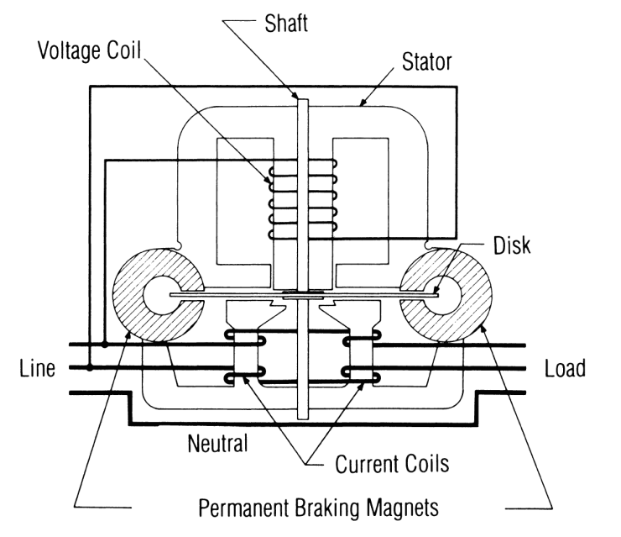
Induction Meters
Using concepts put forth by Tesla and Ferraris, several inventors created early induction watthour meters
Two coils and a conducting (usually aluminum) disk. A braking magnet.
Magnetic field from the first coil generates eddy currents in the disk
Magnetic field from the second coil interacts with the eddy currents to cause motion
Disk would accelerate without bound except for eddy currents caused by motion through fixed magnetic field which slows the disk
The end result is that each revolution of the disk measures a constant amount of energy

Slide 67
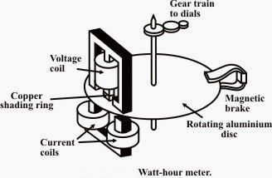
1897
Schallenberger meter is redesigned into a smaller, lighter 12 pound meter. This significantly less expensive meter is known as the “round meter”.

Slide 68
Basic Energy Formula
The essential specification of a watthour meter’s measurement is given by the value
K_{h} [ Watthours per disk revolution ]
The watthour meter formula is as follows:

Slide 69
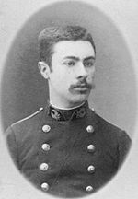
1893: Blondel’s Theorem
The theory of polyphase watthour metering was first set forth on a scientific basis in 1893 by Andre E. Blondel, engineer and mathematician. His theorem applies to the measurement of real power in a polyphase system of any number of wires. The theorem is as follows:
  - If energy is supplied to any system of conductors through N wires, the total power in the system is given by the algebraic sum of the readings of N wattmeters, so arranged that each of the N wires contains one current coil, the corresponding voltage coil being connected between that wire and some common point. If this common point is on one of the N wires, the measurement may be made by the use of N-1 wattmeters.

Slide 70
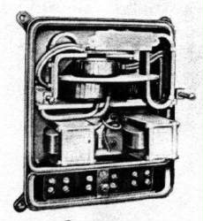
SHALLENBERGER POLYPHASE METER
Shallenberger modifies his meter to work on a polyphase circuit but the close spacing of the stators and the use of a solid disk resulted in the meter being less accurate than expected.

Slide 71
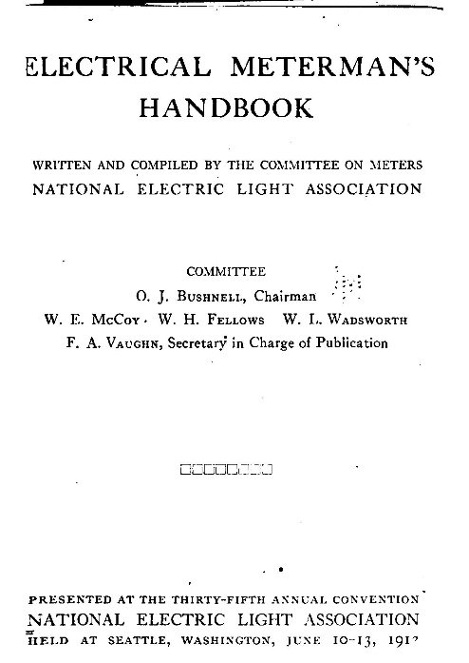
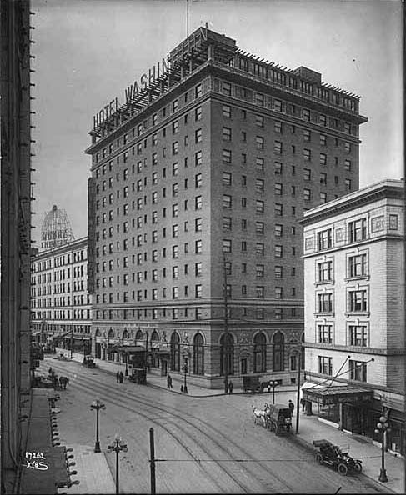
The “Handbook”
Based on the work of the AEIC Code, NELA Members began work on an “Electric Meterman’s Handbook” presenting the 1st Edition in Seattle WA at the Historic Hotel Washington
The NELA/AEIC Joint Presentation also Featured Contributing Vendors still active today: Thomson (General Electric), Westinghouse, Fort Wayne, Sangamo, Duncan Columbia, The Eastern Specialty Company (TESCO), Cutler-Hammer, Biddle, Leeds & Northrup and The States Company
This handbook is updated and republished every twenty years or so. There are also pocket reference guides available for meter techs. All are invaluable resources. Get one and use this as your bible.

Slide 72

Questions and Discussion
Tom Lawton
President
tom.lawton@tescometering.com
TESCO – The Eastern Specialty Company
Bristol, PA
215-228-0500
This presentation can also be found under Meter Conferences and Schools on the TESCO website: tescometering.com
ISO 9001:2015 Certified Quality Company
ISO 17025:2017 Accredited Laboratory

