Slide 1
Metering 101
MEUA
March 12, 2024 2:15 – 3:00 PM
Perry Lawton, TESCO

Slide 2
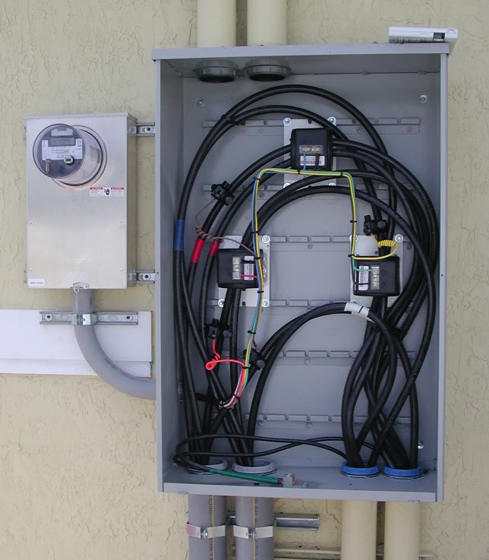
Topics Overview
Meter Forms
Current Transformers
Site Verification & Safety

Slide 3
Meter Forms
MEUA
March 12, 2024 2:15 – 3:00 PM
Perry Lawton, TESCO

Slide 4
Agenda
Meters 101 - Electro-Mechanical vs Solid-State
Meter Forms
Self-Contained vs Transformer Rated
Blondel’s Theorem
Available References (Hardy’s, UGLY’s Elect Ref)
Examples
1S, 2S, 9S, 16S

Slide 5
Meters 101 - Electromechanical
Overview of Functionality
The electromechanical induction meter operates through electromagnetic induction
A non-magnetic, but electrically conductive, metal disc which is made to rotate at a speed proportional to the power passing through the meter
The disc is acted upon by two sets of induction coils, which form, in effect, a two phase linear induction motor.
One coil is connected in such a way that it produces a magnetic flux in proportion to the voltage
The other coil produces a magnetic flux in proportion to the current.
The field of the voltage coil is delayed by 90 degrees, due to the coil's inductive nature, and calibrated using a lag coil
This produces eddy currents in the disc and the effect is such that a force is exerted on the disc in proportion to the product of the instantaneous current and instantaneous voltage
A permanent magnet acts as an eddy current brake, exerting an opposing force proportional to the speed of rotation of the disc
The equilibrium between these two opposing forces results in the disc rotating at a speed proportional to the power or rate of energy usage
The disc drives a register mechanism which counts revolutions, much like the odometer in a car, in order to render a measurement of the total energy used.
The amount of energy represented by one revolution of the disc is denoted by the symbol Kh which is given in units of watt-hours per revolution.
A Kh of 7.2 is typical. In this example, each full rotation of the disk is equivalent to 7.2Wh of energy.

Slide 6
Meters 101 – Solid State
Overview of Functionality
Potential and Current is scaled down and conditioned with transformers and filters
ADC’s (analog to digital converters) digitize the signals
A micro-processor or DSP executes the calculations
Resulting data is displayed, sent externally via the communication circuits, and used for the calibrated pulse output
MICRO
PROC
CURRENT TRANSFORMER
DISPLAY
FILTER
ADC
COMM
POTENTIAL TRANSFORMER
FILTER
ADC
PULSE

Slide 7
Meter Forms
ANSI C12.10

Slide 8
Meter Forms
14S
39S
17S
1S
2S
3S
12S
35S
4S
25S
10S
76S
46S
45S
66S
11S
32S
5S
26S
6S
16S
9S
13S
15S
24S
56S

Slide 9
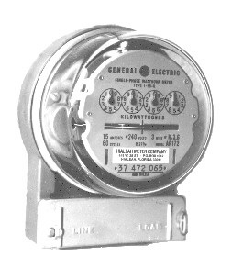
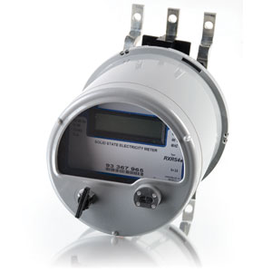
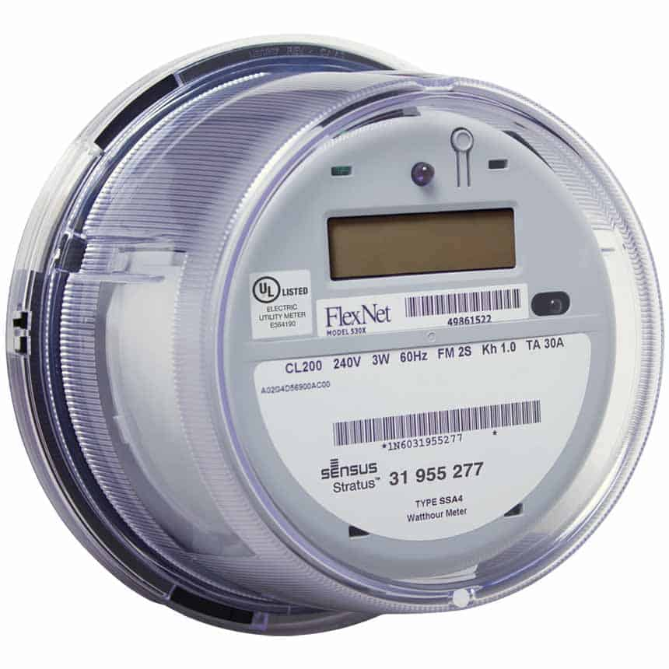
Meter Forms

Slide 10
Meter Forms
14S
39S
17S
1S
2S
3S
12S
35S
4S
25S
10S
76S
46S
45S
66S
11S
32S
5S
26S
6S
16S
9S
13S
15S
24S
56S

Slide 11
Meter Forms
SELF-CONTAINED
TRANSFORMER-RATED
39S
36S
1S
14S
3S
7S
12S
29S
2S
76S
5S
35S
25S
46S
4S
8S
16S
11S
26S
17S
66S
6S
45S
9S
13S
56S
10S
15S
32S
24S

Slide 12
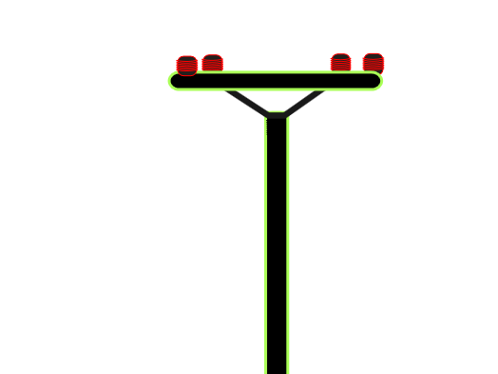
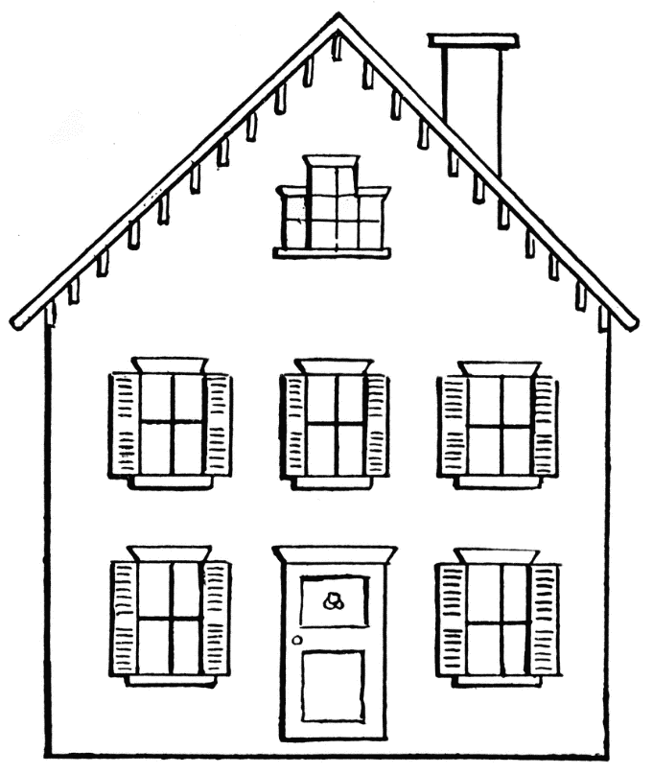
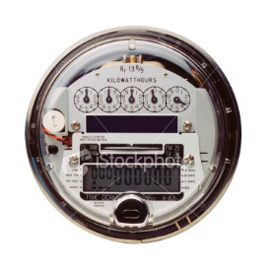
Self-Contained
Primarily Residential
Relatively Low Current
Example: 100A

Slide 13
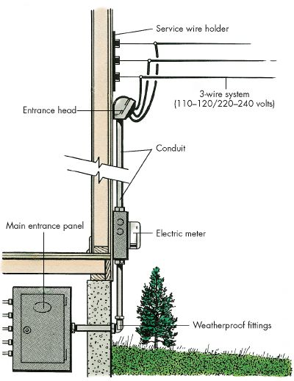
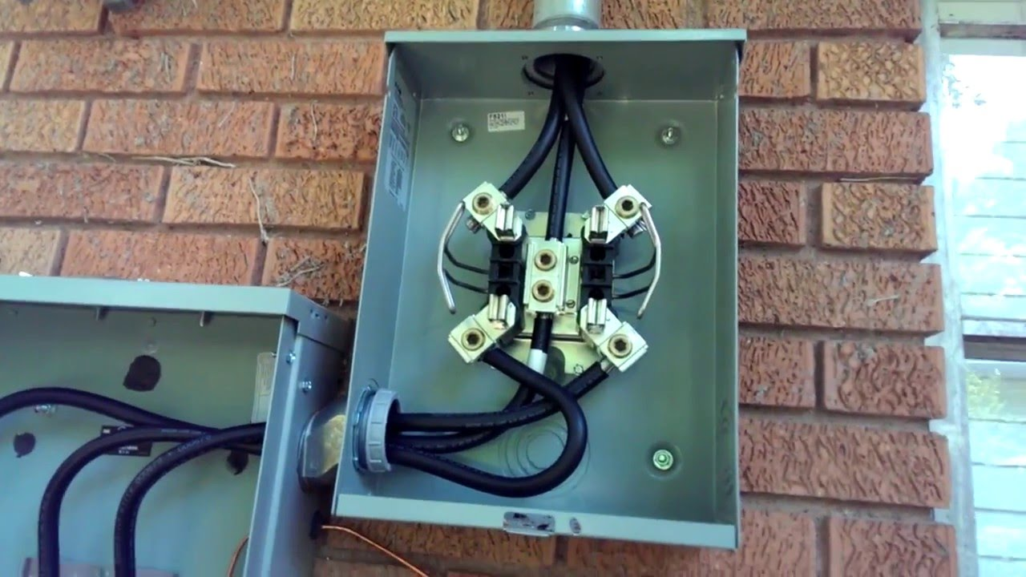
Self-Contained
Primarily Residential

Slide 14
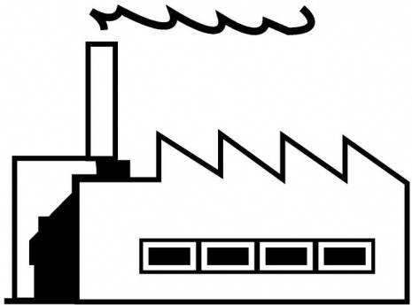
Transformer-Rated Meters
Primarily Commercial/Industrial
Relatively High Current
Example: 4000A
Notes:
14

Slide 15
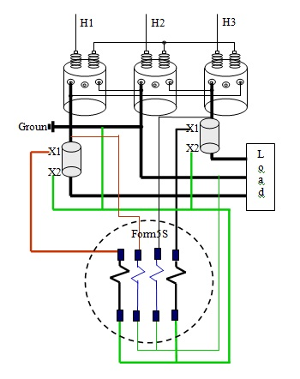
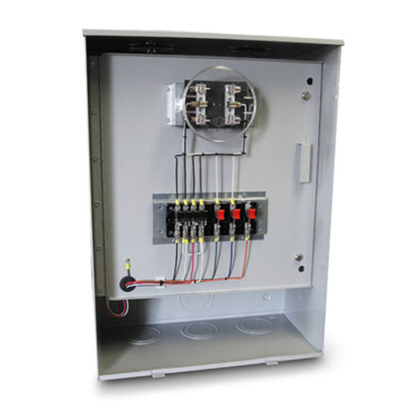
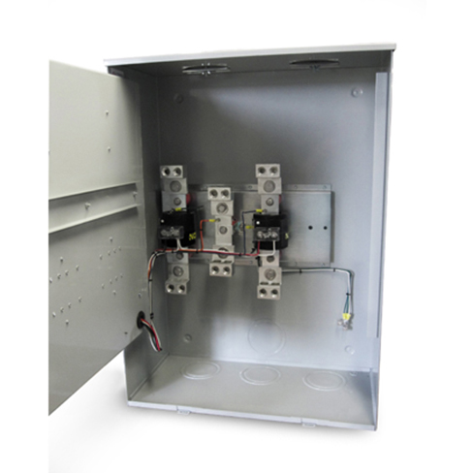
Transformer-Rated Meters
Primarily Commercial/Industrial

Slide 16
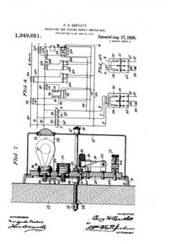
Transformer-Rated Meters
Safety Test Switch
August 17, 1920
TESCO founders Joseph Seaman and Burleigh Currier, along with Percy Bartlett
Isolates the meter from the service during testing

Slide 17
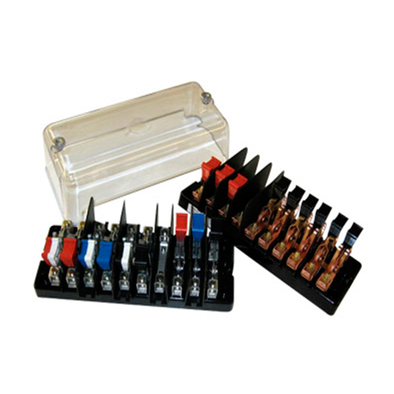
Transformer-Rated Meters
Safety Test Switch

Slide 18
Diagram Example
References
Power Measurements Handbook, Dr. Bill Hardy
UGLY’s Electrical References
Meterman’s Handbook
Manufacturer’s websites

Slide 19
Diagram Example
References
Power Measurements Handbook, Dr. Bill Hardy
UGLY’s Electrical References
Meterman’s Handbook
Manufacturer’s websites

Slide 20
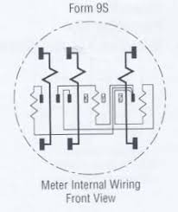
Diagram Example
3 Current Coils
3 Potential Coils

Slide 21
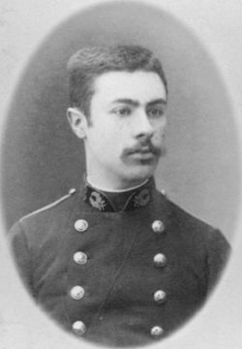
Blondel’s Theorem
French Electrical Engineer Andre Blondel
Attempt to simplify electrical measurements and validation of the results
Paper submitted to the International Electric Congress in Chicago in 1893.
E = n - 1
The theorem states that the power provided to a system of N conductors is equal to the algebraic sum of the power measured by N watt-meters. The N watt-meters are separately connected such that each one measures the current level in one of the N conductors and the potential level between that conductor and a common point. In a further simplification, if that common point is located on one of the conductors, that conductor's meter can be removed and only N-1 meters are required.

Slide 22
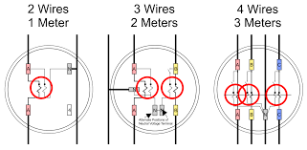
Blondel’s Theorem
E = n - 1
Blondel Compliant
1S
12S
9S
The theorem states that the power provided to a system of N conductors is equal to the algebraic sum of the power measured by N watt-meters. The N watt-meters are separately connected such that each one measures the current level in one of the N conductors and the potential level between that conductor and a common point. In a further simplification, if that common point is located on one of the conductors, that conductor's meter can be removed and only N-1 meters are required.

Slide 23
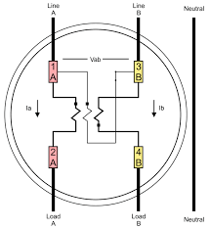
Blondel’s Theorem
E = n - 1
Non-Blondel Compliant
2S
The theorem states that the power provided to a system of N conductors is equal to the algebraic sum of the power measured by N watt-meters. The N watt-meters are separately connected such that each one measures the current level in one of the N conductors and the potential level between that conductor and a common point. In a further simplification, if that common point is located on one of the conductors, that conductor's meter can be removed and only N-1 meters are required.

Slide 24
Blondel’s Theorem
Why is non-Blondel metering bad?
Makes assumptions about the service
Example: balanced voltages
Assumptions might not be true
When these assumptions are not true, then there are power measurement errors even if the meter is working perfectly.
The theorem states that the power provided to a system of N conductors is equal to the algebraic sum of the power measured by N watt-meters. The N watt-meters are separately connected such that each one measures the current level in one of the N conductors and the potential level between that conductor and a common point. In a further simplification, if that common point is located on one of the conductors, that conductor's meter can be removed and only N-1 meters are required.

Slide 25
Blondel’s Theorem
Why are non-Blondel meters used?
Fewer elements (meters) = lower cost
Especially true for electro-mechanical meters
Fewer CT’s and PT’s = lower cost
Less wiring and cheaper sockets
The theorem states that the power provided to a system of N conductors is equal to the algebraic sum of the power measured by N watt-meters. The N watt-meters are separately connected such that each one measures the current level in one of the N conductors and the potential level between that conductor and a common point. In a further simplification, if that common point is located on one of the conductors, that conductor's meter can be removed and only N-1 meters are required.

Slide 26
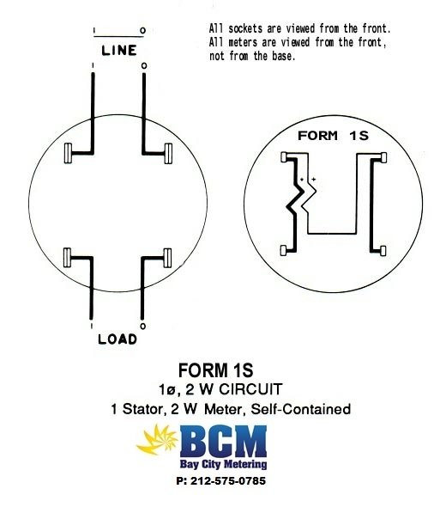
Metering Examples

Slide 27
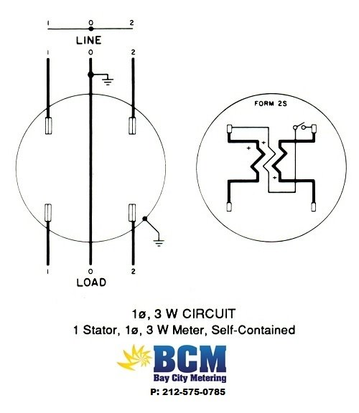
Metering Examples

Slide 28
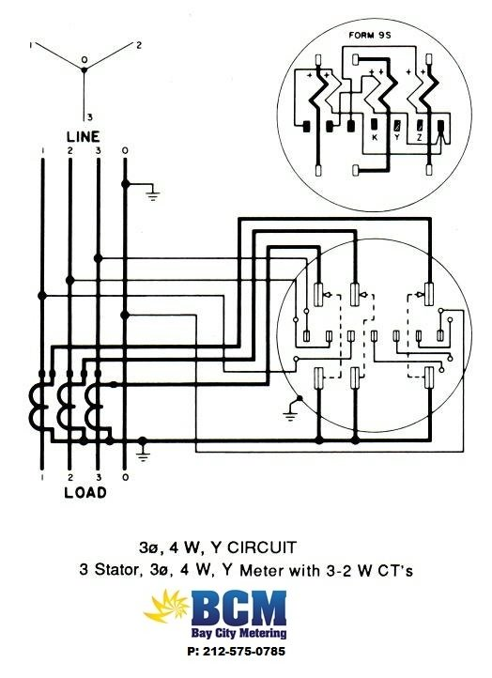
Metering Examples

Slide 29
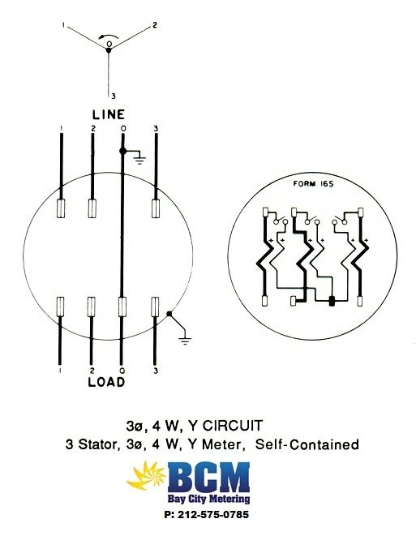
Metering Examples

Slide 30
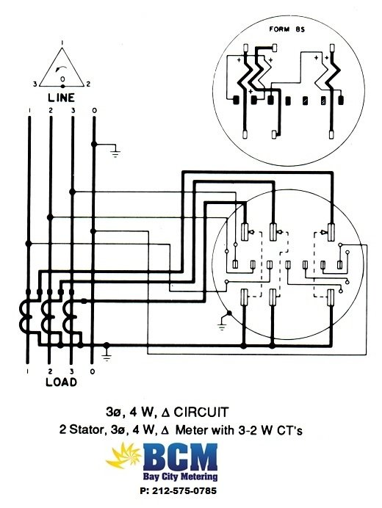
Metering Examples

Slide 31
Current Transformers
3/12/24
2:15 – 3:00 PM
Perry Lawton, TESCO
Notes:
31

Slide 32
Definitions
Instrument Transformer: A transformer that reproduces in its secondary circuit in a definite and known proportion, the voltage or current of its primary circuit with the phase relation substantially preserved.
Current Transformer: An instrument transformer designed for the measurement or control of current. Its primary winding, which may be a single turn or bus bar, is connected in series with the load. It is used to reduce primary current by a known ratio to within the range of a connected measuring device.
Potential Transformer: An instrument transformer designed for the measurement or control of voltage. Its primary winding is connected in parallel with a circuit. It is used to reduce primary voltage by a known ratio to within the range of a connected measuring device.

Slide 33
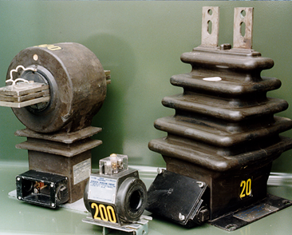
Three Types of ITs
Three basic types of instrument transformers:
Window type (applies to CT’s only)
Bar type (applies to CT’s only)
Wound type (applies to CT’s and PT’s)

Slide 34
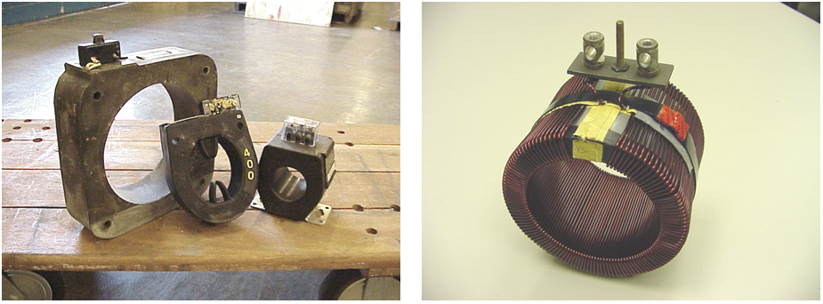
Window Type CT (Passthrough)
Definition: A current transformer that has a secondary winding insulated from and permanently assembled on the core, but has no primary winding as an integral part of the structure. (The secondary winding of all CT’s is intended for connection to the meter or other measuring device.) The line conductor can be passed through the window to provide the primary winding.

Slide 35
Bar Type CT
Definition: A current transformer that has a fixed, insulated straight conductor in the form of a bar, rod, or tube that is a single primary turn passing through the magnetic circuit and that is assembled to the secondary core and winding.

Slide 36
Wound Type CT
Definition: A current transformer that has a primary winding consisting of one or more turns mechanically encircling the core. The primary and secondary windings are insulated from each other and from the core and are assembled as an integral structure.

Slide 37
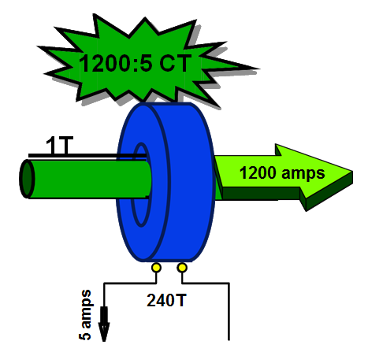
Current Transformer Ratio
A current transformer’s ratio is typically expressed with a secondary rating of 5 amps.
The current transformer illustrated here would have a ratio of 1200 to 5.
1200 amps flowing through its primary winding (line wire) would cause 5 amps to flow to the meter

Slide 38
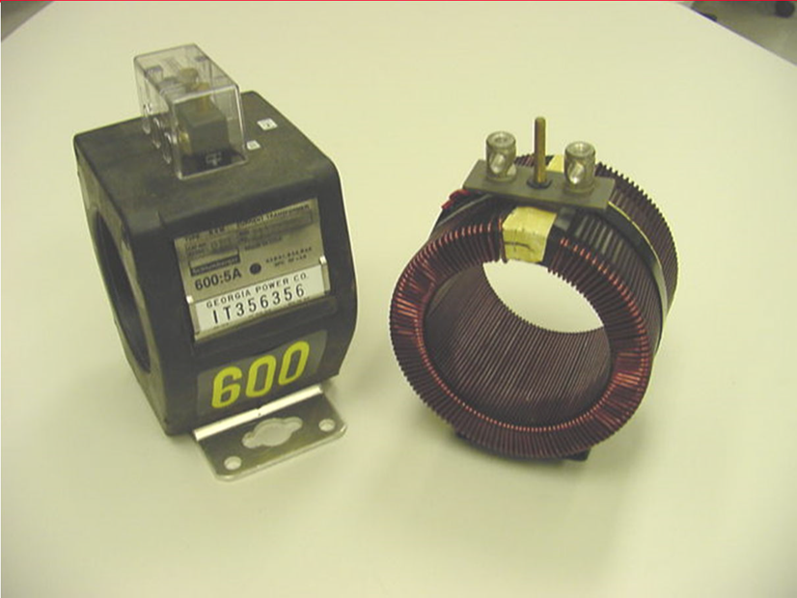
Current Transformer Turns Ratio
A current transformer will have few primary turns and many secondary turns.
The window-type CT to the right will have one primary turn (the customer’s line wire) and 120 secondary turns.
The turns ration is 120:1

Slide 39
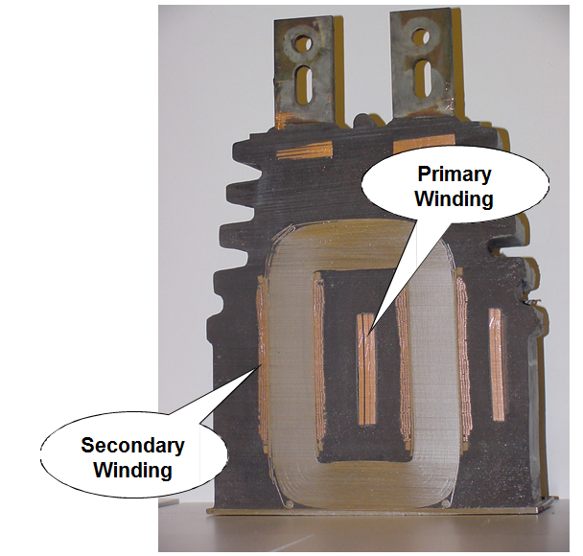
Current Transformer Turns Ratio
The wound-type current transformer to the right has two primary turns.
The conductor making up the primary winding consists of multiple layers of thin copper strapping approximately four inches wide.
The secondary winding consists of many turns of small copper wire.

Slide 40
Burden
Burden is the term used to refer to the load on the secondary circuit of instrument transformers.
An instrument transformer’s “rated burden” is the load which may be imposed on the transformer secondary circuit by associated meter coils, leads and other connected devices without causing an error greater than the stated accuracy classification.
Current transformer rated burdens are normally expressed in ohms impedance such as B-0.1, B-0.2, B-0.5 or B-1.8.
Potential transformer rated burdens are normally expressed in volt- amperes at a designated power factor. This VA rating is typically represented by the letters W, X, M, Y, Z, or ZZ. For example, the letter “Y” designates a burden of 75 VA @ .85 power factor.

Slide 41
Accuracy of Instrument
Two sources of error determine the accuracy of instrument transformers:
(1) Ratio error
(2) Phase angle error
The “accuracy classification” of instrument transformers includes a correlation between ratio correction factor and phase angle so as to show the overall effect on meter registration.
The ratio correction factor (RCF) is the ratio of the true ratio to the marked ratio.
The phase angle of an instrument transformer is the phase displacement, in minutes, between the primary and secondary values.
The transformer correction factor (TCF) is the correction for overall error due to both ratio error and phase angle.
ANSI has established accuracy classes for both current and potential transformers. Typical classifications are 0.3% error for metering, and 0.6% to 1.2% error for indicating instruments. (ANSI C57.13)

Slide 42
Accuracy is Burden Dependent
An accuracy classification for an instrument transformer includes the standard burden as well as the maximum percent error limits for ratio and phase angle error.
The standard burdens for which a transformer’s accuracy rating applies will be designated along with the accuracy rating.

Slide 43
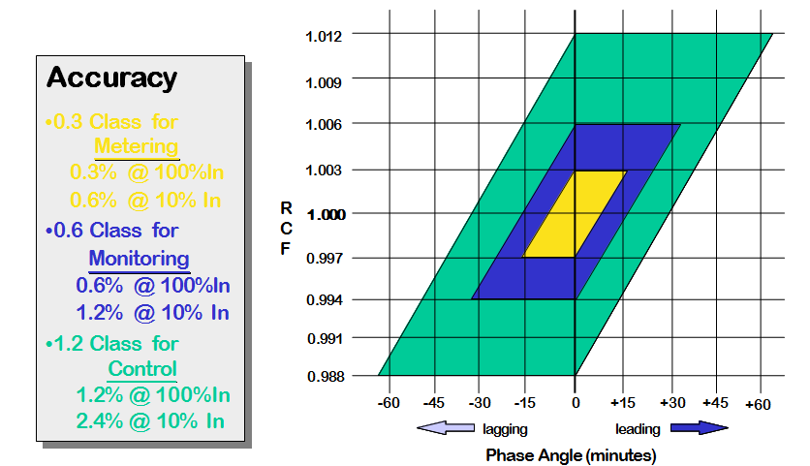
Current Transformer Accuracy
The corresponding ratio correction factor and phase angle for any point inside the 0.3 class parallelogram for 100% rated current will always give a transformer correction factor between .997 and 1.003.

Slide 44
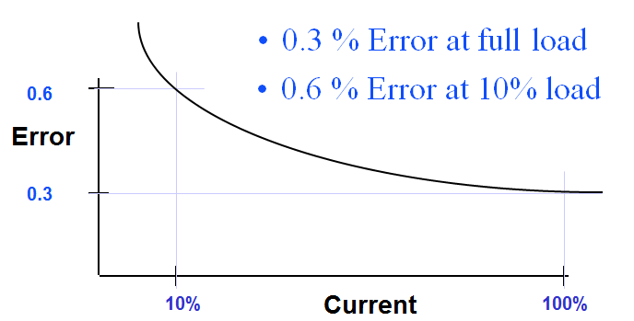
Current Transformer Accuracy
In addition to burden (secondary load), a CT’s accuracy is affected by the Metered Load (primary current).
The limit of permissible error in a current transformer for a given accuracy class has one value at 100% rated current and twice that amount of error at 10% rated current.
Below 10% rated current, error may be as much as 5 – 10%.

Slide 45
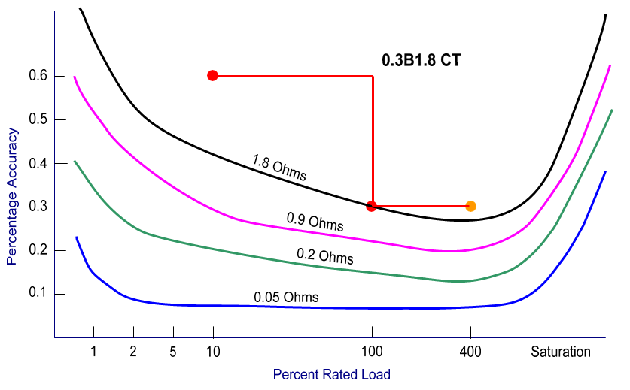
Current Transformer Accuracy
Example of a CT with a rating factor of 4 and a rated burden of 1.8

Slide 46
CT Accuracy Summary
A CT’s accuracy is best between 100% rated load and it’s maximum rated load with rating factor applied.
Below 10% rated load, a CT’s accuracy is unknown and errors can be significant.
Above maximum rated load (with rating factor applied), a CT’s core can become saturated and errors can be significant.
A CT’s accuracy improves as secondary burden decreases.
Errors in Current Transformer accuracy from any of the above conditions always result in a loss for the utility.

Slide 47
Sources of Burden on CTs
1. Size & Length of metering control cable
Resistance for #12 copper wire is approximately .0018 Ohms per foot.
50 feet of control cable = .09 Ohms burden.
2. Connections
How many connections are in a CT’s secondary circuit?
Quality of connections: Are they tight? Is there oxidation or corrosion?
3. Meter
The current coils in the meter are considered equivalent to a short circuit and the burden imposed on the circuit is insignificant.

Slide 48
CT Rating Factor
Rating factor (RF) is a term which applies only to current transformers.
Also known as “thermal rating factor” or “continuous thermal rating factor.”
It is the number by which the primary load current may be increased over its nameplate rating without exceeding the allowable temperature rise and accuracy requirements.
The rating factor is temperature dependent.
The ambient temperature at which the rating factor applies will be stated.
The standard ambient reference levels are at 30 and 55 degrees centigrade. (86 and 131 degrees Fahrenheit)
Usually, the manufacturer will only list the rating factor at 30 degrees ambient.
It is very important that the ambient temperature be considered when applying CT’s above the nameplate rating.

Slide 49
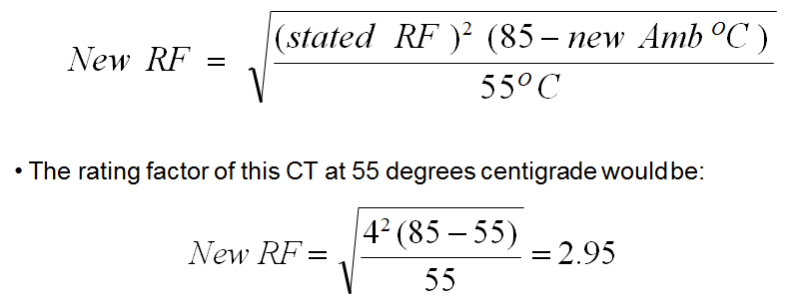
CT Rating Factor
If a current transformer has a rating factor of 4 at 30 degrees centigrade, it will safely carry, on a continuous basis, 4 times the nameplate rating.
In other words, a 200:5 CT with a RF of 4 will safely carry 800 amps at 30 degrees centigrade ambient temperature.
We can use the formula below to determine what the CT’s rating factor would be at 55 degrees centigrade or at any other temperature:

Slide 50
Basic Impulse Level
The BIL rating on instrument transformers are test ratings and never apply to actual in-service voltage.
These test values are for factory dielectric tests that are designed to check the insulation and workmanship of instrument transformers.

Slide 51
Polarity
Primary and secondary terminals of instrument transformers are said to have the same polarity when, at a given instant, the current enters the identified or marked primary terminal and leaves the identified or marked secondary terminal in the same direction as though the two terminals formed a continuous circuit.
In the application of instrument transformers it is necessary to understand and observe polarity markings when connecting watthour meters to them.
All instrument transformers, whether current or potential, will have polarity marks associated with at least one primary terminal and one secondary terminal.
The polarity markings are often white dots.
The polarity markings are sometimes a letter and number combination. H1 for the primary marking and X1 for the secondary mark.

Slide 52
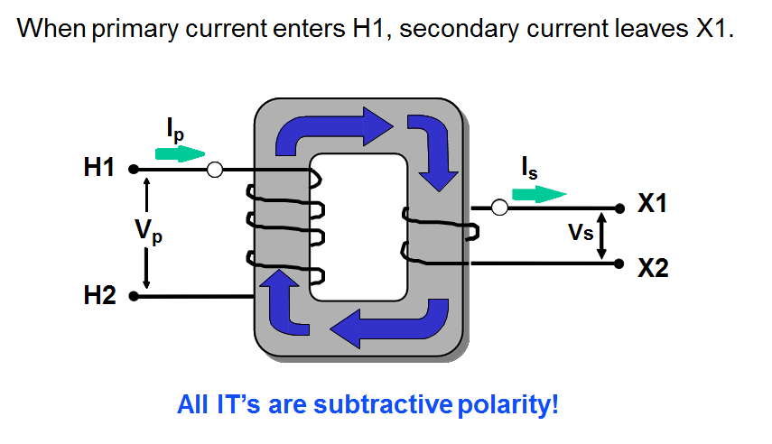
Polarity

Slide 53
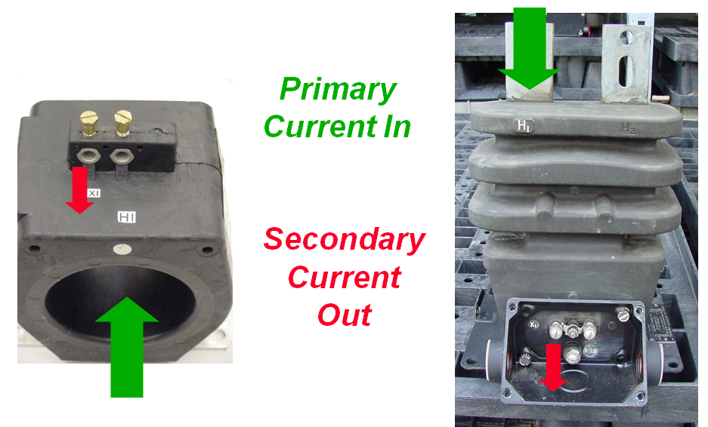
Polarity

Slide 54
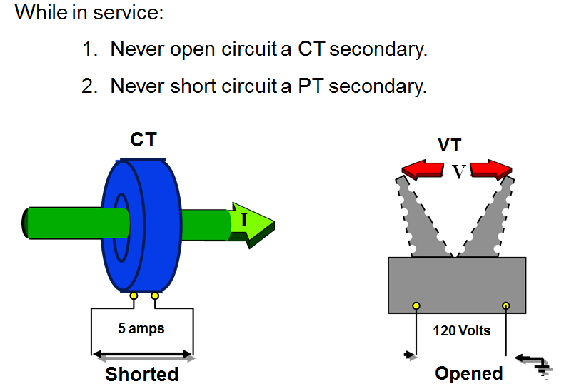
Secondary Currents: Rules to Remember

Slide 55
CT Secondary Circuits
The current transformer has a low voltage secondary as long as the secondary connection is a continuous connection. This continuous connection normally exists through the metering control cable and the current coils in the meter. The meter may be by-passed by closing the shunting device on the CT or by opening the current switches on the test-switch block.

Slide 56
CT Secondary Circuits
If at any time, the secondary connection is opened and there is current flowing in the primary, the CT becomes a step-up voltage transformer and the secondary voltage can rise to very high voltages.
This can be understood by some basic Ohm’s Law calculations.
E = I R
With a continuous secondary connection, the resistance is very low and the voltage remains very low. But, as the secondary circuit is opened, the resistance rises very rapidly and the secondary voltage can quickly rise to thousands of volts. The actual formula is:
The high voltage that is present on the open secondary of an energized CT poses two hazards. The first is an electrical shock hazard to personnel. The second hazard is the breakdown of the current transformer’s insulation, resulting in damage or destruction of the transformer.

Slide 57
OSHA Standard 1910.269(w)(2)

Slide 58
Site Verification & Safety
3/12/24
2:15 – 3:00 PM
Perry Lawton, TESCO
Notes:
58

Slide 59
Site Verification: Why should we invest our limited meter service resources here
These customers represent a disproportionately large amount of the overall revenue for every utility in North America.
For some utilities, the ten percent of their customers who have transformer rated metering services can represent over 70% of their overall revenue.
While these numbers will vary from utility to utility the basic premise should be the same for all utilities regarding where Meter Services should focus their efforts
This is perhaps one of the larger benefits that AMI can provide for our Utilities – more time to spend on C&I metering and less on residential
Easy Answer: Money.

Slide 60
Potential list of tasks to be completed during a Site Verification of a Transformer Rated Metering Site
Double check you are at the correct location by verifying the site and the meter serial number against your records
Perform a visual safety inspection of the site. This includes utility and customer equipment. Things to look for include intact down ground on pole, properly attached enclosure, unwanted voltage on enclosure, proper trimming and site tidiness (absence of discarded seals, etc.)
Visually inspect for energy diversions (intentional and not). This includes broken or missing wires, jumpers, open test switch, unconnected wires and foreign objects on meters or other metering equipment. Broken or missing wires can seriously cause the under measurement of energy. A simple broken wire on a CT or VT can cause the loss of 1/3 to 1/2 of the registration on either 3 element or 2 element metering, respectively.

Slide 61
Site Verification Checklist (cont)
Visually check lightning arrestors and transformers for damage or leaks.
Check for proper grounding and bonding of metering equipment. Poor grounding and bonding practices may result in inaccurate measurements that go undetected for long periods of time. Implementing a single point ground policy and practice can reduce or eliminate this issue.
Burden test CTs and voltage check PTs.
Verify service voltage. Stuck regulator or seasonal capacitor can impact service voltage.
Verify condition of metering control wire. This includes looking for cracks in insulation, broken wires, loose connections, etc.
Confirm we have a Blondel compliant metering set up
Compare the test switch wiring with the wiring at the CTs and VTs. Verify CTs and VTs not cross wired. Be sure CTs are grounded in one location (test switch) only.

Slide 62
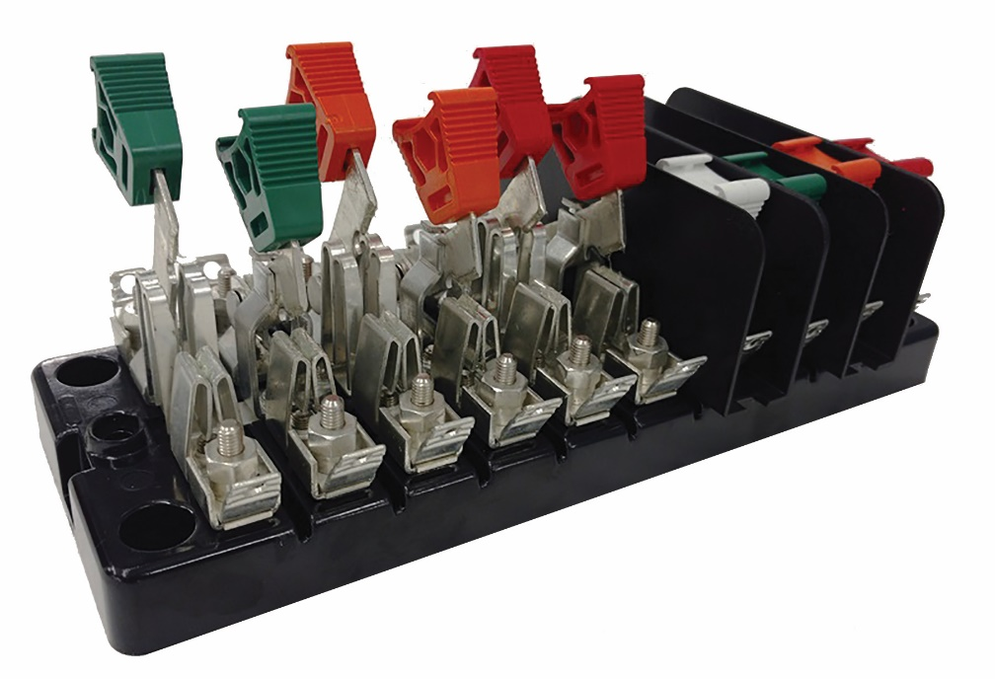
Site Verification Checklist (cont)
Check for bad test switch by examining voltage at the top and bottom of the switch. Also verify amps using amp probe on both sides of the test switch. Verify neutral connection to cabinet (voltage).
Check rotation by closing in one phase at a time at the test switch and observing the phase meter for forward rotation. If forward rotation is not observed measurements may be significantly impacted as the phases are most likely cancelling each other out.

Slide 63
Site Verification Checklist (cont)
Test meter for accuracy. Verify demand if applicable with observed load. If meter is performing compensation (line and/or transformer losses) the compensation should be verified either through direct testing at the site or by examining recorded pulse data.
Loss compensation is generally a very small percentage of the overall measurement and would not be caught under utilities normal high/low checks. However, the small percentages when applied to large loads or generation can really add up overtime. Billing adjustments can easily be in the $million range if not caught early.

Slide 64
Site Verification Checklist (cont)
Verify metering vectors. Traditionally this has been done using instruments such as a circuit analyzer. Many solid state meters today can provide vector diagrams along with volt/amp/pf and values using meter manufacturer software or meter displays. Many of these desired values are programmed into the meters Alternate/Utility display. Examining these values can provide much information about the metering integrity. It may also assist in determining if unbalanced loads are present and if CTs are sized properly. The vendor software generally has the ability to capture both diagnostic and vector information electronically. These electronic records should be kept in the meter shop for future comparisons.
If metering is providing pulses/EOI pulse to customers, SCADA systems or other meters for totalization they also should be verified vs. the known load on the meter. If present test/inspect isolation relays/pulse splitters for things like blown fuses to ensure they are operating properly.
Verify meter information including meter multiplier, serial number, dials/decimals, Mp, Ke, Primary Kh, Kr and Rate. Errors in this type of information can also cause a adverse impact on measured/reported values.
Verify CT shunts are all opened.
Look for signs of excessive heat on the meter base e.g.
melted plastic or discoloration related to heat

Slide 65
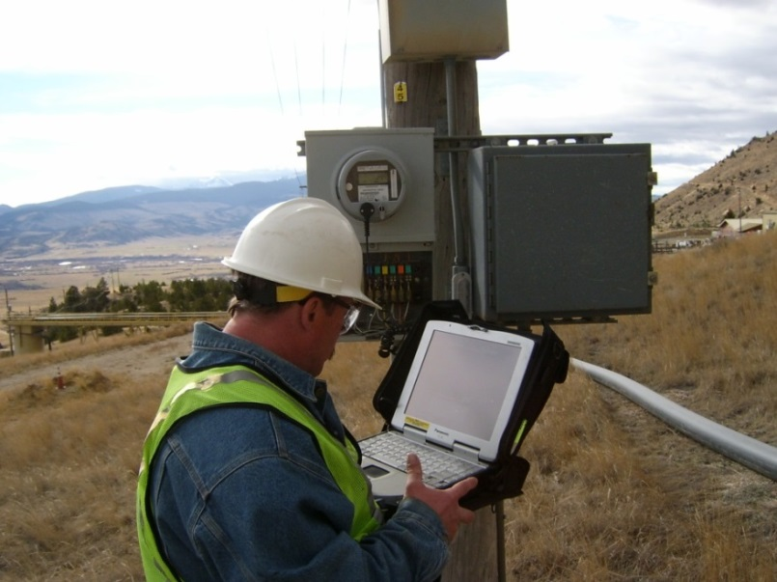
Periodic Site Inspections…..
….Can Discover or Prevent:
Billing Errors
Bad Metering set-up
Detect Current Diversion
Identify Potential Safety Issues
Metering Issues (issues not related to meter accuracy)
AMR/AMI Communications Issues
The need for Unscheduled Truck Rolls due to Undetected Field Related Issues
Discrepancies between what is believed to be at a given site versus the actual setup and equipment at the site

Slide 66
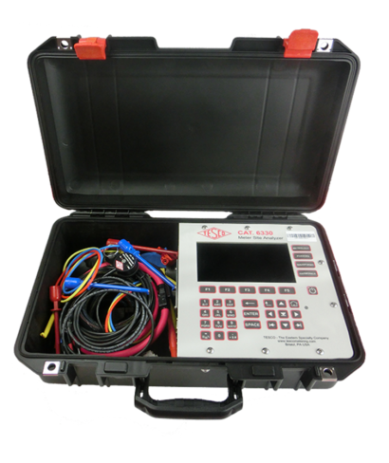
Admittance Testing
What is Admittance?
Admittance testing measures the overall “health” of the secondary loop of the CT.
Measured in units of MiliSiemens (mS)
Admittance is the inverse of impedance.
Impedance is the opposition to current.
Therefore, admittance testing measures the overall “health” of the secondary loop of the CT.

Slide 67
Admittance Testing
Admittance testing devices inject an audio sine wave signal into the secondary loop of the CT.
The resulting current is measured.
The voltage of the initial signal is known.
From these two parameters, the impedance, and thus the admittance can be calculated.

Slide 68
Admittance Testing
Admittance test results are not immediately intuitive.
Some analysis and interpretation is need.
What do all these mS values mean?

Slide 69
Admittance Testing
Three phase process is recommended.
Test each CT individually
Test the matched sets
Test over time

Slide 70
De-magnetization
CT’s can become magnetized, due to a number of reasons, including leaving the shorting clip open, near lightning strikes, and harmonic content.
CT’s can be demagnitized by slowly and smoothly increasing the secondary resistance until saturation occurs, and then slowly and smoothly decreasing the secondary resistance.
A resistance that will cause a secondary current reduction of 65% to 75% will typically put the CT into saturation.
*Some information has been taken from Radian Research’s Application Note 1109A: Admittance Testing Verifies CT Testing Integrity

Slide 71
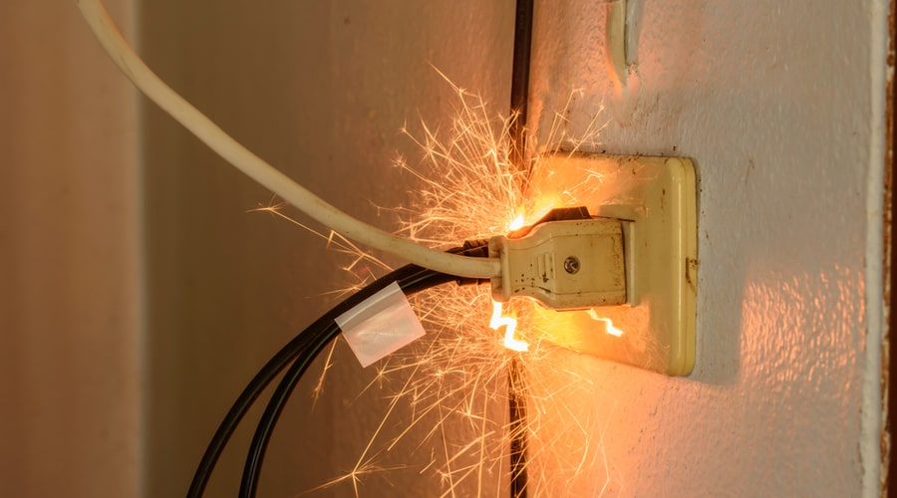
Metering Safety
Fatal Electrical Injuries
The highest rate of fatal electrical injury in 2019 occurred in the Construction industry (0.7/100,000), followed closely by the Utility industry (0.4/100,000).
In 2019, there was one electrical fatality for every 33 fatalities from all causes. The long-term trend has declined from one electrical fatality for each 23 fatalities from all causes in 2003 to the 2019 level of one in 33.

Slide 72
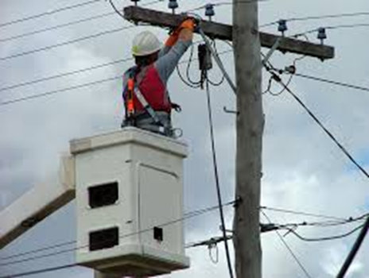
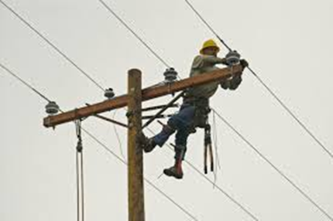
Does Age Matter – Or Experience?
Fatal Electrical Injuries
In 2019, 8% of all electrical injuries were fatal.
By age group Fatalities tend to go down with age and experience (and perhaps a healthier respect for electricity).
16 to 17 – 5.4 times as likely as the average worker to experience an electrical injury on the job site.
18 to 19 years age group – 2.4 times
20 to 24 years age group - 1.8 times
25 to 34 years age group - 1.5 times
35 to 44 years age group – 1.1 times, and;
those 45 years and up are at or below the average frequency of electrical injury.

Slide 73
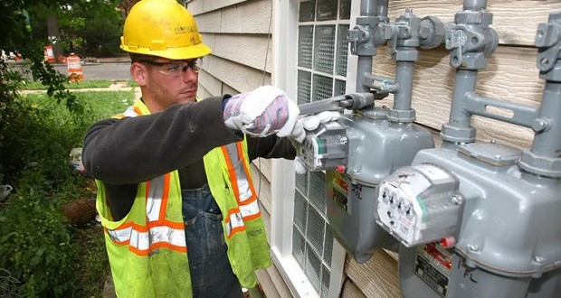
Non-Fatal Electrical Injuries
The median number of days away from work for nonfatal electrical injuries was 9 in 2019.
Electrical injuries are typically classified as burn or shock. For non-fatal injuries, electrical shock injuries were nearly triple the electrical burn injuries in 2019.
The Utility industry rate of nonfatal electrical injury involving days away from work (0.9/10,000) surpassed the Construction industry rate (0.7/10,000) in 2016.
The Mining industry had rate of nonfatal electrical burn injury of 1.0/10,000 for 2016, followed by the Utility industry (0.9) followed by the construction industry (0.4). The rate for all of Private industry remained consistent at 0.1.

Slide 74
How Dangerous is Metering?
Electricity is Organized Lightning – George Carlin
Any Voltage without current will not kill you, but any voltage with current can kill you.

Slide 75
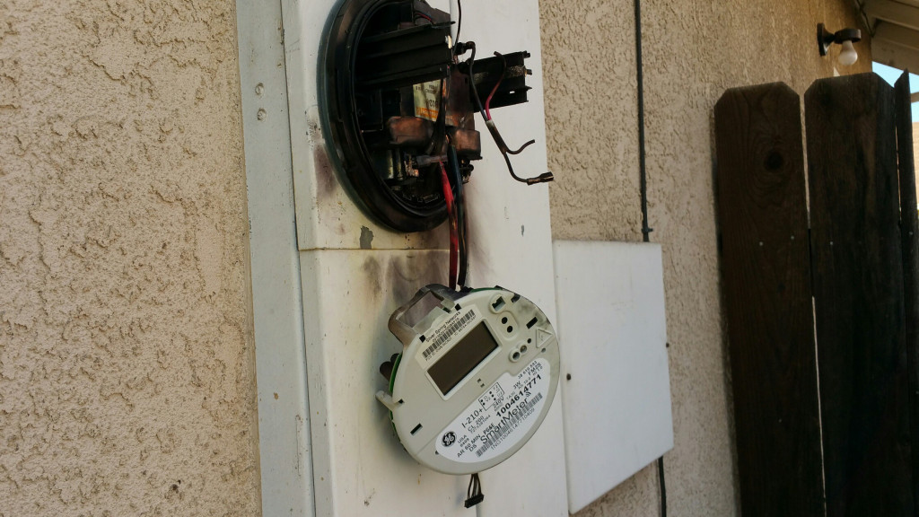
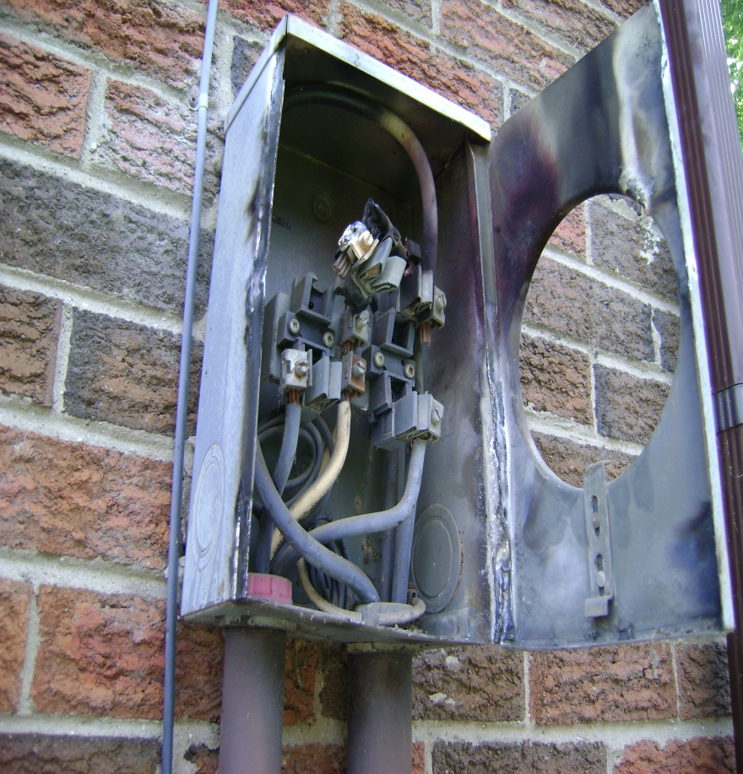
How Dangerous is Metering?

Slide 76
Safety First - PPE
Personal Protective Equipment
Leathers
Rubber Gloves
Face Shield
FR Clothing
Safety Shoes

Slide 77
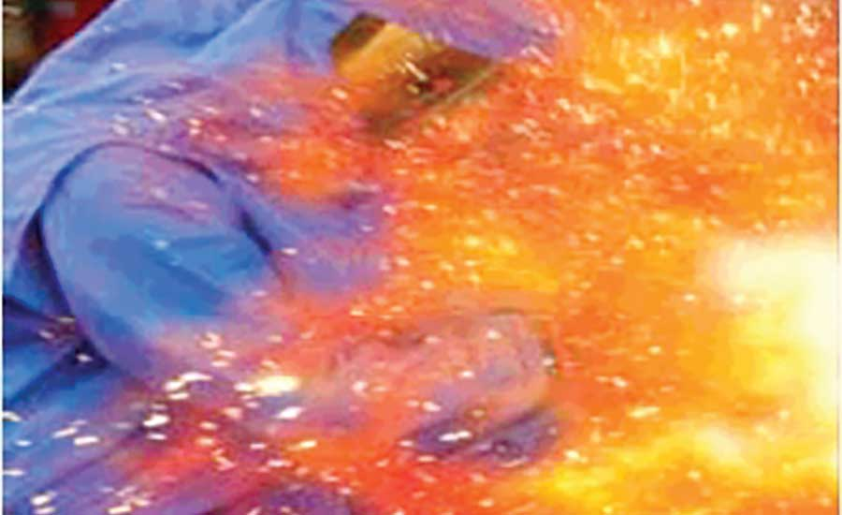
Arc Flash
What is Arc Flash?
While an arc flash is sometimes used interchangeably with “arc fault”, an arc flash is more accurately defined as the light produced during an arc fault. An arc fault is a type of electrical fault that results from the breakdown of an insulating medium between two conductors where the energy is sufficient to sustain an arc across the insulator (often air) and can cause extreme amounts of light (arc flash), immense heat upwards of 19,000 degrees C, and a resulting explosive pressure wave (arc blast). These forces combine to create a hazardous condition that can vaporize metal, destroy equipment, and pose a significant hazard to anyone in the vicinity.

Slide 78
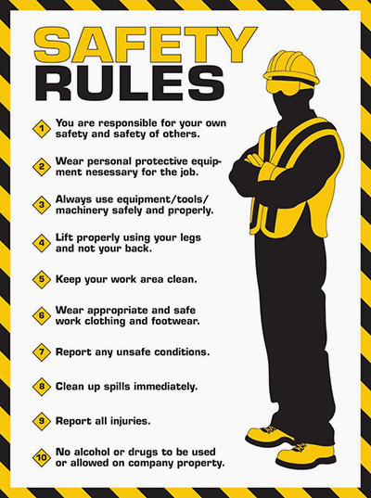
Covering the Basics

Slide 79
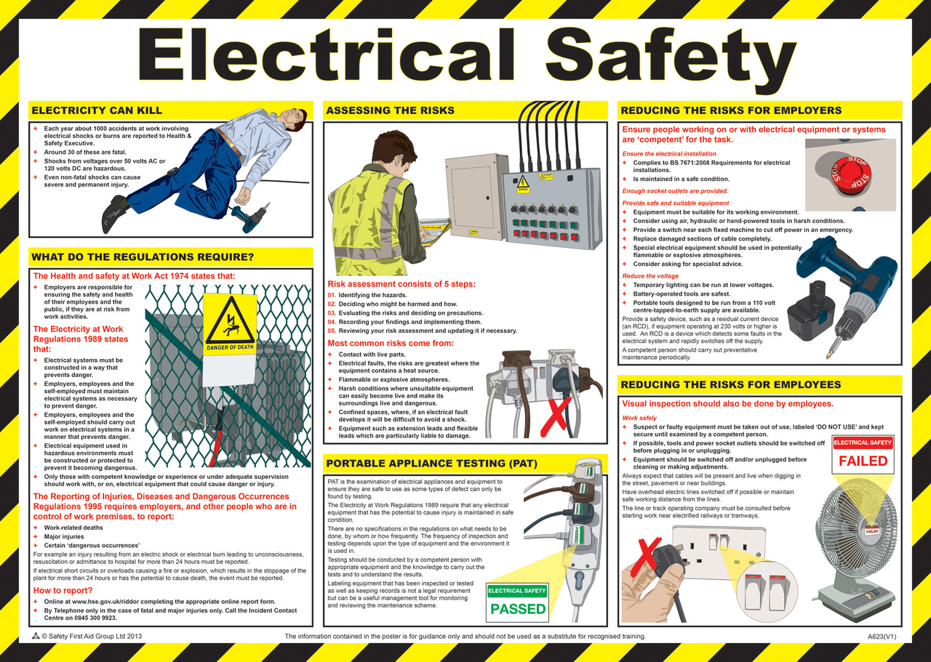
More of the Basics

Slide 80
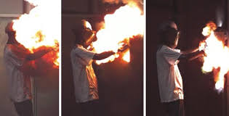
How Bad Can Things Get?
Many thanks to Dominion Power
https://youtu.be/2Xoyb9M5-EA
Rubber Gloves and FR 4:10
Meter enclosure – shorted out 10:48
Thanks to Meter Grabber
https://youtu.be/Azuu8VnM36g

Slide 81
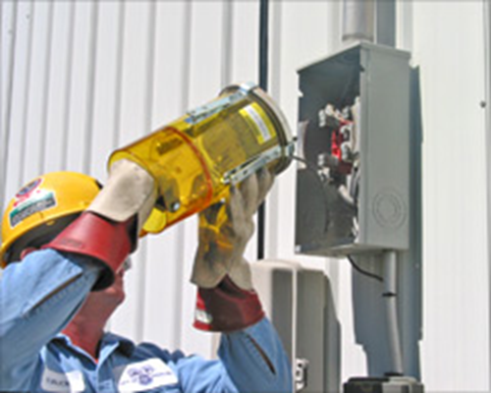
Field Audits, Trouble Shooting and Testing
Always approach an electrical service with caution and while wearing your full PPE. Why?
Never stand directly in front of the meter when removing the meter
Before you even open the box or get the cover off….
Live box
Bees
Other live animals
Broken Seal
Cover dropping off

Slide 82
Field Audits, Trouble Shooting and Testing 2

Slide 83
Field Audits, Trouble Shooting and Testing 3

Slide 84
Once the box is Open: Issues to Look For
Open line – open line side connection to the meter socket.
Missing neutral – missing neutral connection to the center lug in the meter socket
Cross phase condition – cross wiring between the test block and the meter socket.
Hidden jumpers line to load – diversion on both legs.
Dead Short - dead short phase to ground on the load side of one leg of the socket.
Partial Short - partial short phase to ground on the load side of one leg of the socket

Slide 85
Backfeed, Ground Fault and other Issues to Look For
Back fed meter socket
Ground fault
Phase to phase fault
Pulling a meter jaw with the meter

Slide 86
Tools
Socket Pullers
Volt meters
Specialized tools

Slide 87
Summary
Be Careful
Assume the box is live
Assume there is something live in the box
Treat electricity with respect
Treat all meter boxes with respect

Slide 88
Around the room
Issues that you may have seen in your metering career already?
Safety Issues not yet brought up?
Closing
Are you not only following the rules but actively making suggestions?

Slide 89
Most Importantly…
We test and verify the sites to make sure we are not losing money and to make sure the sites are safe.

Slide 90
Questions and Discussion
Perry Lawton
Northeastern Regional Sales Manager
perry.lawton@tescometering.com
TESCO – The Eastern Specialty Company
Bristol, PA
215.228.0500
This presentation can also be found under Meter Conferences and Schools on the TESCO website: tescometering.com
ISO 9001:2015 Certified Quality Company
ISO 17025:2017 Accredited Laboratory

