Slide 1
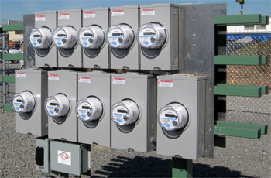
Test Switch Operation and Accessories
Introduction to Transformer Rated Metering and Accessories
Instructor John Greenewald
National Sales Manager- TESCO, The Eastern Specialty Company
John and TESCO have been intimately involved with several AMI pilot programs, meter certification projects, and subsequent deployments over the past several years. TESCO has been asked to provide customized equipment to assist with the certification of new AMI meters and the functional testing of newly received meters, customized software modules to assist in the deployment, and meter engineers and meter technicians to assist throughout the deployment projects in a variety of capacities needed by the different AMI teams.
Prepared by Tom Lawton, TESCO
The Eastern Specialty Company
For Mississippi Electric Meter School
Wednesday, September 27, 2017
11:00am – 12:00pm
2016 Meter School

Slide 2
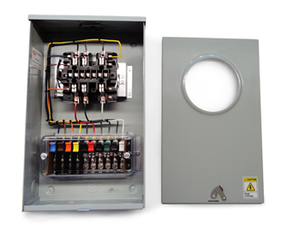
Session Overview
Transformer Rated Metering
Instrument Transformers
Using Test Switches
Meter Test Switch Specifications
Meter Test Switch Configurations
Meter Test Switch Accessories
Pre-Wired Transformer Rated Enclosures
Why we worry about testing and inspecting Transformer Rated Services

Slide 3
Typical Self-Contained Service
Typically found in residential metering
Meters are capable of handling the direct incoming amperage
Meter is connected directly to the load being measured
Meter is part of the circuit
When the meter is removed from the socket, power to the customer is interrupted

Slide 4
Transformer Rated Service
Meter measures scaled down representation of the load.
Scaling is accomplished by the use of external current transformers (CTs) and sometimes voltage transformers or
PTs).
The meter is NOT part of the circuit
When the meter is removed from the socket, power to the customer is not effected.

Slide 5
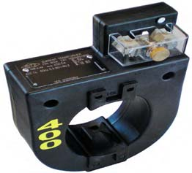
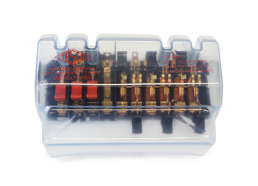
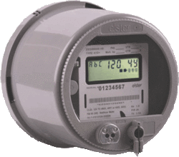
Transformer Rated Service
9S Meter Installation with 400:5 CT’s
SOURCE
LOAD
PHASE A
400A
PHASE B
400A
PHASE C
400A
5A
5A
5A
5A
5A
5A

Slide 6
SAFETY
Testing current transformers while they are in service can be a dangerous operation.
The secondary loop of a current transformer must NEVER BE OPENED when service current is present in the primary. When there is current in the primary, and the secondary of a current transformer is open circuited, the voltage across the secondary can rise to hundreds and even thousands of volts, creating an extremely dangerous situation.
The open CT secondary voltage magnitude varies with CT design and primary current flow. The high voltage that is present on the open secondary of an energized current transformer generates two great hazards.
The first hazard is ELECTRICAL SHOCK TO TESTING PERSONNEL.
The second hazard is THE BREAKDOWN OF THE CURRENT TRANSFORMER INSULATION.

Slide 7
SAFETY (cont)
Both hazards can be avoided provided that the secondary of the current transformer is never opened. The safest current transformer installations for testing are those that have a Test Switch as part of the secondary loop.
A Test Switch is a device that will facilitate inserting instrumentation in the current transformer secondary loop without the danger of opening the circuit.

Slide 8
Test Switch Specifications
ANSI C12 Definitions
Test Switch Materials
Plating
Barriers
Wiring Connections
What to look for
Covers

Slide 9
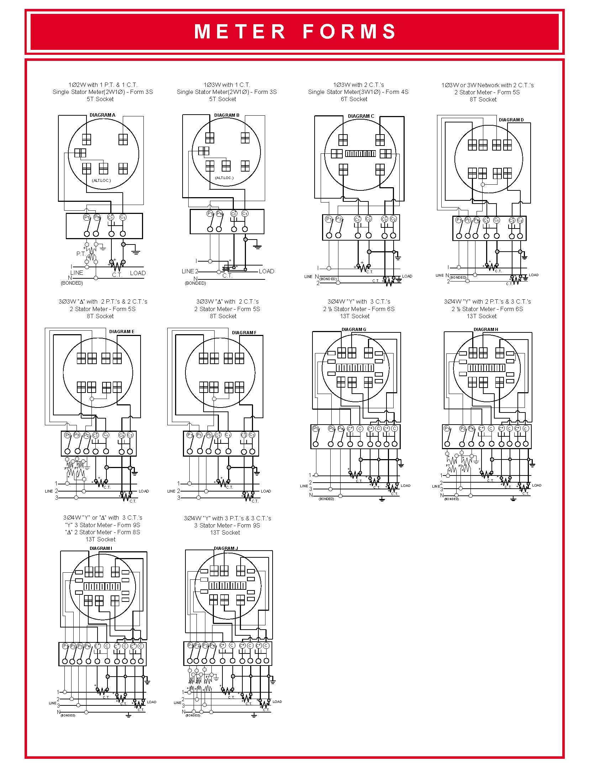
Typical Connections for Common Meter Forms

Slide 10
ANSI C12.9
Test Switch Definitions

Slide 11
ANSI C12.9
Test Switches

Slide 12
ANSI C12.9 General Test Switch Specifications

Slide 13
Test Switch Configurations
Layout
Handle Colors
Reversed vs. Normal Potentials
Current Links
Base Sizing
Barrier Locations

Slide 14
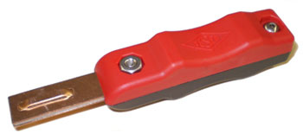
Test Switch Accessories
Test Plugs
Safety Covers
Test Switch Isolators
On installations that contain Test Switches, test leads terminated with a test switch
safety test probe (test plug) should be used for CT testing. This provides a “make-before-break” connection to prevent accidental opening of the current transformer secondary loop.

Slide 15
ANSI C12.9 Test Jack Specifications

Slide 16
ANSI C12.9 Test Plug Specifications

Slide 17
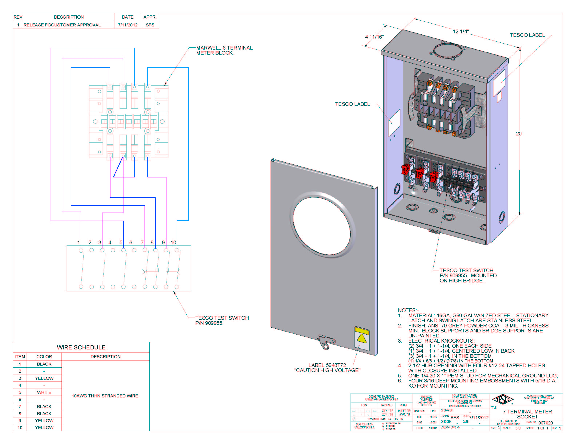
Pre-Wired Transformer Rated Enclosures
Cover Types
Wiring
Sockets

Slide 18
Transformer Rated Service
What issues can we see? How would these affect billing?
SOURCE
LOAD
PHASE A
400A
PHASE B
400A
PHASE C
400A
5A
5A
5A
5A
5A
5A

Slide 19
QUIZ
1. Which type of metering service typically has a test switch?
Self Contained
Transformer Rated
Gas
2. Why would you want to reverse the potentials on test switch?
Aesthetics
To use multiple voltages
To de-energize the potential blades when open for safety
3. What is the purpose of a current link on a test switch?
To enable connection of the test jack and shunt in the current pair to complete the current loop.
To connect the current pairs to the potentials
To eliminate the need for barriers between the poles

Slide 20
QUIZ (cont)
4. Assuming a balanced load how much of the bill do we lose if one transformer is wired backwards?
One third
One half
Two thirds
5. Assuming a balanced load how much of the bill do we lose if one transformer fails?
One third
One half
Two thirds
6. If the test switch is left open when the meter tech leaves the site how much of the bill do we lose?
One third
One half
Two thirds

Slide 21
Questions and Discussion
Tom Lawton
TESCO – The Eastern Specialty Company
Bristol, PA
215-785-2338
This presentation can also be found under Meter Conferences and Schools on the TESCO web site: www.tesco-advent.com

