Slide 1
Advanced Polyphase Metering
Presented by John Kretzschmar
June 20, 2017

Slide 2
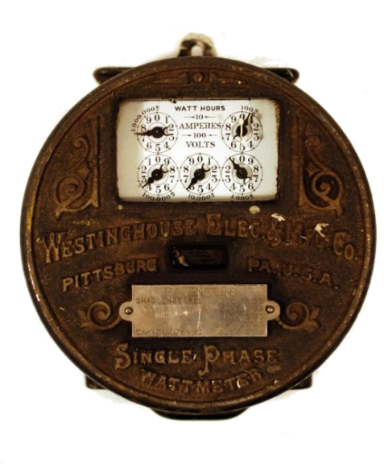
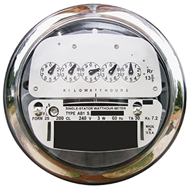
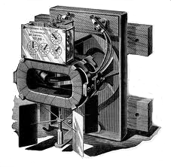
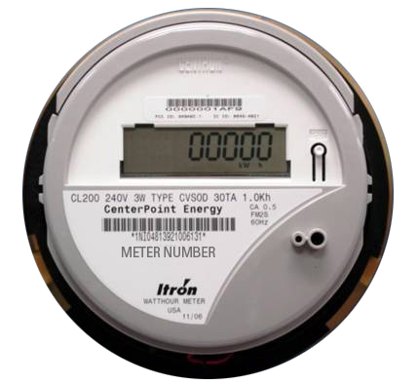
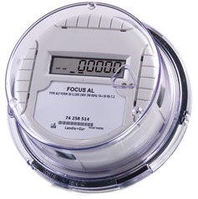

Then – Now – Tomorrow?
Meters
First Meters mid-1990s
Westinghouse 1905
2005
2006
2014
2025 ???

Slide 3
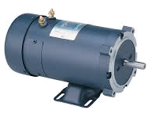
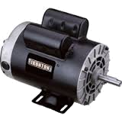

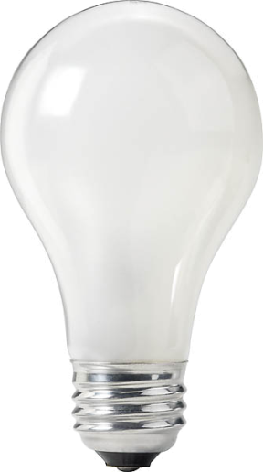



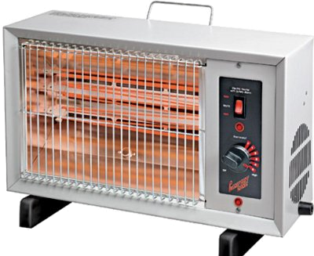
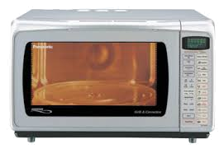
Then – Now – Tomorrow?
Loads
TODAY
YESTERDAY

Slide 4

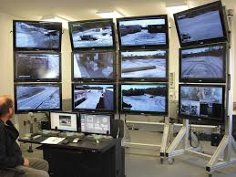
Then – Now – Tomorrow?
Loads
TODAY

Slide 5
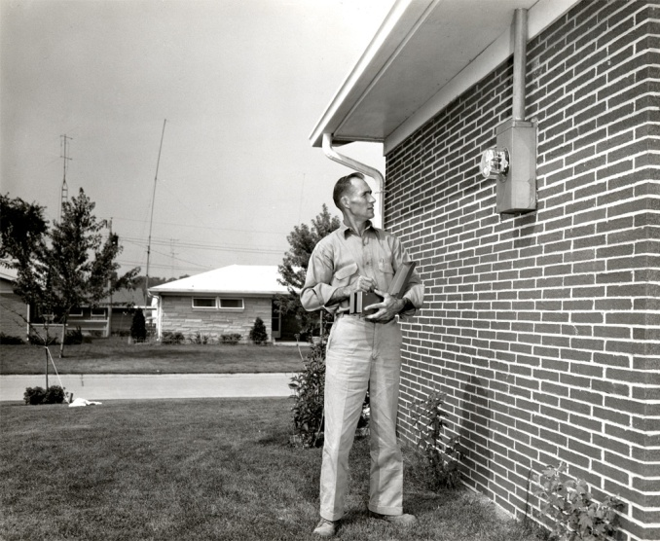
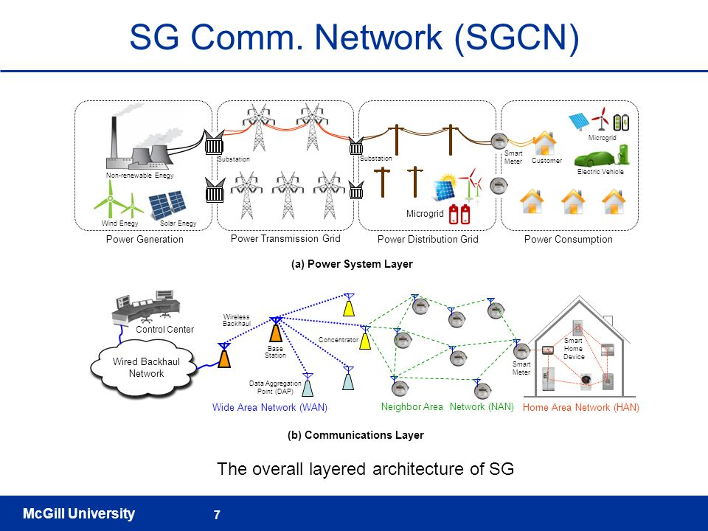
Then – Now – Tomorrow?
Communications
THEN
NOW

Slide 6
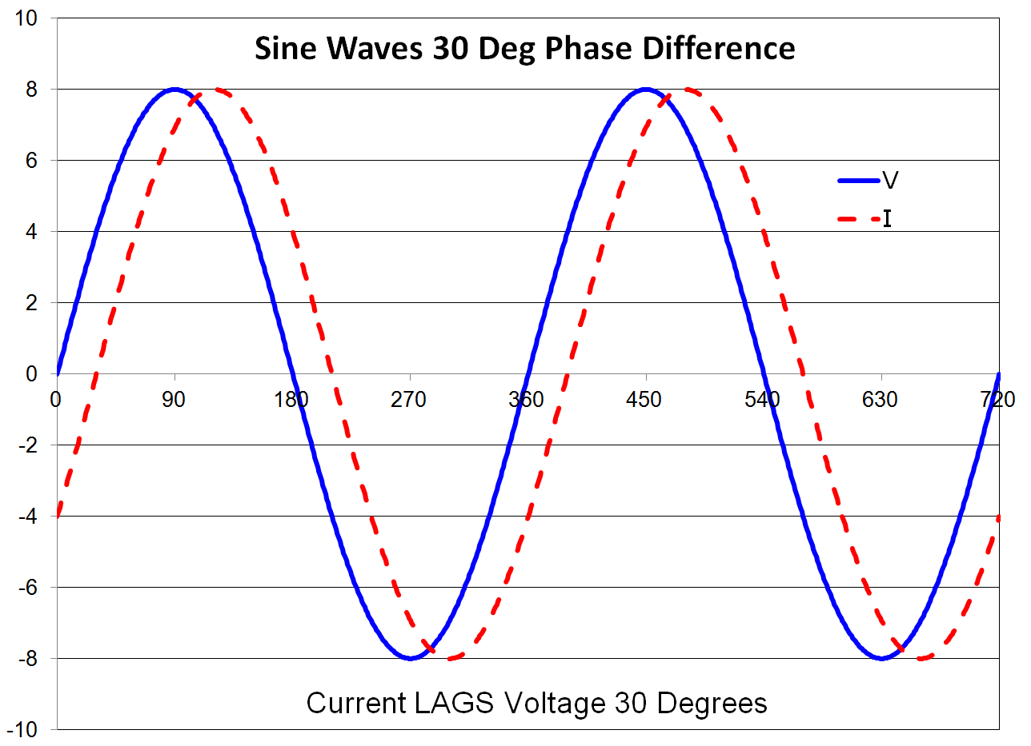
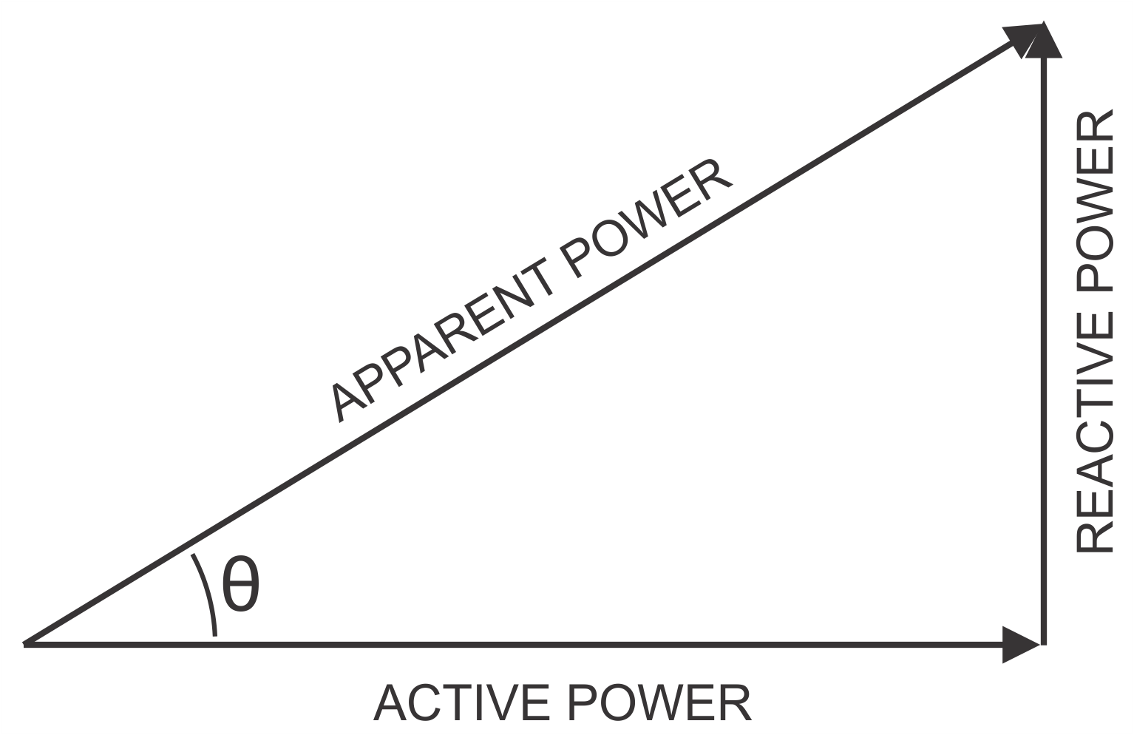
Why Do These Changes Matter?
Changes to our loads have changed the basic computations of metering
When loads were linear the power triangle was all we needed to know

Slide 7
Why Do These Changes Matter?
Today’s loads look more like these

Slide 8
Why Do These Changes Matter?
Today’s loads look more like these

Slide 9
Why Do These Changes Matter?
Today’s loads look more like these

Slide 10
Three Phase Power
Introduction
Basic Assumptions
Three AC voltage sources
Voltages Displaced in time
Each sinusoidal
Identical in Amplitude

Slide 11
AC Theory – Sine Wave

Slide 12
Three Phase Theory
Single Phase - Voltage Plot
ONE CYCLE
Van

Slide 13
Three Phase Theory
Two Phases - Voltage Plot
ONE CYCLE
Van
Vbn

Slide 14
Three Phase Theory
Three Phase - Voltage Plot
ONE CYCLE
Van
Vbn
Vcn

Slide 15
Three Phase Power
At the Generator
Van
Vbn
Vcn
Three voltage vectors each separated by 120°.
Peak voltages essentially equal.
Most of what makes three phase systems seem complex is what we do to this simple picture in the delivery system and loads.

Slide 16
Three Phase Power
Basic Concept – Phase Rotation
Phase Rotation:
The order in which the phases reach peak voltage.
There are only two possible sequences:
A-B-C (previous slide)
C-B-A (this slide)
Vcn
Vbn
Van
Phase rotation is important because the direction of rotation of a three phase motor is determined by the phase order.

Slide 17
AC Theory - Phase

Slide 18
Three Phase Theory
Phasors and Vector Notation
Phasors are a graphical means of representing the amplitude and phase relationships of voltages and currents.
90
V = sin(θ)
180
0
270

Slide 19
Three Phase Power
Phasors and Vector Notation
As stated in the Handbook of Electricity Metering, by common consent, counterclockwise phase rotation has been chosen for general use in phasor diagrams.
90
V = V0sin(θ-120)
180
0
270

Slide 20
Three Phase Power
Phasors and Vector Notation
The phasor diagram for a simple 3-phase system has three voltage phasors equally spaced at 120° intervals.
Going clockwise the order is A – B – C.
90
V = V0sin(θ-240)
180
0
270

Slide 21
Three Phase Theory
Symbols and Conventions
Systems formed by interconnecting secondaries of 3 single phase transformers.
Generally primaries are not show unless details of actual transformer are being discussed.

Slide 22
Three Phase Theory
Symbols and Conventions
Often even the coils are not shown but are replaced by simple line drawings

Slide 23
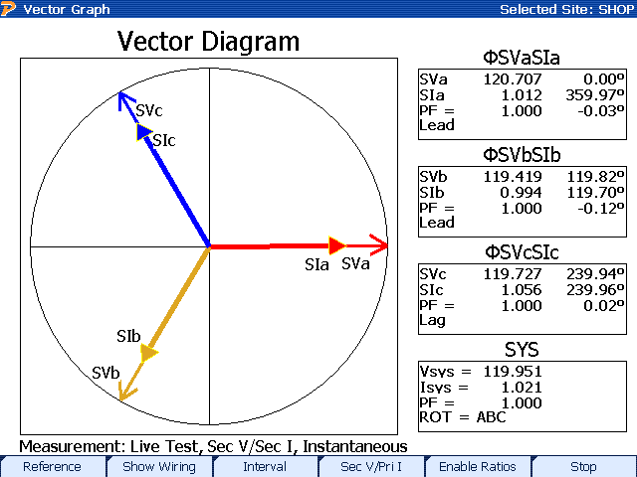
3 Phase, 4-Wire “Y” Service
0° = Unity Power Factor
Three Voltage Phasors
120° Apart
Three Current Phasors
Aligned with Voltage at PF=1

Slide 24
Symbols and Conventions
Labeling
Voltages are generally labeled Va, Vb, Vc, Vn for the three phases and neutral
This can be confusing in complex cases
The recommended approach is to use two subscripts so the two points between which the voltage is measured are unambiguous
Vab means voltage at “a” as measured relative to “b”.

Slide 25
2 Phase, 3-Wire “Y” Service
“Network Connection”
Single phase variant of the service.
Two voltage sources with their returns connected to a common point.
Provides 208 rather than 240 volts across “high side” wires.

Slide 26
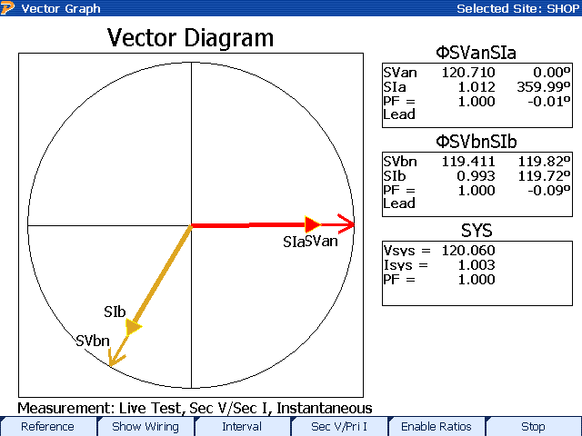
2 Phase, 3-Wire “Network” Service
Two Voltage Phasors
120° Apart
Two Current Phasors
Aligned with Voltage at PF=1

Slide 27
3 Phase, 3-Wire Delta Service
Common service type for industrial customers. This service has NO neutral.
Voltages normally measured relative to phase B.
Voltage and current vectors do not align.
Service is provided even when a phase is grounded.

Slide 28
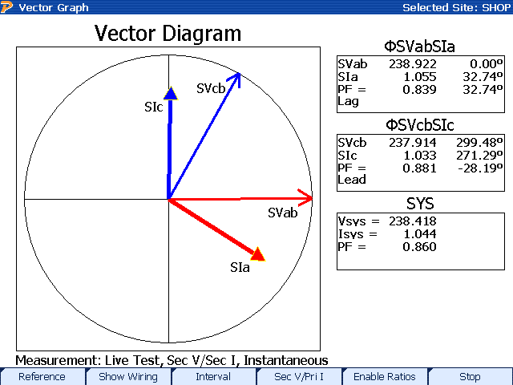
3 Phase, 3-Wire Delta Service
Resistive Loads
Two Voltage Phasors
60° Apart
Two Current Phasors
For a resistive load one current leads by 30° while the other lags by 30°

Slide 29
3 Phase, 3-Wire Delta Service
Resistive Load
Two Voltage Phasors
60° Apart
Two Current Phasors
For a resistive load one current leads by 30° while the other lags by 30°

Slide 30
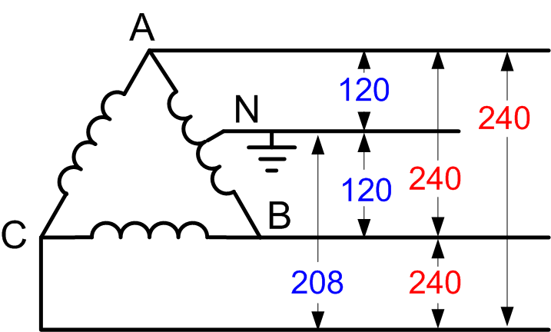
3 Phase, 4-Wire Delta Service
Common service type for industrial customers. Provides a residential like 120/240 service (lighting service) single phase 208 (high side) and even 3 phase 240 V.
Voltage phasors form a “T” 90° apart
Currents are at 120° spacing
In 120/120/208 form only the “hot” (208) leg has its voltage and current vectors aligned.

Slide 31
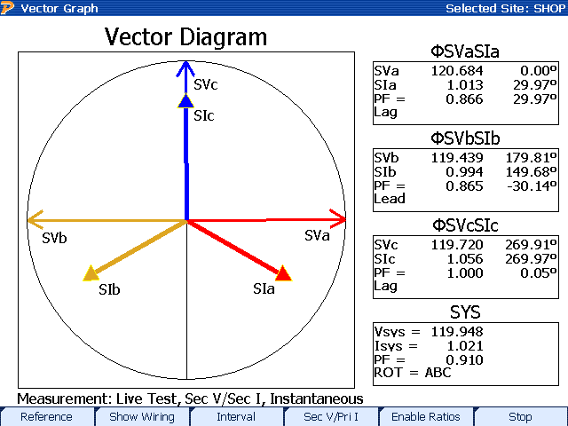
3 Phase, 4-Wire Delta Service
Resistive Load
Three Voltage Phasors
90° Apart
Three Current Phasors
120° apart

Slide 32
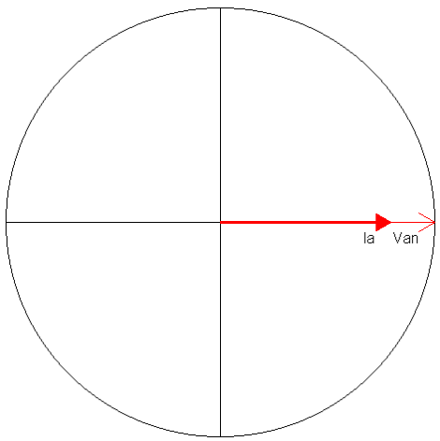
AC Theory – Resistive Load
Resistors are measured in Ohms. When an AC voltage is applied to a resistor, the current is in phase. A resistive load is considered a “linear” load because when the voltage is sinusoidal the current is also sinusoidal.

Slide 33
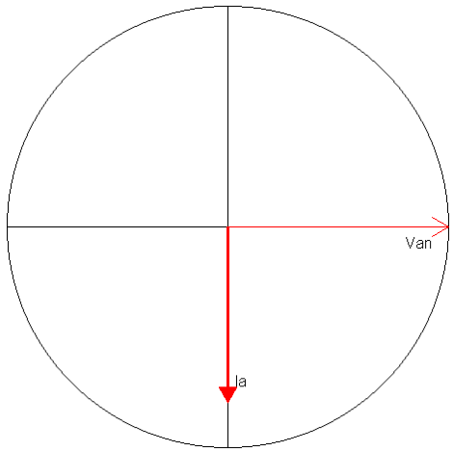
AC Theory – Inductive Load
Inductors are measured in Henries. When an AC voltage is applied to an inductor, the current is 90 degrees out of phase. We say the current “lags” the voltage. A inductive load is considered a “linear” load because when the voltage is sinusoidal the current is also sinusoidal.

Slide 34
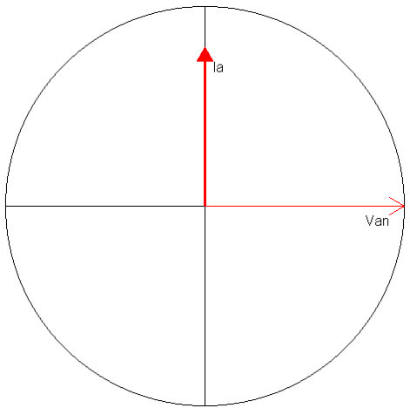
AC Theory – Capacitive Load
Capacitors are measured in Farads. When an AC voltage is applied to a capacitor, the current is 90 degrees out of phase. We say the current “leads” the voltage. A capacitive load is considered a “linear” load because when the voltage is sinusoidal the current is sinusoidal.

Slide 35
AC Theory – Power
Power is defined as: P = VI
Since the voltage and current at every point in time for an AC signal is different, we have to distinguish between instantaneous power and average power. Generally when we say “power” we mean average power.
Average power is only defined over an integral number of cycles.

Slide 36
Time Out for Trig
(Right Triangles)
The Right Triangle:
The Pythagorean theory
c² = a² + b²

Slide 37
AC Theory – Definitions
Inductive Reactance – The inductive opposition in a AC circuit = X_{L}
Capacitive Reactance – The capacitive opposition in a AC circuit = X_{C}
Impedance – Total opposition to the flow of current in an AC circuit which includes resistance, X_{L} and X_{C}.
    Impedance = Z = √ [R² + (X_{L} – X_{C})²]
Resistive Loads – Light bulbs, heater, etc
Inductive Loads – Electric motors, fans, air conditioners, etc.
Capacitive Loads – Capacitors used to compensate for inductive loads

Slide 38
AC Theory – Power Triangle
(Sinusoidal Waveforms)
VA
VARs
Watts
If V = Sin(ωt) and I = Sin(ωt - θ) (the load is linear) then:
Active Power = VICos(θ) Watts
Reactive Power = VISin(θ) VARs
Apparent Power = VI VA
Power Factor = Active/Apparent = Cos(θ)

Slide 39
AC Theory – Active Power
(Real Power (kW))
In a circuit that contains only resistance:
  Real Power (kW) = V_{RMS} * I_{RMS}
In a circuit that contains resistance and reactance:
  Real Power (kW) = V_{RMS} * I_{RMS} * COS (θ)

Slide 40
AC Theory – Apparent Power
(kVA)
Kilo-Volt-Amperes (kVA) are the product of Volts and the Total Current which flows because of the voltage.
In a circuit that contains only resistance, KVA (apparent power) is equal to the Real Power (kW).
When reactance is introduced into a circuit, and V_{RMS} and I_{RMS} are measured quantities, then:
kVA = V_{RMS} * I_{RMS}
In a circuit where only Real Power (kW) and Reactive Power (kVAR) are measured quantities, then:
kVA = √(kW² + kVAR²)

Slide 41
AC Theory – Reactive Power
(kVAR)
Reactive Volt Amperes are the product of the total Volt-Amperes and the Sine of the angle of displacement between Voltage and Current.
Reactive Power (kVAR) = V_{RMS} * I_{RMS} * SIN(θ)
kVAR reduces the efficiency in the distribution system, and is NOT used to deliver active power (kW) to the load.

Slide 42
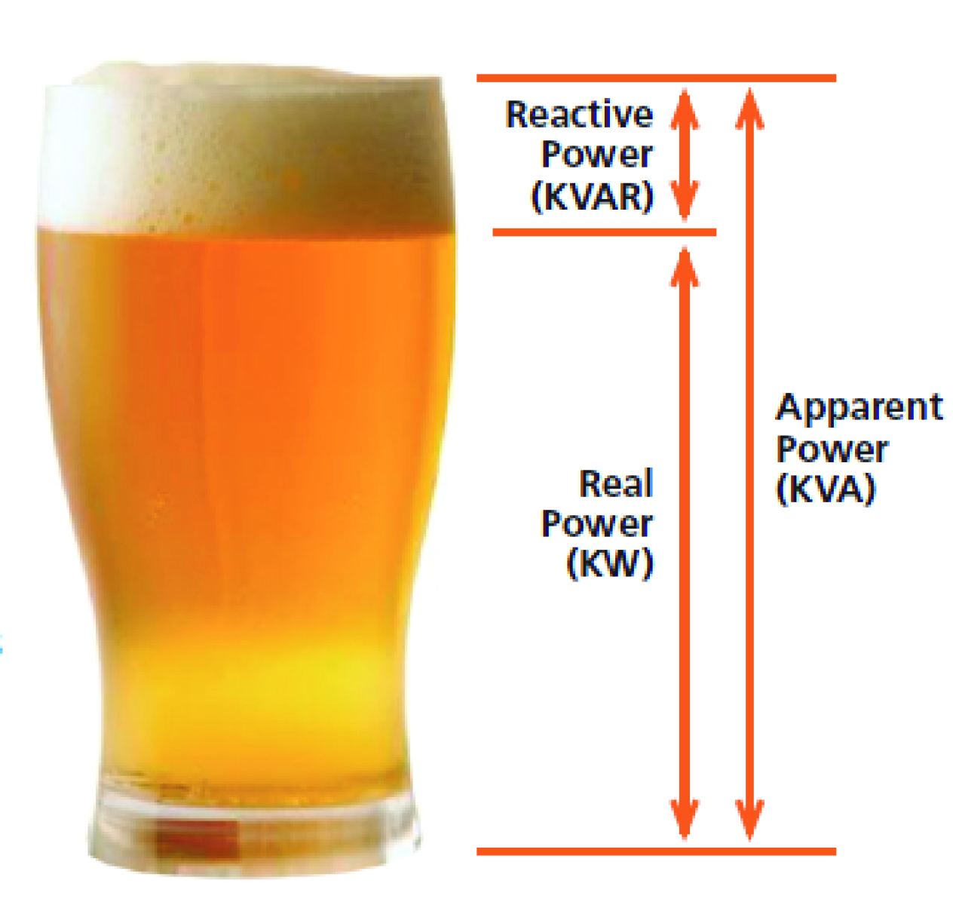
AC Theory – Reactive Power
(kVAR Analogy)

Slide 43
AC Theory
Instantaneous Power
For a resistive load:

Slide 44
AC Theory
Instantaneous Power
For an inductive load:

Slide 45
AC Theory
Instantaneous Power
For a capacitive load:

Slide 46
AC Theory – Complex Circuits
Amplitude (Current)
Phase (Current)
V_{C}
V_{L}
V
V_{C}
V_{R}

Slide 47
AC Theory – Instantaneous Power

Slide 48
AC Theory – Instantaneous Power
From IEEE1459 instantaneous power can be written in several forms:
Active Power
Reactive Power

Slide 49
Three Phase Power
Blondel’s Theorem
If energy be supplied to any system of conductors through N wires, the total power in the system is given by the algebraic sum of the readings of N wattmeters, so arranged that each of the N wires contains one current coil, the corresponding voltage coil being connected between that wire and some common point. If this common point is on one of the N wires, the measurement may be made by the use of N-1 wattmeters.

Slide 50
Three Phase Power
Blondel’s Theorem
Simply put – We can measure the power in a N wire system by measuring the power in N-1 conductors.
For example, in a 4-wire, 3-phase system we need to measure the power in 3 circuits.

Slide 51
Three Phase Power
Blondel’s Theorem
In practice, Blondel’s Theorem is not strictly adhered to in all applications.
Meter manufacturers have found ways to design meters that allow adequate accuracy without the required number of stators.

Slide 52
Three Phase Power
Blondel’s Theorem
One such meter is the common (form 2S) house meter.
It is a single stator meter that is specifically designed to meter a 3-wire circuit.

Slide 53
Three Phase Power
Blondel’s Theorem
Additionally, other meters may be connected in configurations, which may also provide adequate levels of accuracy without the required number of stators.
These are often referred to as Non-Blondel configurations.

Slide 54
Three Phase Power
Blondel’s Theorem
Why are Non-Blondel circuits challenging?
Makes the assumption that the service voltages are balanced.
The assumption may not be true so there are likely to be measurement errors.

Slide 55
Three Phase Power
Blondel’s Theorem
Why are Non-Blondel meters used?
Fewer elements in the meter means lower meter costs.
Fewer PTs and CTs mean lower installation costs.

Slide 56
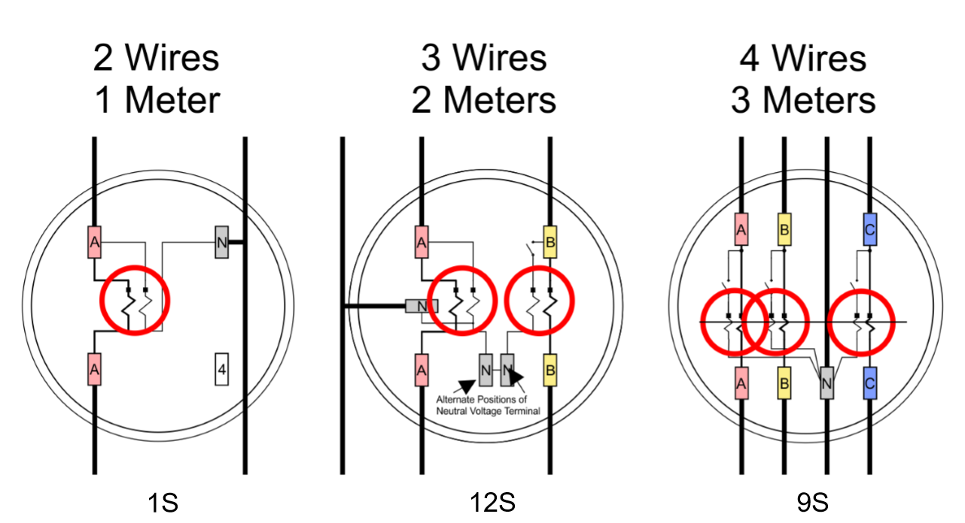
Three Phase Power
Blondel’s Theorem
Blondel Compliant

Slide 57
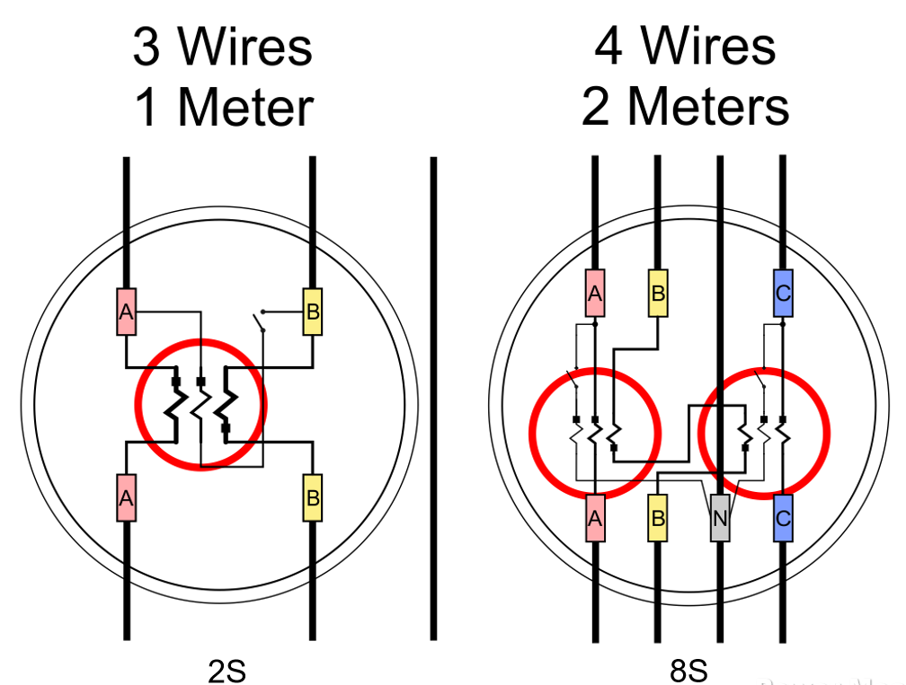
Three Phase Power
Blondel’s Theorem
Non-Blondel Compliant

Slide 58
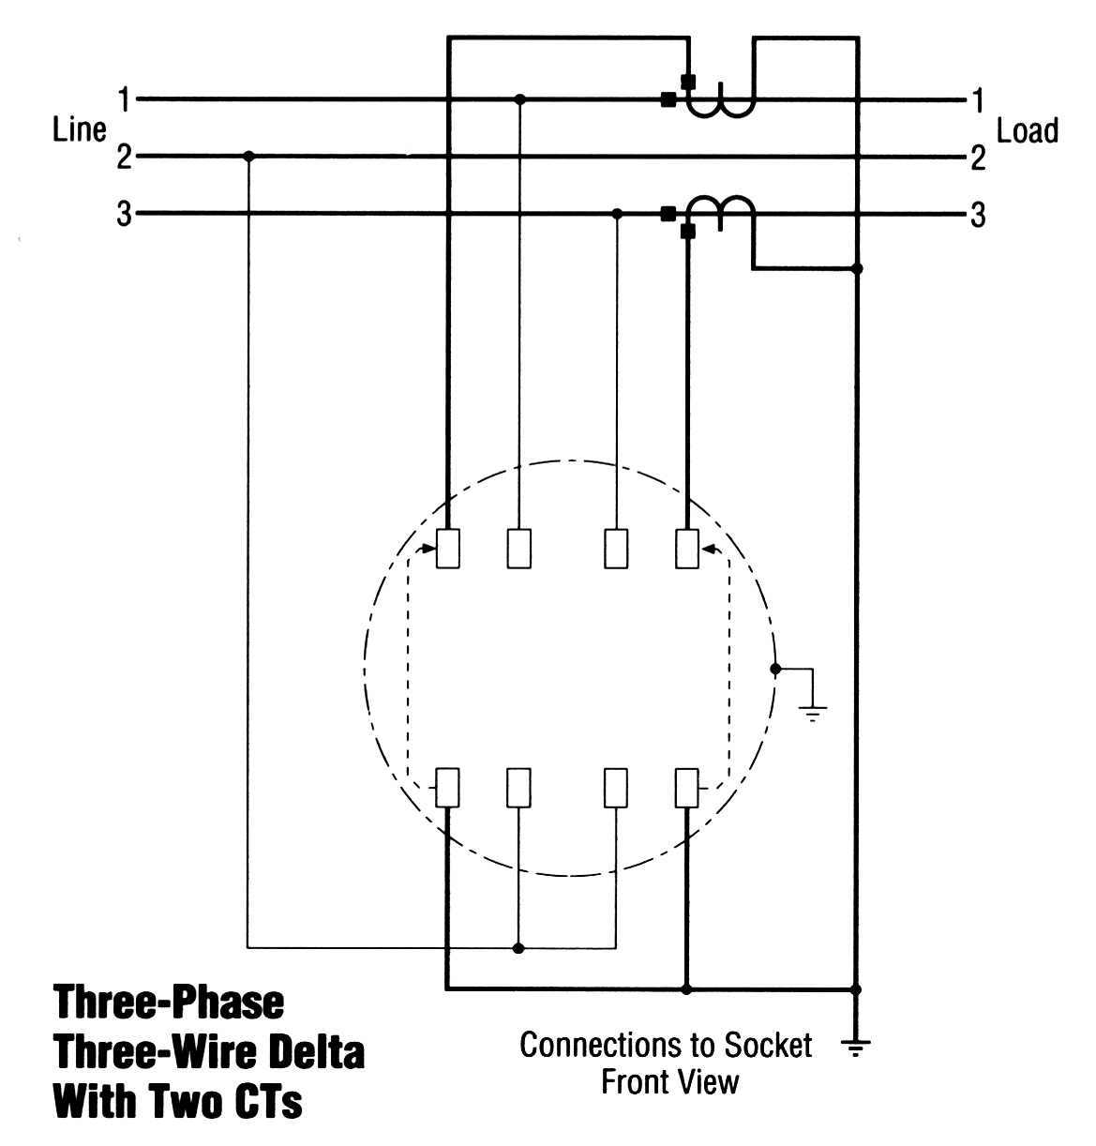
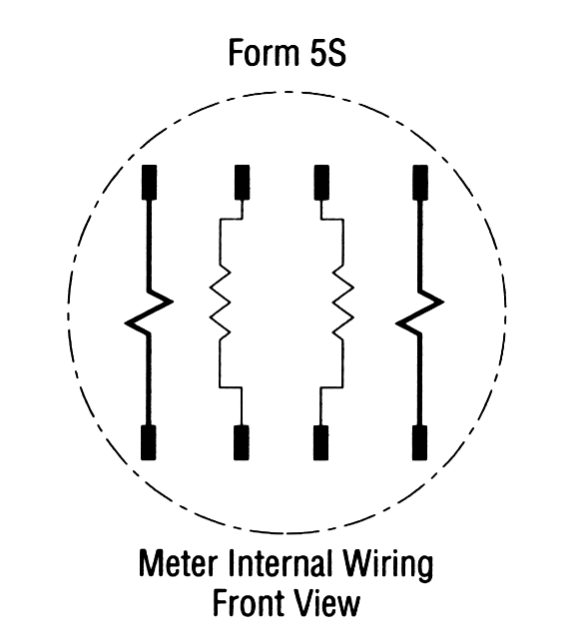
Blondel’s Theorem
Three wires
Two voltage measurements with one side common to Line 2
Current measurements on lines 1 & 3.
This satisfies Blondel’s Theorem.

Slide 59
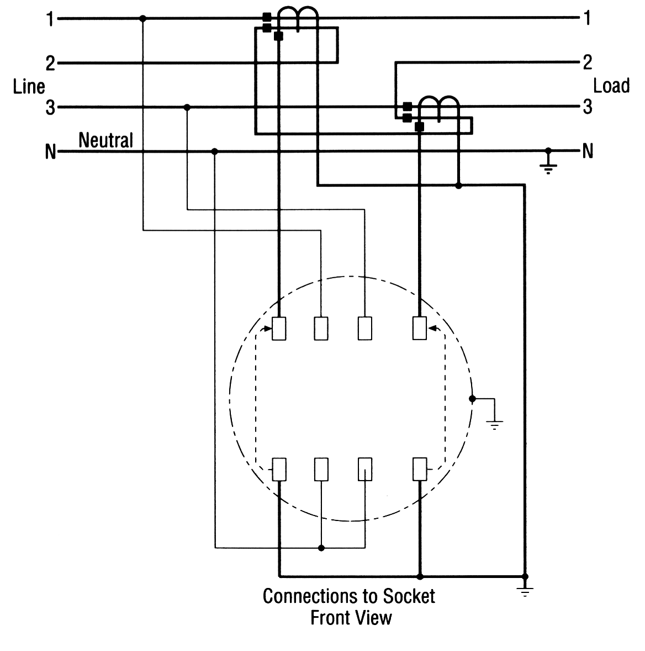
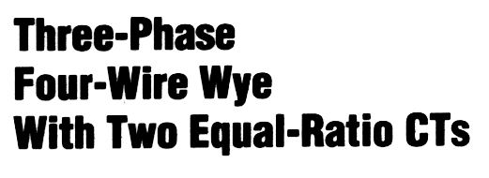
Blondel’s Theorem
Four wires
Two voltage measurements to neutral
Current measurements are on lines 1 and 3 but not line 2.
This DOES NOT satisfy Blondel’s Theorem.

Slide 60
Blondel’s Theorem
In the previous example:
  What are the “ASSUMPTIONS”?
  When do we get errors?

Slide 61
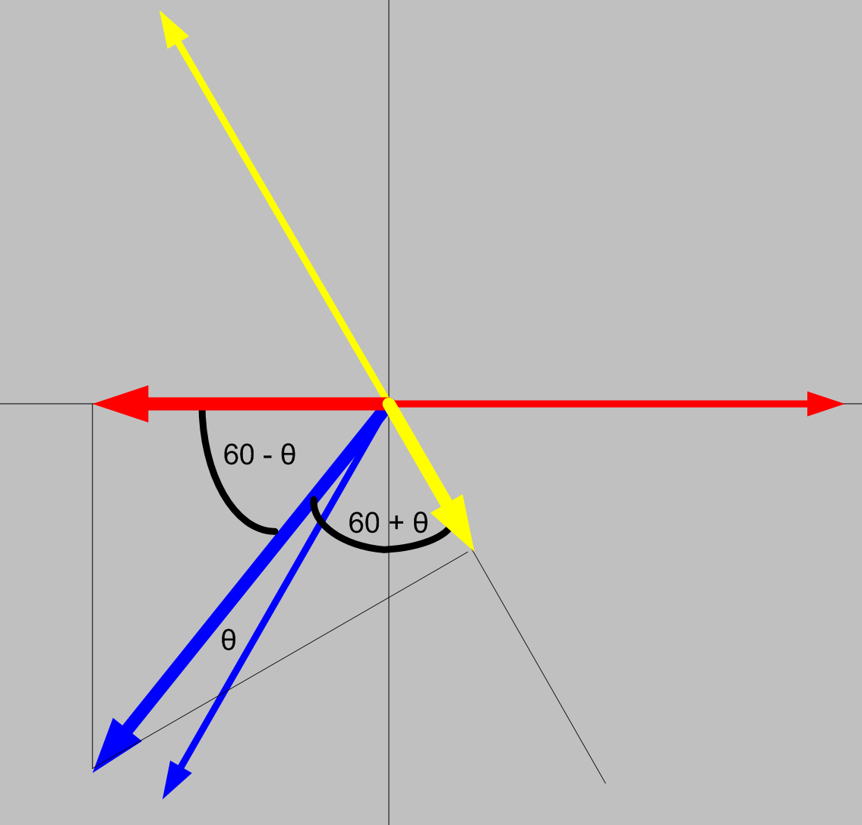
Blondel’s Theorem

Slide 62
Blondel’s Theorem
Phase B power would be:
    P = VbIbCosθ
But we aren’t measuring Vb
What we are measuring is:
    IbVaCos(60- θ) + IbVcCos(60+ θ)

Slide 63
Blondel’s Theorem
Pb = IbVaCos(60- θ) + IbVcCos(60+ θ)
Applying the trig identity
  IbVa(Cos(60)Cos(θ) + Sin(60)Sin(θ))
  IbVc (Cos(60)Cos(θ) - Sin(60)Sin(θ))
  Ib(Va+Vc)0.5Cos(θ) + Ib(Vc-Va) 0.866Sin(θ)
Assuming
  Assume Vb = Va = Vc
  And, they are exactly 120° apart
Pb = Ib(2Vb)(0.5Cosθ) = IbVbCosθ

Slide 64
Blondel’s Theorem
If Va ≠ Vb ≠ Vc then the error is
%Error =
-Ib{(Va+Vc)/(2Vb) - (Va-Vc) 0.866Sin(θ)/(VbCos(θ))
How big is this in reality? If
Va=117, Vb=120, Vc=119, PF=1 then E=-1.67%
Va=117, Vb=116, Vc=119, PF=.866 then E=-1.67%

Slide 65
AC Theory – Power
Power is defined as: P = VI
Since the voltage and current at every point in time for an AC signal is different, we have to distinguish between instantaneous power and average power.
Generally when we say “power” we mean average power.
Average power is only defined over an integer number of cycles.

Slide 66
Harmonics
Curse of the Modern World
Every thing discussed so far was based on “Linear” loads.
      For linear loads the current is always a simple sine wave. Everything we have discussed is true.
For nearly a century after AC power was in use ALL loads were linear.
Today, many loads are NON-LINEAR.

Slide 67
Harmonics - Definition
Non-sinusoidal complex waveforms are constructed by “adding” together a series of sine wave frequencies known as “Harmonics.”
Harmonics is the generalized term used to describe the distortion of a sinusoidal waveform by waveforms of different frequencies.

Slide 68
Harmonic Load Waveform
Eq.# | Quantity | Phase A
1 | V(rms) (Direct Sum) | 100
2 | I(rms) (Direct Sum) | 108
3 | V(rms) (Fourier) | 100
4 | I(rms) (Fourier) | 108
5 | Pa = (∫ V(t)I(t)dt) | 10000
6 | Pb = ½∑VnIncos(θ) | 10000
7 | Q = ½∑VnInsin(θ) | 0.000
8 | Sa = Sqrt(P^2 +Q^2) | 10000
9 | Sb = Vrms*Irms(DS) | 10833
10 | Sc = Vrms*Irms(F) | 10833
13 | PF = Pa/Sa | 1.000
14 | PF = Pb/Sb | 0.923
15 | PF = Pb/Sc | 0.923
V = 100Sin(ωt) I = 100Sin(ωt) + 42Sin(5 ωt)

Slide 69
Harmonic Load Waveform
Eq.# | Quantity | Phase A
1 | V(rms) (Direct Sum) | 100
2 | I(rms) (Direct Sum) | 108
3 | V(rms) (Fourier) | 100
4 | I(rms) (Fourier) | 108
5 | Pa = (∫ V(t)I(t)dt) | 10000
6 | Pb = ½∑VnIncos(θ) | 10000
7 | Q = ½∑VnInsin(θ) | 0.000
8 | Sa = Sqrt(P^2 +Q^2) | 10000
9 | Sb = Vrms*Irms(DS) | 10833
10 | Sc = Vrms*Irms(F) | 10833
13 | PF = Pa/Sa | 1.000
14 | PF = Pb/Sb | 0.923
15 | PF = Pb/Sc | 0.923
Important things to note:
  Because the voltage is NOT distorted, the harmonic in the current does not contribute to active power.
  It does contribute to the Apparent power.
  Does the Power Triangle hold
  There is considerable disagreement about the definition of various power quantities when harmonics are present.
V = 100Sin(ωt) I = 100Sin(ωt) + 42Sin(5 ωt)

Slide 70
3 Phase Power Measurement
We have discussed how to measure and view power quantities (W, VARs, VA) in a single phase case.
How do we combine them in a multi-phase system?
Two common approaches:
      Arithmetic
      Vectorial

Slide 71
3 Phase Power Measurement
Arithmetic vs Vectoral
Both a magnitude and a direction must be specified for a vector quantity.
In contrast, a scalar quantity which can be quantified with just a number.
Any number of vector quantities of the same type (i.e., same units) can be combined by basic vector operations.

Slide 72
3 Phase Power Measurement
VAR and VA calculations can lead to some strange results:
  If we define
PH | W | Q | VA
A | 100 | 0 | 100
B | 120 | 55 | 132
C | 120 | -55 | 132
Arithmetic VA |  |  | 364
Vector VA |  |  | 340

Slide 73
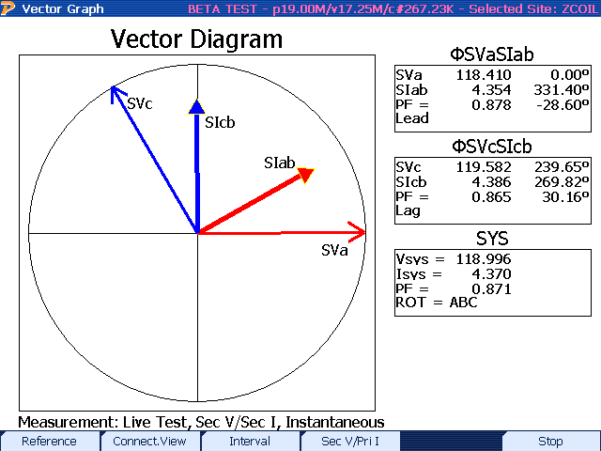
3 Phase Power Measurement
Arithmetic Calculation - Form 6 – 4 Wire Y Site
Voltages and Currents Aligned at 0°

Slide 74

3 Phase Power Measurement
Vector Calculation - Form 6 – 4 Wire Y Site
Voltages and Currents Aligned at 0°

Slide 75
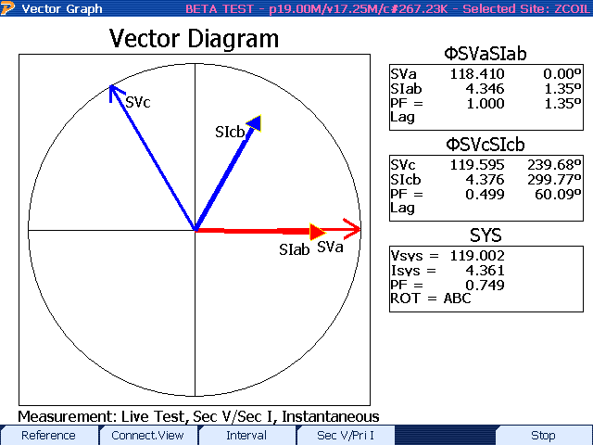
3 Phase Power Measurement
Arithmetic Calculation - Form 6 – 4 Wire Y Site
Currents All shifted by 30°

Slide 76
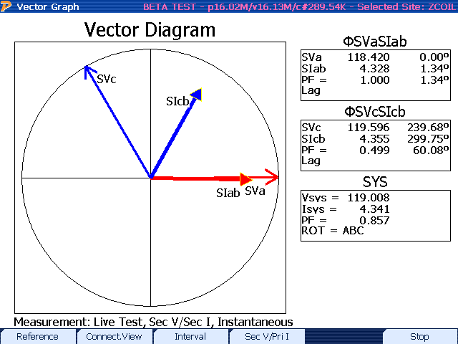
3 Phase Power Measurement
Vector Calculation - Form 6 – 4 Wire Y Site
Currents All shifted by 30°

Slide 77
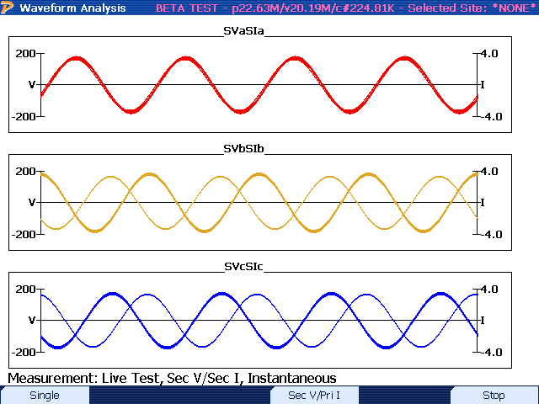
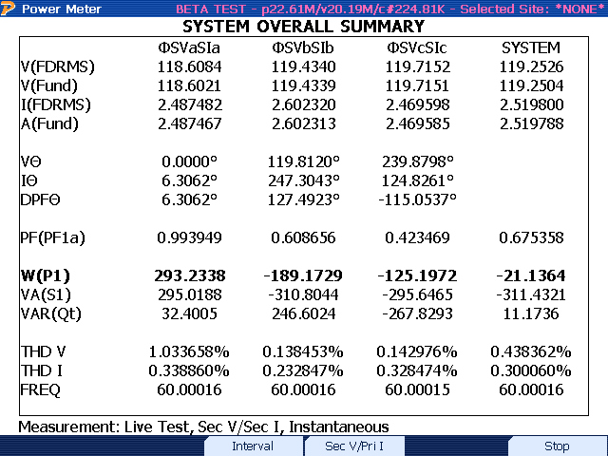
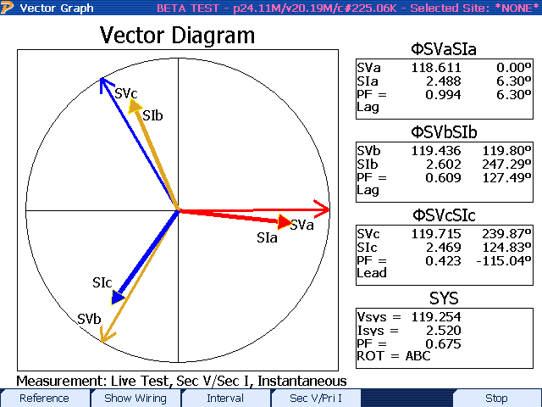
Actual Field Test Case #1: Lots of Clues!

Slide 78
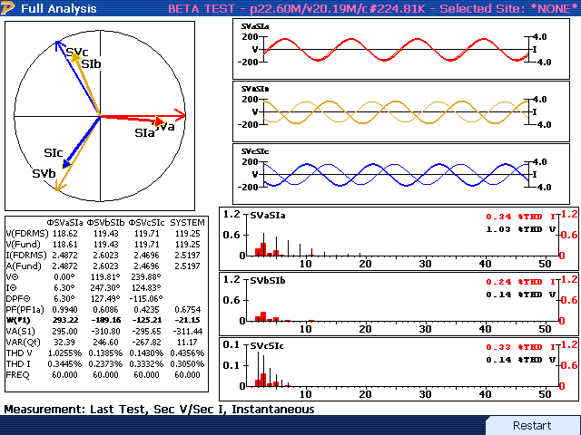
Actual Field Test Case #1: Lots of Clues!
Phase B & C reversed!

Slide 79
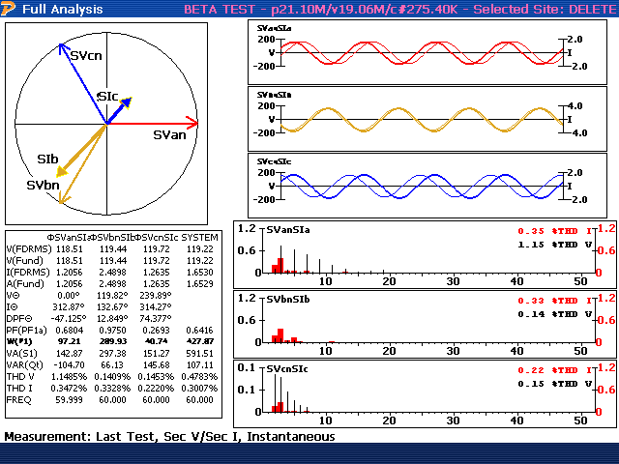
Actual Field Test Case #2
There is no problem!
3-Wire Delta load
On a 4-Wire Wye service.
What is the problem?

Slide 80
Standards Changes
New Revision of C12.20 in 2015
  Polyphase meters tested using polyphase
    Recommended 2015, required 2020
  Unbalanced load testing required
  Full harmonic testing required
  0.1% Accuracy Class added
  Specific call out of Non-Blondel applications where C12.20 does not apply
  Detailed requirements and specs for test outputs added

Slide 81
Standards Changes
New Revision of C12.20 in 2015
  Tighter reference condition performance specifications
  When using polyphase loading meters must be tested in each configuration used

Slide 82
Standards Changes
New Revision of C12.1 in 2015
  0.5% Accuracy Class added
  Testing required for unbalanced loads
  Testing required under unbalanced conditions
  Tighter reference performance requirements
  Bi-directional energy flow testing
  Extensive update on in-service testing

Slide 83
Standards Changes
New Revision of C12.10 in 2015
  Accuracy tests moved here from C12.1
  Much broader safety requirements
  Coordinated effort with UL2735
    Utilities exempt from UL2735 but only if they own and install the equipment

Slide 84
Standards Changes
New Revision of C12.9 in 2014
  Full specifications for test plugs included in standard
    Ensures safe operation between all switches and all plugs
    previously some combinations produced safety hazards
  New barrier requirements between switch elements

Slide 85
Standards Changes
Communications Standards
  New C12.19 which replaces C12.18 and C12.19 is in ballot process
    Major changes – major controversy has held up approval for two years
    Standard will still not guarantee inter-operability
  C12.23 the “Compliance Testing” standard is nearly complete

Slide 86
Next Generation Standards
ANSI C12.46
  New standard in development to replace C12.1 and C12.20
  Structured like OIML IR-46
  A true digital age standard
  Applies to ALL energy measurements
    Watts, VA and VAR
    Contains precise definitions for the quantities based on digitally sampled waveforms

Slide 87
Next Generation Standards
ANSI C12.46
  Covers ALL waveform types
    sinusoidal, harmonic, time varying
  Defines the meter as everything under the cover
    If there is auxiliary functions in the meter they must be fully operational during accuracy testing
    If a option is added to a meter, it must be tested with the option running to remain qualified

Slide 88
Next Generation Standards
ANSI C12.46
  View of accuracy changes
    Currently changes with respect to reference
    New approach is absolute error
Philosophy of C12.46 – When a meter is claimed to be of a specific accuracy class, for example , AC 0.2%, then it’s accuracy under all commonly occurring conditions should be within ±0.2% maximum error.

Slide 89
New Energy Definitions
Time Domain
Active Power
Apparent Power
Reactive Power

Slide 90
New Energy Definitions
Frequency Domain
Active Power
Apparent Power
Reactive Power

Slide 91
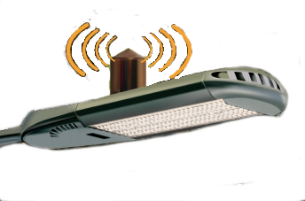
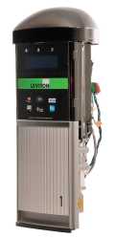
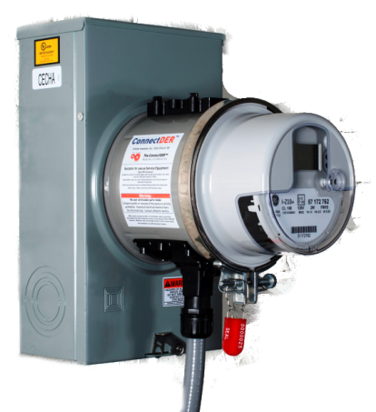
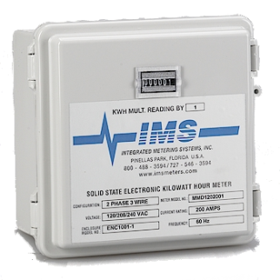
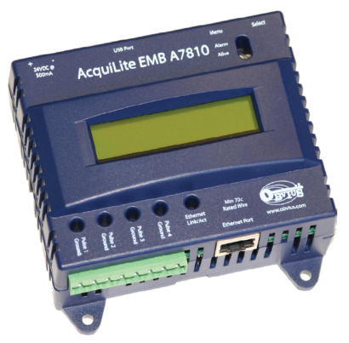
What Does the Future Hold?
Over the next FEW years metering may have a whole new meaning
Do these look like meters to you?

Slide 92
What Does the Future Hold?
Each has an embedded revenue meter
Each claims ANSI C12.1 compliance
METER

Slide 93

Questions and Discussion
John Kretzschmar
john@samscometering.com
864-590-2883 (cell)
This presentation can also be found under Meter Conferences and Schools on the TESCO web site:
www.tesco-advent.com

