Slide 1
Caribbean Meter School
Fundamentals of Transformer Rated Field Meter Testing and Site Verification
John Greenewald, TESCO
January 29, 2019
Atlanta, GA

Slide 2
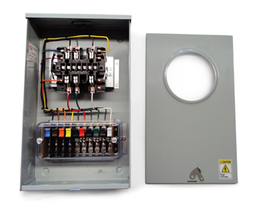
Purpose:
To acquaint the attendees with the use and purpose of Meter Test Switches
Course Breakdown of Topics:
Using Test Switches
Meter Test Switch Specifications
Meter Test Switch Configurations
Meter Test Switch Accessories
Pre-Wired Transformer Rated Enclosures

Slide 3
Typical Self Contained Service
Typically found in residential metering
Meters are capable of handling the direct incoming amperage
Meter is connected directly to the load being measured
Meter is part of the circuit
When the meter is removed from the socket, power to the customer is interrupted

Slide 4
Transformer Rated Service
Meter measures scaled down representation of the load.
Scaling is accomplished by the use of external current transformers (CTs) and sometimes voltage transformers or PTs).
The meter is NOT part of the circuit
When the meter is removed from the socket, power to the customer is not effected.

Slide 5
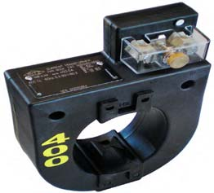
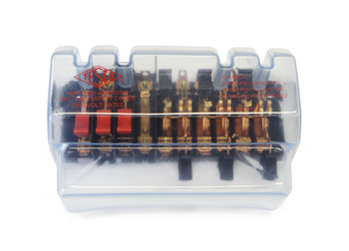
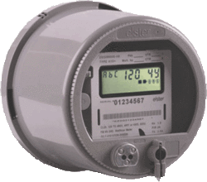
Transformer Rated Service
9S Meter Installation with 400:5 CT’s
SOURCE
PHASE A
400A
PHASE B
400A
LOAD
PHASE C
400A
5A
5A
5A
5A
5A
5A

Slide 6
SAFETY
Testing current transformers while they are in service can be a dangerous operation if certain safety procedures are not followed. The secondary loop of a current transformer must NEVER BE OPENED when service current is present in the primary. When there is current in the primary, and the secondary of a current transformer is open circuited, the voltage across the secondary can rise to hundreds and even thousands of volts, creating an extremely dangerous situation. The open CT secondary voltage magnitude varies with CT design and primary
current flow. The high voltage that is present on the open secondary of an energized current transformer generates two great hazards. The first hazard is ELECTRICAL SHOCK TO TESTING PERSONNEL. The second hazard is THE BREAKDOWN OF THE CURRENT TRANSFORMER INSULATION. Both hazards can be avoided provided that the secondary of the current transformer is never opened. The safest current transformer installations for testing are those that have a Test Switch as part of the secondary loop. A Test Switch is a device that will facilitate inserting instrumentation in the current transformer secondary loop without the danger of opening the circuit.

Slide 7
Typical Connections for Common Meter Forms

Slide 8
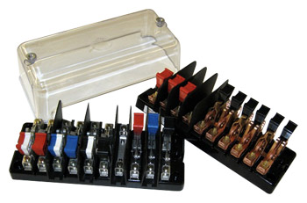
Test Switch Specifications
ANSI C12 Definitions
Test Switch Materials
Plating
Barriers
Wiring Connections
What to look for
Covers

Slide 9
ANSI C12.9 Test Switch Definitions

Slide 10
ANSI C12.9
Test Switches

Slide 11
ANSI C12.9 General Test Switch Specifications

Slide 12
Test Switch Configurations
Layout
Handle Colors
Reversed vs. Normal Potentials
Current Links
Base Sizing
Barrier Locations

Slide 13
Test Switch Accessories
Test Plugs
Safety Covers
Test Switch Isolators
On installations that contain Test Switches, test leads terminated with a test switch
safety test probe (test plug) should be used for CT testing. This provides a “make-before-break” connection to prevent accidental opening of the current transformer secondary loop.

Slide 14
ANSI C12.9 Test Jack Specifications

Slide 15
ANSI C12.9 Test Plug Specifications

Slide 16
For Utilities not Currently Using Test Switches

Slide 17
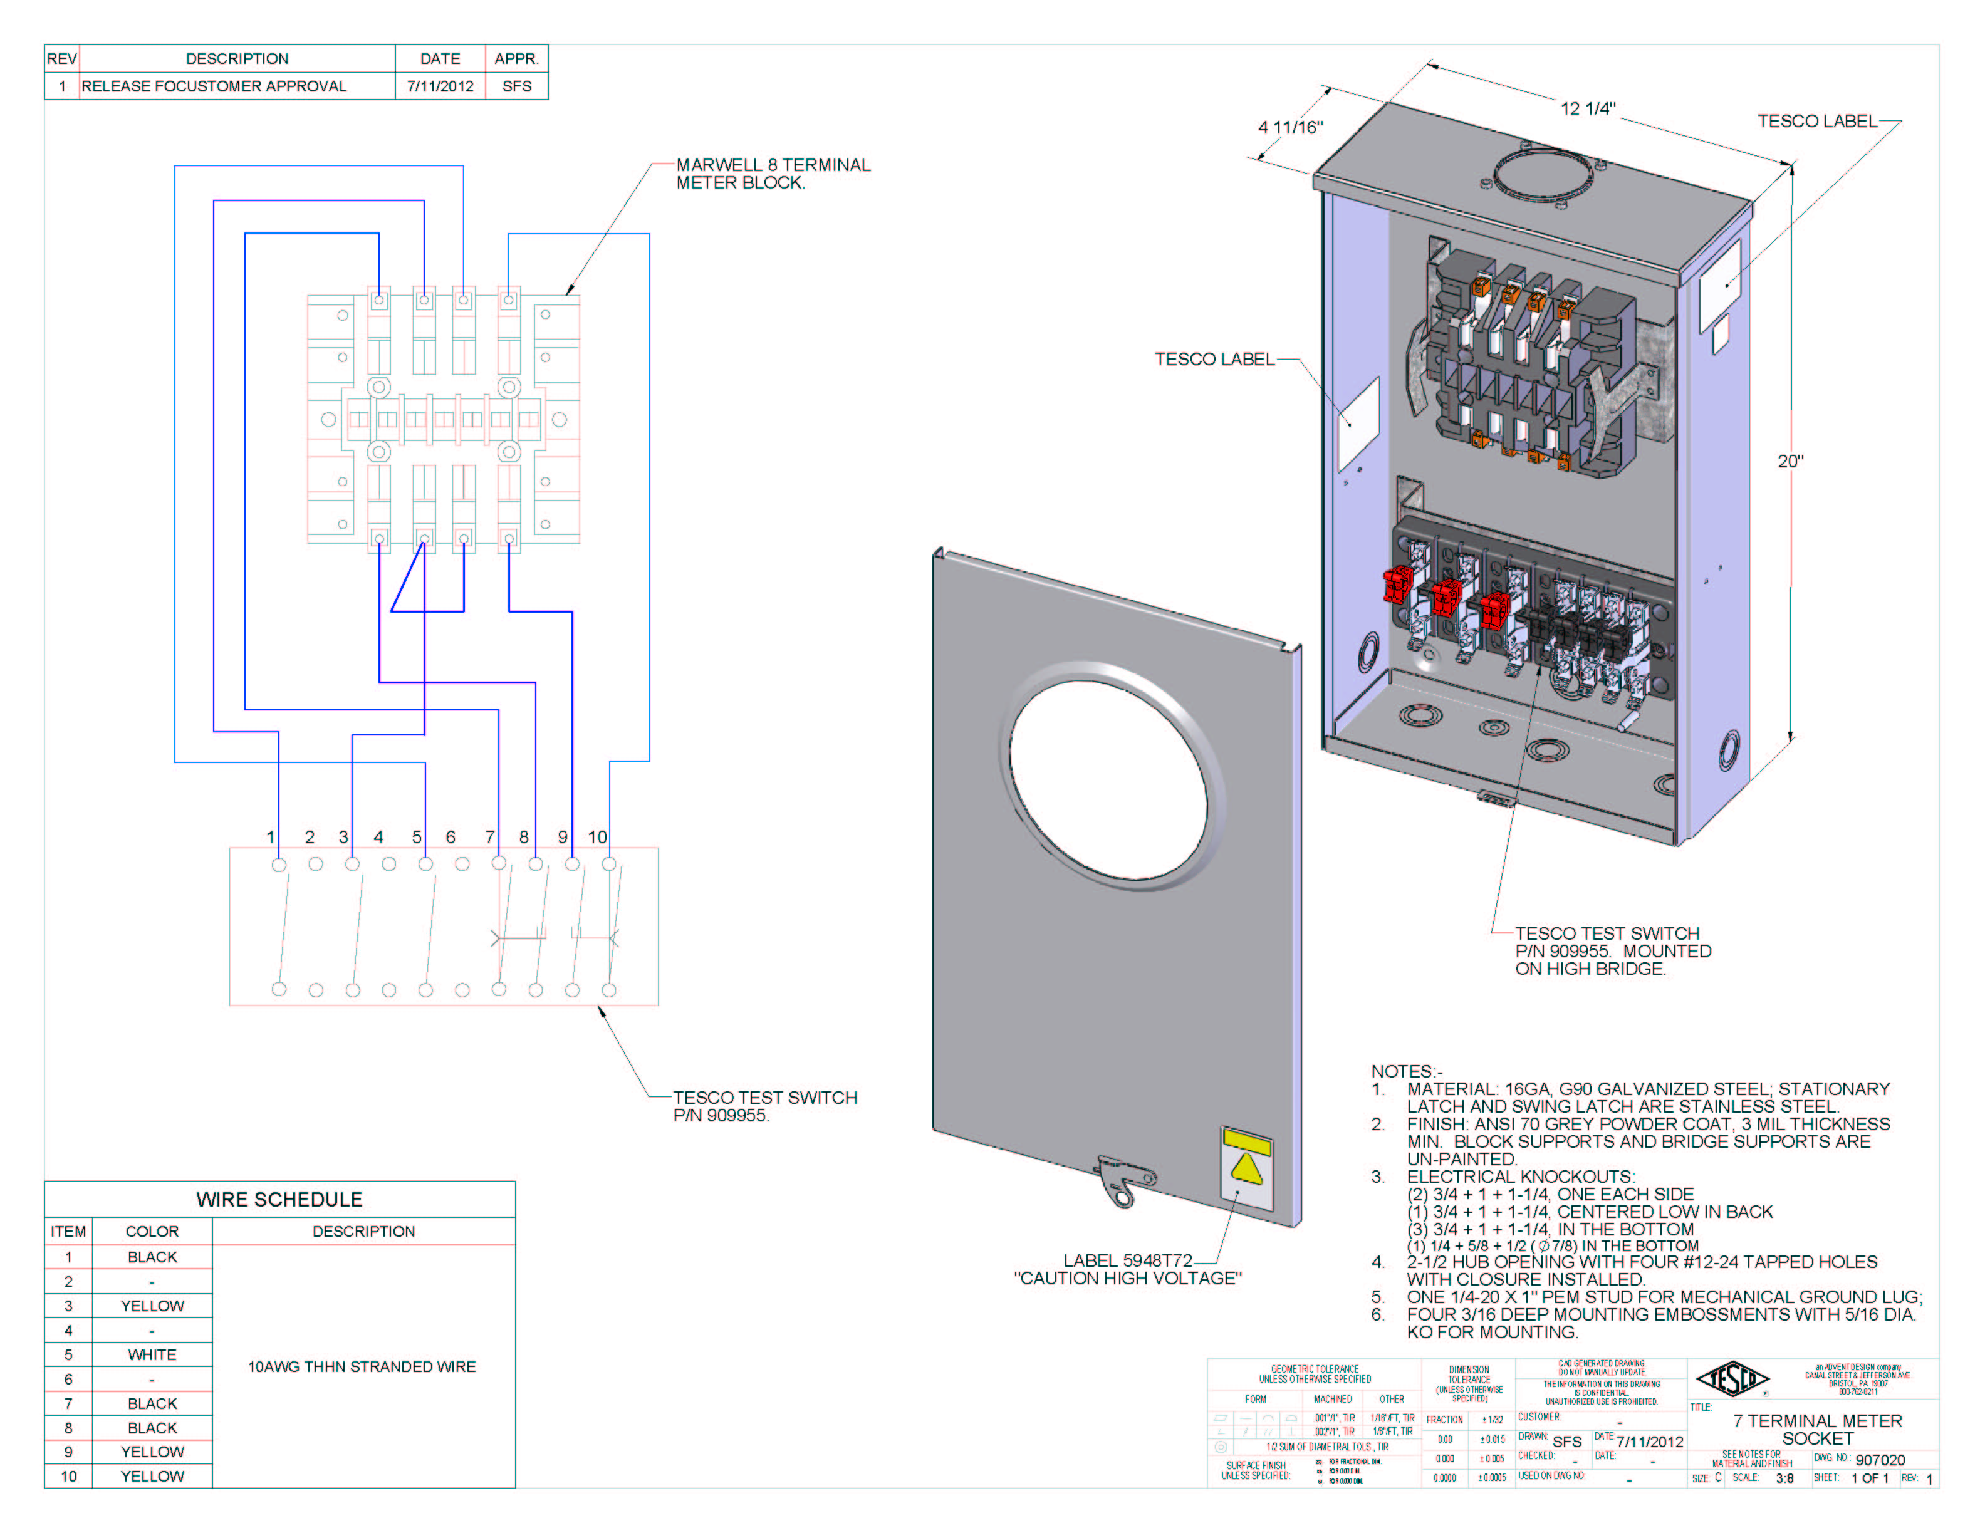
Pre-Wired Transformer Rated Enclosures
Cover Types
Wiring
Sockets

Slide 18
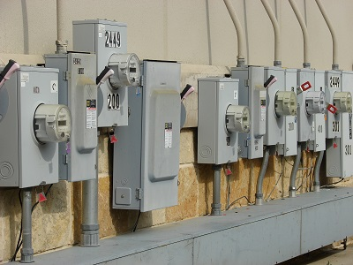
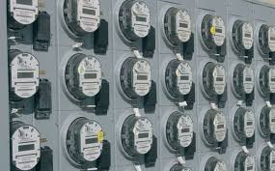
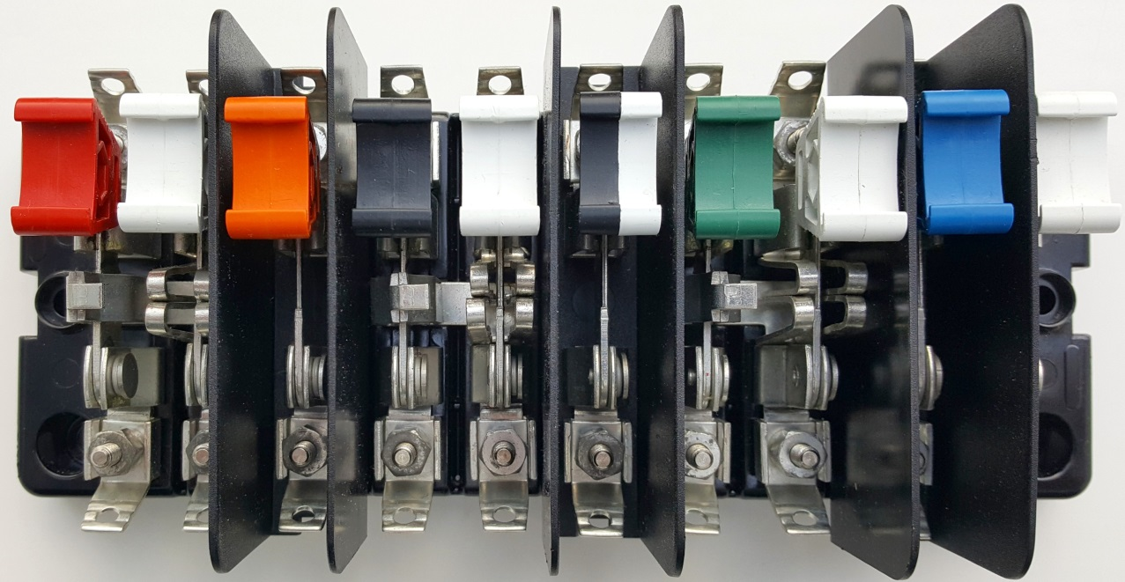
Questions?

