Slide 1
Meter Forms: Wiring and Uses
Prepared by Rob Reese, TESCO
The Eastern Specialty Company
for Pennsylvania Rural Electric Association
XXXXXXXXXXXX

Slide 2
Agenda
Meters 101 - Electro-Mechanical vs Solid-State
Meter Forms
Self-Contained vs Transformer Rated
Blondel’s Theorem
Available References (Hardy’s, UGLY’s Elect Ref)
Examples
1S, 2S, 3S, 4S, 5/35S, 8/9S, 16S

Slide 3
Meters 101 – Electro-mechanical
Overview of Functionality
The electromechanical induction meter operates through electromagnetic induction
A non-magnetic, but electrically conductive, metal disc which is made to rotate at a speed proportional to the power passing through the meter
The disc is acted upon by two sets of induction coils, which form, in effect, a two phase linear induction motor.
One coil is connected in such a way that it produces a magnetic flux in proportion to the voltage
The other coil produces a magnetic flux in proportion to the current.
The field of the voltage coil is delayed by 90 degrees, due to the coil's inductive nature, and calibrated using a lag coil
This produces eddy currents in the disc and the effect is such that a force is exerted on the disc in proportion to the product of the instantaneous current and instantaneous voltage
A permanent magnet acts as an eddy current brake, exerting an opposing force proportional to the speed of rotation of the disc
The equilibrium between these two opposing forces results in the disc rotating at a speed proportional to the power or rate of energy usage
The disc drives a register mechanism which counts revolutions, much like the odometer in a car, in order to render a measurement of the total energy used.
The amount of energy represented by one revolution of the disc is denoted by the symbol Kh which is given in units of watt-hours per revolution.
A Kh of 7.2 is typical. In this example, each full rotation of the disk is equivalent to 7.2Wh of energy.

Slide 4
Meters 101 – Solid-state
Overview of Functionality
Potential and Current is scaled down and conditioned with transformers and filters
ADC’s (analog to digital converters) digitize the signals
A micro-processor or DSP executes the calculations
Resulting data is displayed, sent externally via the communication circuits, and used for the calibrated pulse output
MICRO
PROC
CURRENT TRANSFORMER
DISPLAY
FILTER
ADC
COMM
POTENTIAL TRANSFORMER
FILTER
ADC
PULSE

Slide 5
Meter Forms
14S
39S
17S
1S
2S
3S
12S
35S
4S
25S
10S
76S
46S
45S
66S
11S
32S
5S
26S
6S
16S
9S
13S
15S
24S
56S

Slide 6
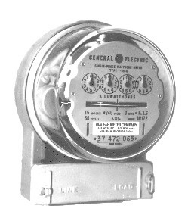
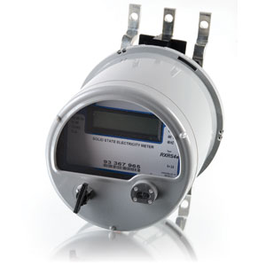
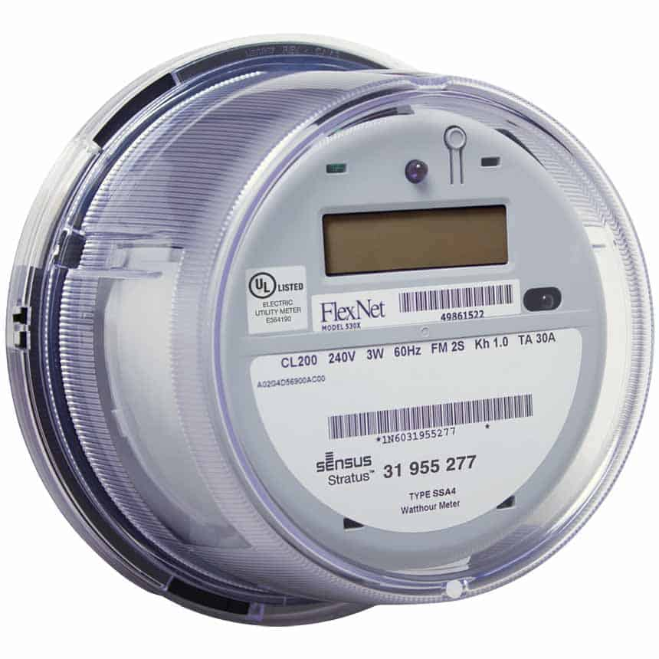
Meter Forms

Slide 7
Meter Forms
14S
39S
17S
1S
2S
3S
12S
35S
4S
25S
10S
76S
46S
45S
66S
11S
32S
5S
26S
6S
9S
16S
13S
56S
15S
24S

Slide 8
Meter Forms
SELF-CONTAINED
TRANSFORMER-RATED
39S
36S
1S
14S
3S
7S
12S
29S
2S
76S
5S
35S
25S
46S
4S
8S
16S
11S
26S
17S
66S
6S
45S
9S
13S
56S
10S
15S
32S
24S

Slide 9
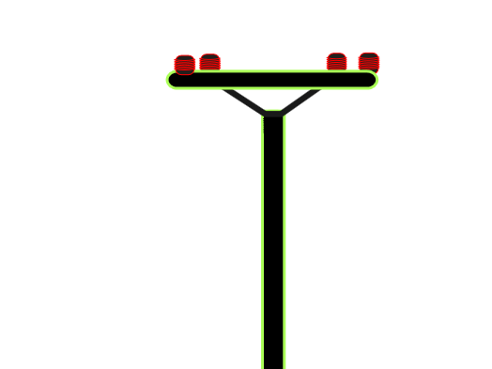
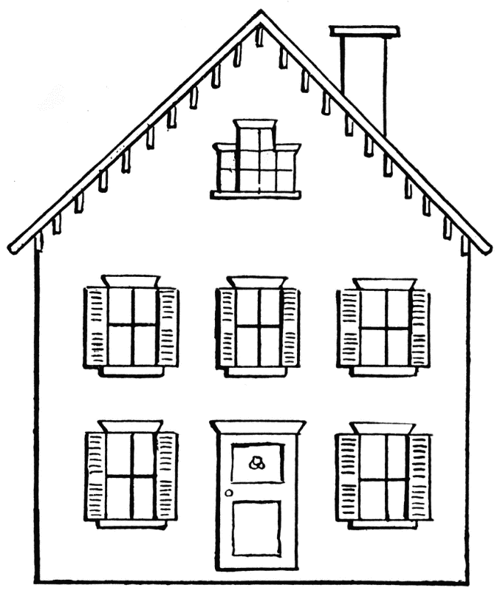
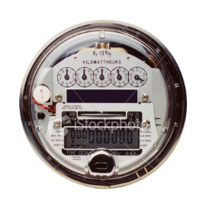
Self-Contained Meters
Primarily Residential
Relatively Low Current
Example: 100A

Slide 10
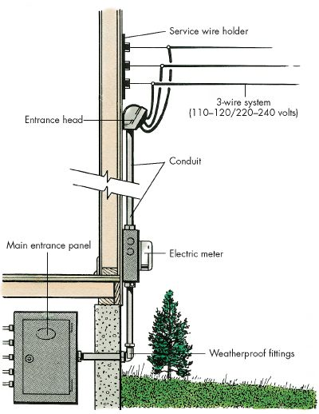
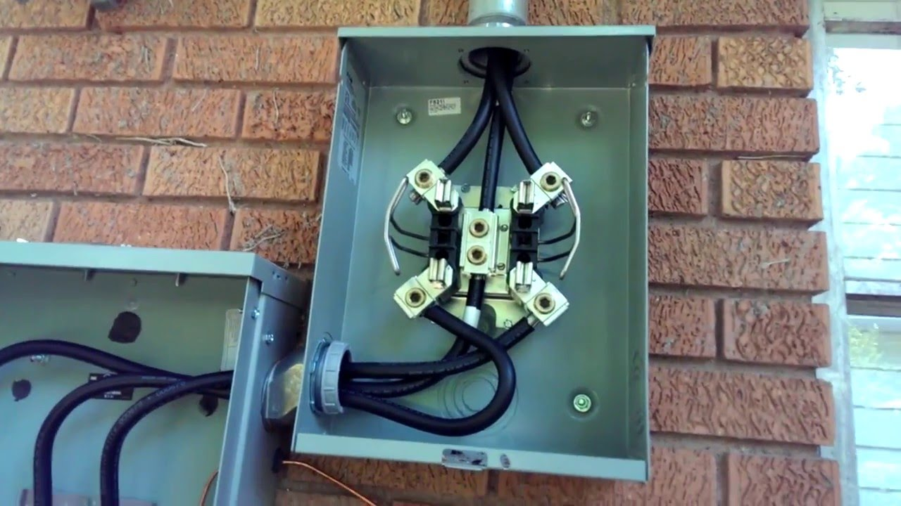
Self-Contained
Primarily Residential

Slide 11
Transformer-Rated Meters
Primarily Commercial/Industrial
Relatively High Current
Example: 4000A
Notes:
11

Slide 12
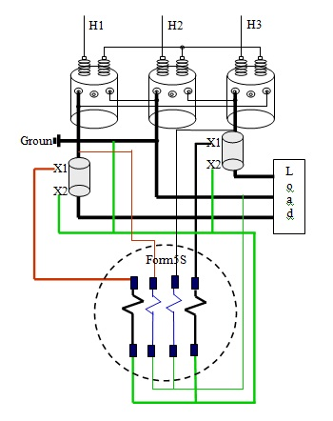
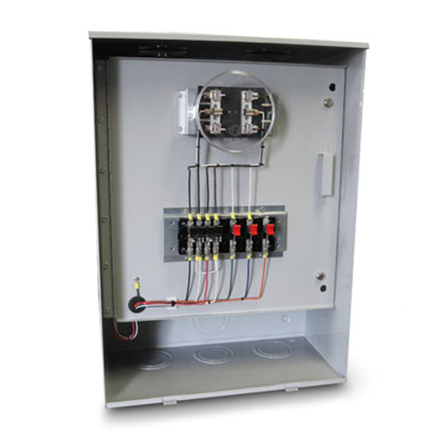
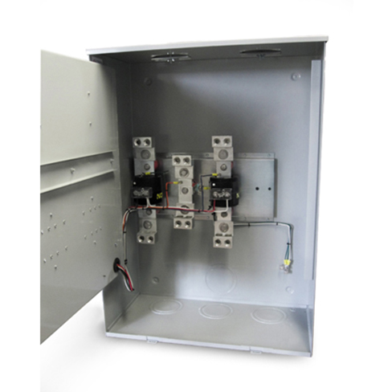
Transformer-Rated Meters
Primarily Commercial/Industrial

Slide 13
Diagram Example
References
Power Measurements Handbook, Dr. Bill Hardy
UGLY’s Electrical References
Meterman’s Handbook
Manufacturer’s websites

Slide 14
Diagram Example
References
Power Measurements Handbook, Dr. Bill Hardy
UGLY’s Electrical References
Meterman’s Handbook
Manufacturer’s websites

Slide 15
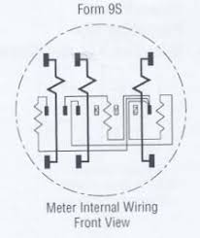
Diagram Example
3 Current Coils
3 Potential Coils

Slide 16
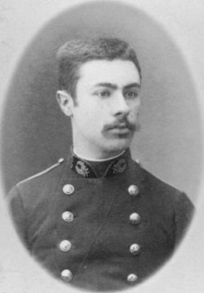
Blondel’s Theorem
French Electrical Engineer Andre Blondel
Attempt to simplify electrical measurements and validation of the results
Paper submitted to the International Electric Congress in Chicago in 1893.
E = n - 1
The theorem states that the power provided to a system of N conductors is equal to the algebraic sum of the power measured by N watt-meters. The N watt-meters are separately connected such that each one measures the current level in one of the N conductors and the potential level between that conductor and a common point. In a further simplification, if that common point is located on one of the conductors, that conductor's meter can be removed and only N-1 meters are required.

Slide 17
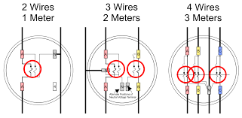
Blondel’s Theorem
E = n - 1
Blondel Compliant
1S
12S
9S
The theorem states that the power provided to a system of N conductors is equal to the algebraic sum of the power measured by N watt-meters. The N watt-meters are separately connected such that each one measures the current level in one of the N conductors and the potential level between that conductor and a common point. In a further simplification, if that common point is located on one of the conductors, that conductor's meter can be removed and only N-1 meters are required.

Slide 18
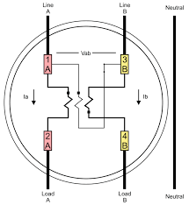
Blondel’s Theorem
E = n - 1
Non-Blondel Compliant
2S
The theorem states that the power provided to a system of N conductors is equal to the algebraic sum of the power measured by N watt-meters. The N watt-meters are separately connected such that each one measures the current level in one of the N conductors and the potential level between that conductor and a common point. In a further simplification, if that common point is located on one of the conductors, that conductor's meter can be removed and only N-1 meters are required.

Slide 19
Blondel’s Theorem
Why is non-Blondel metering bad?
Makes assumptions about the service
Example: balanced voltages
Assumptions might not be true
When these assumptions are not true, then there are power measurement errors even if the meter is working perfectly.
The theorem states that the power provided to a system of N conductors is equal to the algebraic sum of the power measured by N watt-meters. The N watt-meters are separately connected such that each one measures the current level in one of the N conductors and the potential level between that conductor and a common point. In a further simplification, if that common point is located on one of the conductors, that conductor's meter can be removed and only N-1 meters are required.

Slide 20
Blondel’s Theorem
Why are non-Blondel meters used?
Fewer elements (meters) = lower cost
Especially true for electro-mechanical meters
Fewer CT’s and PT’s = lower cost
Less wiring and cheaper sockets
The theorem states that the power provided to a system of N conductors is equal to the algebraic sum of the power measured by N watt-meters. The N watt-meters are separately connected such that each one measures the current level in one of the N conductors and the potential level between that conductor and a common point. In a further simplification, if that common point is located on one of the conductors, that conductor's meter can be removed and only N-1 meters are required.

Slide 21
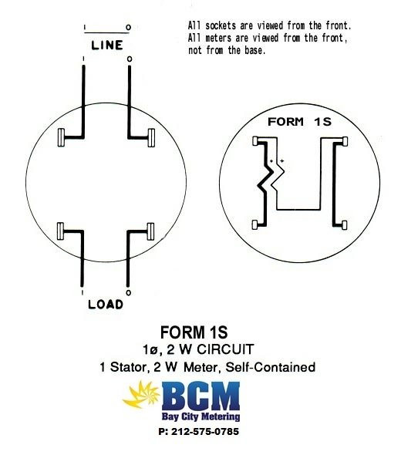
Metering Examples

Slide 22
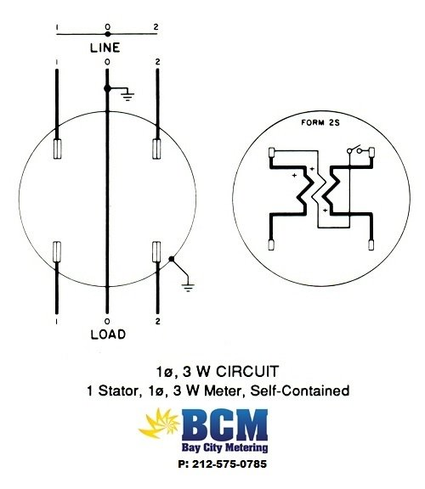
Metering Examples

Slide 23
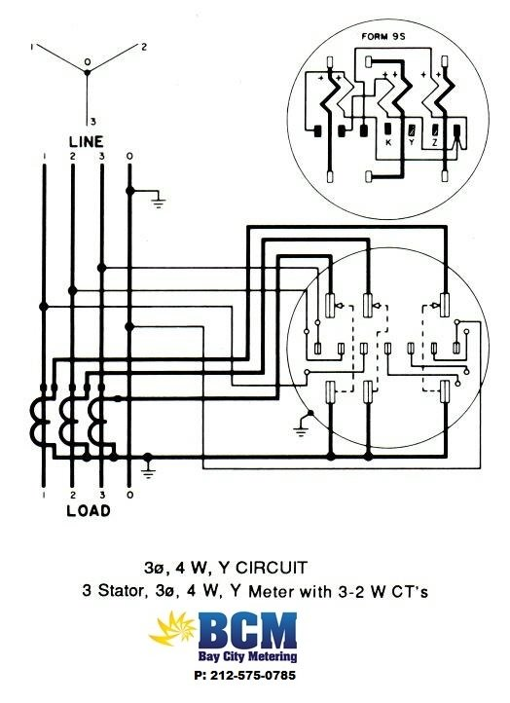
Metering Examples

Slide 24
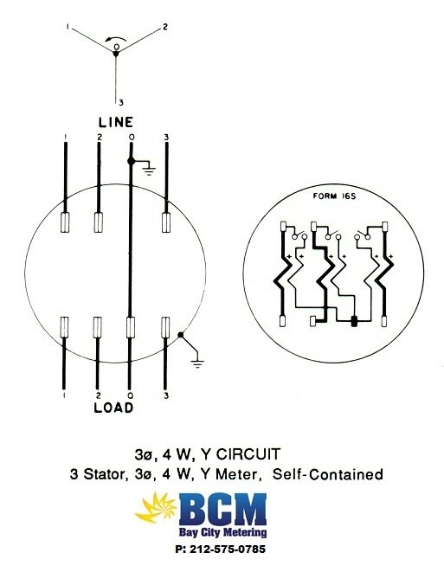
Metering Examples

Slide 25
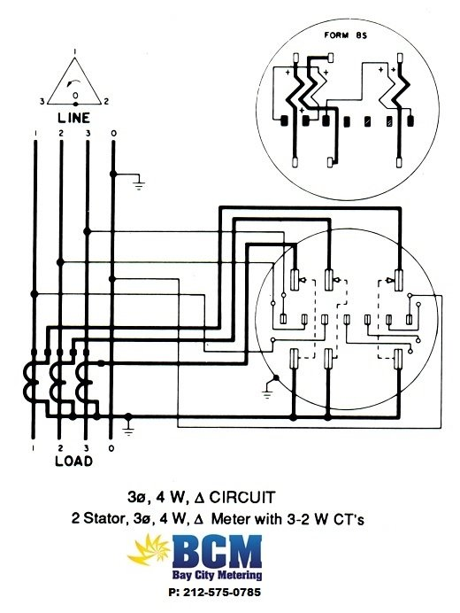
Metering Examples

Slide 26
References
https://en.wikipedia.org/wiki/Blondel%27s_theorem
http://www.powermeasurements.org/library/Presentations/NCMS%202013%20-%20Non-Blondel%20Metering.pdf
https://www.baycitymetering.com/

Slide 27
Questions and Discussion
Rob Reese
rob.reese@tescometering.com
TESCO – The Eastern Specialty Company
Bristol, PA
215-310-8809 (cell)
This presentation can also be found under Meter Conferences and Schools on the TESCO website: www.tescometering.com
ISO 9001:2015 Certified Quality Company
ISO 17025:2017 Accredited Laboratory

