Slide 1
AMI Technology Overview
Tuesday, March 8, 2022
11:10 AM – 12:30 PM
Mike Osterhout and Tom Lawton

Slide 2
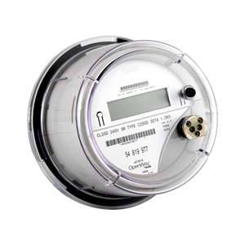
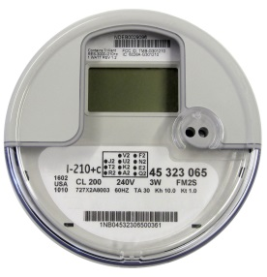
Topics We Will Cover
Benefits of AMI and where we are starting from
Overview of technologies
How AMI is changing Meter Service Departments and metering jobs
Metering and the Future of AMI

Slide 3
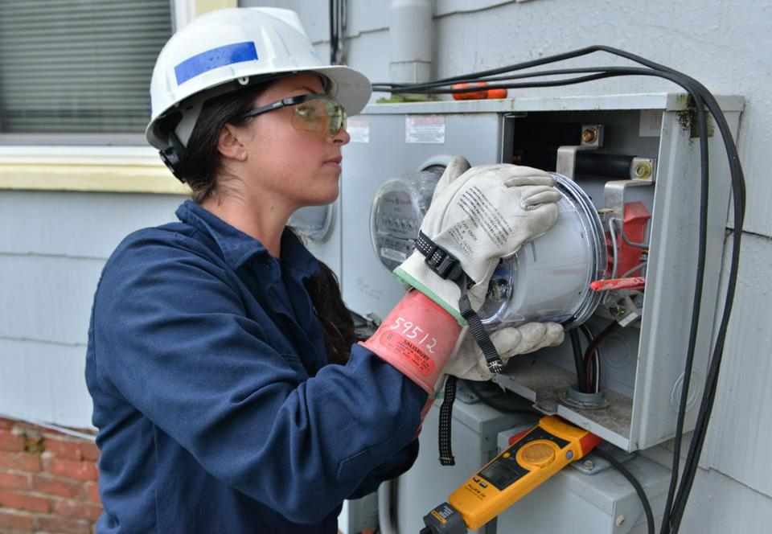
AMI Benefits
Two-way communication to the meter
  Why is this important or desirable?
Usage
Voltage
Current
Power Quality
Disconnect/Reconnect
Outages
The Future
  Location
  Displays

Slide 4
Pre-AMI Meter Operations
Common Features and Common Sources of Concern
Fewer meter techs in the field and in the shop than there were 25 years ago
Fewer Field checks and site verifications due to lack of personnel, lack of experience and lack of expertise
More features under glass in the meters even before AMI deployed
Significantly more features under glass in every AMR and AMI system being considered or being deployed
Metering losses starting to be identified “by accident” as opposed to being “by design”.

Slide 5

The Pendulum Starts to Move
Meter Operations. Prior to deployment many larger utilities take an attitude of “this is only metering – how hard can that be?”. Over the course of deployment Meter Operations gains a stature and a respect from the rest of the organization that was not previously accorded them – even if this is only begrudging respect.
New tests for AMI meters (e.g. communication, disconnect) are identified
The complexity and issues around high revenue metering are at least acknowledged by the rest of the organization
Tests which have not been performed in years are suddenly back in vogue

Slide 6
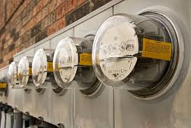
The New Realities
Electro-Mechanical Meters typically lasted 30 years and more. Electronic AMI meters are typically envisioned to have a life span of fifteen years and given the pace of technology advances in metering are not expected to last much longer than this.
This means entire systems are envisioned to be exchanged every fifteen years or so. In the interim the meter population and communication network inherent in the infrastructure for each utility must be maintained.
Meter communication and meter data management are becoming as important to metering operations as meter accuracy.
Firmware upgrades, firmware stability and cyber security are becoming increasingly important to metering departments

Slide 7

What Technologies Are We Using?
RF Mesh
Power Line Carrier (PLC)
LTL Back Haul

Slide 8
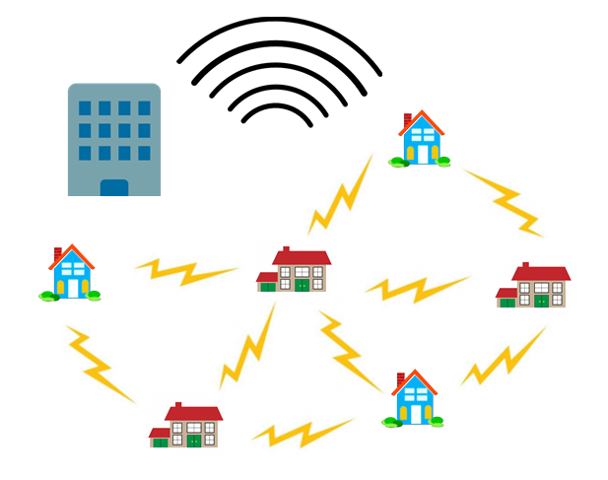
RF Mesh
True RF Mesh
Meters and collectors
Software and firmware
Head End Systems
The difference
between frequencies
  Proprietary and non-proprietary
  frequencies
  Penetration vs. distance trade-off

Slide 9
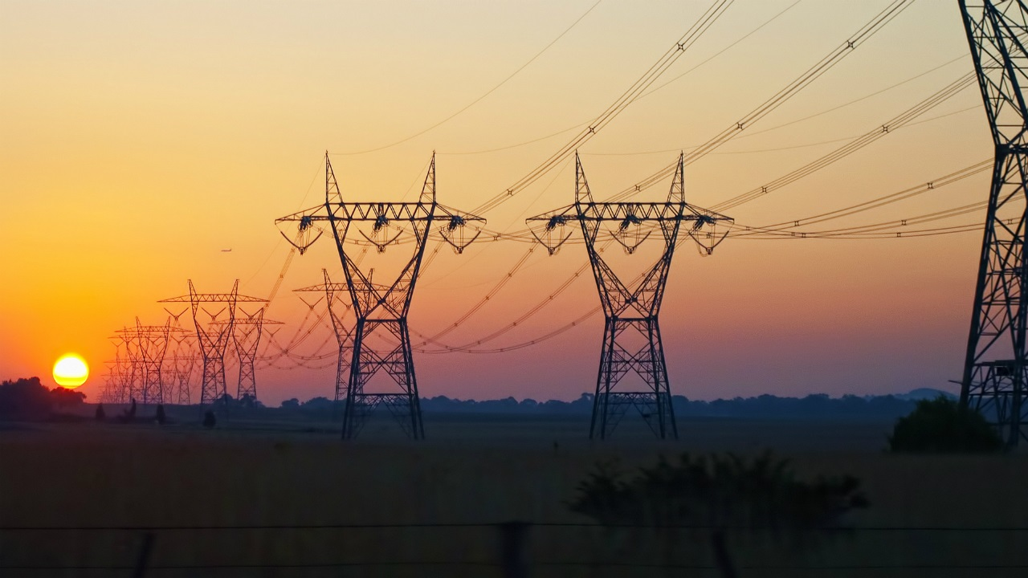
Power Line Carrier
Pros and Cons
  Copper Wires
  Amount of data – now and in the future

Slide 10

LTL Back Haul
Infrastructure will win
  IoT vs. number of meters
    New IoT devices are being installed at a rate of 127 per second or 11 million per day
  165 million connected electric meter customers in the U.S. and Canada
    After 12 years we are 60% complete or roughly 100 million done
But never discount the fact that Electric Utilities will always own the Copper Wires. LTL and PLC will displace RF in the mid term and eliminate RF in the long term – strictly because of infrastructure and not on the merits of technology.

Slide 11
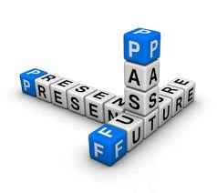
Expected & Unexpected Trends at the
End of Deployment
Expected:
The AMI deployment team will declare victory at some point and move on. Clean-up will be left for the meter service department and these will be the hardest meters to access and to get reliably on the network
Change Management continues to be a tremendous challenge for every vendor through every deployment
Meter Acceptance testing including far more than accuracy testing for every deployment
Firmware upgrades must be checked and tested before mass deployment
Unexpected:
Meter Certification Testing never slowed down over the course of any of the deployments
Notes:
11

Slide 12

Why do AMI Meters Fail?
Looking back at various deployments – what are the chief
causes to reject meter shipments?
Meter functional test failures including but not limited to;
Incorrect firmware
Bad settings
Alarms and errors that do not clear
Communication test failures
Bad tables
Failed disconnect switches

Slide 13
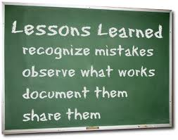
Lessons for the Future?
Are these infant mortality issues or are these issues to be concerned about going forward?
What was NEVER the reason for rejecting a shipment – meter accuracy.
Which are the most difficult meters for every deployment – the transformer rated meters. Often these forms are not available until very late in the deployment and sometimes not until the deployment has officially ended.

Slide 14

Commercial and Industrial Metering Challenges
Most AMI deployments utilize third party contractors to handle the residential and some self contained non-2S services. The balance is typically handled by the meter service department of the utility.
No AMI deployment has used the AMI communication network to handle the communication with the largest customer meters. The risk from even a short term interruption of communication or loss of data far outweighs the benefit of meters which are already being communicated with daily or even several times a day.
As these services are evaluated for new metering technology, issues are being found at some accounts. These issues represent revenue losses due to inappropriate metering schemes or partially failed metering components (e.g. transformers, electronic components).

Slide 15


How are these new realities starting to affect metering operations?
Metering is becoming more about IT. Some metering departments have been reorganized after AMI as part of the IT department.
Metering emphasis will shift strongly toward C&I customers and further and further away from residential meters
Metering resources are being refocused on C&I accounts.
There are fewer levels of meter tech. Every meter tech needs to be at the higher level as there is not enough lower level work to warrant full time employees
Utility commissions are being less forgiving of allowing rate relief for project over runs and metering inaccuracies

Slide 16
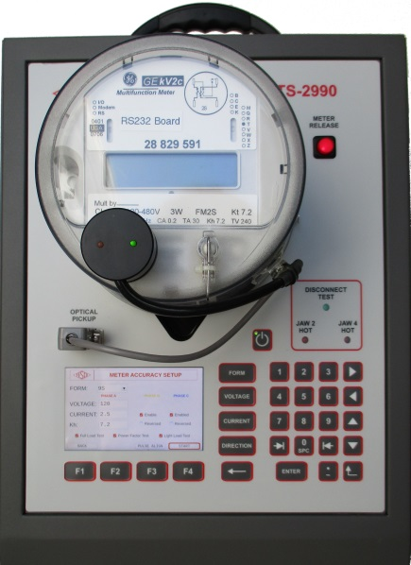
New or expanded roles for metering departments of all sizes
Responsible for either reviewing ANSI Tests or even performing some of these ANSI Tests
Perform Meter Functionality testing on new and returned AMI meters
Register and communication module energy measurement comparison
Disconnect/Reconnect Functionality
Outage Performance
Meter Communications Performance
Consumer safety and combating real and perceived issues
Near continuous research into the “next” technology and the next deployment

Slide 17
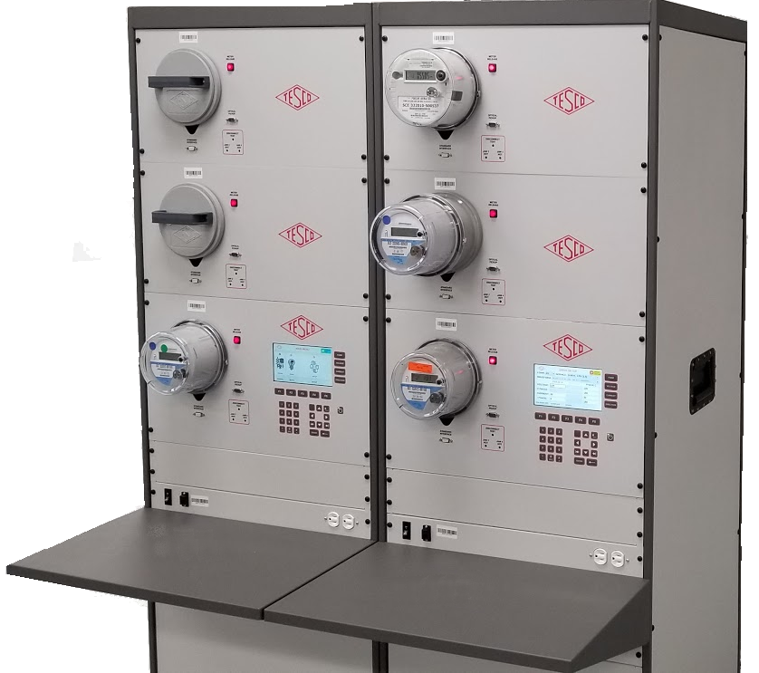
Shop Testing
Accuracy testing
Meter Communications Performance
Software and firmware verification
Setting verification
Functional testing
Disconnect/reconnect Functionality
and as left setting

Slide 18
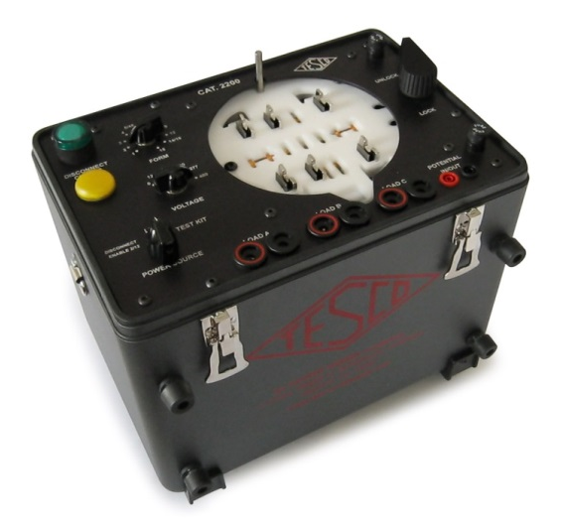
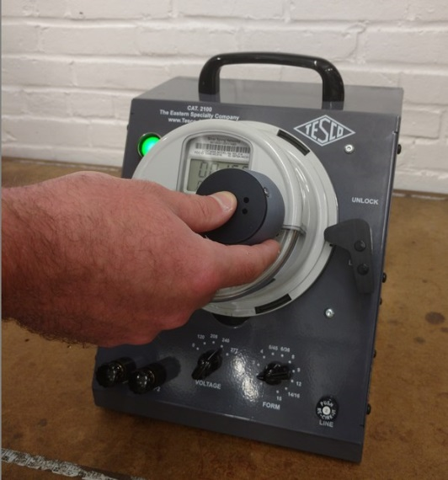
Field Testing and Inspection
Work with third party deployment vendor or perform the deployment
  Self contained
  Transformer Rated
Accuracy Testing
Meter Communications Performance
Software & Firmware Verification
Setting Verification
Functional Testing
Disconnect/Reconnect Functionality
and as left setting
Tamper Verification
Site Audits appropriate to the type
of meter

Slide 19
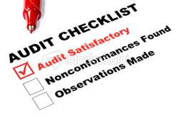
RMA’s, Root Cause Analysis and
In Service Testing
Opportunities to Learn:
Meters returned from the field as bad or flagged on incoming inspection. These RMA’s need to be tracked not only for warranty purposes but more importantly to understand the root cause of the issues.
No one knows the actual life of their AMI meter. To do this we must learn as much as we can from the failures and the performance of the meters we have deployed.
In Service Test programs need to be utilized to understand the overall performance of AMI meters and as failures are identified these meters need to be dissected and the failure mode understood. If necessary, once the failure mode is understood the meter population may need to also be dissected to identify sub-groups of meter that may be similarly affected. This could be a group of meters…
  from the same shipment.
  that were deployed in the same geographic area.
  that saw the same type of usage or environment.

Slide 20
RMA Processing
Typically missed when creating the deployment plan
One area typically overlooked in the planning for AMI deployments is the handling of these RMA’s.
This is a new process with many idiosyncrasies.
This is a new process requiring new equipment and new skill sets
This is a new process that needs to be performed on top of the standard day to day meter service work
AMI helps to reduce a lot of less value add work, but increases the higher value work at every utility. RMA processing is one of the better examples of this type of work.

Slide 21
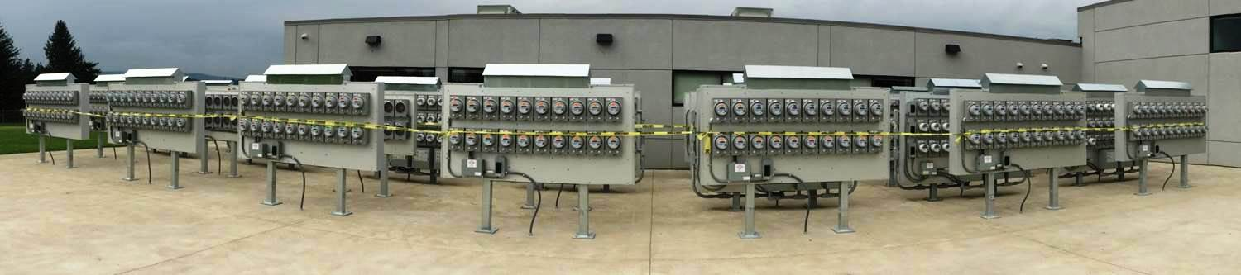
And of Course – the “Out of Left Field” Deployment Issues
Oh – let’s store 1.7 Million Meters by the way. No, we don’t know for how long but here they come.
Yeah…..you’re approved to deploy but we are going to need you to test 100% of the meters you are removing. That won’t be a problem, right?
KYZ? What’s that? You need what from us?
Can we see your audit plan? Where is your audit team by the way?

Slide 22
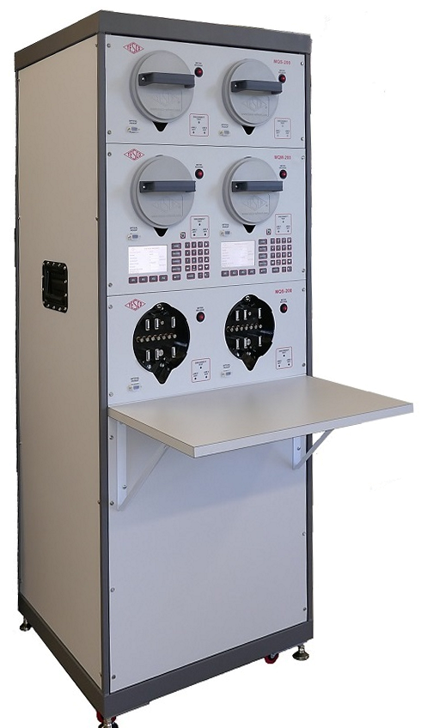
Post-Deployment Needs
AMI Population Management
Once deployment is complete the certification and acceptance testing does not stop.
Everyone understands the importance of acceptance testing, but future generations of a smart meter also require certification testing.
New software and firmware needs to be tested and compared against the performance of older generations.
New hardware must be tested and compared to older generations.
Firmware upgrades need to be checked
New head end systems or IT protocols need to be tested against a large group of meters before going live.

Slide 23
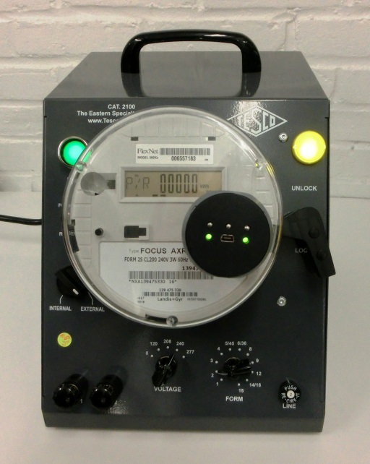
Real Life Examples of Change
Management in Action
Issues in the system not the components – what is the definition of a meter and when did the meter change?
  Meter and communication device interface
Feature Creep – every manufacturer wants to differentiate themselves – sometimes this works in unanticipated ways
  Recovery from power outages
  Short and long demand periods
But we only changed….lessons we
should have learned from Microsoft
  Over the air upgrades
Thank Goodness for test plans – right?
  Half closed disconnect devices
  Disconnect devices of unknown state
  Meters with incorrect firmware

Slide 24

The Need for Analytic Capability in Meter Service Operations
Information is King and AMI is making Meter Services King of the Mountain. But this assumes that Meter Services is able to combine operational knowledge with analytical capabilities by creating teams that have both capabilities. These analytic capabilities include the ability to understand and master “Big Data”. The ability to understand how various data bases are put together and how best to harvest the data and look for trends in this data.
  Operational knowledge
  Revenue diversion knowledge
  Ability to spot trends
  Filter and mine data from various sources in the AMI data stream.
Once this team coalesces under one roof Meter Services is poised to start providing work orders for various operational groups within and outside of traditional Meter Service Departments.

Slide 25
Summary
Benefits of AMI
  Far more information than just accurate energy usage
  Allows Meter Services to focus field resources on Transformer Rated Services
Overview of the Technologies
  PLC and LTL will be here for the long term
  RF will be here for the near term
How AMI is changing Meter Service Departments
  Challenges Meter Services to provide far more value to the organization by providing better analytics of the data being received from the new meters
  Meter Services must add telecommunications tools and expertise
  The meter man of the future knows not only metering but they are communication experts and are involved with handling, reporting and analyzing far more customer and system data
  There are fewer “routine jobs” in the field and many of the standard tasks are no longer required. This will lead to fewer classifications of meter techs going forward and the need for a more highly trained tech.

Slide 26
Summary (cont.)
Metering and the Future of AMI
  Metering will be in a near constant cycle of looking for the next technology, evaluating those technologies, planning for deploying these technologies, and cleaning up the aftermath of the deployment of
  these technologies.
  Metering will begin to run non-metering operational groups
  Each Utility must take a far more active role as part of checking, certifying, and rechecking the functionality of their meters.

Slide 27

Questions and Discussion
Tom Lawton
President
tom.lawton@tescometering.com
TESCO – The Eastern Specialty Company
Bristol, PA
215-228-0500
This presentation can also be found under Meter Conferences and Schools on the TESCO website: tescometering.com
ISO 9001:2015 Certified Quality Company
ISO 17025:2017 Accredited Laboratory

