Slide 1
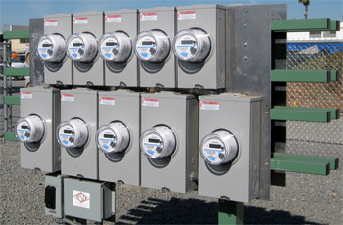
Looking for Dangerous Installations and Incorrect Billing
Prepared by Rob Reese, TESCO
The Eastern Specialty Company
For NREA – Nebraska Rural Electric Association
February 10, 2021
10/02/2012
Slide 1
Notes:
1

Slide 2
Agenda
Importance
Dangerous Installations and Conditions
Incorrect Billing
Useful Tools and Equipment

Slide 3
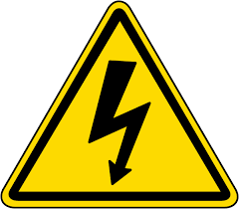
Metering Safety
Fatal Electrical Injuries
There were 166 electrical fatalities in 2019, which was a 3.75% increase over 2018 and the highest number of electrical fatalities since 2011.
In 2019, 8% of all electrical injuries were fatal.
The number of electrical fatalities varies between ages:
11% of electrical fatalities occurred in workers aged 20 – 24
30% of electrical fatalities occurred in workers aged 25 – 34
27% of electrical fatalities occurred in workers aged 34 – 44
17% of electrical fatalities occurred in workers aged 45 – 54
13% of electrical fatalities occurred in workers aged 55 – 64

Slide 4
Metering Safety
Fatal Electrical Injuries
30% of all electrical fatalities occurred at a private residence. Industrial places and premises accounted for another 30% of fatalities. Public buildings accounted for 13%, street and highway accounted for 11%, and farm for 6%.

Slide 5
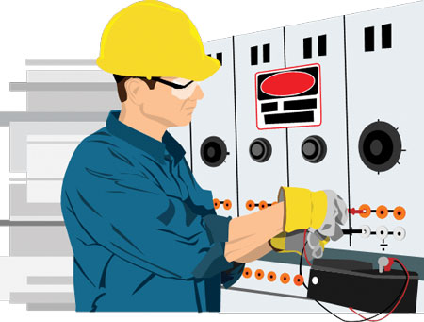
How Dangerous is Metering?
Electricity is Organized Lightning – George Carlin
Any Voltage without current will not kill you, but any voltage with current can kill you.

Slide 6
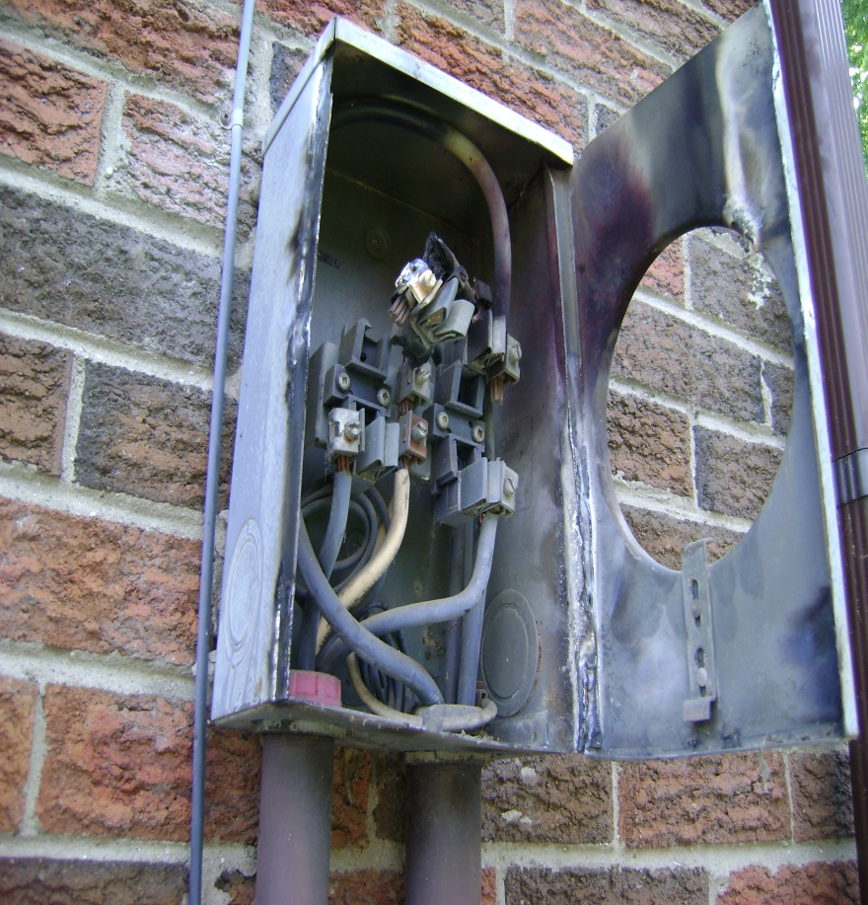
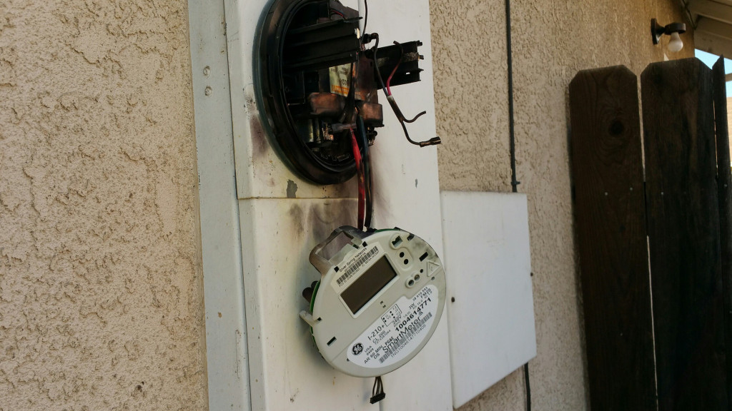
How Dangerous is Metering?

Slide 7
Safety First - PPE
Personal Protective Equipment
Leathers
Rubber Gloves
Face Shield
FR Clothing
Safety Shoes

Slide 8
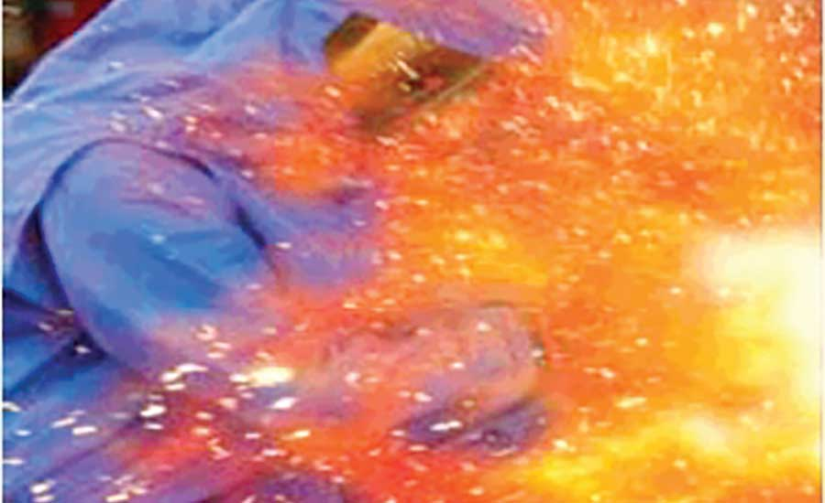
Arc Flash
What is Arc Flash?
While an arc flash is sometimes used interchangeably with “arc fault,” an arc flash is more accurately defined as the light produced during an arc fault. An arc fault is a type of electrical fault that results from the breakdown of an insulating medium between two conductors where the energy is sufficient to sustain an arc across the insulator (often air) and can cause extreme amounts of light (arc flash), immense heat upwards of 19,000 degrees C, and a resulting explosive pressure wave (arc blast). These forces combine to create a hazardous condition that can vaporize metal, destroy equipment, and pose a significant hazard to anyone in the vicinity.

Slide 9
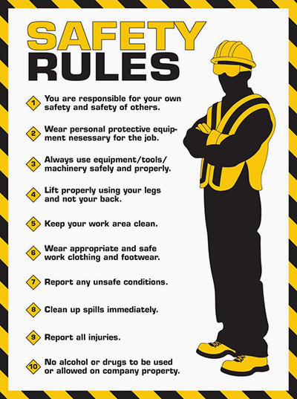
Covering the Basics

Slide 10
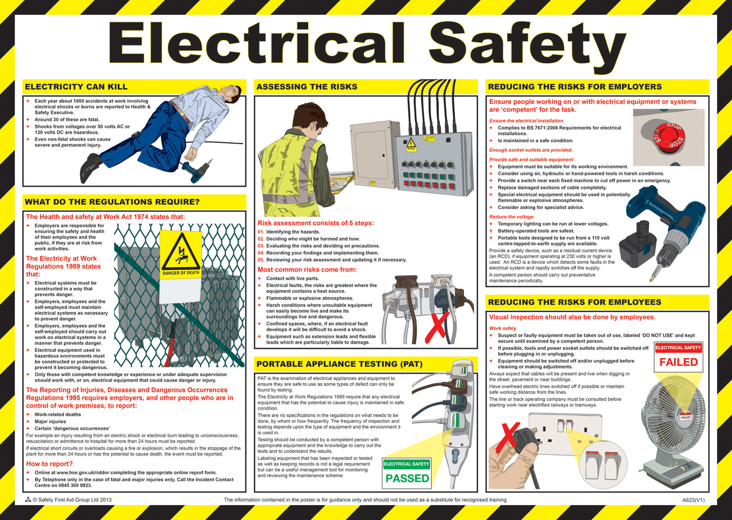
More of the Basics

Slide 11
More of the Basics
IMPORTANT
Always follow your own utility’s and PSC/AHJ’s requirements and guideline for PPE, correct meter installations, and safety procedures.

Slide 12
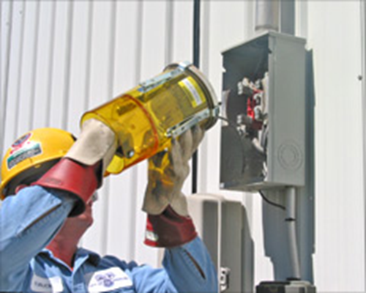
Approaching the Meter Installation
Always approach an electrical service with caution and while wearing your full PPE. Why?
Never stand directly in front of the meter when removing the meter
Before you even open the box or get the cover off….
Live box
Bees
Other live animals
Broken Seal
Cover dropping off
Signs of Vandalism and Tampering
Storm Damage
Missing knock-outs
Cracked or broken conduit
Loose connections of the meter base, including meter pulling away from the building wall and loose mounting screws
Inadequate fastening of the meter base and/or mast to the building

Slide 13
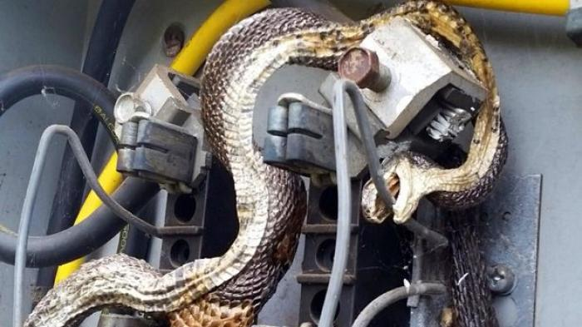
Approaching the Meter Installation

Slide 14
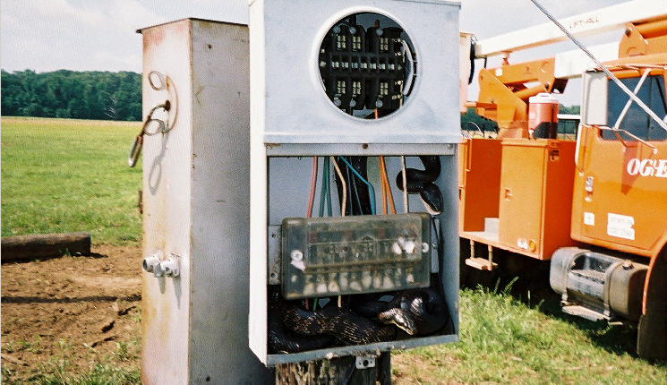
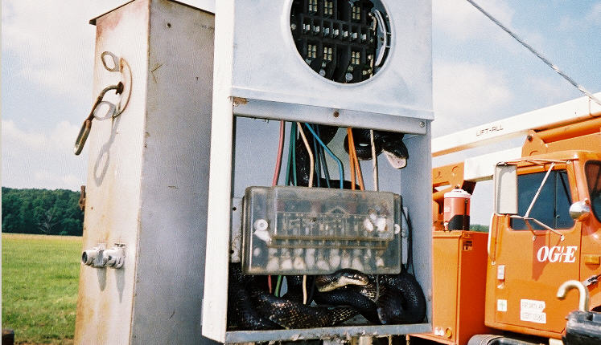
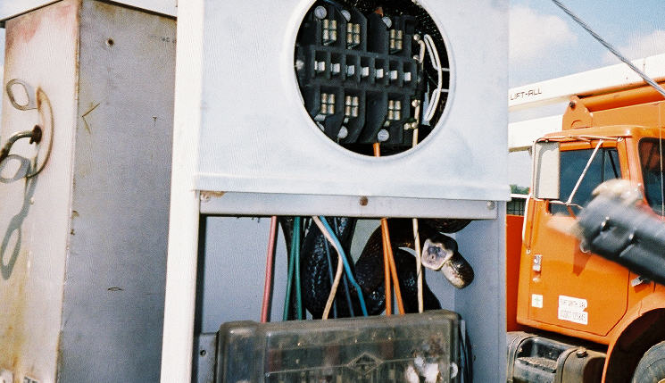
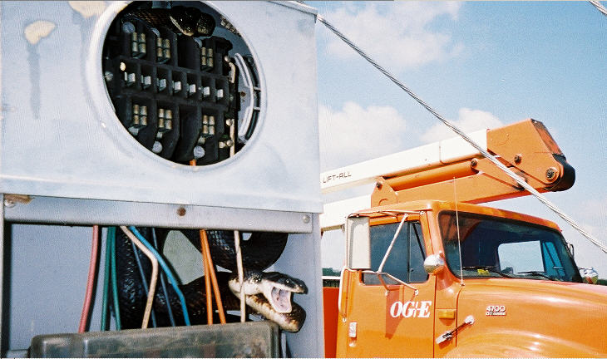
Approaching the Meter Installation

Slide 15
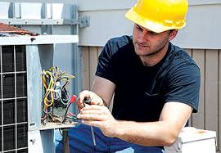
Once the Box is Open Issues to Look For
Open line – open line side connection to the meter socket.
Missing neutral – missing neutral connection to the center lug in the meter socket
Cross phase condition – cross wiring between the test block and the meter socket.
Hidden jumpers line to load – diversion on both legs.
Dead Short - dead short phase to ground on the load side of one leg of the socket.
Partial Short - partial short phase to ground on the load side of one leg of the socket
Notes:
UMPIRE is a
Universal Meter Programming and Reading System
It reads all meters and recorders
It can control all manufactures software

Slide 16
Once the Box is Open Issues to Look For
Mechanical breakdown of components
Excessive moisture
Environmental contaminants
Frequent meter change outs (resulting in loss of jaw tension)
Excessive electrical load (overload or short circuit)
Loose or melted conductors
Ground settling
Signs of previous arc flashes
Corrosion levels on components
Notes:
UMPIRE is a
Universal Meter Programming and Reading System
It reads all meters and recorders
It can control all manufactures software

Slide 17
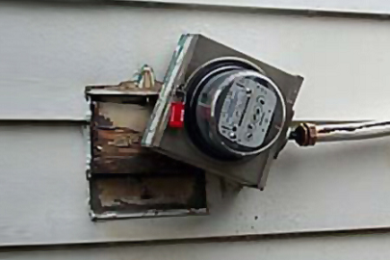
Once the Box is Open Issues to Look For
Back fed meter socket
Ground fault
Phase to phase fault
Pulling a meter jaw with the meter
Evidence of a hot socket
Notes:
UMPIRE is a
Universal Meter Programming and Reading System
It reads all meters and recorders
It can control all manufactures software

Slide 18
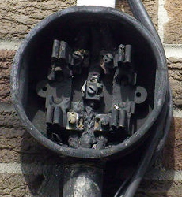
What is a Hot Socket?
Hot Sockets are not a new phenomenon. Virtually every meter man has pulled a meter with a portion of the meter base around a blade melted and virtually every utility has been called to assist in the investigation of a fire at a meter box.
AMI deployments because of the volume of meters involved put a spot light on this issue.
What causes a hot socket?
Are the meters ever the cause of a meter box failure?
What are the things to look for when inspecting an existing meter installation?
What are the best practices for handling potential hot sockets?
This presentation will cover the results of our lab investigation into the sources for hot sockets, the development of a fixture to simulate hot sockets, the tests and data gleaned from hot sockets, and a discussion of “best practices” regarding hot sockets.

Slide 19
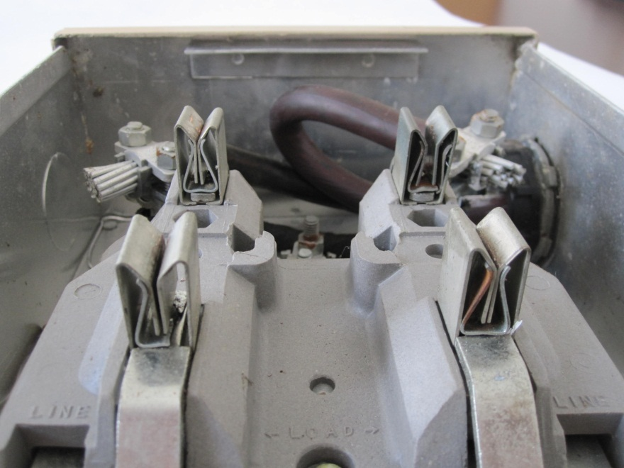
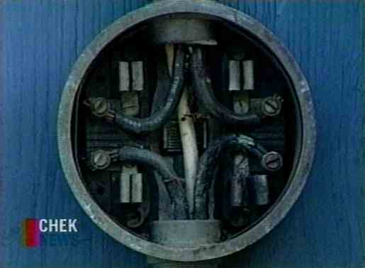
Root Causes
Common Features and Common Sources of Concern
Pitted and discolored meter blades
Melted plastic around one or more of the meter stabs (typically the plastic around one stab is where the deformation starts)
Pitted and discolored socket jaws
Loss of spring tension in the socket jaws

Slide 20
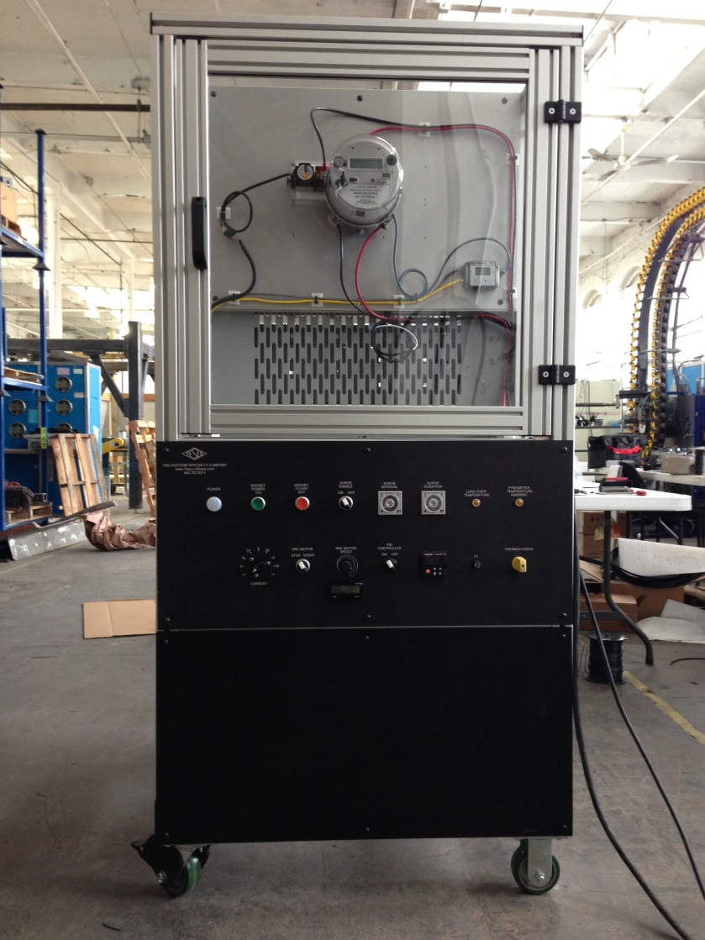
Root Causes

Slide 21
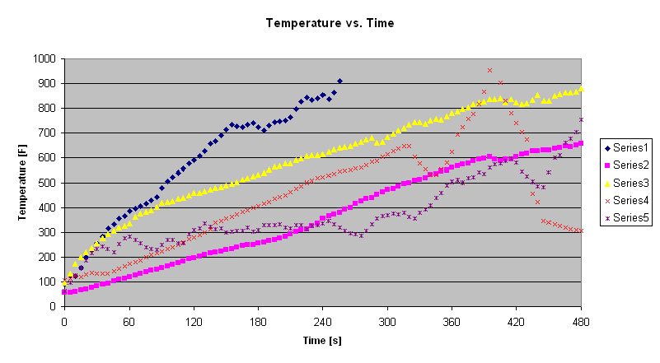
Root Causes
Notes:
21

Slide 22
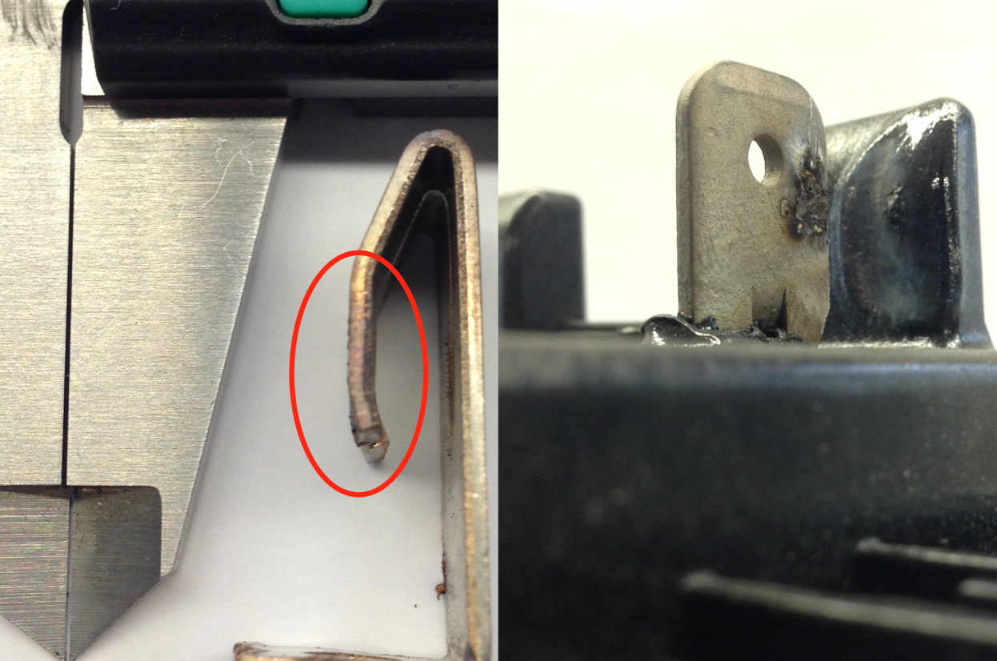
Root Causes
Calipers show a .01” gap, with that size gap between jaws and stabs we were able to heat meter stabs over 1000 degrees Fahrenheit in a few minutes.
The rough spots you see on the post-test jaw next to the calipers are over .005” high. This surface degradation appears on the stab as well.
Between the two surfaces you can have large gaps, along with insulating by-product of the arcing, that can sustain heavy arcing in a solid state.

Slide 23
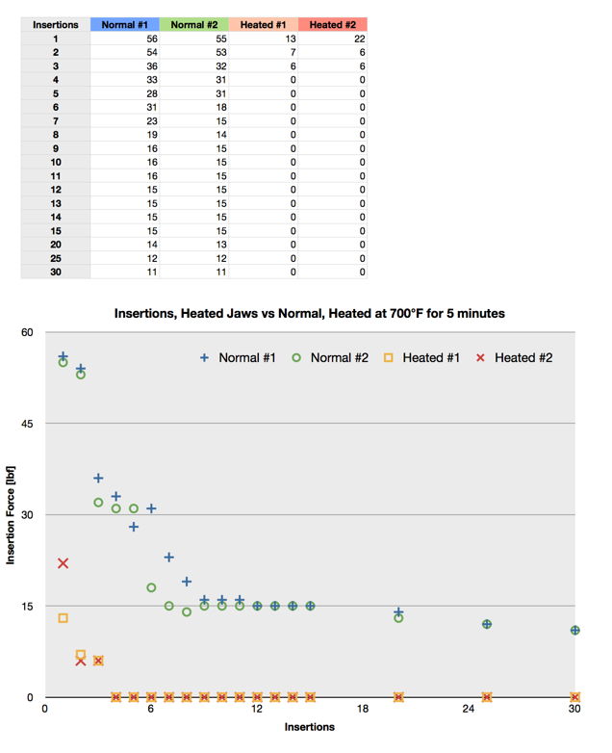
Root Causes

Slide 24
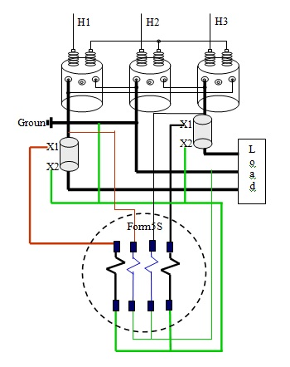
Billing Issues
Any mistake in any part of the service can cause a billing issue

Slide 25
Billing Issues
VT’s Mis-wired

Slide 26
Billing Issues
CT’s Mis-wired
CT’s Shunted
Wrong Label
Magnetized

Slide 27
Billing Issues
Reversed CT Secondaries
Crossed CT’s
Mis-wired Test Switch
Test Switch Left Open

Slide 28
Billing Issues
Inaccurate Meter
Incorrect Multiplier

Slide 29
Billing Issues
Incorrect Multiplier

Slide 30
Billing Issues
Incorrect Multiplier
Difference between meter reading and actual energy usage

Slide 31
Billing Issues
Incorrect Multiplier
Difference between meter reading and actual energy usage
VT’s – 480:120 = x4
480:120

Slide 32
Billing Issues
Incorrect Multiplier
Difference between meter reading and actual energy usage
VT’s – 480:120 = x4
CT’s – 400:5 = x80
480:120
400:5

Slide 33
Billing Issues
Incorrect Multiplier
Difference between meter reading and actual energy usage
VT’s – 480:120 = x4
CT’s – 400:5 = x80
Multiplier = 320
The multiplier is multiplied to the meter registration to equal primary energy used.
480:120
400:5

Slide 34
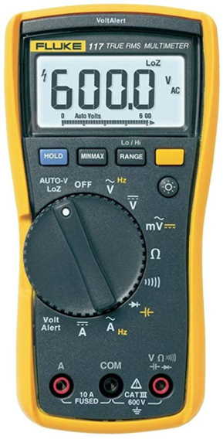
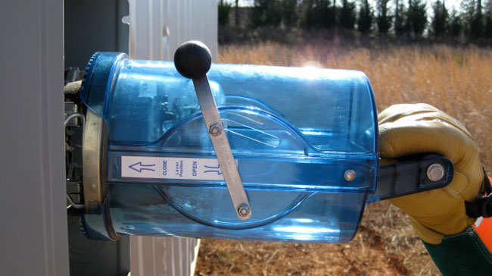
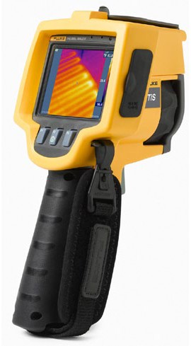
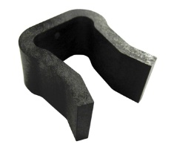
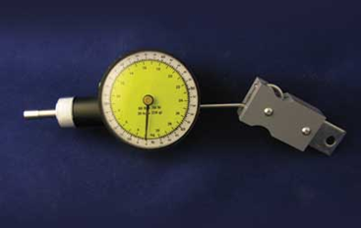
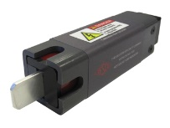
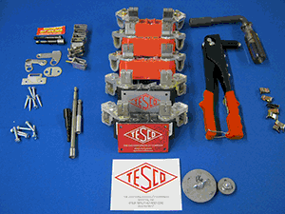
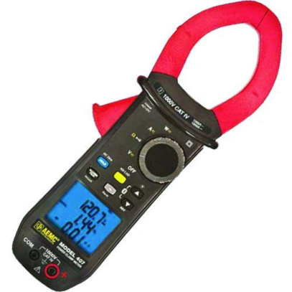
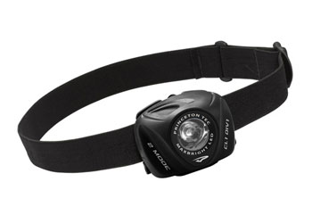
Useful Tools and Equipment

Slide 35
References
https://www.utilityproducts.com/safety/article/16002491/preventing-electric-meter-fires
https://inspectapedia.com/electric/Electric_Meters.php
https://www.myflukestore.com/p8117/fluke_tis.php
https://www.utilitysolutionsinc.com/products/meter-grabber/
https://www.amazon.com/Fluke-117-Electricians-True-Multimeter/dp/B000O3LUEI
https://www.amazon.com/AEMC-407-Clamp-Meter-Capability-Measurement/dp/B008S04GBI
https://www.esfi.org/workplace-injury-and-fatality-statistics#:~:text=Electrical%20fatality%20rates%20were%200.11,0.4%20%2F%20100%2C000)%20in%202019.

Slide 36
Questions?
Rob Reese
TESCO – The Eastern Specialty Company
Bristol, PA
215-310-8809
This presentation can also be found under Meter Conferences and Schools on the TESCO website: www.tescometering.com

