Slide 1
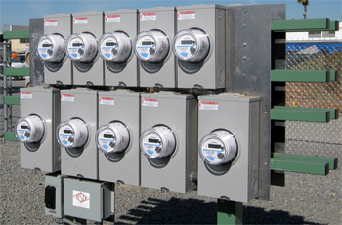
Fundamentals of Transformer-Rated Field Meter Testing and Site Verification
Prepared by Rob Reese, TESCO
The Eastern Specialty Company
For NREA – Nebraska Rural Electric Association
February 10, 2021
10/02/2012
Slide 1
Notes:
1

Slide 2
Site Verification
Why is Site Verification Important?
More than Meter Testing
Testing and Inspecting the Entire Service
Overview of Transformer-Rated Meter Installations
Transformer-Rated Meter Installation Verifications
What to Inspect and Test
Detailed Testing Theory and Equipment
Meter Accuracy
CT Burden, Ratio, Admittance
Vectors and Harmonics
Hot Socket

Slide 3
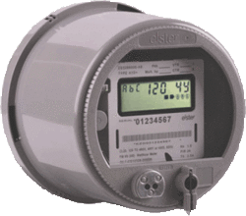
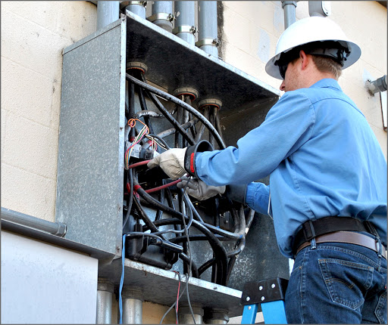
What is Site Verification?
Testing and inspection of more than just the meter accuracy.
99.975% Registration

Slide 4
Premise
Over much of the 20th century, utilities, regulators and customers each relied upon lab and field meter testing efforts which were primarily focused upon the accuracy of the watt-hour meter and demand register.
This focus is now changing with the deployment of electronic AMR and AMI meters to the majority of the 155 Million connected customers in North America.
The focus has now shifted from just the accuracy of the meter to also checking other features of the meter (e.g. communication and disconnect devices), the firmware versions and settings of the meter, and the overall meter installations for both residential and C&I customers.
Incorrect or miscalculated site information or undetected problems can lead to an improperly metered customer not related to the meters accuracy and could also lead to potential safety issues.

Slide 5
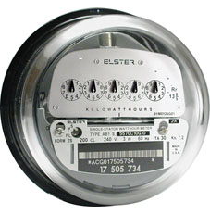
Field Testing
Common Features and Common Sources of Concern
Electro Mechanical meters were subject to registration errors caused by mechanical issues with moving parts resulting in either the loss of revenue to the utility or over billing for the customer. Some of the more common problems were:
Friction wear
Gear mesh misalignment
Retarding magnet failure
Timing motors

Slide 6
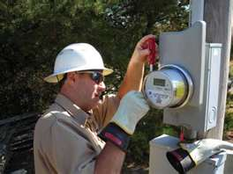
Electronic Meters – new failure modes require new testing and inspection methods
Electronic meters fail as do electromechanical meters but differently
Their overall life expectancy is not nearly the same
Failure modes include drift (unexpected)
Failure modes include catastrophic (expected)
Power supply damage due to lightning surges or other causes
LCD Display failures making a visual read impossible when required
AMR/AMI communications module failures requiring a field visit to repair or replace meter/AMI module and get a read for billing purposes
Failure modes include non-catastrophic but significant measurement error modes sometimes attributed to improper meter programming and in some cases meter firmware issues.
Failure modes can include non-measurement issues which render the meter ineffective or inaccurate for billing purposes
Clerical errors such as incorrect multipliers can do more damage than even the most catastrophic equipment failure in the field.

Slide 7
Best Practices
Residential vs Commercial
Self-Contained vs Transformer Rated
Follow the money and be as proactive as possible

Slide 8
Why Site Verifications are a Valuable Utility Tool
It is important to remember that with current systems it is not just the meter that can cause a major error in the measurement of a given service
A meter test that indicates a meter is within the required accuracy parameters does not mean your service is being measured and billed accurately
A meter test may not catch intermittent errors or identify errors with other equipment at the site, e.g. CT’s & PT’s
A discrepancy between what is thought to be at a given site and what is actually at that site can cause a major billing error (either over or under billed)

Slide 9
Why C&I and what should we invest our limited meter service resources here?
Easy Answer: Money.
These customers represent a disproportionately large amount of the overall revenue for every utility in North America.
For some utilities the ten percent of their customers who have transformer rated metering services can represent over 70% of their overall revenue.
While these numbers will vary from utility to utility the basic premise should be the same for all utilities regarding where Meter Services should focus their efforts – follow the money.

Slide 10
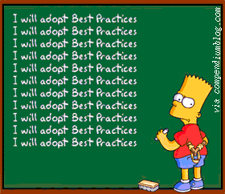
What are the opportunities that can be found in this work and what are our industry’s “Best Practices” for this type of work?
Most Utilities do not have a comprehensive and complete list of every instrument transformer on their system that is involved in providing the billing for the largest 10 to 20% of any utilities revenue.
Most Utilities do not visit, document and verify these same services on any regular basis.
Best practices call for the on-site verification of a Utilities “largest” customers on a periodic basis.
There is no definition of what this verification should entail
There is no definition of what “largest” means
There is no agreement on the frequency of this “periodic” inspection

Slide 11
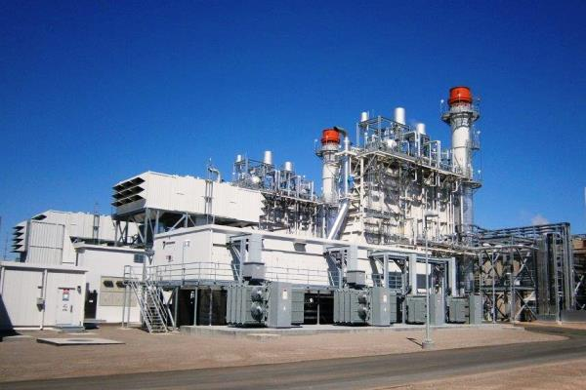
Define “Largest” and what this may represent
Largest should be defined by revenue.
Lost metering revenue is no longer “recovered in the next rate case”, nor is recovered metering revenue necessarily “given back” in the next rate case.
Utility Commissions are having less tolerance for new rate cases.
Over billing of any customer has always been a public relations nightmare.
A facility with an electric bill of $10,000 per month would pay for a meter tech in two years if an error affecting the wiring of only one transformer (estimated lost revenue $160,000 over a two year period). Does this mean that $10,000 per month or more defines large?

Slide 12
Define “Largest” and what this may represent
Largest should be defined by revenue.
Lost metering revenue is no longer “recovered in the next rate case”, nor is recovered metering revenue necessarily “given back” in the next rate case.
Utility Commissions are having less tolerance for new rate cases.
Over billing of any customer has always been a public relations nightmare.
A facility with an electric bill of $10,000 per month would pay for a meter tech in two years if an error affecting the wiring of only one transformer (estimated lost revenue $160,000 over a two year period). Does this mean that $10,000 per month or more defines large?
I would argue that this size customer is universally a “Large customer” and that from here each utility should decide how much smaller they should go in their definition of “Large”.

Slide 13
Define “Periodically” and how frequent this may be
If changes in usage, equipment failures in the metering service, external damage to the service, or energy diversion at a single “large” customer can pay for a single meter tech in just two or three years, and a single meter tech can handle several of these inspections in a single day, then there is ample cost justification for inspecting these services at least once every year.

Slide 14
Self-Contained vs. Transformer-Rated
Self Contained
(direct)
Transformer-Rated
(indirect)

Slide 15
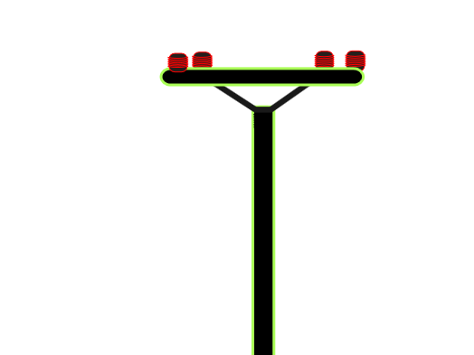
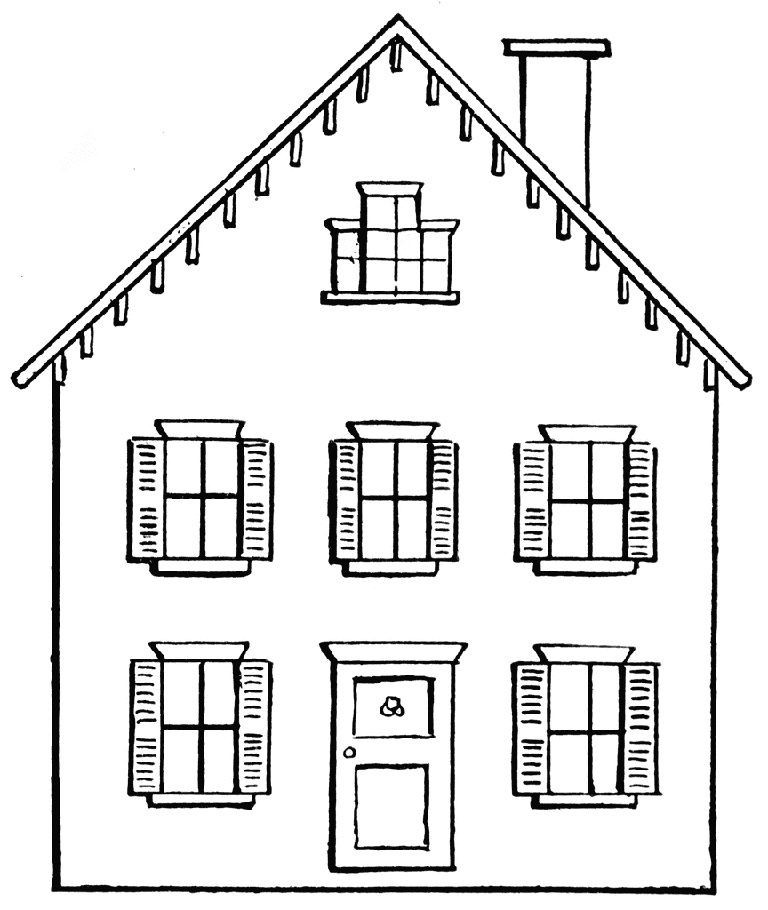
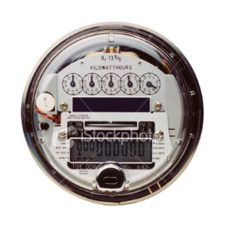
Self-Contained Metering
Primarily Residential
(1S, 2S, 12S)
Relatively Low Current
Example: 100A

Slide 16
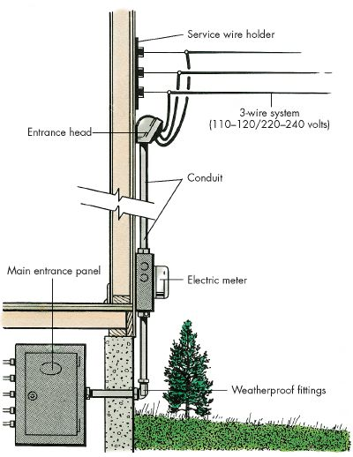
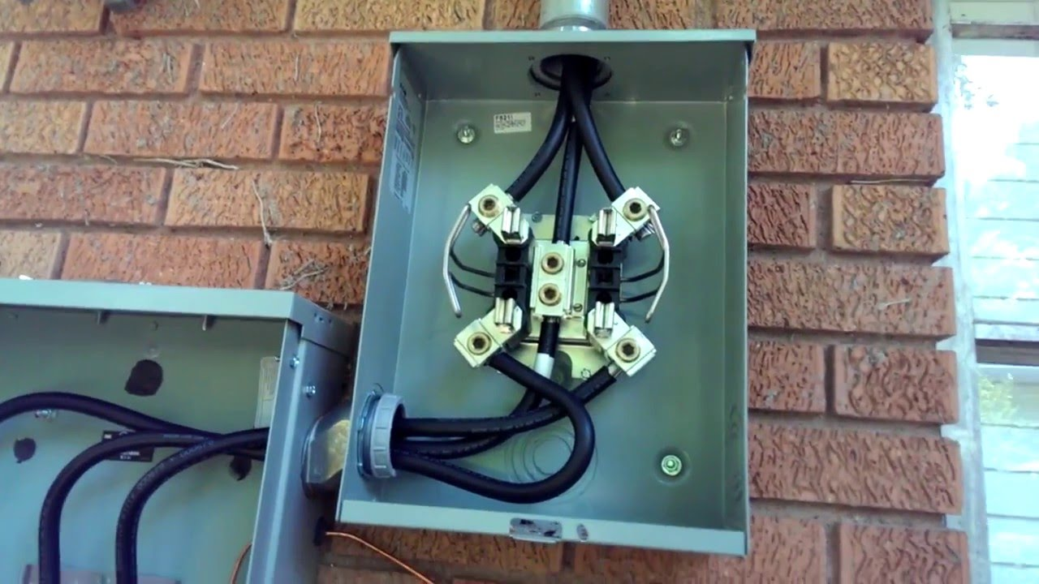
Self-Contained Metering
Primarily Residential
(1S, 2S, 12S)

Slide 17
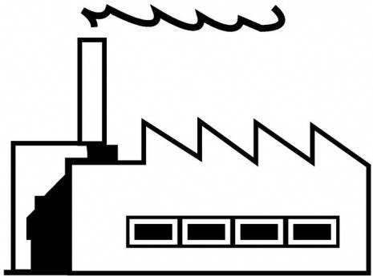
Transformer-Rated Metering
Primarily Commercial/Industrial
(9S, 16S)
Relatively High Current
Example: 400A

Slide 18
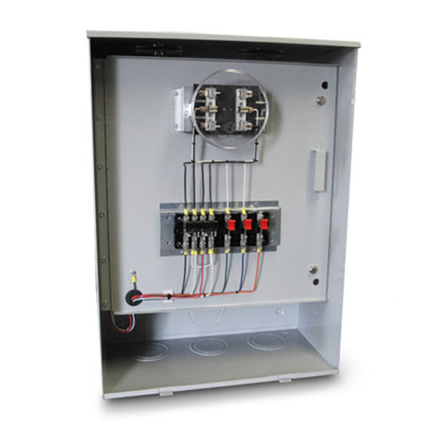
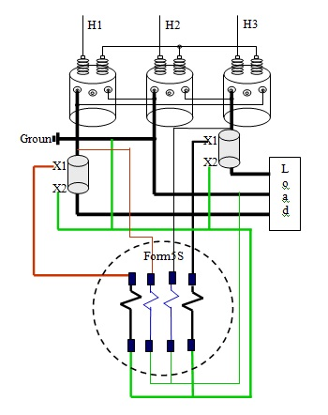
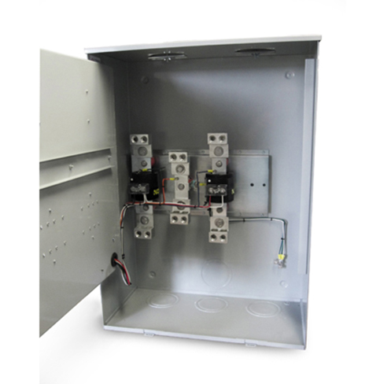
Transformer-Rated Metering
Primarily Commercial/Industrial
(9S, 16S)

Slide 19
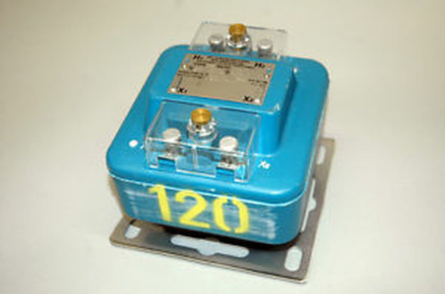
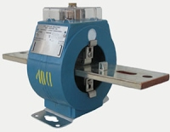
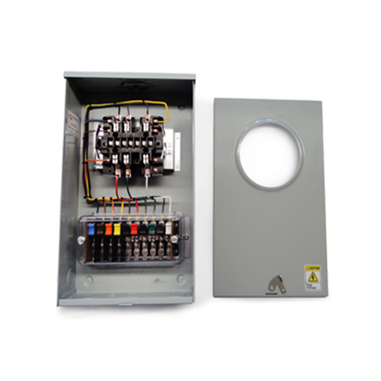
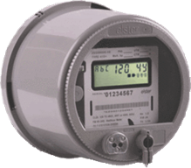
Transformer-Rated Metering
Typical Components of an Installation

Slide 20
Transformer-Rated Metering Verification
Potential list of tasks to be completed:
Double check the meter number, the location the test result and the meter record
Perform a visual safety inspection of the site. This includes utility and customer equipment. Things to look for include intact down ground on pole, properly attached enclosure, unwanted voltage on enclosure, proper trimming and site tidiness (absence of discarded seals, etc.)
Visually inspect for energy diversions (intentional and not). This includes broken or missing wires, jumpers, open test switch, unconnected wires and foreign objects on meters or other metering equipment. Broken or missing wires can seriously cause the under measurement of energy. A simple broken wire on a CT or VT can cause the loss of 1/3 to 1/2 of the registration on either 3 element or 2 element metering, respectively.
Visually check lightning arrestors and transformers for damage or leaks.
Check for proper grounding and bonding of metering equipment. Poor grounding and bonding practices may result in inaccurate measurements that go undetected for long periods of time. Implementing a single point ground policy and practice can reduce or eliminate this type of issue.
Burden, Ratio, and/or Admittance test CTs and voltage check PTs.

Slide 21
Transformer-Rated Metering Verification
Burden, Ratio, and/or Admittance test CTs and voltage check PTs.
Verify service voltage. Stuck regulator or seasonal capacitor can impact service voltage.
Verify condition of metering control wire. This includes looking for cracks in insulation, broken wires, loose connections, etc.
Compare the test switch wiring with the wiring at the CTs and VTs. Verify CTs and VTs not cross wired. Be sure CTs are grounded in one location (test switch) only.
Check for bad test switch by examining voltage at the top and bottom of the switch. Also verify amps using amp probe on both sides of the test switch. Verify neutral connection to cabinet (voltage).
Check rotation by closing in one phase at a time at the test switch and observing the phase meter for forward rotation. If forward rotation is not observed measurements may be significantly impacted as the phases are most likely cancelling each other out.
Test meter for accuracy. Verify demand if applicable with observed load. If meter is performing compensation (line and/or transformer losses) the compensation should be verified either through direct testing at the site or by examining recorded pulse data.

Slide 22
Transformer-Rated Metering Verification
Verify metering vectors. Traditionally this has been done using instruments such as a circuit analyzer. Many solid state meters today can provide vector diagrams along with volt/amp/pf and values using meter manufacturer software or meter displays. Many of these desired values are programmed into the meters Alternate/Utility display. Examining these values can provide much information about the metering integrity. It may also assist in determining if unbalanced loads are present and if CTs are sized properly. The vendor software generally has the ability to capture both diagnostic and vector information electronically. These electronic records should be kept in the meter shop for future comparisons.
If metering is providing pulses/EOI pulse to customers, SCADA systems or other meters for totalization they also should be verified vs. the known load on the meter. If present test/inspect isolation relays/pulse splitters for things like blown fuses to ensure they are operating properly.
Verify meter information including meter multiplier (rework it), serial number, dials/decimals, Mp, Ke, Primary Kh, Kr and Rate. Errors in this type of information can also cause a adverse impact on measured/reported values.

Slide 23
Transformer-Rated Metering Verification
Verify CT shunts are all opened.
Look for signs of excessive heat on the meter base e.g.
melted plastic or discoloration related to heat

Slide 24
Testing Theory and Equipment
Most Important Tools You Have!

Slide 25
Testing Theory and Equipment
Meter Accuracy Testing – A Comparison Test
POTENTIAL SOURCE
CURRENT SOURCE
ENERGY REFERENCE STANDARD
XXXXXXXXX

Slide 26
Testing Theory and Equipment
Meter Accuracy Testing – A Comparison Test
POTENTIAL SOURCE
CURRENT SOURCE
ENERGY REFERENCE STANDARD
XXXXXXXXX
Watthour Meter
Measures Electrical Energy (kWh)
Potential (V) * Current (I) = Power (W)
Power Over Time = Energy (kWh)

Slide 27
Testing Theory and Equipment
Meter Accuracy Testing – A Comparison Test
POTENTIAL SOURCE
CURRENT SOURCE
ENERGY REFERENCE STANDARD
XXXXXXXXX
Energy Reference Standard
Measures Electrical Energy (kWh)
Higher Accuracy Class
Traceability to SI

Slide 28
Testing Theory and Equipment
Meter Accuracy Testing – A Comparison Test
POTENTIAL SOURCE
CURRENT SOURCE
ENERGY REFERENCE STANDARD
XXXXXXXXX
Apply the Same Voltage and Current to the Standard and Meter for a Defined Period of Time
Standard and Meter Should Measure the Same Energy
The Difference is the Error of the Meter

Slide 29
Testing Theory and Equipment
Meter Accuracy Testing – A Comparison Test
POTENTIAL SOURCE
CURRENT SOURCE
ENERGY REFERENCE STANDARD
XXXXXXXXX
Example:
Standard Registers 100kWh / Meter Registers 101.38
Then the Error of the Meter is 1.38%

Slide 30
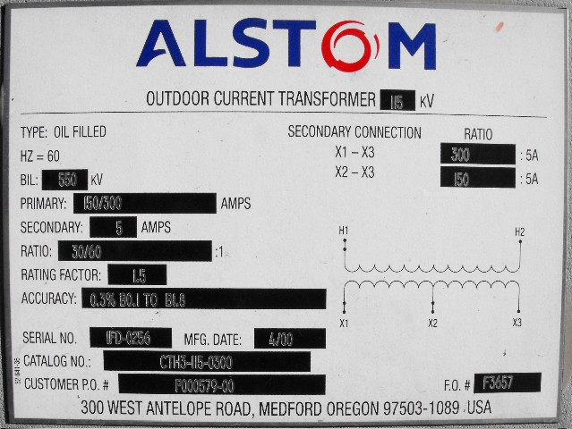
CT Testing
Ratio, Burden, and Admittance

Slide 31
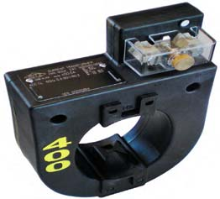
Example Application
SOURCE
LOAD
PHASE A
400A
PHASE B
400A
PHASE C
400A
9S Meter Installation
5A
5A
5A

Slide 32
Faceplate Specifications

Slide 33
Faceplate Specifications
Ratio

Slide 34
CTs Ratio
For instance, a CT with a 400:5 ratio will produce 5A on the secondary, when 400A are applied to the primary.

Slide 35
Faceplate Specifications
Burden Rating

Slide 36
Burden Rating
The burden range, present in the secondary circuit, that the manufacturer will guarantee their CT’s will still accurately function, in regards to the ratio specification.

Slide 37
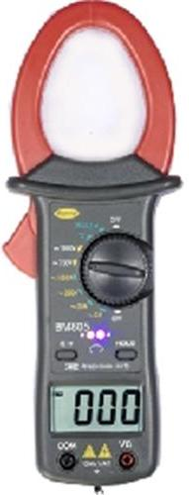
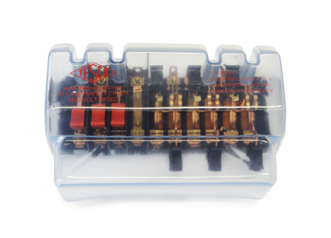
Ratio Testing
Ratio of Primary Current to Secondary Current
SOURCE
LOAD
PHASE A
400A
400A
400A
5A
5A
5A
Calculate Ratio

Slide 38
Burden Testing
Functionality with Burden Present on the Secondary Loop
PHASE A
Some burden will always be present – junctions, meter coils, test switches, cables, etc.
CT’s must be able to maintain an accurate ratio with burden on the secondary.

Slide 39
Burden Testing
Functionality with Burden Present on the Secondary Loop
PHASE A
Some burden will always be present – junctions, meter coils, test switches, cables, etc.
CT’s must be able to maintain an accurate ratio with burden on the secondary.

Slide 40
Burden Testing
Functionality with Burden Present on the Secondary Loop
Example Burden Spec:
0.3% @ B0.1, B0.2, B0.5
or
There should be less than the 0.3% change in secondary current from initial (“0” burden) reading, when up to 0.5Ohms of burden is applied

Slide 41
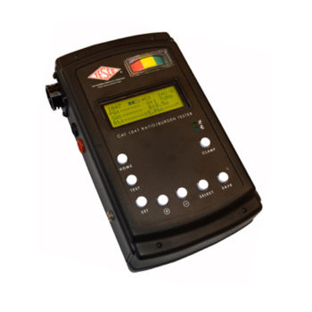
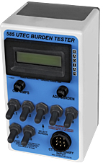
Burden Testing
Functionality with Burden Present on the Secondary Loop
ANSI Burden Values
0.1 Ohms
0.2 Ohms
0.5 Ohms
1 Ohms
2 Ohms
4 Ohms
8 Ohms

Slide 42
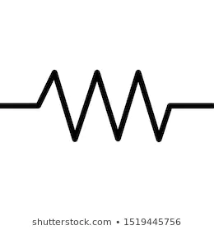
Burden Testing
Functionality with Burden Present on the Secondary Loop
PHASE A
.1 Ohm

Slide 43
Burden Testing
0.3% @ B0.1, B0.2, B0.5
Initial Reading = 5Amps
0.3% x 5A = 0.015A
5A – 0.015 = 4.985A
Burden | Reading
0 | 5.0000
0.1 | 4.9999
0.2 | 4.9950
0.5 | 4.9900
1 | 4.9800
2 | 4.9500
4 | 4.0000
8 | 0.8000

Slide 44
Burden Testing
0.3% @ B0.1, B0.2, B0.5
Initial Reading = 5Amps
0.3% x 5A = 0.015A
5A – 0.015 = 4.985A
Burden | Reading
0 | 5.0000
0.1 | 4.9999
0.2 | 4.9950
0.5 | 4.9900
1 | 4.9800
2 | 4.9500
4 | 4.0000
8 | 0.8000
At 0.5Ohms of Burden
the secondary current is still at 4.990A – Less than 0.3% change – Good CT!

Slide 45
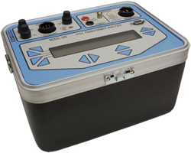
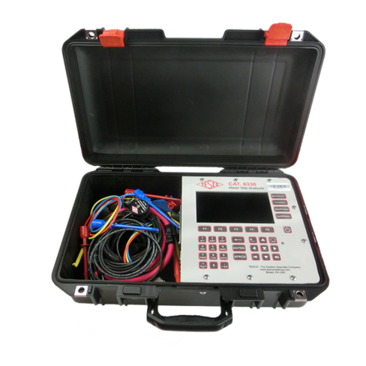
Admittance Testing
What is Admittance?
Admittance testing measures the overall “health” of the secondary loop of the CT.
Measured in units of MiliSiemens (mS)
Admittance is the inverse of impedance.
Impedance is the opposition to current.
Therefore, admittance testing measures the overall “health” of the secondary loop of the CT.

Slide 46
Admittance Testing
Admittance testing devices inject an audio sine wave signal into the secondary loop of the CT.
The resulting current is measured.
The voltage of the initial signal is known.
From these two parameters, the impedance, and thus the admittance can be calculated.

Slide 47
Admittance Testing
Admittance test results are not immediately intuitive.
Some analysis and interpretation is need.
What do all these mS values mean?

Slide 48
Admittance Testing
Three phase process is recommended.
Test each CT individually
Test the matched sets
Test over time

Slide 49
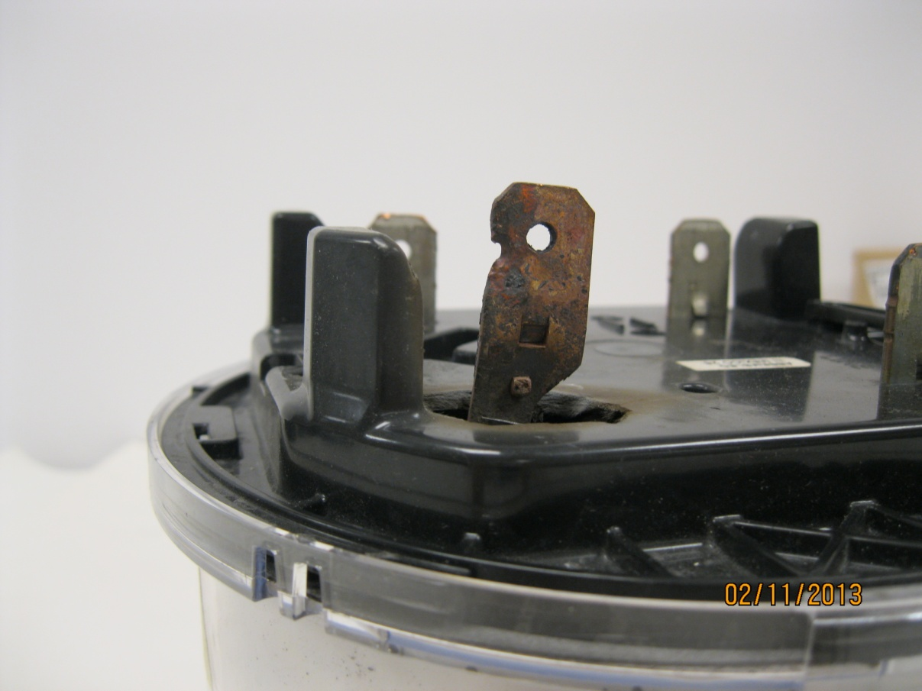
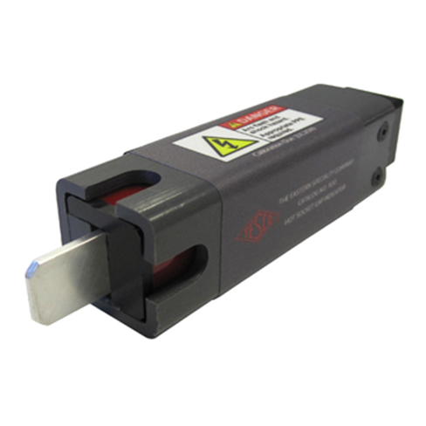
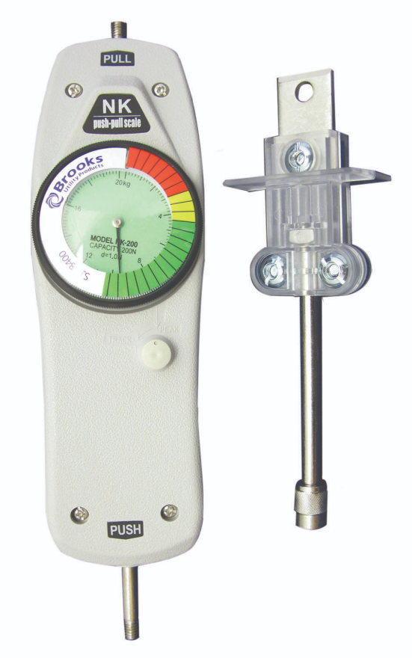
Hot Socket Checks

Slide 50
References and Citations
http://www.texasmeter.com/
https://home.howstuffworks.com/home-improvement/repair/how-to-do-home-electrical-repairs.htm
https://www.youtube.com/watch?v=SeyojxVonrk
https://www.tescometering.com/product/tesco-transockets/
http://www.gecdurham.com/
https://www.radianresearch.com/
http://www.brooksutility.com/products/122

Slide 51
Questions and Discussion
Rob Reese
TESCO – The Eastern Specialty Company
Bristol, PA
215-310-8809 (cell)
This presentation can also be found under Meter Conferences and Schools on the TESCO website: www.tescometering.com

