Slide 1
Zero-Infrastructure AMI Selection and Deployment
Presented by Jon Scott
North Carolina Meter School
Management Track
Tuesday, June 13, 2023
8:00 AM

Slide 2
Zero-Infrastructure AMI
AMI | ADVANCED METERING
Agenda
Introduction to TESCO Nighthawk
Defining Zero-Infrastructure AMI
Case Studies
Full AMI
Tactical/Targeted Deployment
Program-Specific Application

Slide 3
Zero-Infrastructure AMI
About Nighthawk
Over 25 years of utility experience
100+ utilities served
AMI Solutions
Full-Deployment
Tactical
Now a TESCO Company!

Slide 4
AMI Status?
ⓘ Start presenting to display the poll results on this slide.

Slide 5
When you think “Traditional AMI,” what word or phrase comes to mind?
ⓘ Start presenting to display the poll results on this slide.

Slide 6
When you think “Zero-Infrastructure AMI,” what word or phrase comes to mind?
ⓘ Start presenting to display the poll results on this slide.

Slide 7
Zero-Infrastructure AMI
AMI | ADVANCED METERING
Majority of AMI Solutions Require Costly Infrastructure:
Towers, Repeaters, Collectors, Access Points, etc.
Many Require Additional Resources:
Network Administrators, DBA’s, RF-Techs, etc.
Many AMI Technology Flavors

Slide 8
Zero-Infrastructure AMI
AMI | ADVANCED METERING
Defining Zero-Infrastructure AMI
No Costly Infrastructure to Install/Maintain
Communications Under-Glass
IT Friendly / Cloud Hosted

Slide 9
Zero-Infrastructure AMI
AMI | ADVANCED METERING
Zero-Infrastructure AMI
Cellular-Only
Full deployment or tactical
Cellular-RF Mesh Hybrid
Full deployment (great for small – medium size utilities)
Fiber
On the rise especially with the electric cooperatives
Fiber to pole or Fiber to home solutions

Slide 10
Zero-Infrastructure AMI
AMI | ADVANCED METERING
Zero-Infrastructure AMI cont.
Leveraging Private LTE
Mostly applicable to large utilities / IOU’s
Protect lifespan of the data backhaul
Easy access to higher frequencies and amounts of interval data for AMI 2.0 applications

Slide 11
Zero-Infrastructure AMI
AMI | ADVANCED METERING
Case Studies
Full AMI (Co-op and Municipal)
Tactical/Targeted Deployment
Program Specific Application

Slide 12
Zero-Infrastructure AMI
AMI | ADVANCED METERING
Case Study – Full AMI, Multi-Phase Deployment
Hamilton County Electric Cooperative, TX
18,000 electric
Contacts
Lisa Lively, IT Specialist/ AMI Supervisor
Existing system: PLC

Slide 13
Zero-Infrastructure AMI
AMI | ADVANCED METERING
Case Study – Full AMI
Hamilton County Electric Cooperative, TX
Problem/Need:
Current system no longer supported by manufacturer
New meters for current system difficult to procure
Need for timely outage/ voltage reporting
Low to zero infrastructure to install/maintain
Easy to self deploy
Must allow for multi-year, multi-phase self deployment (flexible and scalable)
Low latency
Must integrate with NISC

Slide 14
Zero-Infrastructure AMI
AMI | ADVANCED METERING
Case Study – Full AMI
Hamilton County Electric Cooperative, TX
Solution:
Started with evaluation of AMI technology options
Identified Cellular-Mesh topology to be potential solution
Conducted thorough communications testing and RF-study
Provided full-system deployment plan
Evaluated hardware and software functionality
Integrated with NISC CIS
Used Fulcrum software for self- deployment (meter change out)
Typically order a substation a quarter

Slide 15
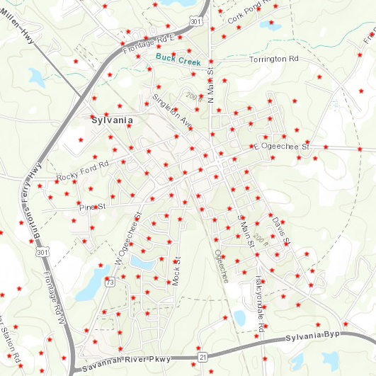
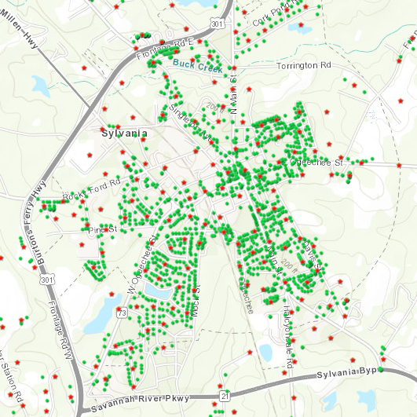
Zero-Infrastructure AMI
AMI | ADVANCED METERING
Cellular Meter Placement
RF-Mesh Meter Placement

Slide 16
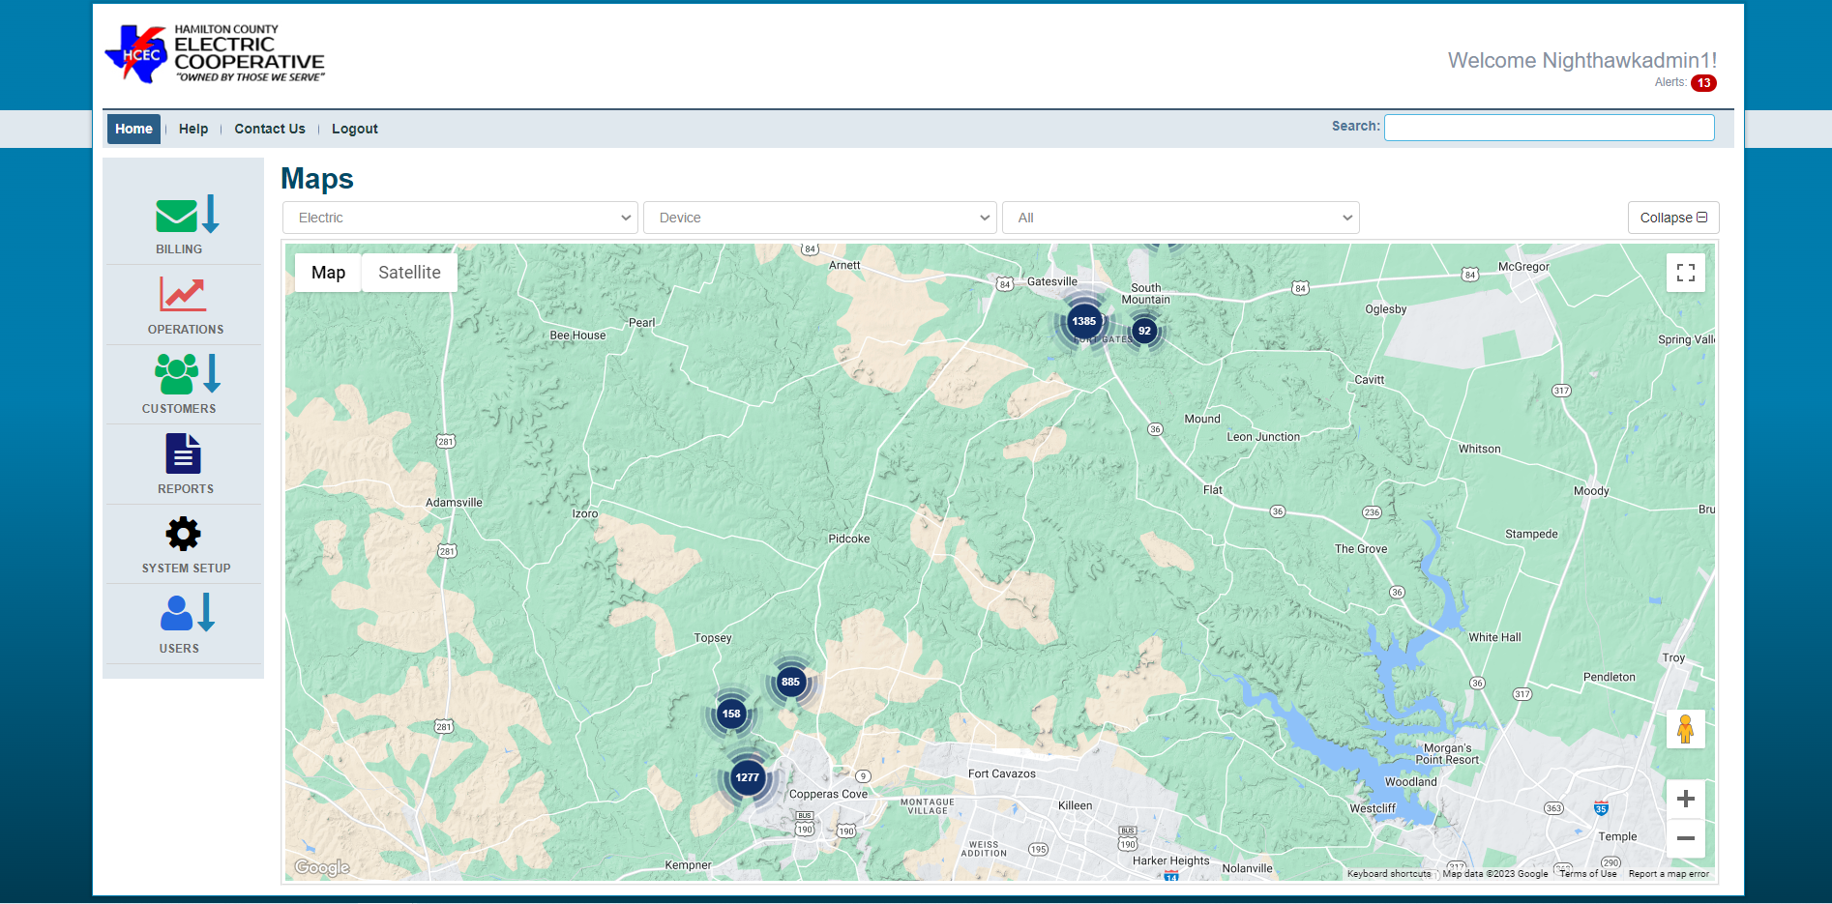
AMI | ADVANCED METERING

Slide 17
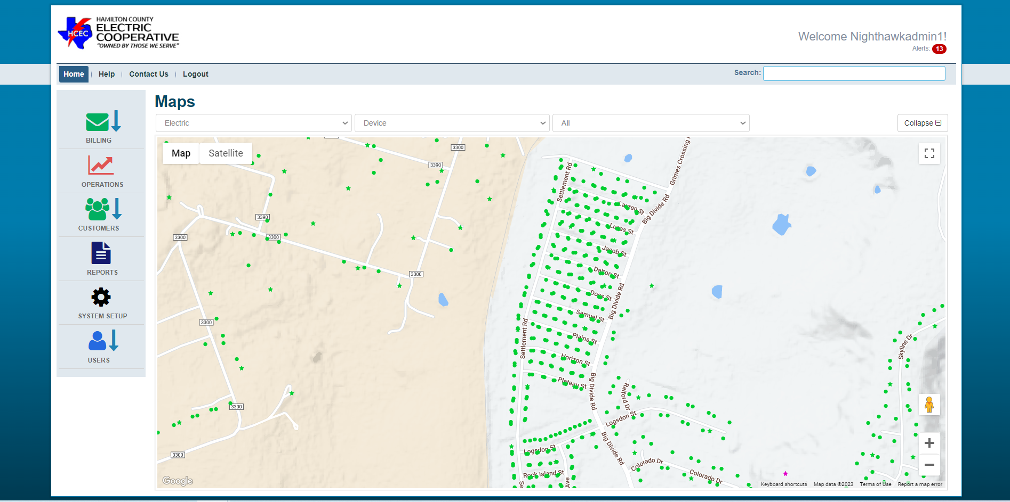
AMI | ADVANCED METERING

Slide 18
Zero-Infrastructure AMI
AMI | ADVANCED METERING
Case Study – Full AMI
Hamilton County Electric Cooperative, TX
Outcome:
2 substations deployed with a third in the works
10-30 seconds for on-demand reads, disconnects, demand resets, etc.
Nothing to maintain beyond the meters (zero-infrastructure)
Standard AMI benefits
Preventing truck rolls
Timely outage/voltage reporting
Remote reading/disconnect
Etc.

Slide 19
Zero-Infrastructure AMI
AMI | ADVANCED METERING
Case Study – Full AMI
Hamilton County Electric Cooperative, TX
Challenges/Lessons Learned:
Working the wrinkles out of the billing integration
Maintaining consistency from previous system
Meter lead times jumping from 3-4 weeks to 6-8 weeks
Resource bandwidth (manpower to deploy)

Slide 20
Zero-Infrastructure AMI
AMI | ADVANCED METERING
Case Study – Full AMI
Hamilton County Electric Cooperative, TX
What’s next:
Continue per-substation deployment

Slide 21
Zero-Infrastructure AMI
AMI | ADVANCED METERING
Case Study – Full AMI
Louisville Utilities, MS
3,200 electric, 3,200 water
TVA member
Contacts
Wilson Webb, General Manager
Jay McLendon, Office Manager
Old system: 10+ year old Electric and Water AMR solution

Slide 22
Zero-Infrastructure AMI
AMI | ADVANCED METERING
Case Study – Full AMI
Louisville Utilities, MS
Problem/Need:
Remote Disconnect/Read, Outage/Voltage reporting
Limited resources
Low to zero infrastructure to install/maintain
Easy to self deploy
Not turning meter-techs into RF techs
Must allow for multi-year, multi-phase self deployment (flexible and scalable)
No onsite server requirement (hosted)
Easy to operate single-software solution (no DBA or network admin)
Low latency
Must integrate with CSA MDM/CIS
Multi-service

Slide 23
Zero-Infrastructure AMI
AMI | ADVANCED METERING
Case Study – Full AMI
Louisville Utilities, MS
Solution:
Started with evaluation of AMI technology options
Explored remote ERT collection as a “bridge” to full AMI
Because of Water-ERT age-related limitations , decided to go straight to AMI
Identified Cellular-Mesh topology to be potential solution
Conducted thorough communications testing and RF-study
Provided full-system deployment plan
Deployed 3-month pilot in “worst case scenario” location
Integrated with CSA MDM
Evaluated hardware and software functionality
Used Fulcrum software for self- deployment (limit human error)
“Pallet a Month Club” to compensate for resource/budget realities

Slide 24
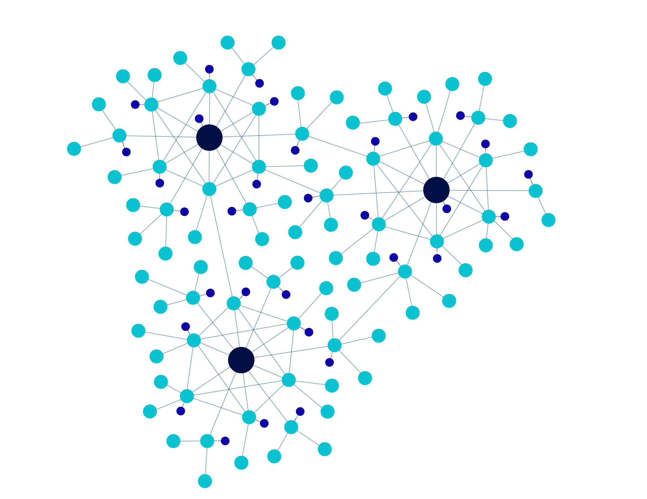
Zero-Infrastructure AMI
AMI | ADVANCED METERING
Cellular-Mesh

Slide 25
Zero-Infrastructure AMI
AMI | ADVANCED METERING
Cellular Meter Placement
RF-Mesh Meter Placement

Slide 26
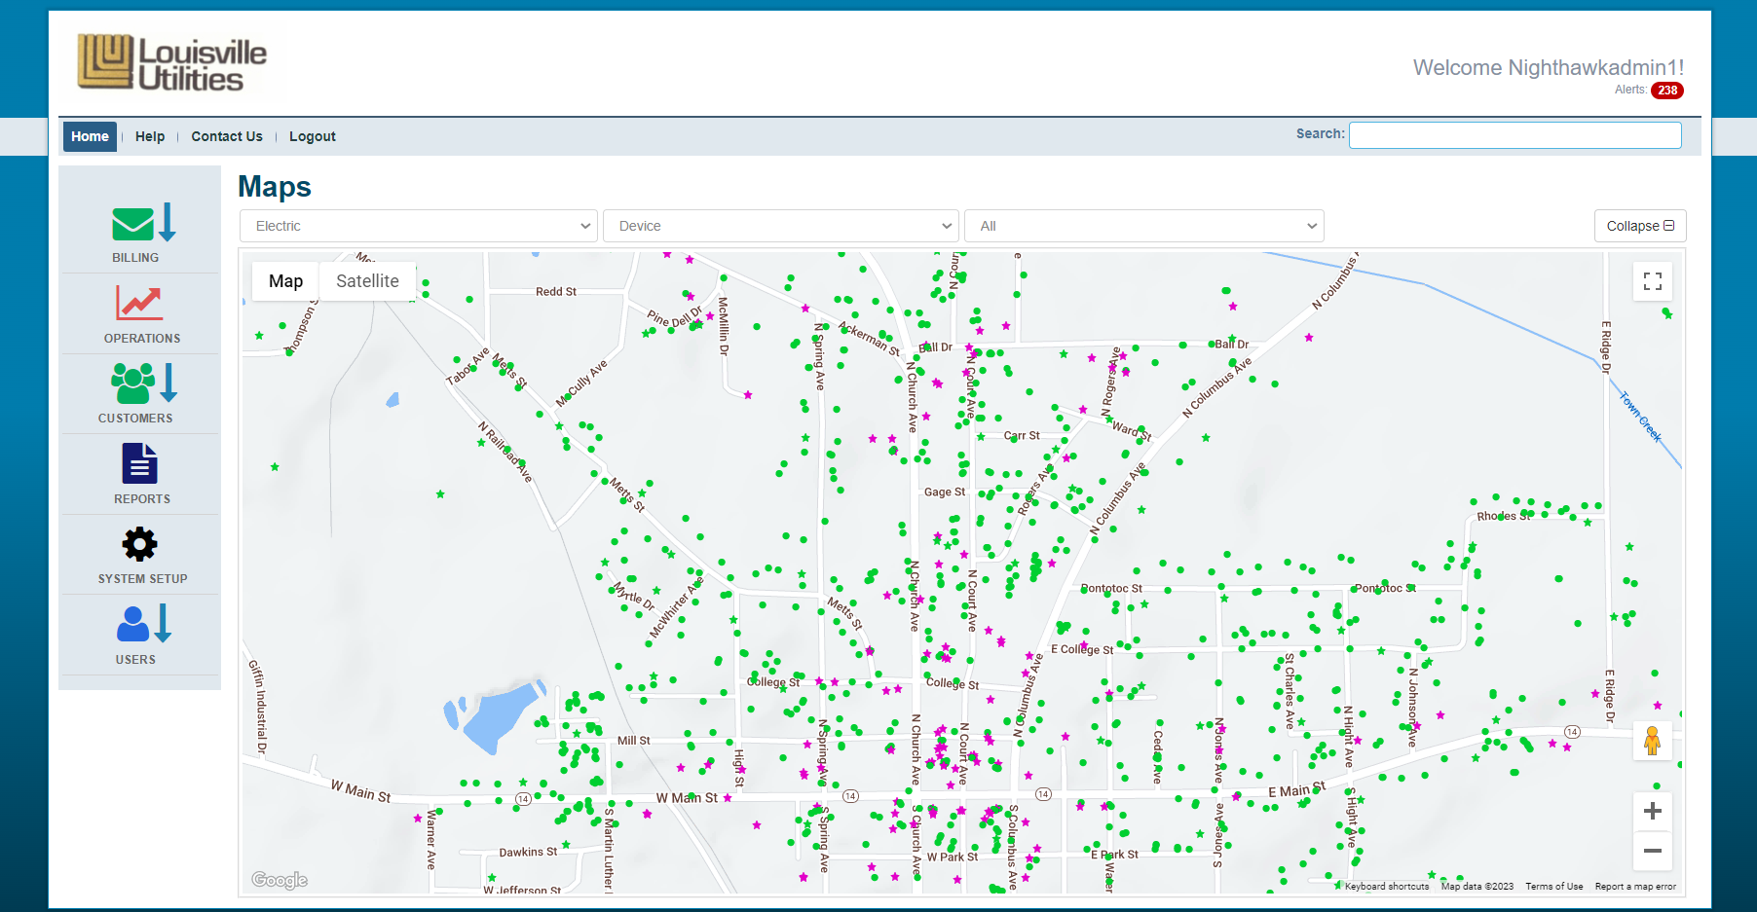
Zero-Infrastructure AMI
AMI | ADVANCED METERING

Slide 27
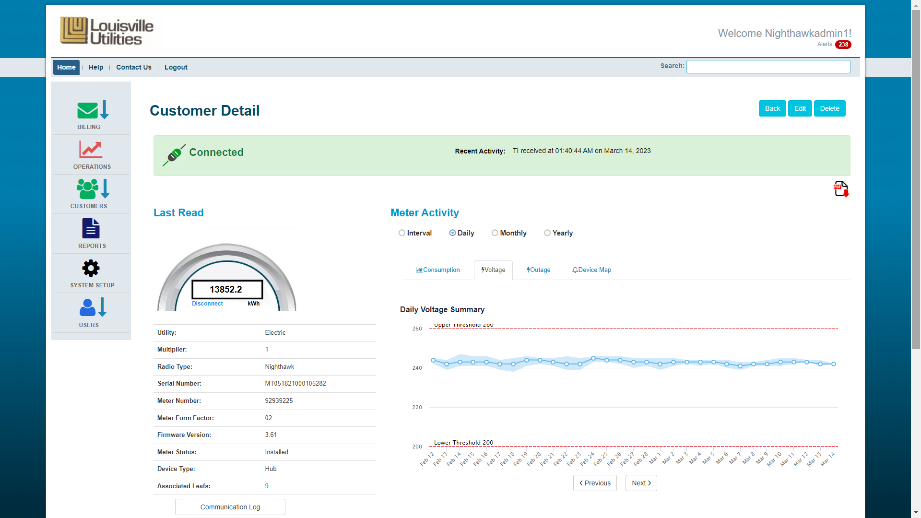
Zero-Infrastructure AMI

Slide 28
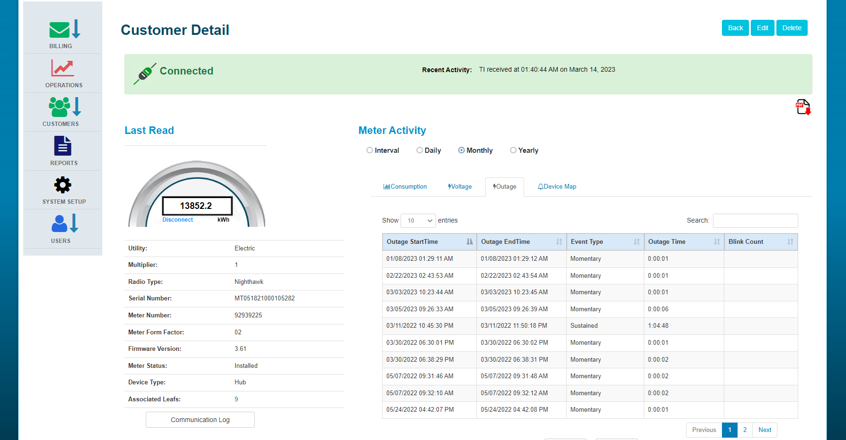
Zero-Infrastructure AMI

Slide 29
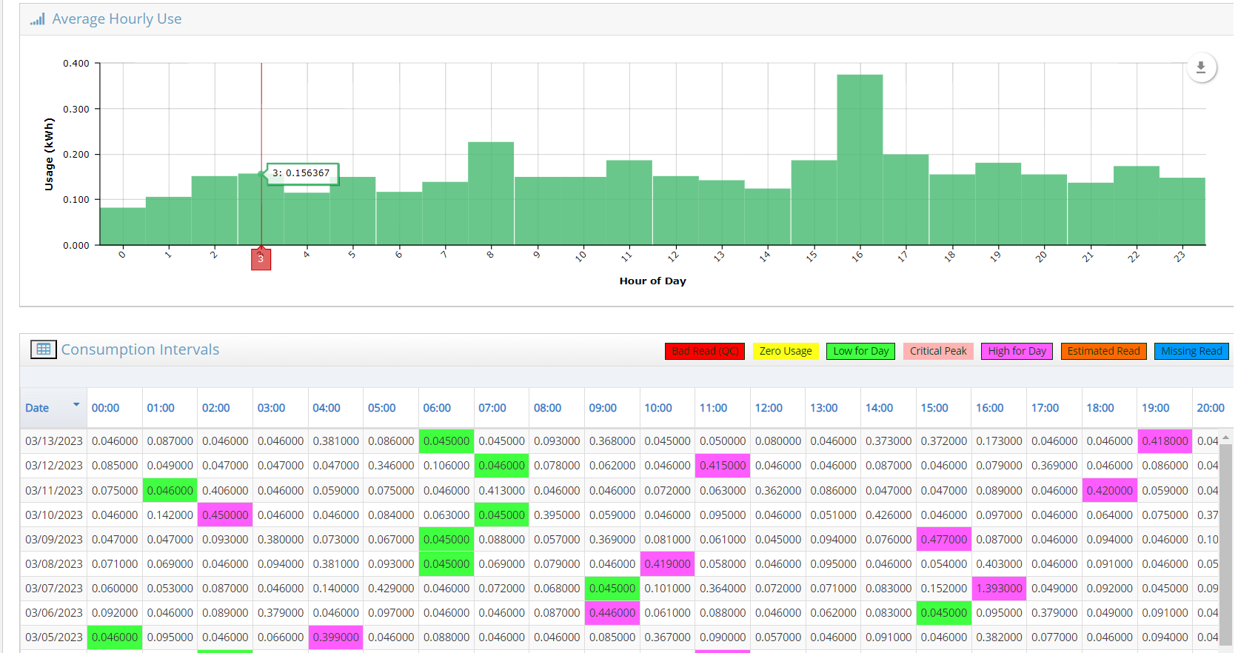
Zero-Infrastructure AMI

Slide 30
Zero-Infrastructure AMI
AMI | ADVANCED METERING
Case Study – Full AMI
Louisville Utilities, MS
Outcome:
Electric 80% deployed
Water 10% deployed
10-30 seconds for on-demand reads, disconnects, demand resets, etc.
Nothing to maintain beyond the meters (zero-infrastructure)
Standard AMI benefits
Preventing truck rolls
Outage/voltage reporting
Remote reading/disconnect
Etc.

Slide 31
Zero-Infrastructure AMI
AMI | ADVANCED METERING
Case Study – Full AMI
Louisville Utilities, MS
Challenges/Lessons Learned:
Older water meter registers hindering retrofit
Meter lead times jumping from 3-4 weeks to 6-8 weeks

Slide 32
Zero-Infrastructure AMI
AMI | ADVANCED METERING
Case Study – Full AMI
Louisville Utilities, MS
What’s next:
Leveraging MDM for AMI commands (deeper integration)
Using AMI data and CSA MDM for transformer loading, line/water loss recovery and other advanced analytical applications

Slide 33
Zero-Infrastructure AMI
AMI | ADVANCED METERING
Case Study – Tactical/Targeted Deployment
Lexington, NC
Problem/Need:
Targeted remote disconnect solution for electric system
Needed to be read by existing drive-by AMR setup
Flexibility to deploy anywhere without infrastructure build-out

Slide 34
Zero-Infrastructure AMI
AMI | ADVANCED METERING
Case Study – Tactical/Targeted Deployment
Lexington, NC
Solution:
100% LTE cellular under-glass solution w/ ERT transmit
AMI headend for remote disconnect (single and batch), outage, voltage and additional command/visualization options

Slide 35
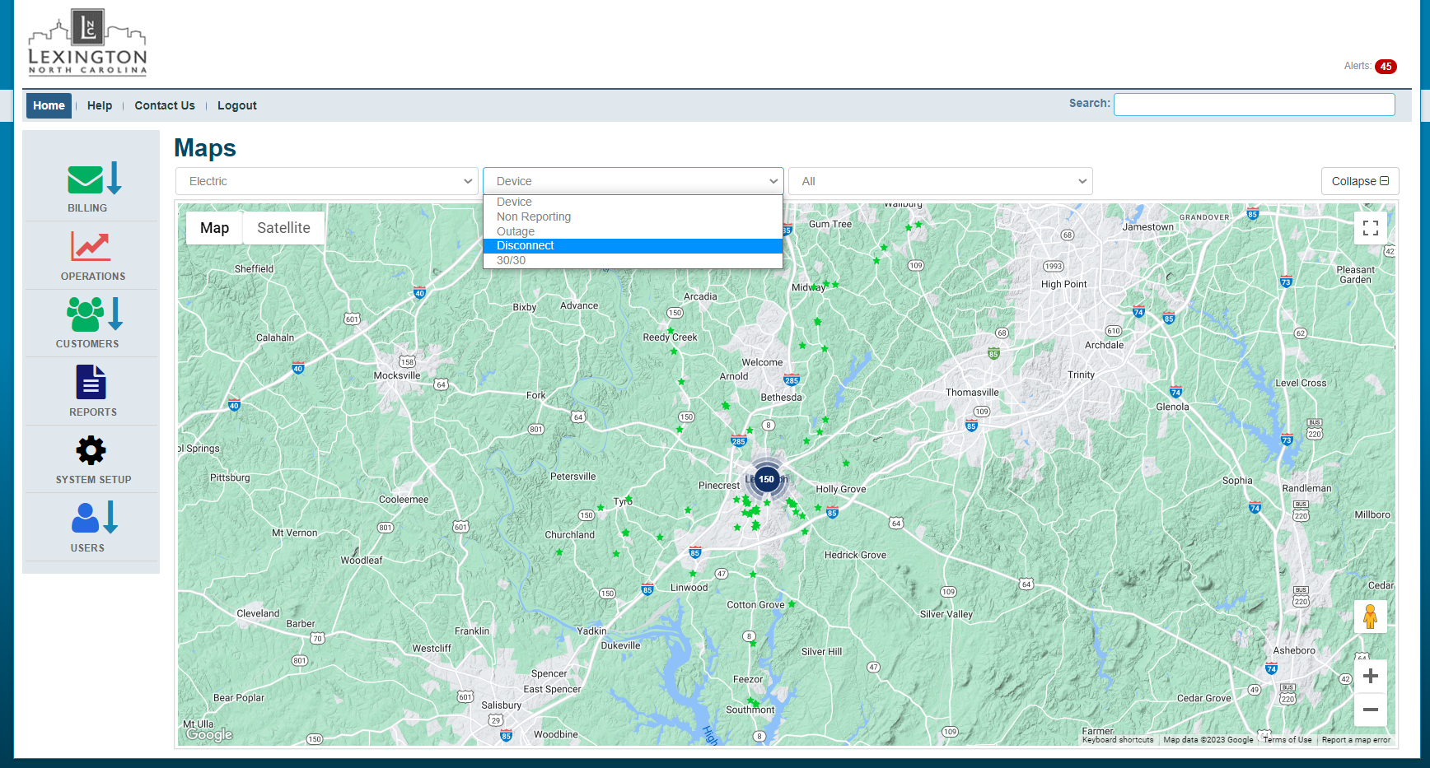
Zero-Infrastructure AMI
AMI | ADVANCED METERING

Slide 36
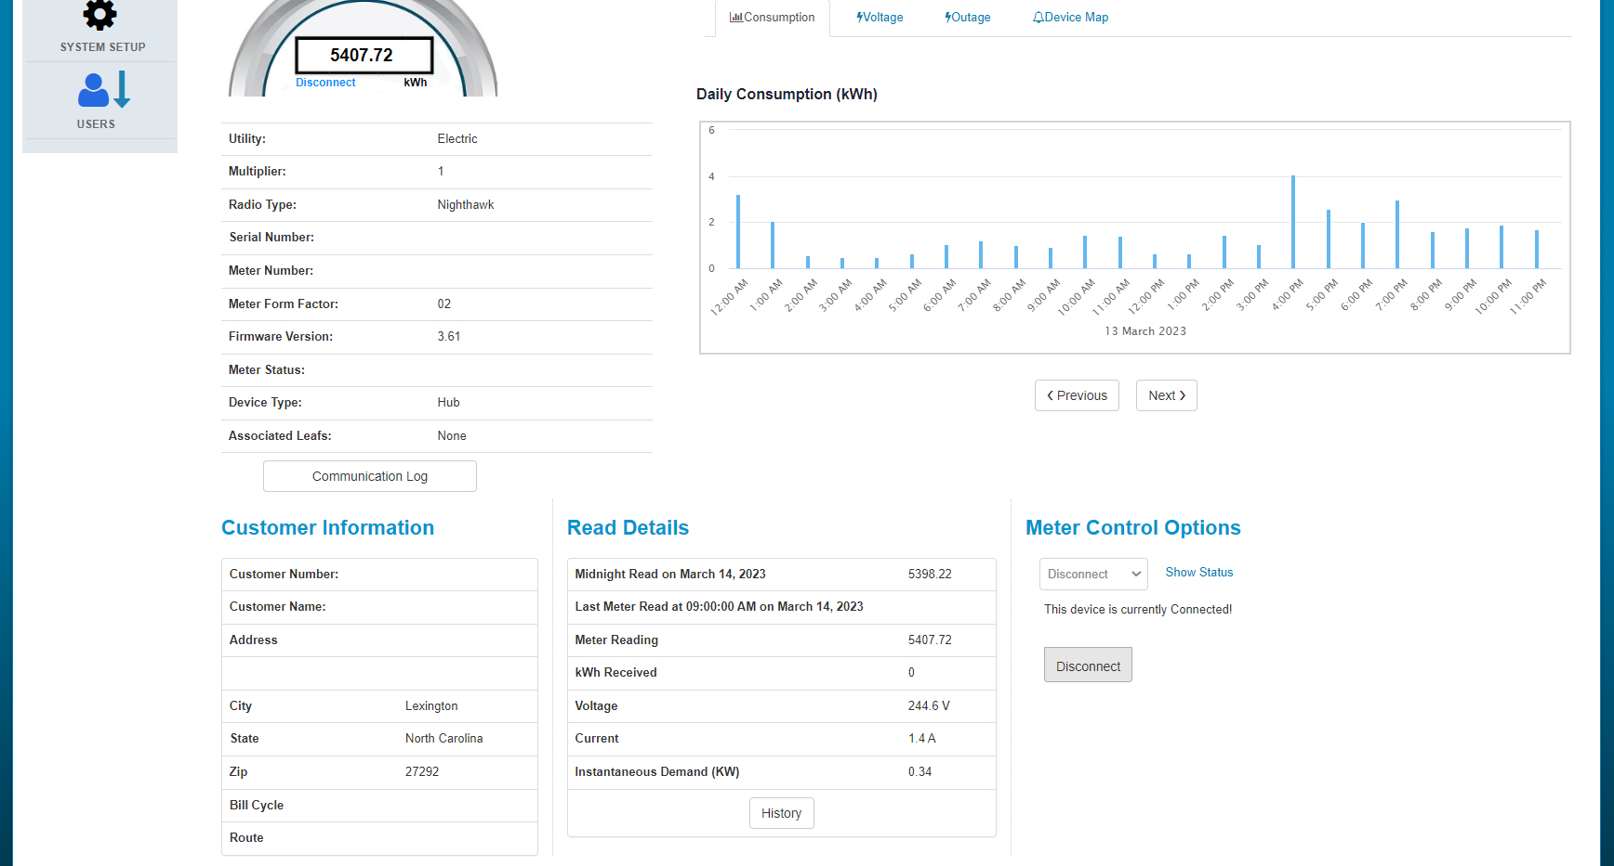
Zero-Infrastructure AMI
AMI | ADVANCED METERING

Slide 37
Zero-Infrastructure AMI
AMI | ADVANCED METERING
Case Study – Tactical/Targeted Deployment
Lexington, NC
Outcome:
Reliable, scalable and flexible disconnect solution for electric system
Integrates with existing drive-by AMR setup
Maximized AMR investment

Slide 38
Zero-Infrastructure AMI
AMI | ADVANCED METERING
Case Study – Tactical/Targeted Deployment
Lexington, NC
Challenges/Lessons Learned:
Transition from CDMA to LTE

Slide 39
Zero-Infrastructure AMI
AMI | ADVANCED METERING
Case Study – Tactical/Targeted Deployment
Lexington, NC
What’s next?:
Existing system can transition to Cellular-Mesh hybrid system if desired
Electric system can act as the communication scaffolding for water and/or gas

Slide 40
Zero-Infrastructure AMI
AMI | ADVANCED METERING
Case Study – Program Specific Application
Electric Cities of Georgia, GA
Contact:
Brian Jaynes, Vice President, Engineering
Electric Cities of Georgia (ECG) is a non-profit organization providing strategic and technical services to 52 public power communities with utility operations.
Program: Customer Choice

Slide 41
Zero-Infrastructure AMI
AMI | ADVANCED METERING
Case Study – Program Specific Application
Electric Cities of Georgia (ECG), GA
Program: Customer Choice – Georgia PSC
Any provider (IOU, Co-op, Municipal) can bid on customer projects typically 900kW and greater
Crypto-mining facilities ~50% - hourly market rates
Warehouses, Movie Studios, etc.
ECG will work with providers on project bids, rate design, and metering, reading, and billing if needed
Typically medium to small utilities
ECG is able to handle the complicated rates/ interval data needed for incentive rates.

Slide 42
Zero-Infrastructure AMI
AMI | ADVANCED METERING
Case Study – Program Specific Application
Electric Cities of Georgia (ECG), GA
Problem/Need:
Resource constraints
Needed an easily maintainable, under-glass solution
Wanted all infrastructure in meter to simplify deployment
No need for a cabinet or power source for external modem/ components
Cost effectiveness upfront and ongoing a factor
Software/Hardware needed to provide interval data (hourly and sub hourly)

Slide 43
Zero-Infrastructure AMI
AMI | ADVANCED METERING
Case Study – Program Specific Application
Electric Cities of Georgia (ECG), GA
Solution:
Evaluated several solutions
Laden with cumbersome communications (dial-up)
Not cost effectively scalable
Lacked the configuration flexibility to meet the ECG’s specific needs
Chose a solution that offers a 100% LTE under-glass option
Vendor handles all communication contracts
Majority of locations use a 9S/20 kV2c.
Headend Software is a scalable AMI dashboard that allows ECG to remotely read and monitor meters across the state of Georgia
Software exports a file that is used by ECG for customer billing

Slide 44
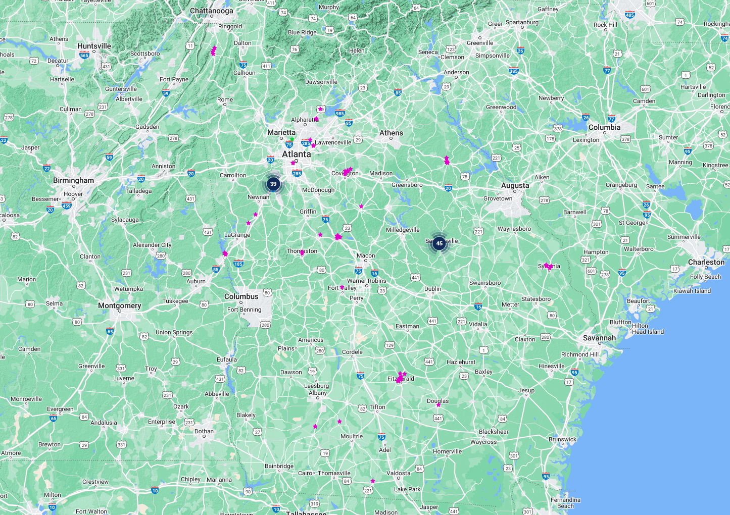
Zero-Infrastructure AMI
AMI | ADVANCED METERING

Slide 45
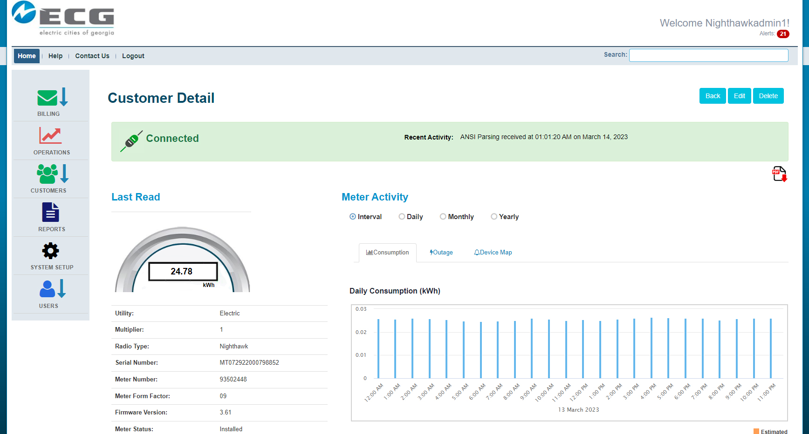
Zero-Infrastructure AMI
AMI | ADVANCED METERING

Slide 46
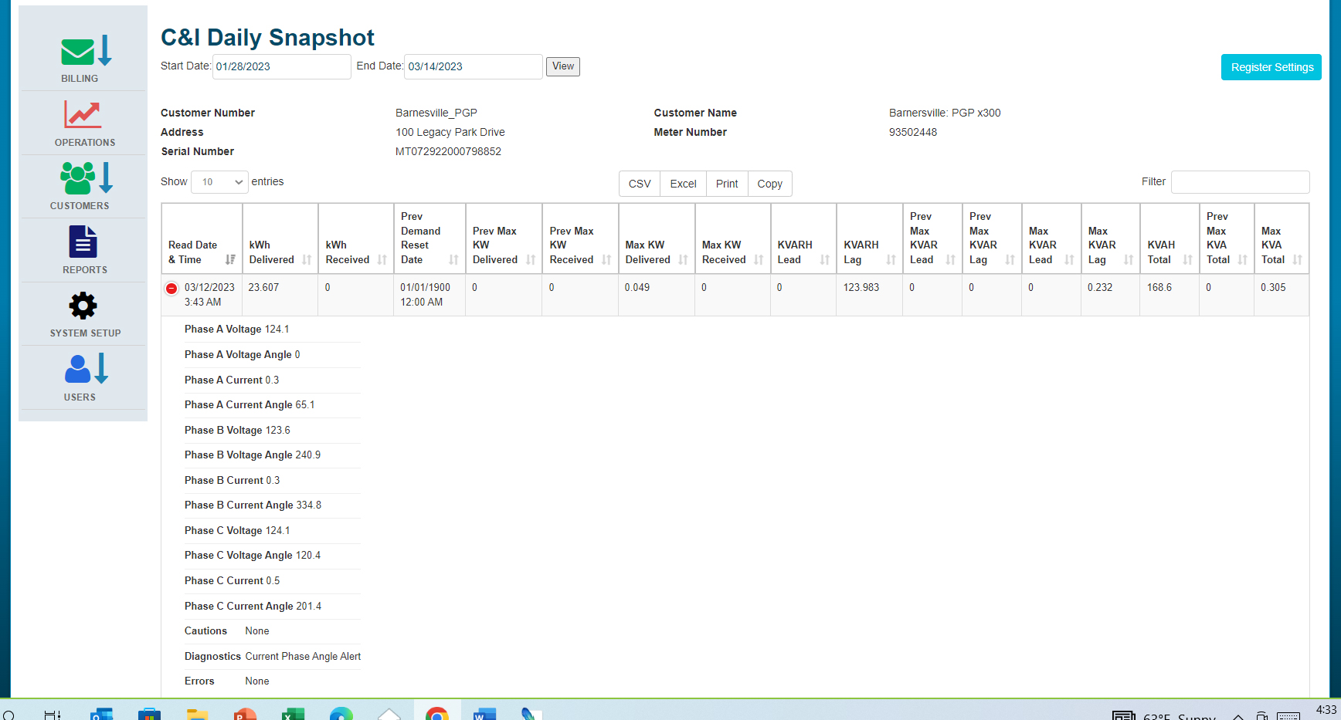
Zero-Infrastructure AMI
AMI | ADVANCED METERING

Slide 47
Zero-Infrastructure AMI
AMI | ADVANCED METERING
Case Study – Program Specific Application
Electric Cities of Georgia (ECG), GA
Outcome:
Grown from 7 initial meters/locations to close to 200 (and growing)
System that’s both easy to deploy, operate and maintain
Can easily access needed hourly and sub-hourly interval meter data
Can see almost instantly if locations are mis-wired from system dashboard
Speeds up troubleshooting / system roll out

Slide 48
Zero-Infrastructure AMI
AMI | ADVANCED METERING
Case Study – Program Specific Application
Electric Cities of Georgia (ECG), GA
Challenges/Lessons Learned:
Tracking meter inventory
Deployment process training

Slide 49
Zero-Infrastructure AMI
AMI | ADVANCED METERING
Case Study – Program Specific Application
Electric Cities of Georgia (ECG), GA
What’s next? :
Bi-directional/Solar metering for providers
Using same headend software - residential and polyphase

Slide 50
Questions?
Jon Scott (404) 451-8444
jon.scott@tescometering.com

Slide 51
Tesco hospitality suite
We would like you to join us in the TESCO Hospitality Suite for networking and more discussions about metering. The discussion will not be exclusively metering……….but we love metering and that is the most common topic.
TESCO Hospitality Suite – Brighton Tower
Monday and Tuesday 8:00 PM – 10:00 PM

