Slide 1
New Power Definitions ANSI C12.31
Prepared by Perry Lawton, TESCO
TESCO Metering
For North Carolina Meter School
Tuesday, June 13, 8:45 AM

Slide 2
Agenda
What is ANSI and why do I care?
What is ANSI 12.31 all about?
Participants
Definitions
Contents

Slide 3
What Is ANSI C12.31 and Why Do I Care?
Waveforms have never been in ANSI before.
You never see nice waveforms and sine waves in the field; you always see harmonics. AC and DC always have cross-signal presence.
If you take a complex metering site (light-rail system, e.g.)
World isn’t perfect – utilities and manufacturers have now agreed that here are some waveforms that represent the host of different conditions you would experience in the real world to express the reality

Slide 4
What is ANSI? ANSI C12?

Slide 5
ANSI
American National Standard Institute, Inc.
Not a government agency
Standards do not have force of Law
All compliance is voluntary
ANSI generates standards through the use of a sponsoring organization called the “secretariat” who actually publishes the Standard.
For C12.1 NEMA (National Electrical Manufacturer’s Association) is the secretariat.
NEMA has seven sections one of which is for Utility Products and Systems. All meter manufacturer’s and manufacturer’s involved in electric metering are members of NEMA or are eligible to be members.
Paul Orr has been the NEMA’s secretary assigned to C12 for over ten years providing continuity to the process. NEMA Manufacturing members determine which efforts will be funded and which will not be funded.

Slide 6
ANSI (cont.)
American National Standard Institute, Inc.
NEMA organizes committees to propose and review standards
Standards are republished approximately every five (5) years and abandoned if not updated or reaffirmed once every ten (10) years.
Standards codify consensus approaches in common practice
In recent years the ANSI committee has had to deal with breaking new ground as well as several controversial issues
This is unusual for the committee and the committee has responded by no longer being reluctant to address them, staying more on point during contentious debates, and moving through the work required in a far more efficient manner. Another example of how AMI is changing everything in our industry.

Slide 7
ANSI C12
All ANSI Standards related to Electric Metering are in the ANSI C12 group of Standards
C12 Main Committee
General makeup has expanded slightly over last few years
30 voting members with representation from three groups (no one group can have more than 40%):
12 - Manufacturers: Meter, Socket, Test Equipment, etc.
10 - Users: Utilities
8 - General Interest: PUC, UL, IEEE, Consultants, etc.
Meets twice a year in conjunction with EEI/AEIC Meter conference.

Slide 8
ANSI C12 (cont.)
C12 Main Committee
Has final approval for all activities on any C12 family standard
Establishes Subcommittees (SC) and Working Groups (WG) to address various standards and issues
Sub committees and Working Groups also meet twice a year in conjunction with EEI Transmission, Distribution and Metering Conference and also hold regular or ad hoc conference calls throughout the year as members put together drafts and other technical material for consideration at the next face to face meeting.

Slide 9
ANSI C12 (cont.)
C12 Subcommittees
Various subcommittees have been organized to review specific standards
This is where the work is really done
Each operates slightly differently
Each meets on a schedule of its own choosing
Most meet at EEI Biannual Transmission, Distribution and Metering Meetings
Communication WG meets more often and longer
Various subgroups meet frequently by teleconference

Slide 10
ANSI C12.31 for Electricity Meters— Measurement of AC Power, Energy and Power Factor

Slide 11
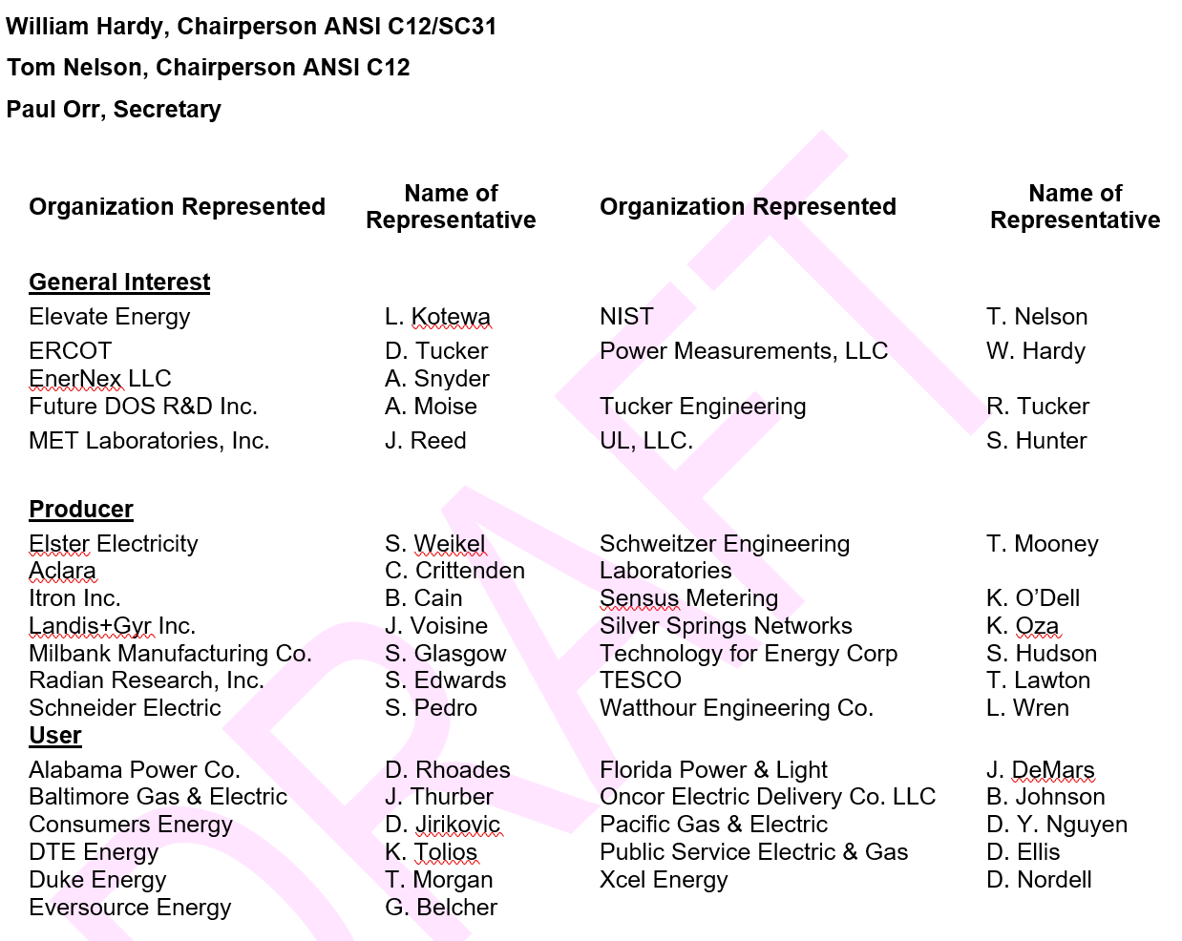
ANSI C12.31 – Who’s in it

Slide 12
ANSI C12.31 – Interpreting it
Defines AC electrical power (active, reactive and apparent), AC electrical energy (active, reactive and apparent) and power factor in terms of sampled voltage and current measurements.
The definitions are provided to facilitate uniform comparison of the power, energy and power factor measurement values reported by electricity meters in comparison to equipment used as reference standards that implement these definitions for the determination of meter accuracy in the time domain and frequency domain.
In the limit of “perfect implementation” the answers given by the time domain and frequency domain formulas should give the same answers within the claimed uncertainty limits.

Slide 13
ANSI C12.31 – Interpreting it
Previous ANSI C12 Standards have only defined the value for VA when the waveforms for current and voltage were sinusoidal.
Since in the modern world this is seldom the case outside of the laboratory, this standard is a first step to bring definitions and testing more in line with the contemporary load environment.
The purpose of this document is to define a standard value that can be computed from a set of simultaneous samples of voltages and currents. The exact computational method to be used is not prescribed, only that the resultant value from whatever calculational method is employed must get the same result as defined by this standard.

Slide 14
C12.31 – What’s in it
General definitions
Single phase, single cycle equations
Quadrant-based definitions
Measurements for greater than one cycle
Polyphase definitions
Annex of informational examples and diagrams

Slide 15
General Definitions
4.2.1 - Sampled Waveform
Reduction of the continuous-time waveform to a set of discrete, evenly spaced amplitude values
4.2.2 - Sampling Rate (R)
The constant rate, in samples per second, at which the discrete measurements of a signal are made.
4.2.3 - Integration Period
The integration period is defined as precisely one cycle of the fundamental of the reference voltage waveform.
4.2.4 - Test Interval
The total time of a measurement used in the performance of a test. The test interval may include both whole and fractional cycles.
4.2.5 - Waveform Representation
For the purpose of this standard, voltage and current waveforms are represented as either a set of data points taken at a constant sample rate, or as a Fourier series as detailed in 4.2.5.1
Notes:
Sine wave – energy is area under the curve. Each meter manufacturer defined a different way of doing it. This defines acceptable methodologies for the modeling of these real-world anomalies or special waveforms.

Slide 16
General Definitions (cont)
4.2.5.1 – Fourier Sequence
These equations can represent any waveform over a single cycle.
The coefficients a_{n} and b_{n,} c_{n} and d_{n} and ω₀ can vary cycle to cycle.
When these coefficients (a_{n}, b_{n,} c_{n} and d_{n)} are used in calculations, it shall be understood that they are calculated based on a single cycle starting at $t=t_{0}$ and ending at $t=t_{0}+T_{0}$.
Note: Generally, Fourier analysis is applied to a data stream containing many cycles that are identical. However, here we apply the technique to a single cycle.
For the purpose of this standard, $t=t_{0}$shall be the positive going zero crossing of the fundamental of the phase A voltage.
Eq. 4.2.5.1.1 $v\left(t\right)=\frac{a_{0}}{2}+\sum_{n=1}^{n=∞}{\left(a_{n}\cos{(}nω_{0}t)+b_{n}\sin{(}nω_{0}t)\right)}$
Eq. 4.2.5.1.2 $i\left(t\right)=\frac{c_{0}}{2}+\sum_{n=1}^{n=∞}{\left(c_{n}\cos{(}nω_{0}t)+d_{n}\sin{(}nω_{0}t)\right)}$
Notes:
Note: $θ_{n}$ is positive when the current LEADS the voltage and negative when the current LAGS the voltage. This choice of sign preserves the normal Cartesian right-handed coordinate system such as the convention that positive angles are measured counterclockwise from the x-axis. It also preserves the normal way in which we draw phasor diagrams as is discussed in Annex D.

Slide 17
Single Phase, Single Cycle
ANSI C12.31 defines single phase, single cycle equations.
Acknowledges that the equations in the standard are computed cycle to cycle, while in the real world, they can the actual period may vary cycle to cycle.

Slide 18
Quadrant-based Definitions
For some applications it may be desirable to separate power and energy quantities into bins based on the flow direction, delivered (imported) and received (exported), of active and reactive energy.
Provides consensus framework for doing so

Slide 19
Measurement of >1 Cycle
When the measurement period is an integer number of cycles, then the result is computed either as the weighted average or sum (depending on the quantity) of the individual cycles.
For multiple cycle intervals the beginning of one cycle is coincident in time with the end of the previous cycle.
Defines integer number of cycles, and arbitrary time intervals

Slide 20
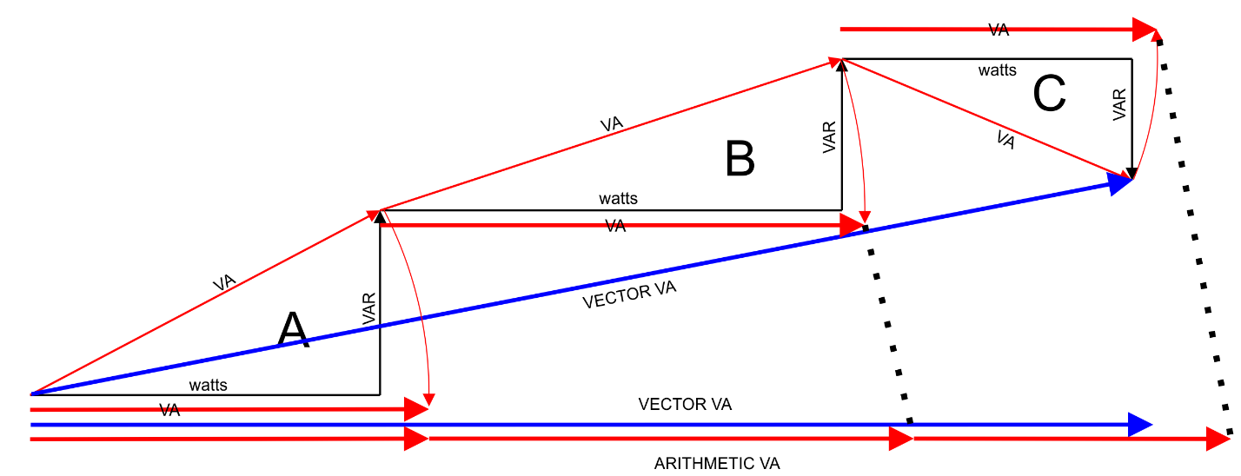
Polyphase Definitions
Establishes consensus definitions for Polyphase Notation, Polyphase Energy, and Polyphase Power Factor.
Example of Figure 8.2.1.2, vector apparent energy

Slide 21
ANSI C12.31 – What’s it do?
ANSI C12.31 provides a legitimate framework and establishes consensus for key definitions required for:
“[…]Uniform comparison of the power, energy and power factor measurement values reported by electricity meters in comparison to equipment used as reference standards that implement these definitions for the determination of meter accuracy in the time domain and frequency domain.”

Slide 22
Questions and Discussion
Perry Lawton
Northeast Regional Sales
Perry.Lawton@tescometering.com
TESCO – The Eastern Specialty Company
Bristol, PA
215-228-0500
This presentation can also be found under Meter Conferences and Schools on the TESCO website: tescometering.com
ISO 9001:2015 Certified Quality Company
ISO 17025:2017 Accredited Laboratory

Slide 23
Tesco hospitality suite
We would like you to join us in the TESCO Hospitality Suite for networking and more discussions about metering. The discussion will not be exclusively metering……….but we love metering and that is the most common topic.
TESCO Hospitality Suite – Brighton Tower
Monday and Tuesday 8:00 PM – 10:00 PM

Slide 24
Definitions
ANSI C12.24 TR:2022 Definitions for Calculations of VA, Vah, VAR, and VARh for Poly-Phase Electricity Meters
t Time,
t₀ Starting point in time for a single cycle calculation, in this standard the positive going zero crossing of the fundamental of the phase A voltage
T₀ Period of the cycle starting at t₀ ‡
$v\left(t\right)$ Instantaneous value of the voltage at time t
$v_{i}$ Sampled instantaneous voltage (see note 2)
N The number of samples taken during a single cycle of the reference voltage waveform
V Root mean square voltage measured over a single cycle ‡
V_{n} Root mean square amplitude of the n^{th} harmonic of the voltage
$i\left(t\right)$ Instantaneous value of the current at time t
$i_{i}$ Sampled instantaneous current (see note 2)
I Root mean square current measured over a single cycle ‡ of the voltage waveform
I_{n} Root mean square amplitude of the nth harmonic of the current
$p\left(t\right)$ Instantaneous active power
P Active power computed over a single cycle ‡ of the voltage
P₁ Fundamental only component of the active power computed over a single cycle ‡ of the voltage
$E_{a}$ Active energy computed over a single cycle ‡ of the voltage
$E_{a1}$ Fundamental only component of the active energy computed over a single cycle ‡ of the voltage
$Q$ Reactive power computed over a single cycle ‡ of the voltage
$Q_{1}$ Fundamental only component of the reactive power computed over a single cycle ‡ of the voltage
$E_{r}$ Reactive energy computed over a single cycle ‡ of the voltage
$E_{r1}$ Fundamental only component of the reactive energy computed over a single cycle ‡ of the voltage
$S$ Apparent power computed over a single cycle ‡ of the voltage
$S_{1}$ Fundamental only component of the apparent power computed over a single cycle ‡ of the voltage
$E_{s}$ Apparent energy computed over a single cycle ‡ of the voltage
$E_{s1}$ Fundamental only component of the apparent energy computed over a single cycle ‡ of the voltage
= Used where a definition is based on continuous variables
≈ Used when a definition is based on sampled data (time or frequency domain), implies equality in the limit of sufficiently high sampling rate
‡ Note 1: In this document single cycle means one period (T₀) of the fundamental of the reference voltage waveform. In polyphase systems it means one period of the reference phase voltage (typically phase A) waveform. In the equations in this standard the integration is shown as starting at a time $t=t_{0}$ and ending at

