Slide 1
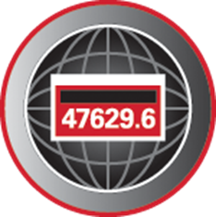
History of Electric Metering
Prepared by Tom Lawton, TESCO
TESCO Metering
North Carolina Meter School
Polyphase Track
Monday June 12, 2023
2:45 PM

Slide 2
Abstract
Circa 1870 - Prior to the Watt-Hour Meter
Early Metering luminaries
Like today – a small metering community
Elihu Thomson
Thomas Edison
George Westinghouse
Oliver B. Shallenberger
Robert C. Lanphier
Thomas Duncan
AC versus DC (battle of the currents)
Meter Manufacturers
The Watt-Hour Meter
How Metering Has Changed
Metering Today

Slide 3
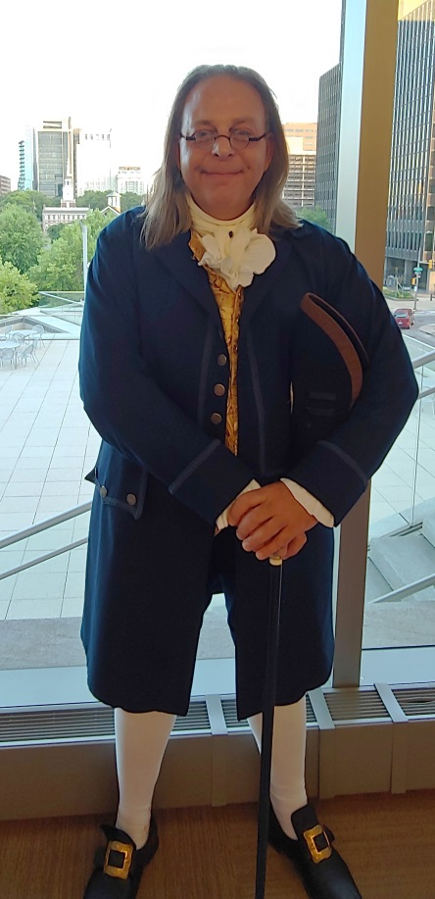
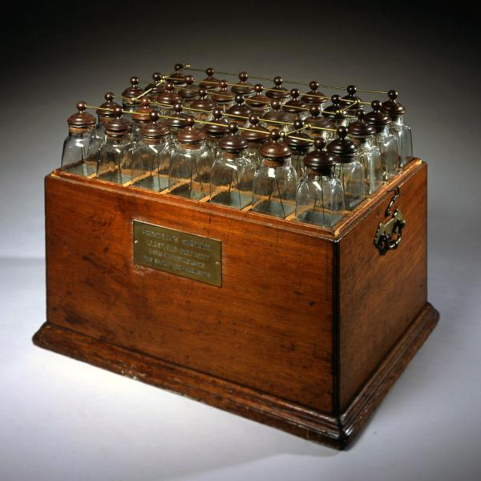
Franklin’s Electric “Battery” circa 1760
Actually his “battery” was actually a collection of Leyden jars which were an early capacitor
Franklin called them a battery, using the military term for weapons functioning together.
Using this he designed an electric motor that could move at 12 to 15 rpm’s and thought this would be perfect for powering a rotisserie.
Ben Franklin’s “Battery,” on display at the American Philosophical Society, Philadelphia, PA
Ben Franklin at TESCO’s Users Group with Independence Hall in the background, Philadelphia, PA

Slide 4
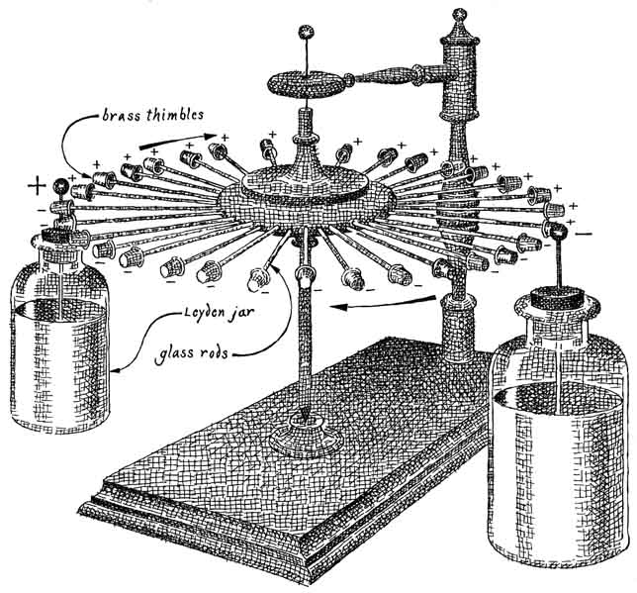
Voltaic Piles and Electric Motors
Franklin felt that his electric motor was not powerful enough to compete with water wheels or steam engines that were just coming on the scene.
The publication where he introduced this concept was eagerly seized upon by the world and cemented Franklin’s International reputation. But not for the battery . For the lightening rod.
In 1799 the Italian Alessandro Volta invented the first actual battery which were initially called “piles”.

Slide 5
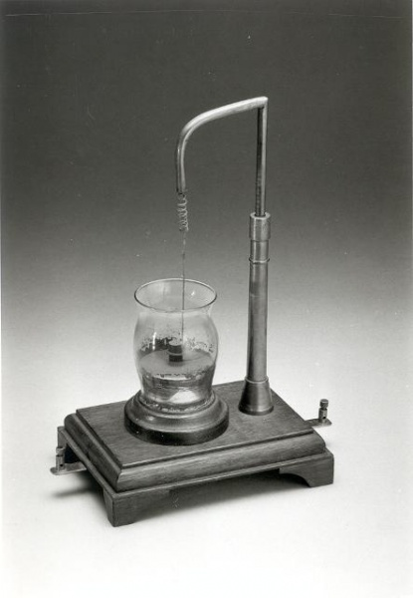
Michael Faraday
By 1831 British Physicist Michael Faraday discovers the principle of electromagnetism and goes on to discover electromagnetic induction and hydroelectricity among other things.
By 1832 he builds the first electric motor, the first generator and the first transformer

Slide 6
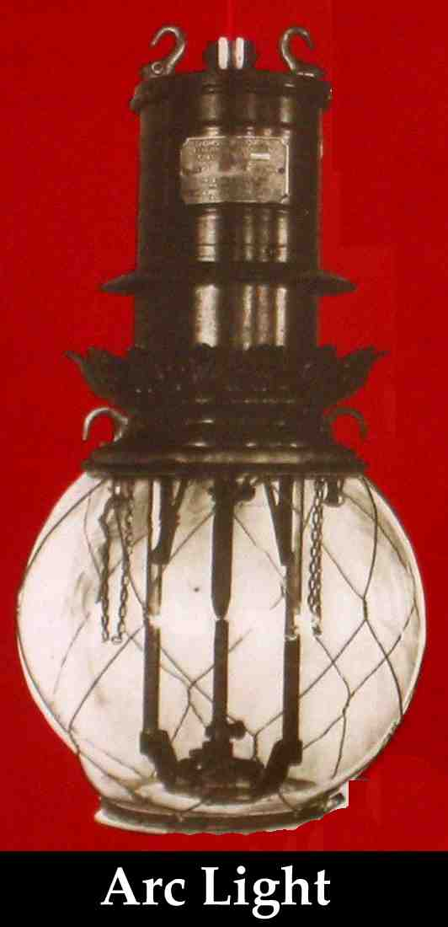
Electric Arc Lamp Invented 1802
Arc lamps were not practical because there was no constant and reliable supply of electricity
Dynamos’s to supply electricity were developed in the 1830’s, improved in the 1850’s and in commercial use in Europe in the 1870’s.
Practical dynamos powering arc lamps were demonstrated by Charles F. Brush in 1870’s
Brush established Brush Electric Company in 1880 to provide arc lighting. Brush was lighting Broadway two years before Edison started the Pearl Street Generating Station in New York City

Slide 7
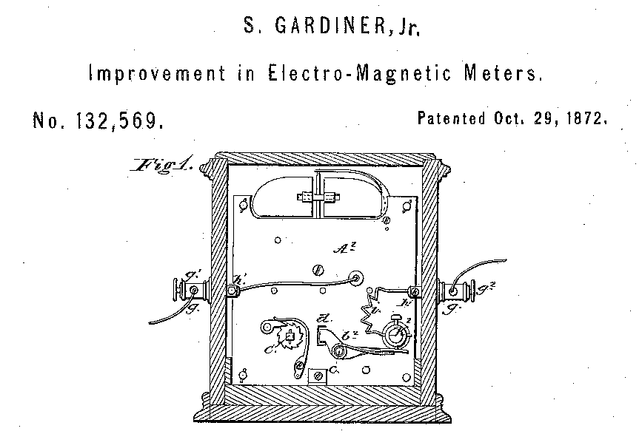
First Meters
1872 - Samuel Gardiner takes out the first known patent on an electric meter. This was a DC lamp-hour meter that was a clock with an electromagnet that started and stopped the mechanism.
1878 - J.B. Fuller takes out a patent on an AC lamp-hour meter that was a clock operated by an armature that vibrated between two coils.
Image from original patent for Samuel Gardiner’s electric meter.

Slide 8
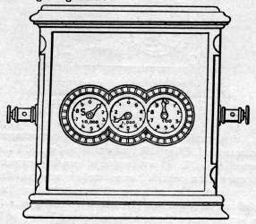
Samuel Gardiner’s Lamp-Hour Meter (1872)
This was one of the earliest meters and the first known model to be patented. It was used with the earliest DC arc-lamp systems and only measured the time energy was supplied to the load as all the lamps connected to this meter were controlled by one switch. The internal workings were nothing more than a clock that was started and stopped by a electromagnet that was connected in series with the load.
Once lights could be independently turned off and on, this type of flat rate metering became obsolete and a new generation of meters had to be developed. Some of the early innovators were Edison's chemical meter, Shallenberger's ampere-hour meter and the Thomson Recording Wattmeter.

Slide 9
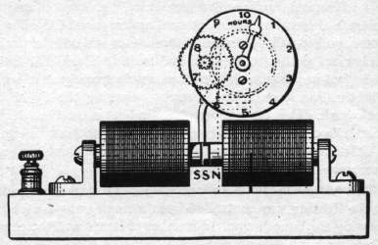
J.B. Fuller’s Lamp-Hour Meter (1878)
This meter was the first known AC meter to be patented, and like the Gardiner DC lamp-hour meter that preceded it, this meter only measured the time energy that was supplied to the load. The meter was simply a clock operated by the alternating fields of the two coils. Lamp-hour meters were soon abandoned as soon as the lines could be sub-divided and customers started adding other electrical appliances and the need arose for meters that measured energy, like Shallenberger’s ampere-hour meter.
One of Jim B. Fuller's assistants was James J. Wood, who would soon become one of the key people at the Ft. Wayne Electric Co.

Slide 10
Flat Rate Billing
Up to the 1870s, electricity had little use beyond the telephone and telegraph. Brush’s arc lamps were connected in series. Since the current was constant and the voltage required for each lamp was known, and all of the lamps were controlled by one switch, it was adequate to measure only the time current that flowed in the circuit (lamp-hours).
Edison’s incandescent lamps provided a softer glow closer to the familiar candle light and he also started with a flat rate tariff that charged by the number of bulbs the user had in service.

Slide 11
…….Until you could not
But the Thomson-Houston Electric Company changed the game again with the development of arc lamps that could be independently turned off. Now we needed a meter. The Thomson-Houston Company was formed in 1883 in Lynn MA when Charles Coffin brought a struggling electric company (the American Electric Company) to town. The Company was led by the former owners and engineers Elihu Thomson and Edwin Houston. Coffin renamed the company for his two engineers.

Slide 12
Incandescent Light Bulb
October 21, 1879 – Thomas Alva Edison “invents” the electric light bulb
Electricity originally used to provide light only
Edison system: Batteries delivered DC directly to user facilities

Slide 13
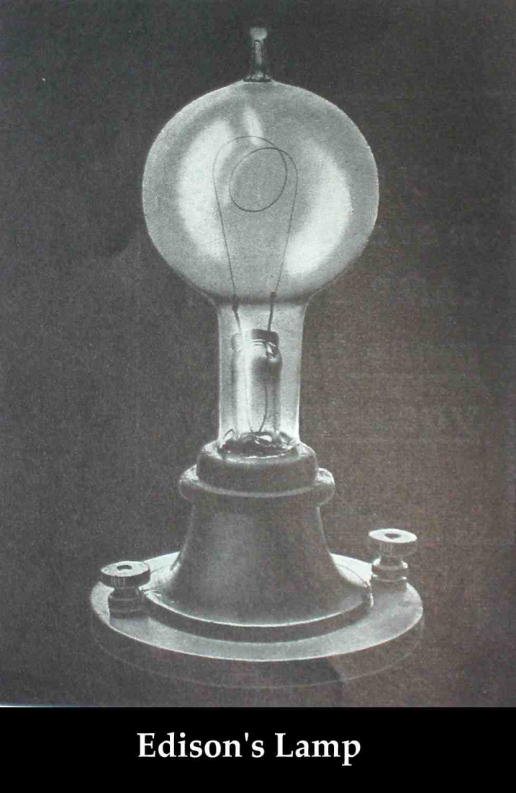
1880: Edison Illuminating Company Formed
September 4, 1882: First central power plant-Pearl Street Station in lower Manhattan
One generator produced power for 800 electric light bulbs.
In 14 months, Pearl Street Station had 508 subscribers and 12,732 bulbs.

Slide 14
First Practical Meters
After the invention of the incandescent lamp by Edison in 1879 and the subdivision of lighting circuits for individual control of the lamps, measuring lamp hours was no longer practical (although this practice continued for arc-lamp street lighting circuits into the 1890’s)
1881 – The Fort Wayne Electric Co. was incorporated to sell a dynamo and arc lamps patented by James Jenney. The company was founded by Ronald T. McDonald who was also the first President.
1882 – Edison starts up his first electric company for incandescent illumination starting first with a per lamp flat rate but then quickly moving to a chemical meter as more items were added to the circuit and lights we capable of being turned on and off.

Slide 15
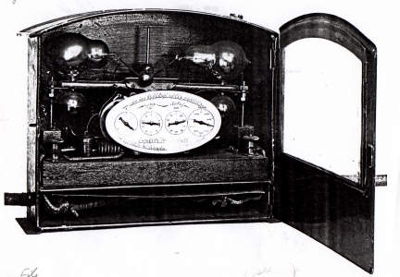
Thomson Walking Beam Meter (1889-1889)
1883 The Thomson-Houston Electric Company was organized in Lynn, MA to manufacture the inventions of Professor Elihu Thomson and Edwin Houston. Charles A Coffin was the President and one of the investors who helped establish the company.
One of their fist developments was the Walking beam meter. This meter was developed by Elihu Thomson and was so complex and delicate that the meter proved of little commercial value. A heating element was connected into the circuit and warmed the lower bottle closest to it. As the alcohol warmed, it evaporated and flowed into the opposite upper bottle. This would upset the balance, shifting the other lower bottle closer to the heater and emptying the upper bottle that was just filled. As the meter rocked, an escapement drove the register which was marked off in lamp-hours.
Thomson learned from this and later developed the far more robust and very successful Thomson Recording Wattmeter.

Slide 16
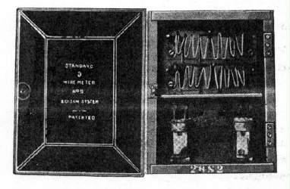
Edison Chemical Meter (1878 to late 1880s)
Edison developed the first meter that measured the amount of electricity instead of how long the circuit was energized. This meter was connected across a shunt in the load and consisted of several jars with zinc plates and a chemical solution. One set of jars was intended for the main reading while the second set was operated off a smaller shunt and was intended for comparison purposes (a primitive check on the meter's accuracy).
The monthly reading was made by removing the plates from the jars and weighing them with a laboratory balance. The change in the plates' weight between readings was a measure of electricity consumption. This meter was very inconvenient to use and in a couple cases mishandling of the plates resulted in large billing errors. Also, as there was no ready way to indicate the usage to the customer, this also made it hard for them to trust its accuracy. These disadvantages and the fact this meter itself had high internal losses made it unpopular enough that these meters were rapidly replaced by more reliable meters in the late 1880's, including the Thomson Recording Wattmeter.

Slide 17
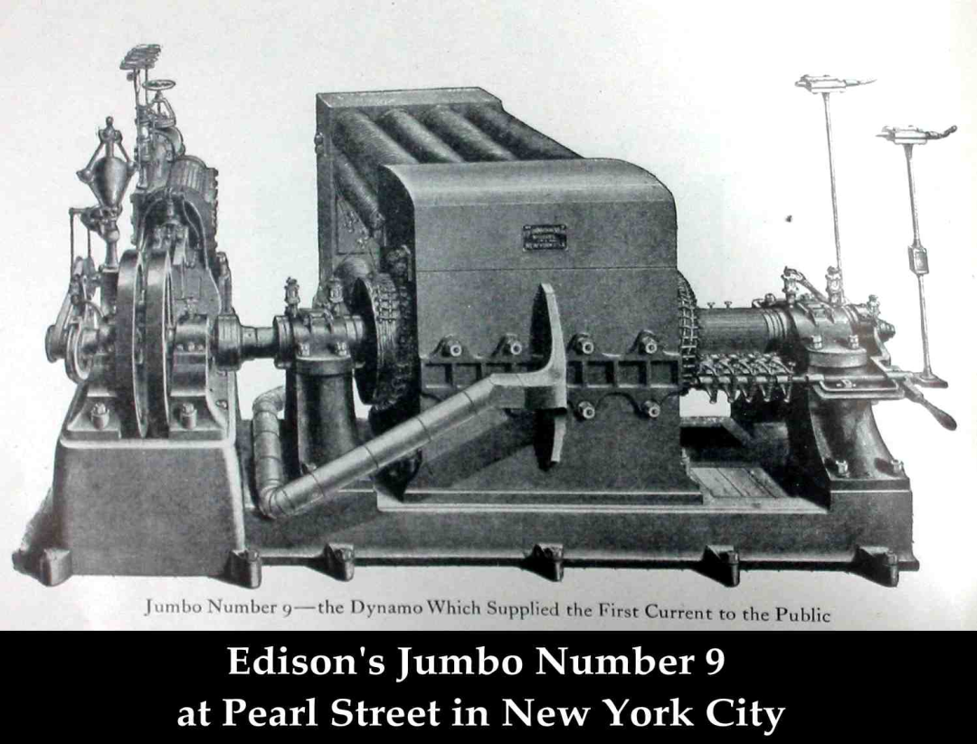
The Problem with Direct Current
High losses required generators to be near the loads – maximum of one mile without huge conductors
Difficult to change voltages for transmission with DC

Slide 18
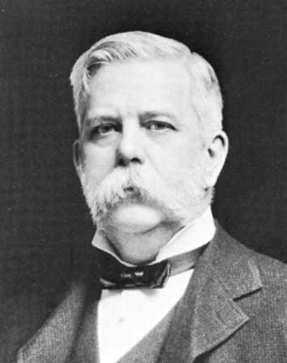
Westinghouse
1884 – George Westinghouse establishes the Union Switch & Signal Co. in Pittsburgh, PA
Buys the U.S. rights to a transformer patented in Europe
The company reorganizes as the Westinghouse Electric and Manufacturing Company
William Stanley joins the company as the chief electrical engineer and Oliver B. Shallenberger resigns as an officer in the U.S. Navy to work under him as the chief electrician.
George Westinghouse

Slide 19
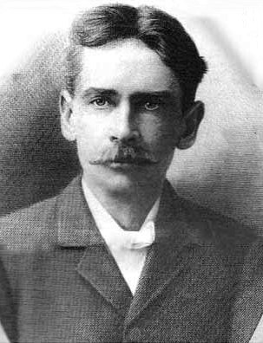
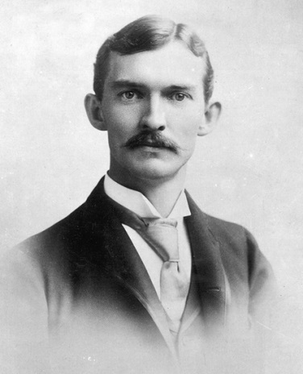
AC Starts to Win
Stanley and Schallenberger: They refine the transformer design and in 1886 Stanley demonstrates the first complete system of high voltage AC transmissions including generators, transformers, and high voltage transmission lines.
AC had none of the issues of DC (voltage drop in long lines and a lack of an easy way to increase or decrease the voltage). However there was no meter that could accurately record the usage of electricity on AC circuits.
William Stanley, Jr.
Oliver Schallenberger

Slide 20
Thomas Edison - 1889
"Fooling around with alternating current is just a waste of time. Nobody will use it, ever."
- Thomas Edison, 1889

Slide 21
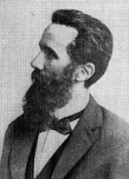
Galileo Ferraris
Tesla in 1882 identified concept of rotating magnetic field
Dr. Ferraris, in 1885, proved that torque could be produced electromagnetically by two alternating-current fluxes, which have a time displacement and a space displacement in the direction of proposed motion.
Dr. Galileo Ferraris

Slide 22
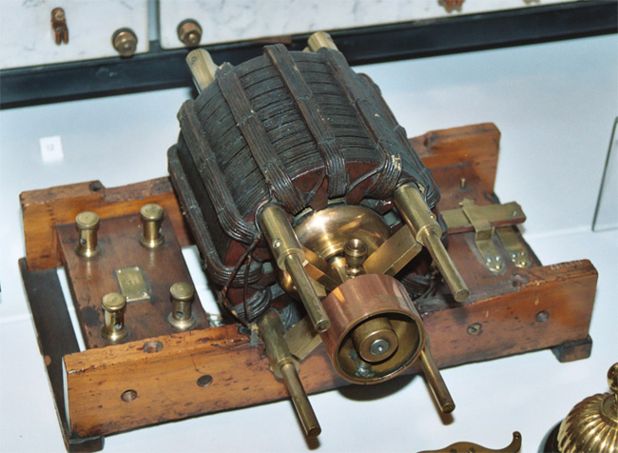
1893 Nikola Tesla Induction Motor Patent
Nikola Tesla takes out a patent covering Ferraris' discovery of the induction motor principle.
There was a brief patent infringement suit, but Tesla was awarded priority. This was just one of Tesla's many patents later purchased by George Westinghouse.
This discovery by Ferraris and patent by Tesla spurs the development of induction-type motors as well as paving the way for the development of the induction-type watthour meter.
One of the original AC Tesla Induction Motors on display in the British Science Museum in London.

Slide 23
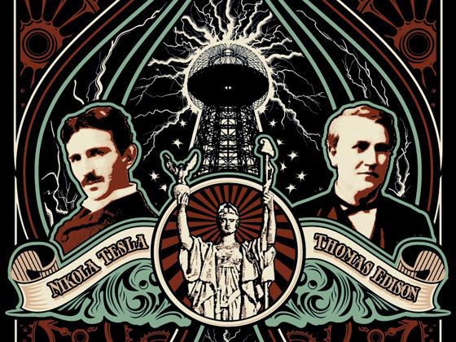
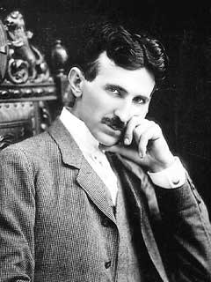
The Battle of the Currents
Edison was a shrewd businessman who wanted to profit from his inventions
Tesla was a brilliant scientist but not a good businessman
Edison took advantage of Tesla’s technical skills without compensating him
Westinghouse treated Tesla with respect and funded his experiments in AC power
Edison lobbied for AC power to be used in executions and then claimed AC was “too dangerous”
Nicola Tesla, "The Wizard of The West"

Slide 24
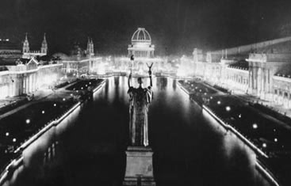
1888: A Young Serb Named Никола Тесла (Nicola Tesla) Meets George Westinghouse
1893: World’s Fair Chicago lighted by Westinghouse / Tesla
1888: Westinghouse, American entrepreneur and engineer meets Tesla
1882: Induction Motor

Slide 25
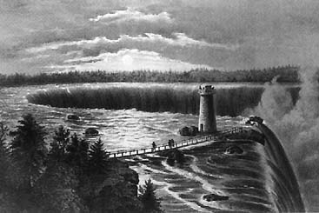
1893: Westinghouse Awarded the Contract for Powerhouse at Niagara Falls
Edward Dean Adams power station at Niagara, with ten 5,000-horsepower Tesla/Westinghouse AC generators — the culmination of Tesla's dream. (Courtesy Smithsonian Institution)

Slide 26
Types of Early Electric Meters
Electrolytic Meters are exclusively ampere-hour meters
Chemical cells measure electricity by change of weight of cell plates
Motor Meters
Typically ampere-hour meters. AC or DC electric motor
Intermittent Registering Meters
Some form of ampere-meter or watt-meter registers the current or power passing into the house
A clock makes periodic readings of the ampere-meter or watt-meter and adds to a mechanical register
Induction Meters – AC only. Predecessors of modern electricity meters

Slide 27
Fort Wayne is Bought Out
In 1888 the Fort Wayne Electric Company needed additional capital to expand. Ronald T. McDonald was a good friend of Charles A. Coffin and the Thomson-Houston company purchased a controlling interest in Fort Wayne (who was making a fairly complex lamp-hour meter at the time).
In 1890, 100 Thomson-Houston electric employees move to Fort Wayne, IN, to work on a new arc-lighting system including Thomas Duncan.

Slide 28
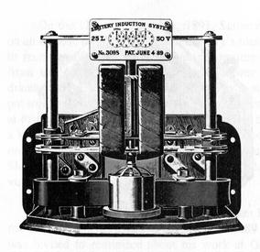
FORT WAYNE
Not much is known right now about this meter, but it was a lamp-hour meter to go with the electric system developed by Marmaduke Marcelus Michael Slattery (whew!) for the Fort Wayne Electric Company
This meter was designed and sold prior to Thomas Duncan's arrival at Fort Wayne, and was discontinued after Slattery passed away in 1892 (all the equipment he had developed was quickly discontinued in favor of better equipment developed by J. J. Wood and others at Fort Wayne)

Slide 29
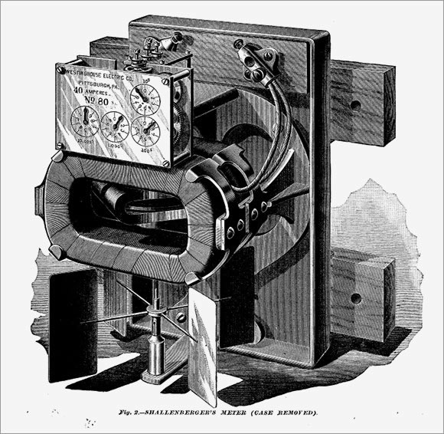
Mistakes and Meters
In April 1888 O.B. Schallenberger and an assistant are working on a new AC arc lamp and a spring fell out and came to rest inside the lamp. Schallenberger notices that before his assistant can pick up the spring, the spring had rotated. He realized the spring had rotated due to rotating electric fields in the lamp and designs an AC ampere-hour meter in three weeks that went to market three months later. Over 120,000 are sold by Westinghouse Electric within 10 years.

Slide 30
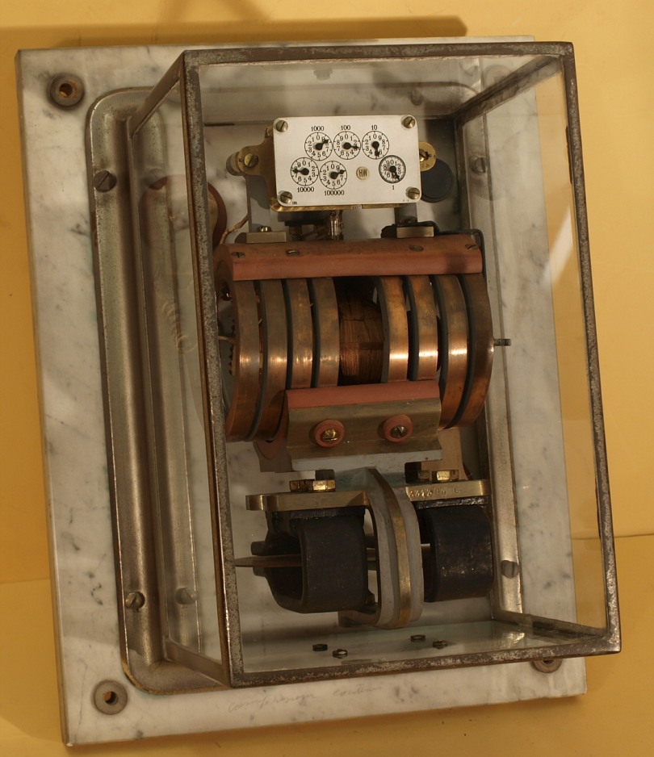
Elihu Thomson
1889 Thomson introduced his recording wattmeter (AC or DC – a commutator-type meter).
This was the first true watthour meter, and it was an immediate commercial success, many utilities adopting it as their "standard" model.
Although this meter was initially designed for use on AC circuits, it worked equally well with the DC circuits in use at the time.
The introduction and rapid acceptance of induction-type watthour meters in the late 1890s relegated the use of this commutator-type meter to DC circuits.

Slide 31
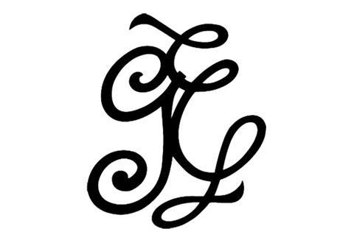
General Electric
In 1891 Edison General Electric Company wins the lawsuit over the light bulb patent and they start merger discussions with Thomson-Houston as their patents are highly complementary (light bulbs and AC distribution)
In 1892 the two companies merge forming General Electric.
Original GE logo

Slide 32
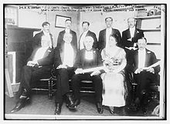
Magnetic Gaps vs. Jewel Bearings
In 1895 William Stanley returned to Great Barrington, MA to establish the Stanley Instrument Co. to sell watthour meters designed by himself and Fredrick Darlington. This meter was unique - it used a disk that was floated in the magnet gap without using the traditional jewel bearing. This model worked at first but problems forced the company to produce a few other models with jewel bearings.
Stanley (second row, second from right) in Philadelphia on May 19, 1915 during the awarding of the Franklin Medal with Thomas Alva Edison, courtesy of Wikipedia.
Fun Fact: William’s son, Harold Stanley, founded Morgan Stanley with J.P. Morgan’s grandson, Henry Sturgis Morgan.

Slide 33
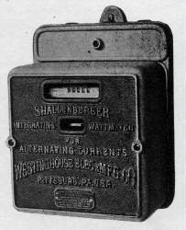
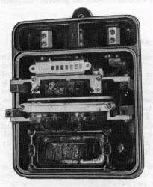
Induction Watthour Meter
1892 Thomas Duncan develops the first induction watthour meter to use a single disk for both the driving and braking element but the design never went into production.
1894: With the rapid growth of the electric industry at this time, AC was now being used to run motors, and the existing ampere-hour meters and commutator-type watthour meters were unable to take into account varying voltages and low power factors on AC circuits.
Several inventors worked to develop a new meter to meet this need, but Shallenberger hit on the most workable approach - a small induction motor with the voltage and current coils 90 degrees out of phase with each other.
This concept was refined into the first commercially produced induction watthour meter. This model was one of the heaviest ever offered at 41 pounds and one of the most expensive of its time.

Slide 34
SHALLENBERGER INTEGRATING WATTMETER (1894 TO 1897)
By the mid-1890s, Shallenberger's ampere-hour meter was popular but because of the increasing use of motors, a true watthour meter was needed to account for varying voltages and power factors.
First commercially produced induction watthour meter.
Large and heavy (41 pounds)
More than twice as expensive as comparable meters in its time.
This meter was one of the first models to use a cyclometer register.
Depending on the customer's preference, this register was equipped with 4 drums (registering in kwh) or 7 drums (registering in watthours).
The stator was similar to ones in later meters with its voltage and current coils arranged on opposite sides of the disk and had a magnet assembly to damp the disk's speed
Becomes the modern day meter

Slide 35
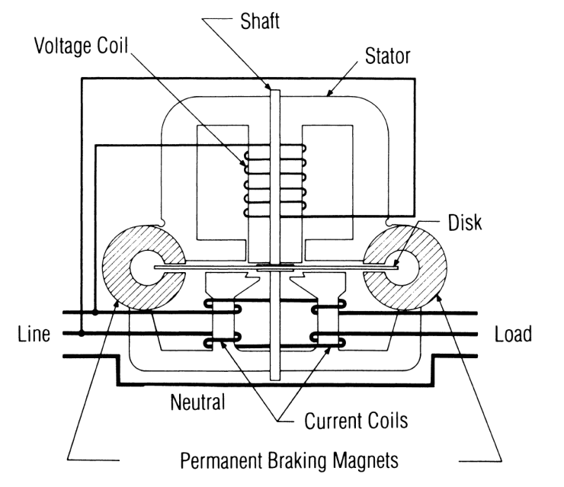
Induction Meters
Using concepts put forth by Tesla and Ferraris, several inventors created early induction watthour meters
Two coils and a conducting (usually aluminum) disk. A braking magnet.
Magnetic field from the first coil generates eddy currents in the disk
Magnetic field from the second coil interacts with the eddy currents to cause motion
Disk would accelerate without bound except for eddy currents caused by motion through fixed magnetic field which slows the disk
The end result is that each revolution of the disk measures a constant amount of energy

Slide 36
Basic Energy Formula
The essential specification of a watthour meter’s measurement is given by the value K_{h} [ Watthours per disk revolution ]
The watthour meter formula is as follows:
tescometering.com
36

Slide 37
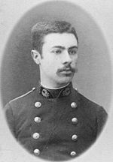
1893: Blondel’s Theorem
The theory of polyphase watthour metering was first set forth on a scientific basis in 1893 by Andre E. Blondel, engineer and mathematician. His theorem applies to the measurement of real power in a polyphase system of any number of wires. The theorem is as follows:
- If energy is supplied to any system of conductors through N wires, the total power in the system is given by the algebraic sum of the readings of N wattmeters, so arranged that each of the N wires contains one current coil, the corresponding voltage coil being connected between that wire and some common point. If this common point is on one of the N wires, the measurement may be made by the use of N-1 wattmeters.

Slide 38
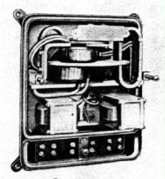
SHALLENBERGER POLYPHASE METER
Shallenberger modifies his meter to work on a polyphase circuit but the close spacing of the stators and the use of a solid disk resulted in the meter being less accurate than expected.

Slide 39
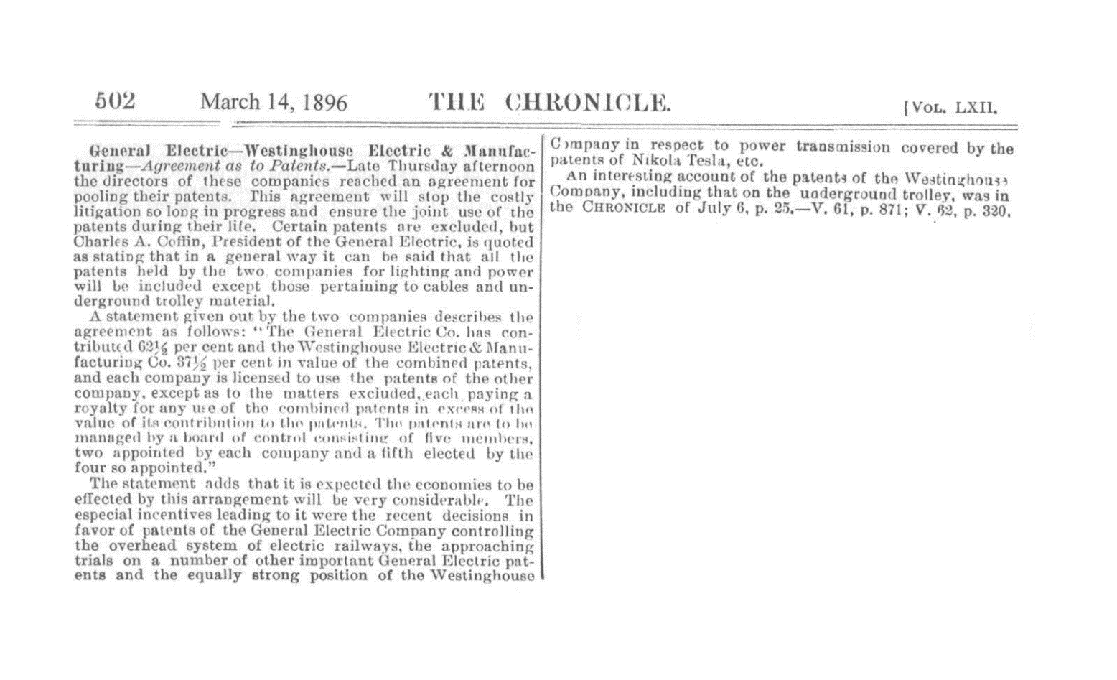
GE – WESTINGHOUSE AGREEMENT
1896 – another patent war loomed between Westinghouse and GE. They “agreed” to set up a Board of Patent control that allowed them to license each other’s patents.

Slide 40
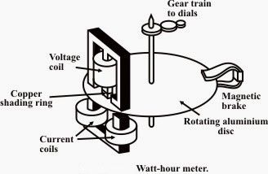
1897
Schallenberger meter is redesigned into a smaller, lighter 12 pound meter. This significantly less expensive meter is known as the “round meter”.
Duncan develops a watthour meter for the Fort Wayne Electric Co before GE buys them out completely.

Slide 41
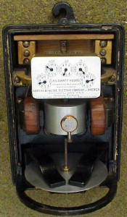
SIEMENS & HALSKE DUNCAN INTEGRATING
WATTMETER (1899, 1900)
After R.T. McDonald died in 1899, Duncan left Fort Wayne for a brief stint at Westinghouse before coming back to Ft. Wayne. Shortly after his return, he and several other employees were lured away by C.S. Knight (who was a manager at Ft. Wayne himself before being hired by S & H). Once at S & H, Duncan refined his watthour meter into a slimmer, top-connected version. The light load adjustment was changed to use a copper ring with an iron core. In early 1900, shortly after Duncan's arrival, there were widespread strikes in the Chicago area, and Siemens & Halske's plant was one of the affected companies. This put the company in such a position they had to sell out to GE, but the strikes were soon settled and existing orders were filled. Late that year, GE closed the S & H plant and moved the tooling and many employees to Fort Wayne. However, Duncan felt the time was right to leave for Lafayette, IN to establish the Duncan Electric Mfg. Co.

Slide 42
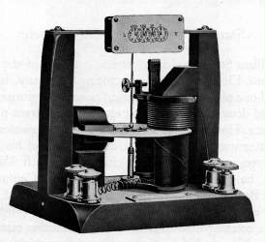
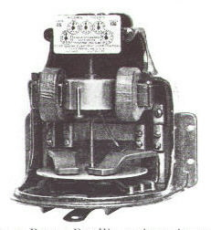
DUNCAN WATTHOUR METERS (1892-1898)
The first model shown represented a landmark in watthour meter development. This model was developed by Thomas Duncan in 1892, two years before O.B. Shallenberger introduced his watthour meter. This also predated Tesla's patent on the induction motor principle - this was one of his many patents bought by Westinghouse, and the one that was invoked in 1903 against all the other manufacturers (except for GE due to a licensing arrangement). It was also the first meter to use a single disk for both the driving and braking element. For reasons unknown, Duncan never patented or adapted this model for production. If he had done so, Duncan would have had a significant advantage over GE and Westinghouse!
The second model shown is of the watthour meter Duncan later developed for the Fort Wayne Electric Corporation. The overall appearance of this meter is very similar in design to the Thomson Recording Wattmeter introduced by Thomson-Houston around that time. The main difference between this model and the T.R.W. is in the arrangement of the coils and the can-type rotor (which carried over into the K series of meters). Duncan may have been inspired to base his new meter design on the TRW as he did work for a short time in the 1888-1889 timeframe at Thomson-Houston alongside Elihu Thomson while the Ft. Wayne Electric Co. rebuilt its facility after a fire destroyed the plant in 1888.

Slide 43
1899 to 1902
Westinghouse develops a viable polyphase meter – two single phase meters in a tall case with a common shaft and register. This design remains in use until 1969.
Thomas Duncan founds the Duncan Electric Manufacturing Company and starts shipping meters a year later.
Sangamo Electric ships their first electric meter.
Westinghouse releases the Type A meter with a ball bearing instead of a pivot.

Slide 44
PATENT INFRINGEMENT 1903
Westinghouse sues Sangamo and Duncan over infringement of the Tesla patents and forces them out of the induction meter business until 1910.

Slide 45
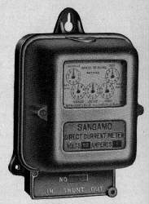
SANGAMO 1899-1975
After being barred from making induction meters until the end of 1910 (following a patent lawsuit brought by Westinghouse) in 1903, Robert Lanphier sought out a design for a meter that didn't infringe on Tesla's patents (held by Westinghouse). He decided to work with the mercury-motor meter which was widely used in England at the time, and developed the first practical mercury-motor watthour meter. The design of this meter was unique, since this meter used the voltage coil to generate the braking field instead of the permanent magnets normally used for the brake. The coarse full-load adjustment was made by adjusting the resistance of a shunt inside the meter, and the fine adjustment was made by adjusting the depth of the contacts into the mercury chamber. The light load adjustment was made by varying
the resistance of the voltage circuit. Unlike the later mercury-motor meters, this model depended on the disk's natural buoyancy in mercury alone. The rotation of the element was indicated by a hand on the top of the shaft assembly and was visible through a window set in top of the meter cover (which was factory-sealed just like the previous Gutmann Type B meter). This design had several major flaws, the fatal one being that the material used for the mercury chamber softened when the temperature of the surroundings got too warm and leaked. All the Type C meters were recalled and replaced with an improved version (the first version of the Type D).

Slide 46
And Now a Need for Standards
Safety - Standards specify minimum behavior of systems
Accuracy - Standards can specify system accuracy
Reliability - Standards can specify system reliability
Security - Standards can help to ensure information and system security
Openness - Standards give users options. Standards also give vendors the ability to specialize rather than build the entire system
Notes:
There are lots of good reasons to use standards. The utility industry has identified - and used - many of these in the construction of our modern systems. Imagine a world in which we had not agreed on service voltage, frequency, or interface connectors. Imagine a world in which electricity meters were engineered from the ground up for each utility company.
Standards have served us well to ensure safety, accuracy, reliability, and low cost. Standards allow vendors to specialize by building niche devices which interoperate with other devices from other manufacturers without any vendor needing to “build it all”.
Standards properly deployed can also help to ensure information security by making the structure of the “lock” public knowledge but making the exact key private.

Slide 47
But the Process is Not Trivial
Inertia of existing practices
Proprietary “standards”
Defining a vision
Identifying existing standards to use as building blocks
Gaining consensus
Hammering out details, details, details, details, details…..
47
Notes:
The process of moving from the old to the new is not trivial. We have the inertia of existing practices, the use of private “standards” - normal for the utility industry, the need for a defining vision for the future, the identification of existing standards to use as building blocks, and the hard work of gaining consensus and working out all the details.
Sometimes it is just easier to continue with the status quo. But, as we will see, the rewards are worth it, and the end user doesn’t need, in the end, to deal with all of the details. Leave that to the experts.

Slide 48
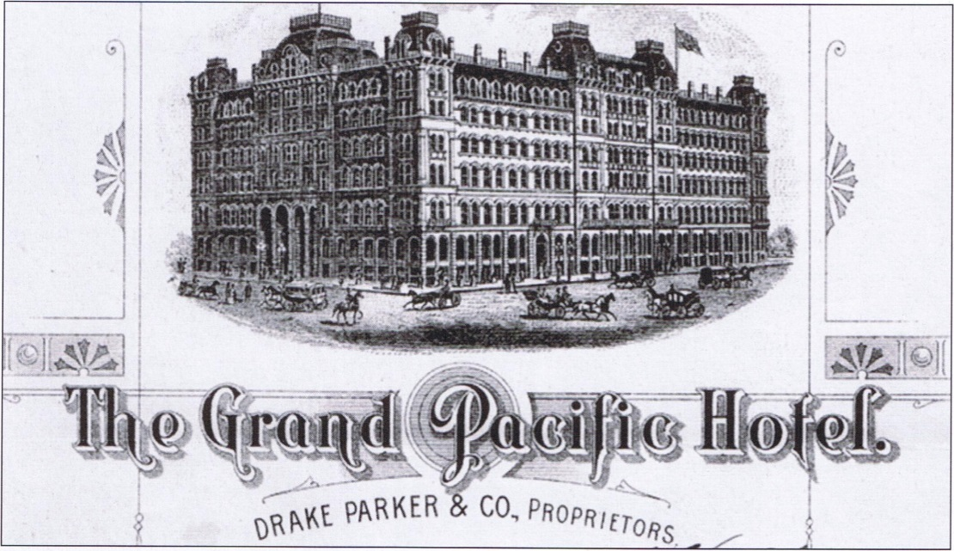
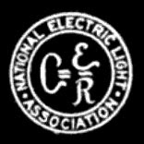
National Electric Light Association
Formed in 1885
J. Frank Morrison, Brush Company of Baltimore Baltimore, MD 1st President
Held at the Grand Pacific Hotel
Vendor Dominated
One Operating Committee
Notes:
Ref. 1885 Proceeding of the National Electric Light Association: Pg. 4 & 12: http://babel.hathitrust.org/cgi/pt?id=mdp.39015011403139;view=1up;seq=13
Incandescent lighting, particularly in regard to length of circuit upon which it can be run with profit. 2. Locating and avoiding crosses with telephone wires. 3. Power and its conversion into light. 4. Electric light globes and shades. 5. The best modes of connecting dynamos with power. 6. Electric lighting by water power. 7. Rates and rebates on electric lights by the year. 8. The use of electricity as applied to motors. 9. Where an electric light system requires No. 6 conductors, is it desirable to use No. 6 and No. 4 in the same line?
10. Will armatures become affected by frost when exposed in transportation? 11. Special insulation or guards between insulations of lines at dangerous points and places. 12. Street lighting, the best manner and modes of accomplishing it. Location of lights and running the circuits for the same. 13. Experience and results in the use of underground conductors. 14. That the fireman should receive more pay than the engineer. 15. Help generally. 16. Experience of electric light companies in the use of cop- per-coated and bare carbons.

Slide 49
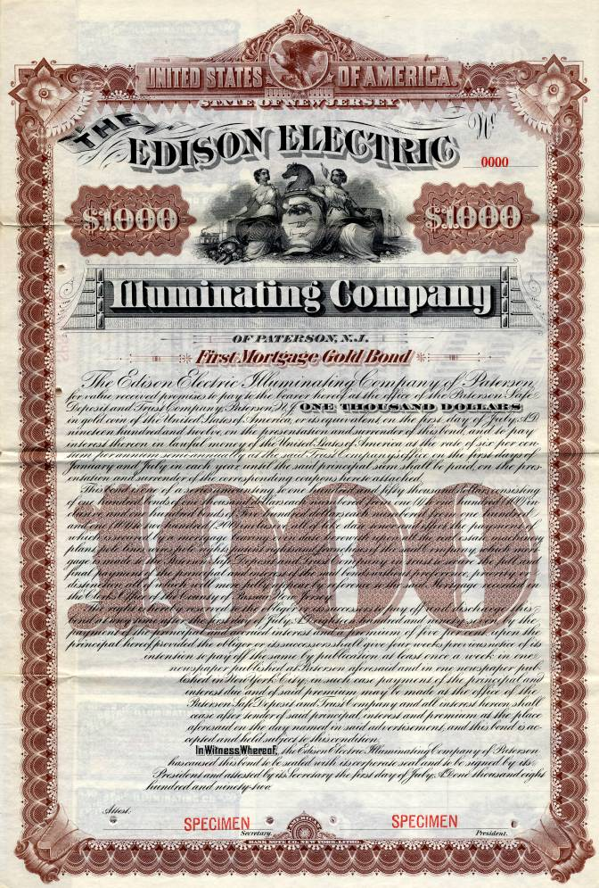
Association of Edison Illuminating Companies
AEIC was formed in 1885
James S. Humbird of Cumberland, MD, First President
Held in Harrisburg, PA at Harrisburg Edison Electric Light Co.
Only Edison Franchisees and Guests Were Invited to First Meeting

Slide 50
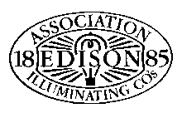
NELA vs. AEIC
Large Flashy Industry Meetings
Objective was to promote Lighting Manufacturers, Apparatus Integration, and Systems Construction
Focused On Arc-Lighting Systems Promotion
Prioritized Expansion of Electric Systems, Regardless of AC or DC
Small, Focused Utility Group Meetings
1885 By-Laws - Objectives: “Mutual Protection of (Electric System) Owner Interests; Thoughtful Information Collection and Dissemination”
Focused on Incandescent Lighting Promotion
Prioritized Standardization of electrical Systems

Slide 51
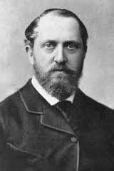
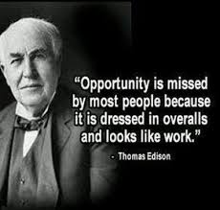
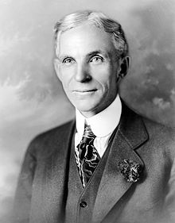
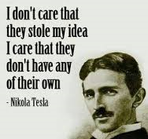
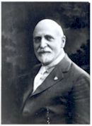
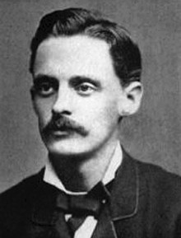
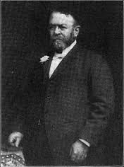
Meeting Attendance
Lord Stanley
Thomson-Houston

Slide 52
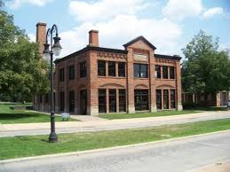
AEIC Meter Committee
The Issue of metering was discussed as early as 1887 as part of the formal meeting.
The AEIC Committee on Meters was first discussed in 1896
The committee was established in 1898, with Alex Dow, Edison Illuminating company of Detroit, presiding as chair.
About Alex Dow…. Scotland to Cunard Lines to Baltimore to the Brush Company to do lighting for the World’s Fair in Chicago, to helping Detroit to design and supervise a city-owned electric company, to manager of the Detroit Edison Illuminating Company (1896) which became Detroit Edison in 1903, rising from General Manager to President in 1912.

Slide 53
Early AEIC Meter Committee Activity
The Wright vs. Barstow Debate
Barstow – TOU
Wright – Demand
Emerging Technologies
Research and Development
Pre-Paid Metering
Battery Storage Implications

Slide 54
The Rise of the NELA Meter Committee
NELA Meter Committee Established in 1908, With Alex Dow, Edison Illuminating Company of Detroit, Presiding
Samuel Insull had great influence on both the formation of the Committee and the topics covered

Slide 55
Publishing The First Works
Beginning in 1897, NELA put a focus on developing the first edition of the National Electric Code
Beginning in 1902, AEIC began work on collecting requirements from member companies for meter standardization
By 1908, the AEIC Committee began work on the Code for Electricity Meters

Slide 56
The Coming Together
The AEIC and NELA Metering Committee first met in 1910 at the Hotel Frontenac in Thousand Islands, NY
They met for the historic publishing of the AEIC Code For Electricity Meters – The predecessor to ANSI C12
It was deemed in 1910 that all future work on the Code for Electricity Meters shall be collaborative between NELA and AEIC

Slide 57
The “Handbook”
Based on the work of the AEIC Code, NELA Members began work on the first “Electric Meterman’s Handbook”
Presented at the Historic Hotel Washington in Seattle, WA
The NELA/AEIC Joint Presentation also Featured Vendors: Thomson (General Electric), Westinghouse, Fort Wayne, Sangamo, Duncan Columbia, The Eastern Specialty Company (TESCO), Cutler-Hammer, Biddle, Leeds & Northrup and The States Company

Slide 58
After the Patent…
After the Tesla patents expired in December 1910, Sangamo immediately introduced a new induction-type meter known as the Type H. As with the previous Gutmann meters, the disk rotated clockwise (to the left) unlike its competitors' which all rotated to the right.
20 years after Duncan developed his single-disk meter, the Duncan Electric Mfg. Co. introduces its first induction-type meter, the Model M. It was not as sound as its competitors' offerings as two improved versions of this model (Models M1 and M2) came out in the next 3 years.
Notes:
There are lots of good reasons to use standards. The utility industry has identified - and used - many of these in the construction of our modern systems. Imagine a world in which we had not agreed on service voltage, frequency, or interface connectors. Imagine a world in which electricity meters were engineered from the ground up for each utility company.
Standards have served us well to ensure safety, accuracy, reliability, and low cost. Standards allow vendors to specialize by building niche devices which interoperate with other devices from other manufacturers without any vendor needing to “build it all”.
Standards properly deployed can also help to ensure information security by making the structure of the “lock” public knowledge but making the exact key private.

Slide 59
1920s
The late 1920s saw several key advances in meter design. With the introduction of meter service cabinets to protect the meter connections, polyphase meters were redesigned to move the terminal chambers from the sides to the bottom. Also, all meters were redesigned to add two types of compensation to improve performance. Temperature compensation enabled meters to maintain accuracy over a wide range of temperatures. Before temperature compensation, the utilities were seeing seasonal fluctuations in accuracy that required readjustment of the meter. Overload compensation enabled meters to handle a broader range of loads and provide accurate metering over this range (in fact, a typical modern meter that can handle 200 amperes actually has a nominal rating of 30 amperes). Before overload compensation was added, low-capacity meters could not handle overloads well, and high-capacity meters were insensitive to light loads.
Westinghouse introduces the first socket-type meter, the OB "detachable“ – Manufactured in Newark, NJ and released in 1928.
Notes:
There are lots of good reasons to use standards. The utility industry has identified - and used - many of these in the construction of our modern systems. Imagine a world in which we had not agreed on service voltage, frequency, or interface connectors. Imagine a world in which electricity meters were engineered from the ground up for each utility company.
Standards have served us well to ensure safety, accuracy, reliability, and low cost. Standards allow vendors to specialize by building niche devices which interoperate with other devices from other manufacturers without any vendor needing to “build it all”.
Standards properly deployed can also help to ensure information security by making the structure of the “lock” public knowledge but making the exact key private.

Slide 60
1930s
The National Electric Code was revised to allow the meter to be connected ahead of switches and fuses, which made it harder for dishonest customers to tap into the unmetered part of the electrical service on their property. This change along with the introduction of socket-type meters a couple years later made it possible for utilities to start moving the meters outside where they could be read without entering the customer's premises.
Up to the mid-1930s, meters made by different manufacturers (or even different models or versions of the same model) were made with little attention to consistency in design. This resulted in a problem for electric utilities in that a meter changeout often required rearranging the wiring to the meter. In 1934, a committee consisting of representatives from the manufacturers and the larger electric utilities came up with two new standardized designs ("S" type or socket and "A-base" or bottom-connected) for the meter enclosures. This simplified meter change-outs in the field to simply taking out the old meter and installing the new.

Slide 61
1930s cont.
1934 - Sangamo introduces the last mechanical prepayment meter, the Type HFP. By this time, prepayment metering was falling out of favor due to fraud and decreasing costs of electricity.
The late 1930s saw another round of improvements to meter design. Polyphase meters were redesigned to incorporate a laminated disk, which allowed the stators in the meter to be placed side by side without interacting with each other. Polyphase meters made with this new design were only slightly larger than single-phase meters (Westinghouse continued with the multiple-disk design until 1954, and Duncan abandoned the laminated disk in 1950, reverting to the multiple-disk design until 1969). The other major improvement was in response to a problem that became obvious once meters were installed outdoors in rural areas. After lightning storms, some meters started running fast since the brake magnets were weakened by power surges during the storm. This was solved by replacing the chrome steel magnets with magnets that were made of Alnico, which did a much better job of holding their strength. Westinghouse took a different approach by heavily copper-plating their chrome steel magnets and continued this practice until 1954.

Slide 62
1940s
1940 - GE begins development on a new type of bearing using the magnetic suspension principle (as attempted in the Stanley meters) but work on this was put on hold when the US entered WWII.
1948 - GE opened a new meter plant in Somersworth, NH. Also, the magnetic bearing GE had been working on was finally introduced on the I-50 single phase meter (which was billed "The first all-new meter in 50 years").

Slide 63
1950s
1952 - Duncan relocates its meter plant to a larger location just outside Lafayette, IN.
1954 - GE moves all remaining watthour meter production from the original Lynn, MA, plant to Somersworth, NH.
1957 - Westinghouse moves meter production from Newark, NJ, to a new plant in Raleigh, NC.
The mid- to late 1950s saw another fundamental evolution in meter design, which was to abandon the metal base used in socket meters in favor of compression-molded bases made of various materials. Also, an improved type of Alnico magnet was introduced which allowed the brake magnets to be incorporated into the frame, simplifying the design and improving calibration stability.

Slide 64
1960s
Duncan, Sangamo, and Westinghouse all introduce meters using magnetic bearings.
In the late 1960s, the single-phase watthour meter underwent its final major change: It was redesigned for a lower profile to make it less obvious and less prone to damage. This redesign also had another benefit - the new models were at least one pound lighter than the older models.

Slide 65
1970s
1975 - Landis & Gyr of Switzerland buys Duncan Electric Co. and continued operations in Lafayette, IN, unchanged, relabeling the meters with the Landis & Gyr name starting in 1984.
1975 - Schlumberger of France buys Sangamo Electric Co. and moved meter production from the original facility in Springfield, IL, to another one of Sangamo's plants in West Union, SC.
With the advances in electronics in the 1970s, the manufacturers (as well as a few third-party companies) started introducing electronic registers and automatic meter reading devices.

Slide 66
1980s and 1990s
By the mid-1980s, the manufacturers were offering hybrid meters with electronic registers mounted on induction-type meters.
1990 - ABB of Switzerland buys Westinghouse's meter and load control division and continues production unchanged except for re-labeling all the product with the ABB logo. (In 1998, the load control business was sold to Cannon Technologies.)
AMR is introduced and communication modules are introduced into meters

Slide 67
2000 to Present
The last electromechanical meters are produced. All new meters in North America are electronic
AMI is introduced and a host of new communication vendors enter the market
L&G (formerly Duncan) becomes L+G
Schlumberger (formerly Sangamo) becomes Itron
Sensus enters the market
ABB (formerly Westinghouse) becomes Elster becomes Honeywell
GE becomes Aclara becomes Hubbell

Slide 68
Questions and Discussion
Tom Lawton
President
tom.lawton@tescometering.com
TESCO – The Eastern Specialty Company
Bristol, PA
215.228.0500
This presentation can also be found under Meter Conferences and Schools on the TESCO website: tescometering.com
ISO 9001:2015 Certified Quality Company
ISO 17025:2017 Accredited Laboratory

Slide 69
Tesco hospitality suite
We would like you to join us in the TESCO Hospitality Suite for networking and more discussions about metering. The discussion will not be exclusively metering……….but we love metering and that is the most common topic.
TESCO Hospitality Suite – Brighton Tower
Monday and Tuesday 8:00 PM – 10:00 PM

