Slide 1
Cellular based ami: Pros and Cons
Tuesday June 14, 2023
3:30 PM Advanced Track
Presented by Jon Scott, TESCO-Nighthawk

Slide 2
Cellular Technology
A communication network where the last link is wireless.
The network is distributed over areas call ‘cells’ that are served by at least one transceiver.
When joined together, these cells provide radio coverage over a wide area.
This cellular coverage enables numerous portable devices such as phones, tablets and laptop computers to operate anywhere within the network.

Slide 3
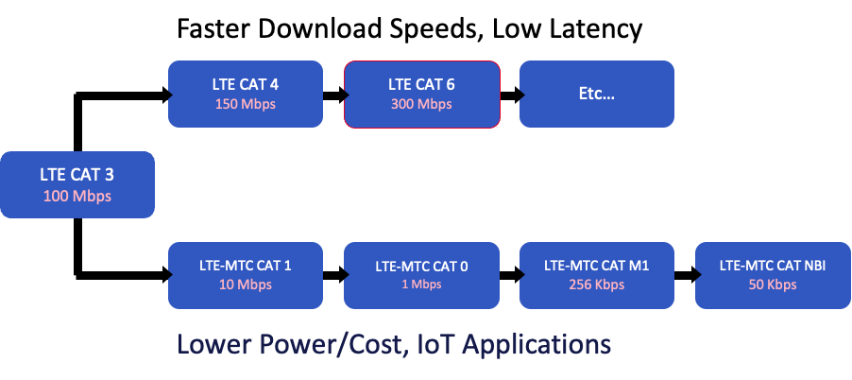
LTE Variations
Faster Download Speeds, Low Latency
LTE CAT 4
150 Mbps
LTE CAT 6
300 Mbps
Etc…
LTE CAT 3
100 Mbps
LTE-MTC CAT 1
10 Mbps
LTE-MTC CAT 0
1 Mbps
LTE-MTC CAT M1
256 Kbps
LTE-MTC CAT NBI
50 Kbps
Lower Power/Cost, IoT Applications

Slide 4
Cellular Technology
LTE is still the cellular technology of choice around the world
Serving over 6.6 devices as of January of this year.
LTE offers high bandwidth connectivity with predictable latency
It is extremely secure, has a large ecosystem of suppliers and offers a robust roadmap

Slide 5
How fast is 4G LTE?
In theory, LTE's maximum speed is 100Mbps. In practice, it tops at 15Mbps. Of course, it all depends on where you're located.
What about LTE-A and LTE+?

Slide 6
LTE-A, LTE-Advanced, 4G+, and LTE+
LTE-A, LTE-Advanced, 4G+, and LTE+ are all acronyms for the same 4G service. It's a faster version of LTE.
How fast is LTE-A? In theory, LTE-A data rates are up to 300Mbps. In practice, you can expect between 40 to 90Mbps.

Slide 7
The Future of LTE
The future of 4G LTE is still bright. Some capabilities of the 5G are not available yet and will not be needed right away for existing applications that are functioning well with the bandwidth and latency offered by 4G LTE networks. 4G devices will continue to work and can often wait to upgrade to 5G. Because 4G LTE and 5G share spectrum, and 5G devices offer failover to 4G for areas where 5G is not yet established, the migration from LTE to 5G will occur over a period of at least a decade or more.

Slide 9
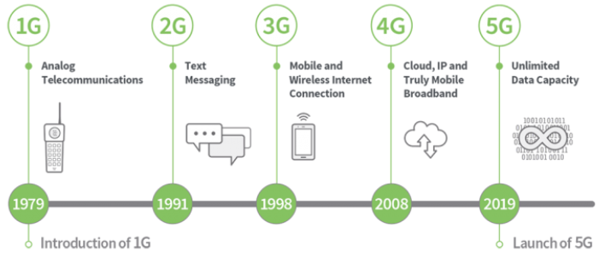
Evolution to 5G Technology

Slide 10
5G Technology
5G brings more improvements, but it’s comprised of a suite of new technologies
Small cells
Millimeter waves
Massive Multiple-input Multiple-output (MIMO)
Beamforming
Full duplex

Slide 11
Small Cells
Small cells are miniature cell phone towers that can be placed in inconspicuous places like light poles and the roofs of buildings
They don’t require as much power as full-sized towers, and perform better when clustered together

Slide 12
Millimeter Waves
Small cells transmit data using millimeter waves, which get their name from their narrower-than average wavelength
They occupy frequencies in the 30-300GHz range — high enough to avoid interference from surrounding signals, but too high to pass through physical barriers
In some cases, the leaves of trees are enough to interrupt a download

Slide 13
Multiple Input Multiple Output (MIMO)
Millimeter waves have limitations, but they’re a good fit for MIMO — a wireless system that uses multiple radios to send and receive data simultaneously
The 4G LTE networks of today support a maximum of eight transmitters and four receivers, but 5G cell towers can theoretically support dozens

Slide 14
Beamforming
More radios mean more interference; that’s where beamforming comes in
At its most basic, beamforming uses algorithms to choreograph wireless signals’ movements and increase their strength by focusing them in a beam

Slide 15
Full Duplex
Full duplex helps boost the signal even further
Most current-gen cell towers and devices cannot transmit and receive at the same time, but full duplex phones can route incoming and outgoing signals simultaneously, potentially doubling bandwidth

Slide 16
5G Limitations
5G won’t provide nearly as much coverage as 4G LTE, or even 3G. In many ways and it will seem more like Wi-Fi than a cellular technology
5G transmitters will be set a closer to the ground. This requires a lot of ground coverage hardware to insure you’ll have a reliable signal

Slide 17
5G Limitations
The high frequencies and correspondingly low wavelengths of 5G will have difficulty penetrating solid objects such as walls, windows, and even trees
For these and other reasons, industry experts expect 4G LTE to advance alongside 5G
Collaboration is already underway on gigabit 4G LTE connectivity, and at least one carrier has said portions of its existing network reach gigabit speeds.

Slide 18
Cellular Technology Roles
Residential load control
3rd party access
Industrial load control
Interruptible programs
Video feed from security cameras
Back hauling AMI data
Remote disconnect/ reconnect
Remote meter reads
Full AMI systems
18

Slide 19
Advantages of Public Cellular AMI and Targeted Cellular Solutions

Slide 20
Key Features
AMI | ADVANCED METERING
Remote reads
Remote connect / disconnect
Outage management (With alerts)
Voltage management (With alerts)
Time-Of-Use and off-cycle reads
Two-way communications networks
Many AMI “flavors”

Slide 21
Known Benefits
AMI | ADVANCED METERING
Saves utility money and improves service quality
Reconnects and transfers of service handled remotely and immediately
Greater reading and billing accuracy
Collect meter reads on demand
Directly address customer complaints
Re-reads for discontinued, move-ins, move-outs
Allows time-based rate programs and pricing, e.g. time of Use, peak rebates

Slide 22
Benefits for Operations
AMI | ADVANCED METERING
Improved system
Voltage monitoring can lead to better regulation, improved capacitor and regulator placement and more accurate voltage-drop analysis
Improved load information
Leads to better load studies and analysis, resulting in improved planning and system design
Improved reliability monitoring
Can lead to improved outage response, proper system-protection analysis, decrease in outages and outage time, raising reliability indices
Improved monitoring and information flow
Better management of critical assets such as transformers and capacitors
Pinpoint and reduce system losses

Slide 23
Cost Considerations
AMI | ADVANCED METERING
Despite the benefits, AMI systems have been cost prohibitive for many utilities.
Large orders to offset their costs
Proprietary collection networks
Utility IT resources
High infrastructure costs
High software costs
Frequency licensing fees
Maintenance of communications system

Slide 24
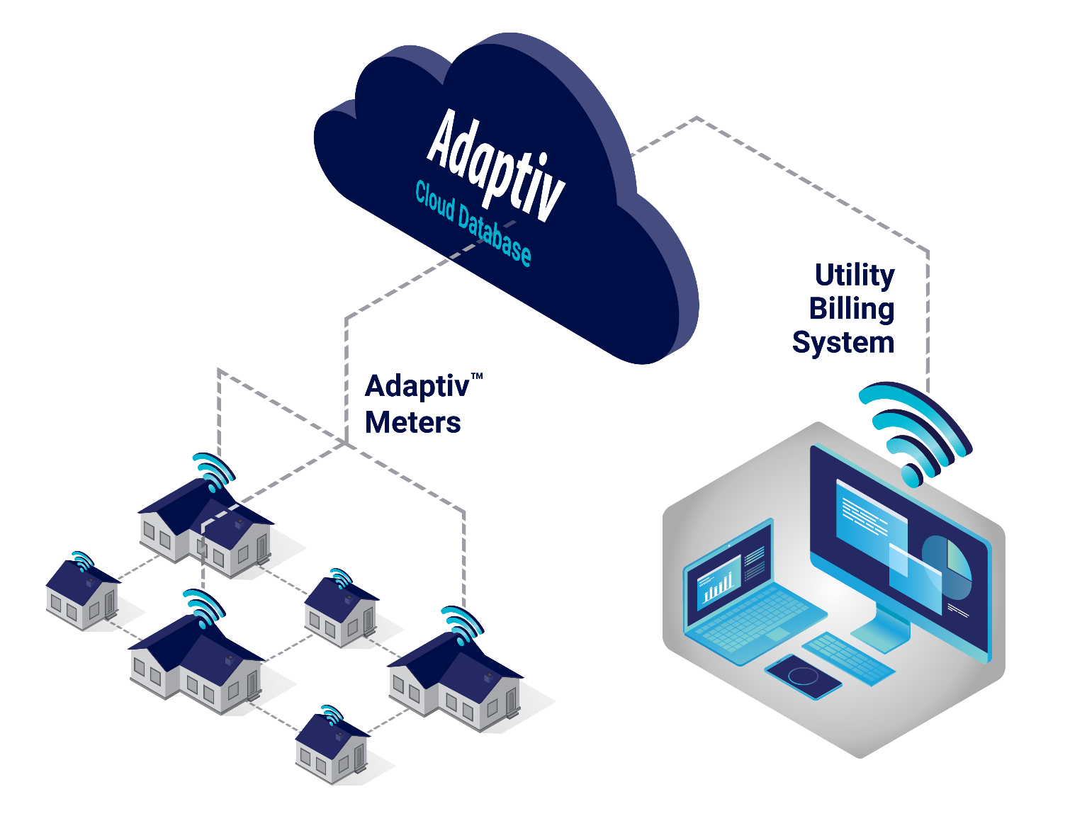
Cost Considerations
AMI | ADVANCED METERING
However, technological advances have come together that make AMI more affordable for all utilities.
AMI Cloud Database
Hosted software
Public cellular communications
Self-healing (mesh-cellular hybrid)
Less reliance on costly utility infrastructure

Slide 25
Advantages of Public Cellular Communications
AMI | ADVANCED METERING
Incrementally deploy your meters
Freedom of meter placement
Essential service / quick repair
No frequency rental fees
Zero utility infrastructure
No maintenance costs
Security

Slide 26
Advantages of a Hosted System
AMI | ADVANCED METERING
Secure data storage (whitepapers available)
Does not require IT resources
Accessible from any device
Fully scalable to any need
Always up to date

Slide 27
CONCLUSION
Public Cellular Communications & Technological Advances Have Simplified AMI
Freedom to deploy on your schedule
Does not require IT resources
Zero upfront network and infrastructure costs
Lower operational costs
Contact us today to learn more

Slide 28
Questions
Jon Scott
Nighthawk
jon.scott@tescometering.com​
John Kretzschmar
(864) 590-2883
john@samscometering.com
404.451.8444
This presentation can also be found under Meter Conferences and Schools on the TESCO web site: www.tescometering.com

Slide 29
Tesco hospitality suite
We would like you to join us in the TESCO Hospitality Suite for networking and more discussions about metering. The discussion will not be exclusively metering……….but we love metering and that is the most common topic.
TESCO Hospitality Suite – Brighton Tower
Monday and Tuesday 8:00 PM – 10:00 PM

