Slide 1
Benefits of Adding ATI to Distribution Transformers
John Kretzschmar, SAMSCO
North Carolina Meter School
Tuesday, June 13, 2023
Management Track
11:15 AM

Slide 2
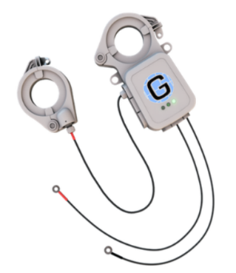
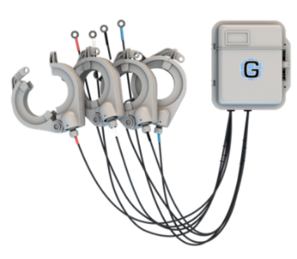
What is an Intra-Grid Sensor?

Slide 3
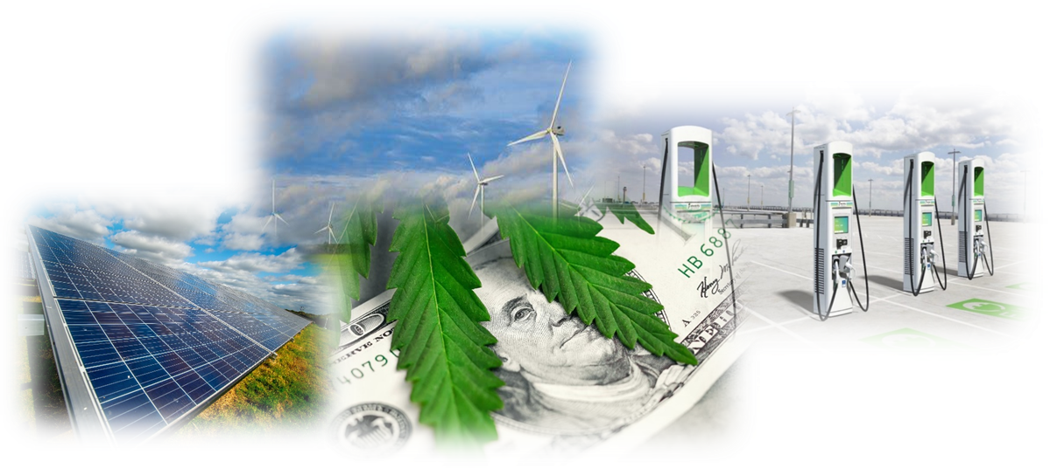
Why do we need Intra-Grid Sensors?

Slide 4
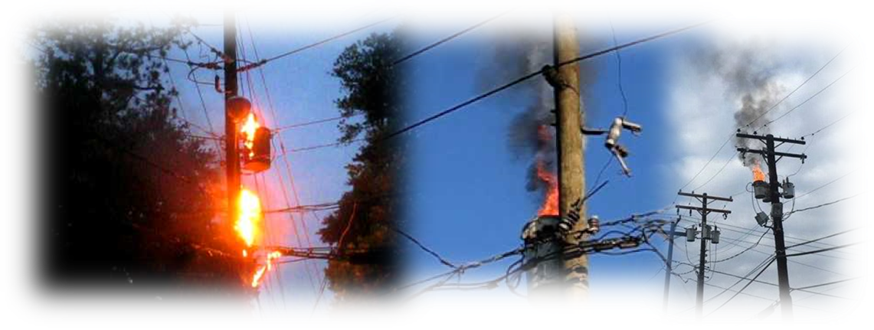
Why do we need Intra-Grid Sensors?

Slide 5
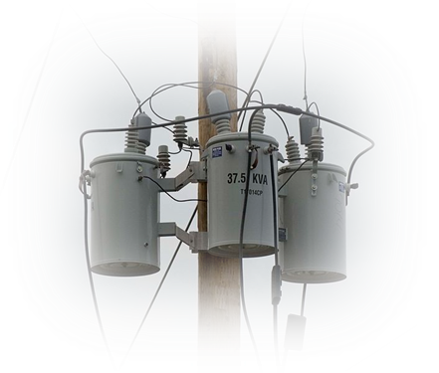
Aging Assets

Slide 6
Aging Assets

Slide 7
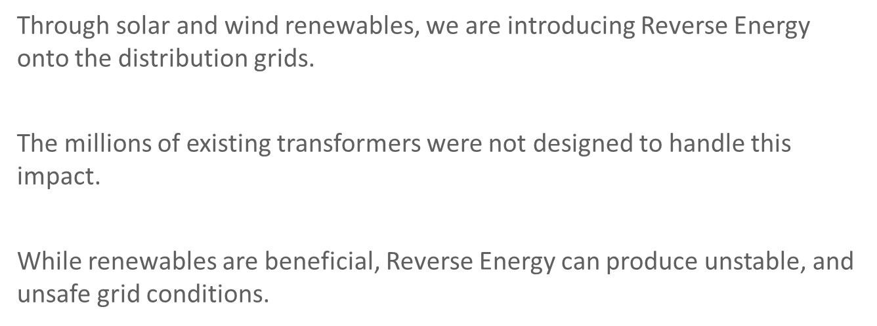
Distributed Energy Resources (DER)

Slide 8
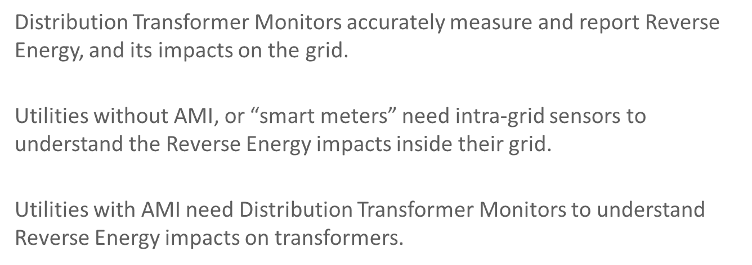
Distributed Energy Resources (DER)

Slide 9
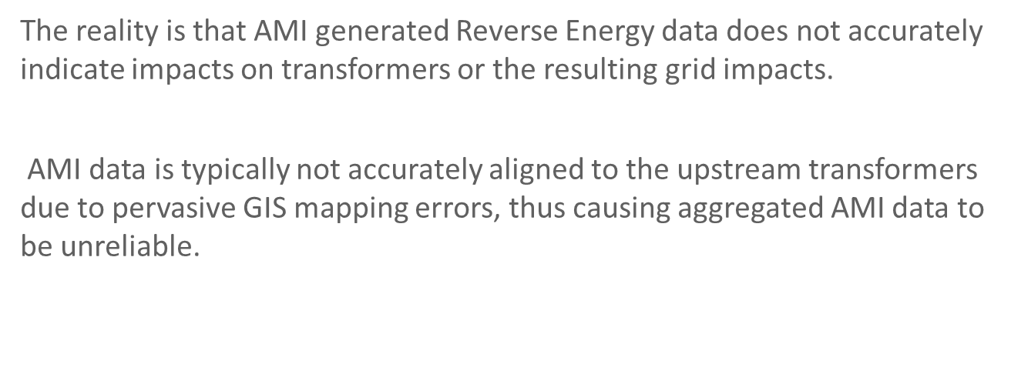
Distributed Energy Resources (DER)

Slide 10
Reverse Energy

Slide 11
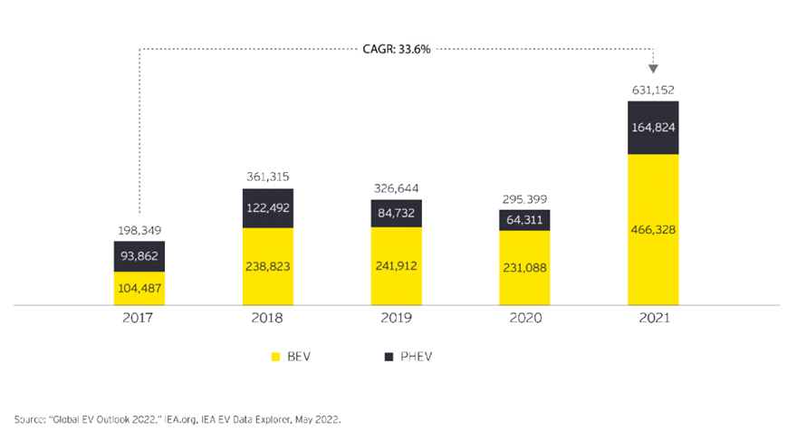
Electric Vehicles

Slide 12
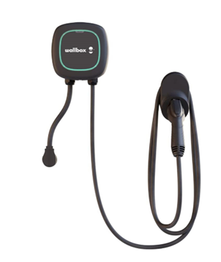
Electric Vehicles

Slide 13
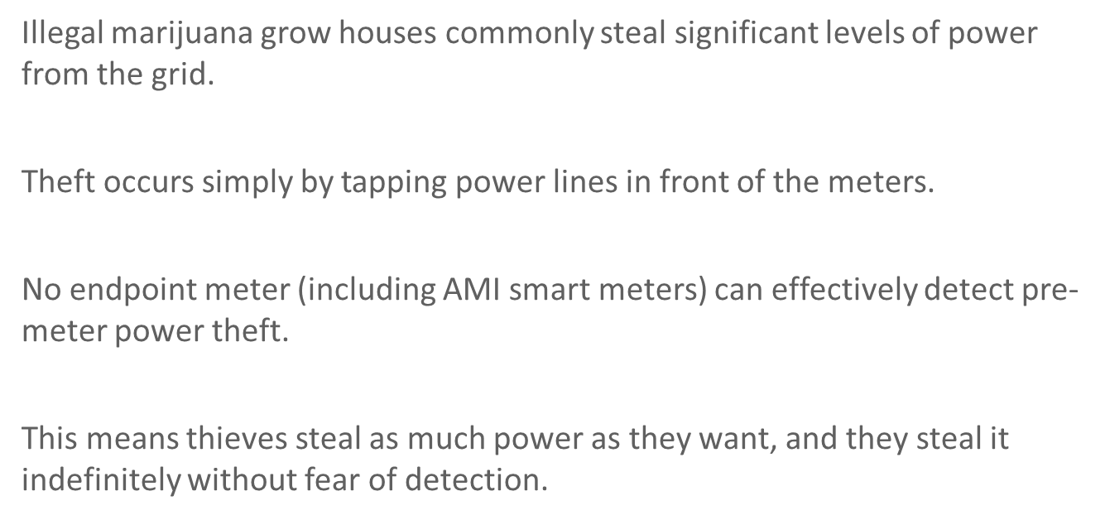
Illegal Marijuana Production

Slide 14
Legalized Marijuana

Slide 15
Power Theft

Slide 16
Power Theft

Slide 17
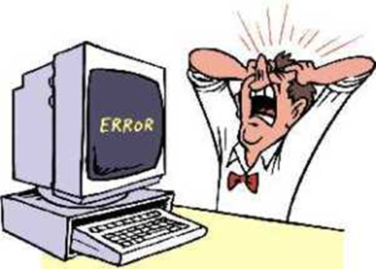
Meter Programming

Slide 18
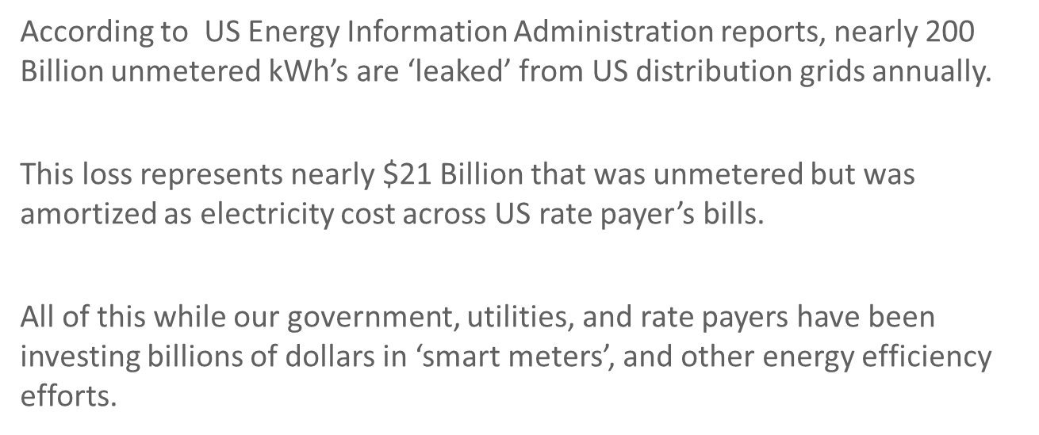
Line Loss

Slide 19
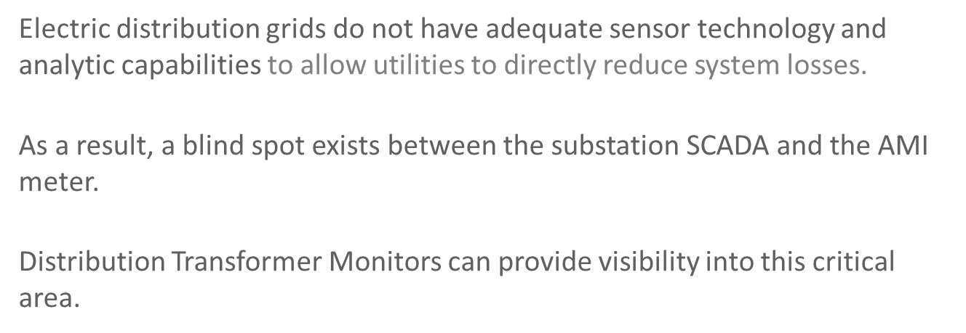
Line Loss

Slide 20
The Next Step In Grid Modernization
Advanced Transformer Infrastructure (ATI)
Reliability Improvements
DER & EV Integration
Fire Mitigation
Outage Notification
Voltage Optimization

Slide 21
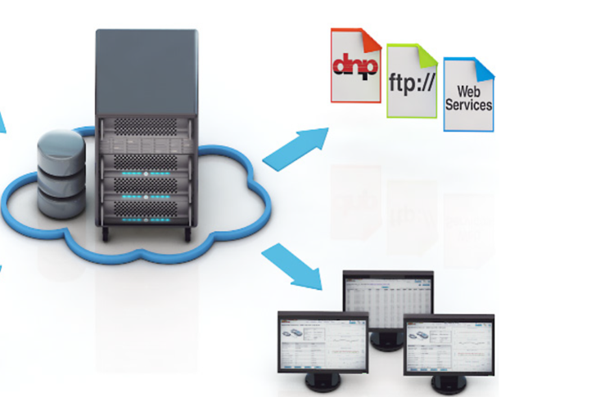
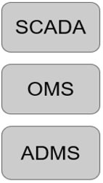
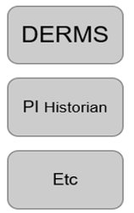
Advanced Transformer Infrastructure
API
GUI

Slide 22
Advanced Transformer Infrastructure

Slide 23
Advanced Transformer Infrastructure
ATI Head-End

Slide 24
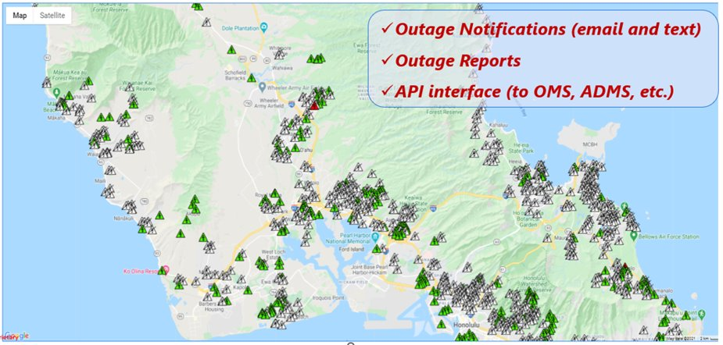
Advanced Transformer Infrastructure
:
Outage Notification

Slide 25
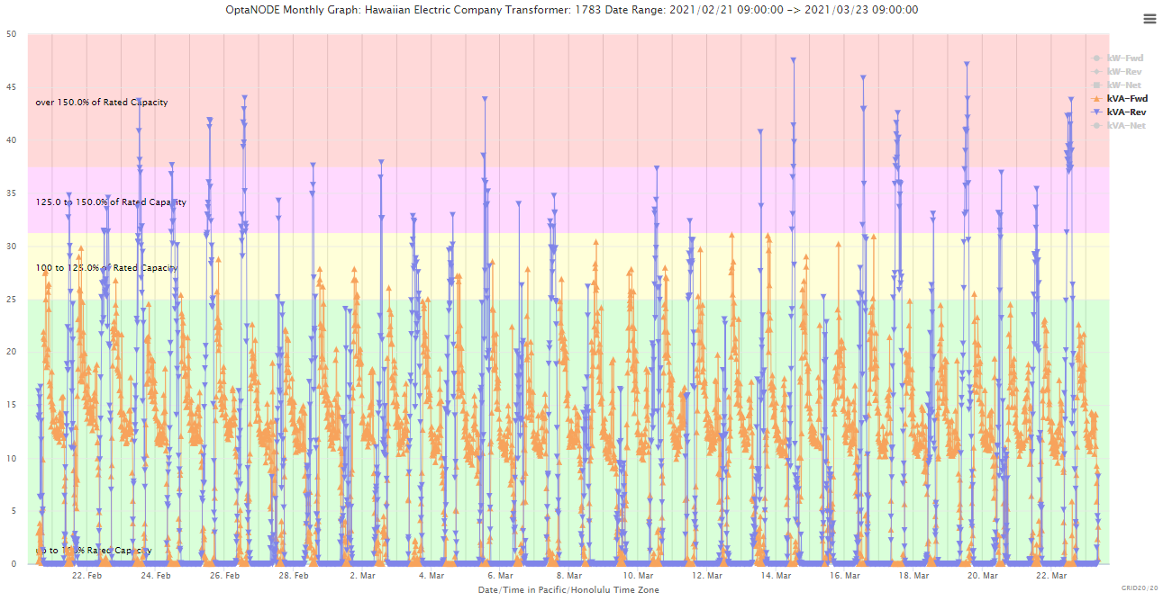
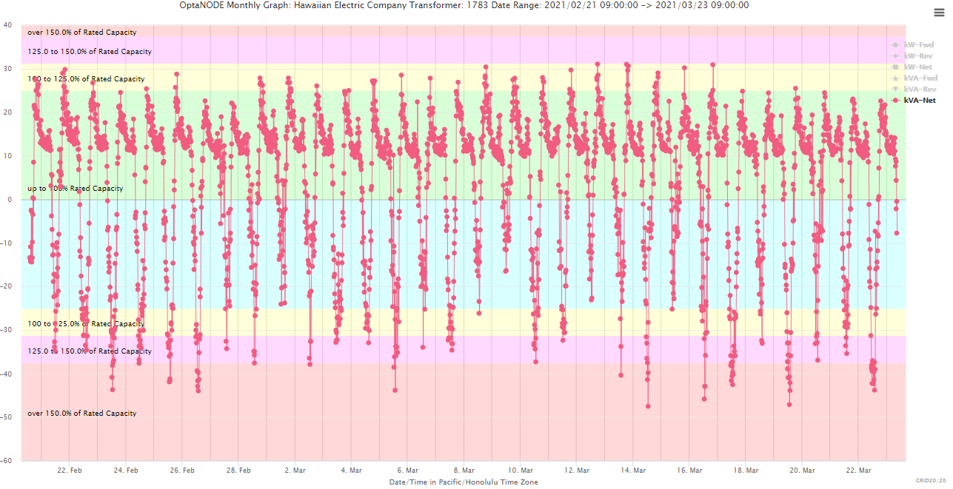
Advanced Transformer Infrastructure
Forward & Reverse Energy Impacts
The combination of excessive Delivered & Received Energy can cause Transformer Overload and Premature Failure (i.e., accelerated End of Life & potential Asset Fires)
ATI Systems can also deliver:
Transformer Overload Awareness = Preventive Intervention
Asset Fires/Wildfires Prevention = Reduces Liability Risk
Improved Lineman & Public Safety = Reduces Liability Risk

Slide 26
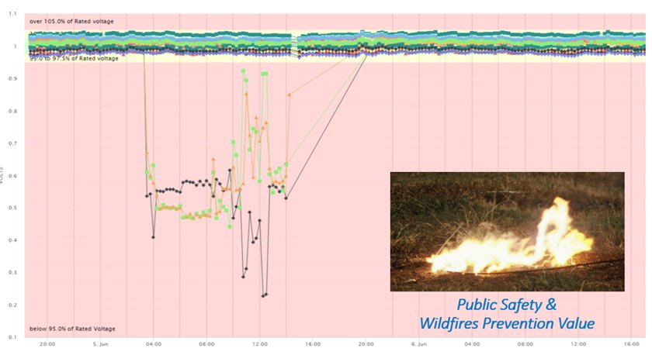
Advanced Transformer Infrastructure

Slide 27
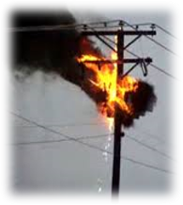
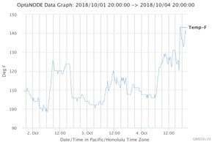
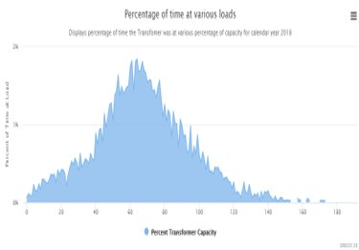
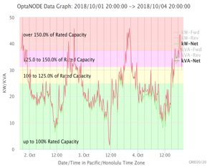
Advanced Transformer Infrastructure

Slide 28
Advanced Transformer Infrastructure
*Achieve Reliability Improvement
*Provide Outage Notifications to Accelerate Restoration
*Reveal Unplanned Loading/Overloading
*Facilitate Improved Fire/Wildfire Mitigation
*Identify Downed Conductor Events
*Proactively Identify Failing Assets
*Reveal DER-Induced Voltage Fluctuations
*Reveal & Document Reverse Energy Entering the Grid
*Facilitate Conservation Voltage Reduction
*Identify Power Theft, Meter Inaccuracies & Bad Multipliers
*Facilitate Safe EV Charging Station & DER Adoption
*Identify Improper Tap Settings

Slide 29
Advanced Transformer Infrastructure
*Identify Harmful Phase Imbalances
*Identify Energy Inefficiencies
*Assist with Clean Energy/Battery Storage Planning
*Reveal GIS Mapping Errors
*Provide Automated Alerts = Hands Free Remote Grid Monitoring
*Support API Calls
*Enhance Microgrids Monitoring
*Facilitate Clean Energy Mandates = Reduce GHG Emissions
*Reduce Corporate Liability Risk

Slide 30
Questions
John Kretzschmar​
SAMSCO​
Spartan Armstrong Metering Supply Company​
Boiling Springs, SC 29316​
john@samscometering.com​
864.590.2883
This presentation can also be found under Meter Conferences and Schools on the TESCO web site: www.tescometering.com

Slide 31
Tesco hospitality suite
We would like you to join us in the TESCO Hospitality Suite for networking and more discussions about metering. The discussion will not be exclusively metering……….but we love metering and that is the most common topic.
TESCO Hospitality Suite – Brighton Tower
Monday and Tuesday 8:00 PM – 10:00 PM

