Slide 1
Introduction to Polyphase Metering
Prepared by Tom Lawton, TESCO
The Eastern Specialty Company
For Mid-South Meter School
Group 2
Wednesday, May 3, 2023 at 10:00 AM
Notes:
1

Slide 2
1-Phase and 3-Phase Power
V
0 30 60 90 120 150 180 210 240 270 300 330 360
Voltage = V_{max} sine α

Slide 3
1-Phase and 3-Phase Power
V_{C}
120⁰
120⁰ ₁₂₀₀
V_{A}
0 30 60 90 120 150 180 210 240 270 300 330 360
V_{B}
Volts Phase A Volts Phase B Volts Phase C
Forward Rotation, ABC

Slide 4
The Need for 3-Phase Power
Single-phase motors provide a pulsating torque to a mechanical load. Loads which require more than 10 horsepower generally also require the steadier torque of a 3-phase motor.

Slide 5
Benefits of 3-Phase Power
Steadier motor torque
Less vibration in machinery
Greater mechanical efficiency
Better voltage regulation
Lower heat losses
Lighter weight conductors

Slide 6
Network Service & Loads
A
120 V
A-N
C
208 V
A-B
N
120 V
B-N
B
Need to meter line-neutral and line-line loads.

Slide 7
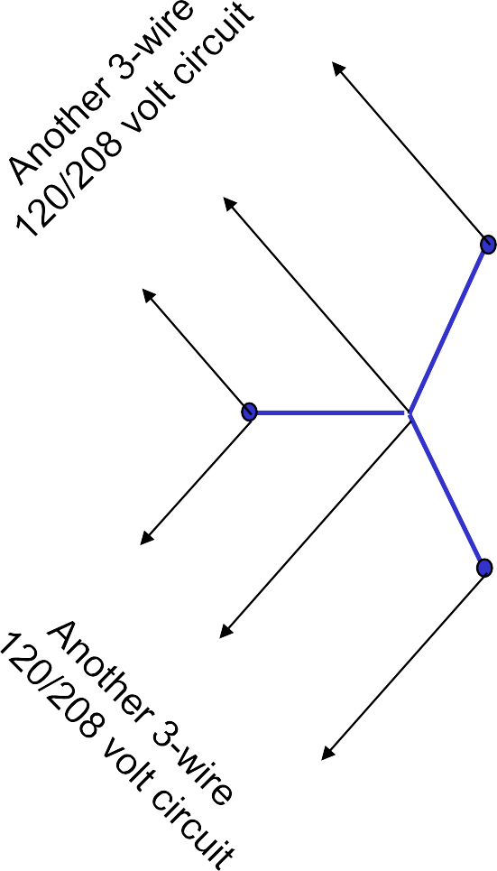
Network Service & Loads
A
N
A
A
C
120 and 208 volt loads
N
C
N
C
B
B
N
B

Slide 8
3-Wire Delta Service & Loads
C
B-C
C-A
A-B-C
B
A
A-B
Need to meter single phase line-line loads, as well as three phase loads.

Slide 9
4-Wire Delta Service & Loads
A
A-B-C
C
A-N
C-A
A-B
N
B-N
B
B-C
Need to meter single phase line-neutral and
line-line loads, as well as three phase loads.

Slide 10
4-Wire Wye Service & Loads
C
A-B-C
C-N
C-A
B-C
A
N
A-N
A-B
B
B-N
Need to meter single phase line-neutral and
line-line loads, as well as three phase loads.

Slide 11
Blondel’s Theorem
Blondel says:
If energy is supplied to any system of conductors through N wires, the total power in the system is given by the algebraic sum of readings of N wattmeters, so arranged that each of the N wires contains one current coil, the corresponding potential coil being connected between that wire and some common point. If this common point is on one of the N wires, the measurement may be made by the use of N-1 wattmeters.
Andre E. Blondel, 1893
We would use “watthour meters” in place of “watt meters” and “energy” in place of “power”.
We would also consider “ground” as a possible current carrying conductor when counting “N”.

Slide 12
Blondel’s Theorem
In a system of N conductors, N-1 meter elements, properly connected, will measure the power or energy taken. The connection must be such that all voltage coils have a common tie to the conductor in which there is no current coil.¹
¹ From the Handbook For Electricity Metering, 9th edition.

Slide 13
What is a Meter Form Number?
A Form designation tells us:
The number and arrangement of meter terminals, and
The number and internal connection of meter elements (stators).
The Form designation describes the meter, not the service.
With modern meters, some meter Forms may be used to correctly meter more than one service configuration.
More than one meter Form could be used with a particular service depending on the connection of the Instrument Transformers.
The same Form designation is usually applicable to equivalent meters of all manufacturers.

Slide 14
Will’s Meter Forms Cheat Sheet
SERVICE | SELF-CONT FORM | XFMR-RATD FORM | NUMBER OF ELEMENTS
1-Phase, 2-W ire | 1S | 3S | 1
1-Phase, 3-W ire | 2S | 4S | 1.5
Network, 3-W ire | 12S | 5S / 45S | 2
3-Phase, 3-W ire, Delta
3-Phase, 4-W ire, Delta | 15S | 8S | 2.5
3-Phase, 4-W ire, Wye | 14S | 6S / 36S
 | 16S | 9S | 3
Consolidated by kV2c Form 16S
Consolidated by kV2c Form 9S
Blondel Solution

Slide 15
Network, 3-Wire
1
120V
0
208V
120V
2

Slide 16
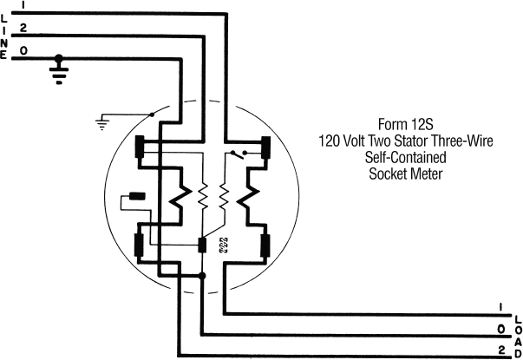
Network, 3-Wire

Slide 17
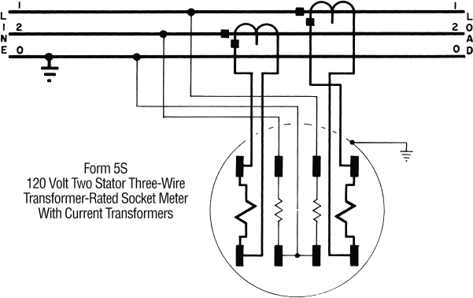
Network, 3-Wire

Slide 18
3-Phase, 3-Wire, Delta
3
A
A
1
A
2
A = 120V, 240V, or 480V

Slide 19
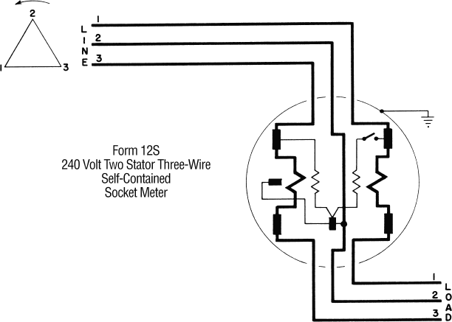
3-Phase, 3-Wire, Delta

Slide 20
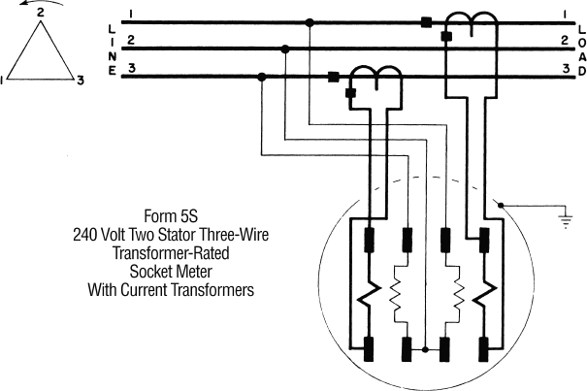
3-Phase, 3-Wire, Delta

Slide 21
3-Phase, 4-Wire, Delta
3
240V
240V
0
1
240V
120V
2
208V
120V

Slide 22
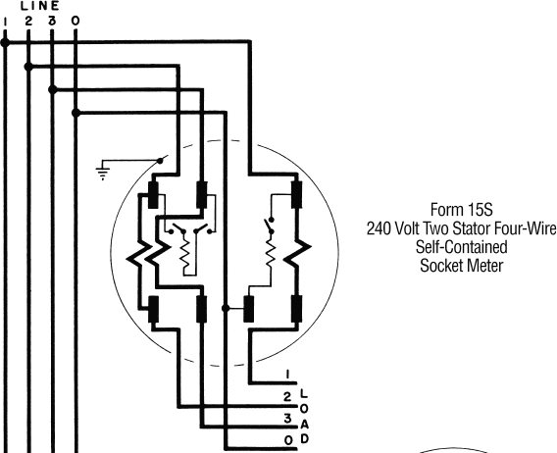
3-Phase, 4-Wire, Delta

Slide 23
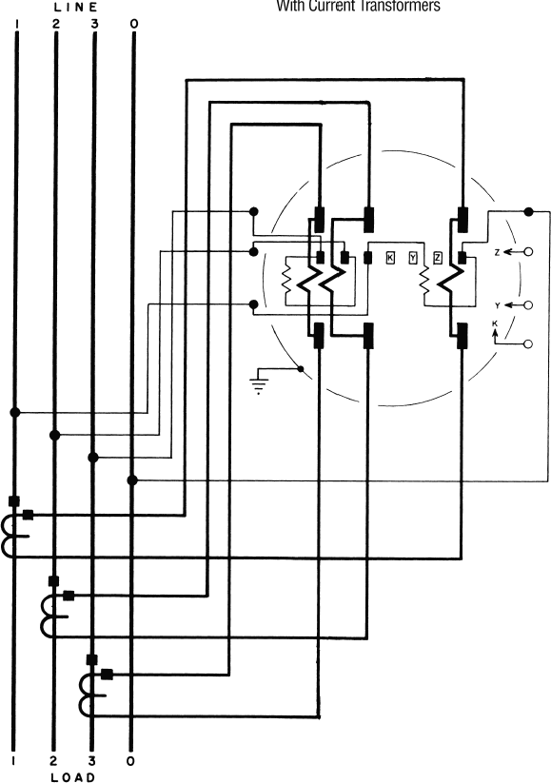
3-Phase, 4-Wire, Delta

Slide 24
3-Phase, 4-Wire, Wye
^{V}C-A
C
^{V}C-N
A
^{V}A-N
^{V}B-C
N
V
A-B
Line Voltages (208 or 480V)
Phase Voltages
^{V}B-N
(120 or 277V)
B

Slide 25
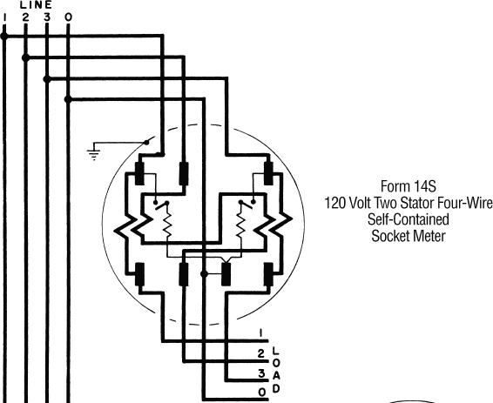
3-Phase, 4-Wire, Wye

Slide 26
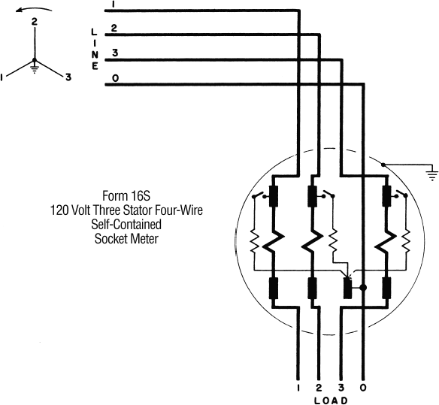
3-Phase, 4-Wire, Wye

Slide 27
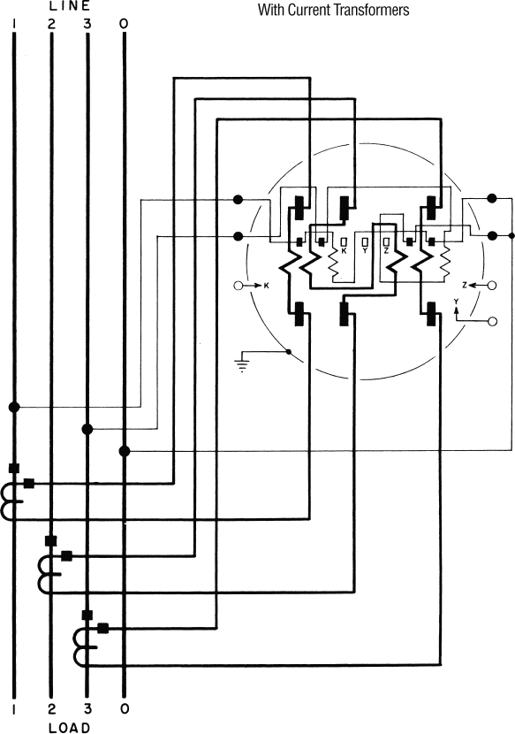
3-Phase, 4 Wire, Wye

Slide 28
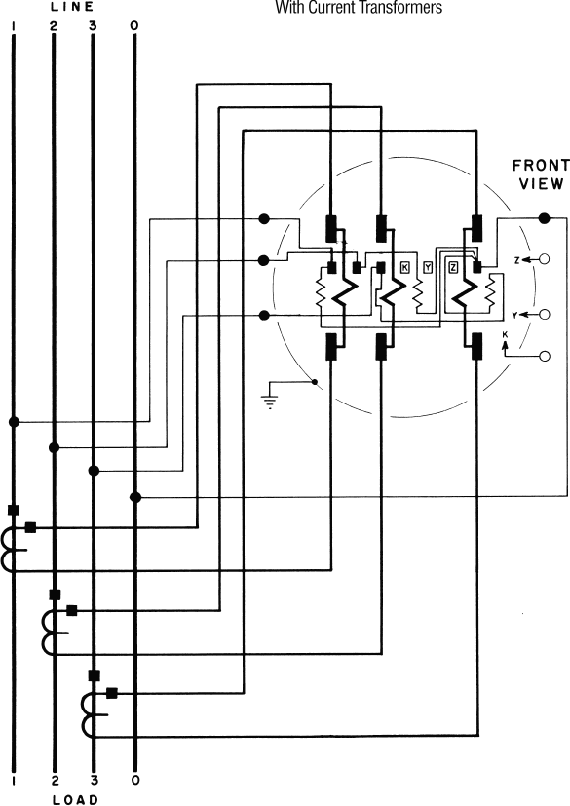
3-Phase, 4-Wire, Wye

Slide 29
4-Wire Wye Metering
K Y Z
K Y
Z
K Y
Z
Form 9
Form 6
Form 36
Element,
wire, wye
2½ Element, 4 wire, wye
2½ Element, 4 wire, wye
Transformer-rated

Slide 30
4-Wire, Wye Metering
N
C
B
A
K Y Z
9S
Transformer-rated

Slide 31
4-Wire, Wye Metering
N
C
B
A
K Y
Z
6S
Transformer-rated

Slide 32
4-Wire, Wye Metering
N
C
B
A
36S
Transformer-rated

Slide 33
2 Element Meters
Form 5 Form 35 Form 45
Typically used for 3 wire Network or 3 wire, 3 phase Delta applications
Occasionally used for other service types including 2 wire single phase, 4 wire Wye and 4 wire Delta (except Fm 35 not for 4W Delta)
Transformer-rated

Slide 34
2 Element Meters
A
A
A
LOAD
C
LINE
C
C
LINE
LOAD
N
N
LOAD
LINE
3 wire, network
45S
A
B
C
3 wire, delta

Slide 35
Polyphase Meters
Other Considerations
Meter Multipliers
Self Contained: The meter multiplier is 1
Transformer Rated: The multiplier is (typically) the product of the CT and VT ratio
Service Types
Some polyphase meters may be used in multiple service types
Selection
Proper wiring and form selection is critical

Slide 36
Polyphase Meters
Select the meter based on the source, not the load.
The “service type” is not always obvious.
Loads other than the “known” load can be connected and may be unmetered.
Meter form numbers describe certain meter characteristics not the service or application
Consider that ground can be a current carrying conductor when applying Blondel’s Theorem.
Understand the operation of present day, polyphase solid state meters and how they may be used to advantage

Slide 37
Combining Polyphase kVAh
kVArh
kVArh
kVArh

Slide 38
Combining Polyphase kVAh
kVArh
C
kWh
B
kWh
A
kWh
Vectoral Method (as the crow flies):
√ (kWh_{A} + kWh_{B} + kWh_{C})² + (kVArh_{A} + kVArh_{B} + kVArh_{C})²
kVArh
kVArh

Slide 39
Combining Polyphase kVAh
kVArh
kVArh
kVArh
Arithmetic Method:
√ kWh_{A}² + kVArh_{A}² + √kWh_{B}² + kVArh_{B}²
+ √kWh_{C} + kVArh_{C}
2 2

Slide 40
Combining Polyphase kVAh
kVArh
C
kWh
B
kWh
A
kWh
Arithmetically combined kVAh > Vectorally combined kVAh They are equal only if all phases have equal phase angles.
kVArh
kVArh

Slide 41
Voltages in a Wye-Connection
^{V}L-L ^{= √ 3 V}L-N
We can prove this by constructing the Line-voltage (L-L) phasors based on the Phase-voltage (L-N) phasors.
120⁰
120
0
120 V
0
A-N

Slide 42
Voltages in a Wye-Connection
30⁰
120⁰ 30⁰
120
0
120 V
0
A-N

Slide 43
Voltages in a Wye-Connection
Using the Law of Sines:
30⁰
^{V}A-C ^{V}A-N
=
sine 120⁰ sine 30⁰
120⁰
30⁰
^{V}A-N
V_{A-C} = V_{A-N} sine 120⁰ / sine 30⁰
^{V}A-C ^{= √ 3 V}A-N

Slide 44
Questions and Discussion
Tom Lawton
tom.lawton@tescometering.com
TESCO – The Eastern Specialty Company
Bristol, PA
215-228-0500
This presentation can also be found under Meter Conferences and Schools on the TESCO website: tescometering.com
ISO 9001:2015 Certified Quality Company
ISO 17025:2017 Accredited Laboratory

