Slide 1
Introduction to TESCO Test Equipment
Prepared by Tom Lawton, TESCO
The Eastern Specialty Company
For Mid-South Meter School
Group 4A
Tuesday, May 2, 2023 at 3:00 PM

Slide 2
Who is TESCO?
TESCO – The Eastern Specialty Company started in Philadelphia in 1904 by two Electric Utility engineers. TESCO developed the first Test Switches in the early 1910’s and has been focused on meter related products, enclosures and meter Test Equipment for nearly 120 years.
We are headquartered in Bristol PA (just outside of Philadelphia) in a historic Mill near the Delaware River. We are focused
on manufacturing and have been
vertically integrating our
manufacturing operations
to better control our lead times,
our supply chain, our quality and
to be better able to respond to
our customers changing needs
and requirements. We have
facilities and people through
out the United states plus
facilities in Canada and the far
east to better support our
customers in those regions.
In short, we know a little about
test equipment for metering
applications.

Slide 3
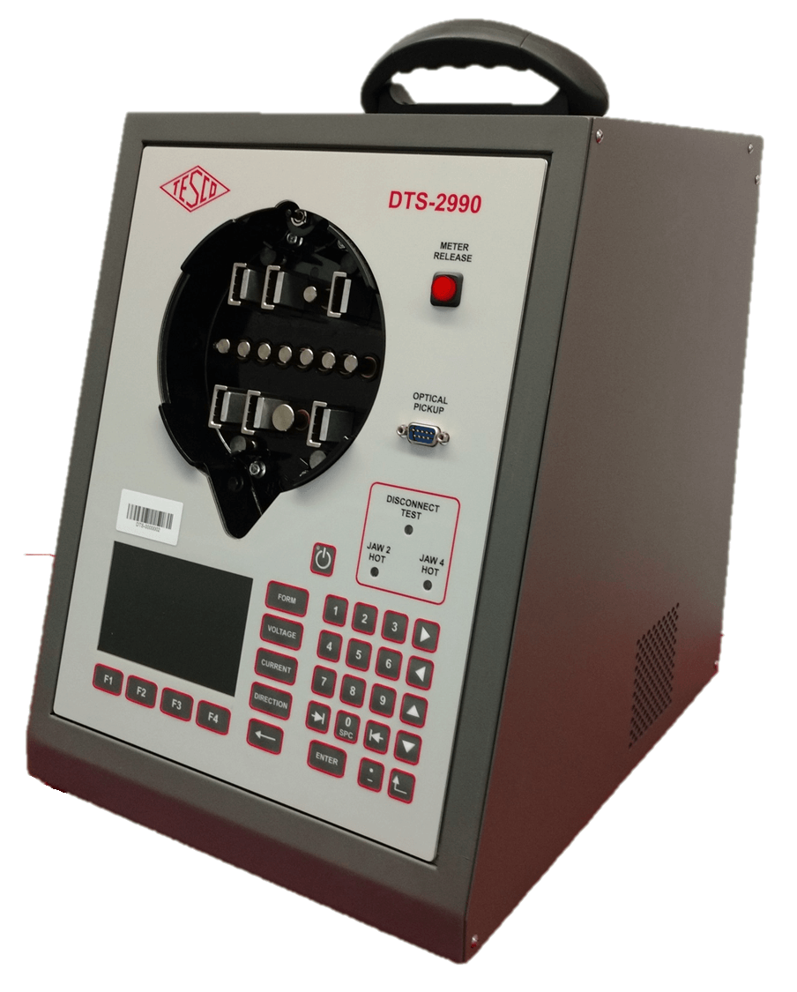
TESCO Catalog No. 2990
Tired of waiting for access to a production test board? Tired of wasting time going to another building to use test equipment? Need flexibility, state-of-the-art performance, and ease of use? If so, then TESCO’s 2990 Desktop Meter Test Station is the answer to what you need.

Slide 4
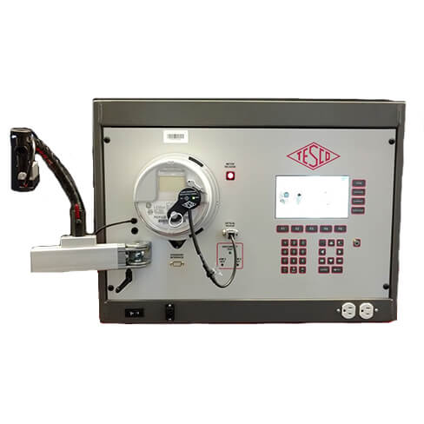
TESCO Catalog No. 3050 and No. 3200
Three Phase Meter Test Board (MTB-3050)
An innovative meter ACCURACY test system offering unsurpassed functionality and ease of use. All of the features you will need to test meters today and tomorrow are standard.
Run standard meter accuracy tests and complex meter accuracy tests under widely varying loading conditions with TESCO’s MTB-3050.

Slide 5
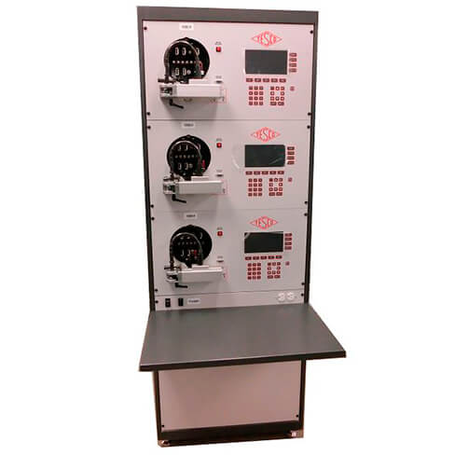
TESCO Catalog No. MTB3
TESCO MTB3 Meter Test Board
Run standard and complex meter accuracy tests under varying loading conditions.
Three-phase, multi-position accuracy test board.
Accuracy: ±0.04% at unity power factor from 0.2A to 50A, ±0.02% typical (Optional 0.02% accuracy boards available upon request)
Current drive: Single range 0.01 to 50A(rms), 70A (peak)
100 amp and 200 amp options available

Slide 6
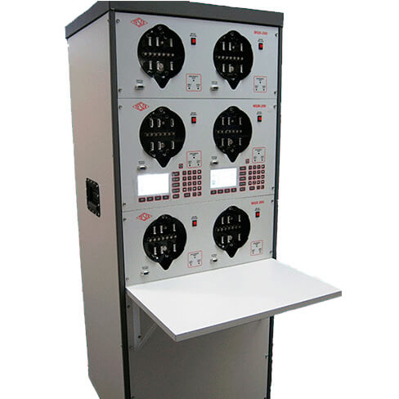
TESCO Catalog No. MQB And MQB1
TESCO Next Gen Meter Qualification Board (MQB)
Power-up and apply load to electric watt-hour meters for functionality testing with TESCO’s multi-position Meter Qualification Boards (MQBs). These boards assist with AMI
Meter Certification process and AMI meter qualification and
communication testing.

Slide 7
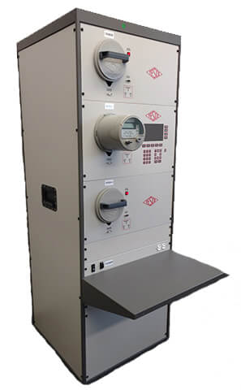
TESCO Catalog No. MQB3
TESCO Three-Phase Meter Qualification Board (MQB3)
The MQB3 facilitates the following meter shop functions in high volume:
New AMI/AMR meters settings check-out
Meter program updates
Software revision checking for both the meter and the communications module
Communications module troubleshooting
Checking of problem meters for open/shorted elements

Slide 8
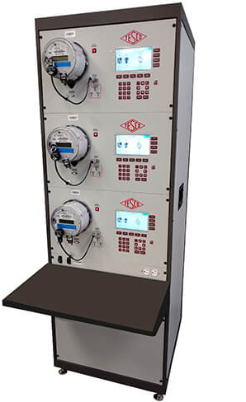
TESCO Catalog No. MEB3
TESCO Meter Engineering Board (MEB)
Perform qualification, disconnect, communication, and advanced functional tests with TESCO’s Meter Engineering Board. With basic metrology (0.1% accuracy) TESCO’s MEB can also be used as a demand board or a time run board, as part of meter
certification, or to meet regulatory testing requirements. A new socket design provides automated operation to make loading easier.

Slide 9
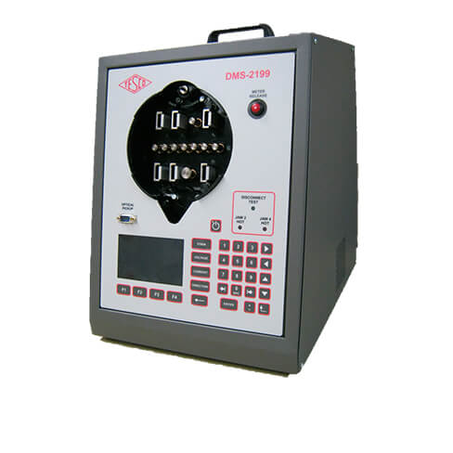
TESCO Catalog No. 2199
Providing complete capabilities for evaluating meters and communications
performance, TESCO’s 2199 Desktop Meter Qualification Board can generate any voltage and load conditions the meter may encounter in the field. Apply non-sinusoidal voltages with complex load waveforms. Perform disconnect tests and reconnect tests without worrying about being able to drive the meter’s switches.

Slide 10
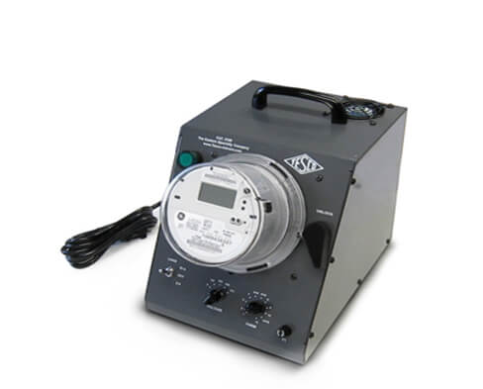
TESCO Catalog No. 2100
The TESCO 2100 Desktop Meter Station is an extremely versatile piece of testing equipment. It can be used as a programming station, a single meter evaluation station, or a test bed for checking meter features and anomalies (including creep testing!).

Slide 11
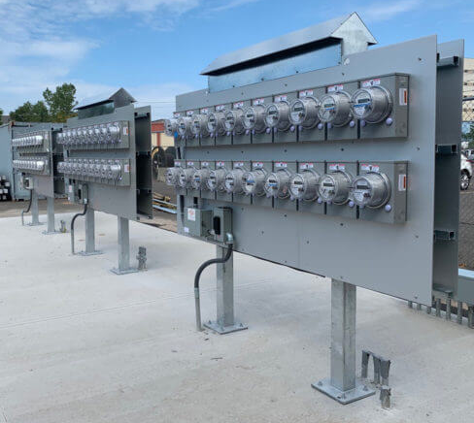
TESCO Meter Farms
Do you have new AMI meters going into the field? Or have you already deployed your new meters, but will have firmware upgrades soon?
The answer? The TESCO AMI Meter Farm will support your AMI Meter Deployment. The Meter Farm powers up banks of meters and runs a current load through each meter.

Slide 12
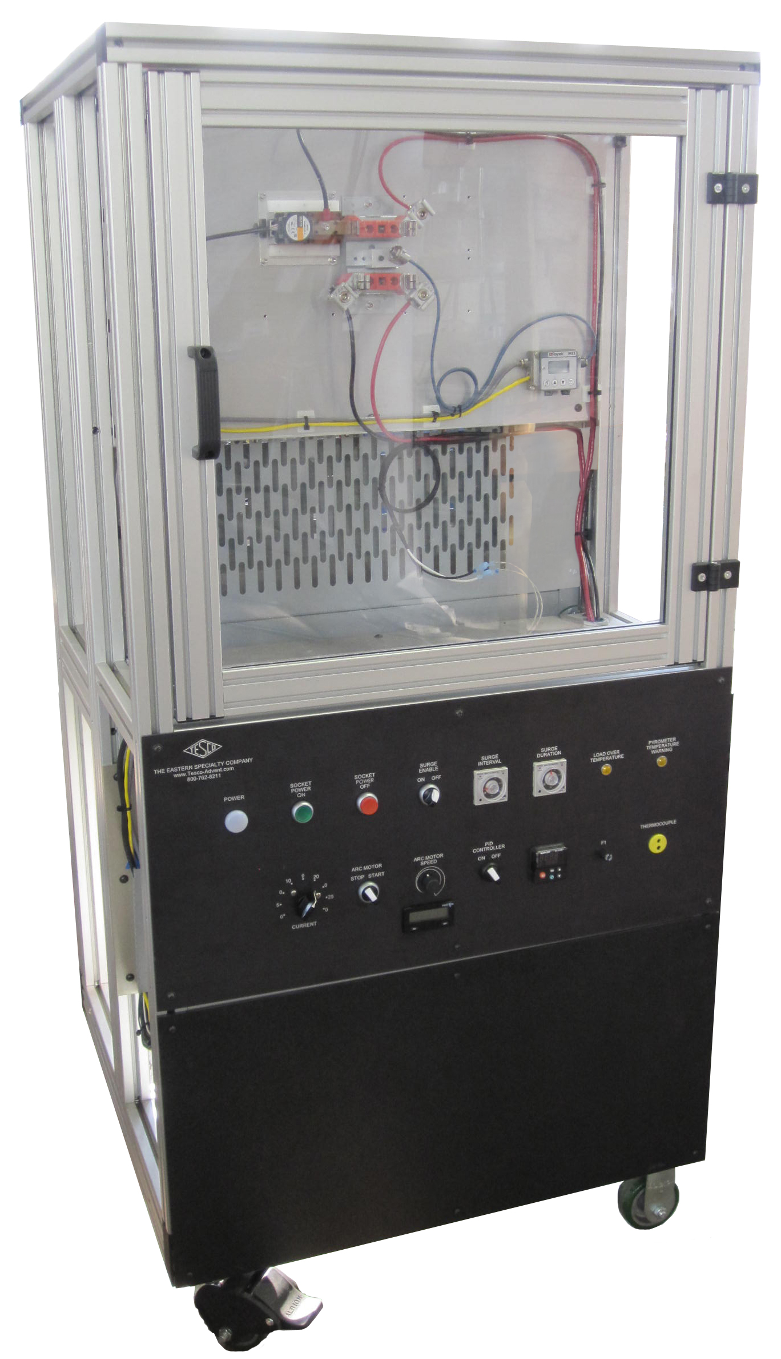
TESCO Catalog No. 3100-L
The TESCO Catalog No. 3100-L Hot Socket Simulator gives you the ability to investigate meter failure issues related to hot socket phenomenon. The Simulator is equipped with one 2S meter socket with four jaws, one of which is the heated jaw. The arcing/heating apparatus can be moved to any of the four jaws (jaw 1 is the standard). Additional arcing/heating elements can be provided as an option for multiple hot jaws on the existing socket.

Slide 13
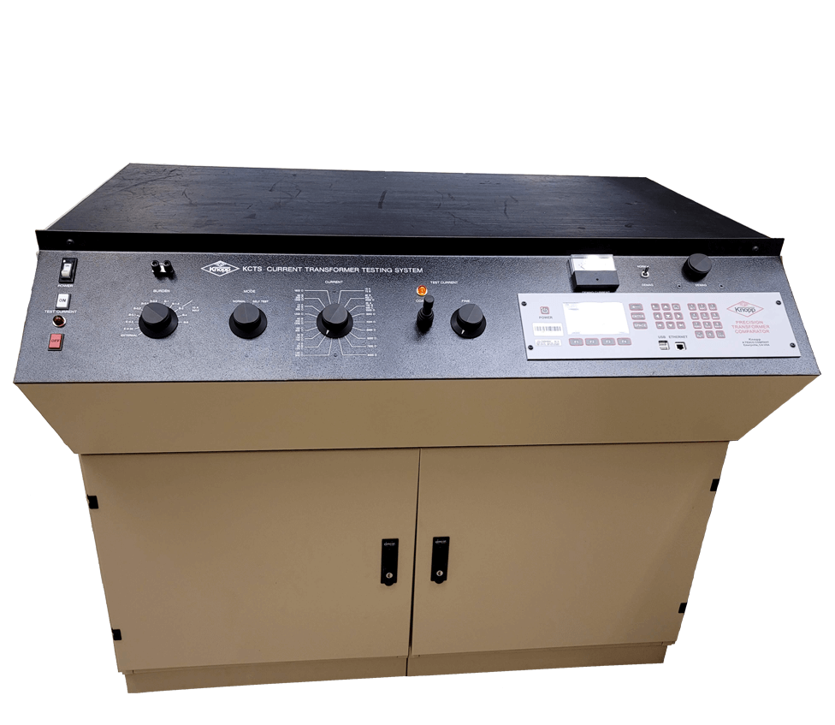
TESCO Catalog No. KCTS-8000
The Knopp Current Transformer Testing System (Type KCTS-8000) is designed to measure the accuracy of instrument transformers having 1 or 5 ampere secondaries and primaries of up to 8000 amperes. The system uses a high accuracy multi-range current transformer as a reference standard. All ANSI standard burdens are included. The phase angle and ratio errors of the transformer-under-test (TUT) are measured by the built-in Knopp Automatic Transformer Comparator.

Slide 14
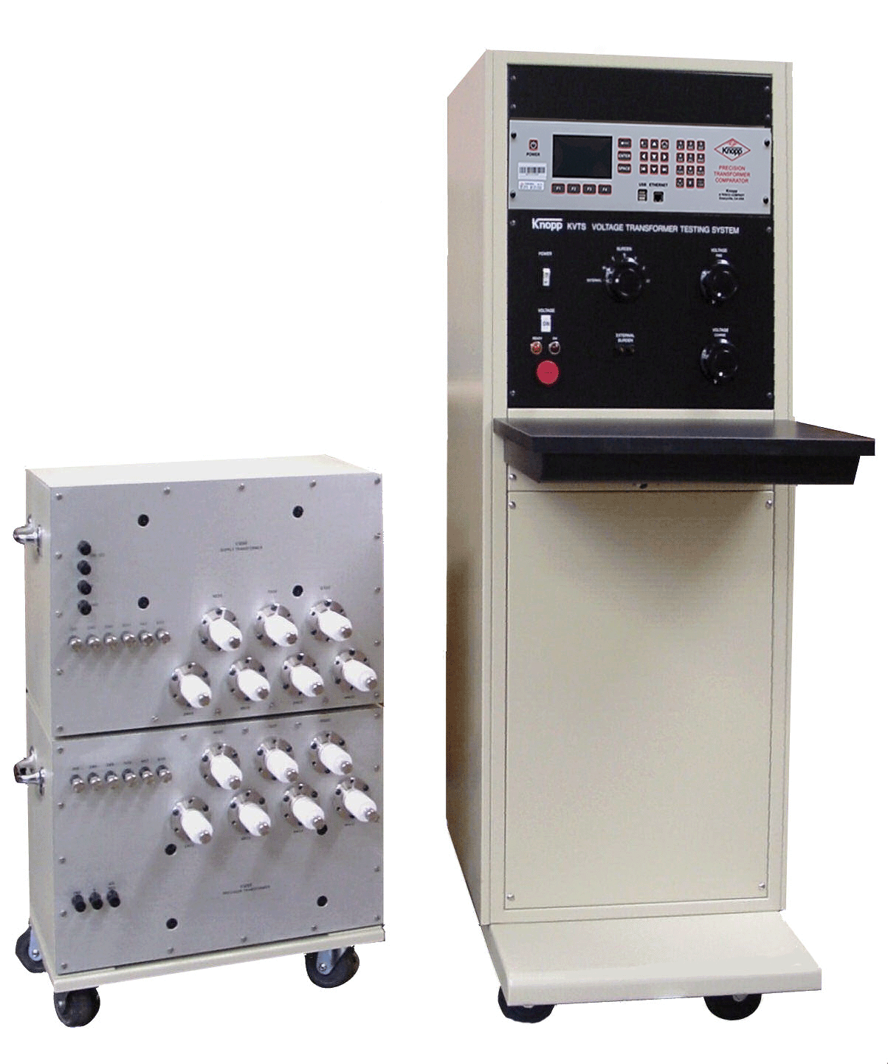
TESCO Catalog No. KVTS
The KVTS Knopp Voltage Transformer Testing System is designed to measure the accuracy of instrument transformers having 120 volt secondaries and up to 14,400 volt primaries (special order for up to 36,000 volt primaries is available). The system includes a control console which contains the control circuitry, ANSI standard burdens, and the Knopp Automatic Transformer Comparator. The Knopp precision and loading transformer set is also included (see picture above) and is connected to the console via a special cable.

Slide 15
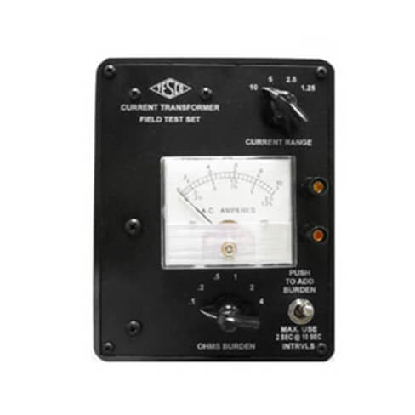
TESCO Catalog No. 1043
The Catalog No. 1043 Current Transformer Burden Test Set is a simple and
inexpensive means whereby a current transformer installation may be quickly checked for many sources of trouble. The tests are made without interrupting the customer’s service and while the load is on.

Slide 16
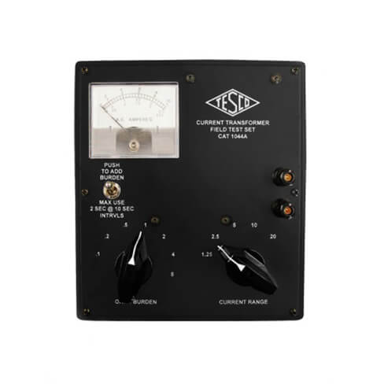
TESCO Catalog No. 1044-A
Due to overwhelming demand, TESCO has re-introduced the Catalog No. 1044A (20) Amp CT Burden Test Set. This lightweight, handheld unit is a simple and inexpensive means whereby a current transformer installation may be quickly checked for many sources of trouble.

Slide 17
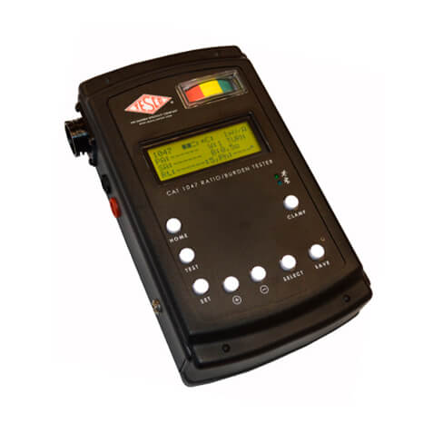
TESCO Catalog No. 1047
TESCO’s Catalog No. 1047 CT Ratio/Burden Tester is a lightweight, portable and highly accurate in-service test set to assist in finding lost revenue by testing the accuracy of your meter circuits. The CT Ratio/Burden Tester can help determine if there are installations errors, loose connections, incorrect ratios, resistance buildup, open CT’s, or manufacturers defects.

Slide 18
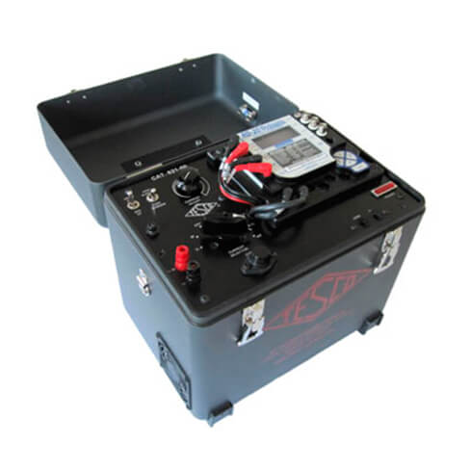
TESCO Catalog No. 621
TESCO’s Catalog No. 621, light-weight, 50 Amp Field Meter Test Kit with Power Factor, has been designed to reduce the weight of field test equipment to the lowest possible limit. The carrying case is fabricated from durable powder-coated aluminum. The total weight of the meter test kit including leads and digital reference standard is only 25 lbs. The Test Kit also incorporates ample storage space for the cable set.

Slide 19
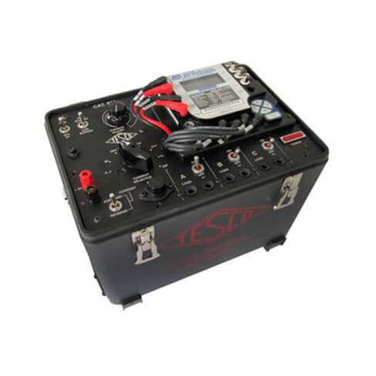
TESCO Catalog No. 630
TESCO’s Catalog No. 630, light weight, closed-link, 30 Amp Field Meter Test Kit with Power Factor, has been designed to reduce the weight of field test equipment to the lowest possible limit when testing electric meters without potential links or with the links closed. The unit is protected within its ergonomic carrying case by a durable powder-coated aluminum shell.

Slide 20
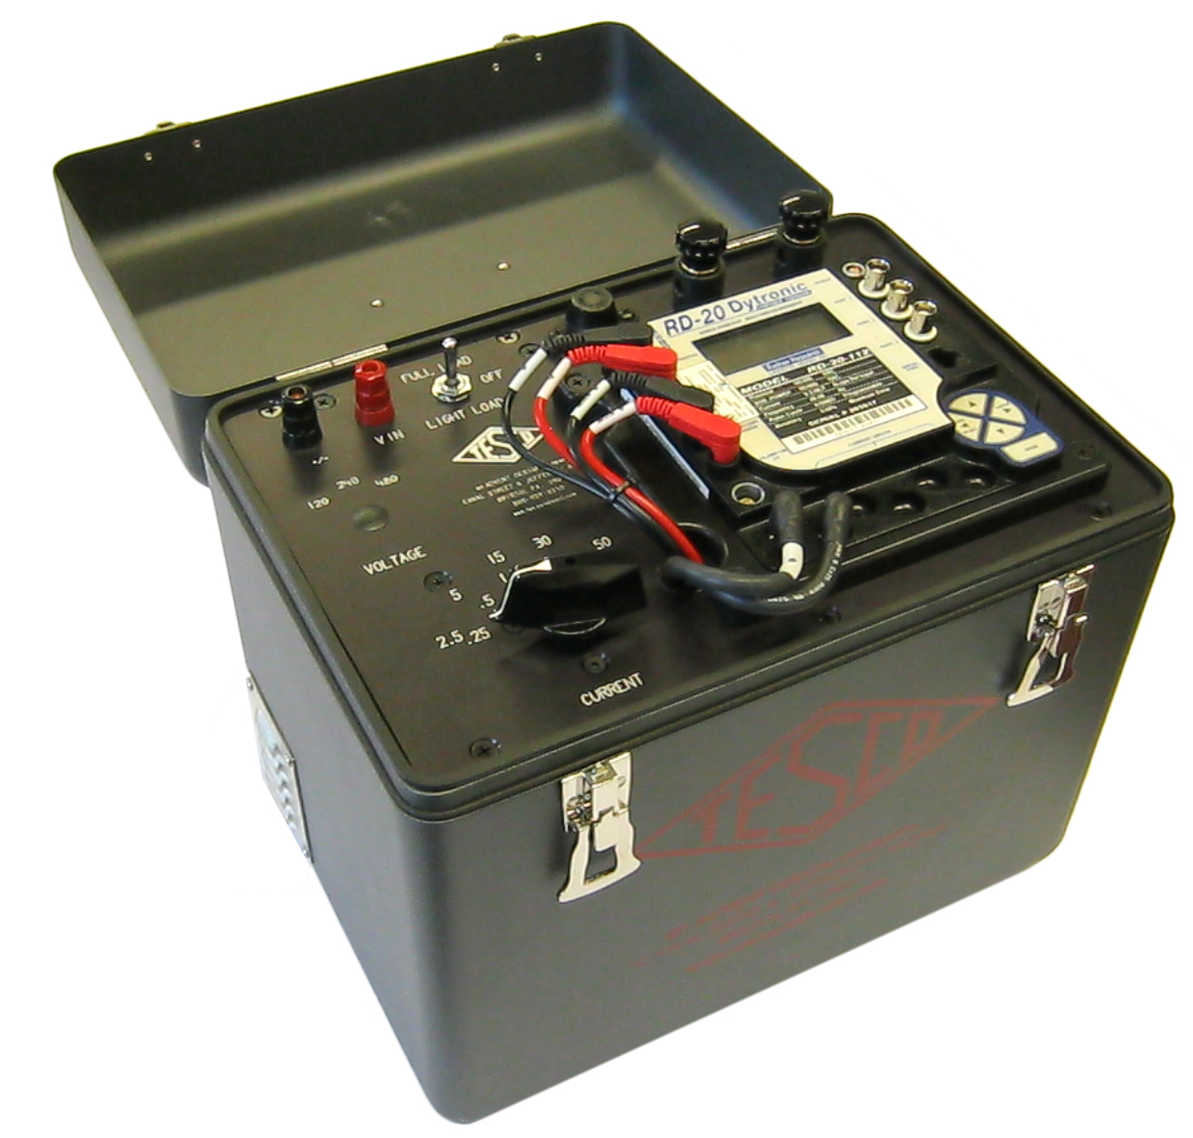
TESCO Catalog No. GA-50 and GA-2.5
TESCO GA Series Field Test Kit (with Resistive Load)
The GA Series Field Meter Test Kit with Resistive Load has been designed to reduce the weight of field test equipment to the lowest possible limit. The carrying case is fabricated from durable powder-coated aluminum. The total weight of the meter test kit including leads and digital standard is approximately 25 lbs.

Slide 21
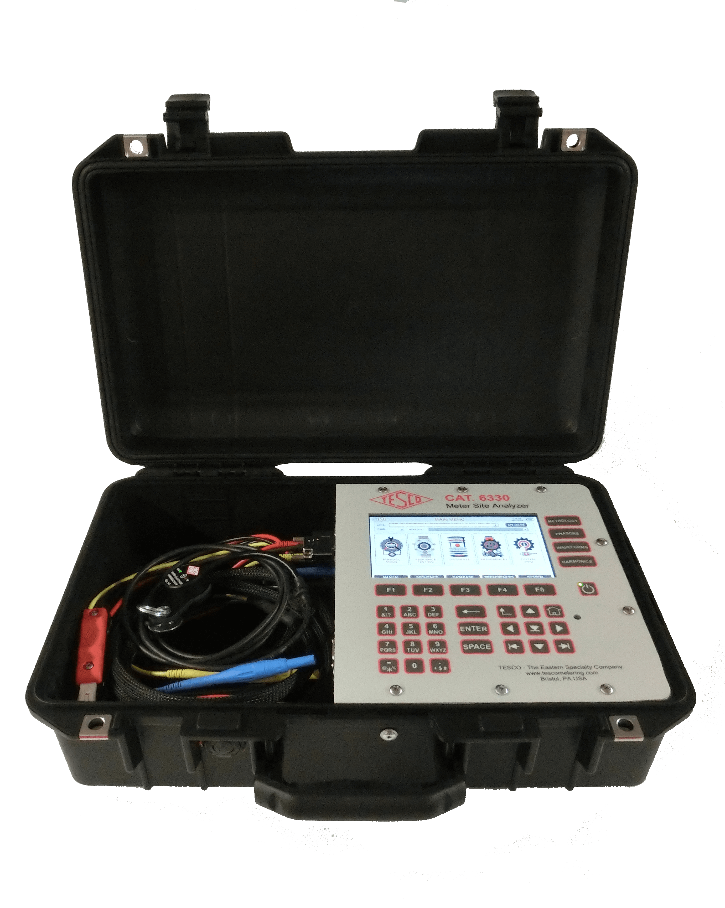
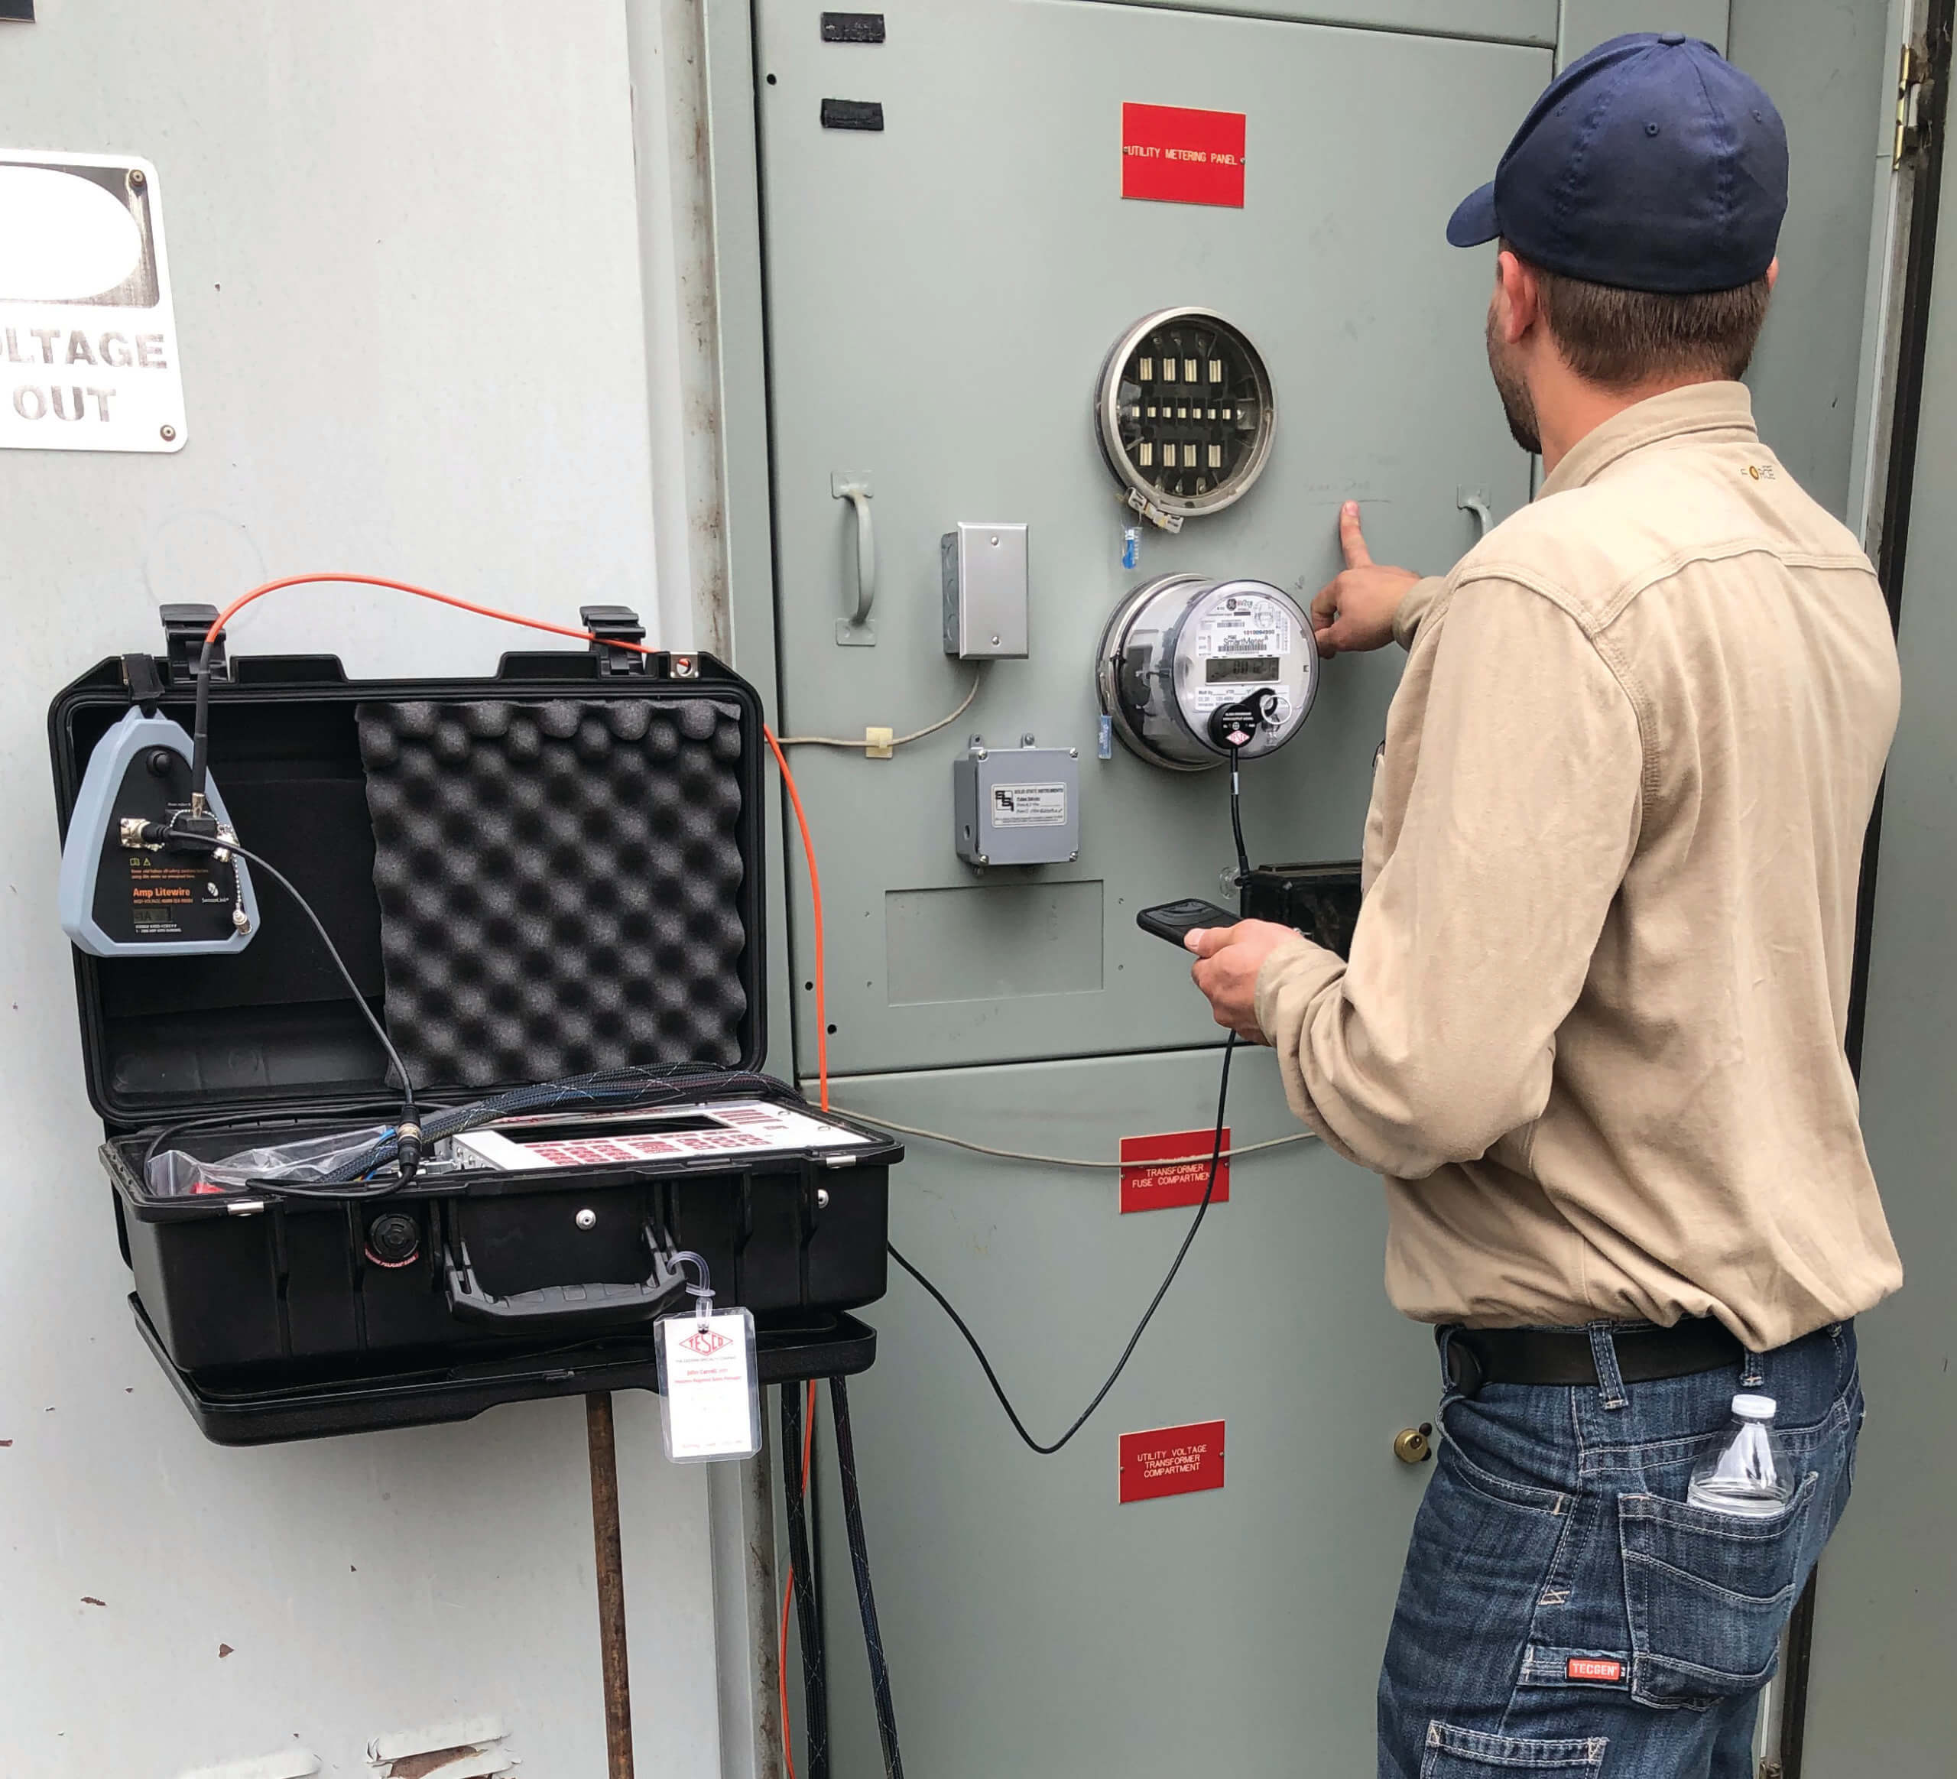
TESCO Catalog No. 6330
TESCO’s Catalog No. Meter Site Analyzer is the most versatile and complete tool for testing the entire functionality of transformer-rated metering installations in a convenient, portable, and ULTRA lightweight kit—only 17.8 lbs!

Slide 22
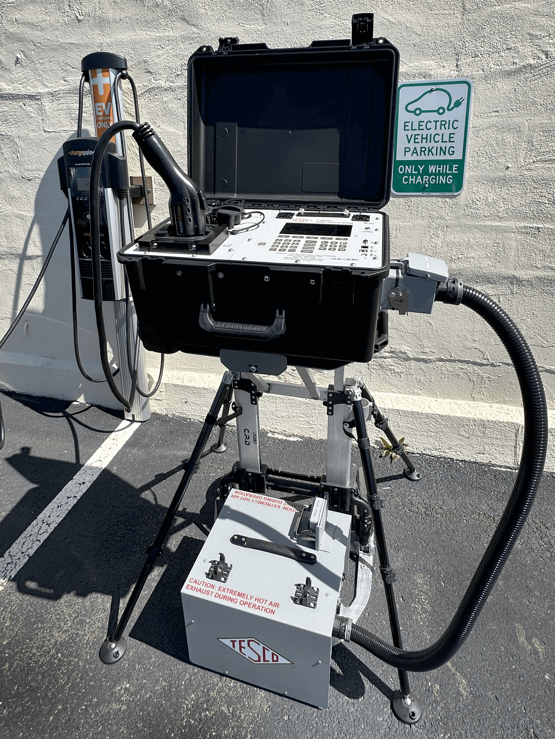
TESCO Catalog No. TS400
Test the accuracy of AC and DC voltages and currents with TESCO’s Electric Vehicle Service Equipment (EVSE) Test System TS400. The TS400 is a valuable instrument with complete testing capabilities and caters to every possible EVSE charging protocol in the world (AC and DC).

Slide 23
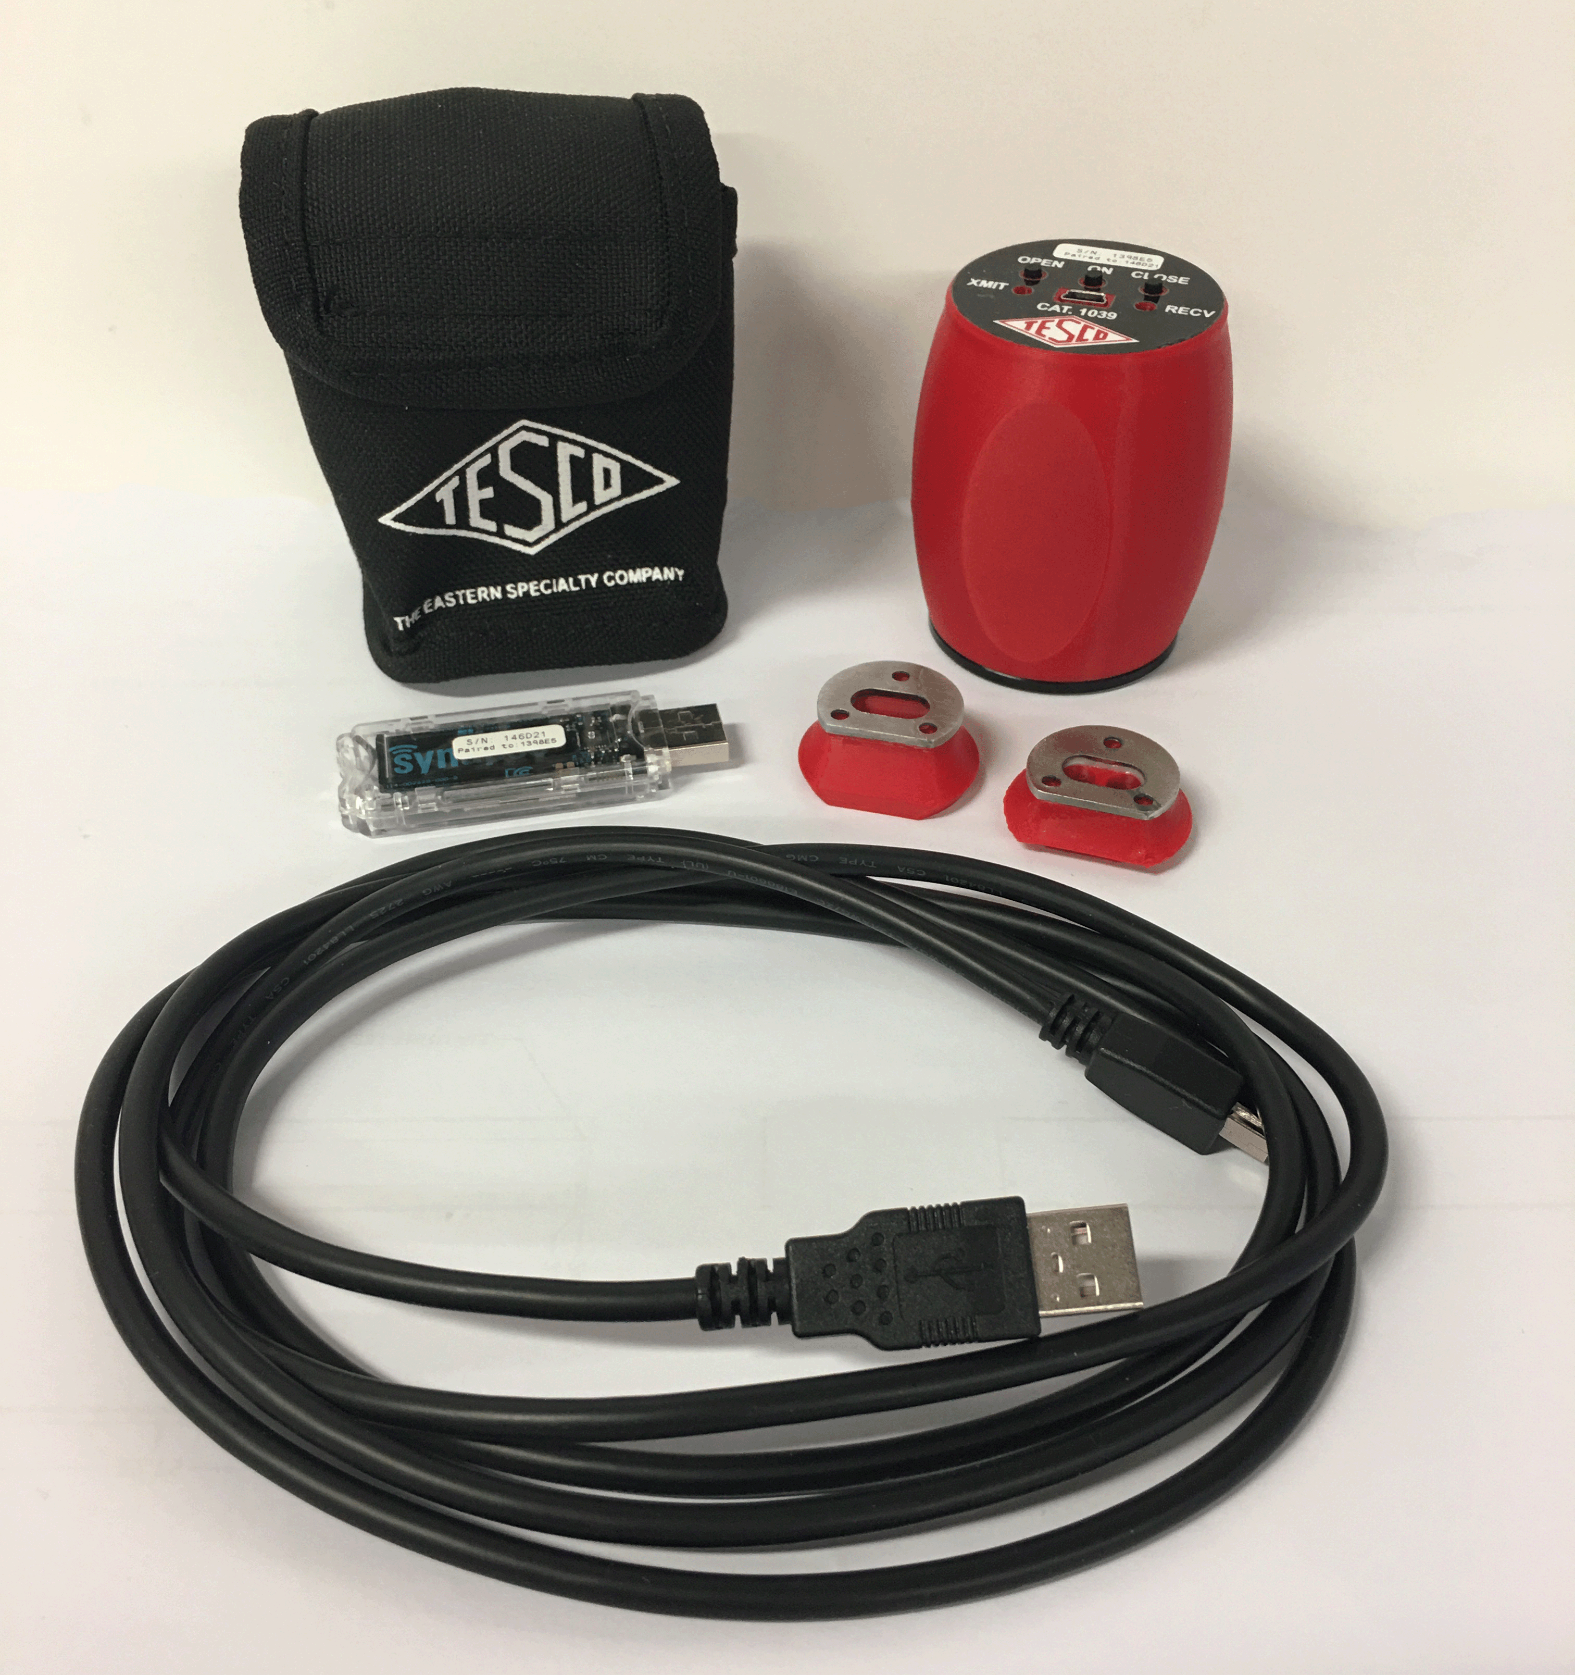
TESCO Catalog No. 1039 and 1039-WP
TESCO Catalog No. 1039 Safety Disconnect Device
Safely disconnect or reconnect power using the meter’s remote disconnect from the palm of your hand.
TESCO’s portable Catalog No. 1039 Safety Disconnect Device allows you to safely disconnect power using the meter’s remote disconnect
TESCO’s Catalog No. 1039-WP Wireless Optical Probe provides easy, two-way communication between a PC and meter with wireless convenience up to 1200 ft.

Slide 24
TESCO Catalog No. 1120
Catalog No. 1120 TESCO RF Meter combines all the features needed for fast, accurate measurements of electromagnetic fields. This instrument was designed to measure RF, but also has the ability to measure electric and magnetic fields.

Slide 25
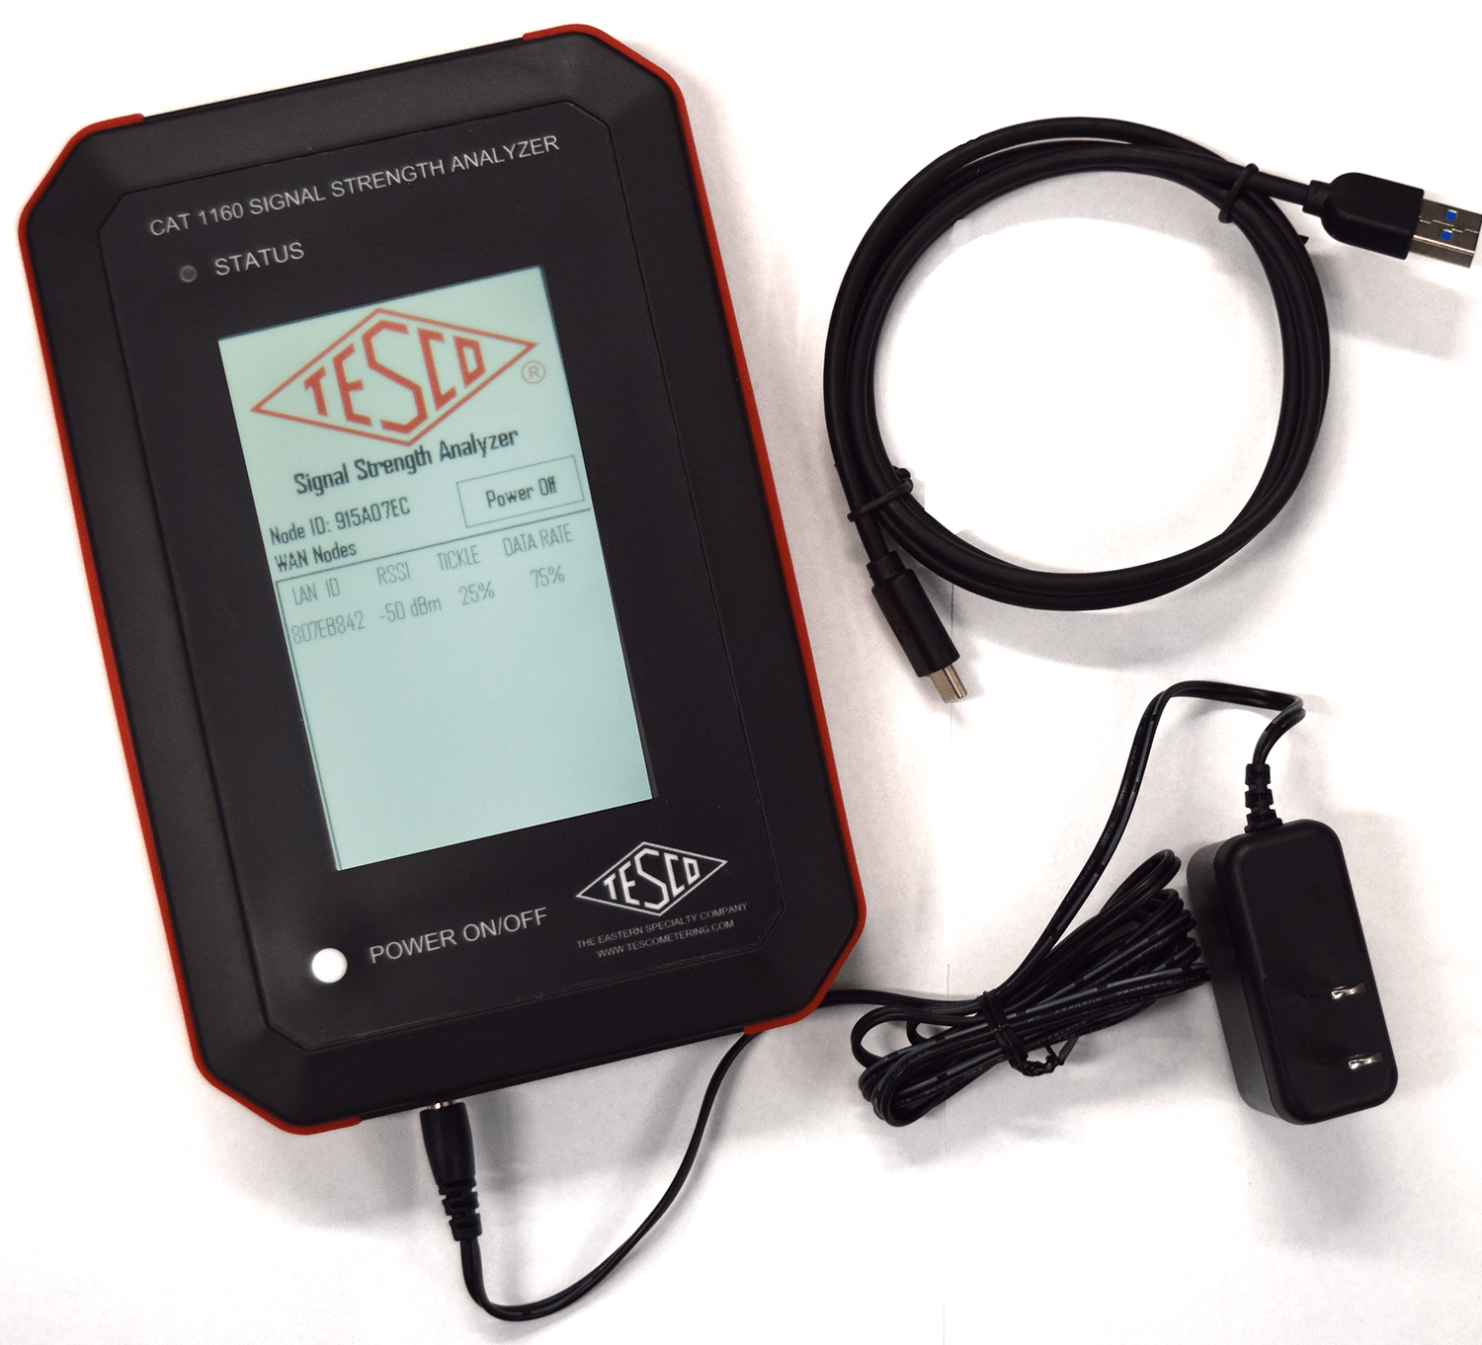
TESCO Catalog No. 1160
For utilities considering or currently involved in AMI implementations, a Catalog No. 1160 Signal Strength Analyzer (SSA) will determine the location with the highest quality signal when placing an antenna for a poorly communicating meter.

Slide 26
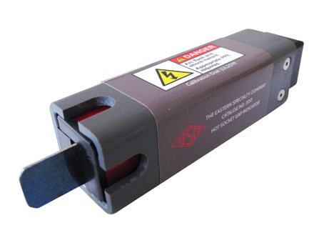
TESCO Catalog No. 300-2
Catalog 300-2: The TESCO Hot Socket Gap Indicator is used to determine if a meter socket jaw has become worn-out and unsafe for continued use. The Gap Indicator determines unsafe holding force on meter socket jaws based on laboratory testing.

Slide 27
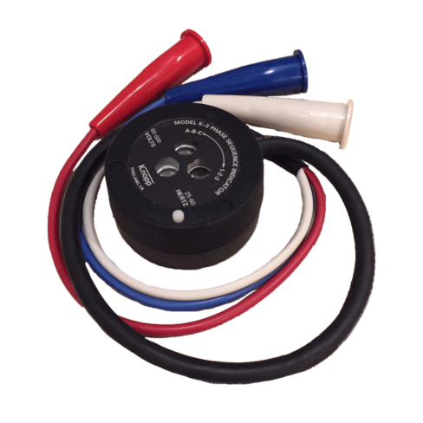
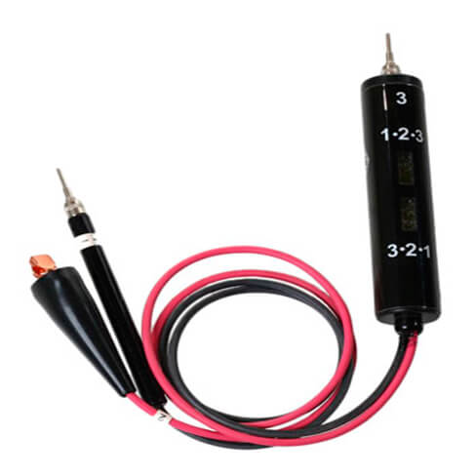
TESCO Catalog No. 500 and No. K-3
The TESCO Catalog No. 500 Phase Sequence Indicator meets the need for an instrument that makes basic phase sequence indication as easy as 1-2-3 (or 3-2-1). It is lighter and more compact than any other indicator available. Phase sequence is simply indicated by two neon lights. One light is for phase sequence 1-2-3 and the other light is for phase sequence 3-2-1.
MODEL K-3: 60-600 volts, 25-60 Hz
Use of the Knopp Phase Sequence Indicator saves man-hours and protects valuable equipment against damage. It pays for itself in a short time.

Slide 28
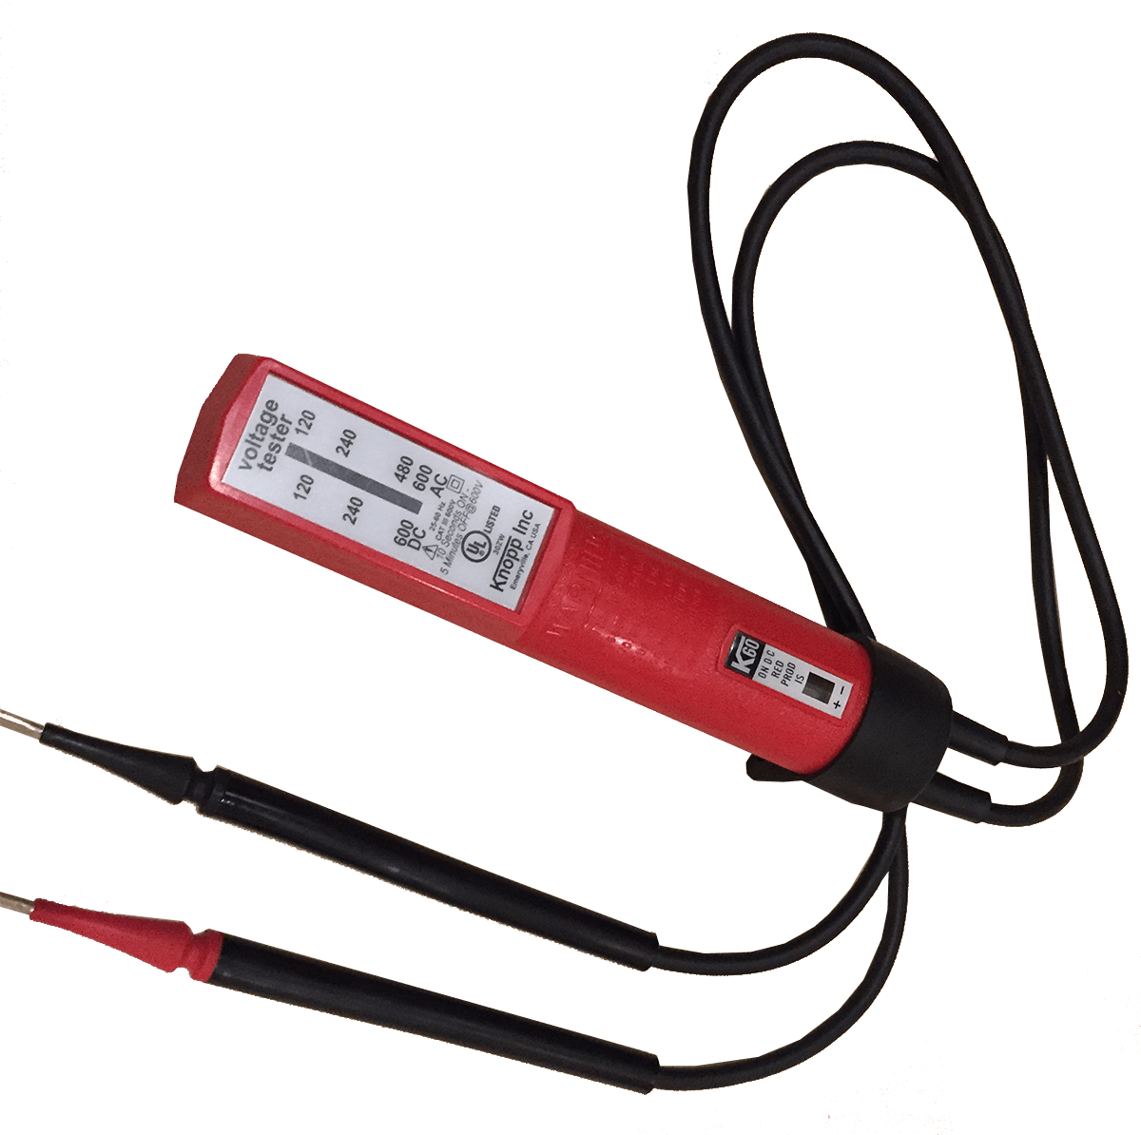
TESCO Catalog No. K-60
K-60 Knopp Voltage Tester for AC and DC with polarity indicator. Double safety indication is by solenoid and by neon lamp.
Knopp Voltage Testers offer portability and ease of use with full protection. These exceptionally versatile and useful tools are backed by a reputation for quality in the design and manufacture of electrical test equipment

Slide 29
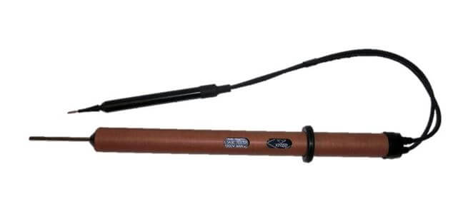
TESCO Catalog No. 4E2-1
The Knopp 4E2-1 Voltage Tester is designed to detect electrical potential (voltage) between the third rail and ground on high voltage electrified transit systems. Two, redundant neon bulbs are used to indicate the presence of voltage.

Slide 30
Questions?
Tom Lawton
TESCO – The Eastern Specialty Company
Bristol, PA
215-228-0500
This presentation can also be found under Meter Conferences and Schools on the TESCO website: www.tescometering.com
ISO 9001:2015 Certified Quality Company
ISO 17025:2017 Accredited Laboratory

