Slide 1
Intra-Grid Sensors and ATI for Distribution Transformers
Distribution Transformer Monitors
Tuesday, May 2, 2023
10:00 AM
John Kretzschmar, SAMSCO

Slide 2
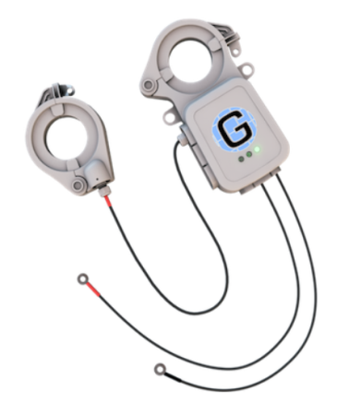
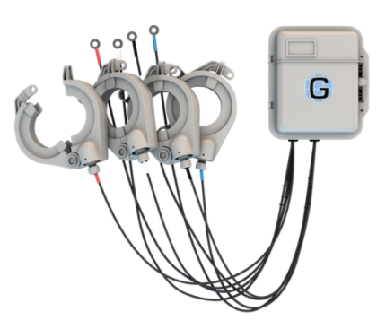
What is an Intra- Grid Sensor?
A sensor used to provide detailed information about conditions that exist between the distribution transformer and the meter.

Slide 3
Why do we need Intra- Grid Sensors?
We are now stressing grid assets with increased unplanned burden and never previously conceived pressures.
Many utilities are still without the comprehensive data that will accurately reveal the intra-grid dynamics created by these changes.

Slide 4
Distributed Energy Resources (DER)
Through solar and wind renewables, we are introducing Reverse Energy onto the distribution grids.
The millions of existing transformers were not designed to handle this impact.
While renewables are beneficial, Reverse Energy can produce unstable, and unsafe grid conditions.

Slide 5
Distributed Energy Resources (DER)
Intra-grid sensors accurately measure and report Reverse Energy, and its impacts on the grid.
Utilities without AMI, or “smart meters” need intra-grid sensors to understand the Reverse Energy impacts inside their grid.
Utilities with AMI need intra-grid sensors to understand Reverse Energy impacts on transformers.

Slide 6
Distributed Energy Resources (DER)
The reality is that AMI generated Reverse Energy data does not accurately indicate impacts on transformers or the resulting grid impacts.
AMI data is typically not accurately aligned to the upstream transformers due to pervasive GIS mapping errors, thus causing aggregated AMI data to be unreliable.

Slide 7
Reverse energy
The reality is that AMI generated Reverse Energy data does not accurately indicate impacts on transformers or the resulting grid impacts.
AMI data is typically not accurately aligned to the upstream transformers due to pervasive GIS mapping errors, thus causing aggregated AMI data to be unreliable.

Slide 8
Reverse energy
AMI-deployed utilities might think they know Reverse Energy impacts, the truth is they typically do not possess accurate AMI-to-transformer information.
This can leave linemen in a position of not knowing what to expect when they approach DER-active transformers.

Slide 9
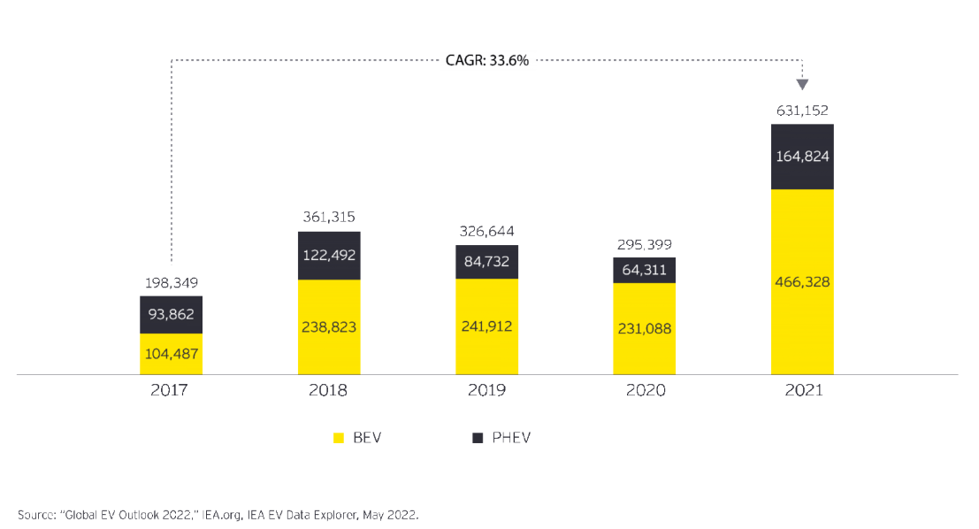
Electric Vehicles
To date, over 2 million EV’s have been sold in the US.
By 2027, annual sales are expected to reach 2 million EV’s.
Electric cars still make up just 1% of cars on our roads.
On average, EV’s cost about $10,000 more than a standard vehicle.

Slide 10
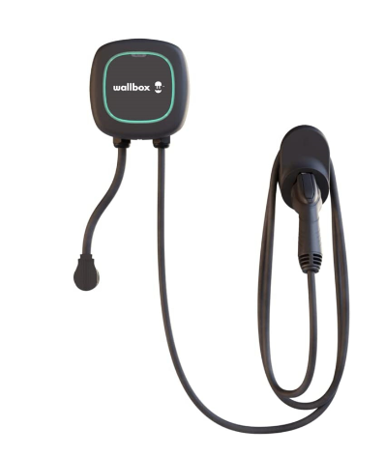
Electric Vehicles
Electric Vehicle charging stations create a new, unplanned load on transformers. Each charging station has the capability of adding up to one additional homes’ worth of power load on a transformer.
This unplanned loading impacts transformers and may exceed a transformer’s designed capacity causing major problems.

Slide 11
Illegal Marijuana production
Illegal marijuana grow houses commonly steal significant levels of power from the grid.
Theft occurs simply by tapping power lines in front of the meters.
No endpoint meter (including AMI smart meters) can effectively detect pre-meter power theft.
This means thieves steal as much power as they want, and they steal it indefinitely without fear of detection.

Slide 12
Legalized Marijuana
When jurisdictions legalize marijuana, significant unplanned loading hits the respective transformers and the grid.
Legalization permits, in some ways encourages residents to grow marijuana using power-intense hydroponic resources. This unanticipated reality then causes additional strain on the existing transformers and the grid.

Slide 13
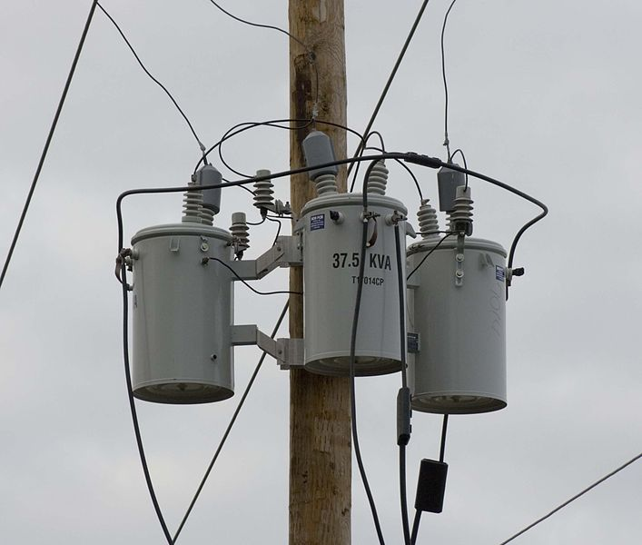
Aging Assets
According to the US Department of Energy, the average age of existing distribution grid transformer is presently in the range of around 38 years.
The average projected life span of transformers is typically 25 years so many transformers have already eclipsed their intended life span, yet we demand more performance, reliability, and various unintended service capabilities.

Slide 14
Aging Assets
Intra-grid sensors proactively reveal over-burdened and failing transformer assets allowing operators to effectively enable preventive maintenance efforts.
This approach enables operators to transition away from costly and disruptive, reactive grid management practices.

Slide 15
Power Theft
Intra-grid sensors proactively reveal over-burdened and failing transformer assets allowing operators to effectively enable preventive maintenance efforts.
This approach enables operators to transition away from costly and disruptive, reactive grid management practices.

Slide 16
Power Theft
Despite significant Smart Meter penetration, power theft is a perpetual problem. Industry experts suggest that U.S. power theft is in excess of $6 Billion per year.
The locations of power theft is typically a mystery. If the affected overburdened transformers finally fail, utility operators then learn where the theft is occurring.

Slide 17
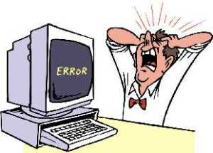
Meter Programming Issues
An incorrectly programmed meter can result in significant errors.
For example: a meter programmed for a 200:5 transformer but has a 400:5 transformer will significantly misreport usage.

Slide 18
What are System Losses?
Energy generated by Power Station does not match energy distributed to the consumers.
The difference between generated and distributed energy is known as Transmission and Distribution loss; aka system loss.
System loss is the energy that is generated but not paid for by users.

Slide 19
Line Loss
According to US Energy Information Administration reports, nearly 200 Billion unmetered kWh’s are ‘leaked’ from US distribution grids annually.
This loss represents nearly $21 Billion that was unmetered but was amortized as electricity cost across rate payer’s bills.
All of this while our government, utilities, and rate payers have been investing billions of dollars in ‘smart meters’, and other energy efficiency efforts.

Slide 20
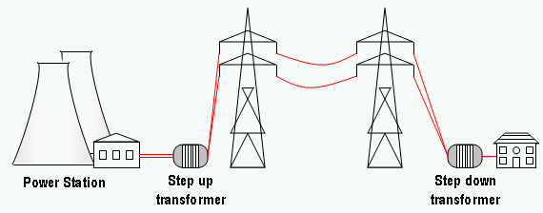
Line Loss
Electric distribution grids do not have adequate sensor technology and analytic capabilities to allow utilities to directly reduce system losses.
As a result, a blind spot exists between the substation SCADA and the AMI meter.
Intra-Grid Sensors can provide visibility into this critical area.

Slide 21
The Next Step in Grid Modernization
Advanced Transformer Infrastructure (ATI)
Reliability Improvements
DER & EV Integration
Fire Mitigation
Outage Notification
Voltage Optimization

Slide 22
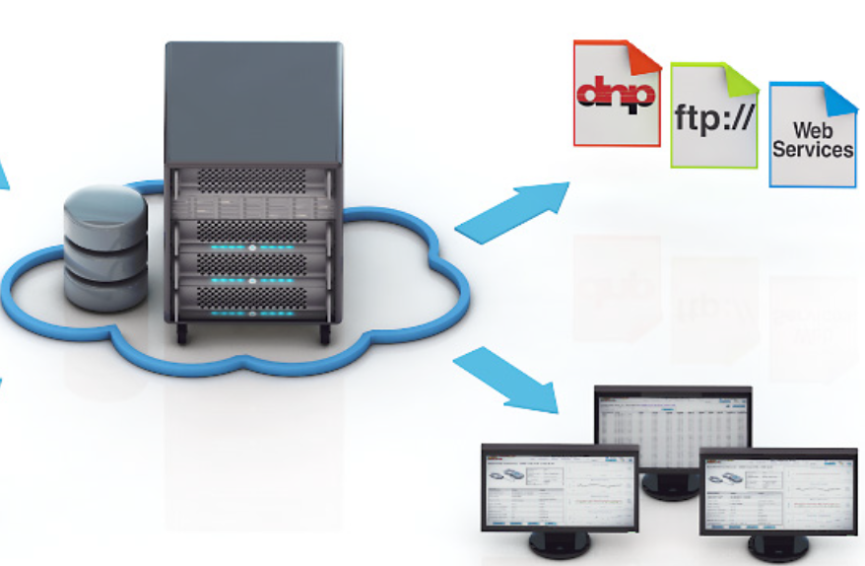
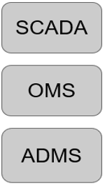
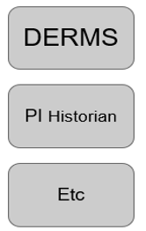
Advanced Transformer Infrastructure
API
API
GUI

Slide 23
Advanced Transformer Infrastructure

Slide 24
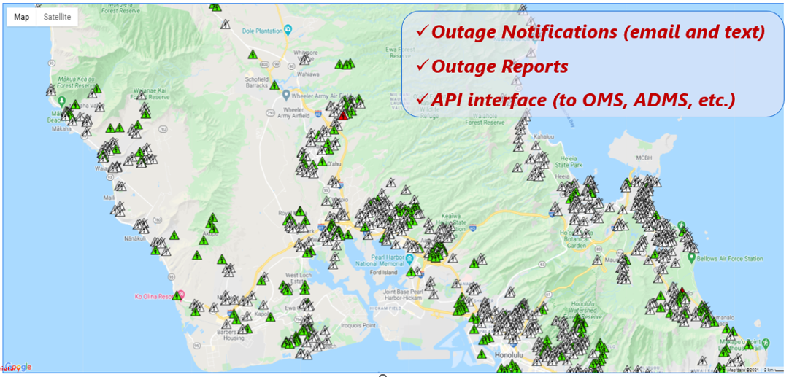
Advanced Transformer Infrastructure
:
Outage Notification

Slide 25
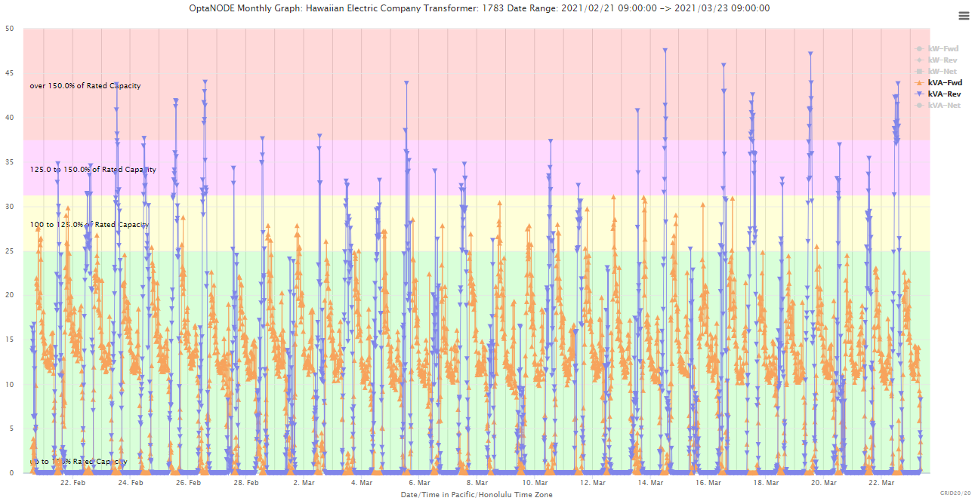
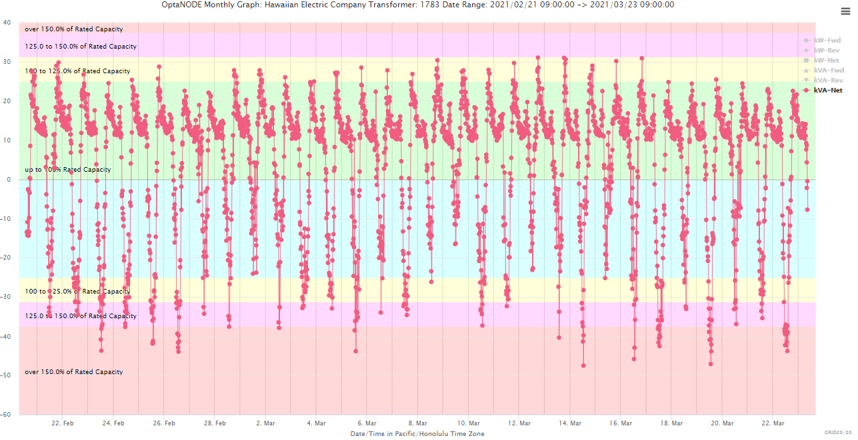
Advanced Transformer Infrastructure
Forward & Reverse Energy Impacts
The combination of excessive Delivered & Received Energy can cause Transformer Overload and Premature Failure (i.e., accelerated End of Life & potential Asset Fires)
ATI Systems can also deliver:
Transformer Overload Awareness = Preventive Intervention
Asset Fires/Wildfires Prevention = Reduces Liability Risk
Improved Lineman & Public Safety = Reduces Liability Risk

Slide 26
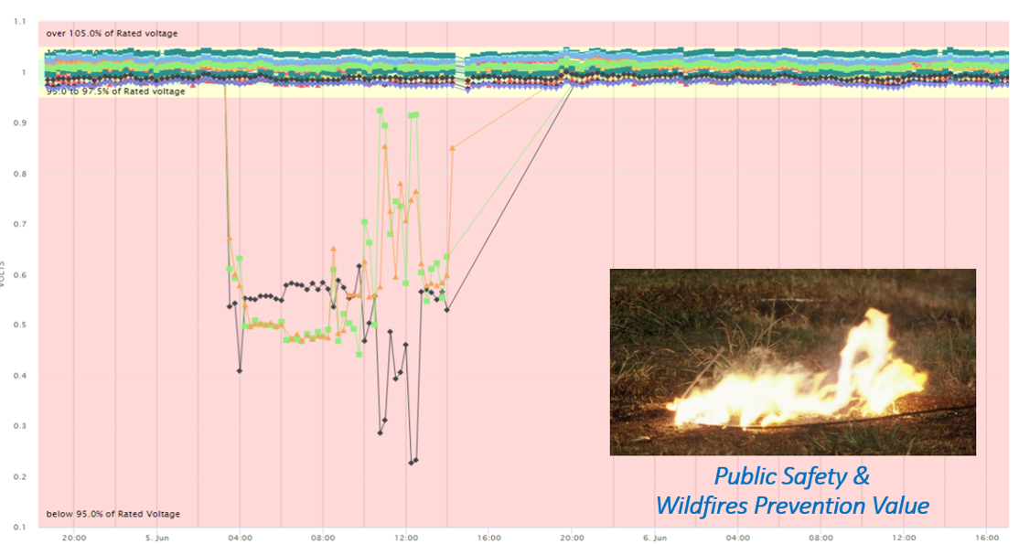
Advanced Transformer Infrastructure

Slide 27
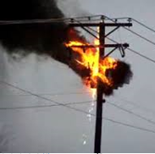
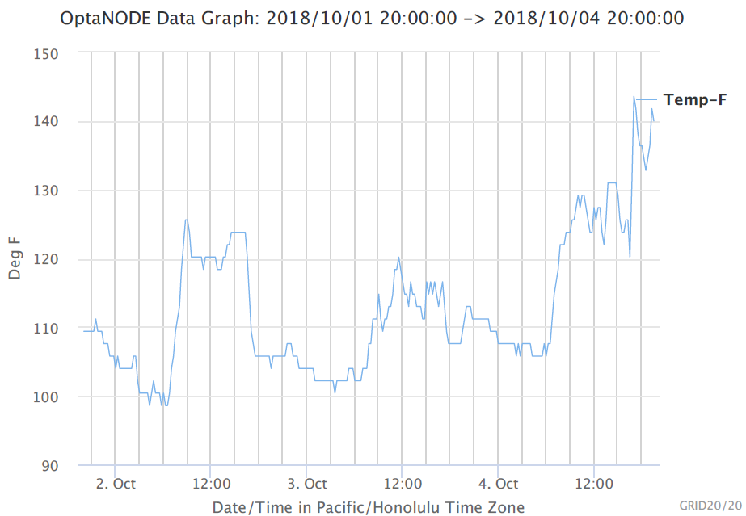
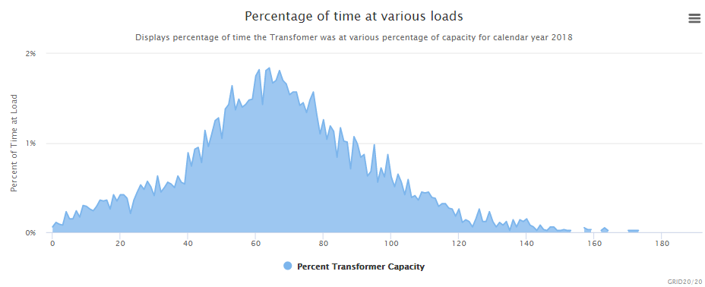
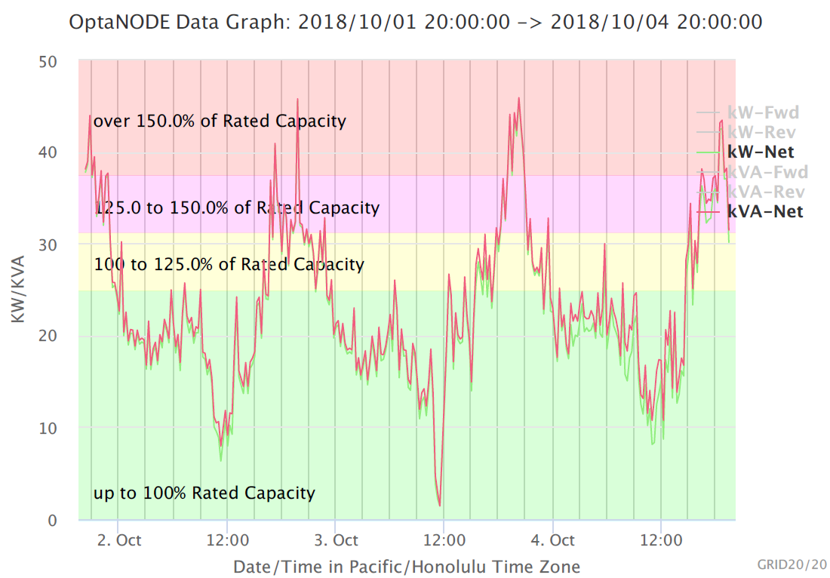
Advanced Transformer Infrastructure

Slide 28
Advanced Transformer Infrastructure
*Achieve Reliability Improvement
*Provide Outage Notifications to Accelerate Restoration
*Reveal Unplanned Loading/Overloading
*Facilitate Improved Fire/Wildfire Mitigation
*Identify Downed Conductor Events
*Proactively Identify Failing Assets
*Reveal DER-Induced Voltage Fluctuations
*Reveal & Document Reverse Energy Entering the Grid
*Facilitate Conservation Voltage Reduction
*Identify Power Theft, Meter Inaccuracies & Bad Multipliers
*Facilitate Safe EV Charging Station & DER Adoption
*Identify Improper Tap Settings

Slide 29
Advanced Transformer Infrastructure
*Identify Harmful Phase Imbalances
*Identify Energy Inefficiencies
*Assist with Clean Energy/Battery Storage Planning
*Reveal GIS Mapping Errors
*Provide Automated Alerts = Hands Free Remote Grid Monitoring
*Support API Calls
*Enhance Microgrids Monitoring
*Facilitate Clean Energy Mandates = Reduce GHG Emissions
*Reduce Corporate Liability Risk

Slide 30
Questions?
John Kretzschmar
SAMSCO
Spartan Armstrong Metering Supply Company
Boiling Springs, SC 29316
john@samscometering.com
864.590.2883
This presentation can also be found under Meter Conferences and Schools on the TESCO web site: www.tescometering.com

