Slide 1

NIGHTHAWK AMI on the Public Network

Slide 2

About Nighthawk
    25-years of utility experience
    100+ utilities served
About Adaptiv™
    Unique zero-infrastructure network
    Cellular + Mesh Communications
      Verizon LTE
      AT&T
    Ideal for either incremental or rapid deployment
    Lowest total cost of ownership in the industry
©2020 Nighthawk
2

Slide 3

Introducing Adaptiv™

Slide 4
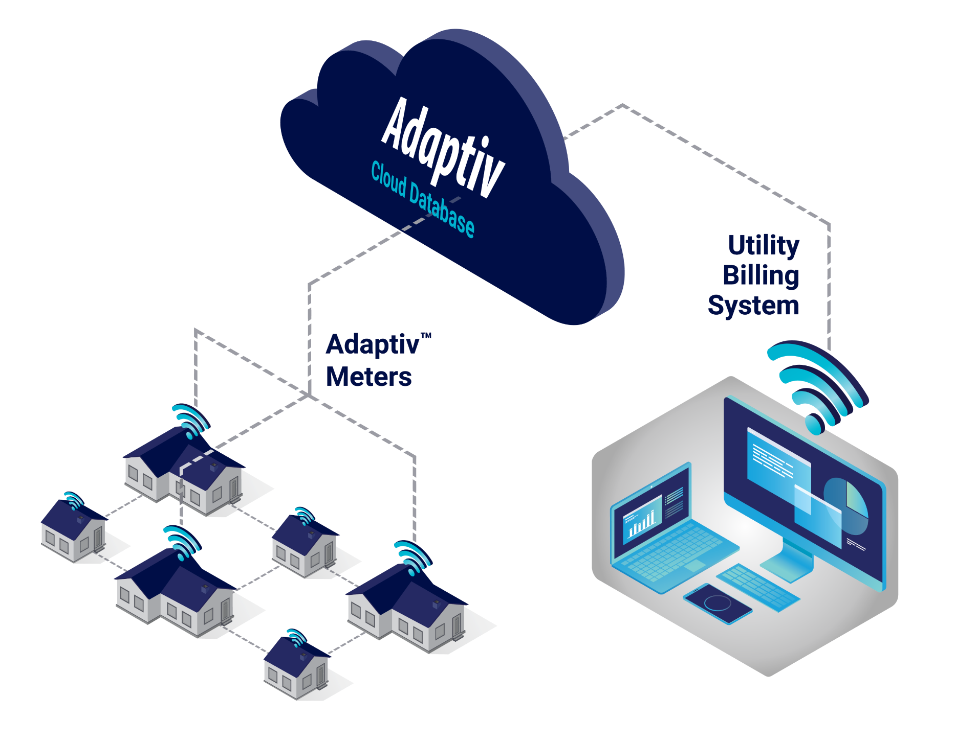
Introducing Adaptiv™ AMI
ADVANCED METERING SOLUTION BY NIGHTHAWK
Zero Infrastructure
Adaptiv™ AMI means no costly
infrastructure to install / maintain
Integrated Data Transfer
Standards-based integration to
utility billing applications
Multispeak, MV-RS, CMEP
Seamless Cloud Software
No hardware to buy or
databases to manage
Secure, Reliable Reads
Secure communications for on-demand
move in/move out reads on all meters

Slide 5

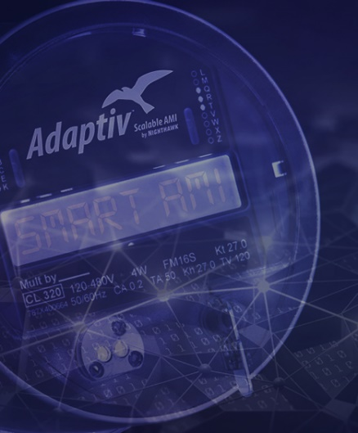

Adaptiv™ Solution Benefits
On-demand remote move-in/ move-out reads
Predictive billing
Interval data for
advanced analytics: load analysis, interruptions monitoring, line
loss calculations
Standards-based integration to other applications
Integration to MDMS
Billing & Operations
FEATURES
Outage and restoration alerts
Voltage monitoring
Bi-directional metering
Remote connect and disconnect
Load control options
Smart
Meter
FEATURES
Integration to prepaid
Customer portal
Interval data collection
and presentment
Complex rates
Consumer Engagement
FEATURES

Slide 6


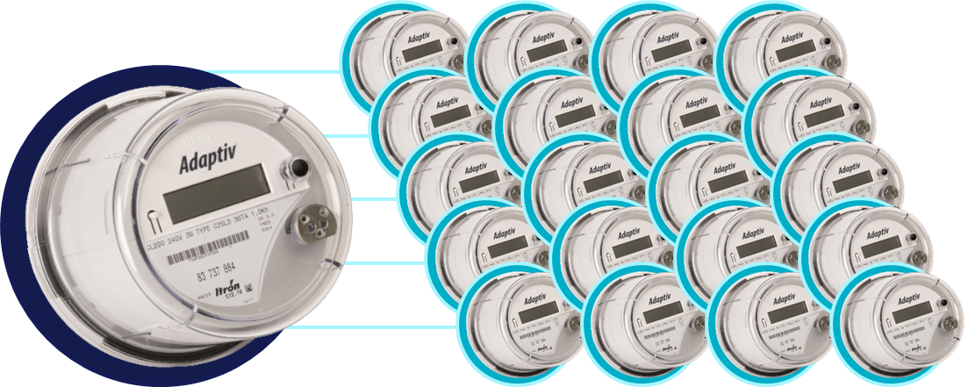
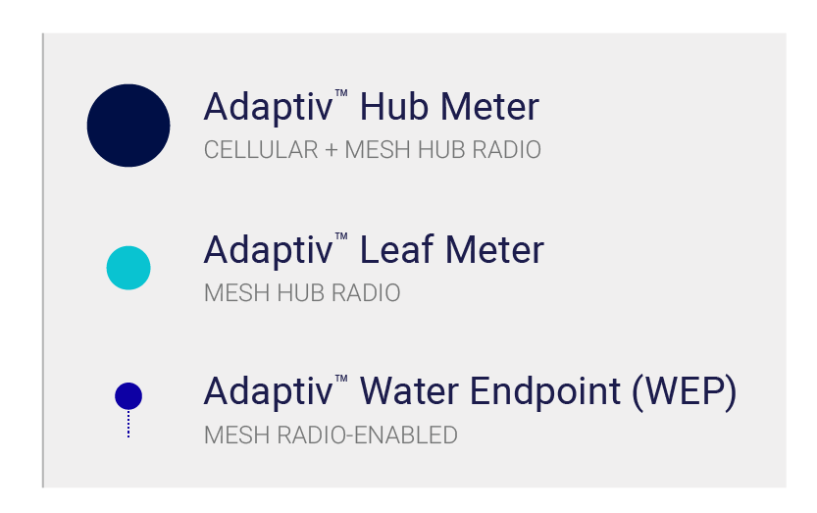
ADAPTIV™ | ONE HUB UNIT TO MANY LEAF UNITS
    Scalable, self-healing,
    self-configuring network
    Next generation high bandwidth cellular-mesh
      One Hub with cellular modem per cluster
      Several Leaf meters within range of hub
      via short-hop RF
    Simple installation
    and maintenance

Slide 7


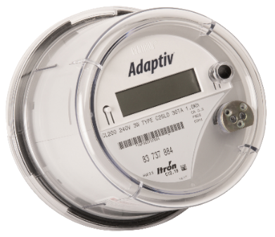
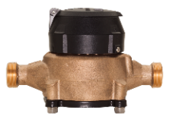
ADAPTIV™ | EASILY ADD WATER ENDPOINTS
    Water LINK sends reads via Adaptiv™ smart meters
    Scalable, self-healing, self-configuring mesh network
    Built-in security
    and redundancy
    Interval data and
    leak detection with exceptional battery life
    ONE WEP PER HUB OR LEAF UNIT

Slide 8
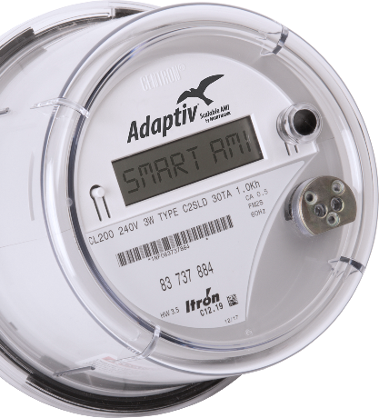


Nighthawk Hub ERT Collector
LINK Xi - Itron C2SLD - Cell
+ Mesh w/ ERT Collector and remote disconnect
  Collects data from Water ERT
  and/or Leaf endpoints
Supports SCM (for older ERTs) and SCM+ (newer ERTs) protocols
  Programmed in bubble-up mode
Uploads on a scheduled basis alternating between SCM and SCM+ modes
Latest daily read and historical daily reads can be viewed in Adaptiv™
Collector stores the latest
reading for each unique ERT
No limit on number of ERT’s
read by a single collector
  ERT collector table uploads collected reads when full (minimum of once daily) and reloads with additional ERT
  reads as needed
LINK Xi-C
ITRON CENTRON II
©2020 Nighthawk

Slide 9

ERT Collector Supported ERTs
Model | ERT Collector Support | Itron Protocol
Electric | Yes | SCM, SCM +
50 W | Yes if in bubble up mode | SCM
60 W | Yes | SCM, SCM +
100 W/G | Yes | SCM, SCM +
100 W+ | Yes | SCM +
+ signifies daily reads, no interval data

Slide 10
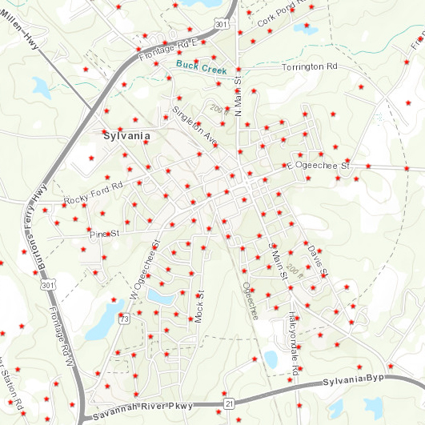
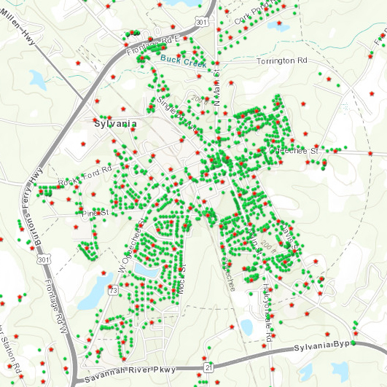
ADAPTIV™ | SIMPLE SYSTEM DESIGN
Cellular Hub Meter Placement
RF-Mesh Leaf Meter Placement

Slide 11

ADAPTIV™ | SIMPLE SYSTEM DESIGN
Plot
Meter Locations
Overlay
Cellular Map(s)
Survey
Potential Gaps
Provide
Rollout Guidelines
Customer location data is plotted using ArcGIS
Verizon map is overlaid to determine cellular coverage.
If necessary, a site survey can be done to determine actual data coverage
A guideline is provided to the utility for Hub placement
Leverage Deep Utility Experience
©2020 Nighthawk

Slide 12
ADAPTIV™
FEATURES & BENEFITS

Slide 13
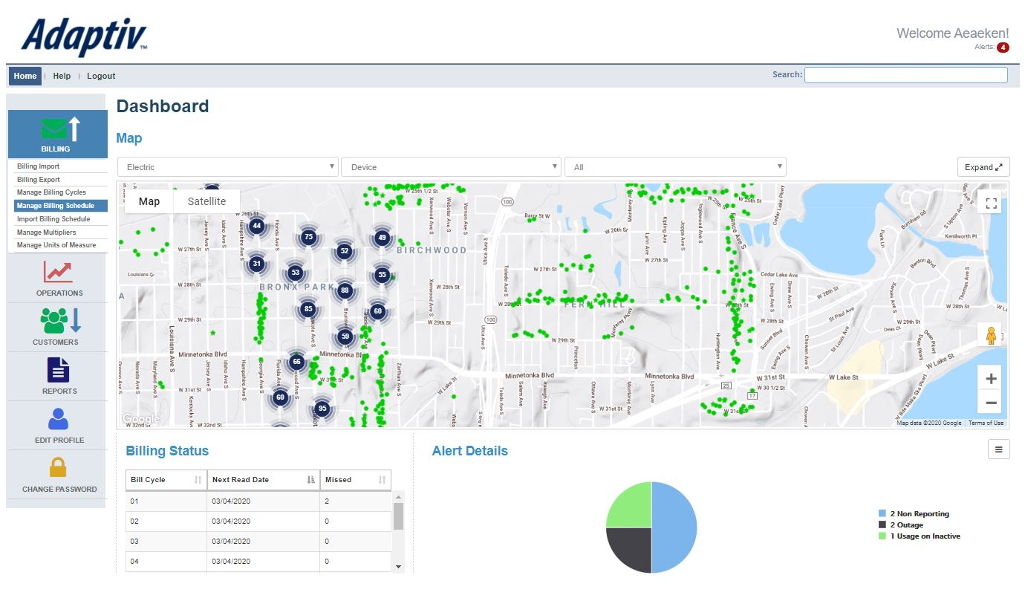


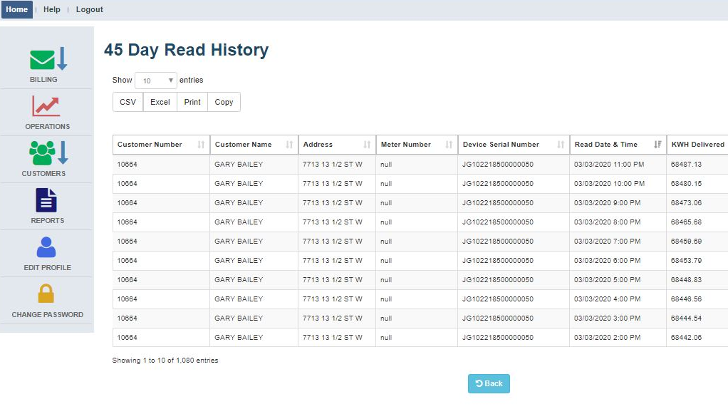
ADAPTIV™ | CUSTOMER SERVICE
    Predictive Billing
    Know what’s missing
    before it’s too late!
    Immediate access
    to current customer information
    Detailed views of
    customer usage by
    day, month, or year
    Resolve billing concerns quickly and efficiently
    Remotely disconnect
    and connect meters
Detailed views of customer usage
Accurate, secure customer
records
©2020 Nighthawk

Slide 14
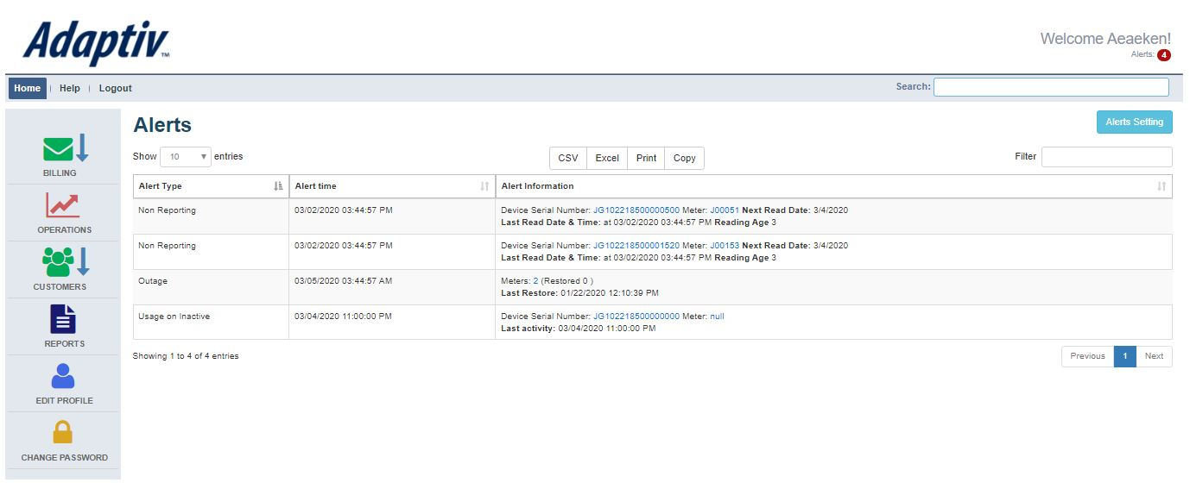
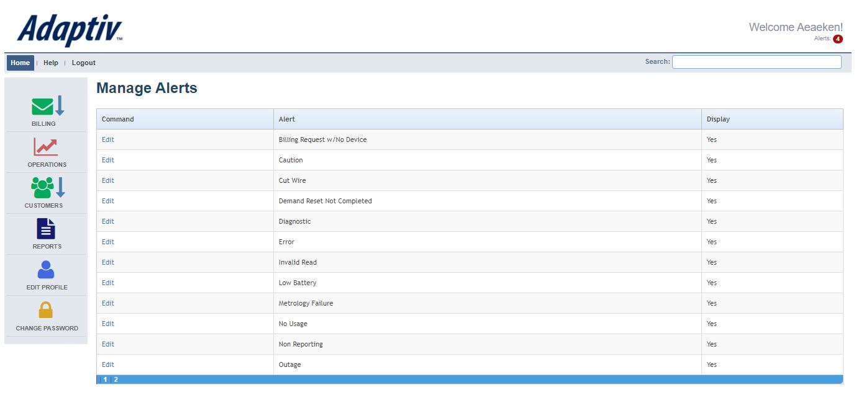
ADAPTIV™ | OUTAGE FEATURES
Outages and blinks are monitored daily, managed easily and effectively
    Immediately notify
    utility personnel of
    a sustained outage
    Effectively monitor blinks
    and momentary outages
    with daily reporting
    Provide precise outage
    data for power quality
    reporting
Refine your alerts to enhance your OMS
*Integration Fees May Be Incurred
©2020 Nighthawk

Slide 15
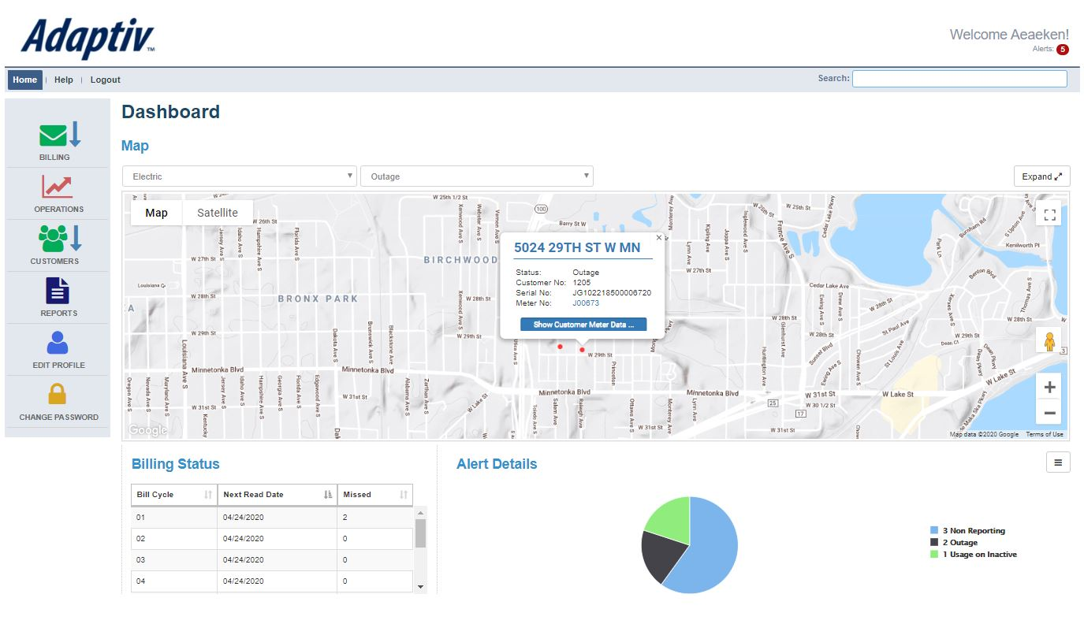
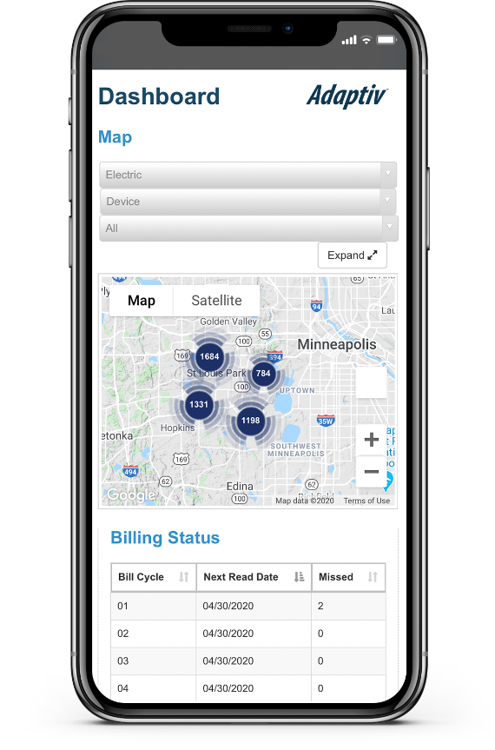

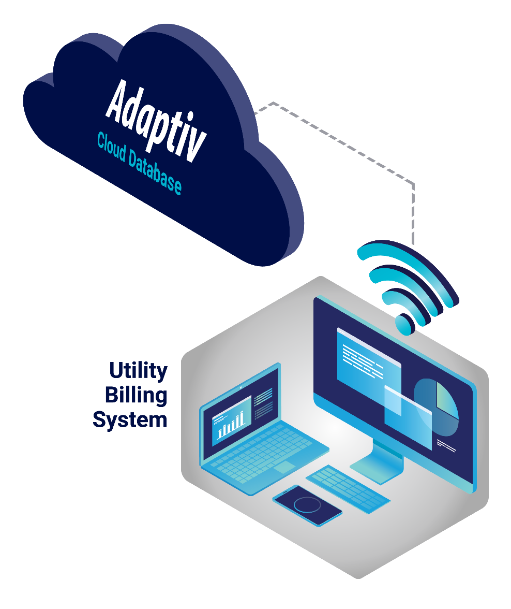
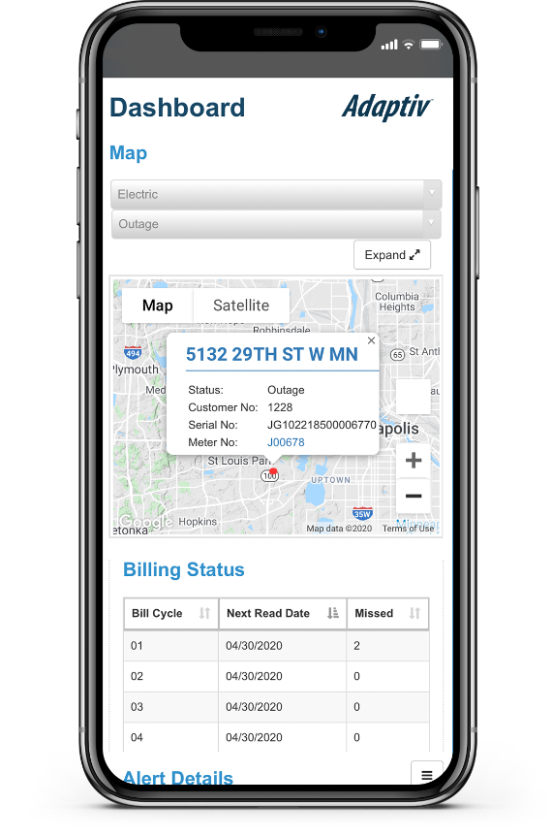
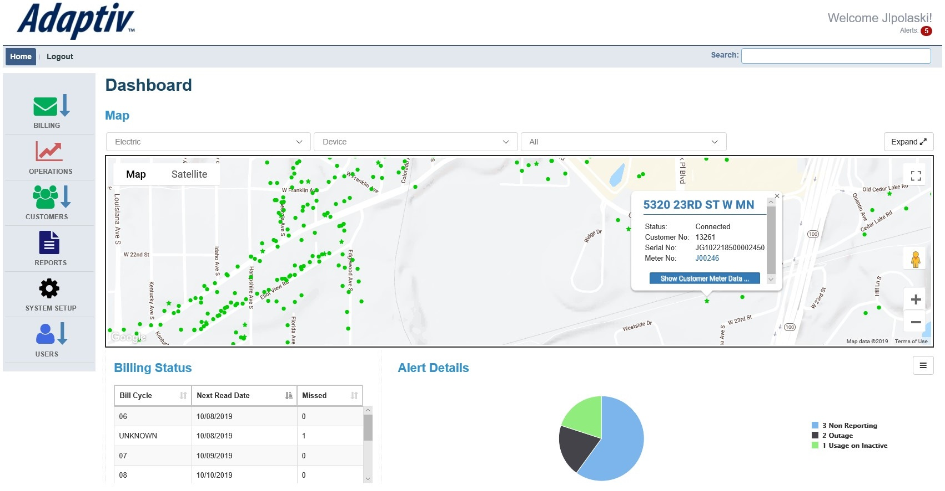
ADAPTIV™ | SOFTWARE SOLUTION
Smart billing integration with secure mobile access
Screenshots
TBD
Over-the-air configuration
and upgrades on
all Adaptiv™ units
©2020 Nighthawk

Slide 16

ADAPTIV™ | SOFTWARE UPDATES
    Adaptiv™ Value for Life
    No additional charges for upgrades, maintenance or support for the life
    of the product
    Over-the-air configuration changes
    and upgrades to firmware
    Designed to evolve with the changing needs of the utility industry by enabling more features as required
©2020 Nighthawk

Slide 17

ADAPTIV™ | SECURITY
  Database & Software Security
    Best-in-class accessibility
    and security standards
    Data securely managed
    through Rackspace
    Secure communication via
    Thawte SSL
    Available multi-factor
    authentication capability
©2020 Nighthawk

Slide 18
ADAPTIV™ | SECURITY
  Network & Device Security
    128-bit AES encryption for all
    mesh-enabled devices
    Unique AES encryption key
    to partition users’ data
    Protects against external tampering via:
      Content encryption
      Channel encryption
      Dedicated private network
©2020 Nighthawk

Slide 19

ADAPTIV™ | PARTNER ECOSYSTEM
  MDMS
    NISC
    CSA
    PrimeStone
    Exceleron
  OMS
    Milsoft
  Load Control
    CSE
  Prepay
    PayGo
    UtiliFlex
    Exceleron
  CIS/Billing
    CSA
    NISC
    Caselle
    Tyler Incode
    SEDC
    DTI
    +more
©2020 Nighthawk

Slide 20

THE ADAPTIV™ DIFFERENCE
Lowest Risk Solution
Zero network infrastructure to install and/or maintain
Low-cost flexible pilots
Uses common radio frequencies (LTE and 2.4GHz)
found in most households and businesses
Most Flexible Deployment Options
Flexible deployment strategies based on your priorities and budget
Solve problems with little effort or cost – disconnect meters (prepay enabled), scope outages, monitor voltage, polyphase first, etc.
Lowest Total Cost of Ownership
Zero infrastructure investment or maintenance
Cost reduction for project management and integration
Easily train your team to use the solution within hours
Low recurring costs are predictable and controllable
Leverage the inherent benefits of our hybrid LTE/mesh system
©2020 Nighthawk

Slide 21
MV-90 Solution
Does not require any middleware – direct connection to MV-90
  Stand-alone solution that does not require Adaptiv Headend or other Adaptiv endpoints
We can offer cellular services if needed, but ideally, the utility should have its own private contract with AT&T or Verizon
  Other carriers can be supported

Slide 22
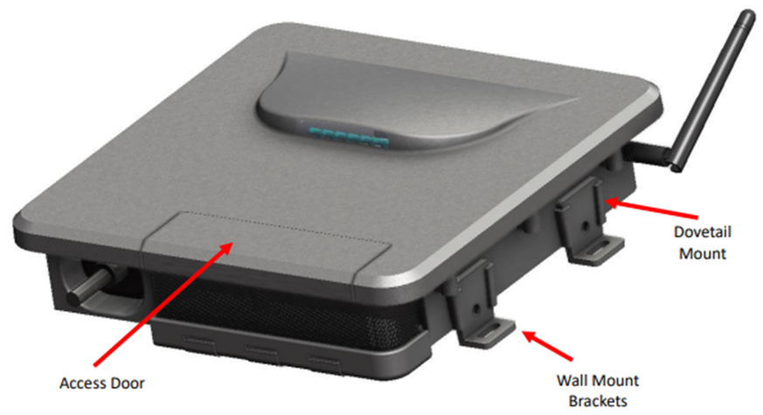
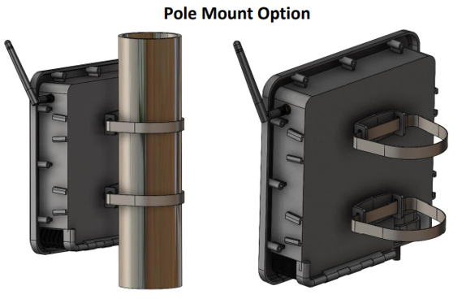
Fiber Hub Solution
The Nighthawk Fiber HUB product is a self-contained mesh HUB device with a wired Ethernet uplink.
  Fiber hub is Adaptiv compatible
  Acts as a cost-effective collector for multiple devices
Ideal for utilities who have mostly fiber throughout service territory
  Federal government incentivizing rural co-op fiber to the home
  Utilities looking for applications to use the deployed fiber
Advanced Outage Management power fail detection
  Configurable blink and sustained outage event thresholds, event logging and data upload
Rechargeable Battery Backup of 10 minutes to allow for last gasp transmissions
Supports OTA firmware upgrades to associated mesh devices
Robust end to end security and encryption

Slide 23
Thank You

