Slide 1

Meter Manager
Metering-Centric Quality Management (Asset, Inventory& Field Service Management Software)
Prepared by Paul Fratellone, TESCO Software
The Eastern Specialty Company
For Mid-South Meter School
Wednesday, May 3, 2023 at 3:00 PM

Slide 2
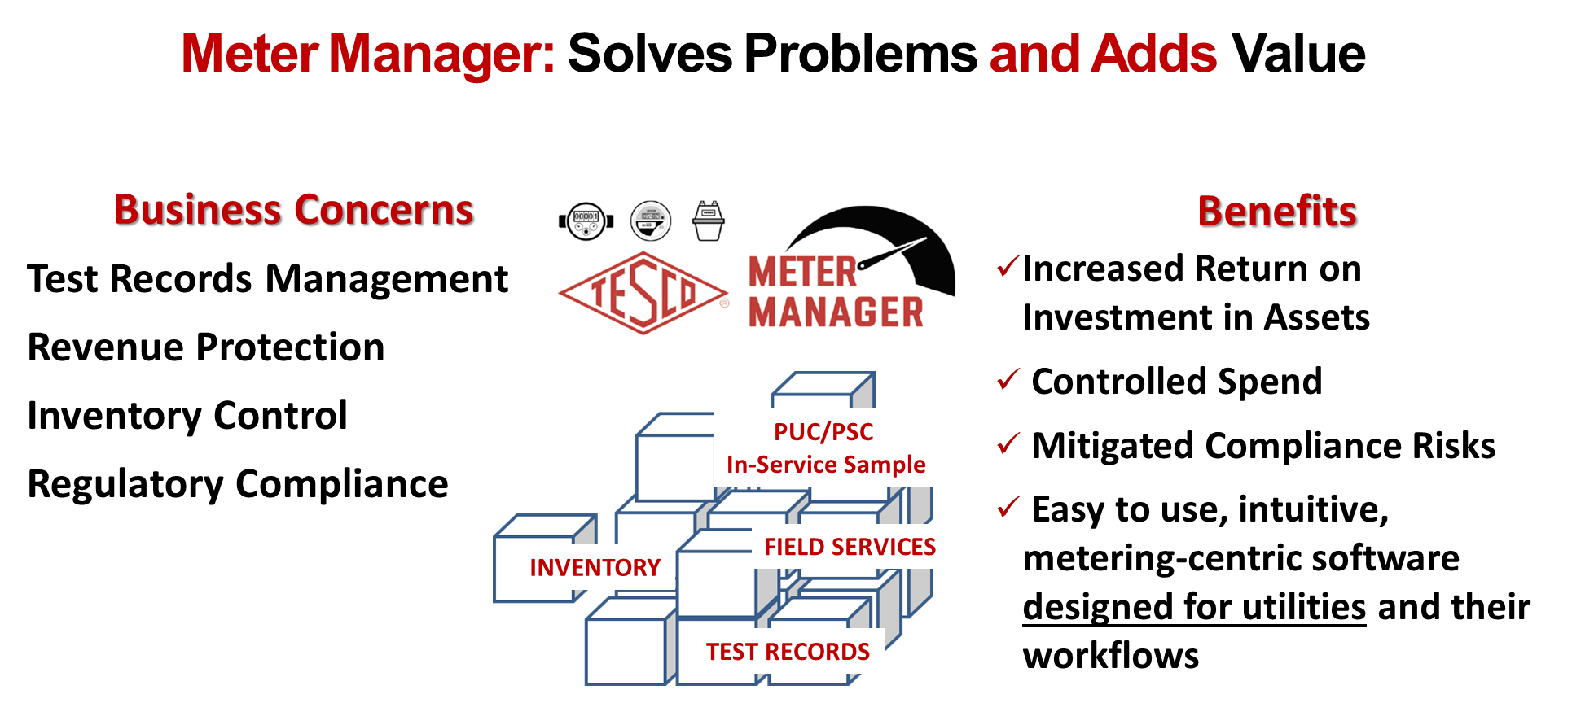
Utility’s Common Challenges

Slide 3
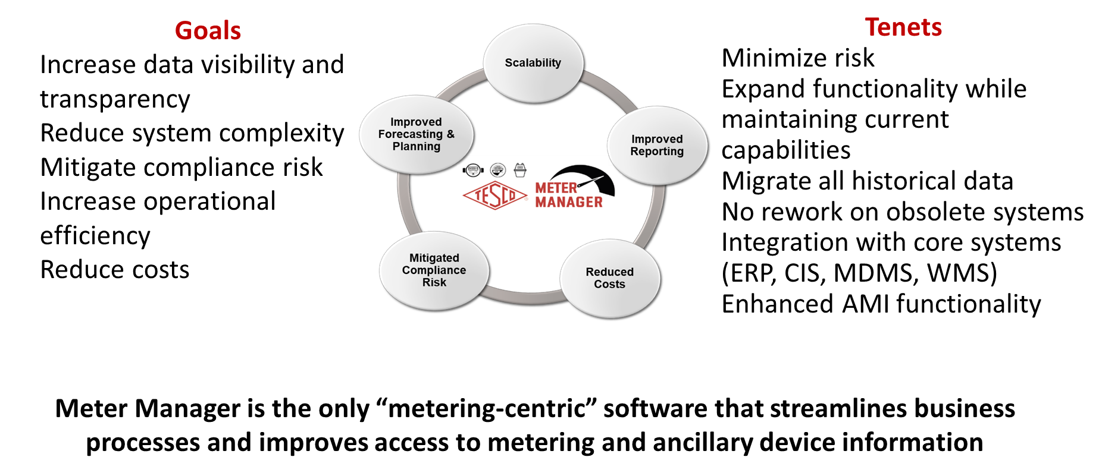
Benefits of Enterprise Software

Slide 4
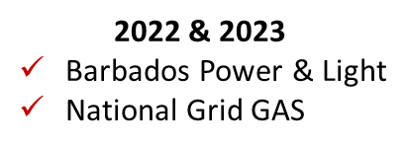
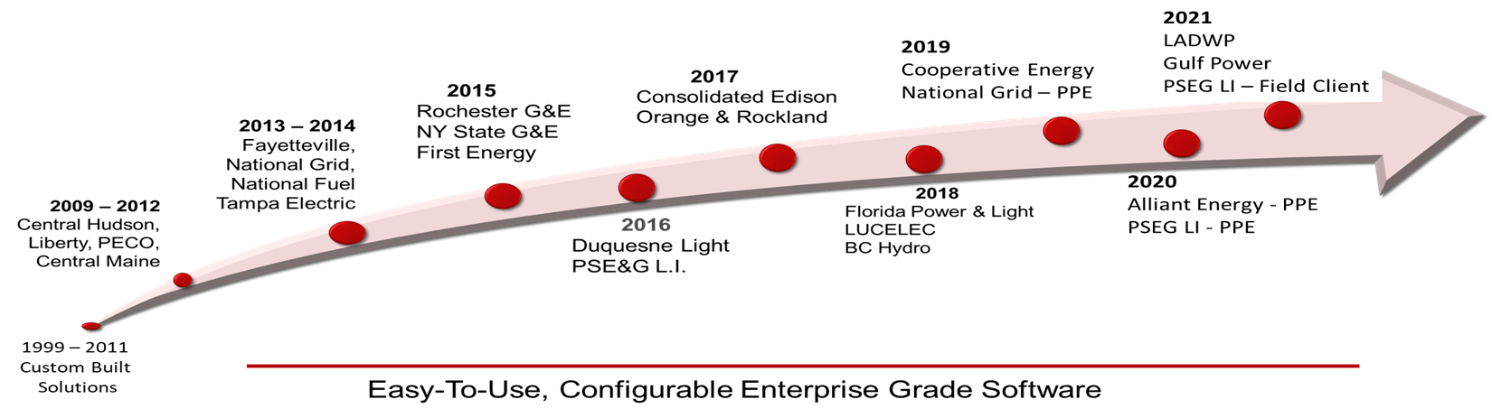
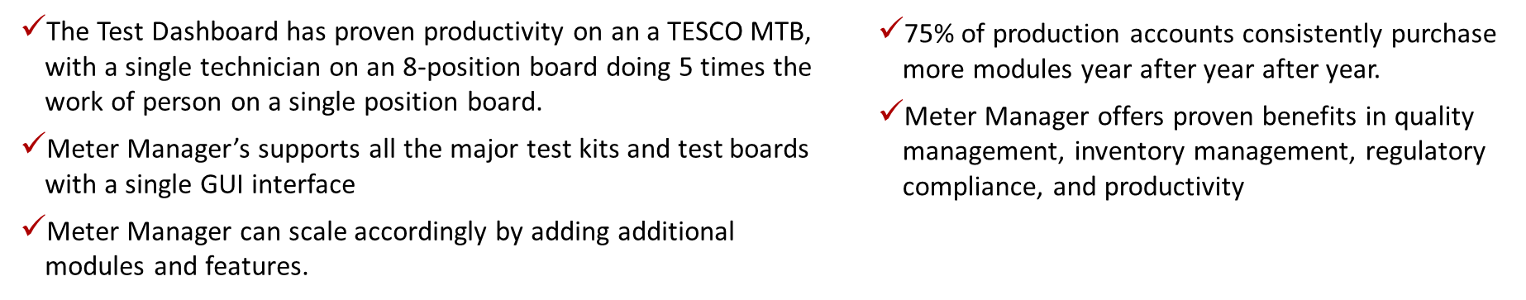
VALUE: Technology & Process Improvements

Slide 5
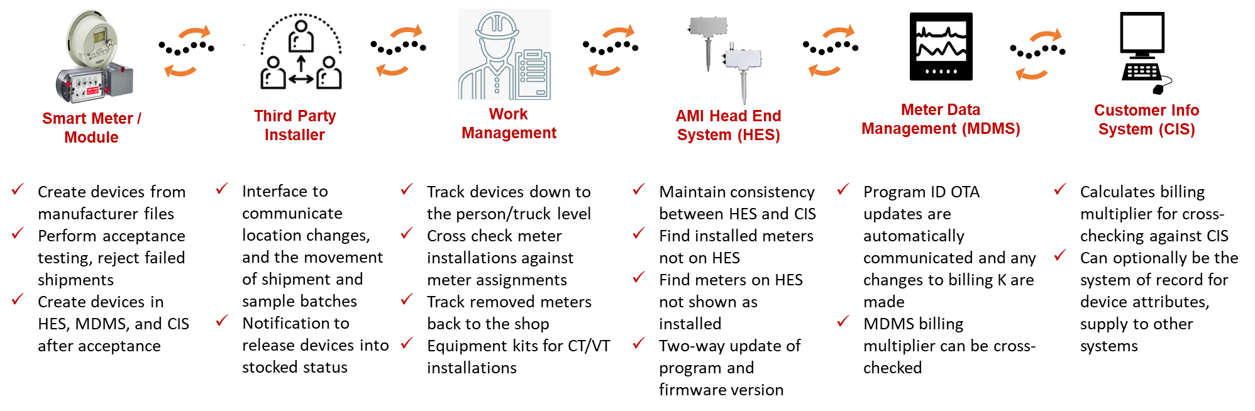
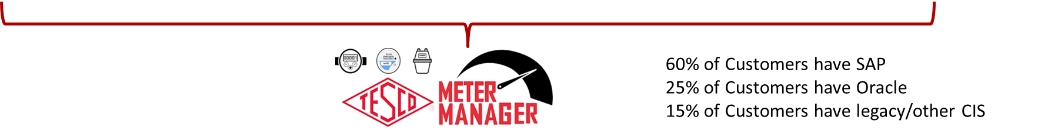
Add Value Throughout the AMI Portfolio
Architected with touchpoints to efficiently process core information

Slide 6
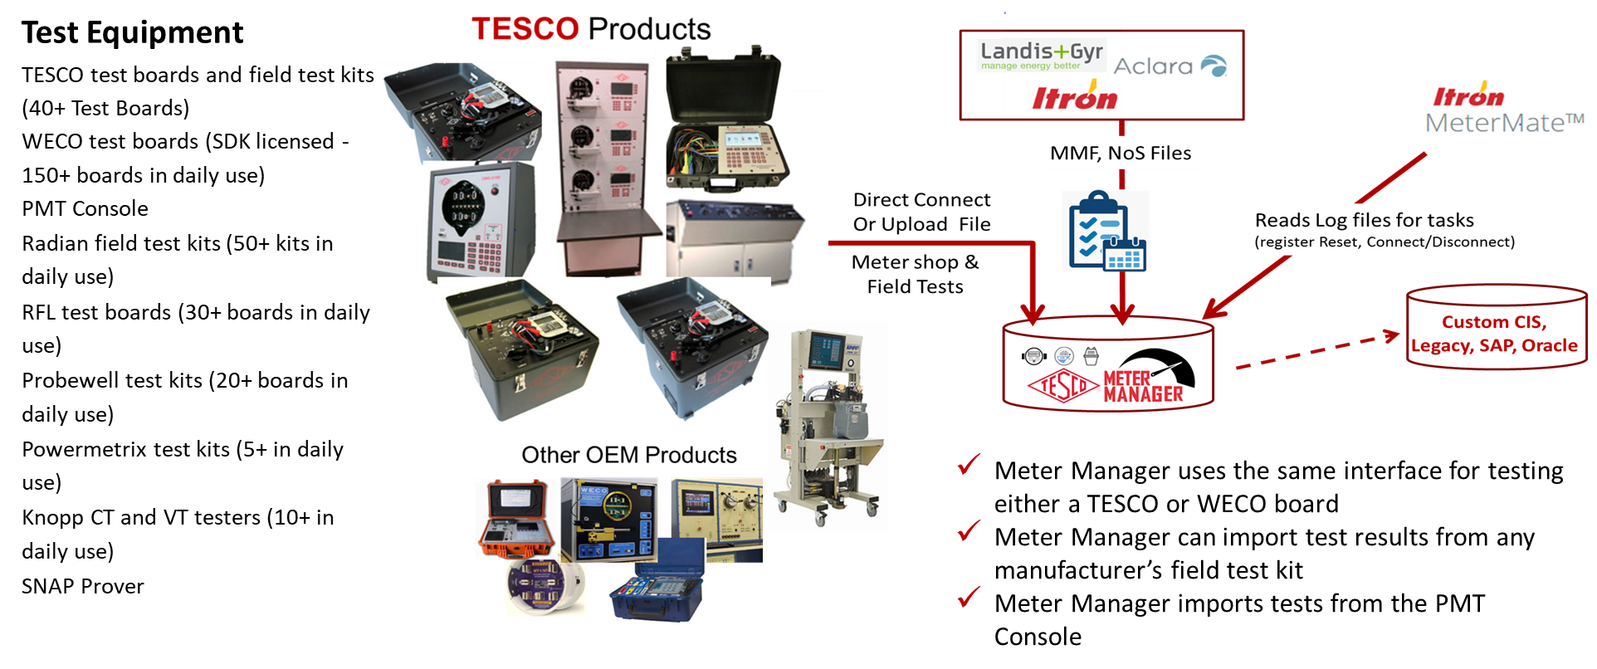
Eliminate Manual entry from Test Records
In the FIELD or METER SHOP, Automatically store test records with manual entry

Slide 7
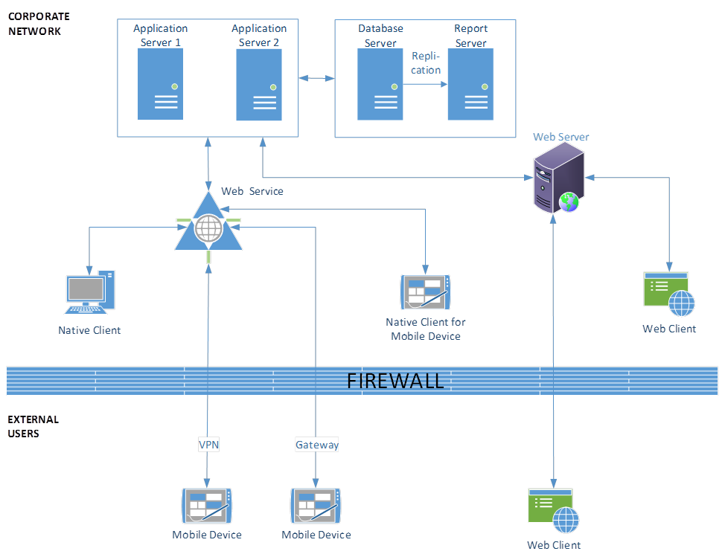
Host On-premise or Your Cloud
Complex
Simple
Managed Services Available

Slide 8
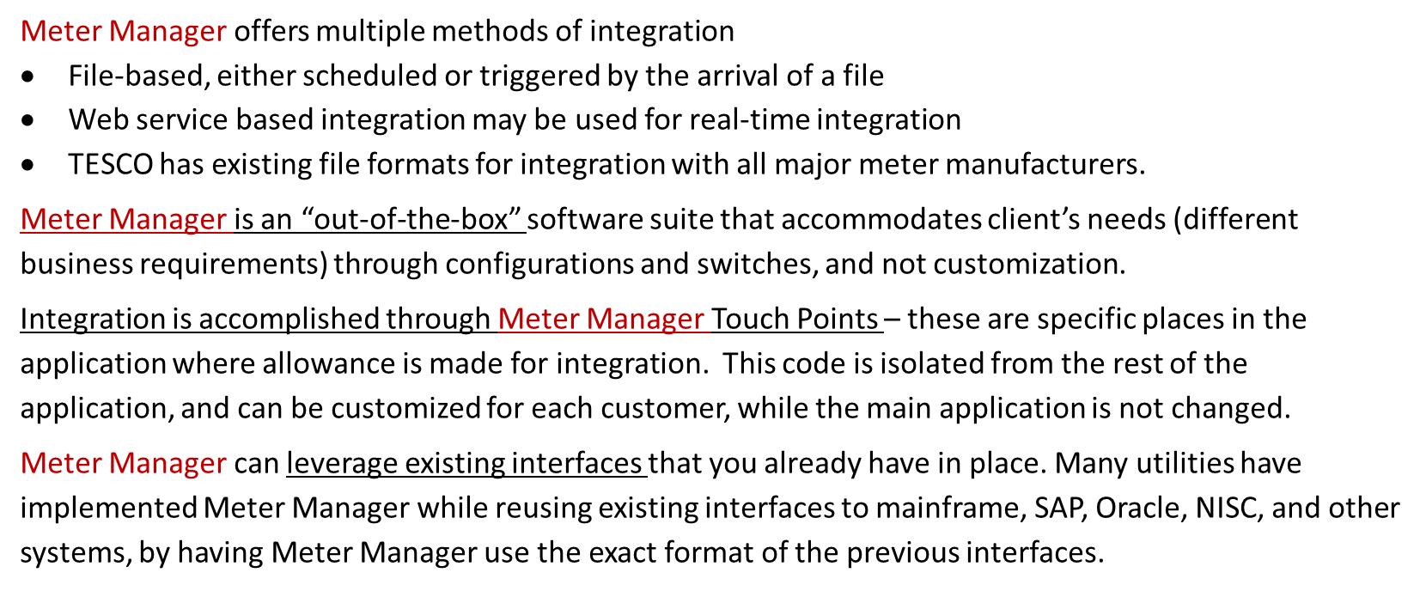
Integration With Enterprise & Legacy Systems

Slide 9
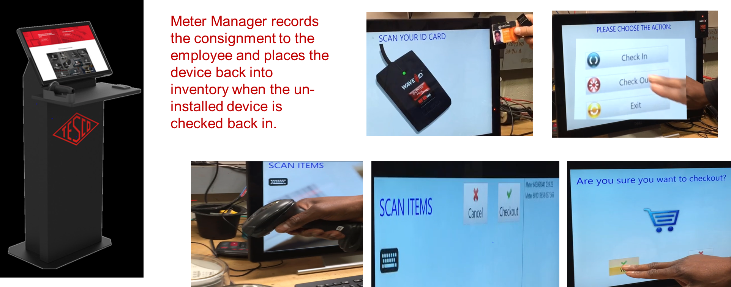
Controlling Inventory and Device Consignment
Built-In Feedback Loops catching potential problems earlier in the workflow

Slide 10
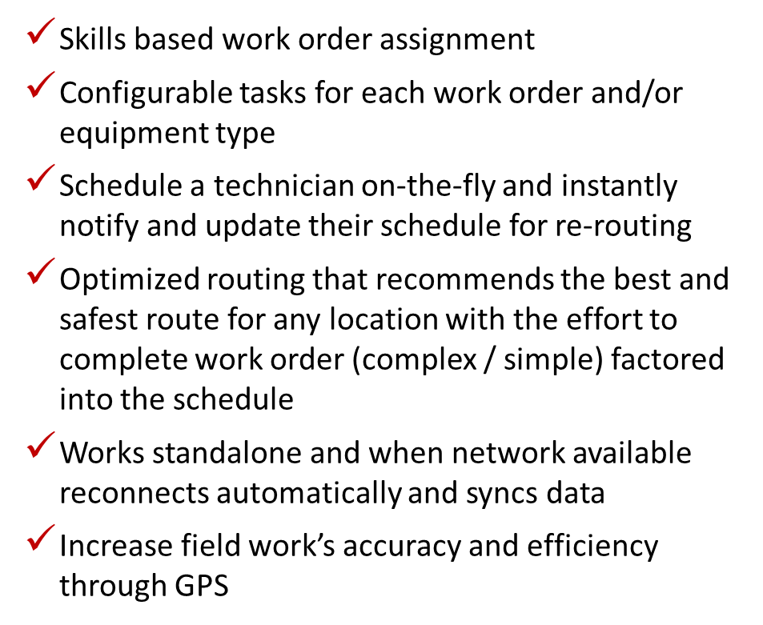
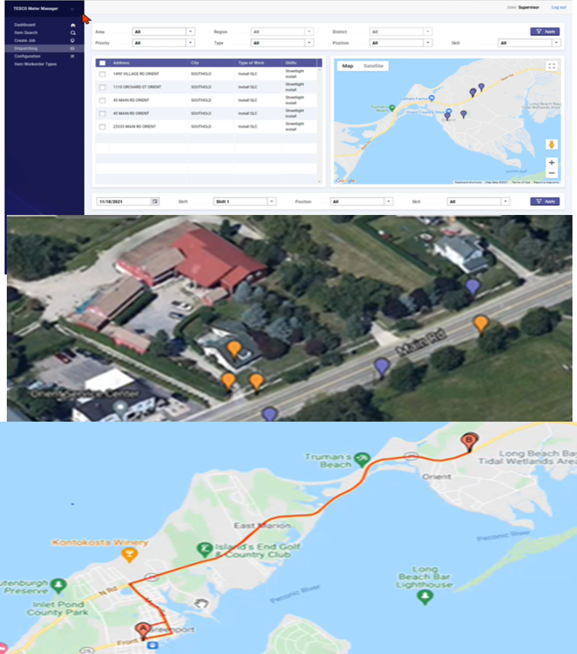
Metering-Centric Field Service Management

Slide 11
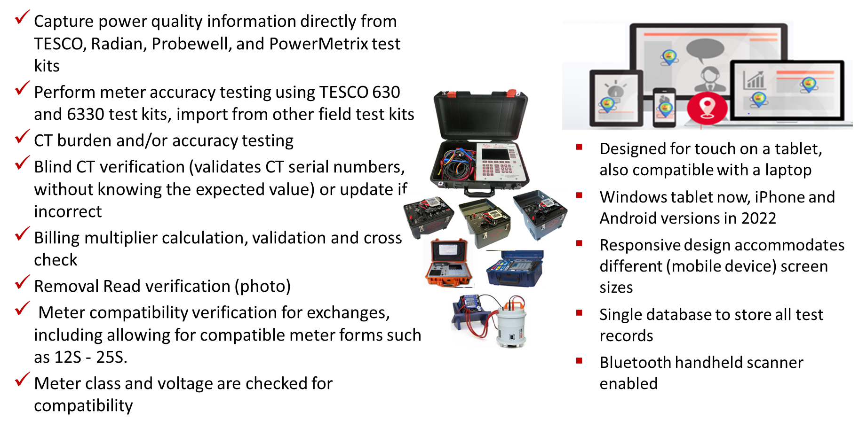
Metering-Centric Differentiators

Slide 12
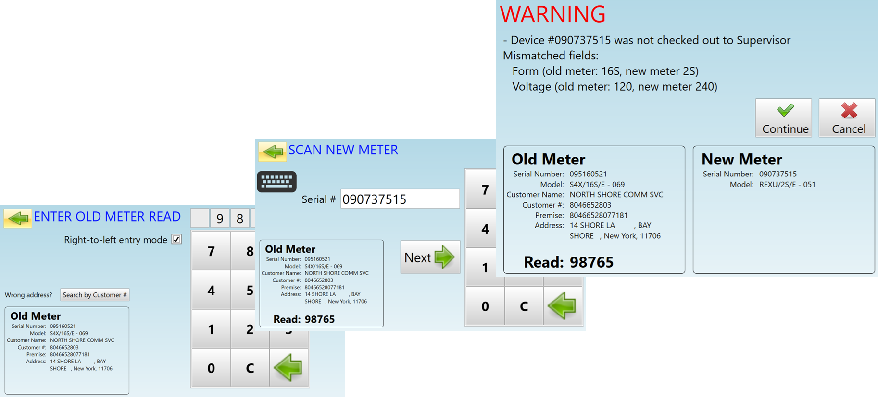
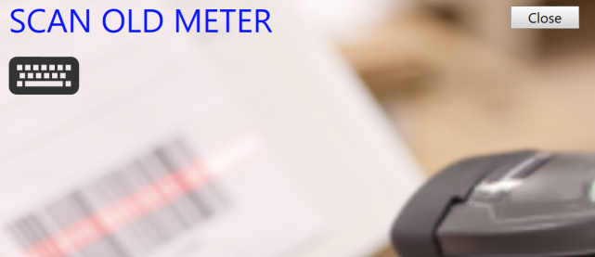
Built in Intelligence with Real-time Information

Slide 13

Experienced, Trusted and Successful
Total control and transparency of your assets throughout the asset lifecycle
Year-on-Year growth and very satisfied customers as over 75% expand their utilization of Meter Manager
Host On-premise, or your private cloud; Infrastructure Managed Services available
Flexible financial models: Purchase, Lease with option to purchase, or subscription model
Ability to scale with new devices (Sensors, Street Light Controllers, ConnectDER, and all AMI equipment)
TESCO Meter Manager
Enabling Control for Every Asset Under Management

Slide 14



Contact Information
Paul Fratellone
TESCO Software
Director Software Products
paul.fratellone@tesco.software
267-588-1418

