Slide 1
Caribbean Meter School
Self-Contained Fundamentals
Tom Lawton, TESCO
January 28, 2019
Atlanta, GA
Notes:
1

Slide 2
Questions to Answer
Why do we test?
How do we test?
What types of meter tests are there?
How do utility tests differ from customer request tests?
What is In-Service Testing?
How do we know meter tests are good?
What do we do with the test data?

Slide 3
Why Do We Test?
Our regulatory commissions require us to test meters.
But only for accuracy. State regulatory commissions want electric utilities to ensure that no customer is being billed unfairly and that no subset of customers is being unfairly subsidized by the rest of the rate payers. Some states mandate only accuracy tests and others require demand and time of use accuracy tests.
Any tests beyond accuracy tests are tests that are simply good business practice.

Slide 4
Complaint Testing
Customers always have the right to request a meter test.
Some utilities and some jurisdictions allow for testing at the customer site, others require a test in a laboratory environment.
Some allow the customer to witness the test and others require the utility commission to witness the test.
Utilities must show that the meter tests well and must demonstrate that they have a test program in place to ensure the meters in service are performing well.

Slide 5
General Meter Testing Requirements
New Meters
Manufacturers tests
In-house tests on new shipments
Return to Service Testing
In-Service Meters
Periodic Tests
Selective, random, or statistical testing
Retirement tests
Testing of related metering equipment

Slide 6
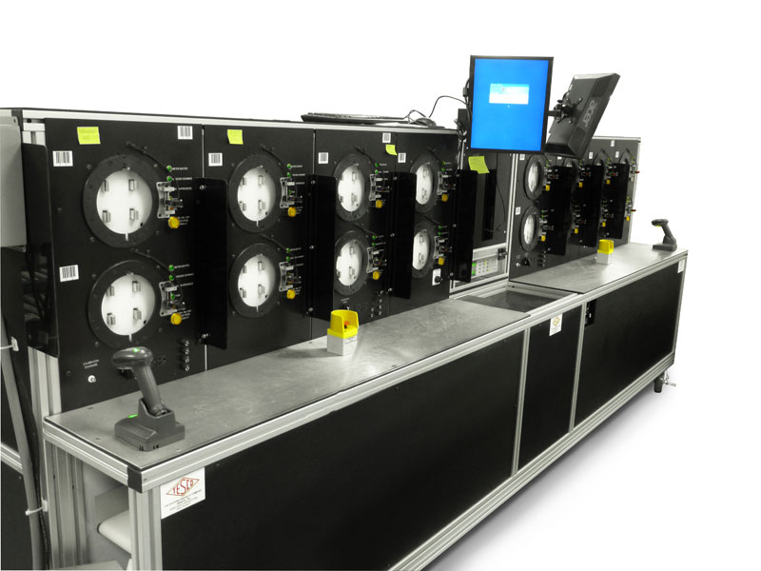
New Meter Testing Programs
Accept the Manufacturer’s Test results
Perform a Statistical Test of an incoming shipment
Perform a 100% test of an incoming shipment

Slide 7
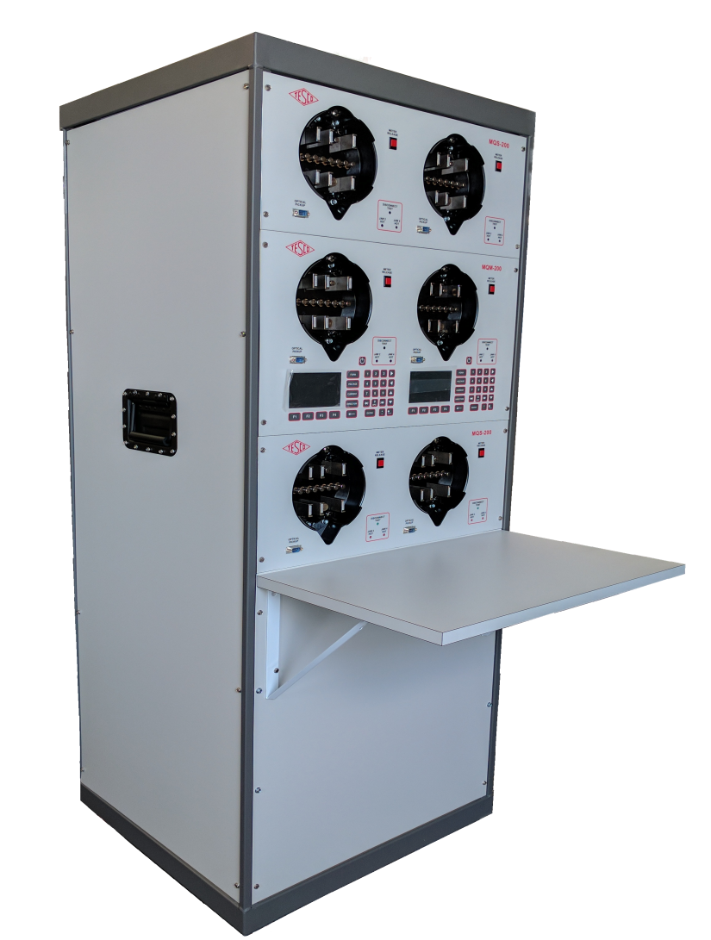
Return to Service Testing
Meters to be returned to service must always (virtually every utility commission requires this) be accuracy tested before being returned to service.
Best business practices also require that the meter is functionally tested as well.

Slide 8
In Service Testing
Meter Testing for new and in-service meters is specified in ANSI C12.1-2015, American National Standard for Electric Meters, Code for Electricity Metering. Most utility commissions use this Standard a reference or the basis for their meter testing requirements.

Slide 9
Test Plans for Meters
Four test plan options available:
Periodic
Statistical
Notes:
UMPIRE is a
Universal Meter Programming and Reading System
It reads all meters and recorders
It can control all manufactures software

Slide 10
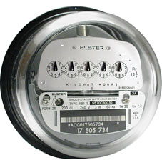
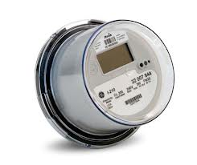
Periodic Test Plans
Periodic
Varies by State
Example provided by ANSI C12.1:
Each Electro Mechanical meter is tested once every 8 years
All other Meters are tested every 16 years
Appendix D provides details for other meters & devices
No guidance for AMI meters
Generally, average of 12.5% of population tested per year
8 Years
16 Years

Slide 11
Statistical Test Plans The Best Approach
ANSI C12.1-2001 Code for Electricity Metering Guidance
Paragraph 5.1.4.3.3 Statistical sampling plan
“The statistical sampling plan used shall conform to accepted principles of statistical sampling based on either variables or attributes methods. Meters shall be divided into homogeneous groups, such as manufacturer and manufacturer’s type. The groups may be further divided into subdivision within the manufacturer’s type by major design modifications.”
NOTE - Examples of statistical sampling plans can be found in ANSI/ASQC Z1.9, the ANSI version of MIL-STD-414 and ANSI/ASQC Z1.4, the ANSI version of MIL-STD-105.

Slide 12
Why Use a Statistical Testing Plan?
Focuses testing on the proper meters
Minimizes number of meters to be tested; usually requires less than 30% of what a periodic testing plan requires
Provides data and analysis tools for use in
understanding what is happening with installed meters
or for use in the purchasing of new meters

Slide 13
Homogeneous Population(s)
The groups or populations being sampled and tested
are made up of the same or similar items, items
which operate in the same way and were made in the
same manner.
For electric meters, this has traditionally been
interpreted as being meters of a specific meter
type from a manufacturer (i.e. AB1, J5S, MX, etc.).
AMR & AMI programs have helped to make the
overall populations more homogenous. This makes a
utility with AMR & AMI meters better prepared to
take advantage of a statistical sampling plan.

Slide 14
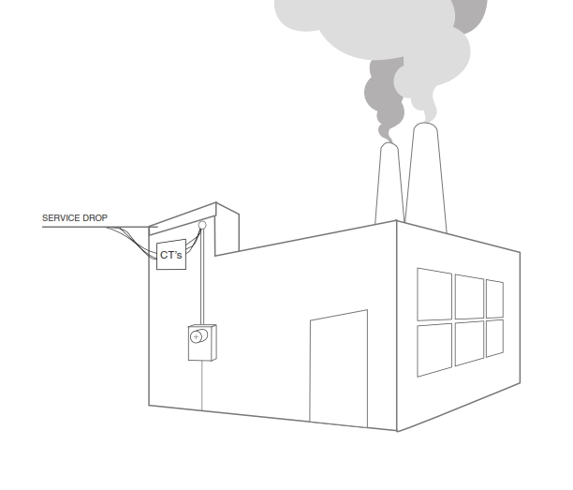
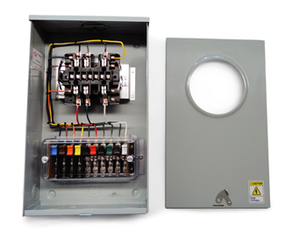
Testing of a Meter vs Testing a Site
Test an installation and system and not just a meter!
Test programs may need to involve testing and checking the meter performance as well as checking and testing the installation. This more extensive test check list needs to be done especially for the higher revenue C&I customers.

Slide 15
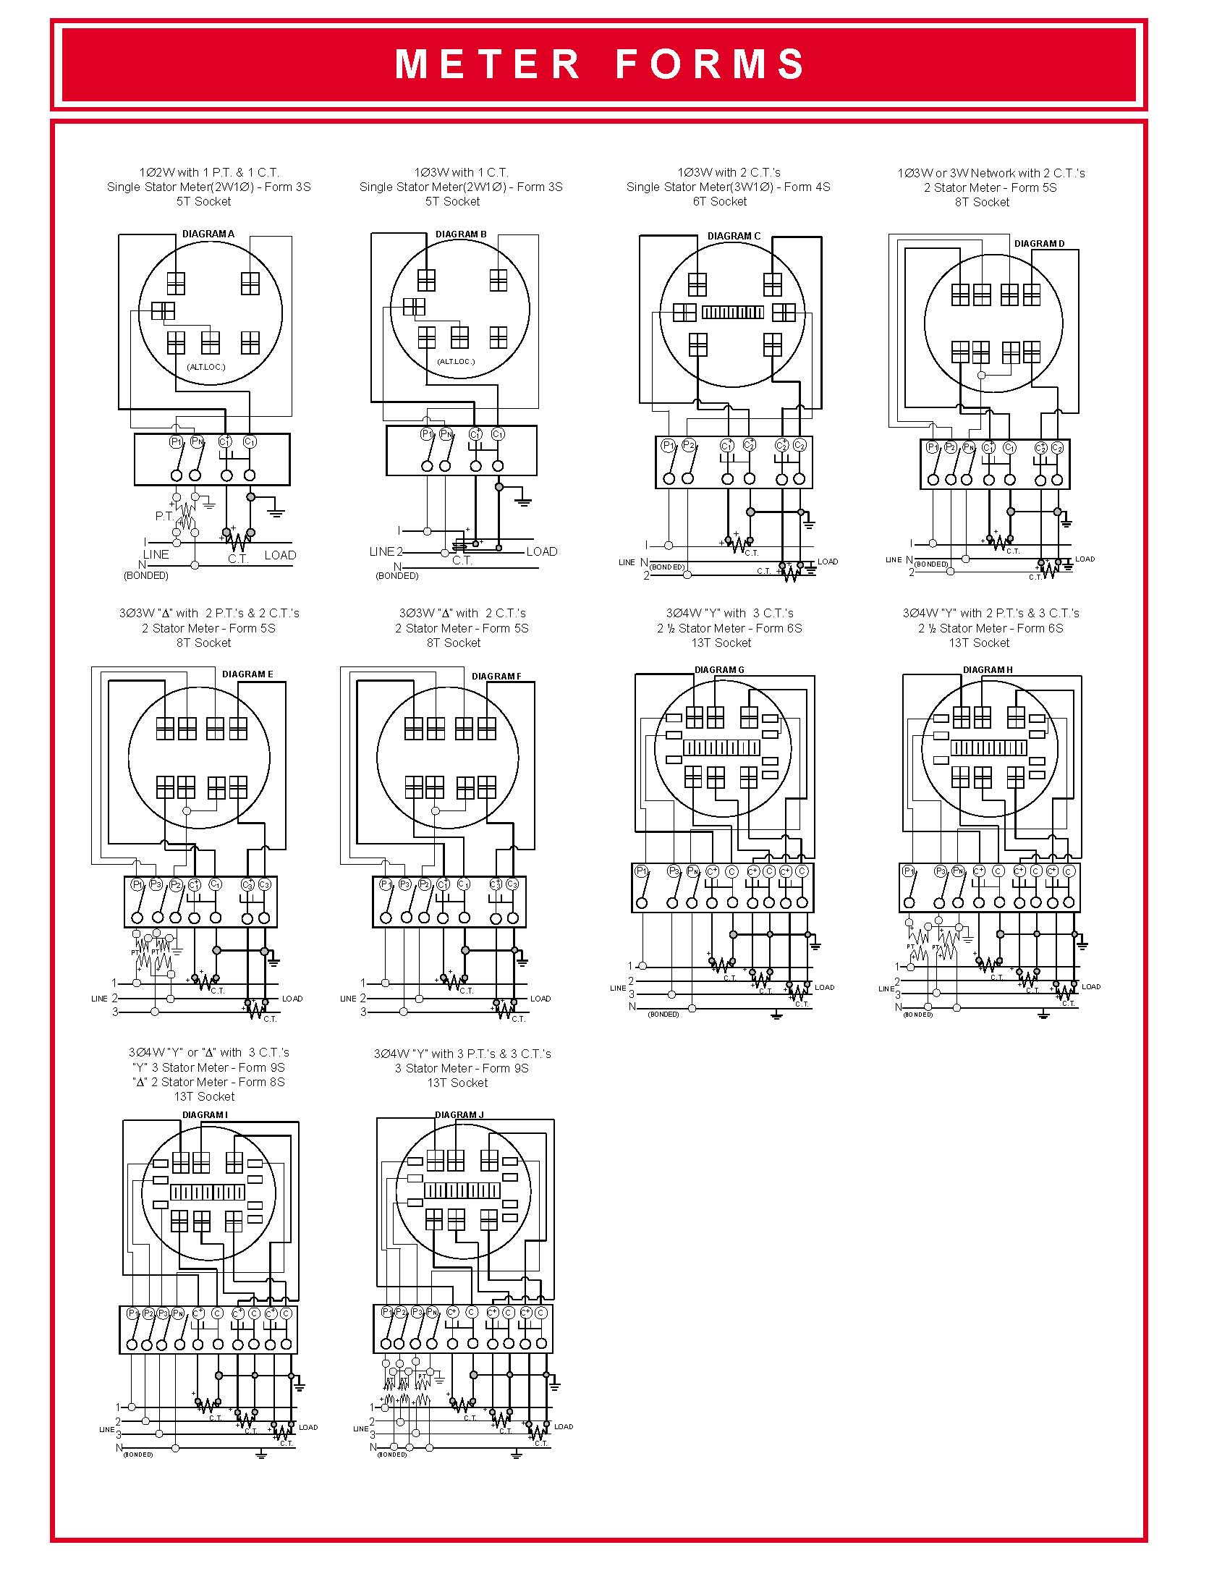

Slide 16
Meter Testing Traceability
Test equipment to NIST standards
Tracking number of meters to be tested per State Commission requirements
Tracking meter test data
Meter Records
Meter Data Management System (MDMS)

Slide 17
Meter Testing Traceability
Traceability is defined as ability to link the results of the calibration and measurement to related standard and/or reference (preferably national or international standard) through an unbroken chain of comparisons.
Calibration is typically performed by measuring a test unit against a known standard or reference.
Master standard (i.e. gages) are kept by National Measurement Institute (NMI) of each country.
Notes:
17

Slide 18
Meter Testing Traceability
National Institute of Standards and Technology (NIST) provides internal tracking numbers, which are often used as evidence of traceability.
WARNING! NIST does not certify or guarantee that calibration and measurements are correct, nor does it provide any kind of certification of accuracy and calibration. NIST only provides certifications for the work performed by them.
Notes:
18

Slide 19
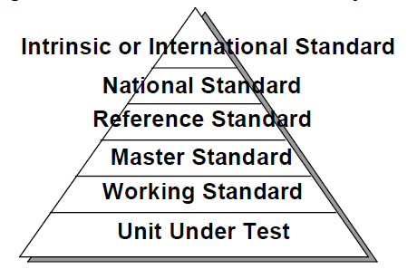
Meter Testing Traceability - Standards
Notes:
19

Slide 20
Meter Testing Traceability - Standards
National Standard
In the US, this is maintained by NIST, in Canada by NRC. Not all countries have a National Standards group and even the US does not have a group for every item of interest to an electric utility (e.g. voltage transformers)
Reference/Master Standard
Item of highest metrological quality located at a site where calibration is being conducted.
Transfer Standard
Lower level of Reference Standard and used for calibration of lower level calibration requirements measuring devices.
Working Standard
Lower level of Reference Standard and used for calibration of lower level calibration requirements measuring devices. Should be compared to Master Standard or Reference Standard on regular basis; used for daily checks comparisons of the calibrated devices.
Notes:
20

Slide 21
Test Equipment Calibration
Primary Requirement: Traceable to NIST Standards
Meter Test Boards, Field Test Kits calibrated to a known master standard maintained at Meter Shop.
Some periodicity such as monthly or quarterly
Reference or Master standard calibrated by outside vendor traceable to NIST or directly by NIST.
Usually annually

Slide 22
Tracking Meter Records
AMI programs help to update and overhaul meter record systems.
Having the records for the entire meter population updated allows for a better chance that test data is available to answer questions and that any meter may be selected as part of the sample for testing.

Slide 23
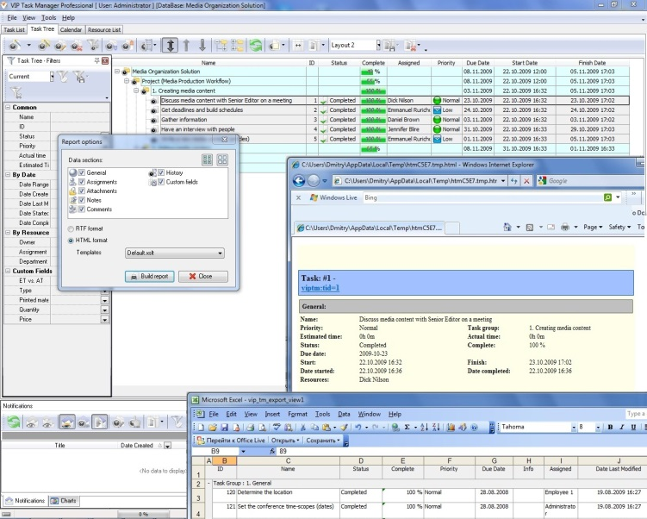
Meter Test Data Tracking
Test data should be tracked throughout meter life
Certification testing, first article, acceptance testing, in-service (field & shop), retirement
Meter test data should be linked to meter record data such as meter form, amps, voltage, display type, etc.
Best time to start to develop the program is before the meters are being installed.
Accuracy test data is usually collected automatically as new meters are tested in meter shops or cross docks.

Slide 24
Meter Test Data Tracking
Need to consider tracking non-accuracy functional testing (meter software configuration, service disconnect testing, voltage, etc.)
Use installation reports to determine if there is any initial concerns about the meters being installed.
Typical reports that should be available:
Failed Meter Report, Project to Date
Electric Meters on Network Report

Slide 25
Meter Test Data Tracking System
System should track meter test results for ease of future reference or for response to public or Utility Commission inquiries.
Maybe part of Meter Data Management System (MDMS) or a separate Meter Records system.
Requires discipline in collecting & entering data, especially field tests.

Slide 26
Basic Electrical Laws
Ohms Law
Voltage = Current times Resistance
V = I X R
THE MOST USEFUL AND THE MOST FUNDAMENTAL OF THE ELECTRICAL LAWS

Slide 27
Basic Concepts: Electricity and Water
Comparing Electricity to Water flowing from a hose
Voltage is the equivalent of the pressure in the hose
Current is water flowing through a hose (coulombs/sec vs gal/sec). The water in a system is the “charge” (coulombs)
Impedance(Resistance) is the size of the hose. The nozzle would provide a change in resistance.
Power is how fast water flows from a pipe (gallons per minute vs kilowatts). Power is a rate of energy consumption

Slide 28
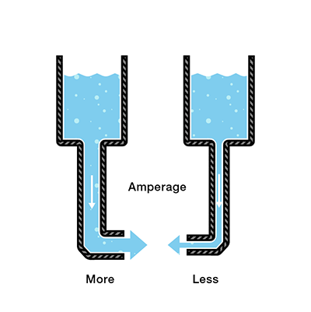
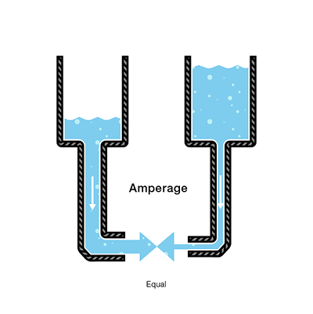
Basic Concepts: Electricity and Water

Slide 29
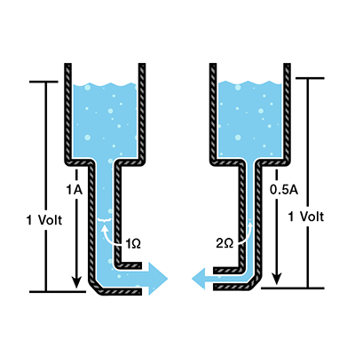
Basic Concepts: Electricity and Water

Slide 30
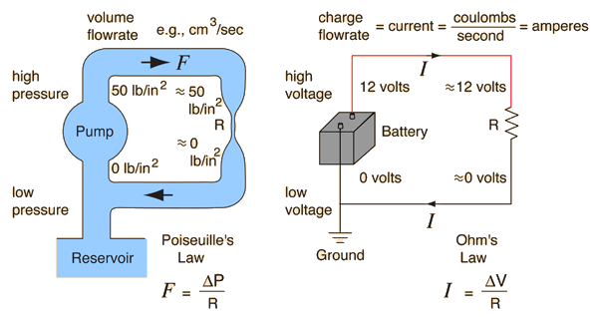
Practical Electricity

Slide 31
Basic Electrical Laws
Ohms Law Examples
If V = 20 volts and I = 5 amperes what is the resistance?
R = V / I = 20 / 5 = 4 ohms
If R = 20 ohms and V = 120 volts what is the current?
I = V / R = 120 / 20 = 6 amps
If I = 10 amperes and R = 24 ohms what is the voltage?
V = I x R = 10 x 24 = 240 volts
Problem: If V = 240 volts and R = 6 ohms what is the current?
I = V / R = 240 / 6 = 40 amps

Slide 32
Basic Electrical Laws

Slide 33
Basic Electrical Laws
Power = Voltage x Current = V x I = I²R = V^{2/}R
If V = 20 volts and I = 8 amperes what is the power?
P = V x I = 20 x 8 = 160 watts
If R = 5 ohms and V = 120 volts what is the power?
P = V^{2/}R = 120 x 120 / 5 = 2880 watts
If I = 10 amperes and R = 20 ohms what is the power?
P = I²R = 10 x 10 x 20 = 2000 watts
1 kilowatt (kW) = 1,000 watts
1 megawatt (MW) = 1,000,000 watts

Slide 34
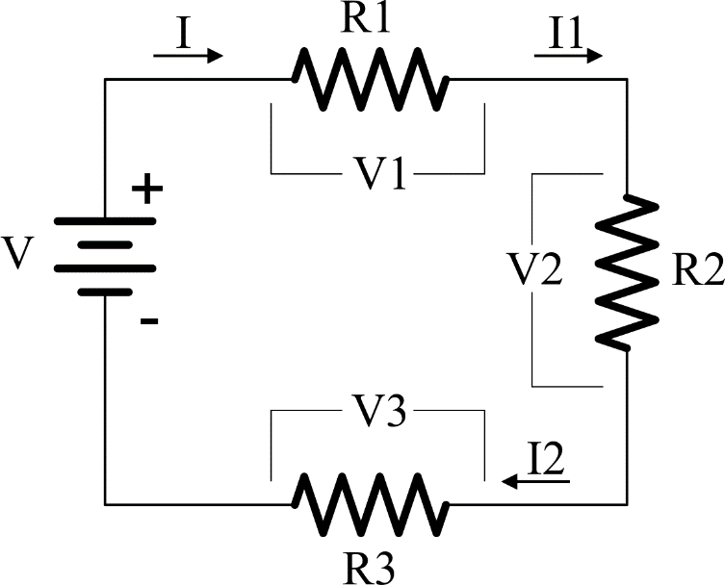
Basic Electrical Laws
Kirchoff’s Voltage Law (KVL)
The sum of the voltages around a circuit loop is zero.
V = V1 + V2 + V3 = I * (R1 + R2 + R3) = I1 * R1 + I2 * R2 + I3 * R3
I = I1 = I2 = I3
Resistors in series add

Slide 35
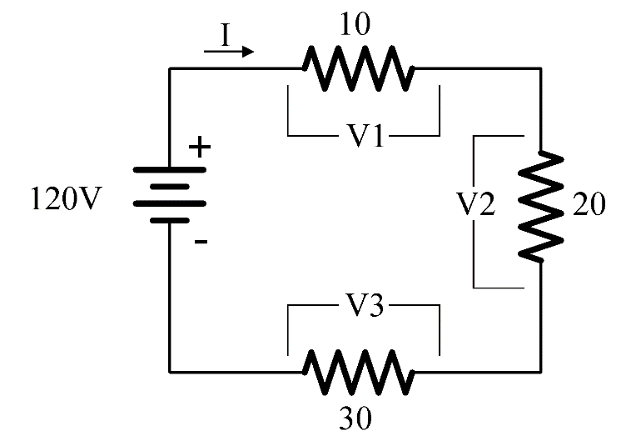
Basic Electrical Laws
Kirchoff’s Voltage Law (KVL) – PROBLEM #1
I = V / R = V / (R1 + R2 + R3) = 120/(10+20+30) = 2 amperes
V1 = I*R1 = 2 *10 = 20 volts
V2 = I*R2 = 2 *20 = 40 volts
V3 = I*R3 = 2 *30 = 60 volts
What is the current in the circuit?
What are V1, V2, V3?

Slide 36
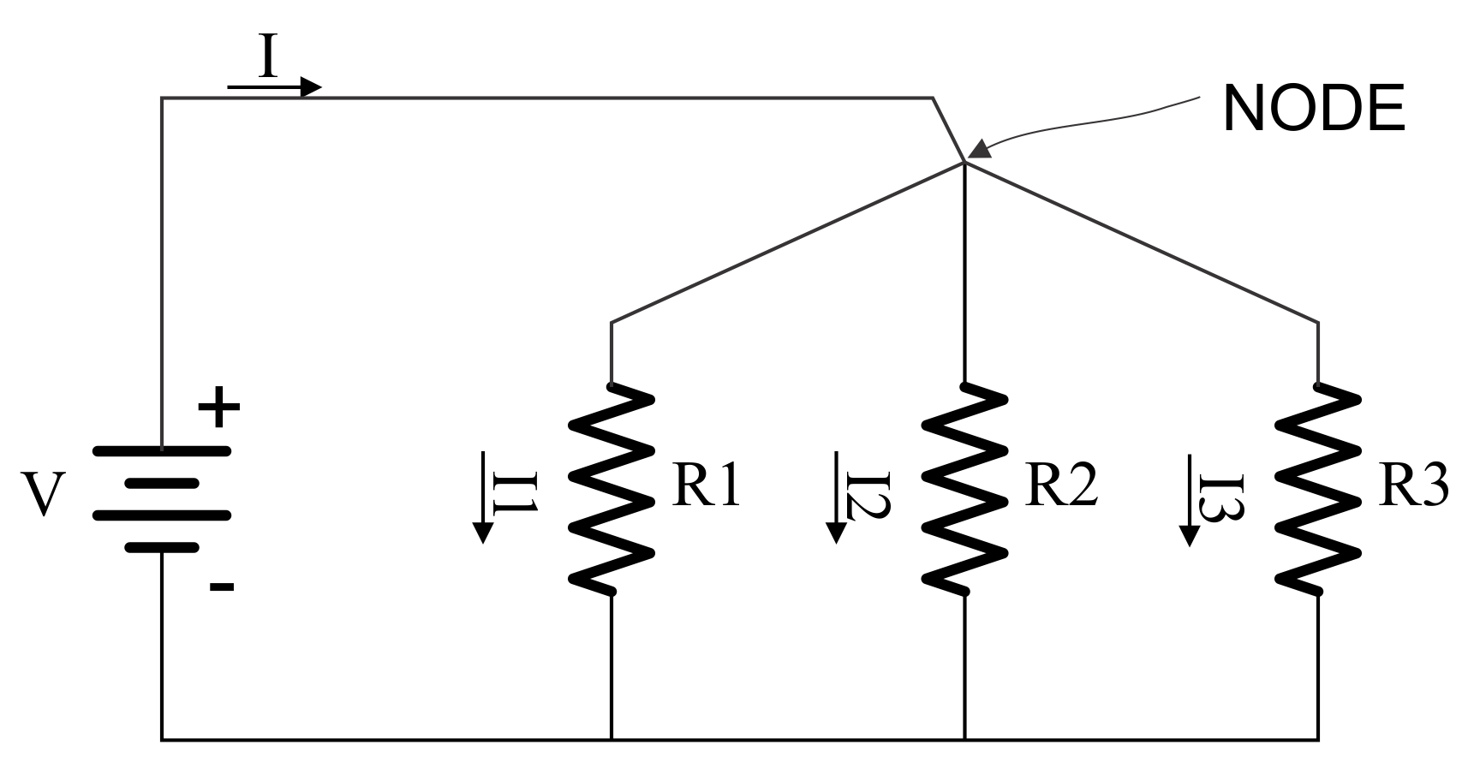
Basic Electrical Laws
Kirchoff’s Current Law (KCL)
The sum of the currents at a node in a circuit is zero.
I = I1 + I2 + I3
If Loads are placed in parallel they sum up.
So does power
P = V x I = V x I1 + V x I2 + V x I3

Slide 37
Basic AC Theory Power – The Simple View
E = Voltage (rms)
I = Current (rms)
PF = Power Factor
Power = Watts = E x I x PF
Power is sometimes
referred to as Demand
Sinusoidal
Waveforms
Only
NO
Harmonics
For a 120 Volt service drawing
13 Amps at Unity (1.0) PF,
how much power is being drawn?
Power = 120 x 13 x 1.0 = 1560 Watts

Slide 38
Basic Meter Math Power – The Simple View
For a 120 Volt service drawing
13 Amps at 0.866 PF,
how much power is being drawn?
Power = 120 x 13 x 0.866 = 1351 Watts
For a 480 Volt service drawing
156 Amps at 0.712 PF,
how much power is being drawn?
Power = 480 x 156 x 0.712 = 53,315 Watts

Slide 39
Basic AC Theory Power – The Simple View
In the previous example we had:
Power = 480 x 156 x 0.712 = 53,315 Watts
Normally we don’t talk about Watts, we speak in Kilowatts
1000 Watts = 1 Kilowatt = 1 kW
Watts / 1000 = Kilowatts
For a 480 Volt service drawing
156 Amps at Unity (0.712) PF,
how many Kilowatts are being drawn?
Power = 480 x 156 x 0.712 / 1000 = 53.315 kW

Slide 40
Basic AC Theory Energy – What We Sell
If power is how fast water flows from a pipe,
then energy is how much water we have in a bucket
after the water has been flowing for a specified time.
Energy = Power x Time
1 kW for 1 Hour = 1 Kilowatt-Hour = 1 kWh
Energy (Wh) = E x I x PF x T
where T = time in hours
Energy (kW) = (E x I x PF / 1000) x T

Slide 41
Basic Meter Math Energy – What We Sell
For a 120 Volt service drawing 45 Amps at a Power Factor of 0.9 for 1 day,
how much Energy (kWh) has been used?
Energy = (120 x 45 x 0.9 / 1000) x 24 = 116.64 kWh
For a 240 Volt service drawing 60 Amps at a Power Factor of 1.0 for 5.5 hours,
how much Energy (kWh) has been used?
Energy = (240 x 60 x 1.0 / 1000) x 5.5 = 79.2 kWh

Slide 42
Basic Meter Math Energy – What We Sell
For a 120 Volt service drawing 20 Amps at a Power Factor of 0.8 from 8:00AM to 6:00PM,
and 1 Amp at PF=1.0 from 6:00PM to 8:00AM
how much Energy (kWh) has been used?
8:00AM to 6:00PM = 10 hours
6:00PM to 8:00AM = 14 hours
Energy = (120 x 20 x 0.8 / 1000) x 10 = 19.2 kWh
Energy = (120 x 1 x 1 / 1000) x 14 = 1.68 kWh
Energy = 19.2 kWh + 1.68 kWh = 20.88 kWh

Slide 43
Basic AC Theory What is VA?
Power was measured in Watts. Power does useful work. The power that does useful work is referred to as
“Active Power.”
VA is measured in Volt-Amperes. It is the capacity required to deliver the Power. It is also referred to as the “Apparent Power.”
Power Factor = Active Power / Apparent Power
VA = E x I
PF = W/VA

Slide 44
Basic Meter Math Power – VA
For a 120 Volt service drawing 13 Amps at 0.866 PF
How much power is being drawn?
Power = 120 x 13 x 0.866 = 1351 Watts
How many VA are being drawn?
VA = 120 x 13 = 1560 Volt-Amperes

Slide 45
Basic Meter Math Power – VA
For a 480 Volt service drawing 156 Amps at 0.712 PF
How much power is being drawn?
Power = 480 x 156 x 0.712 = 53,315 Watts
How many VA are being drawn?
VA = 480 x 156 = 74,880 Volt-Amperes

Slide 46
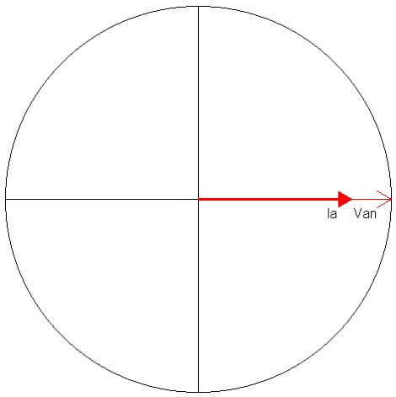
Basic Meter Math Power – VA
For a 120 Volt service drawing 60 Amps at 1.00 PF
How much power is being drawn?
Power = 120 x 60 x 1.00 = 7,200 Watts
How many VA are being drawn?
VA = 120 x 60 = 7,200 Volt Amperes

Slide 47
Basic AC Theory Sinusoidal Waveforms
Peak Value
RMS Value

Slide 48
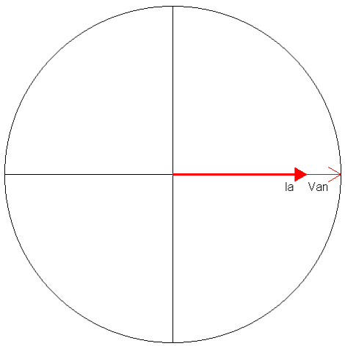
Basic AC Theory Power Factor = 1.0

Slide 49
Basic AC Theory Instantaneous Power
Average Power
P = 11520 Watts
Power is a “rate of flow” like water running through a pipe.

Slide 50
Basic AC Theory Instantaneous Power
Average Power
P = 9,976 Watts
PF=0.866

Slide 51
Basic Energy Formula
The essential specification of a watthour meter’s measurement is given by the value K_{h} [ Watthours per disk revolution ]
The watthour meter formula is as follows:

Slide 52
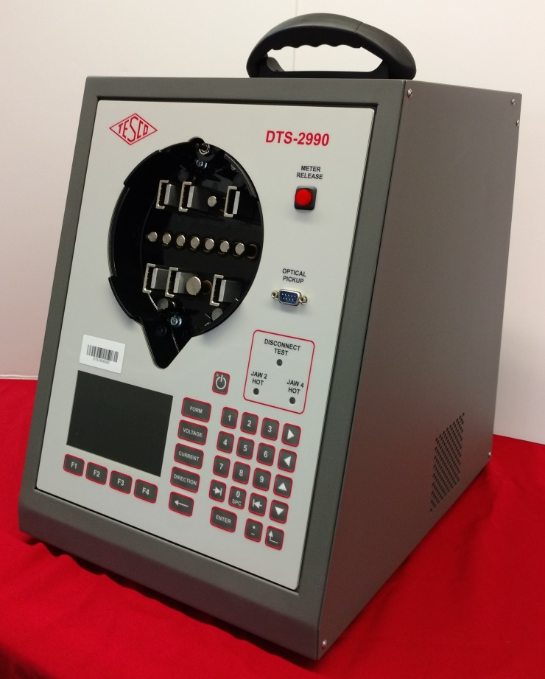
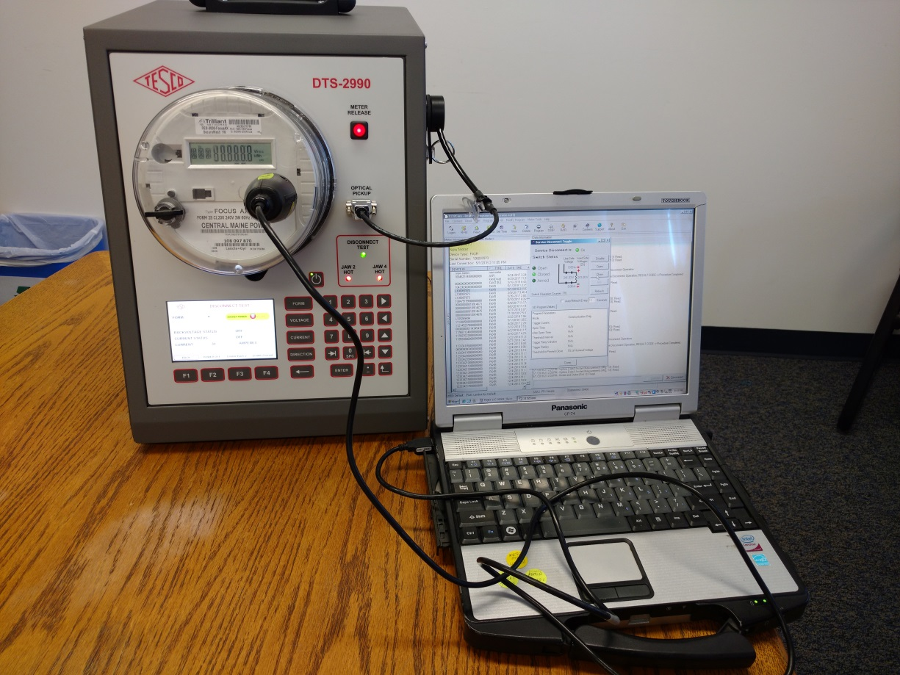
Meter Shop Accuracy Test Demo

Slide 53
Questions to Answer
Why do we test?
How do we test?
What types of meter tests are there?
How do utility tests differ from customer request tests?
What is In-Service Testing?
How do we know meter tests are good?
What do we do with the test data?

Slide 54
Questions?
Tom Lawton
TESCO – The Eastern Specialty Company
Bristol, PA
215-785-2338
This presentation can also be found under Meter Conferences and Schools on the TESCO web site: www.tescometering.com

