Slide 1



Verifying
Transformer Rated Service Installations
January 2019

Slide 2
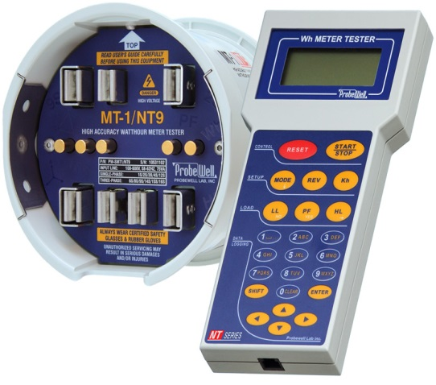
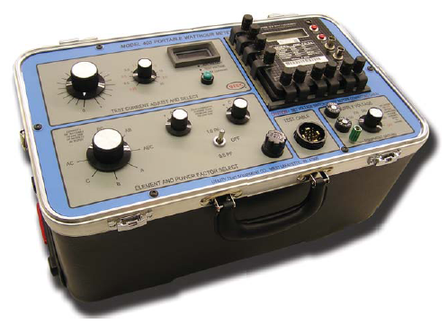
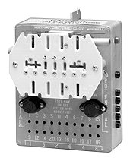
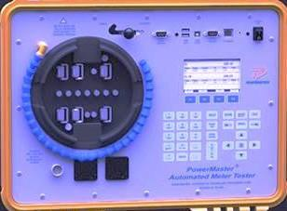
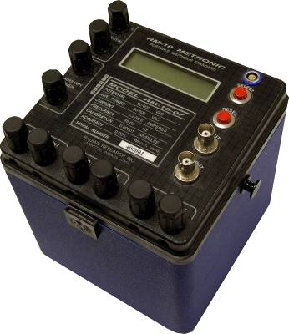
Field Meter Testing Using
Phantom Load
Notes:
These are great test sets, But only test the meter. We would like to test and inspect the complete site

Slide 3
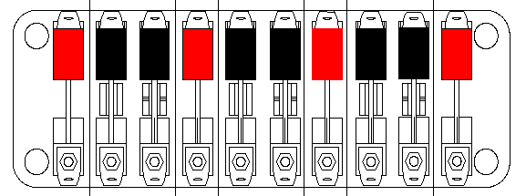
Opportunity for a problem beyond the meter?
H2
X1
H2
X1
3
3
0
0
0
0
H2
X1
3
0
0
Notes:
Lot of opportunities to have something else wrong beside just the meter.

Slide 4
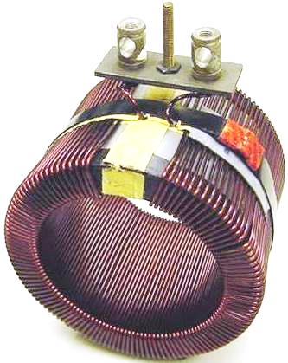
Instrument Transformers

Slide 5
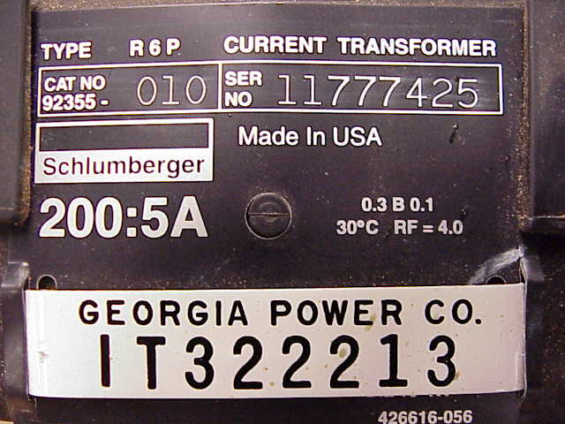
Instrument Transformers

Slide 6
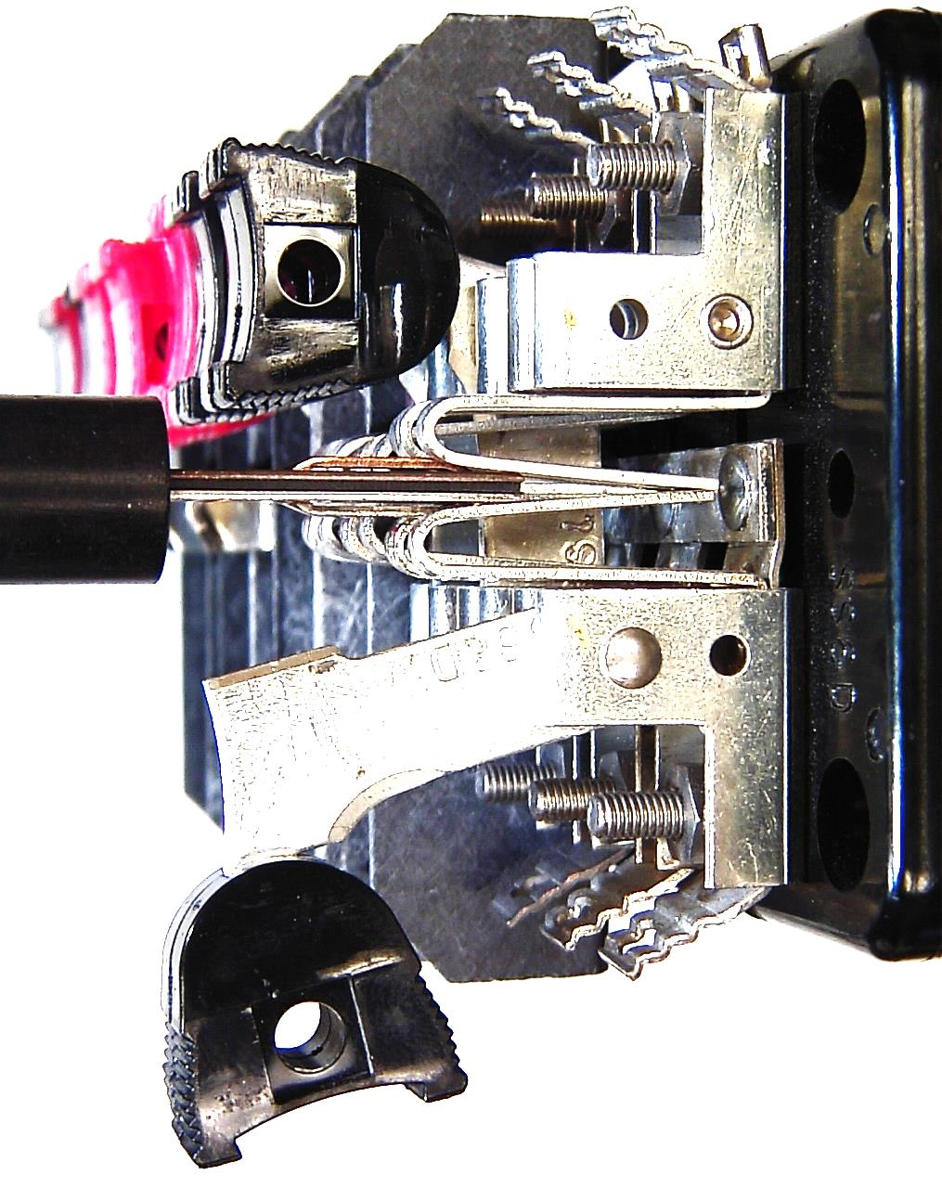
Current Return Switches

Slide 7
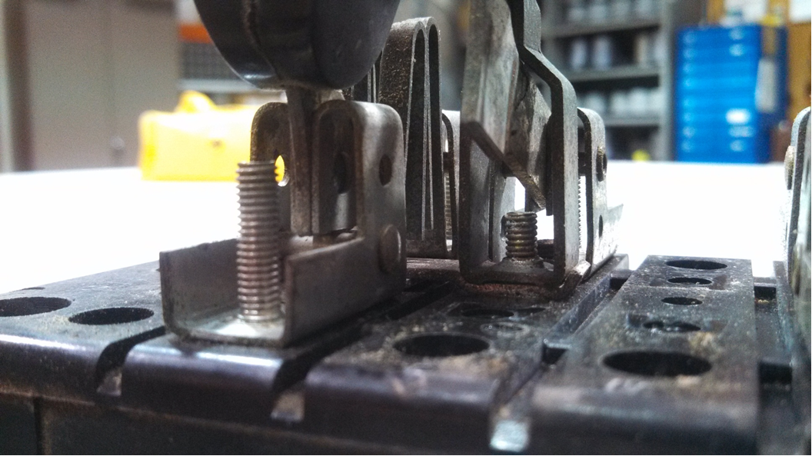
Current Return Switches
C Phase Current in open position

Slide 8
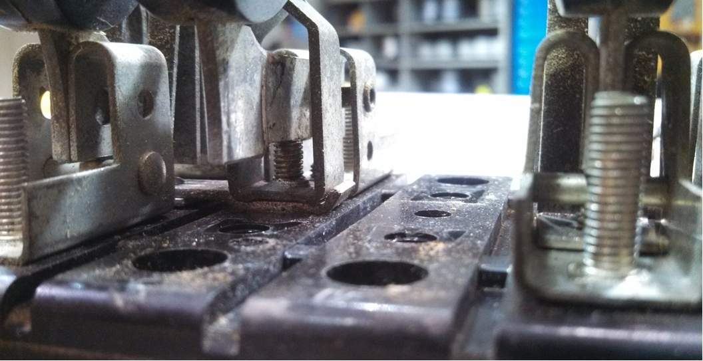
Current Return Switches
C Phase Current in closed position making contact with attachment screw for shunt buss.
This re-routes current to by pass the meter.

Slide 9
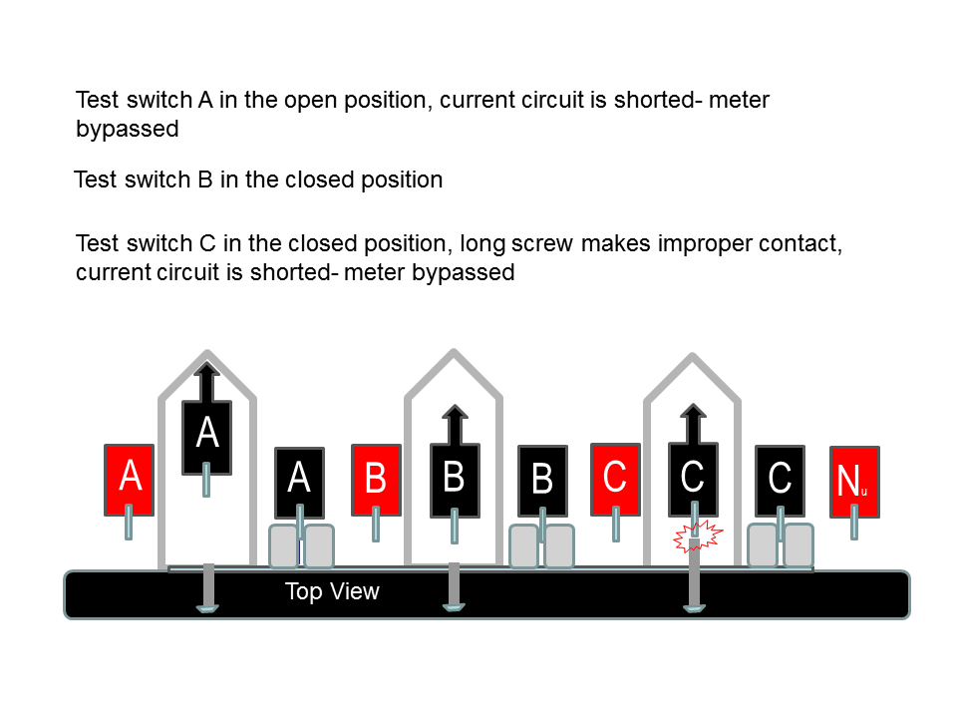
Current Return Switches

Slide 10
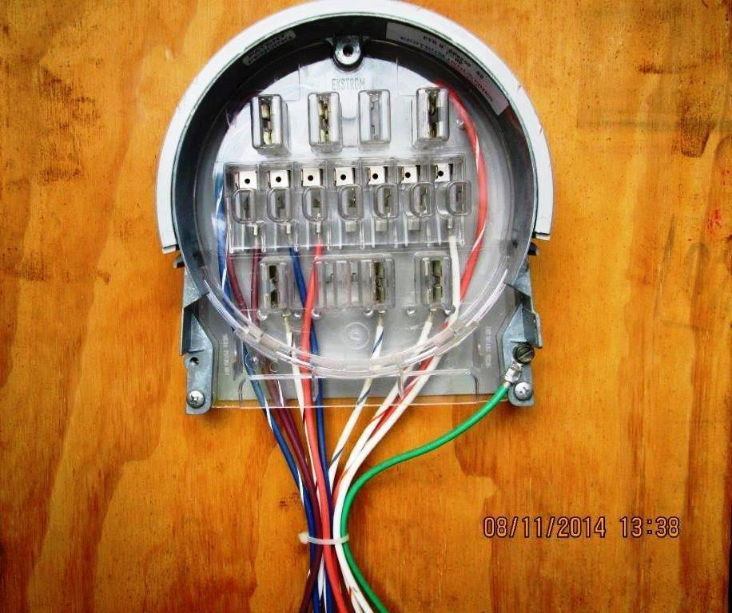
Form 9S Abase Adaptor
Notes:
Inspection of materials that can be bad.

Slide 11
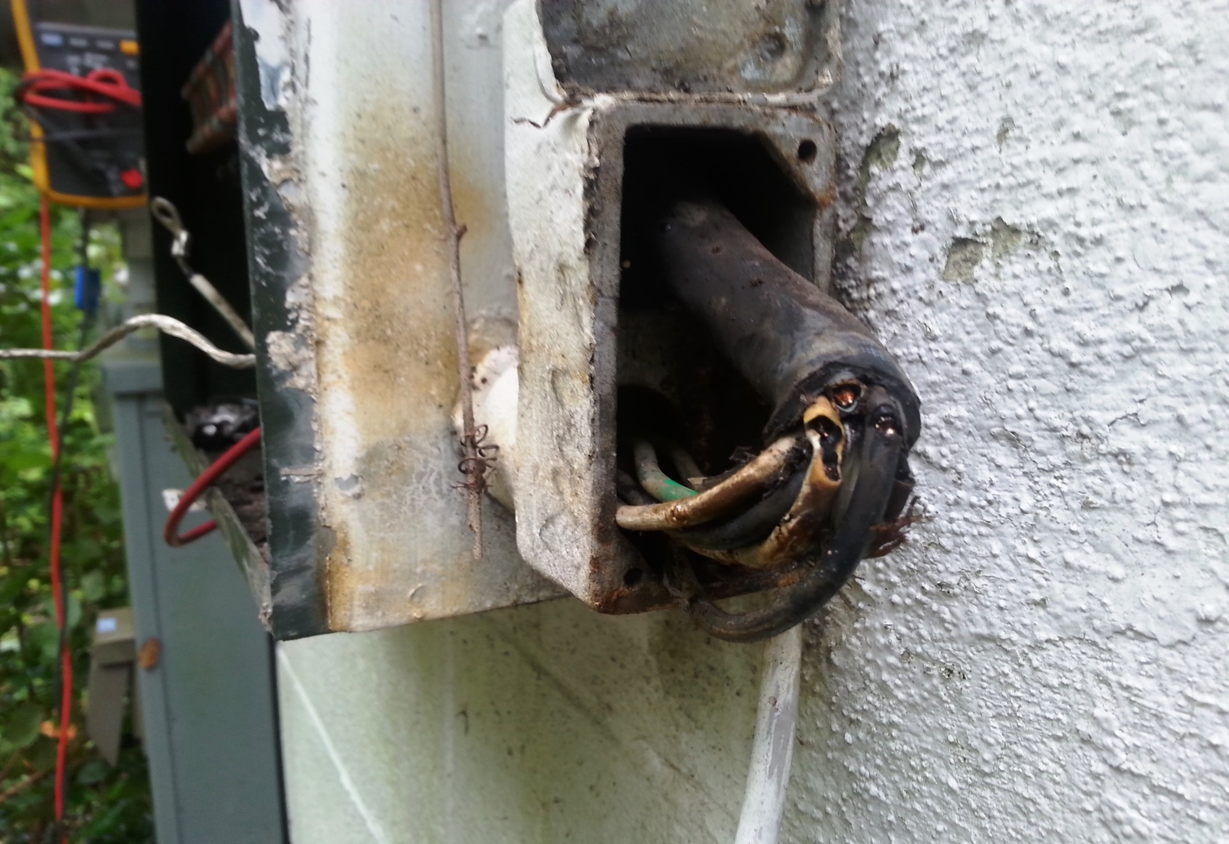
Nicked Control Cable

Slide 12
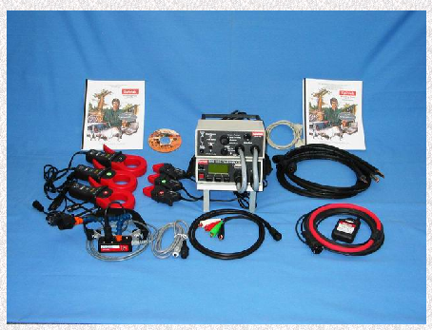
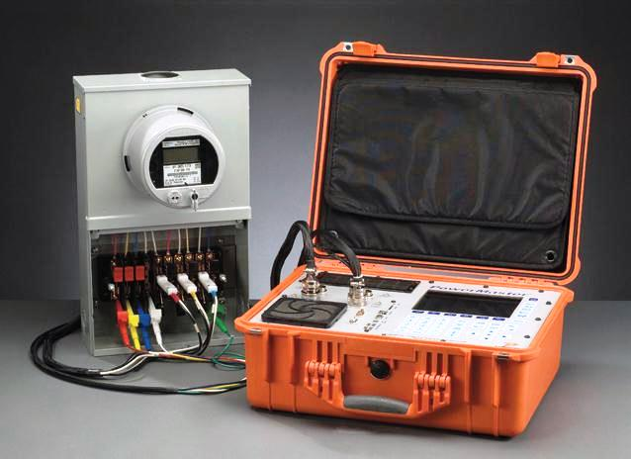
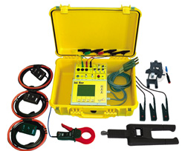
System Analyzers
Spinlab
Bird Dog Plus
Radian
RD31-221
testMET
Gold Miner
PowerMetrix
PowerMaster
Notes:
Explain there are many types available
At GPC we have chosen the PowerMaster

Slide 13
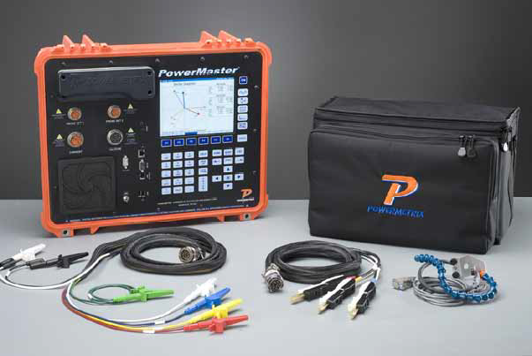
System Analyzer We Use
PowerMaster
5 Series Model

Slide 14
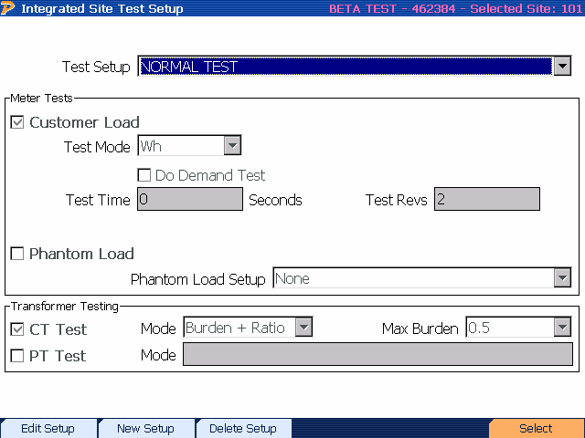
Testing Options Available
On the PowerMaster
Notes:
KWH test with customer load; KVRH test for reactive metering; phantom load; CT burden and/or ratio

Slide 15
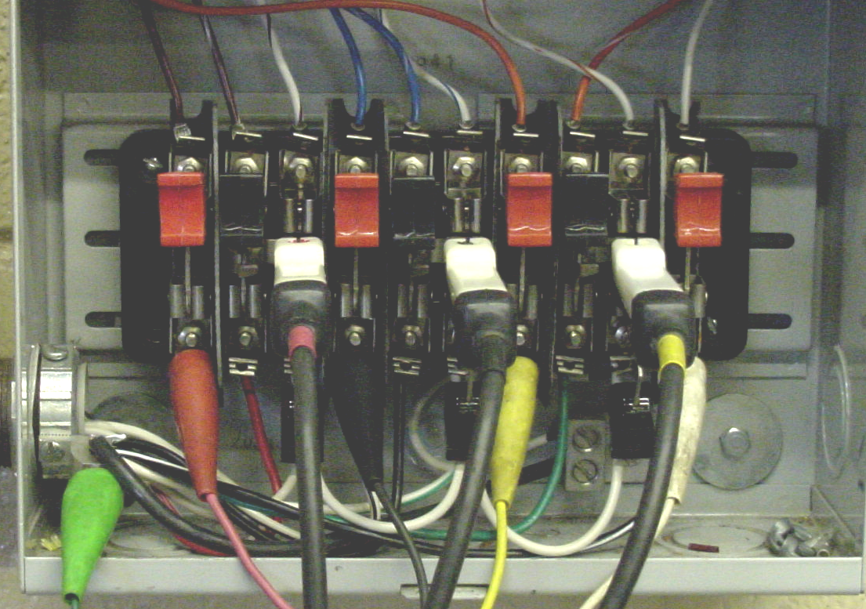
Before Beginning the Integrated Site Scan
The Following Steps Must be Performed
Proper PPE must be worn and all Safety Guidelines followed.
Install the Duckbill Current Leads
Connect the Potential Leads making sure they are matched to the proper current.

Slide 16
Select the Vector Analysis Option
Before Starting
Why ?
Vector

Slide 17
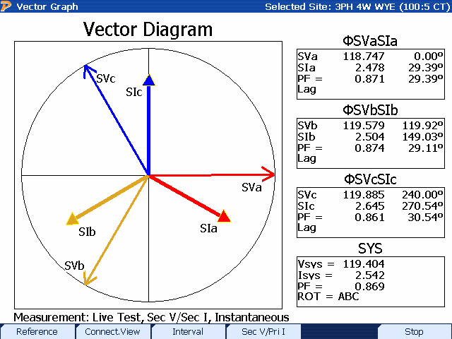
View the Vector to Verify your Connections …

Slide 18
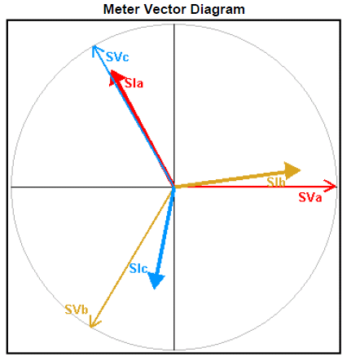
View the Vector to Verify your Connections …

Slide 19
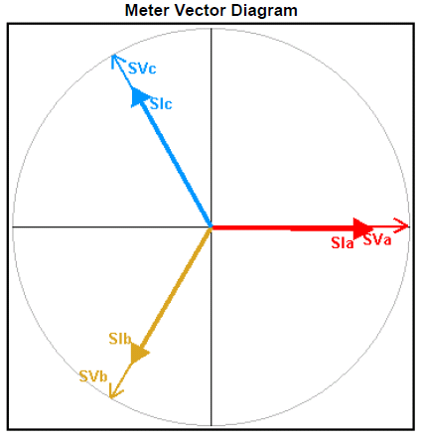
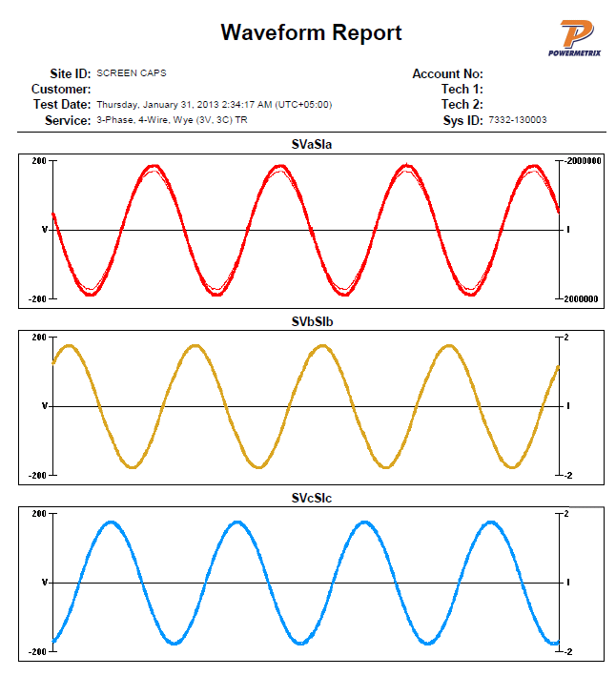
4 Wire Wye Service at Unity Power Factor

Slide 20
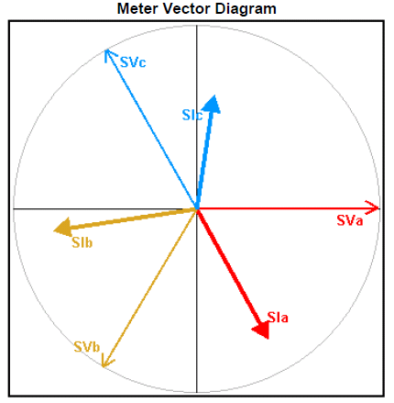
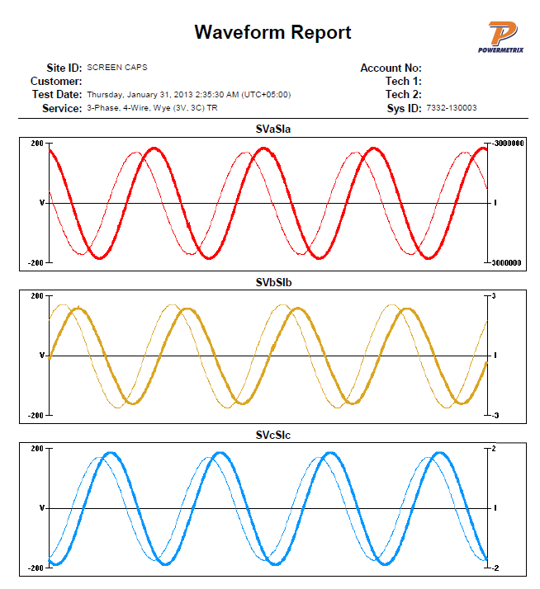
4 Wire Wye Service at 50% Power Factor

Slide 21
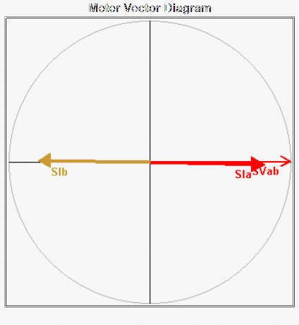
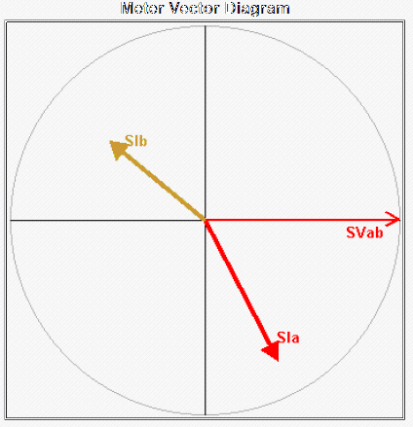
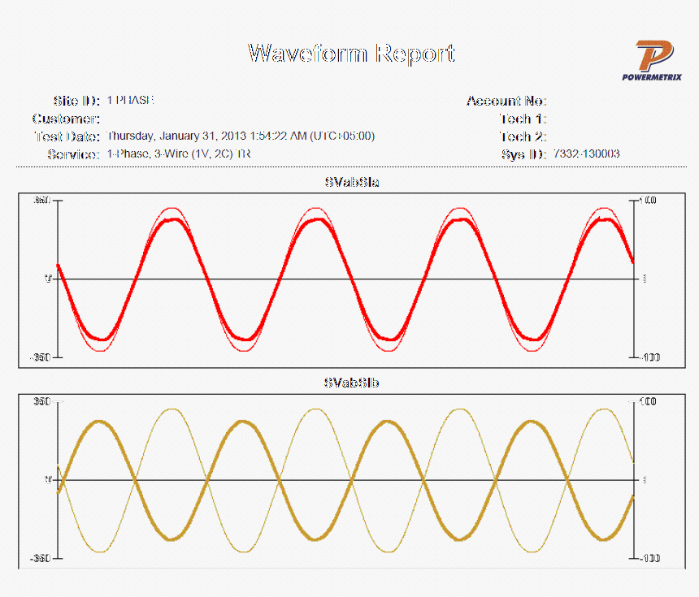
Single Phase Service
Unity
50% PF
Unity

Slide 22
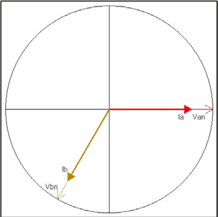
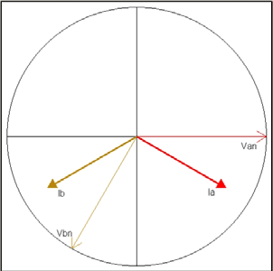
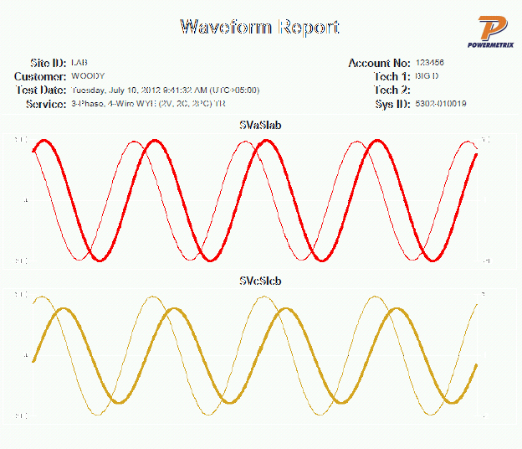
Three Wire Three Phase Network Service
No Lag (1.00 PF)
30° Lag (0.866 PF)
Waveform

Slide 23
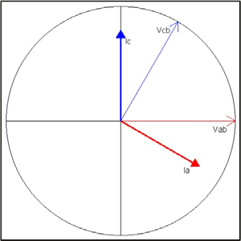
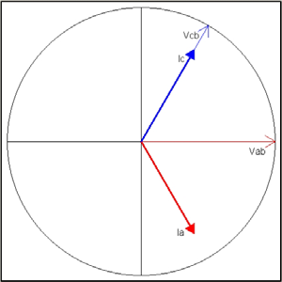
Three Wire Three Phase Delta Service
No Lag (1.00 PF)
30° Lag (0.866 PF)

Slide 24
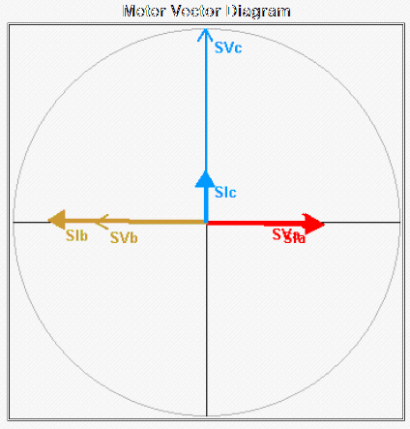
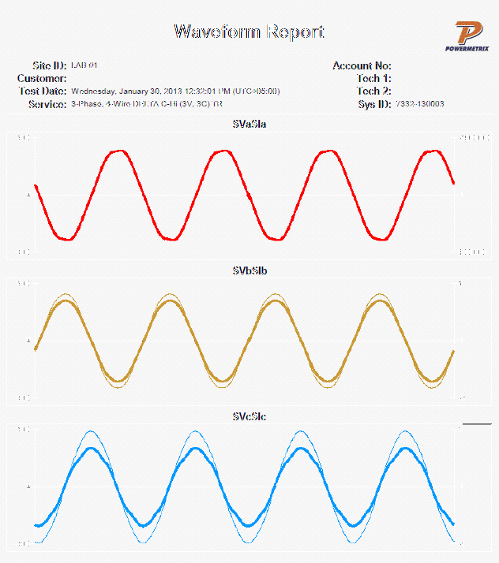
Delta Service at Unity Power Factor

Slide 25
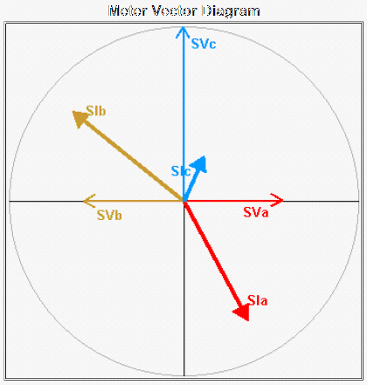
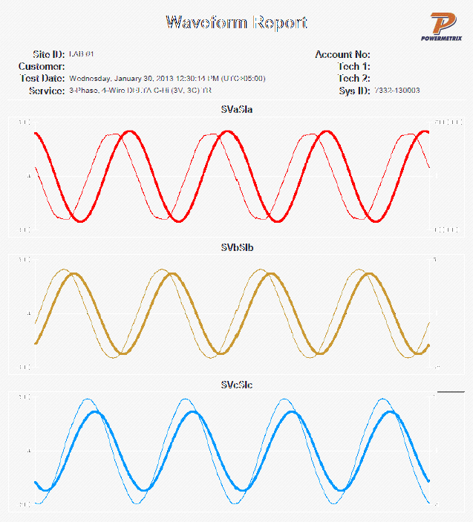
Delta Service at 50% Power Factor

Slide 26
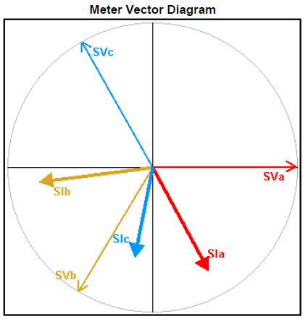
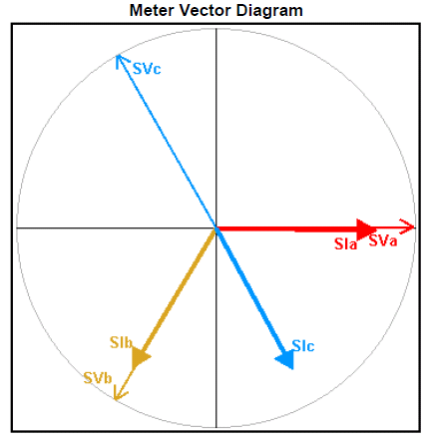
View the Vector to Verify your Connections …

Slide 27
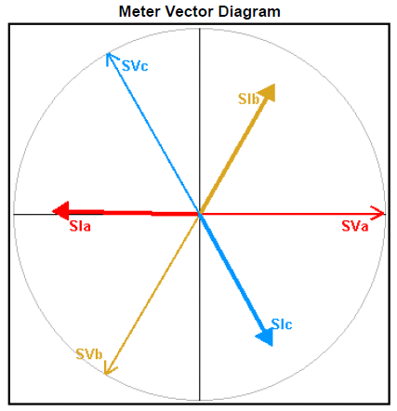
View the Vector to Verify your Connections …

Slide 28
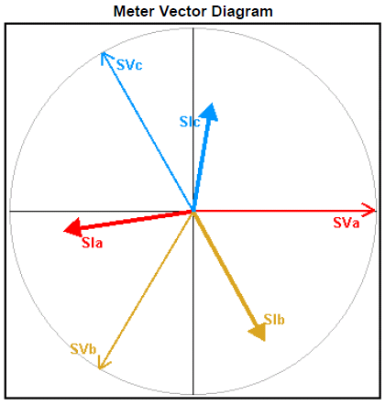
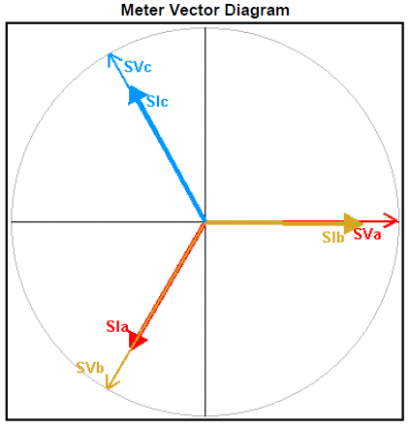
View the Vector to Verify your Connections …

Slide 29
What your Looking For!
Correct Vector
Potentials and Currents Match.
Start the Scan

Slide 30
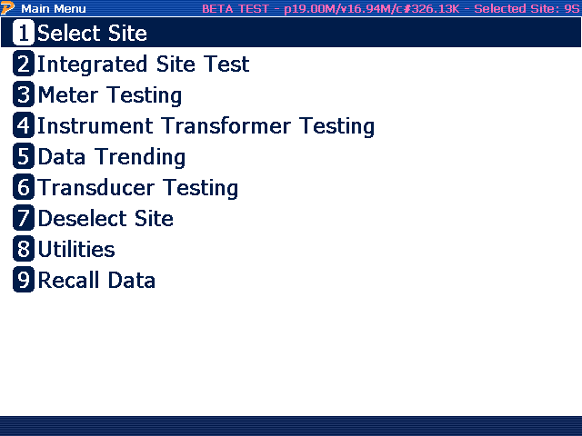
Integrated Site Test

Slide 31
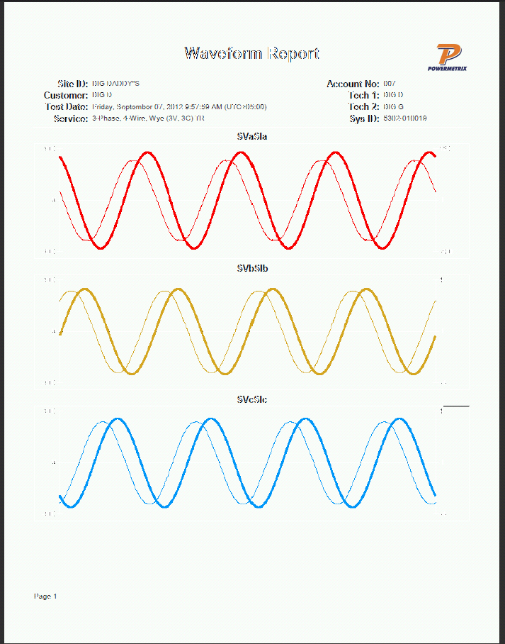
Capture of Sine Waves of Amps & Volts

Slide 32
Capture of Vector

Slide 33
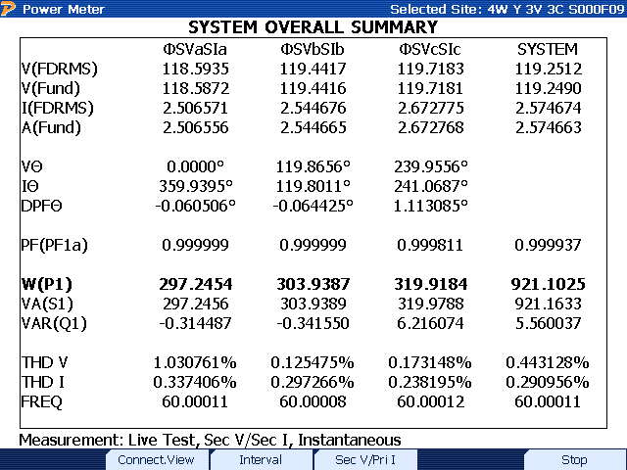
Captures System Overall Summary
“Breakdown Of Vector”

Slide 34
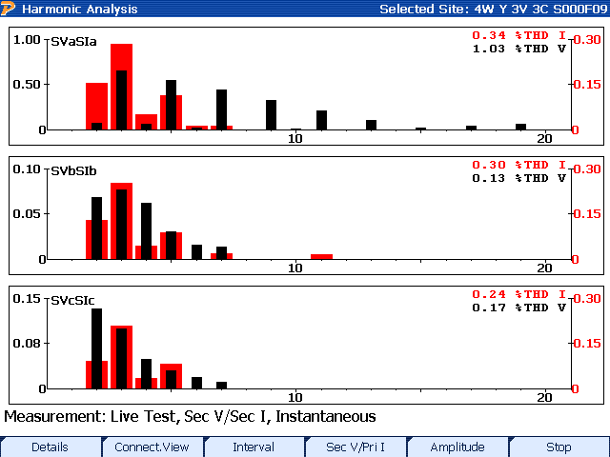
Harmonics for Amp And Volts
Amps
Volts

Slide 35
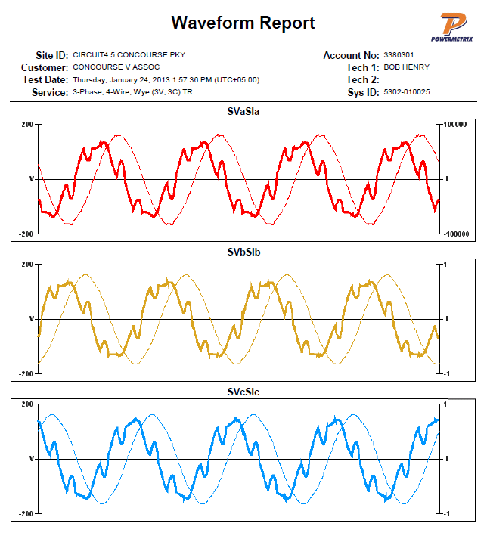
Harmonics

Slide 36
Causes of Harmonics
Harmonics are caused by devices that use an irregular current sinewave when the normal sinewave voltage is applied
LINEAR LOADS (Few Harmonics)
Incandescent Lights
Heating Loads (Resistive)
Some Motors
NON-LINEAR LOADS (Harmonics)
DC Drives
Power Rectifiers
Compact Fluorescent Bulbs

Slide 37
Harmonic Distortion
Harmonic waveforms are simply multiples of the fundamental waveform.
The graphs below show the relationship between a fundamental (60 Hz) current waveform and a 5th harmonic (300 Hz) component with about 25% peak deviation.
Fundamental (60Hz)
Resultant Wave Form
5th Harmonic (300Hz)

Slide 38
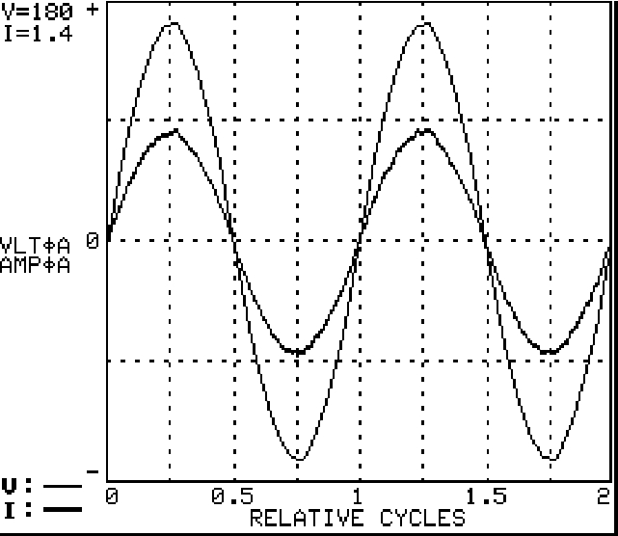

Incandescent Bulb

Slide 39
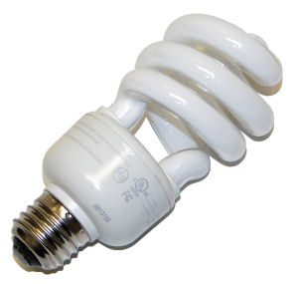


Compact Fluorescent Bulb

Slide 40


Motor

Slide 41


Power Supply for Lap Top Computer

Slide 42
Meter Accuracy Test

Slide 43


Meter Accuracy Test
Notes:
Increase in revolutions under customer load sometimes makes a difference.
Note Elapsed Test Times
Still falls under GPC standards

Slide 44

Customer or Phantom Load Test

Slide 45


Meter Accuracy Test Setup
Notes:
Discuss number of pulses to using the test time in the Powermate
Three minutes is GPC Standard

Slide 46
Meter Test Results
kWH

Slide 47

Phantom Load Tests Results

Slide 48
Verifying CT Accuracy

Slide 49

Setup Screen for Verifying CT Accuracy

Slide 50


Devices Used to Measure the CT’s “Primary” Current (Customer Load)
Flex 36 for Services 600 Volts or Less
High Voltage Fiber Optic
Probe
Used on Primary and Overhead
Secondary Services

Slide 51
Measuring Secondary Current

Slide 52


Verifying CT Accuracy on 600 Volts or Less

Slide 53


Flex Probe Measuring CT’s “Primary” Current in an U.G. Transformer

Slide 54


Flex Probe Measuring CT’s “Primary” Current in Switchgear
Notes:
Stress Importance of getting on the line side of the CTs closest to the transformer

Slide 55

Important Note
Get ahead of the CTs…
WHY?
Source Side of the CTs
Notes:
Stress Importance of getting on the line side of the CTs closest to the transformer

Slide 56


Do your best to get close to the source as possible…
But do it SAFE!

Slide 57



Fiber Optic Horseshoe Probe used on
Primary Services (above 600 volts)
Notes:
Explain “PRIMARY” Current

Slide 58



Fiber Optic Horseshoe Probe used on
Primary Service (above 600 volts)
Notes:
Explain “PRIMARY” Current

Slide 59




Phase A
125v 1.66a
Phase B
125v 1.60a
Phase C
125v 0.00a
Notes:
Explain “PRIMARY” Current

Slide 60



Fiber Optic Horseshoe Probe used on
Primary Service (above 600 volts)
Notes:
Explain “PRIMARY” Current

Slide 61

Notes:
Explain “PRIMARY” Current

Slide 62

Fiber Optic Horseshoe Probe can also be used on Over Head Secondary Service
Notes:
Explain “PRIMARY” Current

Slide 63

CT Ratio Test Information Results
Possible Errors will be
in RED, this appears to
be a CT running backwards.
If you didn’t check the vector before starting, this is probably your probe installed in
reverse. Check the probe and retest the phase in question.

Slide 64

CT Ratio Test Information Results

Slide 65

Results for Ratio Only

Slide 66

Results for Burden Only

Slide 67



Should be 2000:5
Ratioed at 1432:5

Slide 68


Slide 69

Bad CT
Failure Began Before .1 Ohms Of
Burden Is Applied

Slide 70


Bad CT ?
Ratio Should Be 200 : 5

Slide 71

No, Just A Bad Electrician
Additional run of wire installed and pulled
through Two CTs backwards
Current Flow
Current Flow

Slide 72

Bad CT ?
300 : 5 Primary CTs Ratio Results at 112%

Slide 73

Same CT 15 Minutes Later
What Happened ?
21% of CT
Rated Load
Best Resolution Achieved If Secondary Amps
Are At Least 10% of CT Value
Notes:
Earlier Slide CT only had .022% of CT rating where this CT has 21% of CT Load rating

Slide 74
Vectors
What Do We Look For ?

Slide 75
Services At Unity Power Factor
4 wire WYE
3 wire Delta
4 wire Delta

Slide 76
Typical WYE Service

Slide 77
Problem ?
A Phase and B Phase Current Crossed

Slide 78
Problem ?
CTs Wired Backwards

Slide 79

Three Wire Three Phase
Delta Service

Slide 80

Three Wire Three Phase Delta
Bad Power Factor
15° (Lag)
Normally Leading BY 30 °
Normally Laging BY 30 °
74°
Notes:
“C” current would usually be at 270° there is a phase shift of 45° putting the phase angle at 15°
“A” Current would usually be shifted to 30° out of phase with AB potential there is a phase shift of 44° creating an overall phase angle of 74° the result being a .265 power factor.
The combination of the two creates an overall Power Factor of .717

Slide 81

Three Wire Three Phase Delta
with Worse Power Factor

Slide 82

Three Wire Three Phase Delta
with Even Worse Power Factor
93°
33°
Forward Rotation Stops at 90°
as the Angle Increases Reverse Rotation Begins

Slide 83

Problem- Crossed Potentials?
It looks like A-phase current is matched with B-phase potential, and B-phase current with A-phase potential.
Notes:
This turned out to be a CT cabinet with two runs of conductor through each CT. On two of the CTs the conductors were not “brothered.”
Phase-C CT was correct. It appeared that an electrician had added another panel at some time after the original installation.

Slide 84


Problem- Crossed Potentials?
Instrumentation data from the Metercat Diagnostic Read agreed with data reported from the AMI meter.
As the load changed, the meter would alternate between forward energy flow and reverse energy flow.

Slide 85

The actual problem was found to be non-brothered service conductors through two of the current transformers. Phase-C current transformer on the far right was correct.
C
A
B
B
A
Notes:
The meterman had marked the conductors with tape in preparation for correcting the problem, but his A and B phase markings did not match what the meter was seeing as A and B phase due to the conductors on which the meter potential wires were connected. This did not affect getting the problem corrected, but it would have affected our understanding of our vector analysis – therefore the labeling was photo shopped so that our current measurements and vector analysis would make sense.
The conductors marked B-phase were the original conductors feeding the original 400 amp panel. You can see the taped area on the conductor where we originally would have had a split bolt connector for our meter potentials. Someone installed the Utilco connectors and swapped the meter potential wires to the conductors feeding the 225 amp panel that was added. This condition existed when that was done. From other pictures you can see that a #6 bonding wire was added to bond the meter socket. A QA inspection was done here in 2008.

Slide 86


C-phase CT
Measured 9.5 amps and 49.1 amps

Slide 87

C-phase CT
Total current measured by C-phase CT was 58.6 amps
Vectors with the same angle simply add together

Slide 88
Total current measured
Voltage
Current
A
B
C

Slide 89


A-phase CT
Measured 92.3 amps on B-phase and 15.4 amps on A-phase
A
A
B
B
Notes:
The purpose of the next series of slides is to show the current through each conductor compared to the total current measured by the CT and sent to the meter. The CT is summing two currents that have different phase angles. This illustrates that these two currents do not simply add together.

Slide 90

A-phase CT
Total current measured by A-phase CT was 85.3 amps
How does 92.3 and 15.4 add up to be 85.3 ?

Slide 91


B-phase CT
Measured 12.5 amps on B-phase and 56.9 amps on A-phase

Slide 92

B-phase CT
Total current measured by A-phase CT was 47.2 amps
How does 12.5 and 56.9 add up to be 47.2 ?

Slide 93
Total current measured
Voltage
Current
A
B
C

Slide 94

A complex number can be visually represented as a pair of numbers (a, b) forming a vector on a diagram, representing the complex plane. "Re" is the real axis, "Im" is the imaginary axis, and i is the imaginary unit

Slide 95

Illustration of on-site measurements
The customer added the 225 amp panel some time after the original installation.

Slide 96

Metering Problem ?
Opportunity to Bill for Excessive Reactive Load
Bad Power Factor
Balanced Load

Slide 97
What can a Customer or Utility do about Bad Factor?

Slide 98

VARs Compensator
?

Slide 99


Site With VARs Compensator Installed
Vars Compensator Off
Vars Compensator On
Notes:
Some customers have a bad enough Power Factor that they will install a VARs Compensator to get a Power Factor that they will not be penalized for.
Also may help us in the case of an Isolated line out in a rural area that will effect
Residential customers on the line when a load is being pulled.

Slide 100

SAFETY
IS THE ABSOLUTE NUMBER ONE PRIORITY
•
Hardhat
•
Eye Protection
•
FR Clothing
•
Rubber gloves with
“Grabbit” gloves or Leather
outer protectors

