Slide 1
Caribbean Meter School
ANSI Best Practices and Current Trends
Tom Lawton, TESCO
January 29, 2019
Atlanta, GA

Slide 2
ANSI
American National Standard Institute, Inc.
Not a government agency
Standards do not have force of Law
All compliance is voluntary
ANSI doesn’t actually generate any standards
Each standard is controlled by an industry organization as the “secretariat”
For C12 NEMA (National Electrical Manufacturer’s Association) is the secretariat
Paul Orr has been the NEMA’s secretary assigned to C12 for over ten years providing continuity to the process

Slide 3
ANSI
American National Standard Institute, Inc.
NEMA organizes committees to propose and review standards
Standards are republished approximately every 5 years
Standards codify consensus approaches in common practice
Generally, they do not break new ground or deal in controversial issues
This is changing. Can’t avoid issues any longer.

Slide 4
ANSI C12
C12 Main Committee
General makeup has expanded slightly over last few years
34 voting members with representation from three groups:
12 - Manufacturers: Meter, Socket, Test Equipment, etc.
13 - Users: Utilities
9 - General Interest: PUC, UL, IEEE, Consultants, etc.
Meets twice a year in conjunction with EEI/AEIC Meter conference.

Slide 5
ANSI C12
C12 Main Committee
Has final approval for all activities on any C12 family standard
Establishes Subcommittees (SC) and Working Groups (WG) to address various standards and issues
Sub committees and Working Groups also meet twice a year in conjunction with EEI Transmission, Distribution and Metering Conference and also hold regular or ad hoc conference calls throughout the year as members put together drafts and other technical material for consideration at the next face to face meeting.

Slide 6
ANSI C12
C12 Subcommittees
Various subcommittees have been organized to review specific standards
This is where the work is really done
Each operates slightly differently
Each meets on a schedule of its own choosing
Most meet at EEI Biannual Transmission, Distribution and Metering Meetings
Communication WG meets more often and longer
Various subgroups meet frequently by teleconference

Slide 7
ANSI C12 – Sub-Committees
Sub-Committee | Standards
C12 SC1 | C12.1, C12.4, C12.5, C12.10
C12 SC15 | C12.6, C12.7, C12.8, C12.9, C12.11
C12 SC16 | C12.20, C12.24
C12 SC17 | C12.18, C12.19, C12.21, C12.22, C12.23, C12.26
C12 SC29 | C12.29 Standard for Field Testing of Metering Sites
C12 SC31 | C12.31 VA Measurement Standard
C12 SC46 | C12.46 American National Standard for Electricity Meters - 0.1, 0.2 and 0.5 Accuracy Classes for the Measurement of Active, Apparent and Reactive Power

Slide 8
ANSI C12 SC 1
C12.1– Code for Electricity Metering
C12.1-2014 published in 2016
Changes in this Revision
Vector diagrams for balanced voltages are defined for common services
Various definitions have been updated
Bi-directional metering is added and tests updated to include bidirectional measurements
Significant changes were made to the temperature rise section based on TRINIWOG tests

Slide 9
ANSI C12 SC 1
C12.1 – Code for Electricity Metering
Changes in this Revision (continued)
Table 1b on maximum errors for reference standards was added
Tightened to 0.05% and 0.02%
Meter Accuracy Class 0.5 was added to the standard
A new column was added to all tables with tighter specs for AC 0.5
Section 5 on Standards for New and In Service Performance was completely rewritten
Appendix D was rewritten and simplified
A new Appendix F was added

Slide 10
ANSI C12 SC 1
C12.1 – Code for Electricity Metering
Safety
Work is under way to move the safety related sections of C12.1 into C12.10
C12 is coordinating efforts with UL and its work on Subject 2735
UL2735C (Canadian) is about to be balloted
New topics for next revision
Changes to EMC Testing
Addition of demand testing
Revision of Temperature Rise Test based on additional testing

Slide 11
ANSI C12 SC 1
C12.10 – Physical Aspects of Watthour Meters – Safety Standards
Published C12.10 – 2011
New revision in editorial review
Will add safety sections from C12.1
New safety requirements in development
Working with UL to achieve consistency with UL 2735C
10 new meter forms with auxiliary power pins

Slide 12
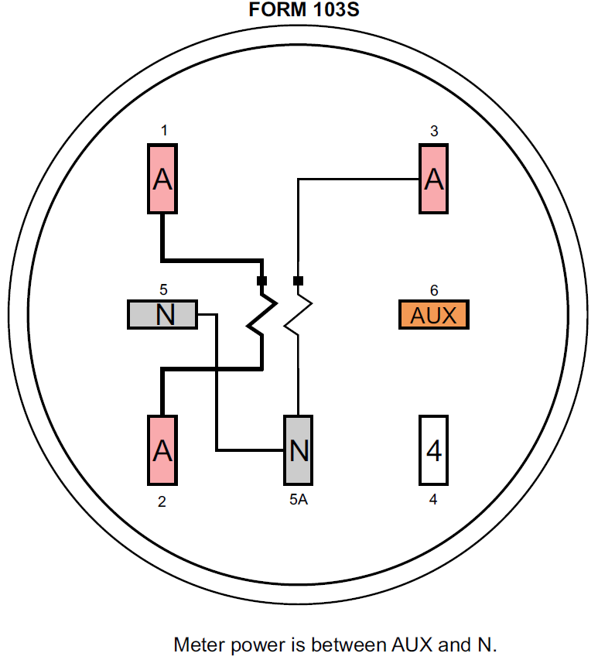
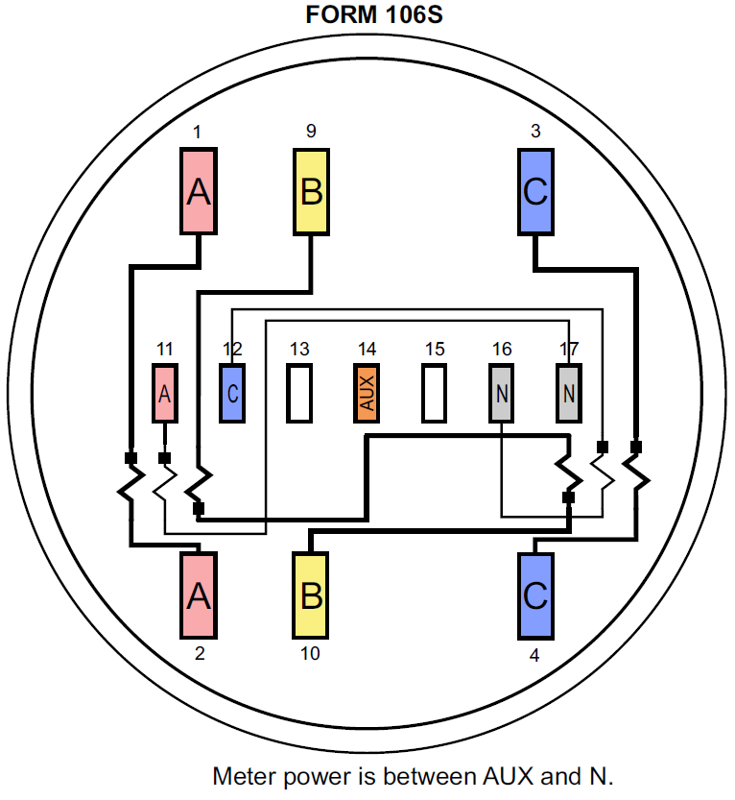
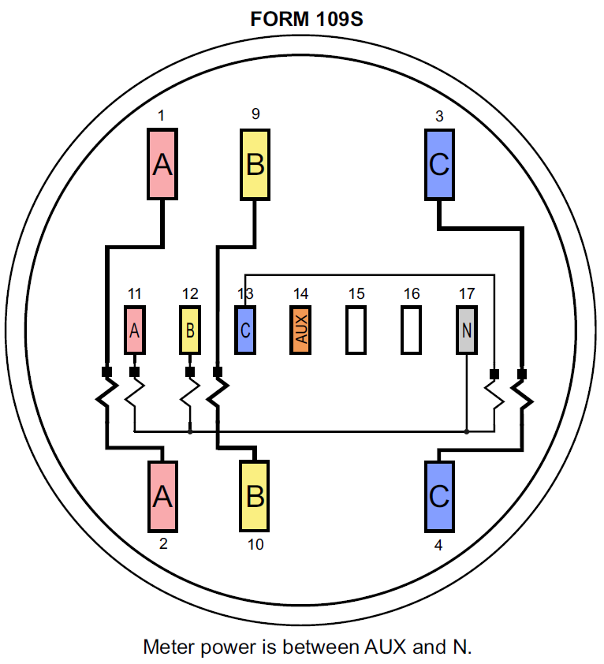
ANSI C12 SC 1
New meter forms with Auxiliary Power

Slide 13
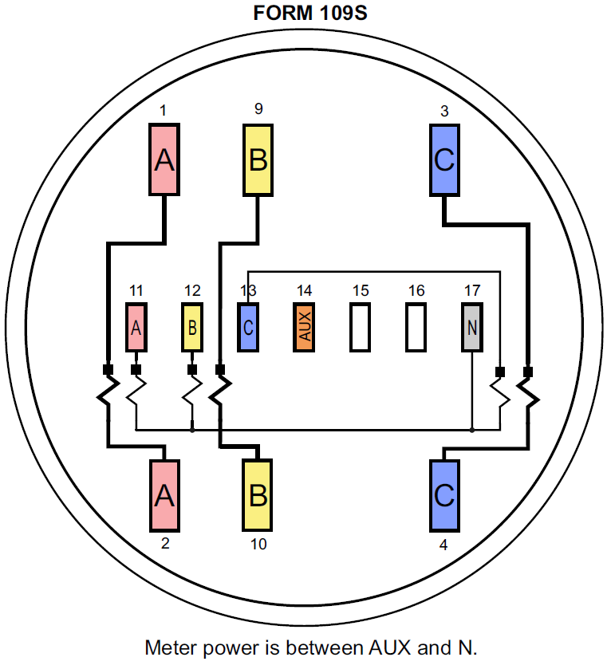
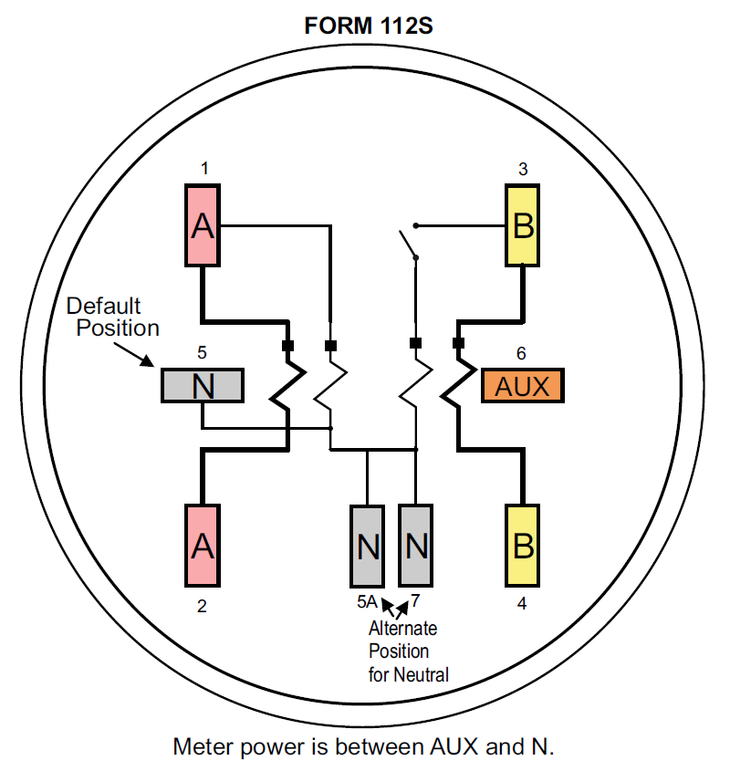
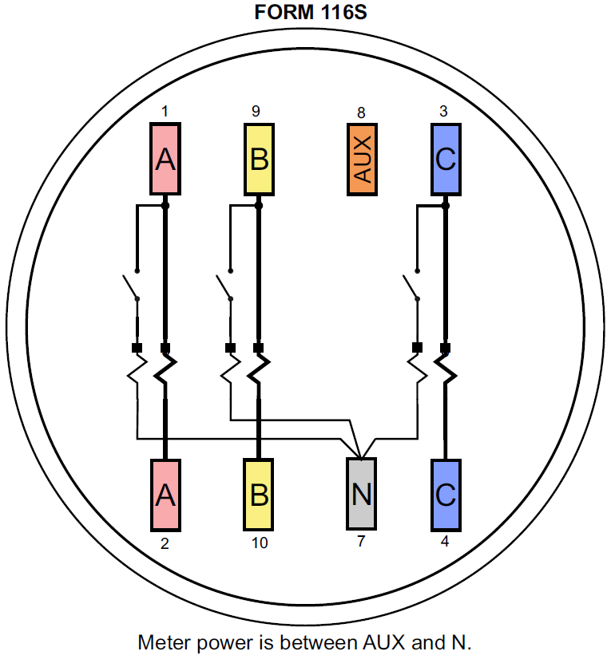
ANSI C12 SC 1
New meter forms with Auxiliary Power

Slide 14
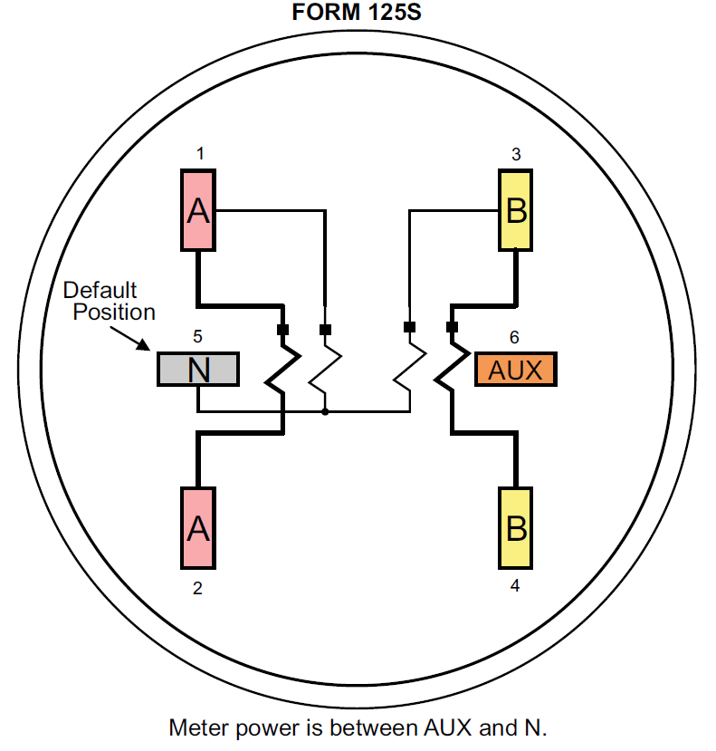
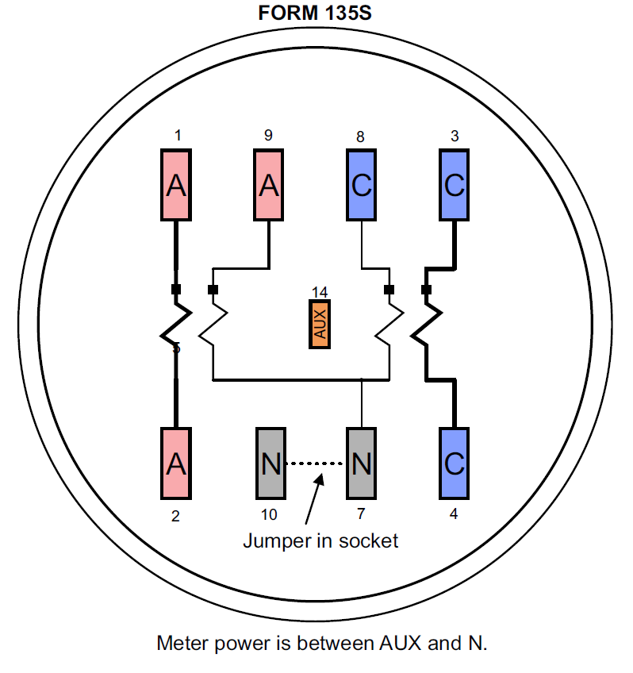
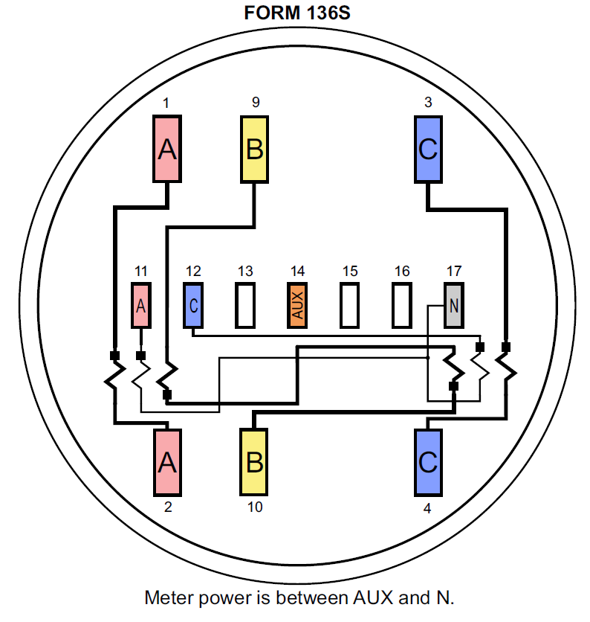
ANSI C12 SC 1
New meter forms with Auxiliary Power

Slide 15
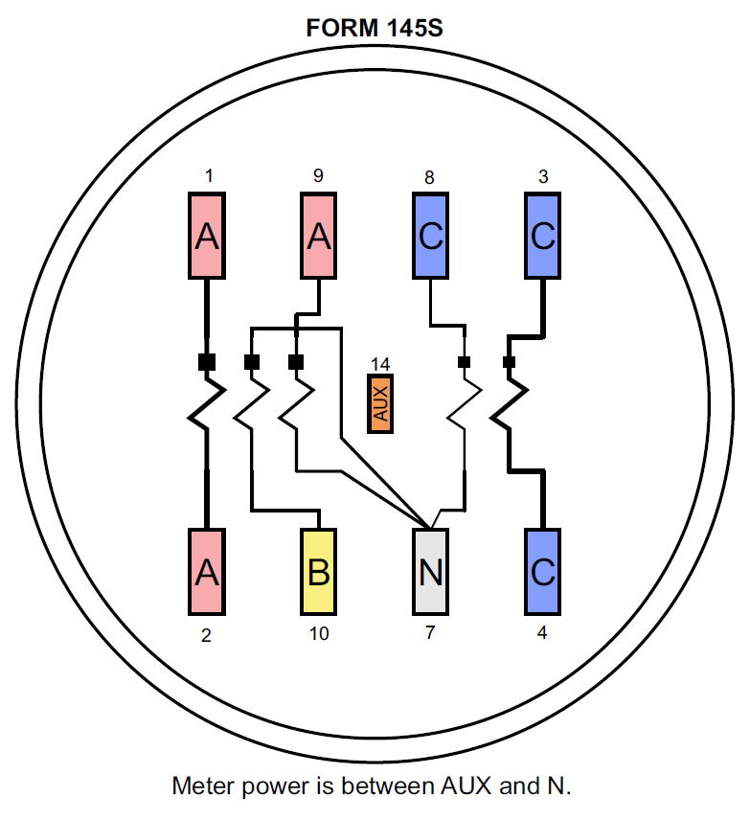
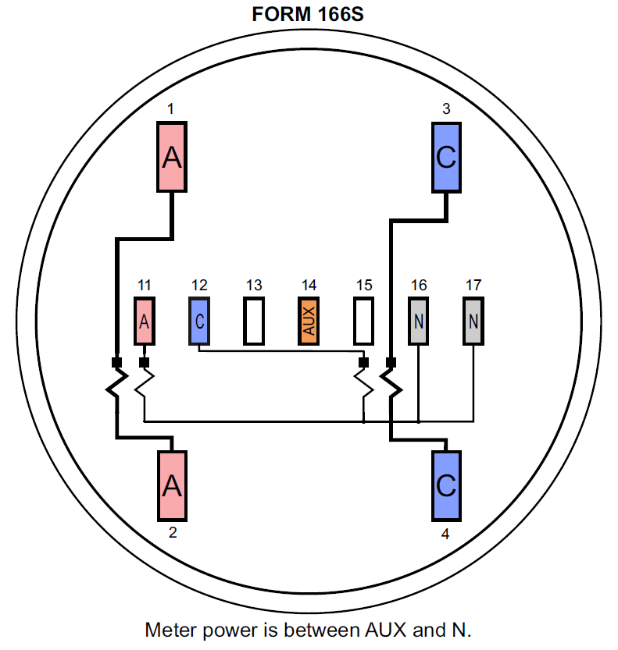
ANSI C12 SC 1
New meter forms with Auxiliary Power

Slide 16
ANSI C12 SC 15
C12.6 – Marking and Arrangement of Terminals for Phase-Shifting Devices used in Metering
About to be reissued without change
C12.7 – Requirements for Watthour Meter Sockets
Published – Feb 2015
Notes:
16

Slide 17
ANSI C12 SC 15
C12.8 – Test Block and Cabinets for Installation of Self contained “A” Base Watthour Meters
Published without change Dec 2012
Will be deprecated once Figure 4 is moved to C12.7 in its next release
Notes:
17

Slide 18
ANSI C12 SC16
C12.9 – Test Switches and Plugs for Transformer Rated Meters
Extensive Revision in last publication
Specifications for test plugs added
Published – March 2015
Notes:
18

Slide 19
ANSI C12 SC16
C12.11– Instrument Transformers for Revenue Metering, 10 kBIL through 350 kBIL
Revised to parallel C57.13
Published – July 2014
New proposal on the table to revise barcode formats to allow QR and other more modern codes
Notes:
19

Slide 20
ANSI C12 SC16
C12.20 – 0.1, 0.2 and 0.5 Accuracy Class Metering
C12.20 -2015 Published May 2017, Errata sheet also published
0.1 Percent Accuracy Class Added
New column added to all accuracy test tables
Section 4.6 added to provide specifications for test outputs
Type B port specifications were made “informative” due to a lack of unanimity. No Standard can force a manufacturer or utility to change their existing practices without their voluntary consent.

Slide 21
ANSI C12 SC16
C12.20 – 0.1, 0.2 and 0.5 Accuracy Class Metering
Tighter performance at reference conditions was specified
Table 2 updated to make clear which forms and applications are Blondel compliant.
Table 2A added to make clear which forms and applications are NOT Blondel compliant
Therefore NOT covered by the standard

Slide 22
ANSI C12 SC16
C12.20 – 0.1, 0.2 and 0.5 Accuracy Class Metering
Areas of activity for next revision
Auxiliary device influences (requiring accuracy testing with any communication devices active)
Disturbances test for memory corruption due to rapid power cycling such as during dropout/reclosure events
Extended temperature operating ranges

Slide 23
ANSI C12 SC29
Field Testing of Metering Installations
Field Testing of Metering Accuracy
Hope to send for approval after next meeting
Agreement on single set of acceptability criteria for testing under all three modes
Voltage and current supplied by test equipment
Site voltage, equipment provided current
Site voltage and current (customer load)
Final issue is review of “acceptability” values

Slide 24
ANSI C12 SC31
VA and VAR Metering Standard
Establish a legal definition for VA and VAR
VA being addressed first in order to “Fast Track” the result.
Definitions agreed upon
Initial draft completed
At this meeting, new quantity “source VA” was proposed by Landis+Gyr
Committee agreed to consider during a series of WEB conferences
Goal is to promote VA and active energy (watts) as the primary metering quantities.

Slide 25
ANSI C12.46
Sub-Committee to Develop a Replacement for C12.1 and C12.20
Adopts the structure of OIML IR-46
Addresses 0.1, 0.2, and 0.5 Accuracy Classes
Addresses Active, Reactive, and Apparent Energy
Will be biggest change to metering standards in 100 years
Review and editing of draft in process
Expected Publication 2020

Slide 26
Questions and Discussion
Tom Lawton
TESCO – The Eastern Specialty Company
Bristol, PA
215-688-0298(cell)
215-785-2338 (office)
Tom.Lawton@tescometering.com
This presentation can also be found under Meter Conferences and Schools on the TESCO website:
www.tescometering.com

