Slide 1



Caribbean Meter School
Test Switch Operations and Accessories
John Greenewald, TESCO
January 29, 2019
Atlanta, GA

Slide 2
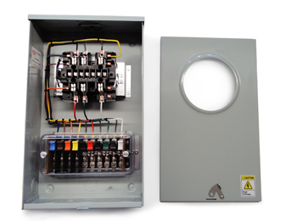
Purpose:
To acquaint the attendees with the use and purpose of Meter Test Switches
Course Breakdown of Topics:
Using Test Switches
Meter Test Switch Specifications
Meter Test Switch Configurations
Meter Test Switch Accessories
Pre-Wired Transformer Rated Enclosures

Slide 3
SAFETY
Testing current transformers while they are in service can be a dangerous operation if certain safety procedures are not followed. The secondary loop of a current transformer must NEVER BE OPENED when service current is present in the primary. When there is current in the primary, and the secondary of a current transformer is open circuited, the voltage across the secondary can rise to hundreds and even thousands of volts, creating an extremely dangerous situation. The open CT secondary voltage magnitude varies with CT design and primary current flow. The high voltage that is present on the open secondary of an energized current transformer generates two great hazards. The first hazard is ELECTRICAL SHOCK TO TESTING PERSONNEL. The second hazard is THE BREAKDOWN OF THE CURRENT TRANSFORMER INSULATION. Both hazards can be avoided provided that the secondary of the current transformer is never opened. The safest current transformer installations for testing are those that have a Test Switch as part of the secondary loop. A Test Switch is a device that will facilitate inserting instrumentation in the current transformer secondary loop without the danger of opening the circuit.

Slide 4
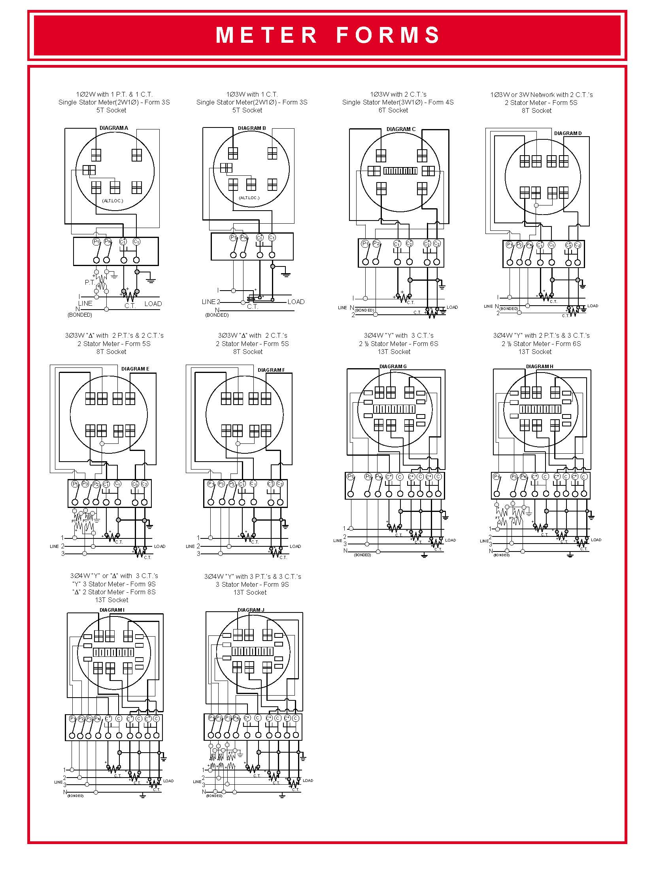
Typical Connections for Common Meter Forms

Slide 5
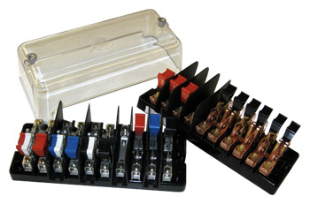
Test Switch Specifications
ANSI C12 Definitions
Test Switch Materials
Plating
Barriers
Wiring Connections
What to look for
Covers

Slide 6
ANSI C12.9 Test Switch Definitions

Slide 7
ANSI C12.9
Test Switches

Slide 8
ANSI C12.9 General Test Switch Specifications

Slide 9
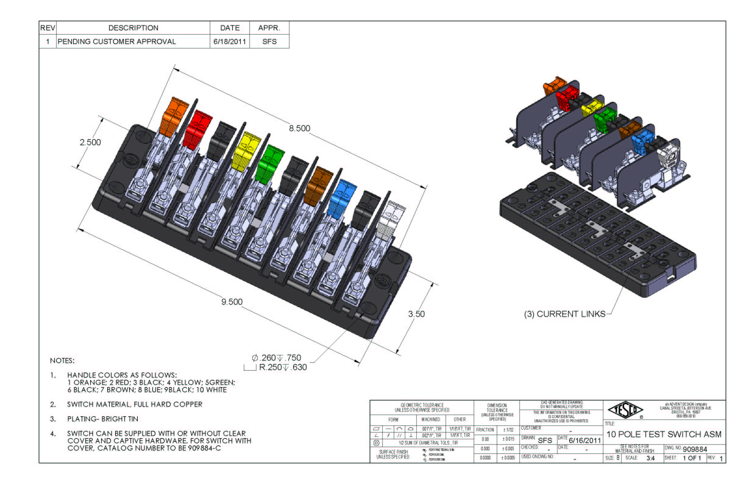
Test Switch Configurations
Layout
Handle Colors
Reversed vs. Normal Potentials
Current Links
Base Sizing
Barrier Locations and Removable vs Fixed

Slide 10
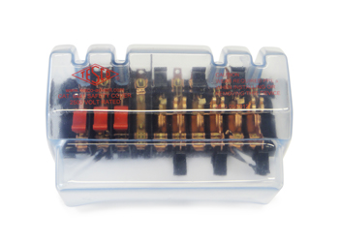
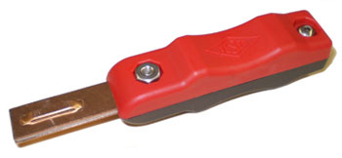
Test Switch Accessories
Test Plugs
Safety Covers
Test Switch Isolators
On installations that contain Test Switches, test leads terminated with a test switch
safety test probe (test plug) should be used for CT testing. This provides a “make-before-break” connection to prevent accidental opening of the current transformer secondary loop.

Slide 11
ANSI C12.9 Test Jack Specifications

Slide 12
ANSI C12.9 Test Plug Specifications

Slide 13
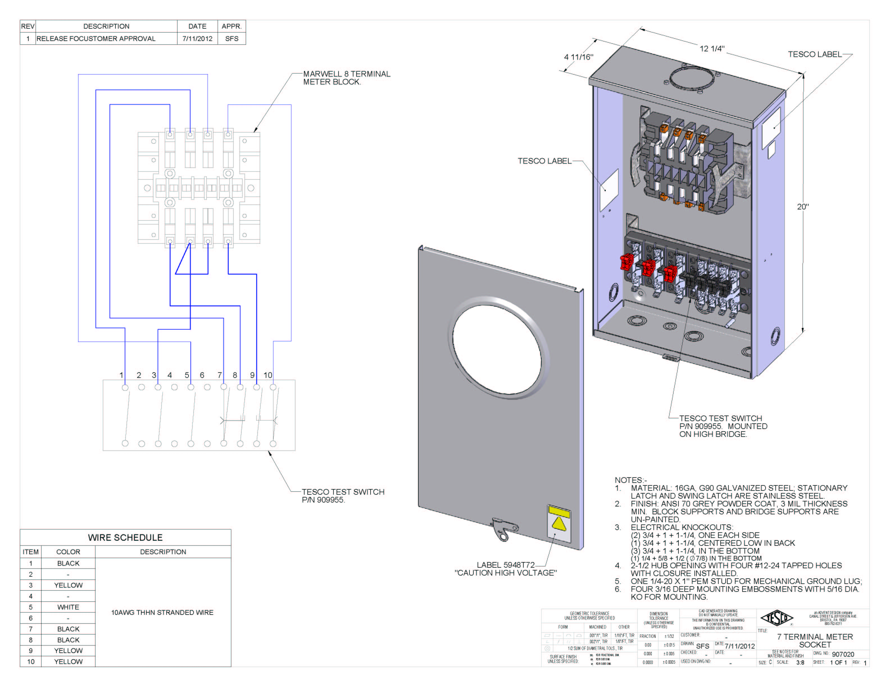
Pre-Wired Transformer Rated Enclosures
Cover Types
Wiring
Sockets

Slide 14

Caribbean Meter School
Hot Sockets- Issues, Causes and Best Practices
John Greenewald, TESCO
January 29, 2019
Atlanta, GA

Slide 15
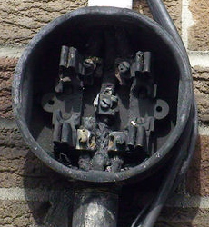
The Issue
Hot Sockets are not a new phenomenon. Virtually every meter man has pulled a meter with a portion of the meter base around a blade melted and virtually every utility has been called to assist in the investigation of a fire at a meter box.
AMI deployments because of the volume of meters involved put a spot light on this issue.
What causes a hot socket?
Are the meters ever the cause of a meter box failure?
What are the things to look for when inspecting an
existing meter installation?
What are the best practices for handling potential hot
sockets?
This presentation will cover the results of our lab
investigation into the sources for hot sockets, the
development of a fixture to simulate hot sockets,
the tests and data gleaned from hot sockets, and
a discussion of “best practices” regarding hot sockets.

Slide 16
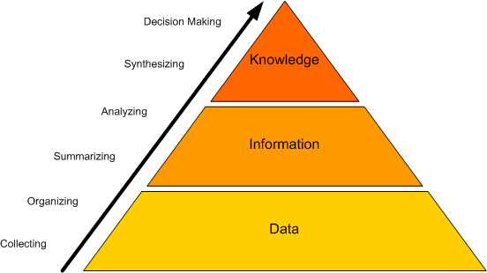
Why do we know anything about hot sockets?
TESCO has been fortunate enough to be involved in several meter deployments where we supplied full time and part time meter engineers and project managers to our customer’s AMI deployment teams. In this capacity we have been involved in evaluating hot socket issues and helping to determine an appropriate response to actual or potential hot sockets.
TESCO’s meter lab has been contracted to develop a laboratory fixture that would simulate the various features common to most hot sockets found in the field.
TESCO developed and refined a fixture since 2013 running tests and gathering data on the effect of hot sockets on meters.
TESCO has access to a large number of meters which have been exposed to hot sockets both before and after catastrophic failure.
We have access to a limited number of sockets that were hot sockets and did not yet fail catastrophically.

Slide 17
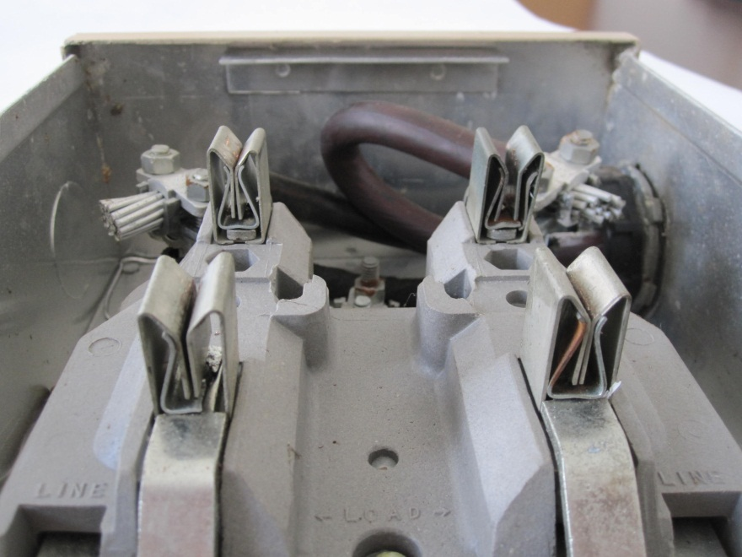
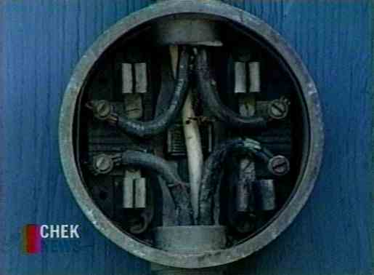
Searching for Hot Socket sources
Common Features and Common Sources of Concern
Pitted and discolored meter blades
Melted plastic around one or more of the meter stabs (typically the plastic around one stab is where the deformation starts)
Pitted and discolored socket jaws
Loss of spring tension in the socket jaws

Slide 18
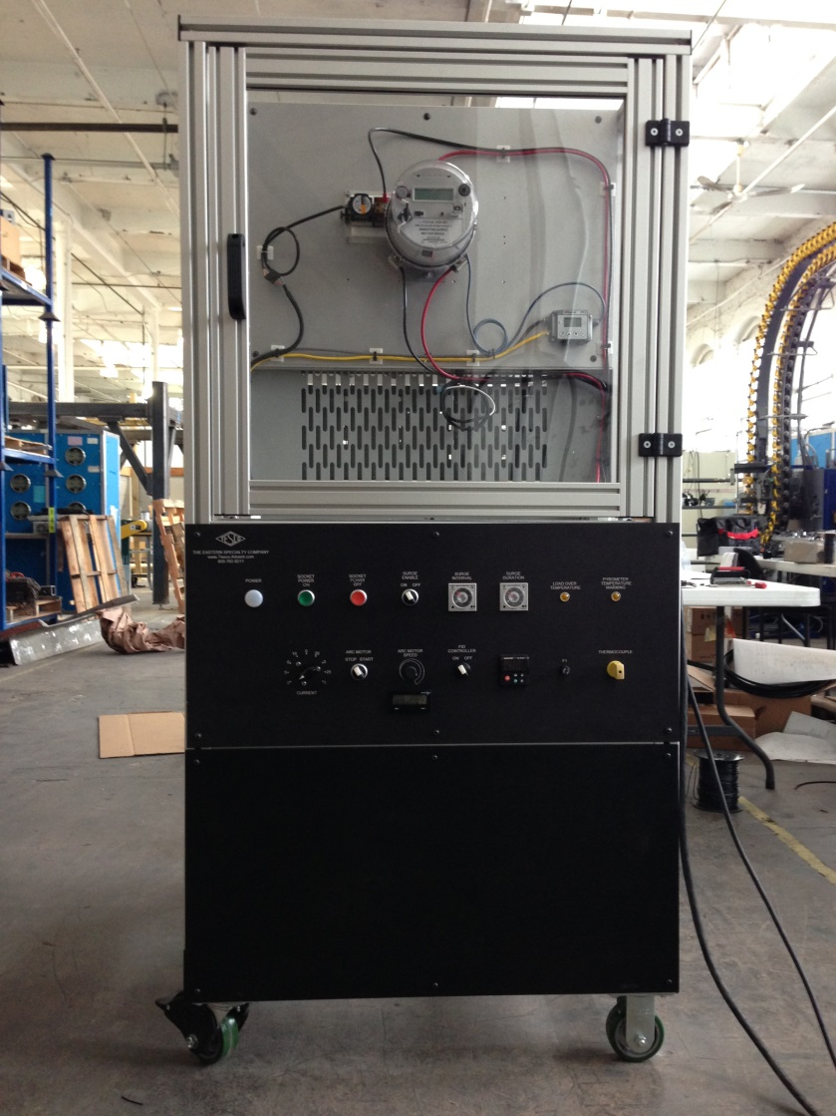
Hot Socket Simulation Fixture

Slide 19
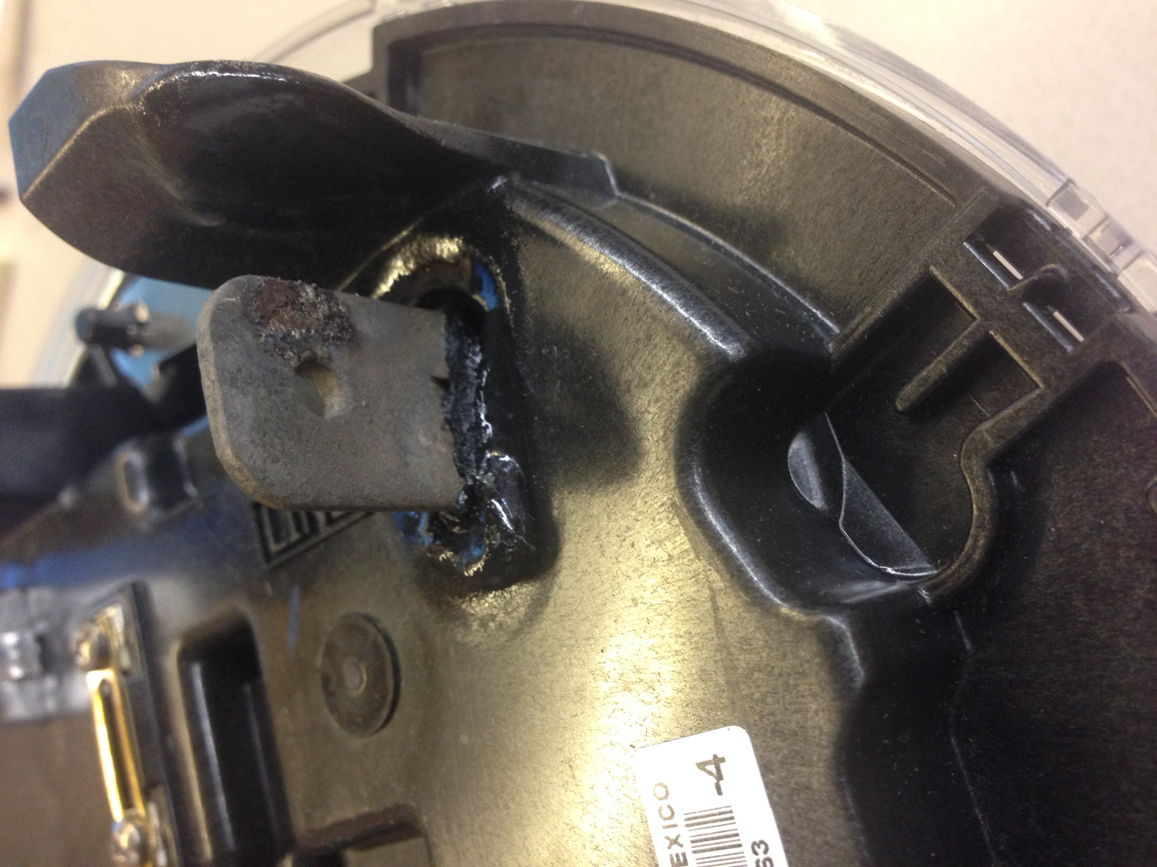

Slide 20
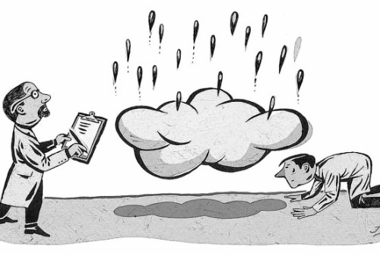
Expected & Unexpected Results
Expected:
Hot Sockets are exactly that – hot sockets. The hot sockets are the source of the problem and not hot meters.
Electromechanical meters withstand hot sockets better than solid state meters
Unexpected:
Current plays only a small role in how quickly a meter will burn up. Meters were burned up nearly as quickly at 3 amps, 30 amps, and 130 amps.
Relatively small amounts of vibration can be the catalyst in the beginning and eventual catastrophic failure of a hot socket. Note: Other catalysts include but are not limited to power surges, debris, humidity, salt water.
Contact resistance plays no role in creating a hot socket
Notes:
20

Slide 21
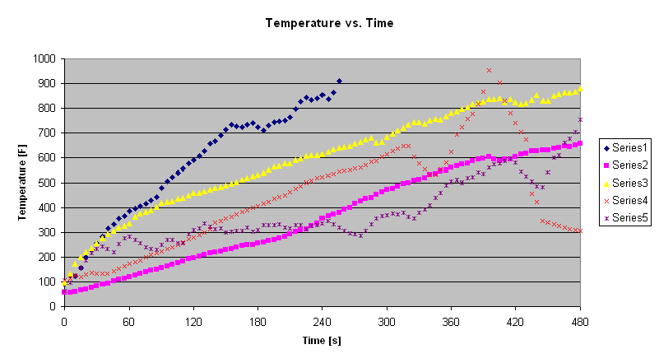
Temperature Rise Data

Slide 22
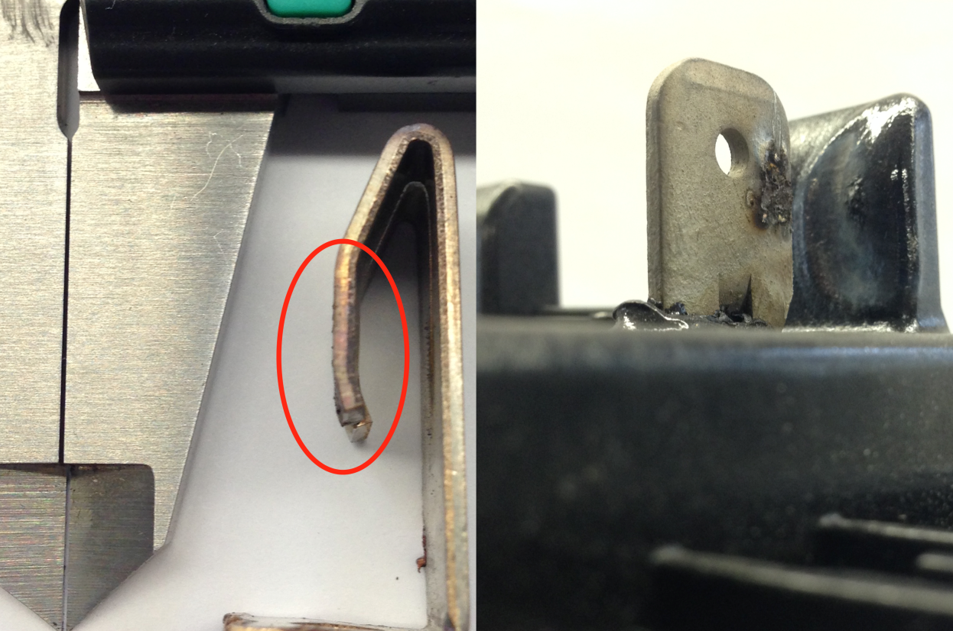
Gap Evaluation
Calipers show a .01” gap, with that size gap between jaws and stabs we were able to heat meter stabs over 1000 degrees Fahrenheit in a few minutes.
The rough spots you see on the post-test jaw next to the calipers are over .005” high. This surface degradation appears on the stab as well.
Between the two surfaces you can have large gaps, along with insulating by-product of the arcing, that can sustain heavy arcing in a solid state.

Slide 23
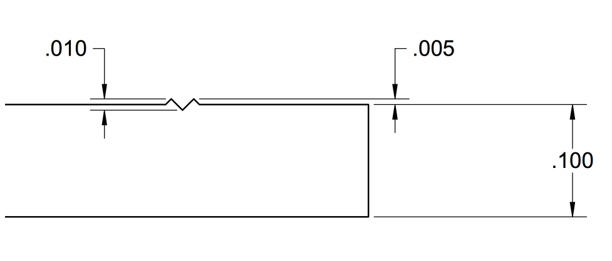
Service Degradation
In a representative side view of a .1” thick standard meter stab, you can see how small these distortions appear relative to the thickness of the stab, while creating an air gap large enough for significant arcing.

Slide 24
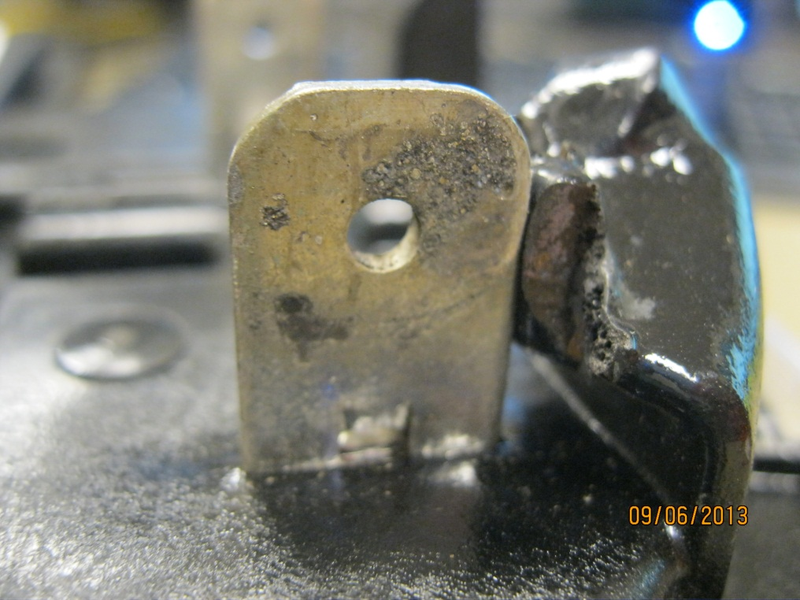
Jaw to Blade Arcing
Jaws with intermittent connections will arc to the meter blade resulting in pitting on the blade.
Blade shows early signs of arcing.
Tin Melts at 232ºC which is lower than the 350ºC base plate plastic.

Slide 25
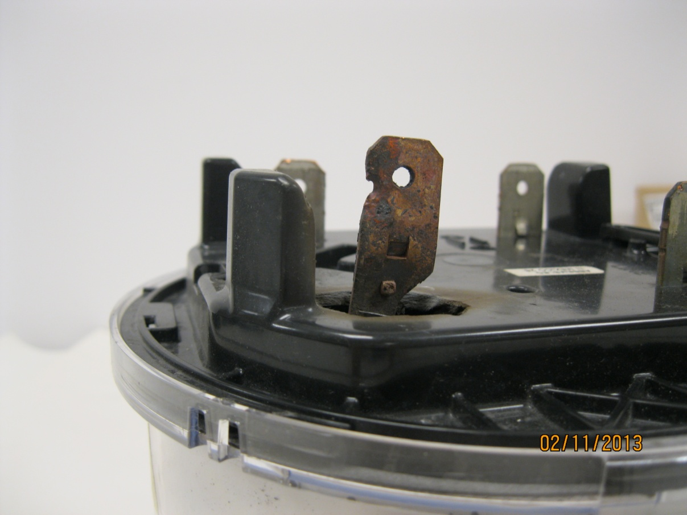
Severe Arcing Jaw to Blade
Tin burned off
Blade hole due to arcing to jaw – Copper melts at 1040ºC (1900ºF)
AX-SD base thermoset plastic melts at 960ºC (1760ºF)
25

Slide 26

What are the necessary ingredients for a hot socket?
There are three necessary ingredients to create a hot socket (Note: We are not suggesting that we have simulated or even understand all causes for all hot sockets and meter related fires, but rather that we have simulated and understand the causes behind most hot sockets and meter related fires);
  Loss of jaw tension in at least
  one of the socket jaws.
  Vibration (or other catalyst
  to initiate arcing)
  Minimal load present

Slide 27
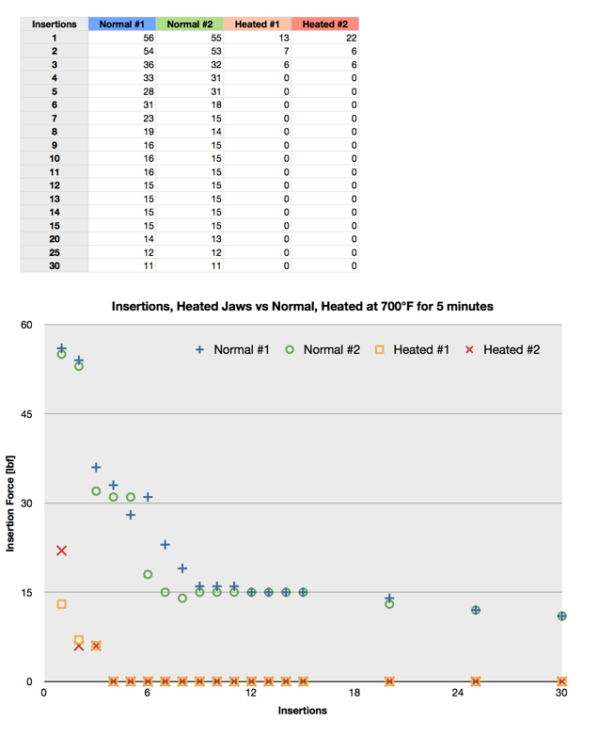

Slide 28

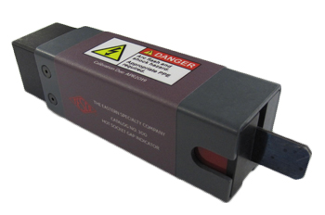
Field Inspection of Sockets
Best Practices
Example field check list
  Gaps in meter socket jaws
  Discoloration of one jaw vs. the other three
  Signs of melted or deformed plastic on meter base
  Pitting of either meter blade or socket jaw
  Loss of tension in meter socket jaws
  Check condition of wire insulation and connections to meter jaws
  Check the overall condition of the box, socket, meter and how they attach to each other and the building.
  Look for signs of tampering
  Look for signs of water or debris inside of the meter can

Slide 29

What can be done once a hot socket is identified?
Easiest resolution is to replace the damaged jaw.
Never try and repair a damaged jaw. The tension in the damaged jaw will not return simply by taking a pair of pliers and closing the jaw tighter.
Either the entire box should be replaced or the damaged jaw (assuming the wiring and other jaws are deemed safe through the rest of the inspection.)
Notes:
29

Slide 30
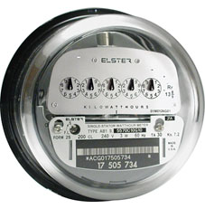
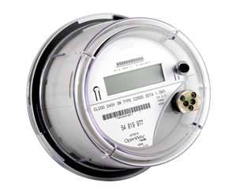
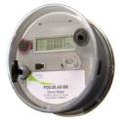
Base Line Data Electro Mechanical meters vs solid state vs the latest generation of meters designed with hot sockets in mind
At the start of our laboratory investigation the oldest electro mechanical meters withstood hot sockets the best
The latest vintage solid state meters withstood hot sockets the least.
Over the course of the past few years some meter manufacturers have begun to release meters designed to withstand hot sockets and some have even begun to put temperature sensing closer to the meter blades instead of only on the metrology boards.
One meter vendor’s service switch meter has used high temperature base plate plastic since it was launched in 2008.)

Slide 31
Summary
Hot sockets start with a loss of tension in at least one of the meter socket jaws. This loss of tension can be from a variety of sources that start as early as improper installation or even “tight sockets”.
Loss of tension is necessary to create the initial micro-arcing conditions.
Sockets with repeated meter exchanges observed to have higher incidence of hot socket issues and “booting” a meter may spring jaws even more.
Vibration appears to be the most common catalyst to the micro-arcing that creates the initial heat in a “hot socket”.
The meter must have some power, but current is not a significant factor in how quickly or dramatically a hot socket occurs
The effects of vibration and weakened jaw are cumulative
Meter Manufacturers have all been working on the design of their meters to better withstand a hot socket. These new meters have better baseline performance than even the older electro mechanical meters, but a hot socket will eventually burn up even the most robust meter.

Slide 32
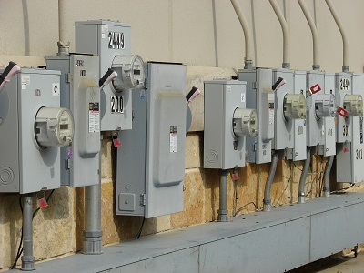

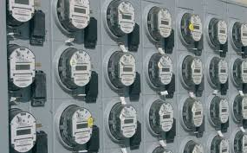

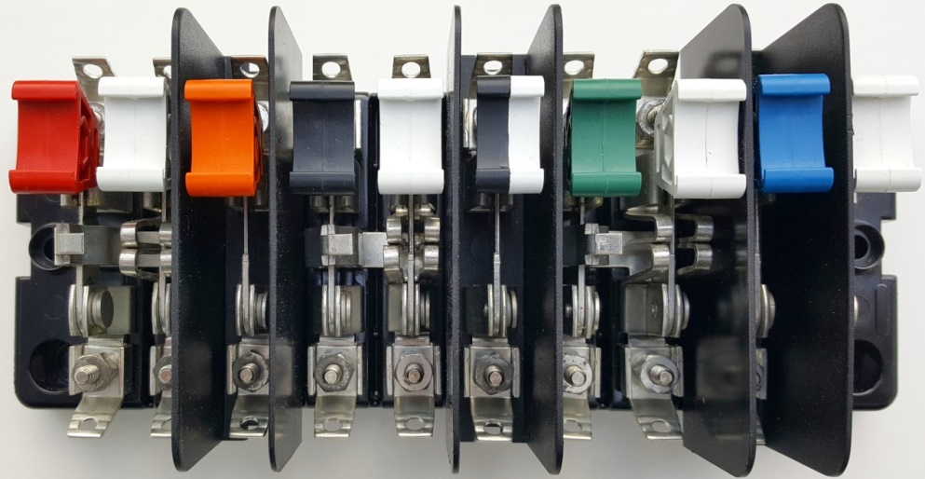
Questions?

