Slide 1



Caribbean Meter School
Fundamentals of Field Testing Meters
George Johnson, Georgia Power
January 28, 2019
Atlanta, GA

Slide 2

Why Do We Test Meters?

Slide 3
We Test for Several Different Reasons
Acceptance testing from Meter Manufacturers (Trust but Verify)
Ensure Accuracy of our Meters
Comply with PSC requirements
Verify the integrity of a new Metering Installation
Verify the integrity of our existing Metering Installations
Satisfy Customer High-Bill inquiries

Slide 4
What Kind of Tests Do We Do?
Complaint Test:
  High Bill Inquiry
Installation Test:
  Any new Trans-Rated Metering Installation
Periodic Test:
  All existing Trans-Rated Metering Installations
Sample Test:
  Required by the PSC
Acceptance Test:
  Shop testing new and returned meters

Slide 5
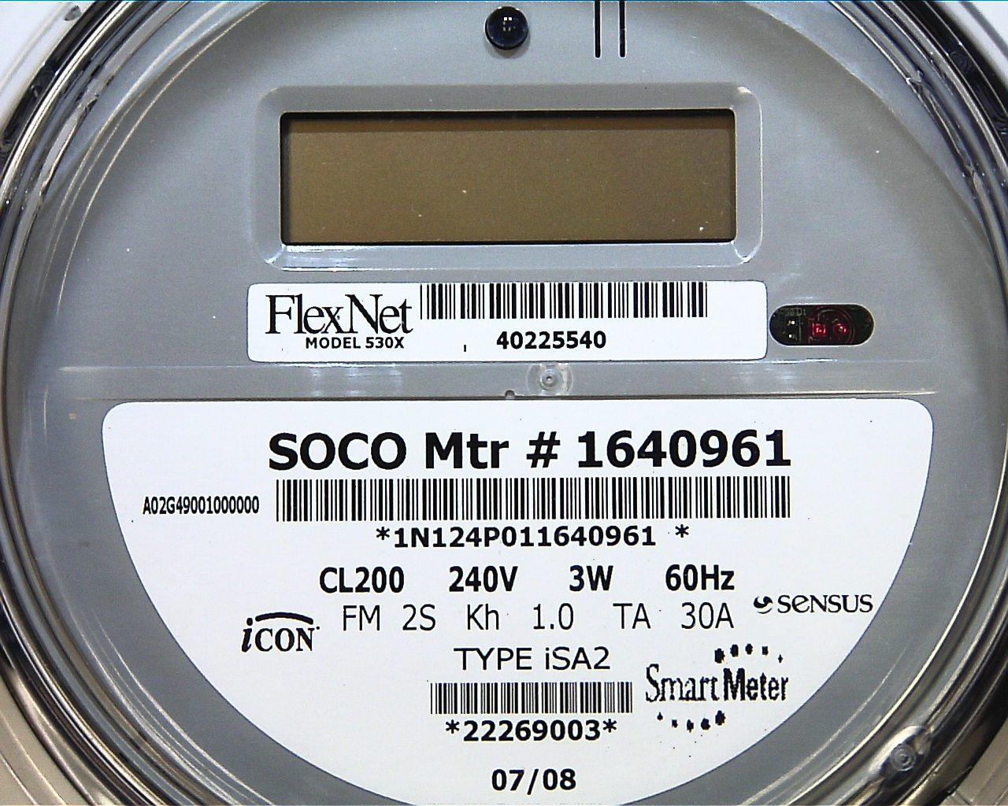
Test Amps & Meter kH
TA (test amps) is the test load recommended by the manufacturer for the full-load test. This meter should be tested using a 30 amp load for the full-load test and a 3 amp load for the light-load test.
On mechanical meters, the kH is the amount of energy required to rotate a meter’s disc one revolution.
On electronic meters, the kH is the amount of energy represented by each test pulse.
One test pulse from this meter represents one watthour of energy.
The kH is used to calculate revolutions of the standard.

Slide 6
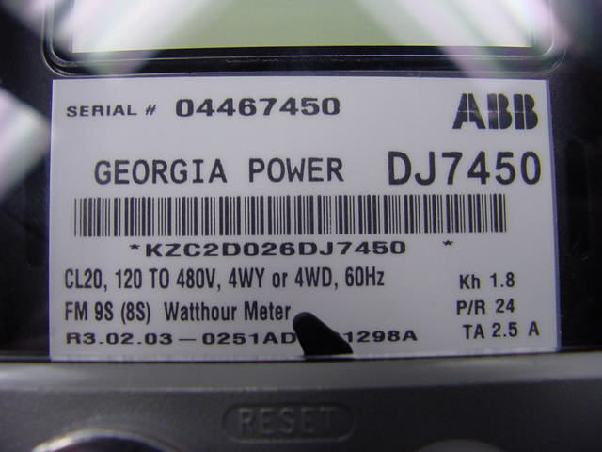
Test Amps for Transformer Rated Meters is typically 2.5 amps
ANSI Code for Electricity Metering states that Test Loads for T.R. Meters may be 100% of the Secondary Current Transformer rating for Full Load, and 10% of rating for Light Load.
Full Load may be tested at 5 Amps
Light Load may be tested at .5 Amps

Slide 7
Calculating Load on Electronic Meters

Slide 8
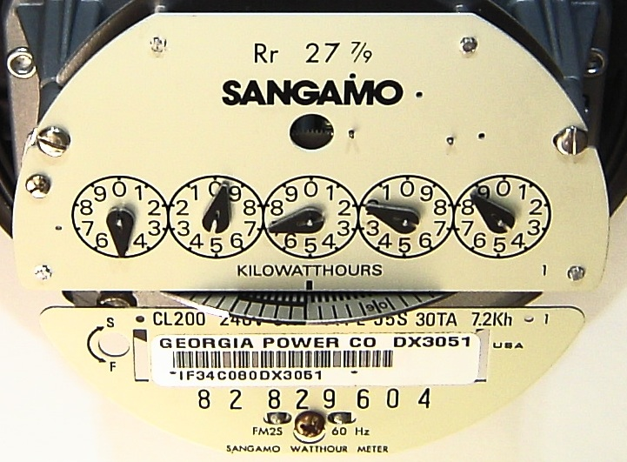
Determining Load on a Mechanical Meter
The Load on Mechanical Meters can easily be calculated by timing the meter’s disk and solving the formula shown below.
Notes:
On mechanical meters, the speed of the disk is proportional to the customer’s load. A larger load will cause the disk to spin faster. The actual load in watts can be calculated by timing the speed of the disk and using the formula shown here. To do this, it is necessary to know the meter’s watthour constant. This value which is referred to as the meter “Kh” is always found on the faceplate of the meter. It is the amount of electrical energy consumed each time the meter disk makes one complete revolution. The meter pictured here has a watthour constant of 7.2. Each time this meter makes one revolution, the customer has consumed 7.2 watthours of energy.
We will assume that we timed this meter and the disk made one revolution in 43 seconds. We can then work the formula by multiplying 3600, which is the number of seconds in an hour, times the meter Kh value of 7.2, times the meter multiplier of one. The meter multiplier is one because this is a self-contained meter. We will then divide by 43 seconds, giving us a load of approximately 603 watts. This tells us that the customer’s load is approximately equivalent to six 100 watt light bulbs, or ten 60 watt light bulbs.

Slide 9
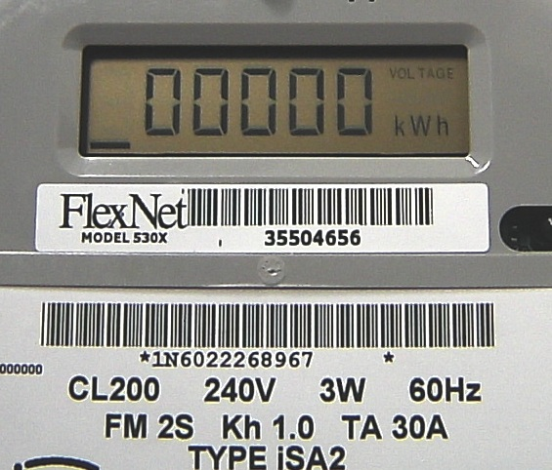
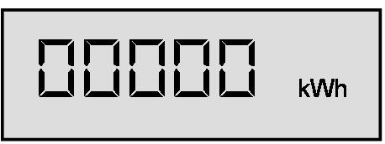
Determining Load on a Sensus iCon Meter
Each increment of the line segment represents one Kh value.
Notes:
Of course electronic meters do not have disks that spin, but they all have some type of indicator on the display to indicate current flow and to show when one watthour constant or Kh value of energy has been consumed. The Sensus iCon meter pictured here has an arrow on the right side of the display to indicate current flow. The arrow points to the right to indicate forward current flow or to the left to indicate reverse current flow. You can think of the arrows as being equivalent to the direction that the disk on a mechanical meter would spin. A short line segment moves across the bottom of the display to represent the load. As with the speed of the disk on a mechanical meter, the faster the line segment moves, the larger the load. Each increment of the line segment denotes one Kh value of energy consumed. This meter has a Kh value of 1.0, so each movement of the line segment represents one watthour of energy. The line segment will increment eight times to move all the way across the display. If the indicator is timed from the instant it first appears on the left side of the display until the instant that it returns to the left side of the display, a Kh value of eight can be substituted in the formula.

Slide 10
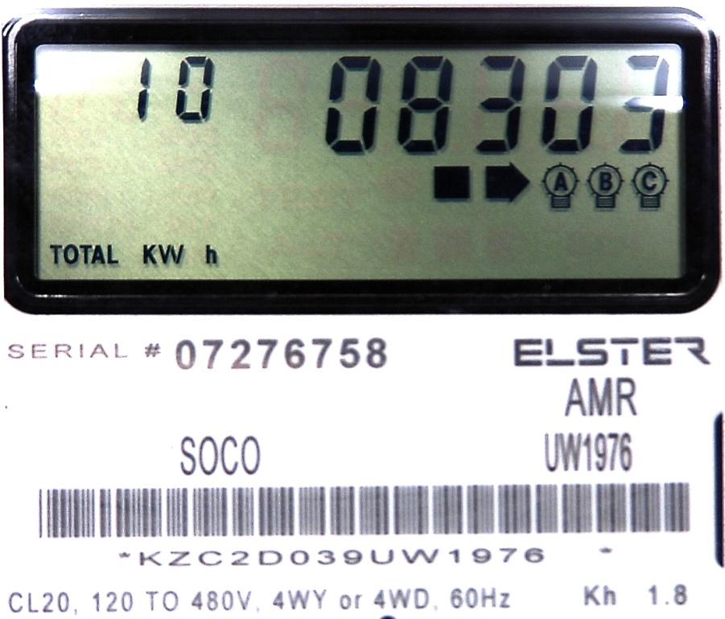
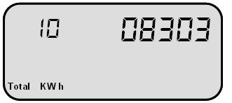
Determining Load on an Elster Meter
The black square indicates load on an Elster meter.
The time from the instant that the square first appears, goes away, and then reappears represents one Kh value.
Notes:
Elster meters also have arrows to indicate the direction of current flow. An arrow pointing to the right indicates forward current flow and an arrow pointing to the left indicates reverse current flow. Next to the arrow is a small black square that appears and disappears to indicate when one Kh value of energy has been consumed. From the instant that the square appears to the instant that it reappears, represents 1.8 watthours of energy consumption on this meter.
Notice that this is a Class 20 meter. This tells us that it is a transformer-rated meter, so it will have a meter multiplier that must be included in the formula.

Slide 11
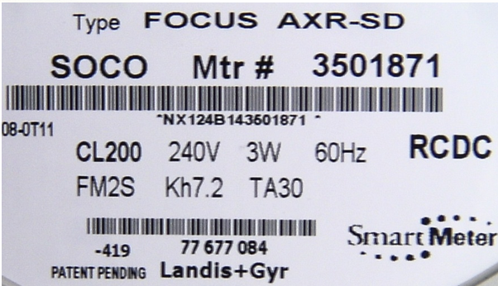
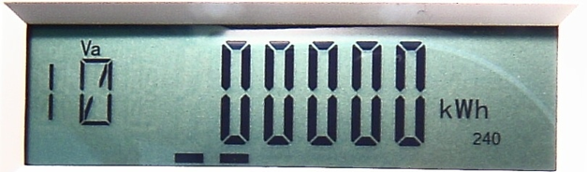
Determining Load on a Landis + Gyr Meter
Landis + Gyr meters have two short line segments that move across the bottom of the display.
When the two line segments make a complete trip across the display, one Kh value of energy has been consumed.
Notes:
Other meter manufacturers may utilize a double line segment moving across the bottom of the display to simulate equivalent disk revolutions. When the two line segments on this Landis + Gyr Focus meter make one trip across the bottom of the display, one Kh value of energy has been consumed. As you can see, timing the load on electronic meters is not quite as straight forward as timing the disk on a mechanical meter. You must be familiar with how the indicators function on each manufacturer’s meters.

Slide 12
Overview of Field Test Methods
&
Equipment

Slide 13
ACCURACY REQUIREMENTS
ANSI C12.1-1995
Test Loads
Full Load 100% of Test Amperes at unity power factor
Light Load 10% of Test Amperes at unity power factor
Power Factor 100% of Test Amperes at 50% power factor
(Test Loads for T.R. Meters may be 100% of Secondary Current
Transformer rating for Full Load and 10% of rating for Light Load.)
Acceptable Performance
Average Percent registration shall not be less than 98% or more than 102%
Avg % Registration = FL + LL Weighted % Registration = 4FL + LL
Adjustment Limits
Adjustments are required when error in registration exceeds 1% at Light Load and Full Load or 2% at Power Factor.
Meter accuracy shall be adjusted as close to 100% as practical.
2
5

Slide 14
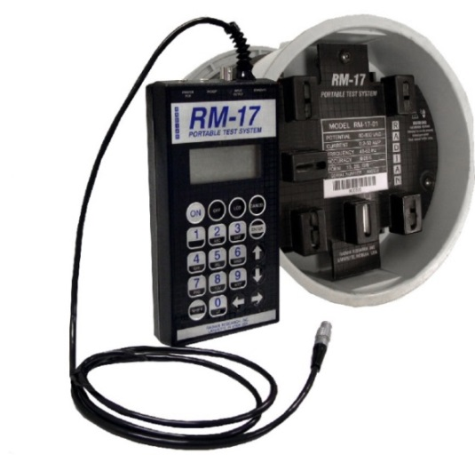
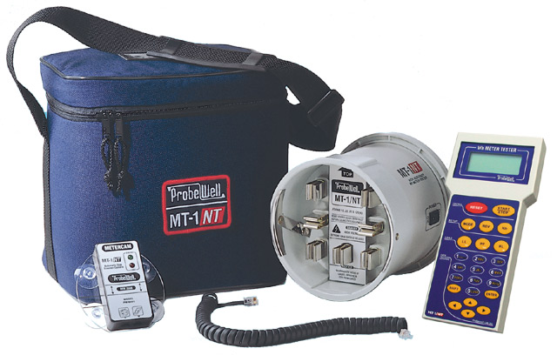
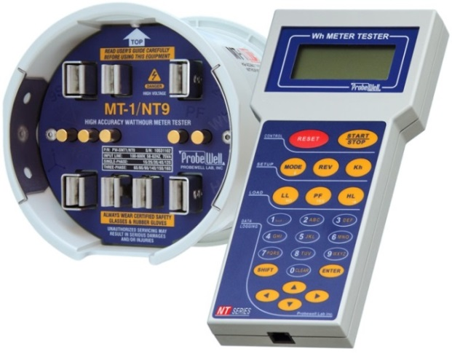
Comparison Test Using a Portable Meter Test System
Test Jack, Watthour Standard and Current Synthesizer in one lightweight unit.
No setup wiring is needed.
Simple to use, even for non-metering personnel.
Limited Use
  Some units are limited to Single Phase meters only.
  Others will test all Self-contained and Transformer Rated meters except the 5S/35S/45S.

Slide 15
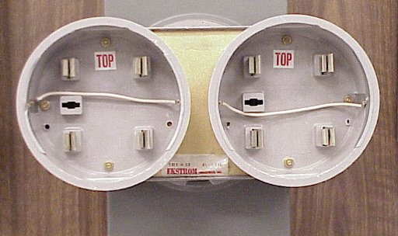
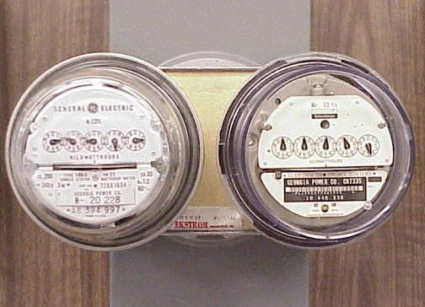
Comparison Check Using a Second Watthour Meter
Easy and inexpensive way to handle high bill complaints.
A control meter, with known accuracy is placed in series with the customer’s meter using a duplex adapter.
The control meter is left in place for a sufficient period of time (i.e. one week).
Readings on both meters are recorded when the control meter is installed and when removed.
The accuracy of the customer’s meter is calculated from any difference in consumption.

Slide 16

Radian RM-17
Tests Single Phase Self-Contained watthour meters.
Meter Forms 1S, 2S, 2SE, 12S and 12SE.
Closed link meter testing.
Produces 0.2 - 50 amps current.
Operates on any AC voltage source (60 to 600 volts).
Tests Full Load, Light Load and Power Factor

Slide 17
Radian RM-17
The socket adapter jumps the Customers service when installed but the front of the adapter remains de-energized.
Programmed with default Meter Forms, Kh values and tests.
Customizable program to create new or edit existing tests.
Once test is chosen select Run Test. The meter will power up and the test will start.
Test results will provide FL, LL, PF and Weighted Accuracy Average.

Slide 18
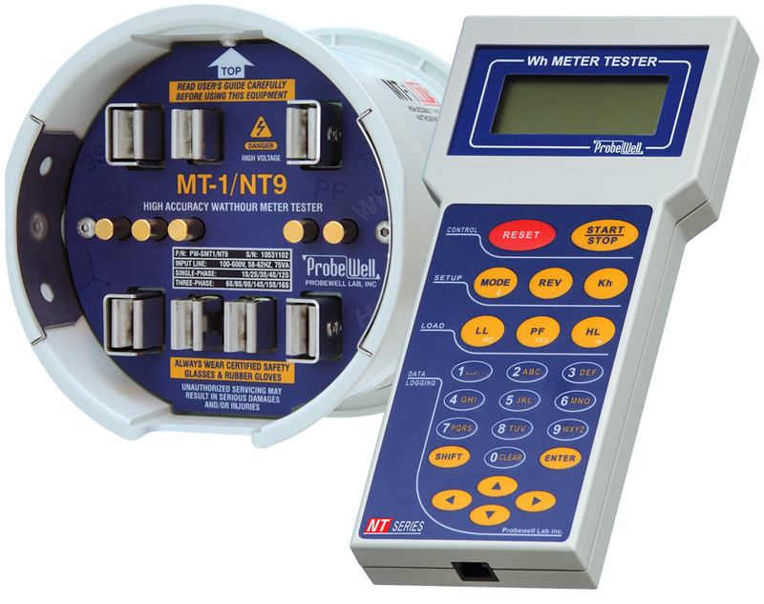
ProbeWell MT-1/NT9
Portable 3 Phase watthour meter tester.
Tests meter forms: 1S, 2S, 2SE, 3S, 4S, 6S, 8S, 9S, 12S, 12SE, 14S, 15S, 16S and 16SE
Does NOT test a 5S, 35S or 45S
Closed link testing.
Capable of producing 0.25 to 50 amps of three phase current.
Operates on any AC voltage source (100-600 volts).
Test results will provide FL, LL, PF and Weighted Accuracy Average.
Reverse power flow capability for bi-directional solid state meters.

Slide 19

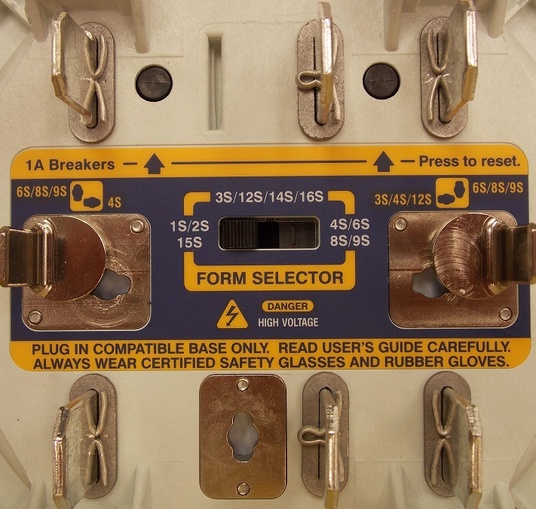
ProbeWell MT-1/NT9
Set the Form Selector switch on the back of the adapter to the correct form and move the twist spades to the correct location.
The socket adapter jumps the Customers service when installed but the front of the adapter remains de-energized.
Choose the Preset-Quick, Preset-Full test or select User-Defined Test.
If either Preset Test is selected the unit will determine the type of service and meter form installed.
When the optical pickup is used testing a solid state meter the test becomes fully automatic after the power switch is turned on.
Once the test is complete the results page will display the FL, LL, PF and Weighted Accuracy average.

Slide 20
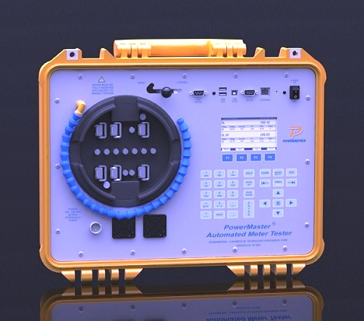
Powermetrix Automated Meter Tester
Tests most ANSI socket based meters.
Closed link meter testing
Synthesized voltage & up to 30 amps current source.
Operates on any AC voltage source (100 to 530 volts).
Test Wh, VARh, VAh

Slide 21
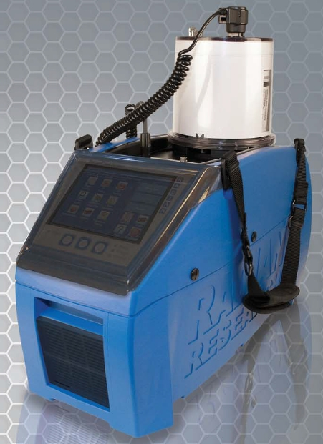
Radian Portable Three-phase Meter Tester
Tests most ANSI socket based meters.
Closed link meter testing
Synthesized voltage & up to 50 amps current source.
Operates on any AC voltage source (90 to 300 volts).
Test Wh, VARh, Vah
CT Burden & Ratio
Site Analysis

Slide 22
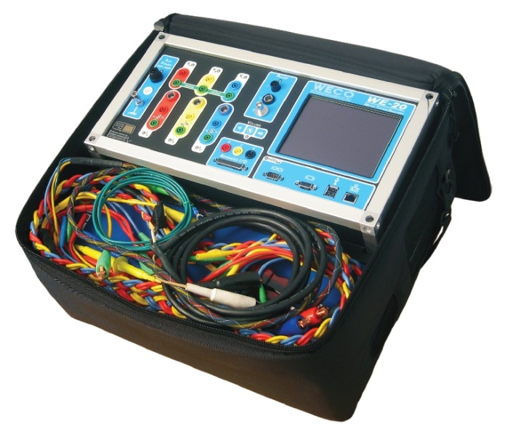
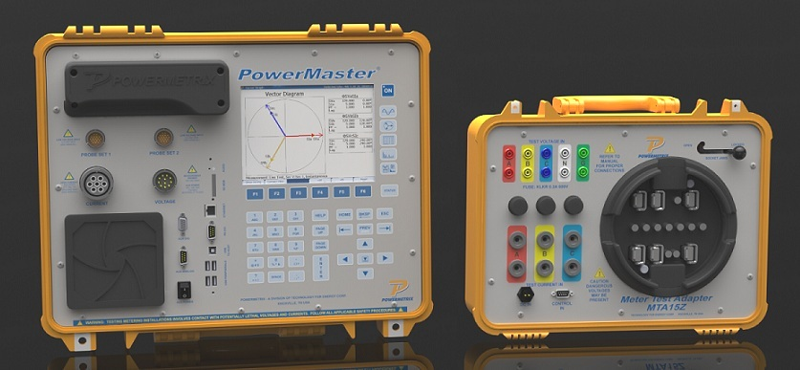
Meter Tester / Site Analyzer
Capable of Customer Load or Phantom Load Testing
Available with built in Phantom Load for when there is little or no customer load, or whenever an ANSI compliant test is desired.
A true Three phase voltage source is also available.
CT Burden & Ratio, Service Vector Analysis, Harmonic Analysis
WECO WE-20 from Radian
“Portable Three-Phase Meter Tester / Analyzer”
Powermaster from Powermetrix
“Portable Three-Phase Meter Tester / Analyzer”
Meter Test Adapter is available

Slide 23
Field Testing Using
Customer’s Load

Slide 24
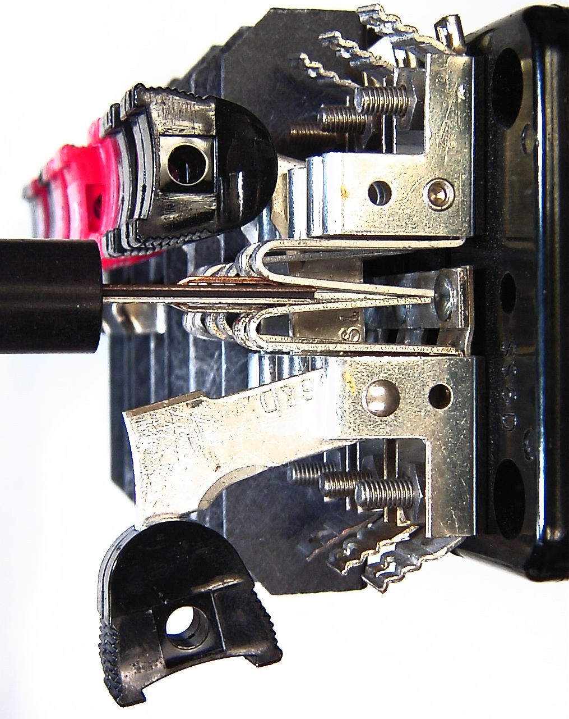
“Current Return Switches”
Each current return switch has a spring loaded contact into which the current probe from the test equipment is inserted.
The spring contact is designed to make the circuit through the test equipment before it breaks the contact through the test switch. This guards against accidentally opening the CT secondary circuit.
The current probe from the test equipment has two contact surfaces with an insulator in between. GPC’s test equipment requires the copper contact to be up and the tin plated contact to be down so that the current flows in a forward direction through the test equipment.

Slide 25
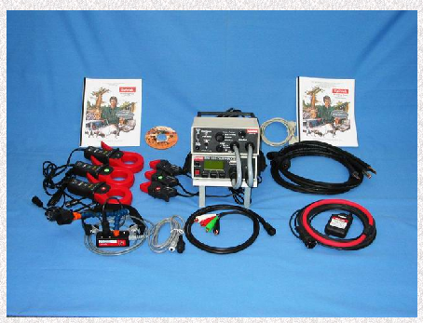
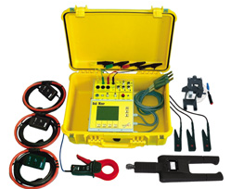
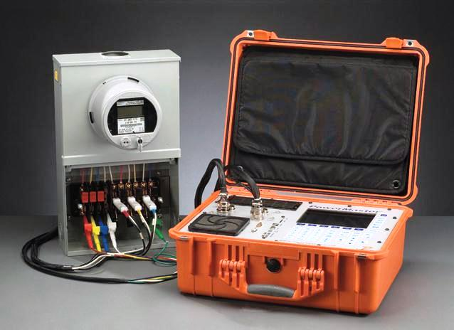
Customer Load Testing and System Analyzers
Spinlab
Bird Dog Plus
Radian
RD31-221
testMET
Gold Miner
PowerMetrix
PowerMaster
Notes:
Explain there are many types available
At GPC we have chosen the Powermate 330

Slide 26
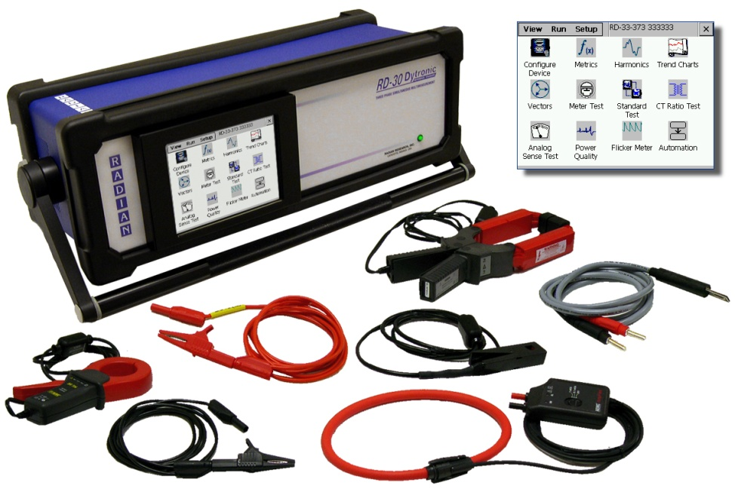
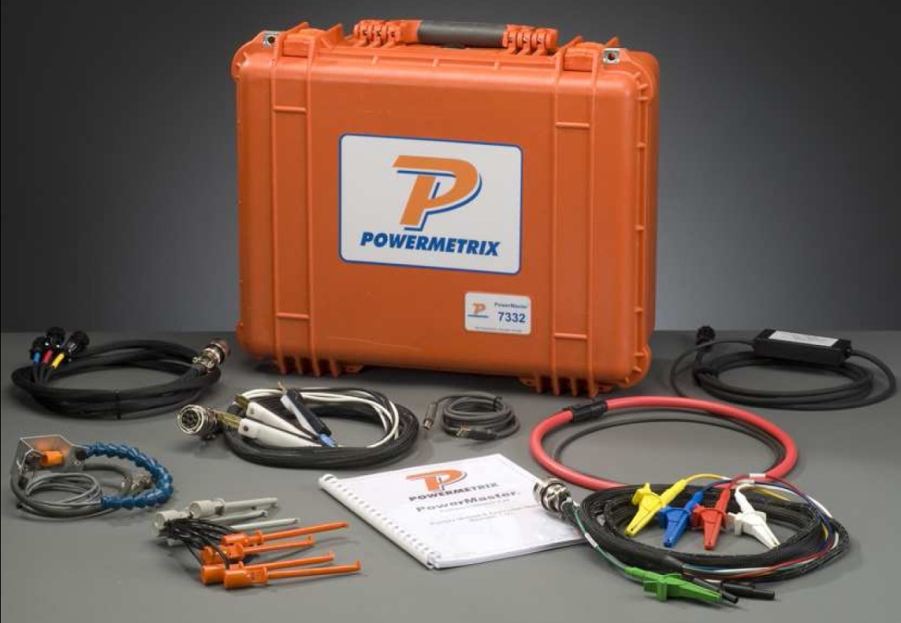
Comparison Test Using Customer’s Load
Test equipment is put in series with the customer’s load.
Meter continues to register – No need to put meter in Test Mode.
Radian Research RD-30
Three Phase Analyzing Standards
Powermaster
“Portable Three-Phase Meter Tester / Analyzer”
In addition to meter accuracy tests:
CT burden and ratio test
System wiring verification
Harmonic analysis

Slide 27
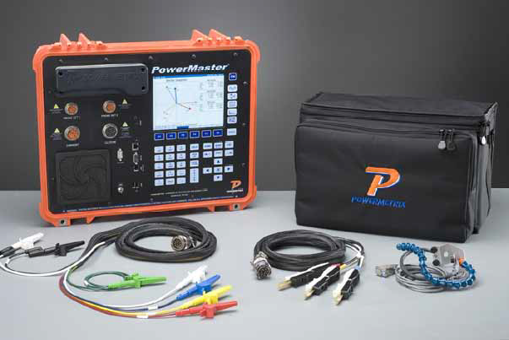
PowerMetrix – Power Master
PowerMaster
5 Series Model

Slide 28
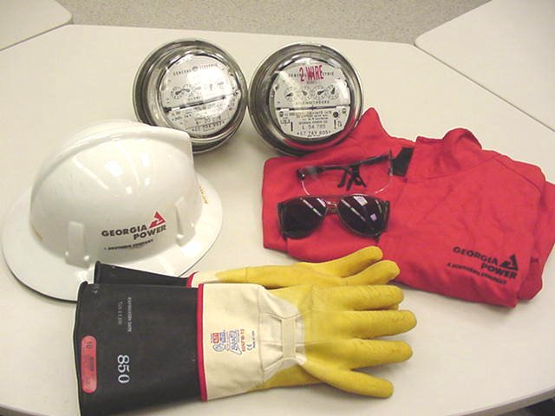
SAFETY IS THE ABSOLUTE NUMBER ONE PRIORITY
Always use your Personal Protective Equipment
Hard Hat
Safety Glasses
FR Clothing
Dielectric Gloves with “Grabbit” or Leather Protectors

Slide 29
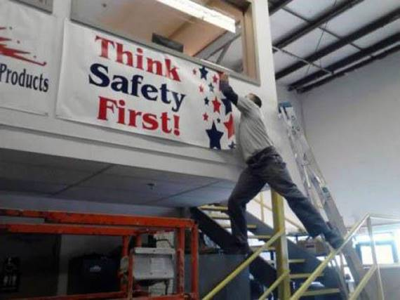

Slide 30
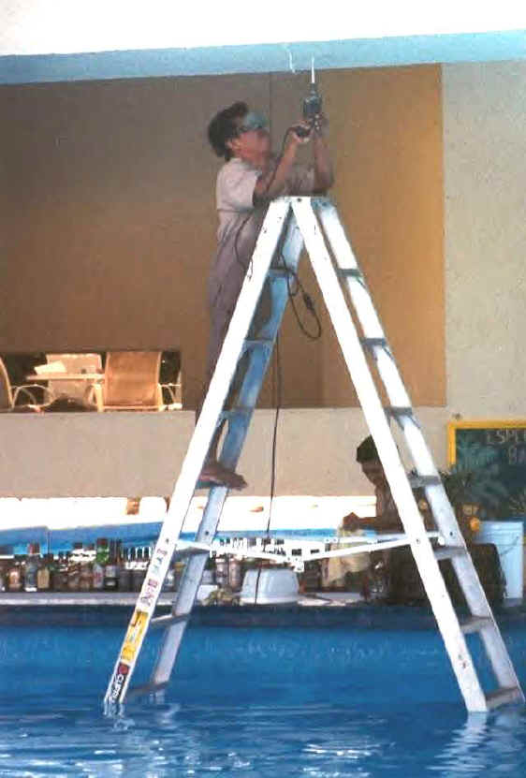

Slide 31
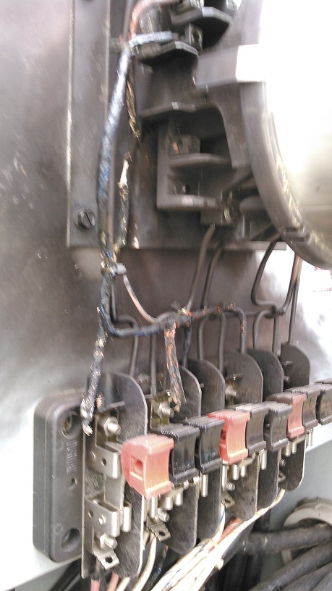
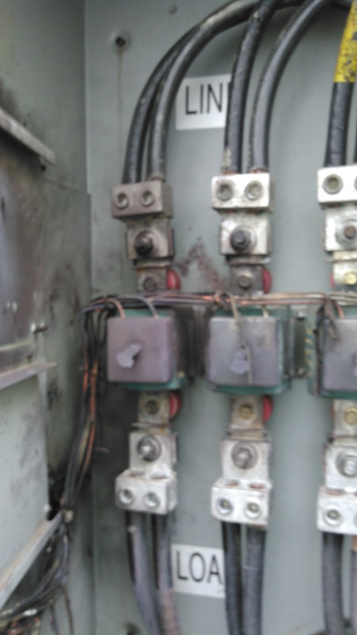

Slide 32
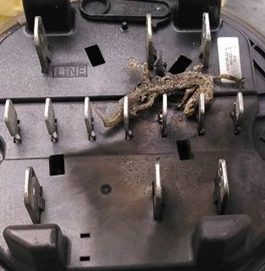

Slide 33
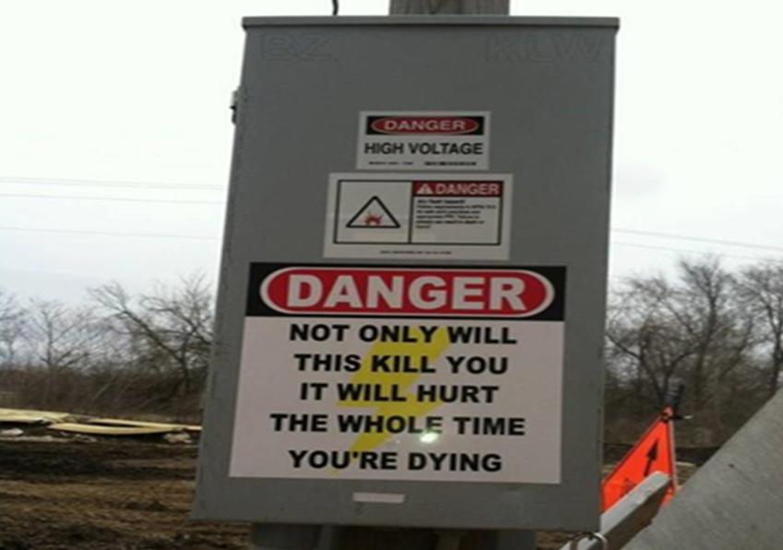
33

Slide 34
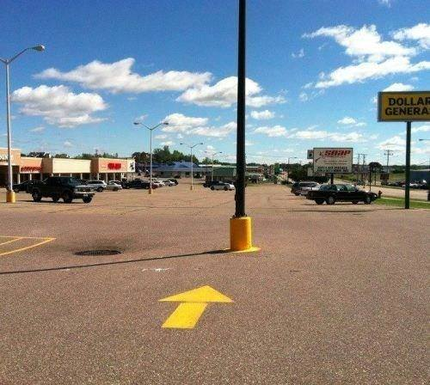
34

Slide 35
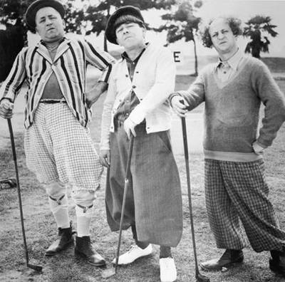
Our Experts are here to answer all of your questions.
Art
George
Trent

Slide 36
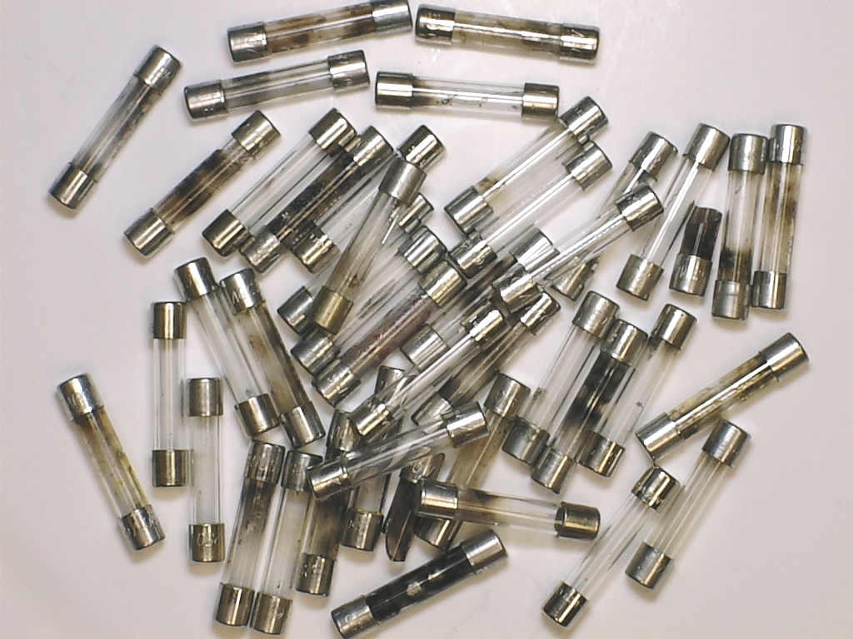
The End
Always remember, fuses are your friend.

