Slide 1
How Meter Services Can Relieve Customer Perceptions and Concerns About New AMI Systems
For Mississippi State Electric Power and Meter School 2023
Prepared by Tom Lawton, TESCO
The Eastern Specialty Company
METER II
Wednesday April 5th, 2023 10:30 AM

Slide 2
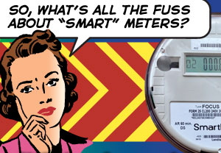
Session Objectives
Understand Customer concerns about Smart Meters and AMI
Be able to respond as a Utility and as a Utility Worker

Slide 3
Most Common Customer Concerns
Health - new AMI meter’s will kill my cat or make me sick
Safety – new AMI meter’s will burn down my house
High Billing – new AMI meter is going to increase my bill
Privacy - Big Brother is watching me

Slide 4
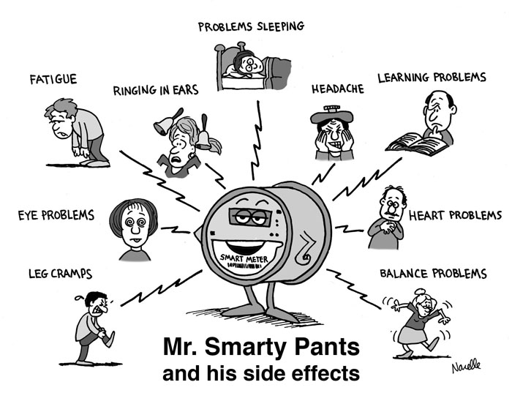
Health Concerns
RF Emissions – “Don’t they hurt me?”
Web sites and internet information and misinformation – “But I saw a video on line…”
Whisper down the lane – “My cousin’s, hairdressers husband’s friend said….”
Discussion points: Cell Phones vs Meters
Measuring RF: Demonstrating that the meter broadcasts forward as well as other sources

Slide 5
Safety Issues?
For the first time in our collective careers meters have been in the popular meter in an unflattering way. Segments of the general population have the perception that;
AMI Meters may spontaneously catch fire
AMI Meters may blow up
AMI Meters may disconnect power by themselves
AMI meters are “cheap computers” and are not robust enough for long term outdoor use

Slide 6
What Regulatory Alternatives Are Out There?
When US Consumers think about electrical safety within their home they think about licensed electricians and inspectors for electrical work and the UL Mark for products used within their home.
Customer: Why don’t meters have a UL label?
Are the AMI meters safe?
Utility: Are ANSI standards “tough” enough?
How good is the meter vendor testing?
- Excerpt from PECO News Release October 9, 2012

Slide 7
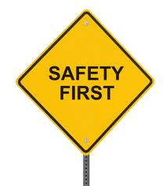
UL Meter Safety Standard 2735
The original release of 2735 is to be revised to conform with 2735C the Canadian version as this version is being developed jointly by UL and Utilities. Meter manufacturers have voluntarily complied with UL and have a UL mark on their meters.
What is covered:
All Type S and Type A electric meters rated up to 600 volts and any other type of meter intended for installation within the enclosure of “complete equipment”.
Contents
Meter Construction Requirements
Meter Performance
Meter Markings
Standards for Components

Slide 8
UL Meter Safety Standard 2735
Meter Construction Requirements
Meter forms as defined in ANSI C12.10 unless alternate forms are specified by a Utility
Enclosures
Covers
CT’s, internal and external
Batteries
Service Switches
Circuit Boards
UL recognized or tested components

Slide 9
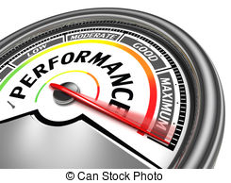
UL Meter Safety Standard 2735
Meter Performance Tests
Tests for various fault conditions
How easy to set on fire
Strength of Construction
Some tests from ANSI C12.1 Section 4

Slide 10
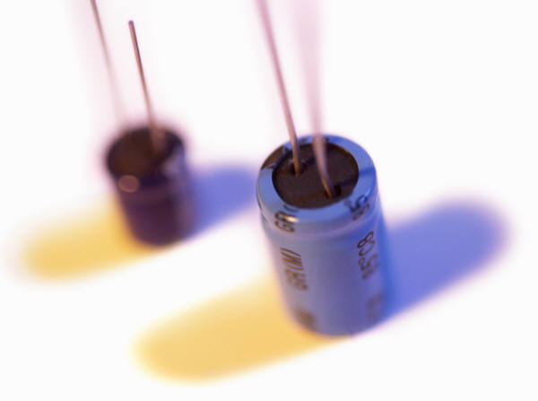
UL Meter Safety Standard 2735
Component Standards
UL Standards for many meter components will apply:
Fuses
Transformers
Switches
Terminal Blocks
Connectors

Slide 11
Issues to Address
UL is very interested in capitalizing on this opportunity to regulate electric meters – a market they have been excluded from in the past by the NFPA
Draft Standard 2735 was issued without any prior notification to the ANSI C12 Main Committee despite assurances that UL would work with and participate with ANSI to avoid a Standard that contradicts the complementary ANSI standard
UL is now working in Canada with the Canadian Utilities who are participants at the ANSI meetings to publish UL 2735C that will conform with ANSI C12.1

Slide 12
Challenges of Implementing a UL Standard
Agreement on a common standard by UL and ANSI
Meter vendor acceptance of the new standard
Coordination of UL and ANSI testing of meters
Lead Time and Cost of UL listing
Need for ANSI Testing in the shadow of a UL Standard
UL part of new meter certification process
UL part of new component selection and design changes

Slide 13
Pro’s and Con’s of a UL Mark on Electric Meters
Pro’s
Greater perception of safety by the general public
Outside inspection to maintain certification
All changes to meter construction are monitored and approved by an outside group

Slide 14
Pro’s and Con’s of a UL Mark on Electric Meters
Con’s
Greater cost to Utility and Utility customers
Slower innovation for meters
Potential for short term meter shortages after implementation
Potential for fewer meter vendors and options for Utilities

Slide 15
Use of UL as an Independent Test Lab
Current involvement of UL in the metering space
Independent Test Lab to run ANSI tests
Independent Test Lab to run customer specific tests
Independent Test Lab to recommend and run safety tests on any metering product

Slide 16
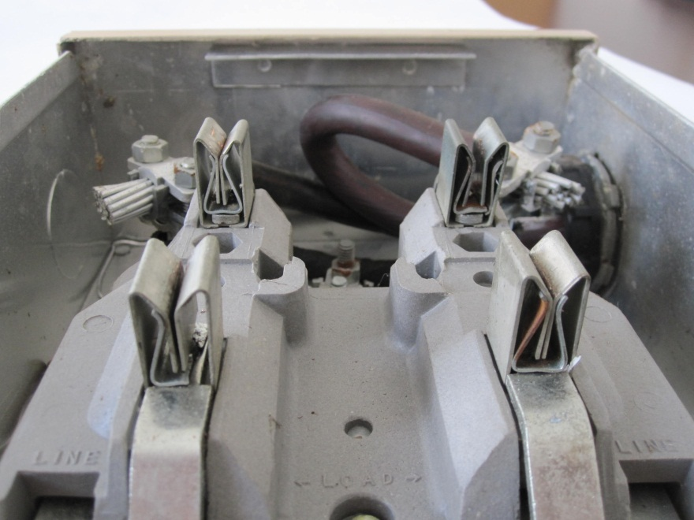
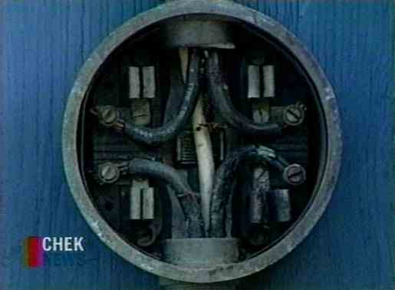
Searching for Hot Sockets - Common Features and Common Sources of Concern
Hot Sockets are just that – hot sockets and not hot meters
Some meters handle hot socket situations better than others
Physical Symptoms
Pitted and discolored meter blades
Melted plastic around one or more of the meter stabs (typically the plastic around one stab is where the deformation starts)
Pitted and discolored socket jaws
Loss of spring tension in the socket jaws
Notes:
16

Slide 17
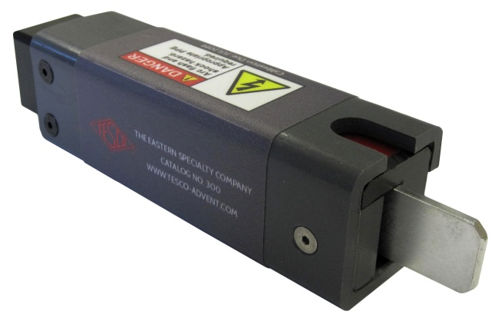
Field Inspection of Sockets Best Practices
Example field check list
Gaps in meter socket jaws
Discoloration of one jaw vs. the other three
Signs of melted or deformed plastic on meter base
Pitting of either meter blade or socket jaw
Loss of tension in meter socket jaws
Check condition of wire insulation and connections to meter jaws
Check the overall condition of the box, socket, meter and how they attach to each other and the building.
Look for signs of tampering
Look for signs of water or debris inside of the meter can
Notes:
17

Slide 18
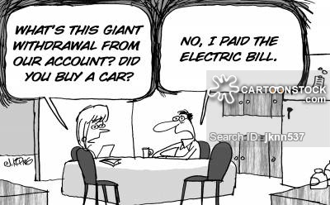
High Bills
Bill increases after a meter installation is always perceived as a new meter issue – this has always been true.
Public is now more aware that a new meter is going on their house and any increase in their bill is immediately linked to the new meter and not to a change in usage.

Slide 19
High Bills – what are the causes
Most Common
Bad final read. This happens on a regular basis but is easily mitigated by taking a picture of the meter prior to removal so there is an indisputable record of the final read
User pays attention to their bill for the first time in months or more typically years and do not recall their increased usage over that time frame
Beer fridge or meat freezer on their way out increase usage
New pool or expanded HVAC
Kids growing up
Less Common
Old meter really was slow
Previous owner had been stealing energy by compromising the old meter

Slide 20
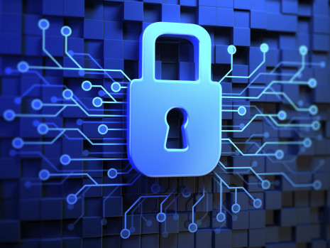
Privacy Issue–Big Brother is Watching Me
The utility knows everything I am doing
Current involvement of UL in the metering space
The utility will know everything I am doing
My every move can be tracked
I will never have any privacy again

Slide 21
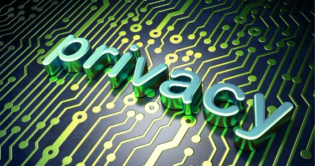
Privacy Issues – real or imagined
Discussion Points
The information available from the internet is far more of a privacy invasion
The phone utility knows who you are talking to
The electric utility only knows how much energy you are using
Electric utilities are starting to gain the ability to understand the energy signature of various appliances in the home and can use this information to alert the consumer to changes in usage or failing equipment
Under no scenario does the electric utility know what is happening inside the house or even who is inside the house. The cell phone companies know this, and internet providers may know this, but electric utilities do not.
This Photo by Unknown Author is licensed under CC BY-SA

Slide 22
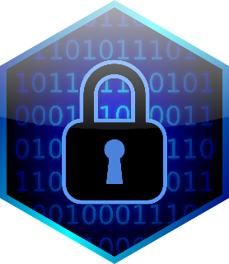
What are the Pro’s of AMI?
“But Why are you putting these new meters in? My old meter was just fine….”
The Discussion Points are ironically the same ones plus a trump card – Improved Reliability
Privacy - No one needs to come to their home to read the meter any more. This gives the rate payer more privacy and less intrusions into their life.
Safety – the new meters have sensors embedded in them to help detect if there is an electrical issue or if there is are elevated temperatures that could lead to a fire. There is also a disconnect that can be used to shut off power (grossly elevated temperature or a wild fire situation)

Slide 23
What are the Pro’s of AMI?
Cost reduction – No one needs to read the meter reducing costs. The meters firmware can be updated remotely and even rates can be changed remotely.
Health – Nope, we got nothin’ here. We do not affect your health other than we can provide more reliable power and peace of mind.

Slide 24
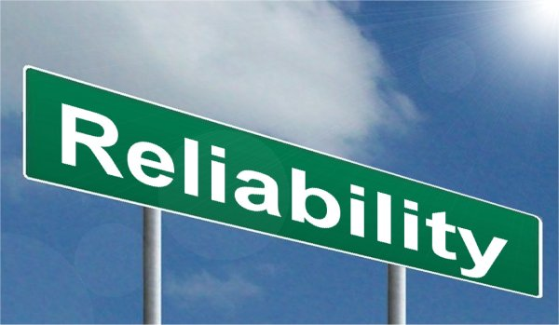
Most Important Pro of them all - Reliability
Trump Card – Reliability
Reliability – Meters can help the consumer to understand when appliances are failing or are just inefficient. More importantly using AMI data utilities can understand issues in the distribution system. Voltage issues, under sized conductors, loose connections, theft and these are just the tip of the iceberg. A smart meter is the heart of a smart grid. With energy usage increasing significantly (had plateaued starting in 2005) we are lagging in our ability to build new generation, but with smart meters we can now have a smarter grid and use the energy we have more effectively.

Slide 25
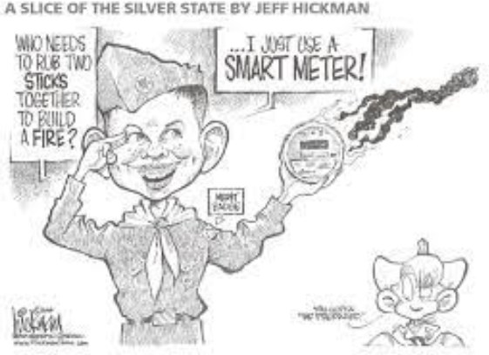
Review of Session Objectives
Understand Customer concerns about Smart Meters and AMI
Be able to respond as a Utility and as a Utility Worker
Health – only improved peace of mind
Safety - improved
High Bills/Cost reduction & savings
Privacy – increased & not reduced
Improved RELIABILITY

Slide 26
Questions and Discussion
Tom Lawton
TESCO – The Eastern Specialty Company
Bristol, PA
1-215-228-0500
This presentation can also be found under Education on the TESCO web site: www.tescometring.com

