Slide 1
VAR, VA, and 4 Quadrant Metering
Presented By: Nathaniel Dunn

Slide 2
1
Power Review
2
VARs & VAs
3
Sources of Reactance
4
Metering W, VAR, VA
5
4 Quadrant Metering
6
Power Quality

Slide 3
Power Theory Review
Ohm’s Law and Power Calculations

Slide 4
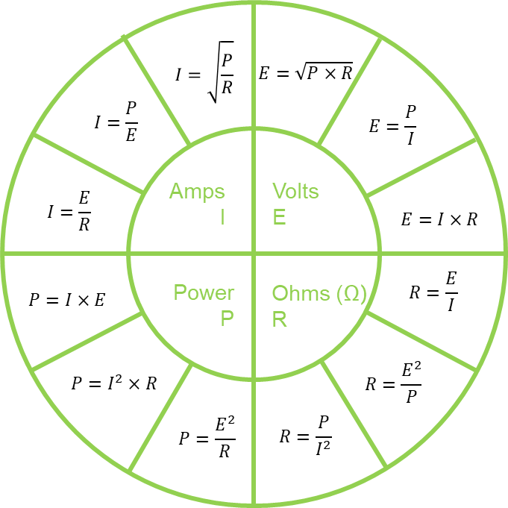
Ohm’s Law provides basic formulas used for calculating power.
The law states that the current, I, through a conductor is directly proportional to the voltage, E.
The figure to the right provides all the power related formulas derived from Ohm’s Law
Ohm’s Law
Notes:
-Defined for DC circuits
?What is difference between DC and AC circuits?
?How is Resistance different/affected in AC circuits?
?How do inductors and capacitors behave in DC circuit?AC circuit?

Slide 5












$$I=\sqrt{\frac{P}{R}}$$
$$E=\sqrt{P×R}$$
$$I=\frac{P}{E}$$
$$E=\frac{P}{I}$$
Amps
I
Volts
E
$$I=\frac{E}{R}$$
$$E=I×R$$
Power
P
Ohms (Ω)
R
$$R=\frac{E}{I}$$
$$P=I×E$$
$$R=\frac{E^{2}}{P}$$
$$P=I^{2}×R$$
$$P=\frac{E^{2}}{R}$$
$$R=\frac{P}{I^{2}}$$

Slide 6
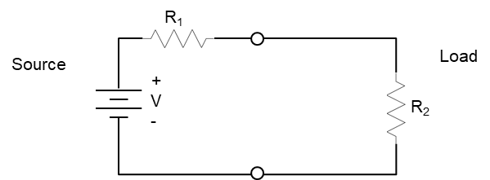


Basic Circuits
In a basic DC circuit, we can use Ohm’s Law to calculate the current for this circuit
Then we can calculate the power consumed by the load
R₁ reflects resistant in line from source to load, and R₂ is the resistance of the load. In most cases R₂ would be much greater than R₁. Thus, most of the power is consumed by the load.
These are the same basic applied to metering to measure the power and energy consumed by the load
$$I=\frac{E}{R_{1}+R_{2}}$$
$$P=I^{2}×R_{2}$$

Slide 7




Capacitance and Inductance
DC vs. AC Circuits
Capacitors are resistive elements in a circuit that don’t have real resistance, but reactance
In AC circuits they create an induced current that affects the phase relationship between voltage and current for that phase
A cap bank is an example of a capacitor
Capacitive Reactance is defined as;
Inductors similarly are resistive elements in a circuit that don’t have real resistance, but reactance
Like capacitors, in an AC circuit they induce a current into the circuit that affects the phase relationship between voltage and current for that phase
A transformer is an example of an inductor. Most loads have inductive elements/models
Inductive Reactance is defined as;
$$X_{C}=\frac{1}{2πfC}$$
$$X_{L}=2πfL$$
Capacitance
Inductance
Notes:
What is the reactance in a DC circuit for a capacitor (infinite)? And, Inductor (0)?

Slide 8
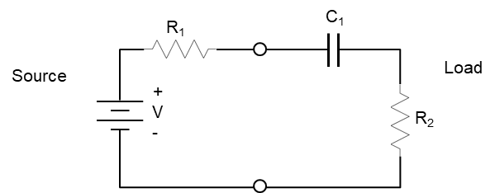
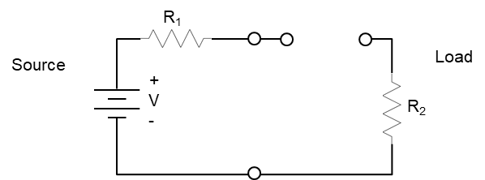
RC and RL Circuits
DC vs. AC Circuits
Capacitors and inductors behave differently in AC circuits compared to DC circuits
In DC circuits a Capacitor will look like an open circuit after fully charging; RC time constant

Slide 9
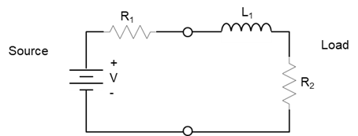
RC and RL Circuits
DC vs. AC Circuits
Capacitors and inductors behave differently in AC circuits compared to DC circuits
In DC circuits a Capacitor will look like an open circuit after fully charging; RC time constant

Slide 10
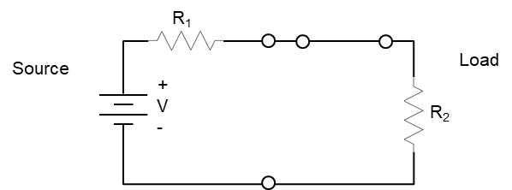
RC and RL Circuits
DC vs. AC Circuits
Capacitors and inductors behave differently in AC circuits compared to DC circuits
In DC circuits a Capacitor will look like an open circuit after fully charging; RC time constant
Inductors will look like a short circuit after fully charging; 1/RL time constant

Slide 11
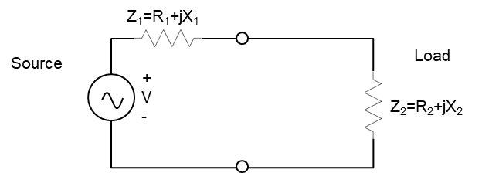
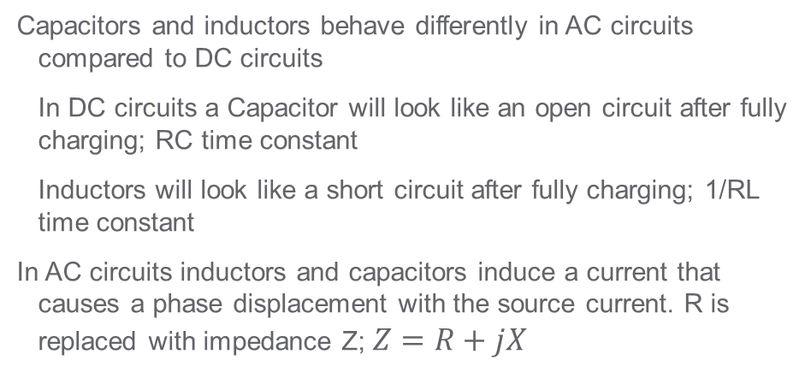
RC and RL Circuits
DC vs. AC Circuits
Capacitors and inductors behave differently in AC circuits compared to DC circuits
In DC circuits a Capacitor will look like an open circuit after fully charging; RC time constant
Inductors will look like a short circuit after fully charging; 1/RL time constant
In AC circuits inductors and capacitors induce a current that causes a phase displacement with the source current. R is replaced with impedance Z; $Z=R+jX$

Slide 12
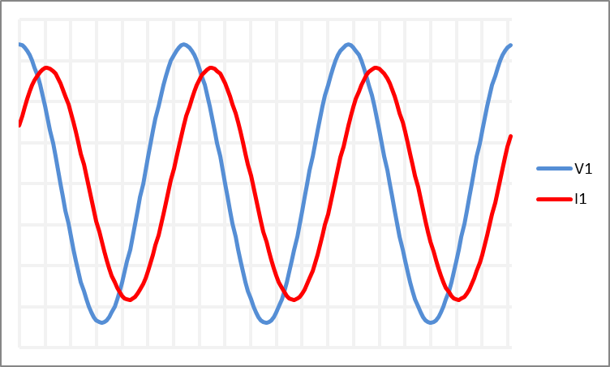
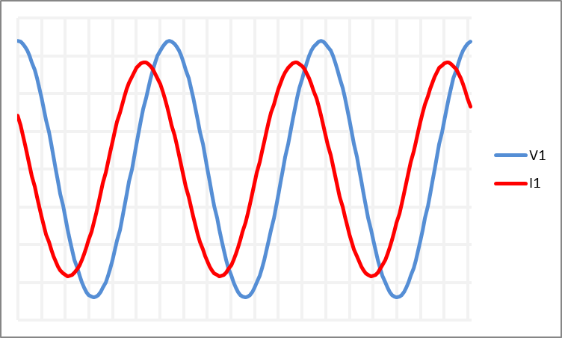
ELI the ICE man
How does inductance and capacitance affect AC power?
In inductive (L) circuits, voltage (E) leads current (I) - ELI
In a capacitive (C) circuit, current (I) leads voltage (V) - ICE
Inductor – Voltage leads Current
Capacitor – Current leads voltage

Slide 13

R₁
R₁
L₁
Source
Load
Source
Load
+
V
-
+
V
-
R₂
R₂
Z₁=R₁+jX₁
Source
Load
+
V
-
R₁
C₁
Z₂=R₂+jX₂
Source
Load
+
V
-
R₂
R₁
Source
Load
+
V
-
R₂

Slide 14
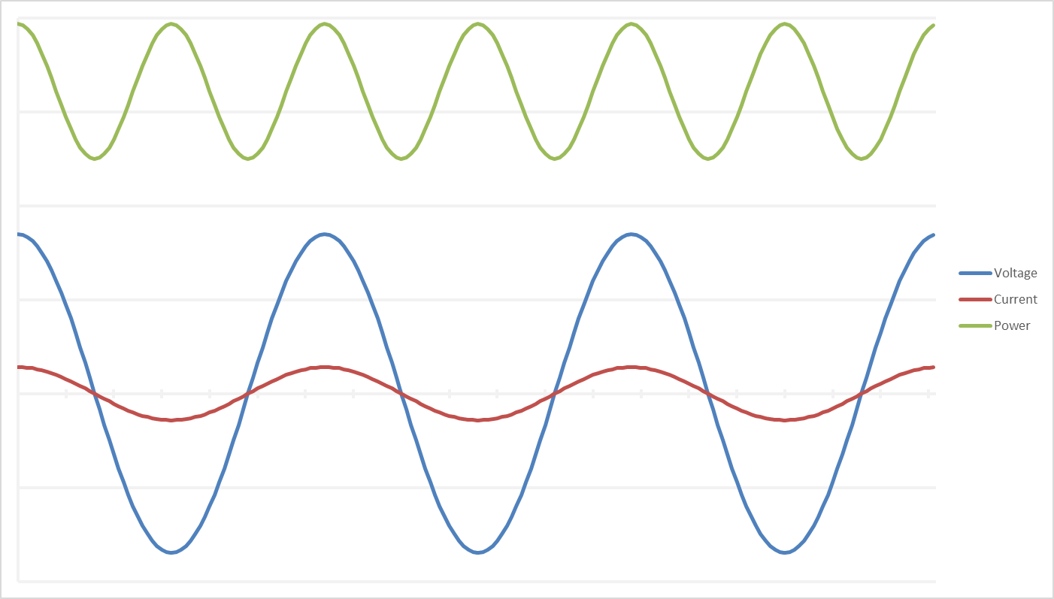
When calculating AC power you must account for the phase angle difference between the voltage and current signals.
You will notice there are 3 calculations for AC single phase power. We will cover the differences in more detail later
The signals to the left are at unity PF
The base formula of AC power is still;
P = I X E
$$Single Phase Real Power (Watts)= V_{A_{rms}}×I_{A_{rms}}×cos\left(∅_{V_{A}}+∅_{I_{A}}\right)$$
$$Single Phase Reactive Power (VARs)= V_{A_{rms}}×I_{A_{rms}}×\sin\left(∅_{V_{A}}+∅_{I_{A}}\right)$$
AC Power Calculations
$$Single Phase Apparent Power(VAs)= V_{A_{rms}}×I_{A_{rms}}$$
Notes:
What do you notice between voltage, current, and power

Slide 15
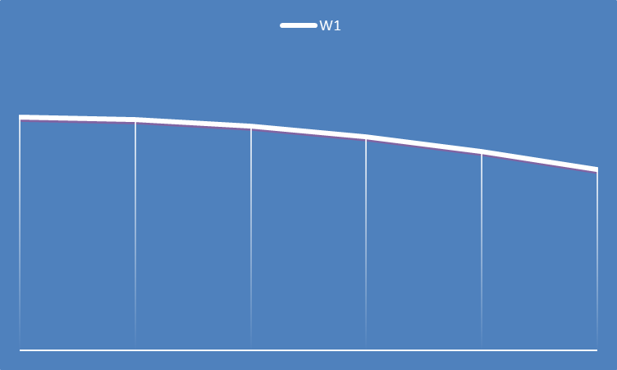

A, B, and C are constant in the equation
Energy can be simplified at calculating the area under the curve
High sampling rates provide small distances between data points and reduce error introduce from noise by keeping the line between points flat
Energy is the sum of the area of each section using the trapezoid formula for area
0 0+t 0+2t 0+3t 0+4t a
$$\int_{0}^{a}{A×B×cos\left(Ct\right)dt}$$
Calculating Energy

Slide 16
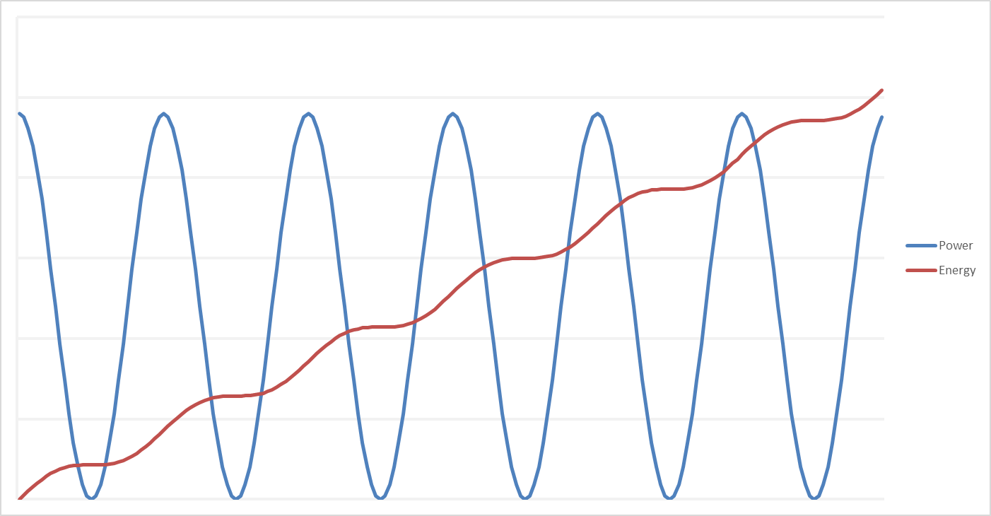
Energy accumulation on a sample-by-sample analysis
Energy accumulation accelerates at peaks and decreases at negative peaks
When power wave crosses X axis energy will fall, or have a negative slope
Higher sampling rates provided a more rounded curve, and increase accuracy
Single Phase Power & Energy

Slide 17
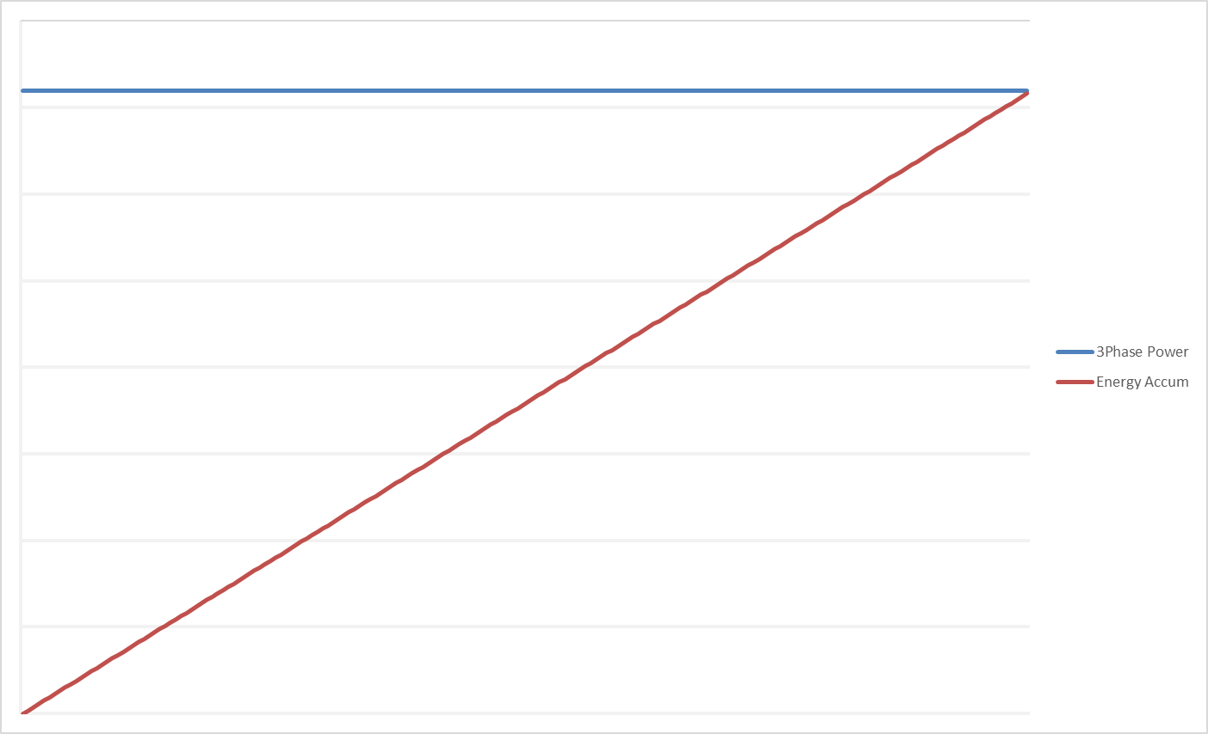
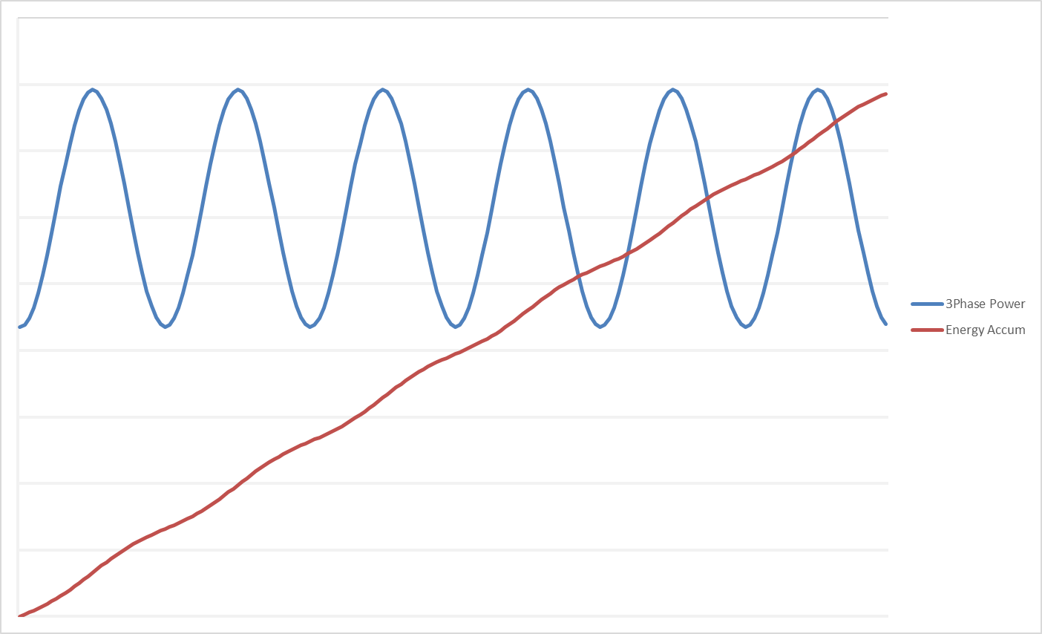
In a balanced 3 phase load, the power total is constant on a sample by sample analysis!
Energy accumulates in a linear progression
This is only true when power is balanced
When power is unbalanced the energy accumulation isn’t linear
3 Phase Power & Energy (Balanced)

Slide 18
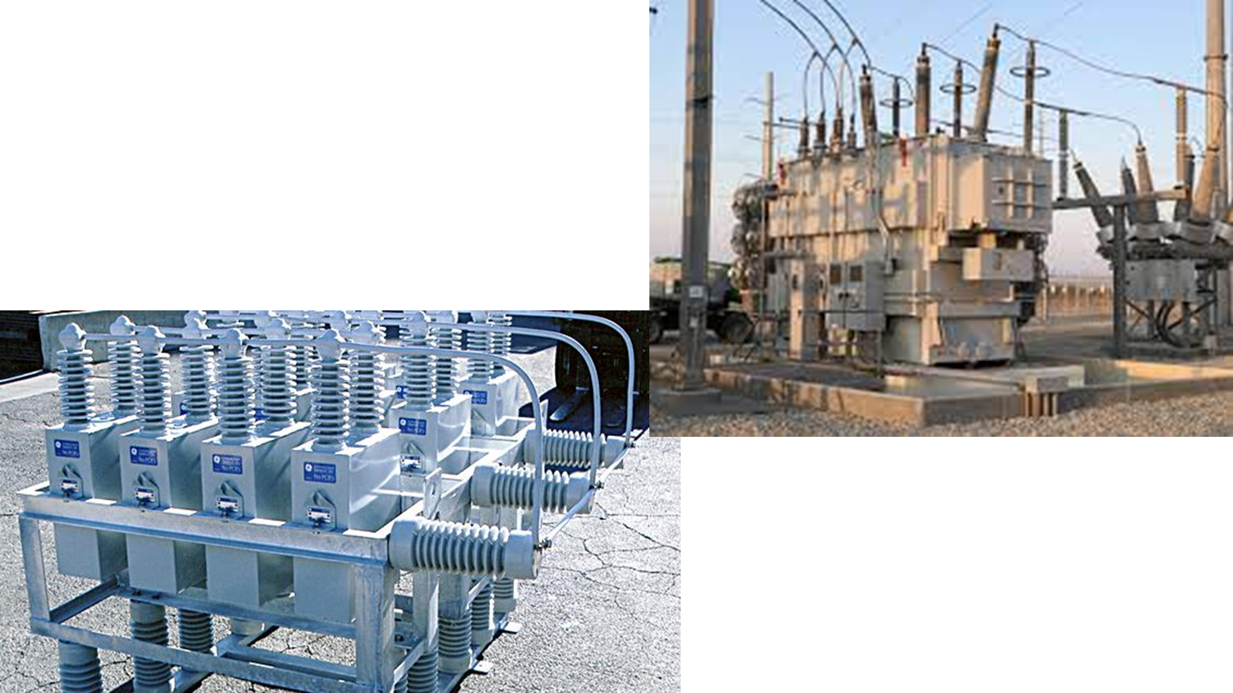
VARs and VAs Calculations
The Power Triangle

Slide 19
What are VARs and VAs
VA stands for Volt-Amps
  VA represents the total demand of a load
  It doesn’t account for phase relationship in calculation, and is determined by the magnitude of voltage and current
VAR stands for Volt-Amps Reactive
  VARs represents the power lost to reactive components, usually as heat.
  VARs are a result of reactive loads like inductors and capacitors
  Calculation for VARs is very similar to calculation for power but uses the sin function instead of cosine.
$$Single Phase Apparent Power(VAs)= V_{A_{rms}}×I_{A_{rms}}$$
$$Single Phase Reactive Power (VARs)= V_{A_{rms}}×I_{A_{rms}}×\sin\left(∅_{V_{A}}+∅_{I_{A}}\right)$$

Slide 20

Single Phase Power Calculations
Active power (P) is defined by the following calculation;
Reactive power (Q) is defined by the following calculation;
Apparent power (S) is defined by the following calculation;
And the relationship between all three of these quantities is;
$$Single Phase Real Power (Watts)= V_{A_{rms}}×I_{A_{rms}}×cos\left(∅_{V_{A}}+∅_{I_{A}}\right)$$
$$Single Phase Reactive Power (VARs)= V_{A_{rms}}×I_{A_{rms}}×\sin\left(∅_{V_{A}}+∅_{I_{A}}\right)$$
$$Single Phase Apparent Power(VAs)= V_{A_{rms}}×I_{A_{rms}}$$
$$S=\sqrt{R^{2}+Q^{2}}$$

Slide 21
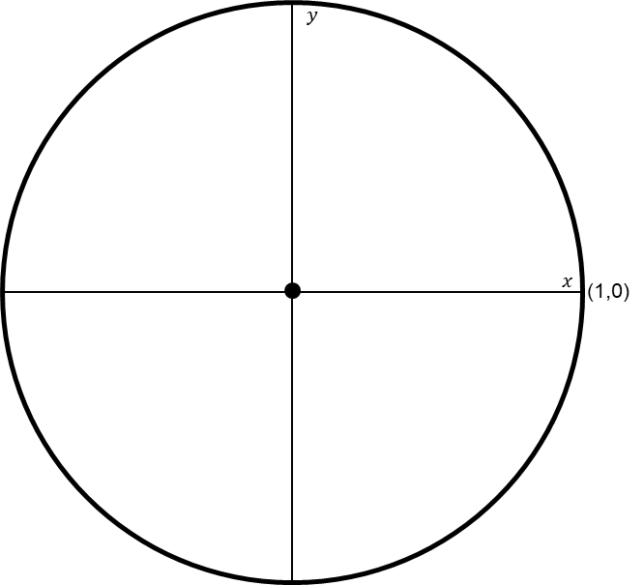
Unity Circle
Understanding Sine/Cosine Relationships
Trigonomic functions like sine/cosine have a triangular relationship that relates to power
In the AC power calculations, you’ll notice that real power calculation include the cosine function
VARs use the sine function.
When you calculate out the unity circle the cos(x) value also correlates to PF
Cos(0) = 1, and sin(0) = 0, Unity PF

Slide 22
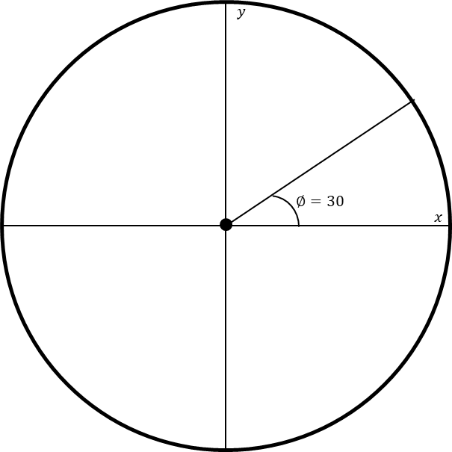

Unity Circle
Understanding Sine/Cosine Relationships
We’ll also look at some common reference points, and their PF values
30 degrees-
cos(30) = 0.866
sin(30) = 0.5
PF = 86.7%
$$\left(\frac{\sqrt{3}}{2},\frac{1}{2}\right)$$

Slide 23
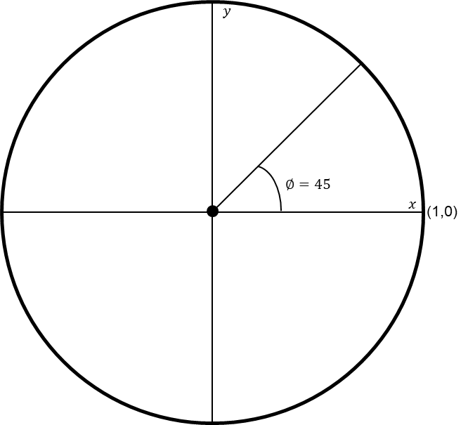
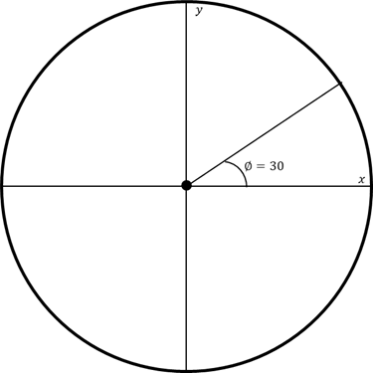


Unity Circle
Understanding Sine/Cosine Relationships
We’ll also look at some common reference points, and their PF values
45 degrees-
cos(45) = 0.707
sin(45) = 0.707
PF = 70.7%
$$\left(\frac{\sqrt{2}}{2},\frac{\sqrt{2}}{2} \right)$$
$$\left(\frac{\sqrt{3}}{2},\frac{1}{2}\right)$$

Slide 24
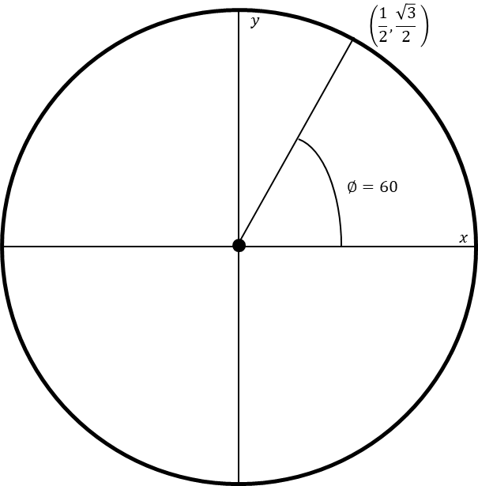
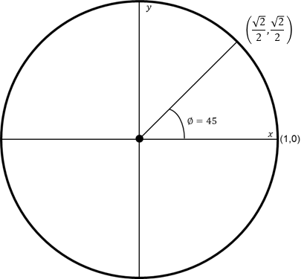
Unity Circle
Understanding Sine/Cosine Relationships
We’ll also look at some common reference points, and their PF values
60 degrees-
cos(60) = 0.5
sin(60) = 0.866
PF = 50%

Slide 25
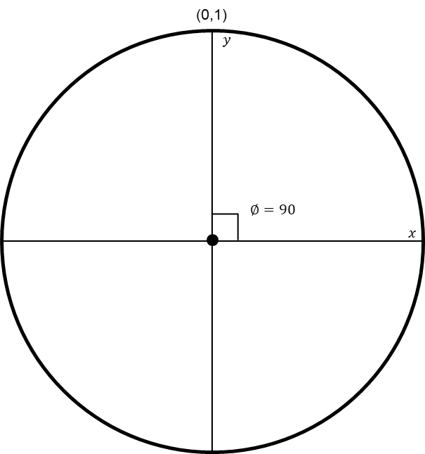

Unity Circle
Understanding Sine/Cosine Relationships
We’ll also look at some common reference points, and their PF values
90 degrees-
cos(90) = 0
sin(90) = 1
PF = 0%

Slide 26
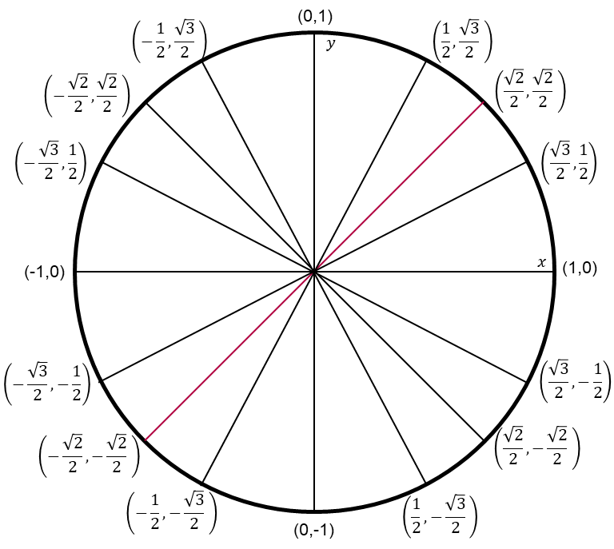
Unity Circle
Understanding Sine/Cosine Relationships
We can populate the rest if the unity circle the same values for every multiple of 30, 45, 60, and 90 degrees
This can be used to quickly identify watt/var relationships and PF at specific points
We calculate the X and Y axis using cosine and sine functions. Similar to calculate watts and vars
Apparent power is also represented in the unity circle by the radius

Slide 27













(0,1)
$$\left(−\frac{1}{2},\frac{\sqrt{3}}{2} \right)$$
$$\left(\frac{1}{2},\frac{\sqrt{3}}{2} \right)$$
$$y$$
$$y$$
$$\left(−\frac{\sqrt{2}}{2},\frac{\sqrt{2}}{2} \right)$$
$$\left(\frac{\sqrt{2}}{2},\frac{\sqrt{2}}{2} \right)$$
$$\left(−\frac{\sqrt{3}}{2},\frac{1}{2}\right)$$
$$\left(\frac{\sqrt{3}}{2},\frac{1}{2}\right)$$
(-1,0)
$$x$$
(1,0)
$$∅=15$$
$$x$$
$$\left(−\frac{\sqrt{3}}{2},−\frac{1}{2}\right)$$
$$\left(\frac{\sqrt{3}}{2},−\frac{1}{2}\right)$$
$$\left(−\frac{\sqrt{2}}{2},−\frac{\sqrt{2}}{2} \right)$$
$$\left(\frac{\sqrt{2}}{2},−\frac{\sqrt{2}}{2} \right)$$
$$\left(−\frac{1}{2},−\frac{\sqrt{3}}{2} \right)$$
$$\left(\frac{1}{2},−\frac{\sqrt{3}}{2} \right)$$
(0,-1)

Slide 28
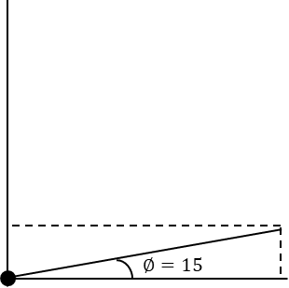

$$y$$
$$∅=15$$
$$∅=15$$
$$x$$
579.6
600
155.4

Slide 29
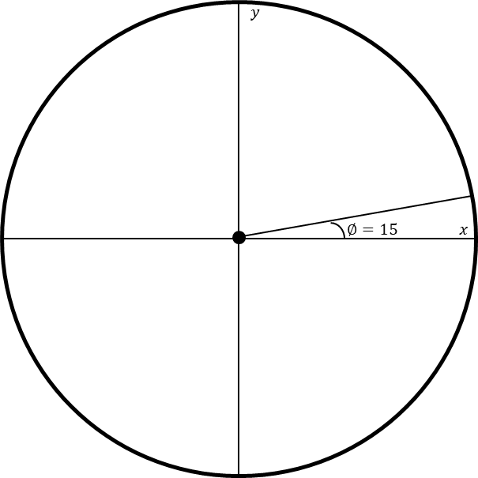
Power Triangle
The unity circle ties directly into the power triangle and 4 quadrant metering
We’re going to calculate power at 15 degrees.

Slide 30
Power Triangle
The unity circle ties directly into the power triangle and 4 quadrant metering
We’re going to calculate power at 15 degrees.
Cos(15) = 0.966
Sin(15) = 0.259
PF = 96.6%
0.966
1
0.259

Slide 31
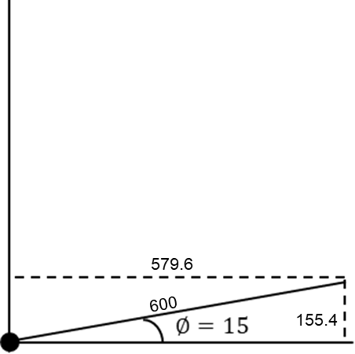
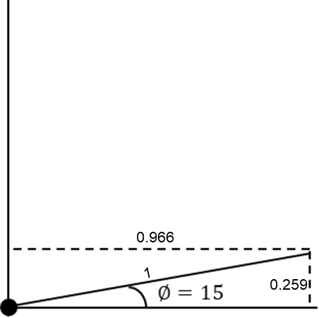
Power Triangle
The unity circle ties directly into the power triangle and 4 quadrant metering
Next, we’ll assume 120 V_{rms} and 5 A_{rms}
This comes to 600 VA
600 VA * 0.966 = 579.6 W
600 VA * 0.259 = 155.4 VAR

Slide 32
Power Calculations
Next we’ll use the AC power calculations;
P = 120 * 5 * cos(15) = 579.6 W
Q = 120 * 5 * sin(15) = 155.3 VAR
S = 120 * 5 = 600 VA
PF = P/S = W/VA = 579.6/600 = 0.966
Understanding the unity circle and the mathematical relationship between P, S, and Q will help understanding 4 quadrant metering

Slide 33
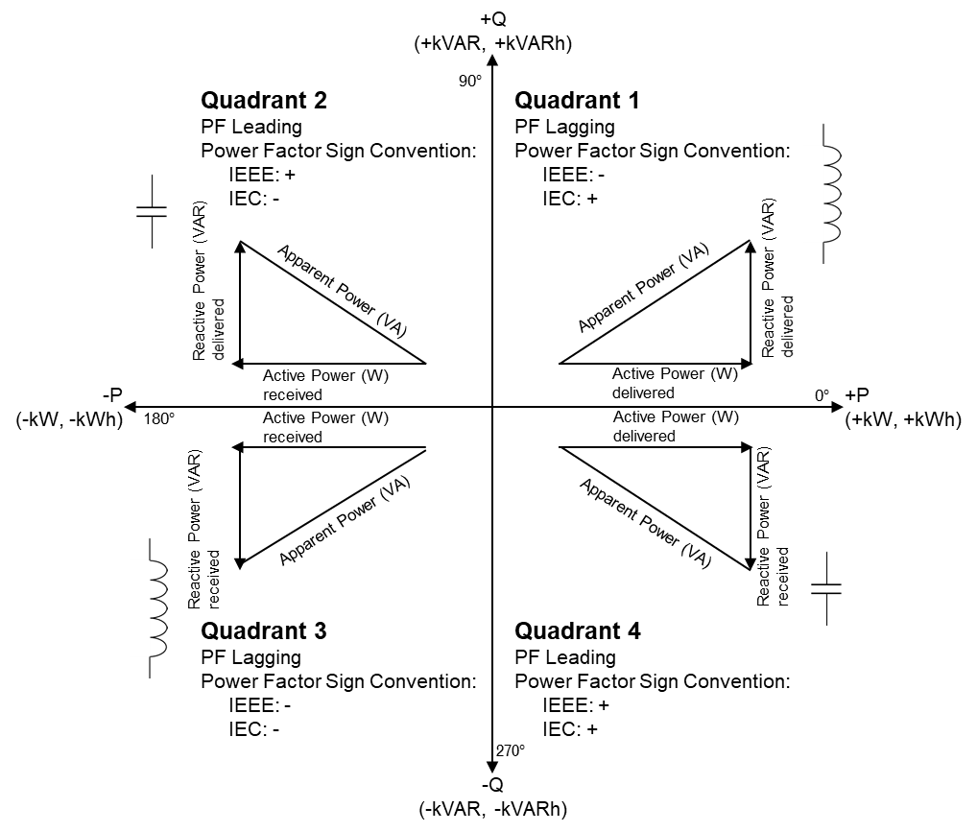

$$PF=\frac{Active Power (W)}{Apparent Power (VA)}$$
Calculation to PF is straight forward, but there are 2 common sign conventions for PF
IEC: Positive Active Power is Positive PF
IEEE: Leading PF is positive, and Lagging is negative
Power Factor Calculations

Slide 34

+Q
(+kVAR, +kVARh)
90º
Quadrant 2
PF Leading
Power Factor Sign Convention:
IEEE: +
IEC: -
Quadrant 1
PF Lagging
Power Factor Sign Convention:
IEEE: -
IEC: +
Reactive Power (VAR)
delivered
Reactive Power (VAR)
delivered
Apparent Power (VA)
Apparent Power (VA)
Active Power (W)
received
Active Power (W)
delivered
-P
(-kW, -kWh)
0º
+P
(+kW, +kWh)
180º
Active Power (W)
received
Active Power (W)
delivered
Reactive Power (VAR)
received
Apparent Power (VA)
Apparent Power (VA)
Reactive Power (VAR)
received
Quadrant 3
PF Lagging
Power Factor Sign Convention:
IEEE: -
IEC: -
Quadrant 4
PF Leading
Power Factor Sign Convention:
IEEE: +
IEC: +
270º
-Q
(-kVAR, -kVARh)

Slide 36
Source of Reactance
Most AC loads have some amount of inductance
Transformers are essentially large inductors and major sources of inductive reactance
Cap banks are large capacitors used to offset inductive reactance on the system
Base load power plants like coal, natural gas, and nuclear have good control on power factor output
Transmission lines also have impedance that is directly proportional to the length of the line
Power lines also have some capacitance between earth ground. A capacitor is essentially 2 electrical plates with a dielectric between them, like air.

Slide 37
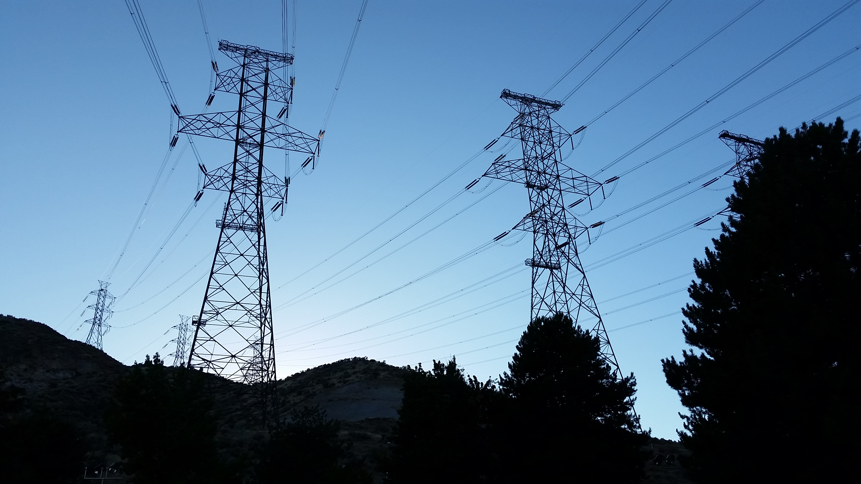
Power Lines
Any powerline of enough length will generate losses
Longer lines will have greater losses, and see voltage drop
Can calculate impedance from cross sectional area of cable, number of cable, and length

Slide 38
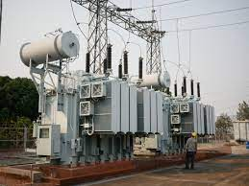
Transformers
Power transformers used to step and step down voltage have core and wiring losses associated with them
A power transformer is basically a large inductor and most of the losses are lost as heat and represented as VARs
Transformer losses can be found on the manufacturers test report

Slide 39
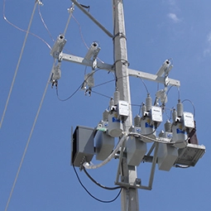
Capacitor Banks
Capacitor banks are used for VAR correction and voltage optimization
They’re basically large caps, and are rated in VARs at system frequency
They do consume a small amount of active power as well

Slide 40

Customer Loads
Customer loads will vary from residential to commercial and industrial loads
PF may vary from 85% up to 95%+
Most agreements with large customers have minimum PF requirements
Customers are only billed on Watts, so poor PF is essentially lost revenue

Slide 41
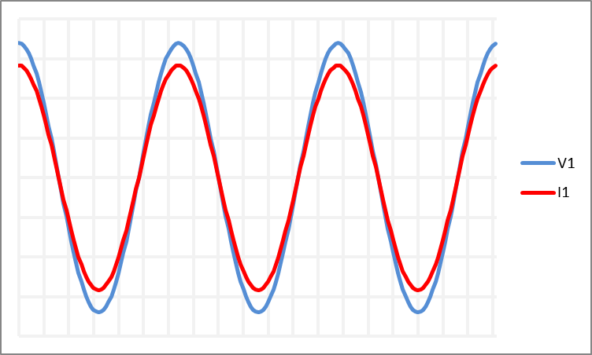
What can you tell me about these signals and their power measurements-
P = S
Q = 0
PF = 100% or Unity
Delivered Watts
Identifying Power from Voltage and Current Signals

Slide 42
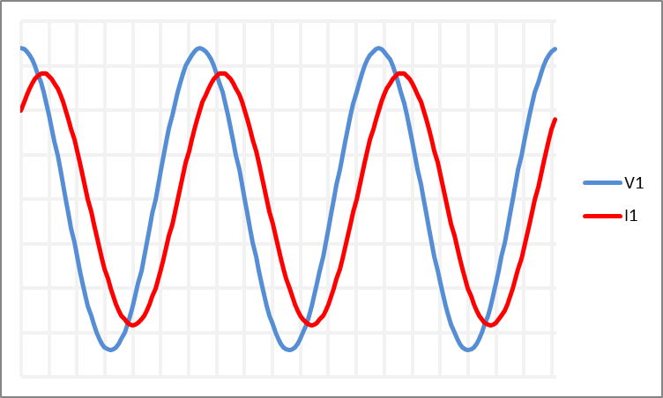
What can you tell me about these signals and their power measurements-
Voltage leads Current
Inductive Load
P=Q
Active Power Delivered
Reactive Power Delivered
Identifying Power from Voltage and Current Signals

Slide 43
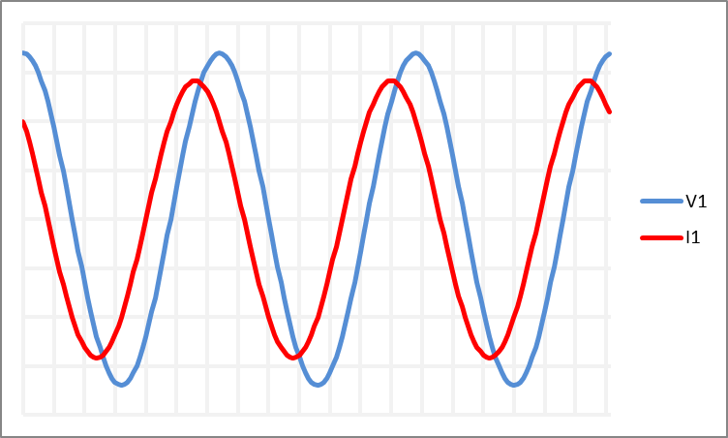
What can you tell me about these signals and their power measurements-
Voltage lags Current
Capacitive Load
P=Q
Active Power Delivered
Reactive Power Received
Identifying Power from Voltage and Current Signals

Slide 44
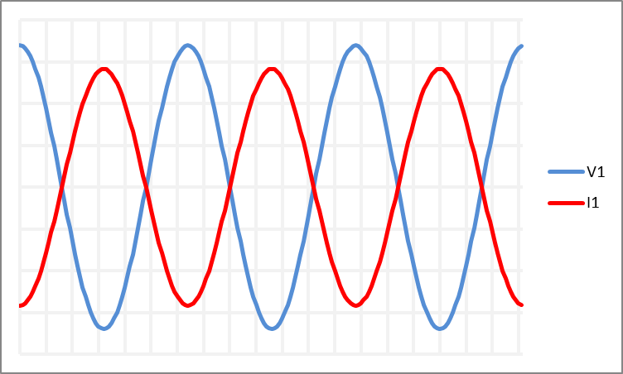
What can you tell me about these signals and their power measurements-
Current and voltage are 180 degrees apart
P = S
Q = 0
PF = -100% or Unity
Received Watts, -P
Identifying Power from Voltage and Current Signals

Slide 45
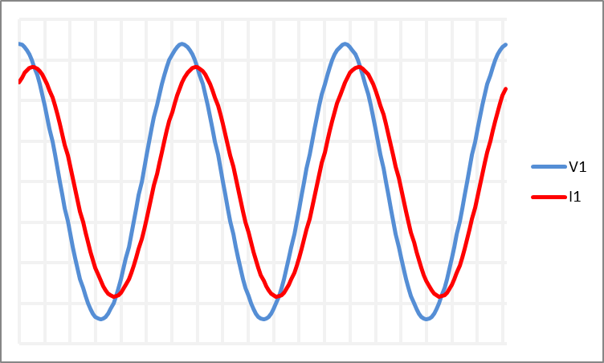

Distance from Peak to Peak = 1 cycle
Our electric grid is 60 Hz, or 60 cycles/sec
1 cycle/period = 16.6 ms
V1 peak to I1 peak is phase difference between signals; 1.389 ms
Voltage leads current tells us this is an inductive circuit
The phase angle difference between the two signals is-
$$PS=360∗td/p$$
How to measure Phase Shift

Slide 46

PS is the phase shift in degrees
td is time difference
p is period or length of 1 cycle
td and p need to use the same measurement, like seconds or milli-seconds
PS = 360 * (1.389/16.67)
= 30 degrees
$$PS=360∗td/p$$
How to measure Phase Shift

Slide 47
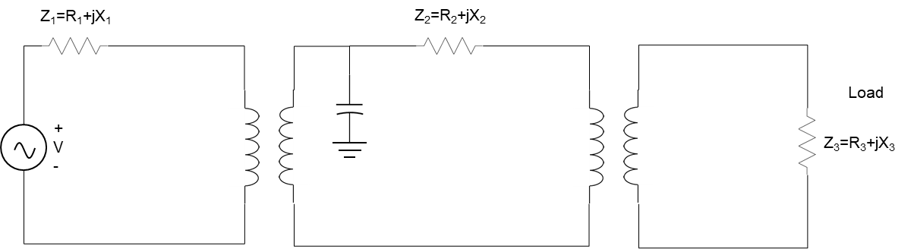
System Overview
Circuit Analysis Point of View

Slide 48
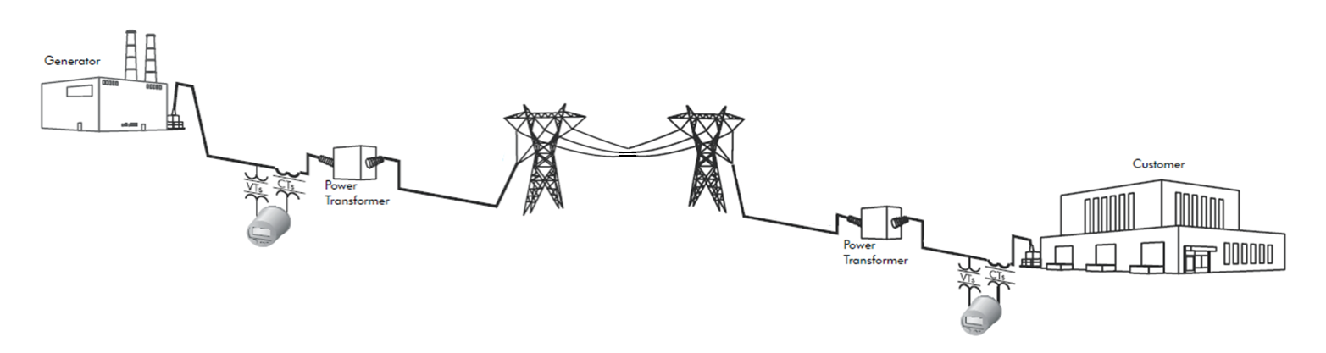
System Overview
Could looks something like this

Slide 49
System Overview
Line Losses
kW tot = 1 MW
kVAR tot = 2 MVAR
kVA tot = 2.24 MVA
Customer Loads
kW tot = 100 MW
kVAR tot = 62 MVAR
kVA tot = 117.65 MVA
Transformer Losses
kW tot = 1 MW
kVAR tot = 10 MVAR
kVA tot = 10.05 MVA
Transformer Losses
kW tot = 1 MW
kVAR tot = 10 MVAR
kVA tot = 10.05 MVA
This example doesn’t reflect an actual study
MVA demand from all the loads is 140 MVA
Only 103 MW is billed
VARs are a result of reactive loads on the system that are dispersed as heat
Notes:
Using easy math, and not reflecting actual results

Slide 50
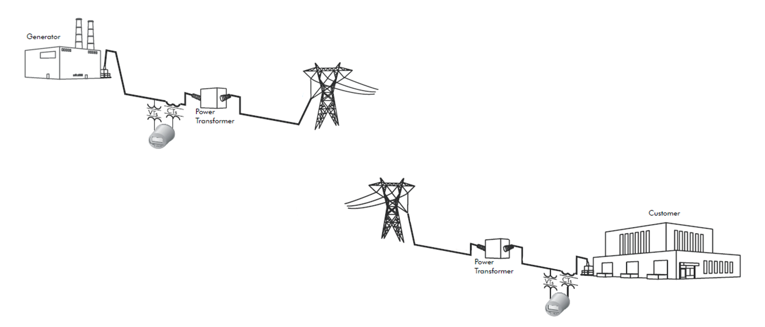

Slide 51

Z₁=R₁+jX₁
Z₂=R₂+jX₂
Load
+
V
-
Z₃=R₃+jX₃

Slide 52
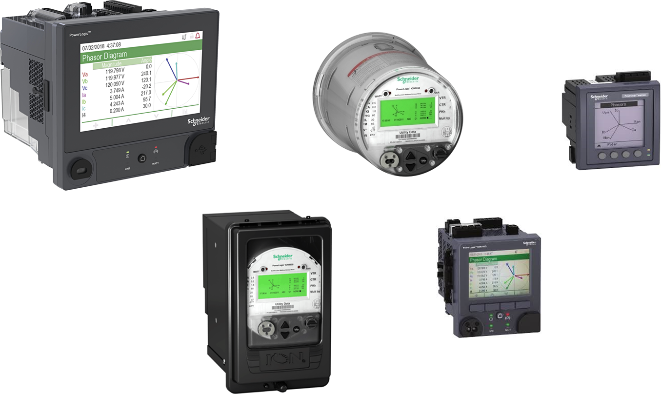
Metering W, VAR, VA

Slide 53
Calculating Power
So far, we’ve primarily looked at AC power by looking at waveshapes and sampled values
Power meters analyze these values, and calculate the RMS values for each input
  In previous formulas I’ve used RMS values in the power formulas
Meters can provide high speed RMS values; updates several times a second down to half-cycle RMS values
Many meters update once a second and provide RMS and fundamental values;
  RMS values include distortion; sampling rate affects how much distortion is captured
  Fundamental values only account for the 60 Hz signal

Slide 54
RMS Values
Root Mean Square of Data Points
RMS refers to the root of the average of the squares for a set a data
For our purposes these are the sampled values.
To the right is an example set for a signal that samples at 8 samples/cycle

Slide 55
RMS Values
Root Mean Square of Data Points
RMS refers to the root of the average of the squares for a set a data
For our purposes these are the sampled values.
To the right is an example set for a signal that samples at 8 samples/cycle
First Step is to square all the sampled values

Slide 56
RMS Values
Root Mean Square of Data Points
RMS refers to the root of the average of the squares for a set a data
For our purposes these are the sampled values.
To the right is an example set for a signal that samples at 8 samples/cycle
First Step is to square all the sampled values
Then, calculate the average of the squares

Slide 57
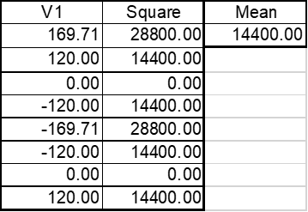
RMS Values
Root Mean Square of Data Points
RMS refers to the root of the average of the squares for a set a data
For our purposes these are the sampled values.
To the right is an example set for a signal that samples at 8 samples/cycle
First Step is to square all the sampled values
Then, calculate the average of the squares
Finally, calculate the square root of the average, of the squares

Slide 58
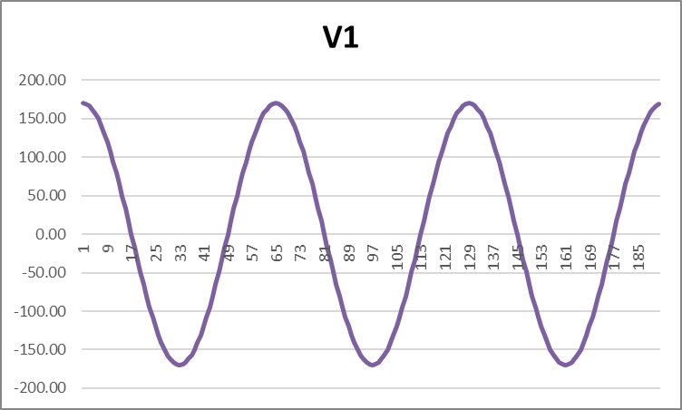

RMS Values
Root Mean Square of Data Points
RMS refers to the root of the average of the squares for a set a data
For our purposes these are the sampled values.
To the right is an example set for a signal that samples at 8 samples/cycle
First Step is to square all the sampled values
Then, calculate the average of the squares
Finally, calculate the square root of the average, of the squares
More simply, the RMS value can be calculated by taking the peak and dividing by the square root of 2.
RMS is also the equivalent DC voltage level
$$V_{RMS}=\frac{V_{PEAK}}{\sqrt{2}}=\frac{169.71}{\sqrt{2}}=120 V$$

Slide 59
3-Phase Power Calculations
Review
Calculations for 3 element connected meters
Calculations for 2 element connected meters
$3 Phase Active Power \left(Watts\right)= V_{A_{rms}}×I_{A_{rms}}×cos\left(∅_{V_{A}}+∅_{I_{A}}\right)+V_{B_{rms}}×I_{B_{rms}}×cos\left(∅_{V_{B}}+∅_{I_{B}}\right)$+ $V_{C_{rms}}×I_{C_{rms}}×cos\left(∅_{V_{C}}+∅_{I_{C}}\right)$
$3 Phase Active Power \left(VARs\right)= V_{A_{rms}}×I_{A_{rms}}×sin\left(∅_{V_{A}}+∅_{I_{A}}\right)+V_{B_{rms}}×I_{B_{rms}}×sin\left(∅_{V_{B}}+∅_{I_{B}}\right)$+ $V_{C_{rms}}×I_{C_{rms}}×sin\left(∅_{V_{C}}+∅_{I_{C}}\right)$
$3 Phase Active Power \left(VAs\right)= V_{A_{rms}}×I_{A_{rms}}+V_{B_{rms}}×I_{B_{rms}}$+ $V_{C_{rms}}×I_{C_{rms}}$
$$3 Phase Active Power \left(Watts\right)= V_{{AB}_{rms}}×I_{A_{rms}}×cos\left(∅_{V_{AB}}+∅_{I_{A}}\right)+V_{{BC}_{rms}}×I_{B_{rms}}×cos\left(∅_{V_{BC}}+∅_{I_{B}}\right)$$
$$3 Phase Active Power \left(VARs\right)= V_{{AB}_{rms}}×I_{{AB}_{rms}}×sin\left(∅_{V_{AB}}+∅_{I_{A}}\right)+V_{{BC}_{rms}}×I_{B_{rms}}×sin\left(∅_{V_{BC}}+∅_{I_{B}}\right)$$
$$3 Phase Active Power \left(VAs\right)= V_{{AB}_{rms}}×I_{A_{rms}}+V_{{BC}_{rms}}×I_{B_{rms}}$$

Slide 60
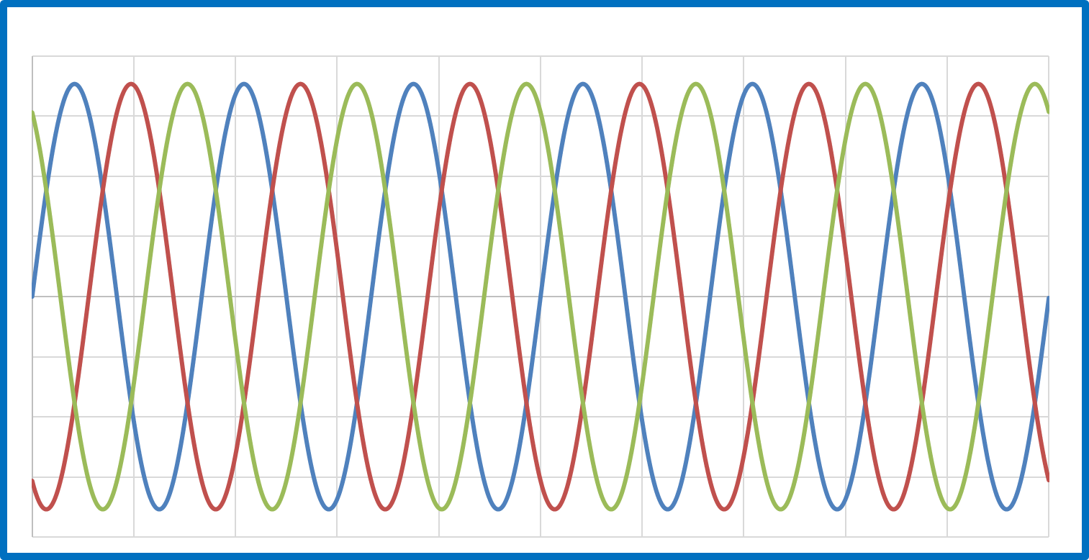
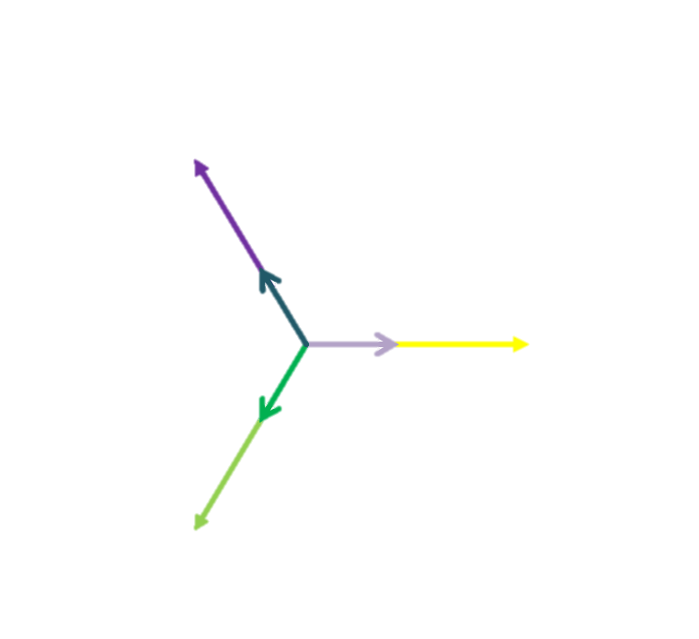
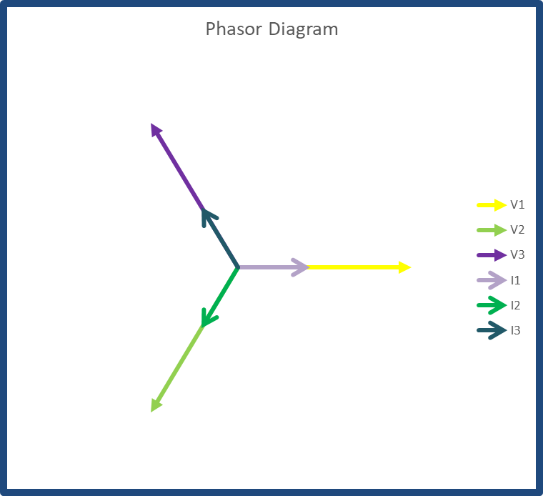



Complex Calculations
$$C=A∗sin(2πft+θ)$$
$$C=Z∠θ$$
$$C=X+jY$$
  The waveshape form is:
    A indicates the peak magnitude of the signal
    2Ωf is the angular frequency
    t represents time, usually reference to 0
    θ indicates displacement to reference signal in radians
  The polar form is:
    Z indicates magnitude only
    The phase angle (θ) is measured counterclockwise from the positive real axis
  The rectangular form is:
    X indicates the real axis
    jY indicates the imaginary axis

Slide 61
Complex Values
The previous 3 calculations are all used to calculate correlated values for voltage and current signals
Samples values are used to calculate RMS and phase angle values used in polar coordinates
Polar coordinate and rectangular coordinates represent the same values, but in different forms
  Polar coordinates are ideal for comparing the phasor relationship between voltage and current elements
  Rectangular coordinates are helpful for applying complex math to phasor values
Complex Math
  You can multiply and divide polar coordinate, but cannon add and subtract
  You can add and subtract rectangular values for Net calculations

Slide 62
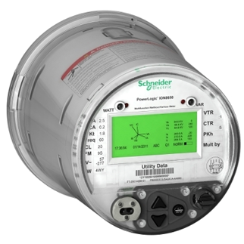
Energy Meter Quantities
Meters today provide real time outputs for;
  Active Power & Energy
  Reactive Power & Energy
  Volt-Amp Power & Energy
  Per phase values for volts, amps, and power
  4 quadrant, bi-directional metering
  And more…!
Data can be collected real time utilizing SCADA, or through data recorders connected to a billing system like MV90

Slide 63
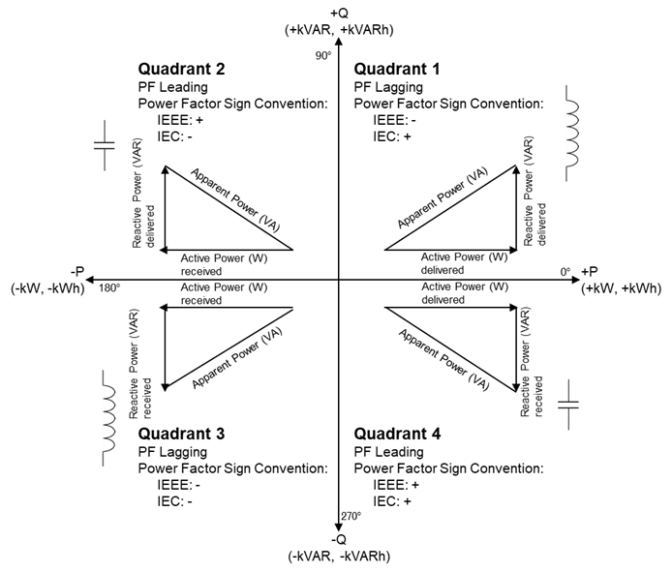
4 Quadrant Metering

Slide 64
4 Metering Quadrants
Power can be broken into 4 quadrants based on direction of active power and reactive power
  +P and +Q is upper right – Quadrant 1
  -P and +Q is upper left – Quadrant 2
  -P and -Q is lower left – Quadrant 3
  +P and -Q is lower right – Quadrant 4

Slide 65
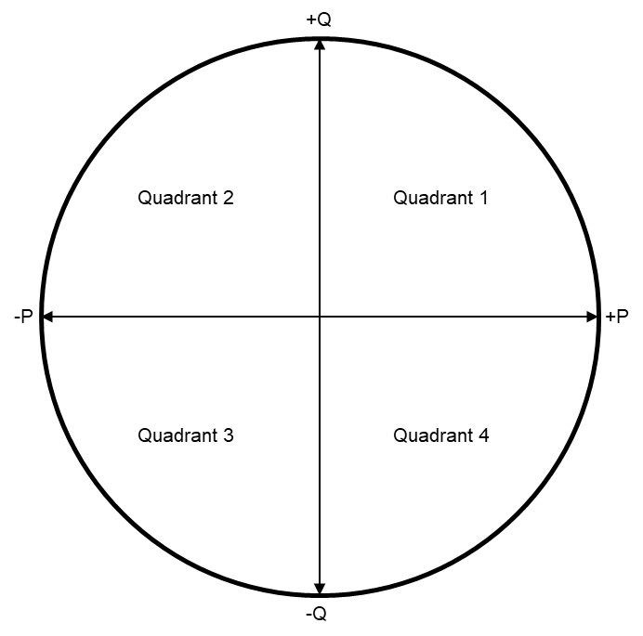
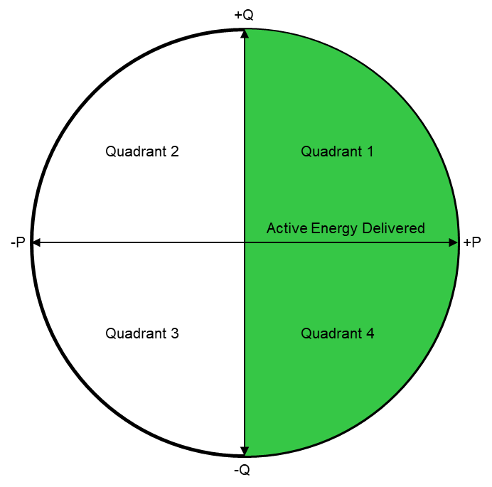
Power Circle
Quadrant or Quantity
Active energy delivered is Q1+Q4

Slide 66


Power Circle
Quadrant or Quantity
Active energy delivered is Q1+Q4
Active energy received is Q2+Q3

Slide 67


Power Circle
Quadrant or Quantity
Active energy delivered is Q1+Q4
Active energy received is Q2+Q3
Reactive energy delivered is Q1+Q2

Slide 68


Power Circle
Quadrant or Quantity
Active energy delivered is Q1+Q4
Active energy received is Q2+Q3
Reactive energy delivered is Q1+Q2
Reactive energy received is Q3+Q4

Slide 69
Active Energy Delivered
+Q
Active Energy Received
Quadrant 2
Quadrant 1
-P
+P
Reactive Energy Delivered
Quadrant 3
Quadrant 4
Reactive Energy Received
-Q

Slide 70
4 Quadrant Metering
Most customer loads will fall into Quadrant 1, from utility perspective
  Active power is delivered to customer
  Most customers will have an inductive impedance which will have reactive power delivered
  Customers with PF correction may have near unity or reactive power received
Bi-directional meters will primarily fall into Q1 and Q3
  Active power delivered and reactive power delivered
  Active power received and reactive power received
Loads in Q2 and Q4 has greater capacitive reactance than inductive, most likely due to PF correction devices
Some generators can output power in Q4 to compensate for low system PF

Slide 71
4 Quadrant Metering Recorders
Configuration 1 captures all active and reactive energy
Configuration 2 captures all active energy, and only reactive energy in inductive quadrants
Configuration 3 captures all active and reactive energy, but splits out reactive energy into quadrants
Preference depends on what power factor correction a customer uses and how to capture it
Channel 1: kWh del
Channel 2: kWh rec
Channel 3: kVARh del
Channel 4: kVARh rec
Channel 1: kWh del
Channel 2: kWh rec
Channel 3: kVARh Q1
Channel 4: kVARh Q3
Channel 1: kWh del
Channel 2: kWh rec
Channel 3: kVARh Q1
Channel 4: kVARh Q2
Channel 5: kVARh Q3
Channel 6: kVARh Q4
Configuration 1
Configuration 2
Configuration 3

Slide 72

Power Quality

Slide 73
PF and Voltage Loss
We’ll focus on Power Factor and Voltage Loss
  Poor PF can increase demand on the system that can’t be recovered
  Lines with significant impedance will see voltage loss over long distances
Corrective devices
  Cap Banks
  Voltage Regulators and Transformer Tap Settings
  Generator and inverter reactive power setpoints
  Static Var Compensators
VVO Software

Slide 74
PF Example
Customer Loads
kW tot = 100 kW
kVAR tot = 62 kVAR
kVA tot = 117.65 kVA
This customer is at 85% PF, and is only billed active energy
Let’s assume $0.10 kWh.
Usage bill at 85% PF would be ~$7.2k
If PF could be increased to 90% PF for month usage bill ~$7.6k
That’s roughly $400 a month or $5k a year
For MW customers the cost will scale by that much!
If you have 100 similar customers that could be $500k a year
Notes:
This is a simplified look at costs of PF.

Slide 75
$$VA=120∠0$$
Z = 10 + j25
$$VB=120∠240$$
$$VC=120∠120$$
V
A
VA: ??? V
VB: ??? V
VC: ??? V
$$IA=5∠0$$
$$IB=5∠240$$
V
$$IC=5∠120$$
VA Demand at Generator would be 1800 VA (secondary)
Accounting for power losses (I² * Z) across system using supplied impedance. VA at customer is 1671.
Current remaining constant, calculate V to be-
VA 111 V
VB 111 V
VC 111 V
Voltage Loss Example
Notes:
This is a simplified look at voltage loss, and using excessive numbers to prove point

Slide 76
VVO Devices

Slide 77
Capacitor Banks
Capacitor banks are used for VAR correction and voltage optimization
They’re basically large caps, and are rated in VARs at system frequency
They do consume a small amount of active power as well

Slide 78

Voltage Regulator and Transformer Tap Settings
A power distribution voltage regulator is an auto transformer that can step-up or step-down voltage to provide consistent system voltage levels. A voltage regulator control senses system voltage and commands the tap changer to operate when voltage changes are needed.
This can be done with power transformers with multiple tap settings to accomplish the same goal

Slide 79

Generator Control
Generators are capable of operating at leading power factors, but will reduce kVA output
Reactive capability curve provides kVA and kVAR capability at different setpoints
Synchronous generators can be setup as a synchronous condenser to pull VARs off the system

Slide 80

Static VAR Compensator
A static VAR compensator (SVC) is a set of electrical devices for providing fast-acting reactive power on high-voltage electricity transmission networks
The SVC is an automated impedance matching device, designed to bring the system closer to unity power factor. SVCs are used in two main situations:
Connected to the power system, to regulate the transmission voltage ("transmission SVC")
Connected near large industrial loads, to improve power quality ("industrial SVC")

Slide 81

Volt/VAR Optimization Software
Volt/VAR Optimization (VVO) optimally manages system-wide voltage levels and reactive power flow to achieve efficient distribution grid operation.
VVO assists distribution operators reduce system losses, peak demand or energy consumption using Conservation Voltage Reduction (CVR) techniques.
Notes:
Volt/VAR Optimization & Control is an advanced function that determines the best set of control actions for all voltage regulating devices and Var control devices to achieve a one or more specified operating objectives without violating any of the fundamental operating constraints (high/low voltage limits, load limits, etc.).
Volt/VAR Optimization includes Conservative Voltage Reduction (CVR) function that is used to calculate and maintain acceptable voltage (e.g. 120 V +/- 5%) at the service entrance of all customers served by the feeder under all possible operating conditions. CVR is used to flatten voltage profiles and lower overall system voltage while staying within the specified ANSI or IEC voltage limits. Overall system demand can be reduced by a factor of 0.7-1.0% for every 1% reduction in voltage. From a consumers perspective, this reduces the energy they consume. From a utility perspective it reduces the amount of power they need to generate or purchase from a generator.

Slide 82
Notes:
Closing slide

