Slide 1
Principals of nist and traceability
July 11th, 2023
Carson Scaccetti

Slide 2
Who is NIST
National Institute of Standards and Technology
USA National Metrological Institute
Department of Commerce
Gaithersburg Maryland
March 3rd, 1901
Notes:
NIST, the National Institute of Standards and Technology is the National Metrological Institute of the United States of America. What is a National Metrological Institute or NMI, it is a federal Agency, typically within the commerce department. NMIs have the responsibility of maintaining national metrological standards and disseminating the International System of Units nationally. NIST’s mission or purpose, as with most NMIs is to promote measurement science, standards and technology to enhance productivity, facilitate trade, and improve the quality of life.

Slide 3
NIST notables
U.S. Congress founded NBS on March 3, 1901
January 16, 1905 First National Conference of Weights and Measures (NCWM)
1906 First Standard Reference Material
1913 Correcting Rail Freight
1915 National electrical safety code
Notes:
Heeding the call from the nation’s scientists and industrialists to establish an authoritative domestic measurement and standards laboratory, the U.S. Congress founded the National Bureau of Standards on March 3, 1901. NIST’s original campus stood at the intersection of Connecticut Ave and Van Ness in Washington D.C. At the turn of the 20th century, uncertainty and unstandardized measures plagued U.S. markets. There were at least 8 different gallons, and 4 different feet in use, and regulation was haphazard with poorly trained inspectors and outdated measuring equipment. On January 16th 1965, NIST convened the first National Conference of Weights and Measures to write model laws, uniform standards, and provide training for inspectors, which resulted in a more orderly and fair marketplace. In 1906, the American Foundrymen’s Association was the first industry grout to task NIST with developing, producing, and standardizing a substance, in this case it was iron. This was the first “standard sample” from NIST. We now refer to them as Standard Reference Materials or (SRMs), and they are utilized in multitudes of industries. In 1913, NIST went to work investigating the rail freight scales, by developing and testing specifically designed and weighted rail cars. The expected and tolerable error was 0.2% (2000PPM) for the rail car. NISTs showed that around 80% of rail scales were off, and by a significant margin of near 3%. States, with the help of NIST, began testing more rigoursly and regularly, and accuracy quickly improved. In the early 20th century, Coal was a major energy source in the United States, and electric generation was heavily reliant upon it. Mining of that coal, was dependent upon electricity, which was a huge safety concern and risk. In 1909, the coal mining industry came to NIST for help developing safety standards. In 1915, NIST’s investigation was published and became the nation’s first model electrical safety code in 1915.

Slide 4
NIST notables
June 17, 1928 First full-scale fire test
January 6, 1949 the First Atomic Clock
1958 invented the diamond anvil cell
1970 developed a truly unbiased military draft
1985 Creation of the 1 volt standard JJA
1932 Helped establish First FBI crime lab
2005 World Trace Center 1 and 2 reports
2014 release of Framework for improving Critical Infrastructure Cybersecurity

Slide 5
About NIST
Mission
To promote U.S. innovation and industrial competitiveness by advancing measurement science, standards, and technology in ways that enhance economic security and improve our quality of life
Vision
NIST will be the world's leader in creating critical measurement solutions and promoting equitable standards. Our efforts stimulate innovation, foster industrial competitiveness, and improve the quality of life.
Core Competencies
Measurement science
Rigorous traceability
Development and use of standards
Notes:
Overarching principals/jobs: Pushing technology and Innovation, standardization and regulation of measurement,

Slide 6
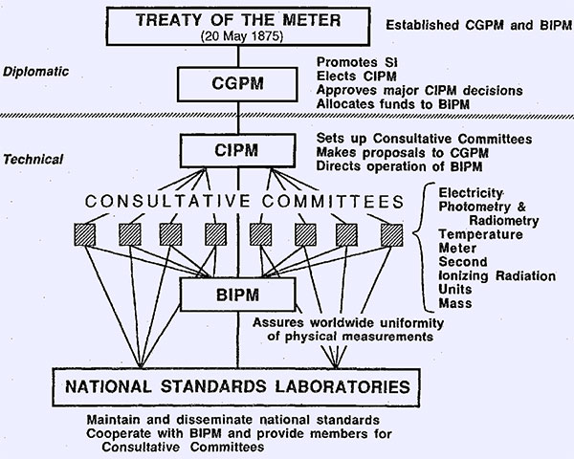
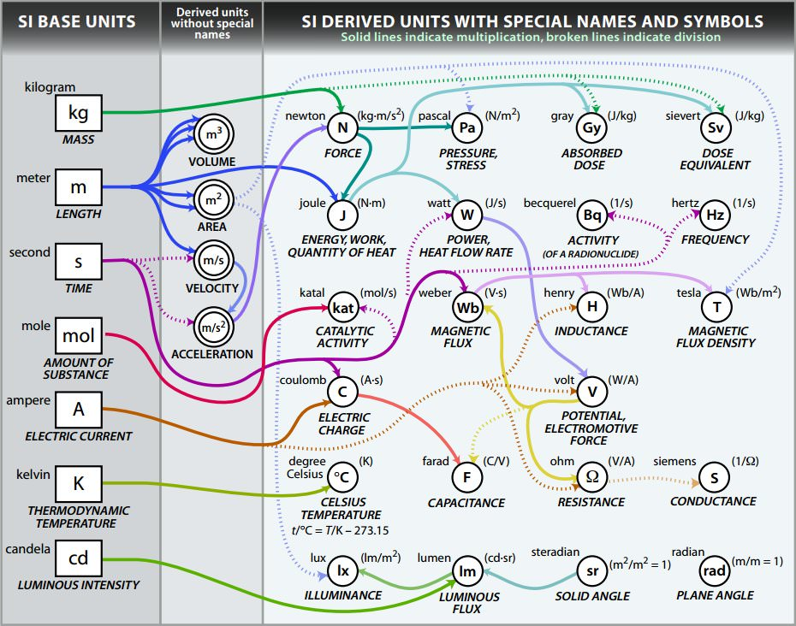
METRE CONVENTION
SI – The International System of Units
International Bureau of Weights and Measures (BIPM)
General Conference on Weights of Measures (CGPM)
International Committee for Weights and Measures (CIPM)
Notes:
SI – The International System of Units. This is the internationally agreed system of measurement. On May 20th (AKA as World Metrology Day) 1875 in Paris France, the metre convention was held with representatives of 17 countries. An international treaty would be signed, often referred to as the “treaty of the meter”, ratifying the creation of the International Bureau of Weights and Measures (BIPM), under the authority of the General Conference on Weights of Measures (CGPM) and the supervision of the International Committee for Weights and Measures (CIPM).

Slide 7
International Quality Infrastructure
1955, The International Organization of Legal Metrology founded (OIML)
International Accreditation Forum (IAF)
International Laboratory Accreditation Cooperation (ILAC)
International Organization for Standardization (ISO)
Mutual Recognition Agreement(MRA)
Multilateral Recognition Agreement (MLA)
Notes:
1955, The International Organization of Legal Metrology founded (OIML). Where as BIPM focuses more on measurement science, upholding standards and traceability, OIML pivots more to the use and application of measurement in the legal and regulation setting. The mission of the OIML is to enable economies to put in place effective legal metrology infrastructures that are mutually compatible and internationally recognized, for all areas for which governments take responsibility, such as those which facilitate trade, establish mutual confidence and harmonize the level of consumer protection worldwide. They don’t have the authority that the CGPM does, but they are intrinsically involved in all dealings of Metrology when it comes to regulation. One such dealing was the Memoranda of Understanding which brought harmony and facilitated cooperation between the IAF and ILAC. The ILAC-agreement concerns calibration, testing, medical examination, proficiency testing, reference materials and inspection. The IAF-agreement concerns certification of - management systems, products, persons and validation and verification.

Slide 8
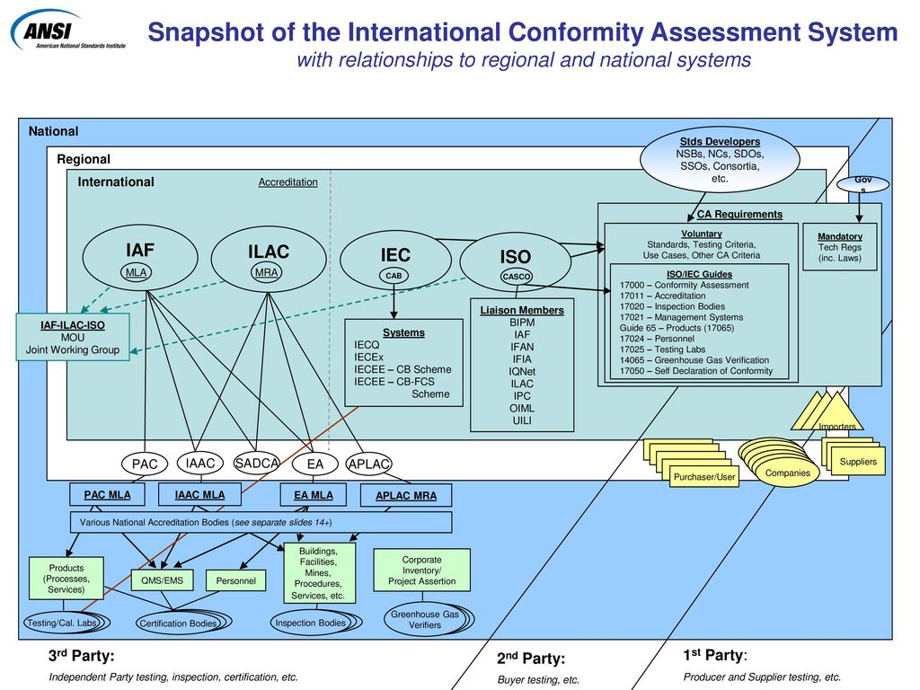
International Conformity Assessment system

Slide 9
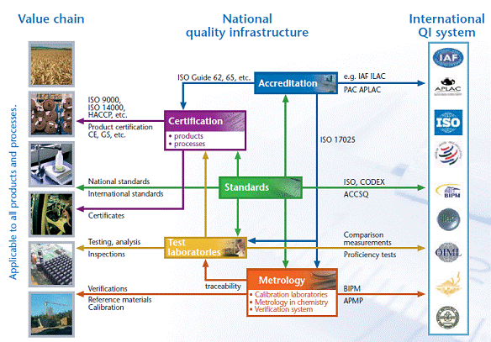
national Quality Infrastructure
Notes:
See on a more granular basis here, and the value of Quality Infrastructure

Slide 10
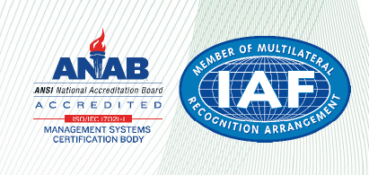
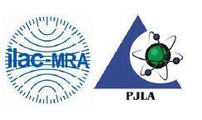
How Does TESCO Fit?
TESCO is ISO 9001:2015 certified
DEKRA – Conformity Assurance Body (CAB)
ANSI National Accreditation Board (ANAB)
Inter-American Accreditation Cooperation MLA (IAAC)
IAF
TESCO’s Laboratory is ISO/IEC 17025: 2017 Accredited
PJLA – Accreditation Body
ILAC MRA
Notes:
PJLA like A2LA, IAS, AIHA, ANAB, and NVLAP

Slide 11
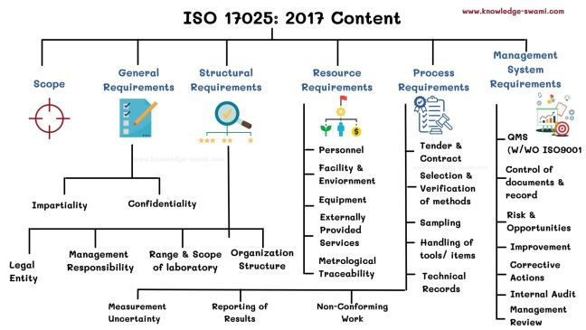
ISO/IEC 17025
ISO/IEC 17025:2017 – General requirements for the competence of testing and calibration laboratories
Repeatable, verifiable, impartial, assured, recognizable results
Hallmarks of 17025
Evaluation of Measurement Uncertainty
Selection, verification, and validation of methods
Reporting of Results
Metrological Traceability
Notes:
It is comprised of various requirements and guidelines used by laboratory customers, regulation boards, accreditation authorities, and organizations to verify, recognize, and ensure the competency, impartiality, and consistent operation of laboratories in their testing and calibration processes. The ISO/IEC 17025:2017 serves as a Quality Management System (QMS) for laboratories to improve their process of facilitating more accurate diagnostics, efficient treatment, and reduced errors in the laboratory process.

Slide 12
ISO/IEC 17025
2.41 Metrological Traceability
Notes:
As defined in the International Vocabulary of Metrology

Slide 13
Notes:
The uncertainty compounding with each step, but increasing in accuracy.

Slide 14
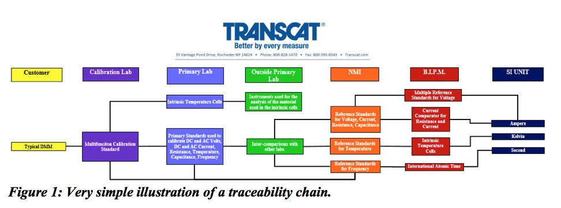
2.42 metrological traceability chain

Slide 15
Calibration Hierarchy

Slide 16
“NIST Traceability”
Why is it that the Industry requires “NIST traceability”?
NAVY
MIL-SPEC
ANSI Z540.1
Risk Mitigation
Measurement veracity
Where do I find this information?
Calibration Certificate – Traceability statement
Guaranteed on a 17025 Cal report/certificate
Look for the Logo/stamp
Traceable to the International System of Units (SI), through National Metrology Institutes e.g. NIST, NRC, NPL, etc.), via ratiometric techniques, or natural physical constants.
“Traceable to SI”

Slide 17
Comments, Questions, Discussion
Carson Scaccetti
TESCO – The Eastern Specialty Company
Laboratory Manager
Carson.Scaccetti@tescometering.com
215-228-0500 EXT 272

Slide 18
sources
https://www.unido.org/sites/default/files/2014-02/2_NMI_highres_0.pdf
https://www.iso.org/sites/JCGM/VIM/JCGM_200e_FILES/MAIN_JCGM_200e/05_e.html
https://www.nist.gov/timelinelist
https://www.ri.se/en/national-metrology-center#:~:text=National%20metrology%20institutes%20(NMIs)%20have,traceability%20for%2032%20physical%20quantities.
https://www.nist.gov/image/nist-logo-blue
https://www.nist.gov/pml/history-nist-quantum-voltage-standards/1980s-history-nist-quantum-voltage-standards
https://www.nist.gov/about-nist
https://safetyculture.com/topics/iso-17025/

Slide 19
sources
https://share.ansi.org/Shared%20Documents/Standards%20Activities/International%20Standardization/Standards%20Alliance/Handbook/StandardsAlliance-Handbook-2022-SECTION1.pdf
https://www.bipm.org/documents/20126/2071204/JCGM_100_2008_E.pdf
https://iaf.nu/en/about-iaf-mla/
https://en.wikipedia.org/wiki/Metre_Convention
https://www.oiml.org/en/about/mou/ilac-iaf
https://www.iso.org/about-us.html#:~:text=SI%20%2D%20International%20System%20of%20Units&text=In%201960%2C%20ISO%20publishes%20the,and%20the%20second%20for%20time
https://anab.ansi.org/about-anab/faq#:~:text=ANAB%20is%20a%20signatory%20of,Pacific%20Accreditation%20Cooperation%20(APAC)
https://www.researchgate.net/figure/A-metrological-traceability-chain-of-measurement-results-in-a-medical-laboratory-test_fig2_303289783

