Slide 1
New Products Intro and Feedback
TESCOOL 2023

Slide 2
New Products Intro and Feedback
A few new items released since our last User’s Group:
  Rogowski Coil extension cable – allows for greater distance from 6330 to line side current connections.
  Potential Blade covers – used to make test switch potential blades safe when opened.
  Cat 703 Transformer Upgrade – Upgraded accuracy and reduced size of streetlight meter transformer-rated assembly
  Heat Rise Tester Socket (for ANSI) – requested by ANSI to have TESCO build them a custom socket for heat rise testing.
  1039 PCB updates for better pickup strength

Slide 3
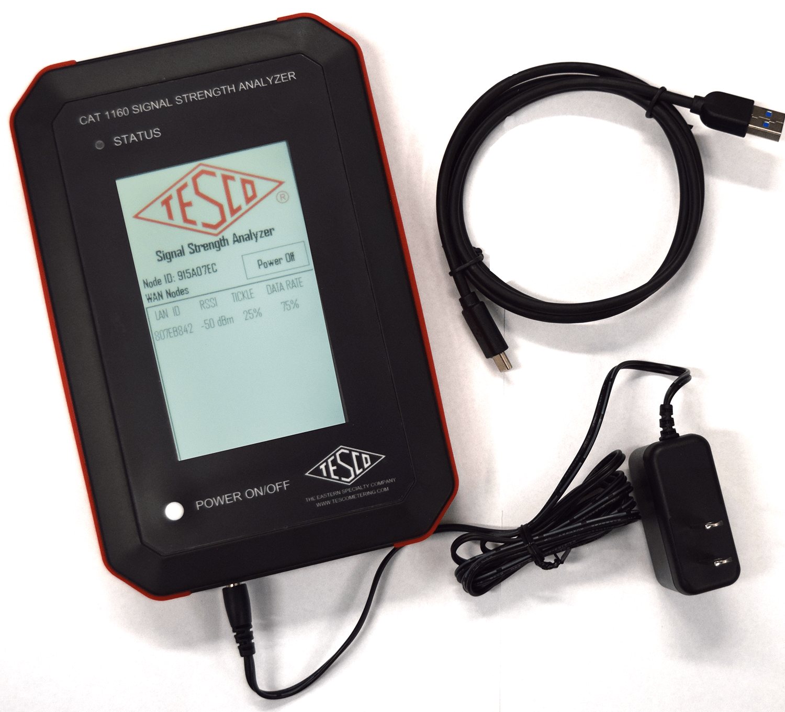
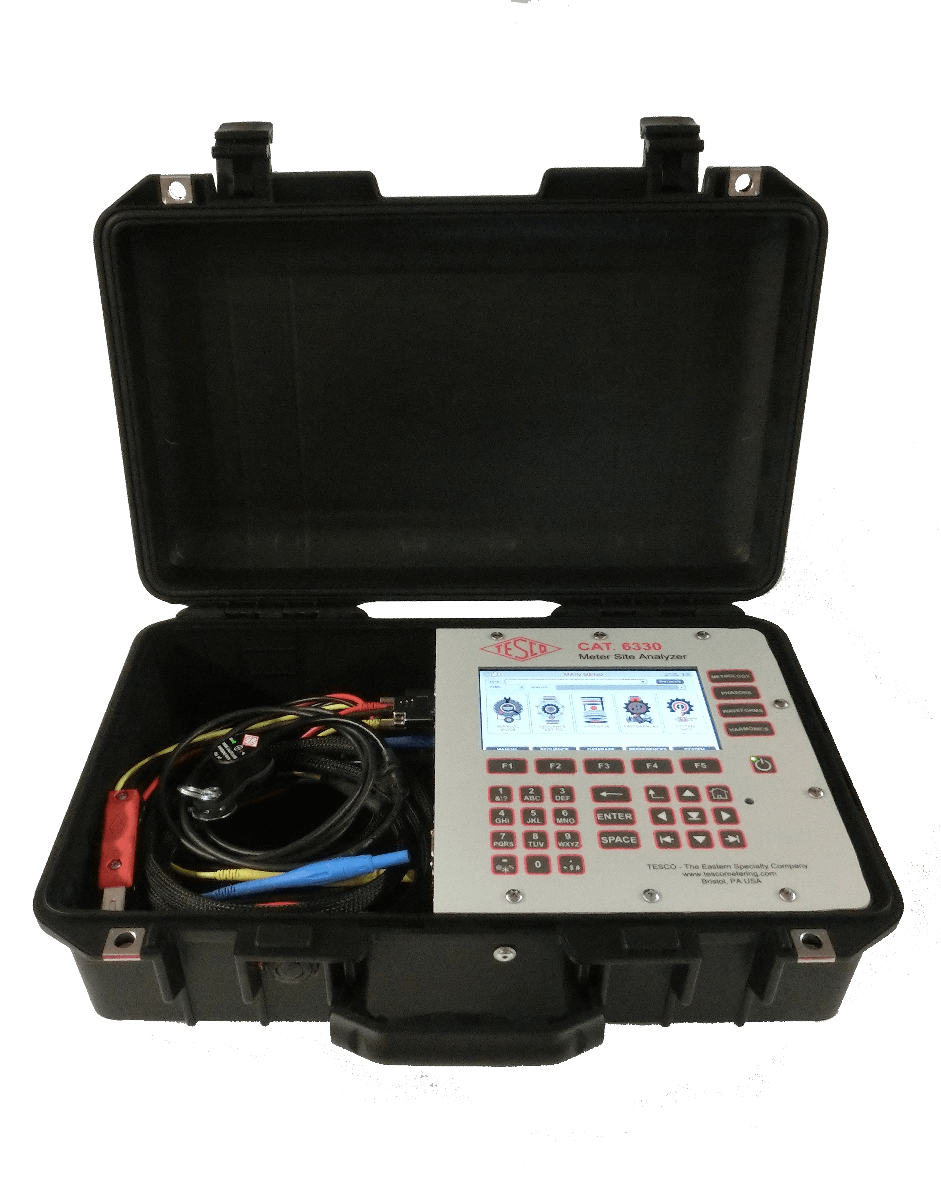
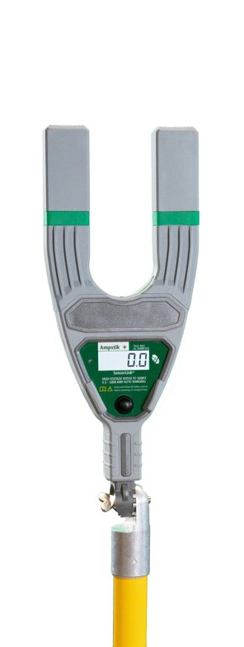
New Products Intro and Feedback
A few new items released since our last User’s Group:
Catalog #1160 Signal Strength Analyzer:
Catalog #802 Sensor Link Probe Pairing with the Catalog #6330 Meter Site Analyzer

Slide 4
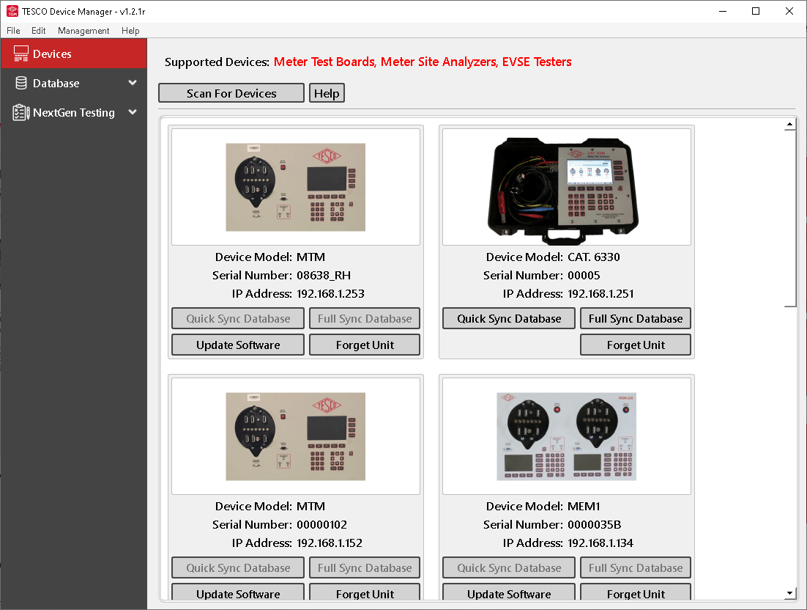
New Products Intro and Feedback
A few new items released since our last User’s Group:
TESCO 8, 10 and 13 Jaw sockets:
TESCO TDM Software:

Slide 5
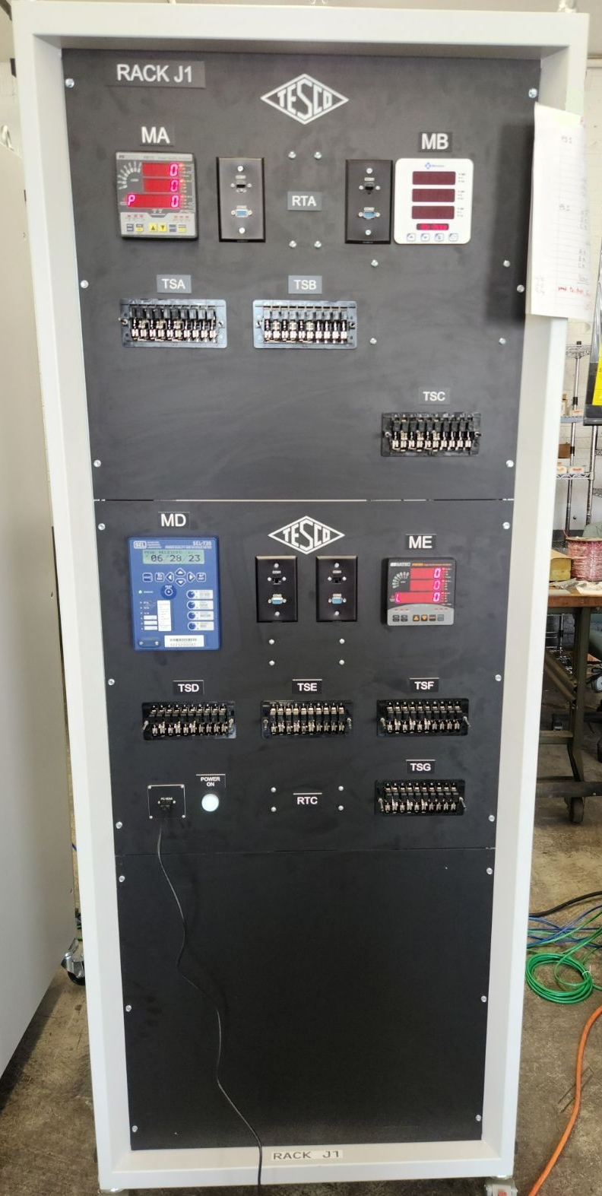
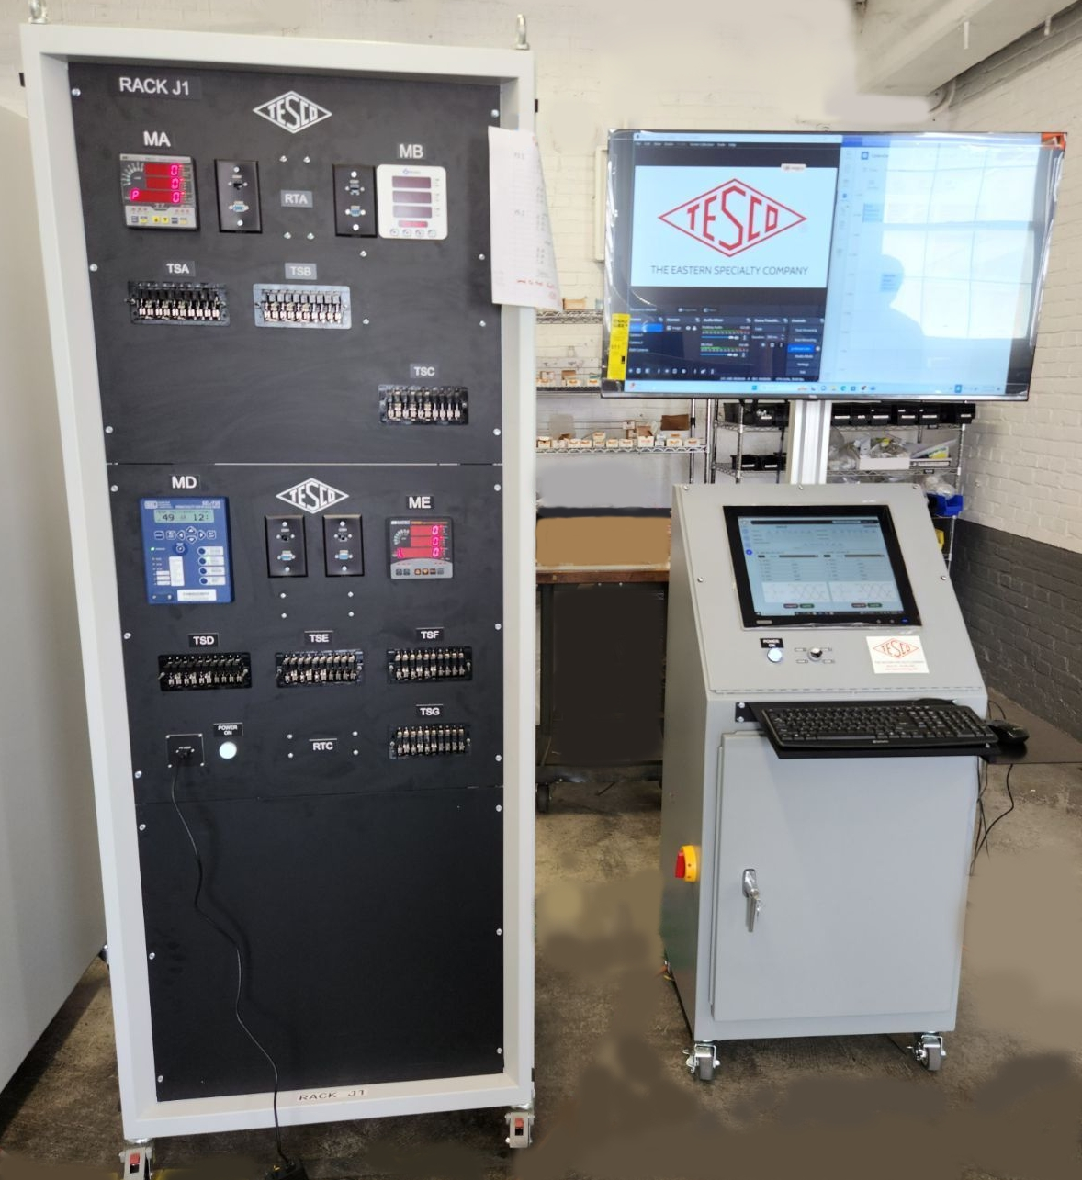
New Products Intro and Feedback
A few new items released since our last User’s Group:
Substation Training Room:

Slide 6
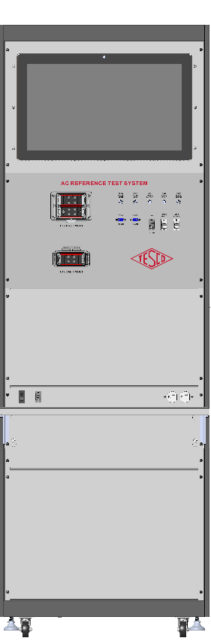
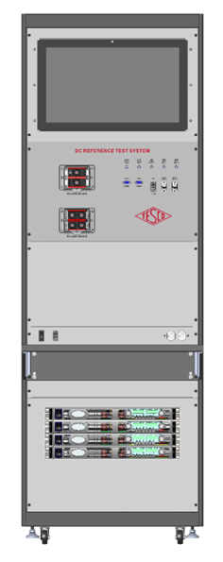
Products scheduled for Release 2023/2024
What we are working on for 2024:
ACT100/DCT 300 Laboratory AC/DC EVSE Test System:
This system will enable the testing and accuracy verification of both AC and DC Electric Vehicle Service Equipment and Field Test Equipment for testing EVSE’s in the field. The system will be rated for 0.04% accuracy for power, and 0.02% for voltage and current.

Slide 7
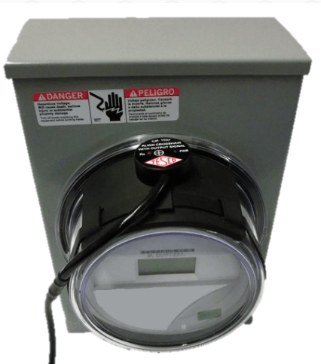
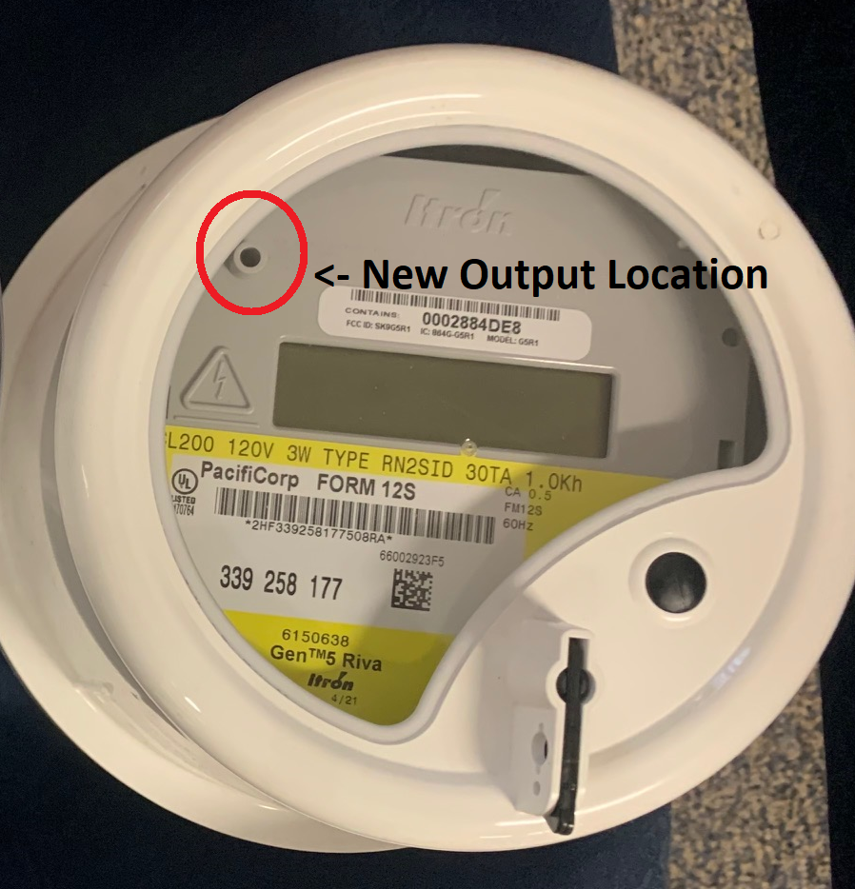
Products scheduled for Release 2023/2024
What we are working on for 2024:
Itron Meter Optical Probe and Pick-up to allow for use of the new optical port location on new Itron Riva Meters

Slide 8
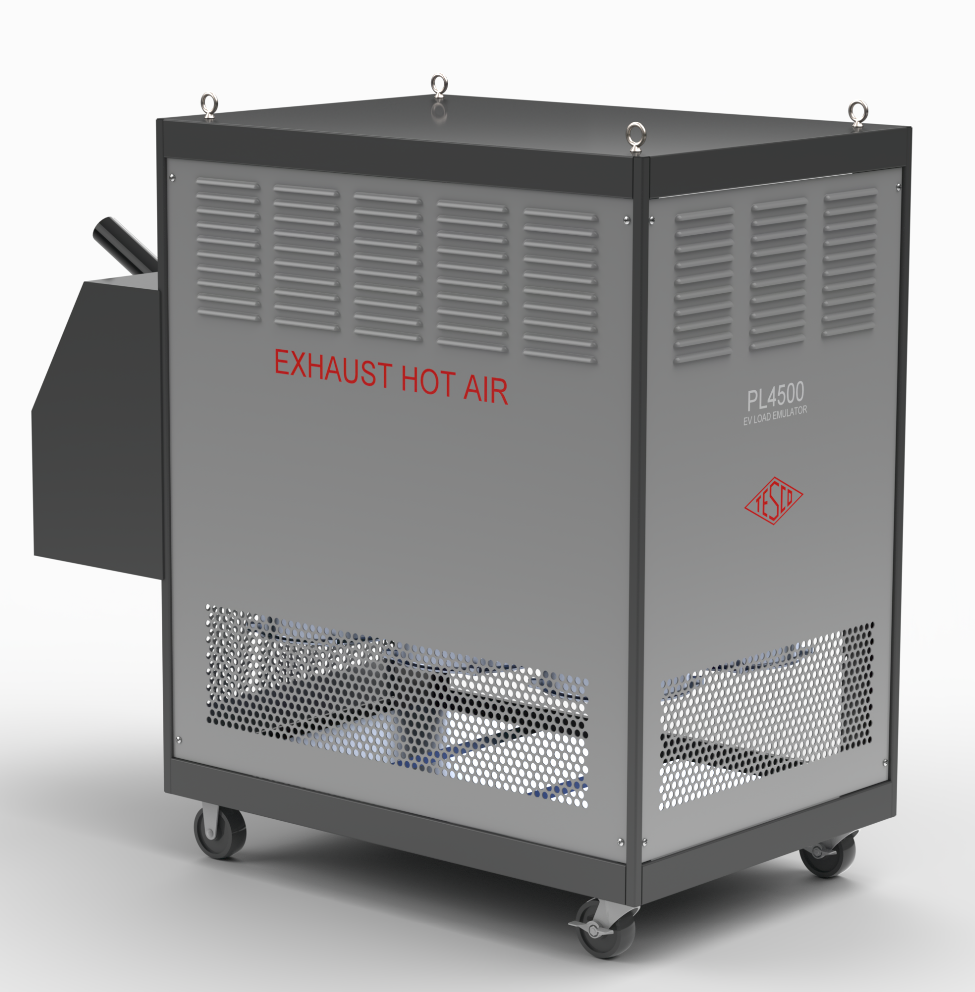

Products scheduled for Release 2023/2024
What we are working on for 2024:
EVSE Higher Amperage DC Charger Testing Capability:
Catalog #T4300 to enable testing of DC Chargers up to 300A
Catalog #MiTM-300- 300 Amp capable Man-in-the-Middle Cable for use between the T4300, DC charging station and electric vehicle.
Catalog #PL4300 DC Load Box for use in back of Weights and Measures Truck capable of testing up to 150KW with ramp loading that will work at 400V and 800V.

Slide 9

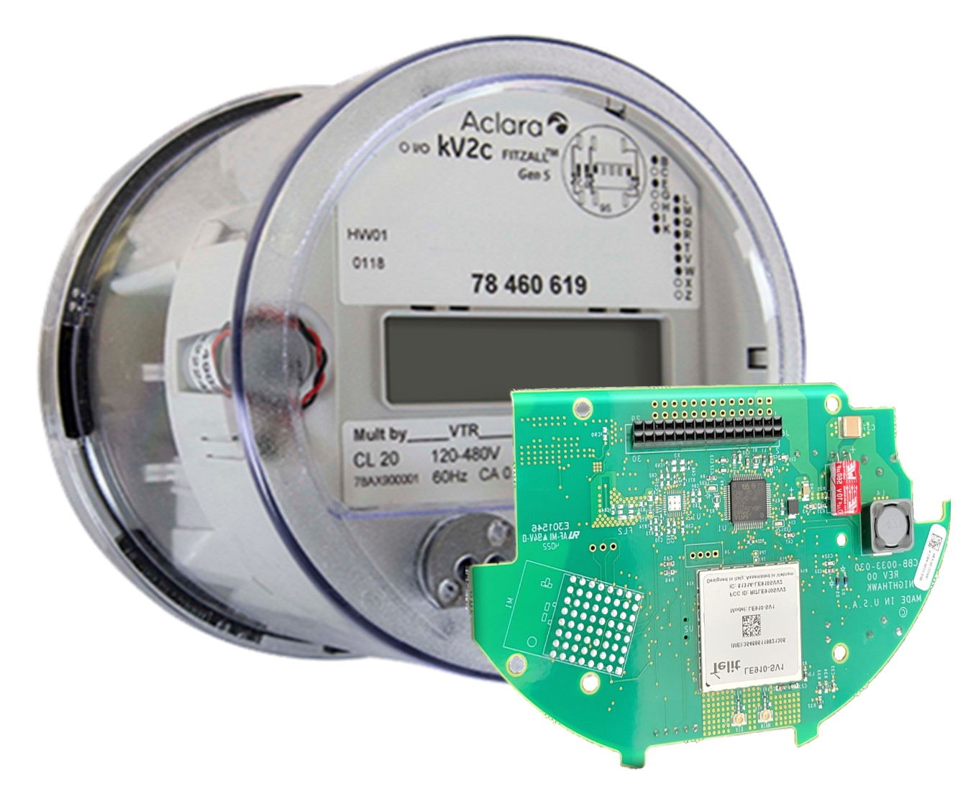
Products scheduled for Release 2023/2024
What we are working on for 2024:
Nighthawk MV-90 Solution:
Connects directly with Itron MV-90, Aclara MeterMate, Trilliant PrimeRead, or Trilliant UnitySuite data acquisition software
Robust, secure, and efficient bidirectional message delivery mechanism
Utilizes same proven LTE hardware as Adaptiv HUB solutions
Does not require any middleware – DirectConnect to MV-90 (or other host)
No recurring fees from Nighthawk. Utility should have its own private contract with AT&T or Verizon

Slide 10
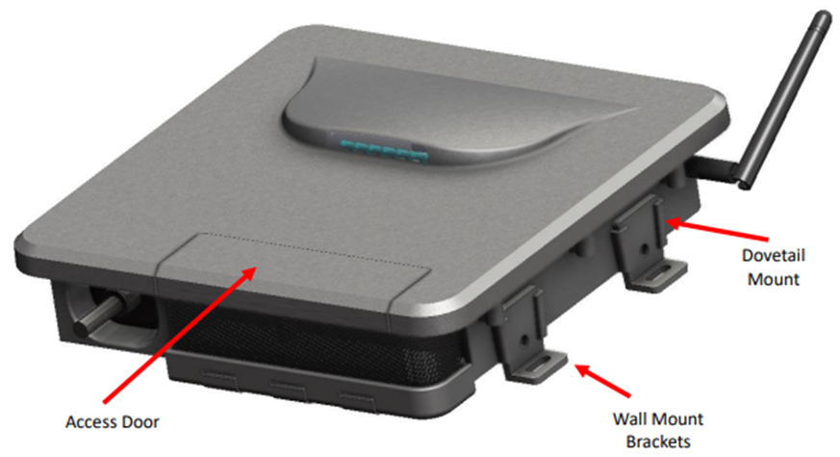
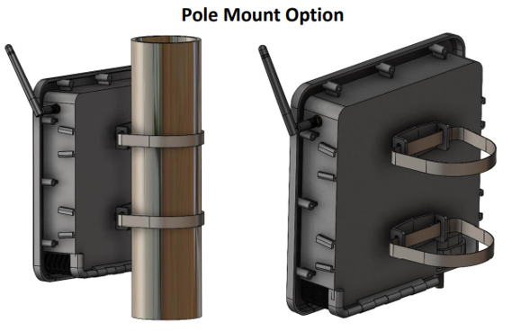
Products scheduled for Release 2023/2024
What we are working on for 2024:
Nighthawk Fiber Hub:
The Nighthawk Fiber HUB product is a self-contained mesh HUB device with a wired Ethernet uplink.
  Fiber hub is Adaptiv compatible
  Acts as a cost-effective collector for multiple devices
Ideal for utilities who have mostly fiber throughout service territory
  Federal government incentivizing rural co-op fiber to the home
  Utilities looking for applications to use the deployed fiber
Advanced Outage Management power fail detection
  Configurable blink and sustained outage event thresholds, event logging and data upload
Rechargeable Battery Backup of 10 minutes to allow for last gasp transmissions
Supports OTA firmware upgrades to associated mesh devices
Robust end to end security and encryption

Slide 11
Products scheduled for Release 2023/2024
What we are working on for 2024:
Pacific Gas & Electric New 30A Back Up Power Transfer Meter Design:
Requirement for the user to shut off the main disconnect to the house is now eliminated.
Requirement for the user to unplug the generator is removed.
More robust voltage sensing.
Increased the robustness of the disconnect contact sensing.
Increased power for the disconnect motor drive to enable the BPTM to overcome sticky motor shafts with greater ease as well as to allow it to be used with Aclara meters with relay disconnects.

Slide 12

Products scheduled for Release 2023/2024
Suggestions from the group other items needed for the marketplace?

