Slide 1
Shedding a Light on Streetlight Meter Testing
July 11, 2023
2:00 PM – 2:45 PM
John Williams

Slide 2
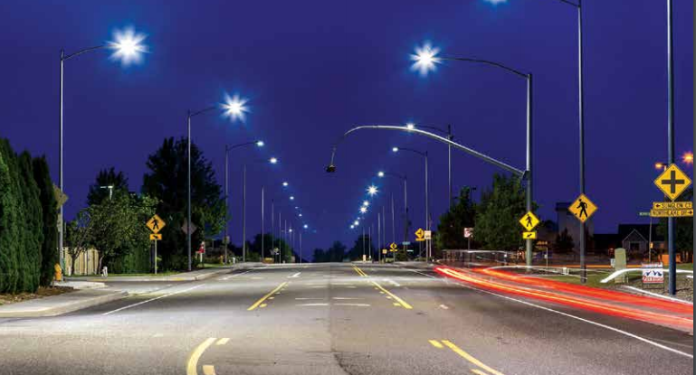
Introduction
This presentation will discuss the current usages and challenges for streetlight metering and the latest in testing/qualification of streetlight meters.
Photos: Acuity Brands Lighting

Slide 3
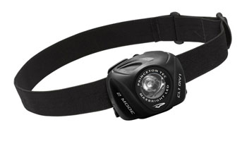
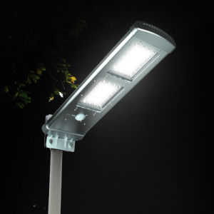
Streetlight Metering—Why change?
LED’s
LED’s have swept through one industry after another over the past twenty five years. Once LED’s are developed for a particular application they take over that industry in just a few years

Slide 4
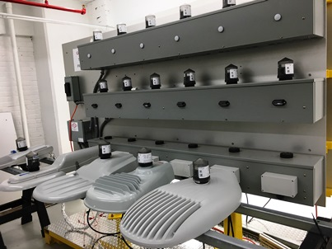
LED’s Start to Take Over
A Better Solution
Better lighting of the pavement surface
Light is better directed so there is less light pollution
Less maintenance
Longer Life
Less energy consumed
Ability to control the lighting load by individual light or bank for
  more suitable use given the location and time of day
  emergency situations

Slide 5
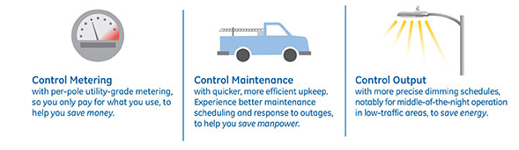
Streetlight Metering—Intelligent Lighting
Streetlight controls:
  Standard photocell operation
  Advanced controls for holiday lighting, billboards, etc.
  Remote mesh network communications
  Scheduling and dimming (LED Lighting)
Graphic: GE lighting

Slide 6
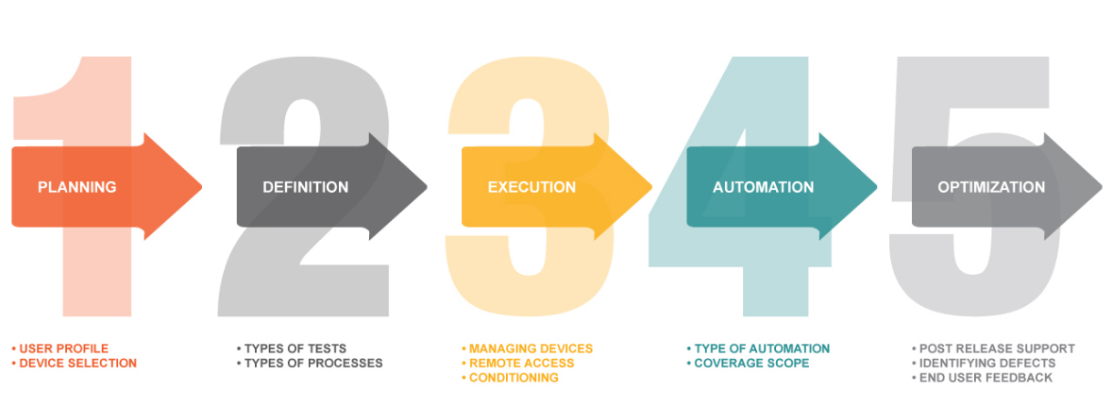
Streetlight Metering—Intelligent Lighting
Integration of metrology into streetlighting…
Graphic: 360Logica.com

Slide 7

Streetlight Metering—Intelligent Lighting
Integration of metrology into streetlighting
  Metrology (metering function) integration into “nodes”
  Combining metrology with remote access gives utilities access to information that they may never have had before.
    Read voltage, current and power factor from each node.
    Determine changes in lighting element faults and poor operation.
    This information can be used to determine lighting outages (and dispatch a service truck automatically).
    Can be used to monitor general outages like
    residential meters are now.

Slide 8

Streetlight Metering—Intelligent Lighting
Energy metering today:
  .5%, 1%, and 2% metering capabilities are now being quoted
  Qualification and validation documentation very sparse.
  No complete ANSI regulation to guide qualification testing, though a committee has formed and a spec is being developed (C136.50)

Slide 9

Streetlight Metering—Intelligent Lighting
Energy metering today:
  Without the type of qualification testing that metering groups are used to doing prior to rollout of new vendor equipment or technology, billing usage for these nodes has been rare.

Slide 10

Streetlight Metering—Intelligent Lighting
Using metrology to do energy metering
  A utility may want to test the accuracy of the nodes and work with local municipalities to determine whether the variance in billing due to metering accuracy could still provide better consistency and more accurate billing than current fixed billing algorithms can provide.

Slide 11
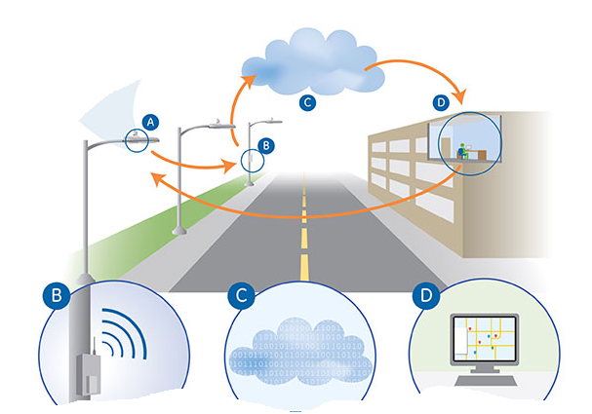
Streetlight Metering—Applications
Applications
  Single streetlight meter
  Group of single streetlight meters
  Meter for a group of streetlights
  Meter for any pole mounted device

Slide 12
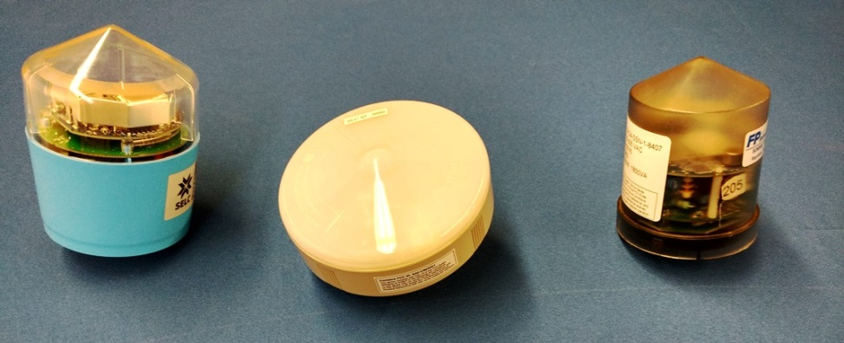
Streetlight Metering—Challenges
Testing Challenges
  Meter test pulse
    Without this pulse, most nodes only report whole watthours through their communications radios. Testing requires 10,000 Wh (in order to get 5 significant digits – 100.00%). 10,000 Wh at 120V and .25A (typical Light Load value) would take 320 hours
  C136.50 is now requiring a pulse for every street light “meter”. Testing can now be done in “conventional” time periods.

Slide 13
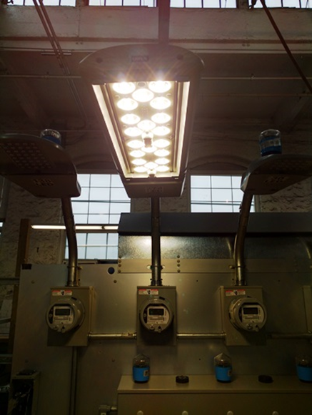
Streetlight Metering—Challenges
Testing Challenges
  Meter setups
    The setup on each node must be checked to make
    sure that it is not setup to do any scheduled
    dimming, or scheduled on/off control, so that
    the output relay remains on during the testing.
    After testing is complete, the setups should
    be returned to the factory settings before
    releasing the node.
  Working to introduce to C136.50 the
  concept of test modes for street light meters.

Slide 14

Streetlight Metering—Challenges
Testing Challenges
  Functional / Communication testing
    This testing is going to be quite similar to standard revenue meters, as the communications networks used are either the same, or similar to what you are used to.
    One difference would be that if the utility is using scheduled on/off/dimming, that program will have to be setup or downloaded to the node before releasing for installation.

Slide 15

Streetlight Metering—Challenges
Testing Challenges
  Conclusions
    A Test Mode will make testing of streetlight meters easier and more consistent to perform in a meter shop environment.
    The testing will all be more equitable for all manufacturers and users once the ANSI specification is released.
    Relevant testing both for accuracy and functionality can still be done in light of the above; it will just take longer and could be somewhat subjective

Slide 16
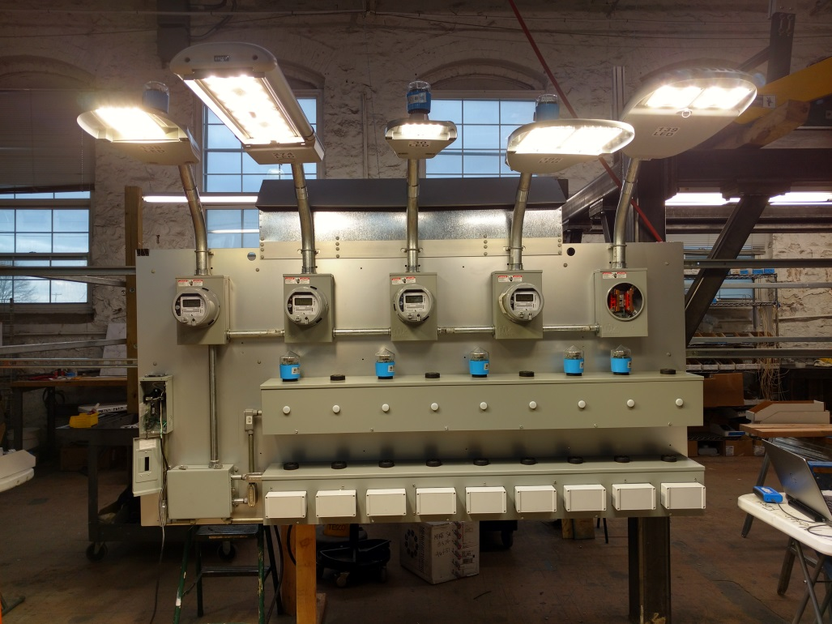
Streetlight Metering—Tests Required
Tests:
Manufacturer product
evaluation testing
Accuracy testing
Functional testing
Qualification testing

Slide 17
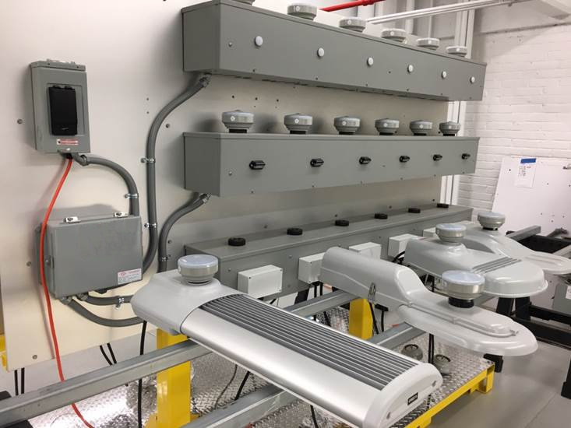
Streetlight Metering in the Meter Shop
Equipment Needed:
Test Boards
Mounting sockets
Transformer Rated applications
Field Test Equipment
Meter Farms
Meter Socket Adapters

Slide 18
Negative Business Case or Business Opportunity?
A large investment by Electric Utilities for less revenue
When the market place wants something there is no wisdom in trying to hold back the flood gates. Embrace and figure out how to not only survive but to thrive.
Smart Poles
Additional Lighting
Controls for the Lighting
Potential new products for Industrial Customers
Potential new products for residential customers
…..but also an investment in future Business Opportunities

Slide 19
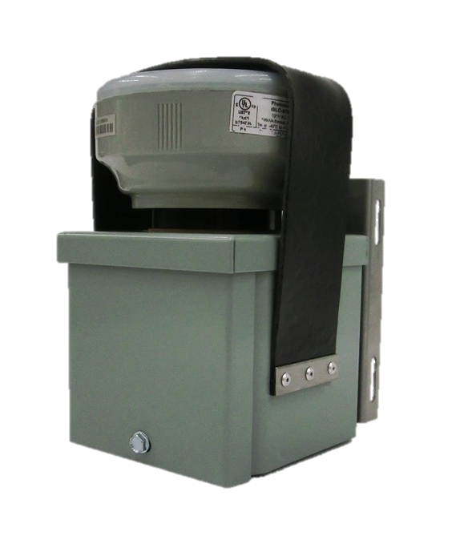
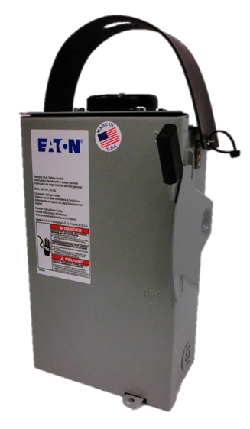
Transformer-Rated SmartPole
Meter and SmartPole Disconnect Box
701 and 702
TESCO’s SmartPole Meter Boxes use a 3-pin adapter and are approved for use with overhead services connected to powered pole attachments whether they be internally or externally mounted.
TESCO’s SmartPole Meter Box, Cat. 701, is designed for smart meters and can be strapped to either a wood or metal pole with the included pole strap kit. The smart meter (not included) is secured to the box with a meter seal lockable strap and is rated for up to 5A self-contained operation.
TESCO’s SmartPole Meter Disconnect Box, Cat. 702, combines the required fused disconnect switch along with the same socket and lockable security strap as the Cat. 701.
Cat. 701 (left) and Cat. 702 (right)

Slide 20
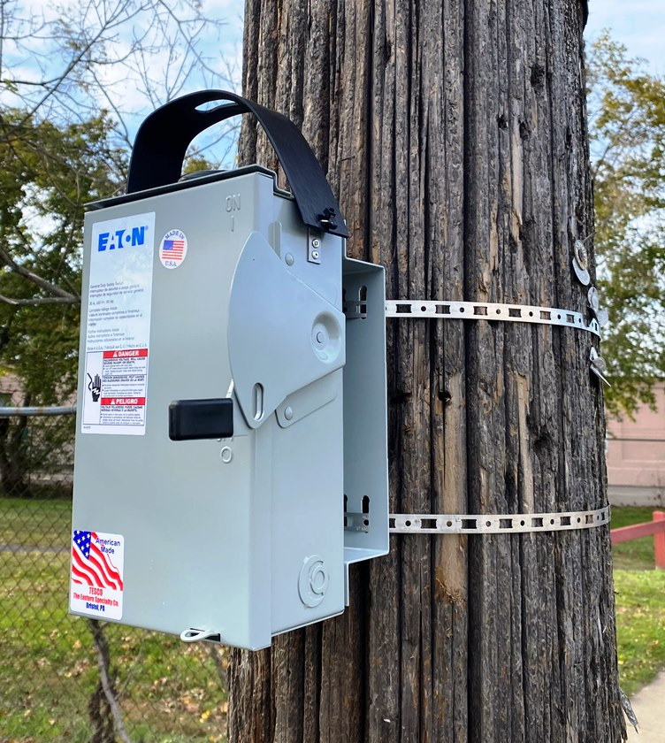
Pole Brackets
702-PB & 703-PB
How do you install an ANSI C136.41 socket based meter to your streetlight pole? TESCO’s Universal SmartPole Meter Boxes are the approved method to install an ANSI C136.41 socket-based meter to your streetlight pole. These SmartPole Meter Boxes can mount streetlight meters, meter telecommunication devices, or meters for any other pole-mounted services using Cat. 702-PB and 703-PB Pole Mounting Brackets.
TESCO’s new Pole Mounting Brackets make it easier to mount the Cat. 702 SmartPole Meter Disconnect Box and the Cat. 703 Transformer-Rated SmartPole Meter Disconnect Box to a streetlight pole.
The Cat. 702-PB pairs with the Cat. 702, and the Cat. 703-PB pairs with the Cat. 703.

Slide 21
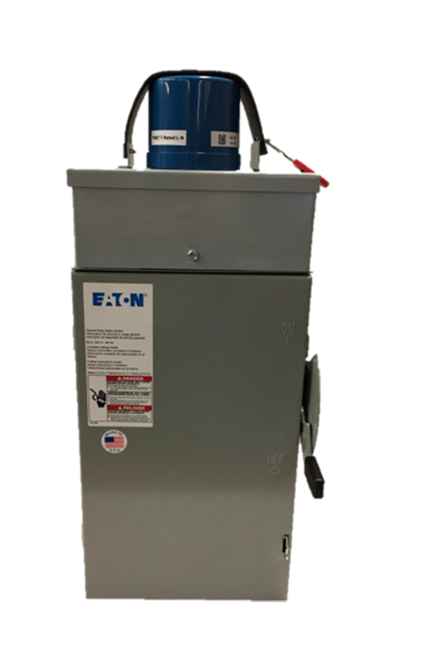
Transformer-Rated SmartPole
Meter Disconnect Box
703
With 5G deployment, communication providers are putting larger and larger new services on utility poles that need to be metered. TESCO’s Cat. 703 Transformer-Rated SmartPole Meter Disconnect Box provides the mounting infrastructure to meter these services.
TESCO’s Transformer-Rated SmartPole Meter Disconnect Box has been created to mount communications provider equipment and node meters on a utility pole.
This meter assembly contains a 100:5 CT and is designed for smart meters and can be strapped to either a wood or metal pole. The smart meter (not included) can be secured to the box with a standard meter box seal.
This assembly is for use with meters rated up to 5A.
Current up to 60A (fuses supplied by customer)
Cat. 703-120 for 120V 2-Wire Single Phase Applications
Cat. 703-240 for 240V 2-Wire Single Phase Applications
Cat. 703 with smart meter (not included)

Slide 22

Questions and Discussion
John Williams
Vice President of Engineering
TESCO Metering
Bristol, PA
215.228.0500
This presentation can also be found under Meter Conferences and Schools on the TESCO website: tescometering.com
ISO 9001:2015 Certified Quality Company
ISO 17025:2017 Accredited Laboratory

