Slide 1
Predictive Maintenance and AI
An Introduction
July 12, 2023
9(:00 AM – 10:00 AM
James Tramel

Slide 2
Agenda
Introduction
History and Statistics
  High level – what matters and why
Analytics
  Rationalizing and Presenting data
  Understanding vs Testing
Machine Learning
  Cloud and compute
  Data engineering and Data science
Predictions and Decisions
  Injecting change
  Assumptions and forecasting
AI
  Automation
  Generative
Predicative Maintenance
  Fault tolerance
What’s next
Notes:
Introduction - 5
History and Statistics - 5
High level – what matters and why
Analytics - 5
Rationalizing and Presenting data
Understanding vs Testing
Machine Learning - 5
Cloud and compute
Data engineering and Data science
Predictions and Decisions - 5
Injecting change
Assumptions and forecasting
AI- 10
Automation
Generative
Predicative Maintenance - 10
Value at Risk
Fault tolerance
What’s next - 5

Slide 3
James Tramel
NYU Stern – Master’s in Risk Management
Microsoft – 8 years – Developer Division
  Visual Studio / VS code / .NET / Js / Python / Java / GitHub / Azure DevOps / Azure App Services
  GitHub Code spaces / Playwright / Azure Load Testing
  Intellicode / Co-Pilot / Developer AI
Campbell’s Soup
Consulting
  Web, CRM, ERP, WCM, NextGen, Cloud, Apps, Mobile
Philosophy / Psychology - Bachelors
Neuroscience PhD dropout

Slide 4

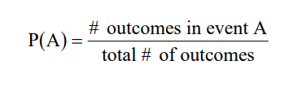
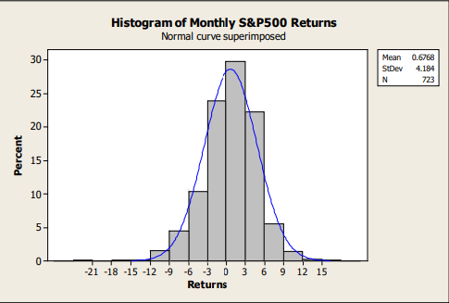
History and Statistics
Average, mean, mode, median
Do this a lot = long run frequency
Normal distribution
Kurtosis
Notes:
This Photo by Unknown Author is licensed under CC BY-SA

Slide 5
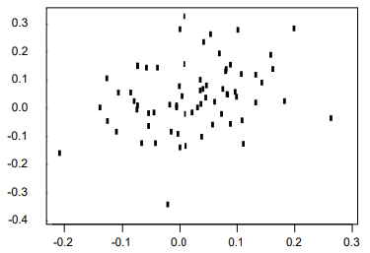
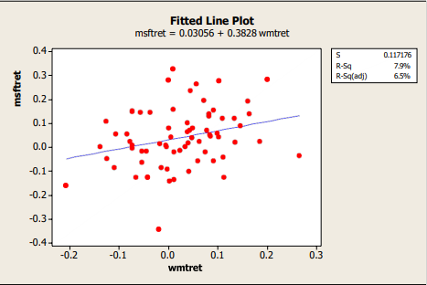
Statitics
Regression / Best fit / Copulas
ANOVA
MANOVA

Slide 6
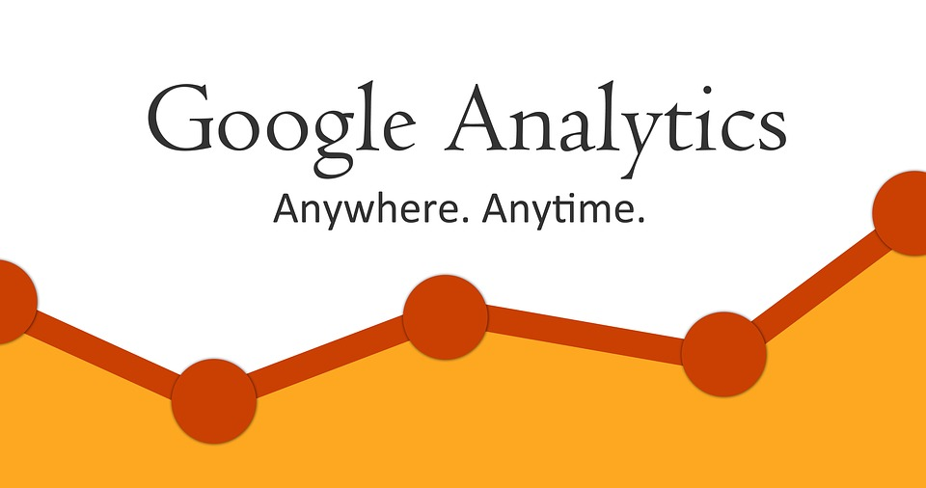
Analytics
Discovery, interpretation, and communication of meaningful patterns in data
Hypothesis testing, null hypotheses
Excel, PowerBI - demo

Slide 7

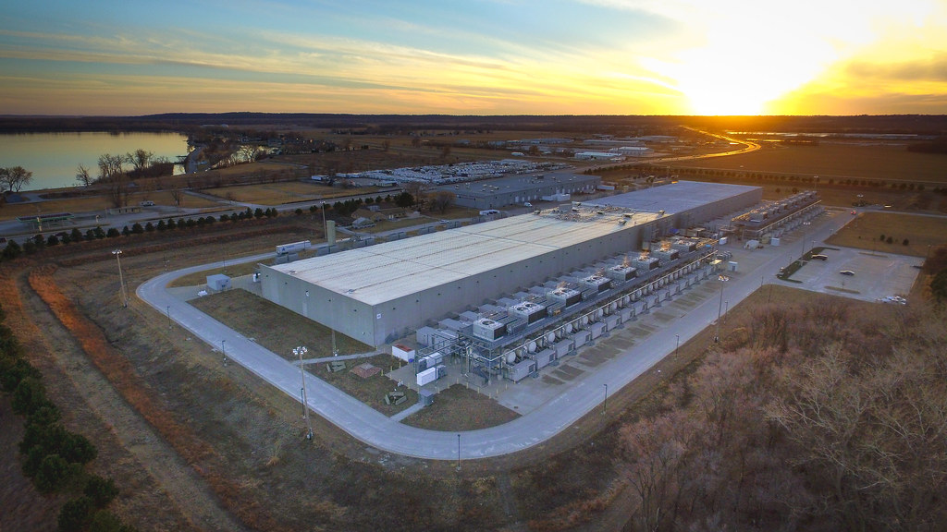
Machine Learning
Cloud and Compute
  CPU, GPU, Quantum

Slide 8
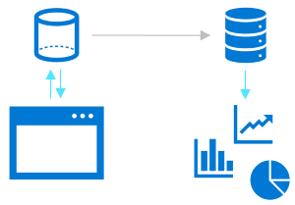
Data Engineering and Data Science
Data Engineering
  Structure, semi-structure, unstructured data
  Integration, consolidation,cleansing transformation
  Operational and analytical data, streaming data, live data
  Data pipelines, data lakes, data warehouses

Slide 9
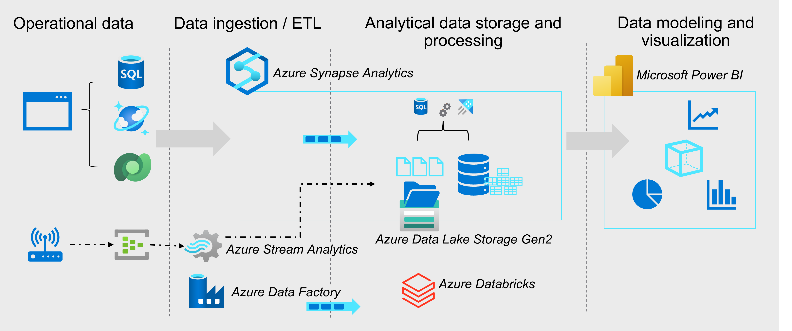
Data Engineering

Slide 10



Data Science

Slide 11
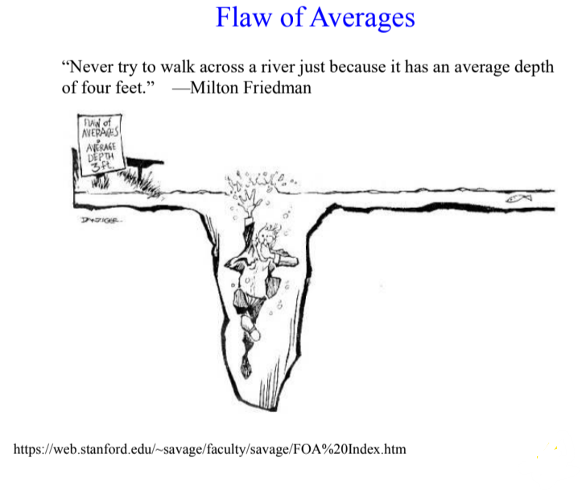
Predictions and Decisons

Slide 12
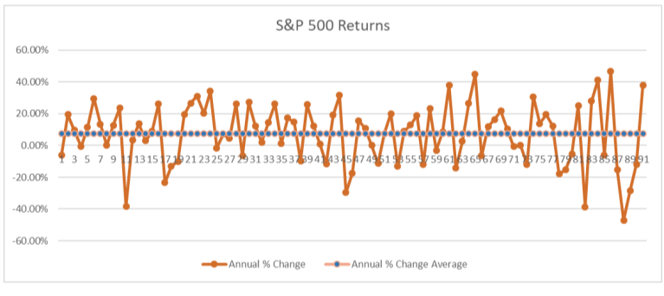
Randomness and Chance

Slide 13
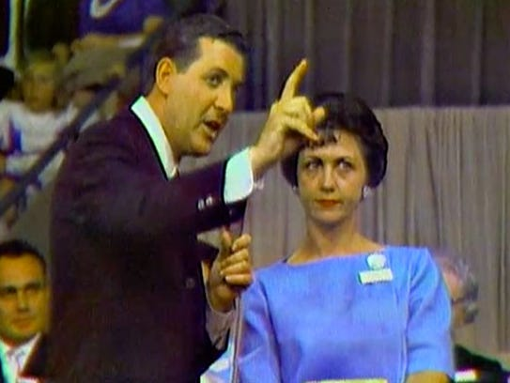
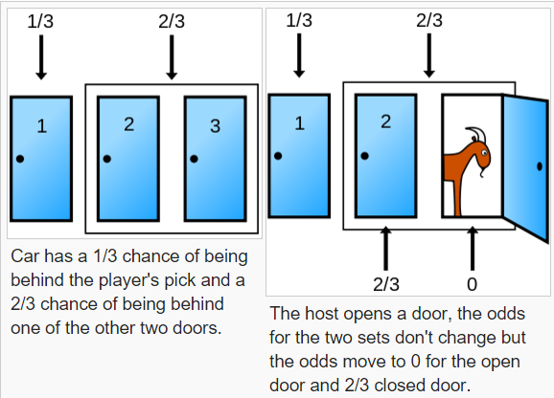
Monty Hall
Notes:
Suppose you're on a game show, and you're given the choice of three doors: Behind one door is a car; behind the others, goats. You pick a door, say No. 1, and the host, who knows what's behind the doors, opens another door, say No. 3, which has a goat. He then says to you, "Do you want to pick door No. 2?" Is it to your advantage to switch your choice?

Slide 14
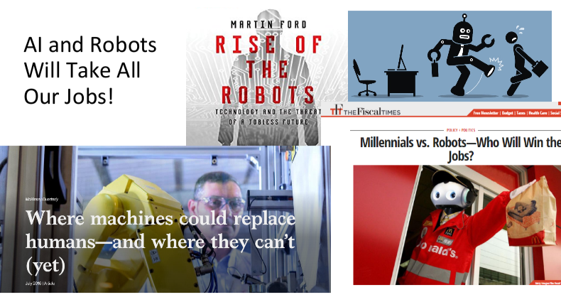
Artificial Intelligence

Slide 15
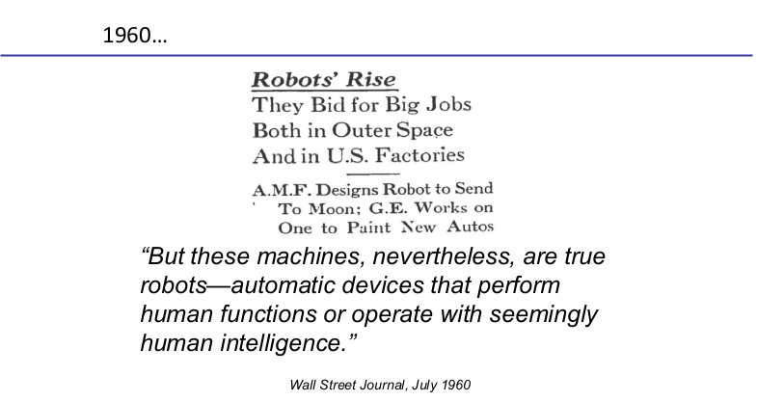
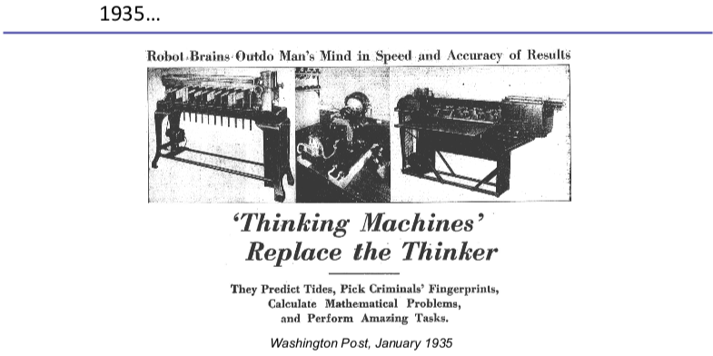
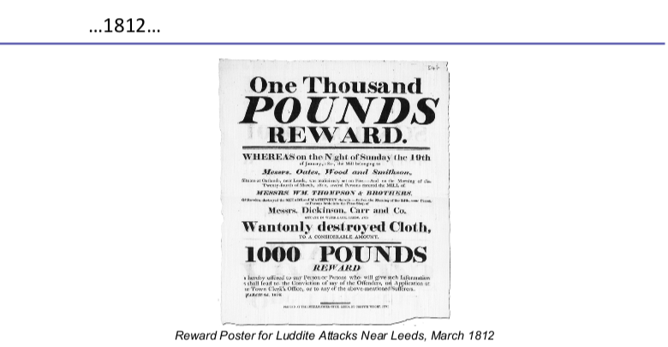

Slide 16
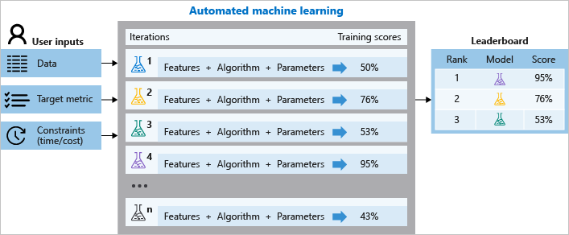
Automated

Slide 17
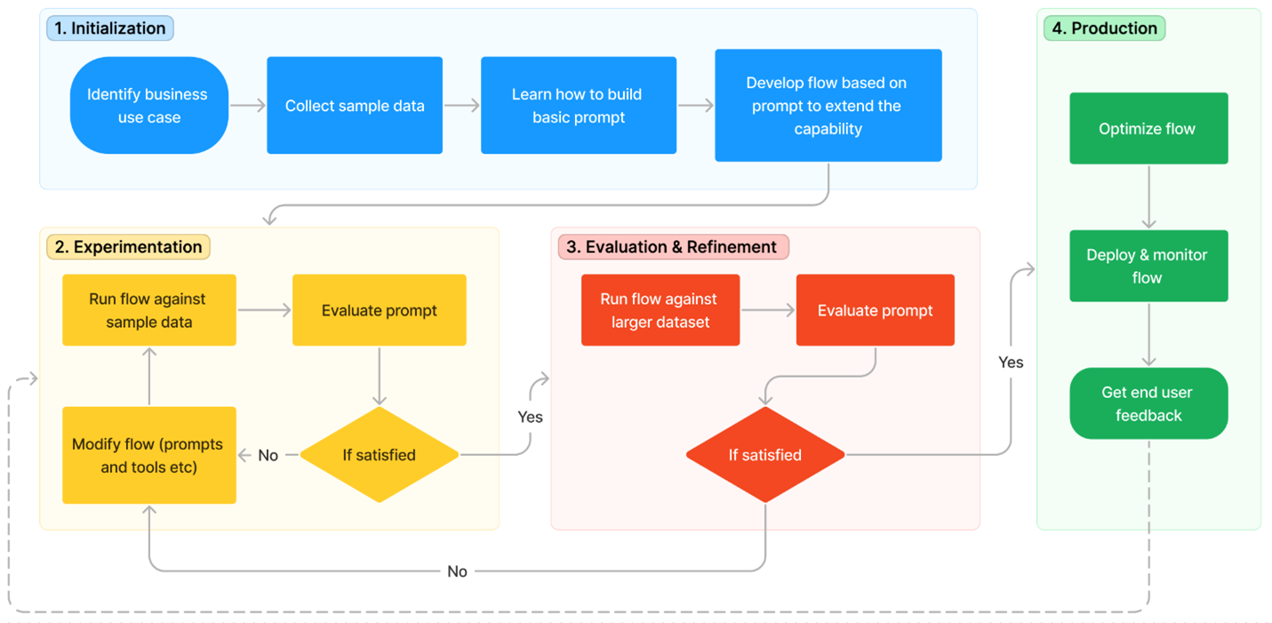
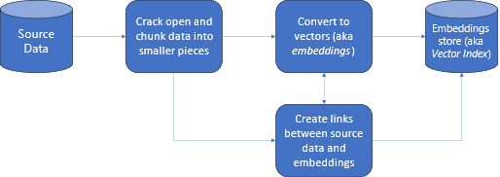
Generated
Large Language Models
Retrieval Augmented Generation (RAG)

Slide 18
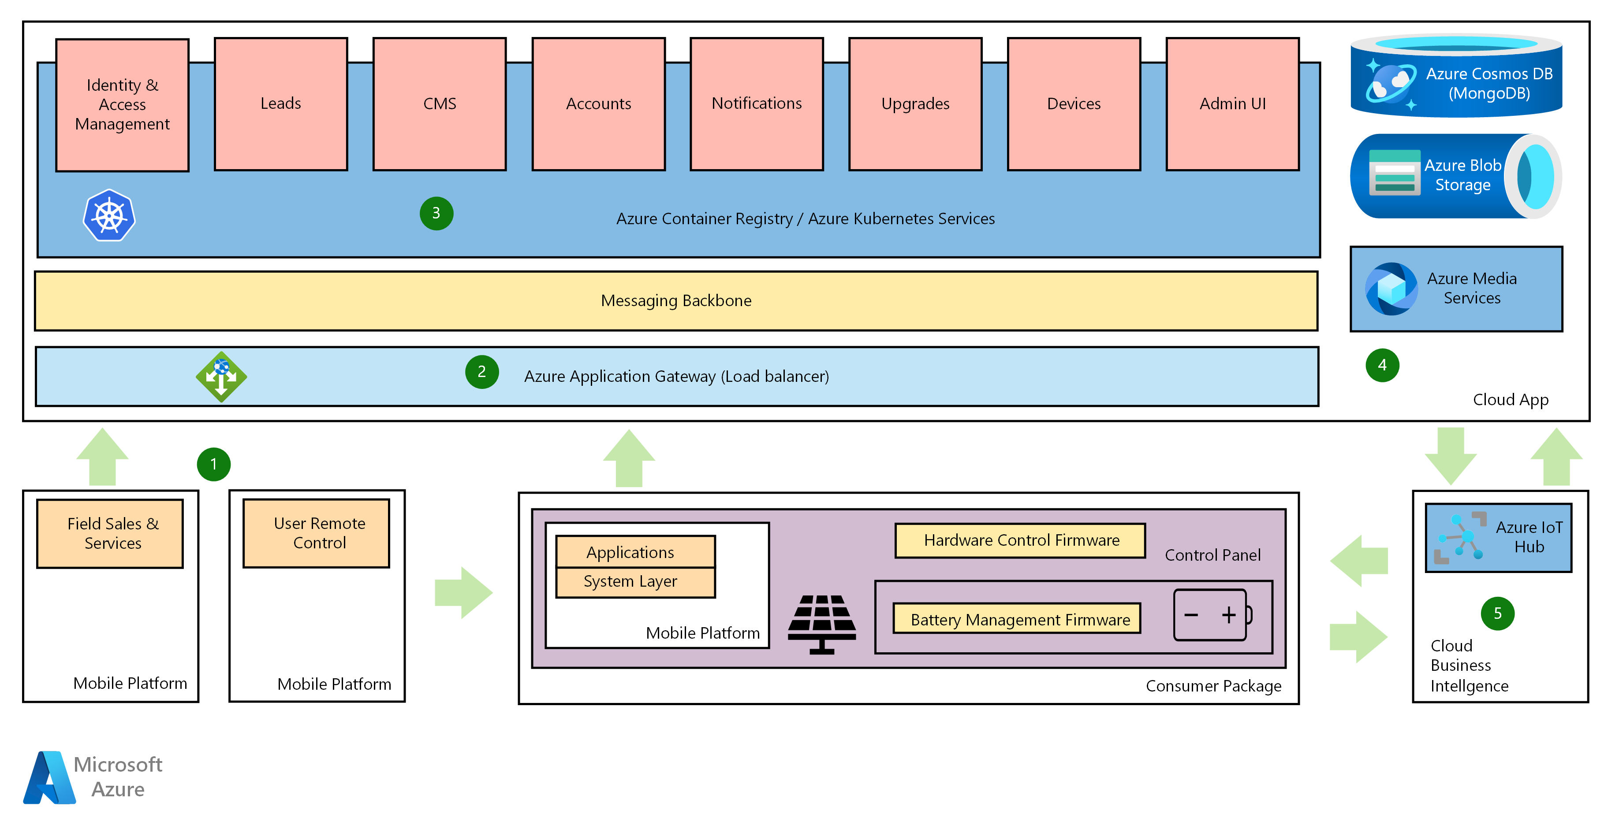
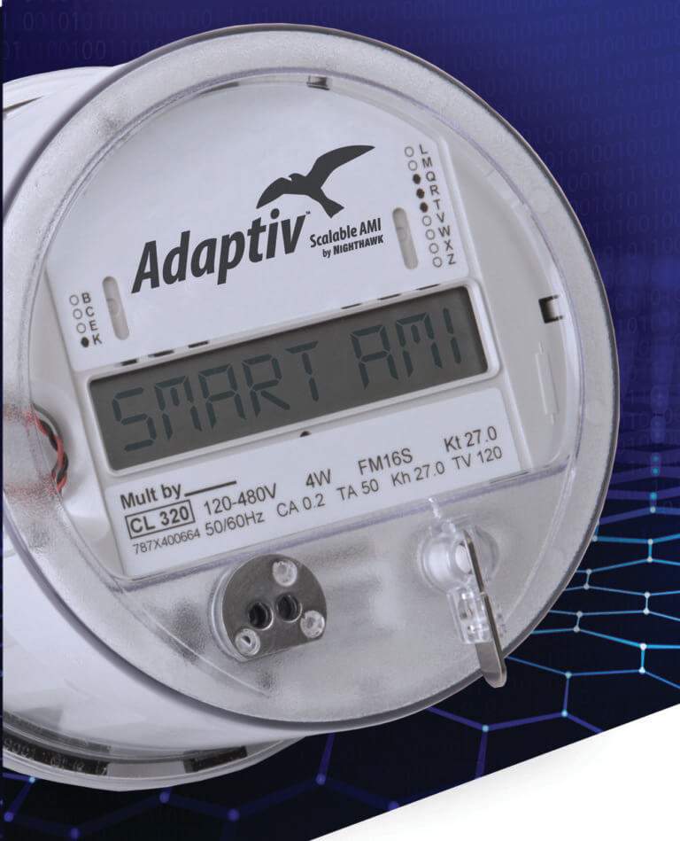
Predictive Maintainence

Slide 19
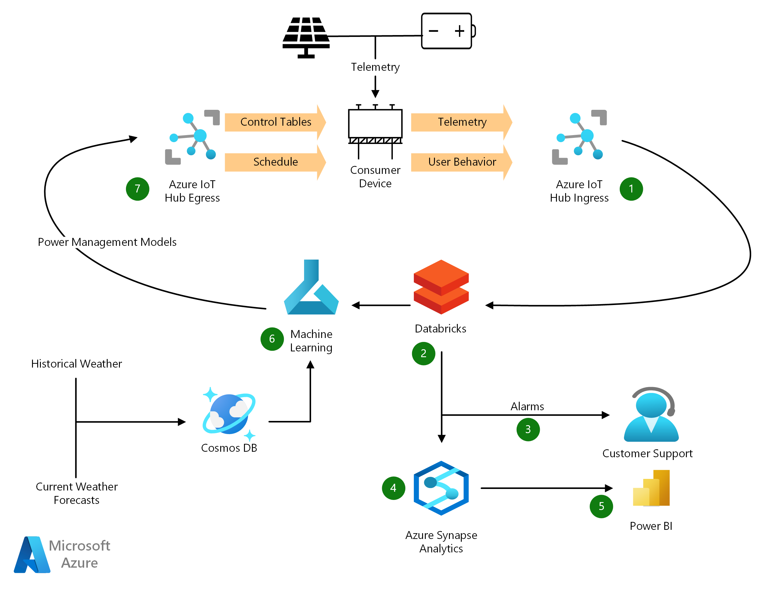
Predictive Maintainence

Slide 20
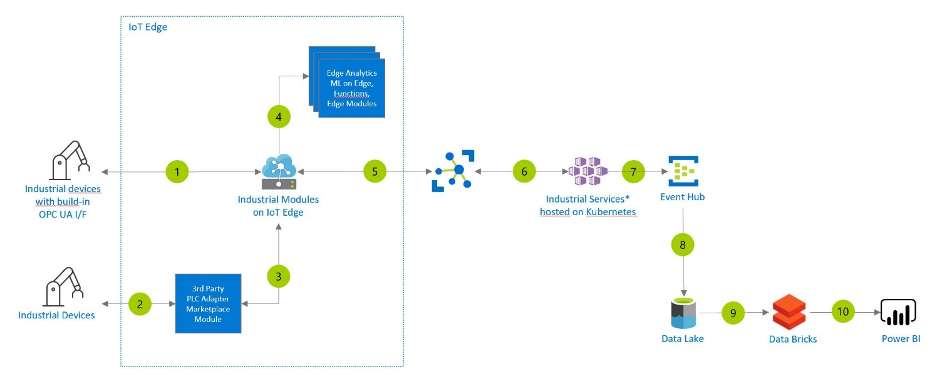
Predictive Maintainence

Slide 21

What’s Next

Slide 22
Thanks

