Slide 1
Metering, Operations and Utilities: 2023 and Beyond
Monday, July 11th, 2023
Dan Falcone
Notes:
1

Slide 2
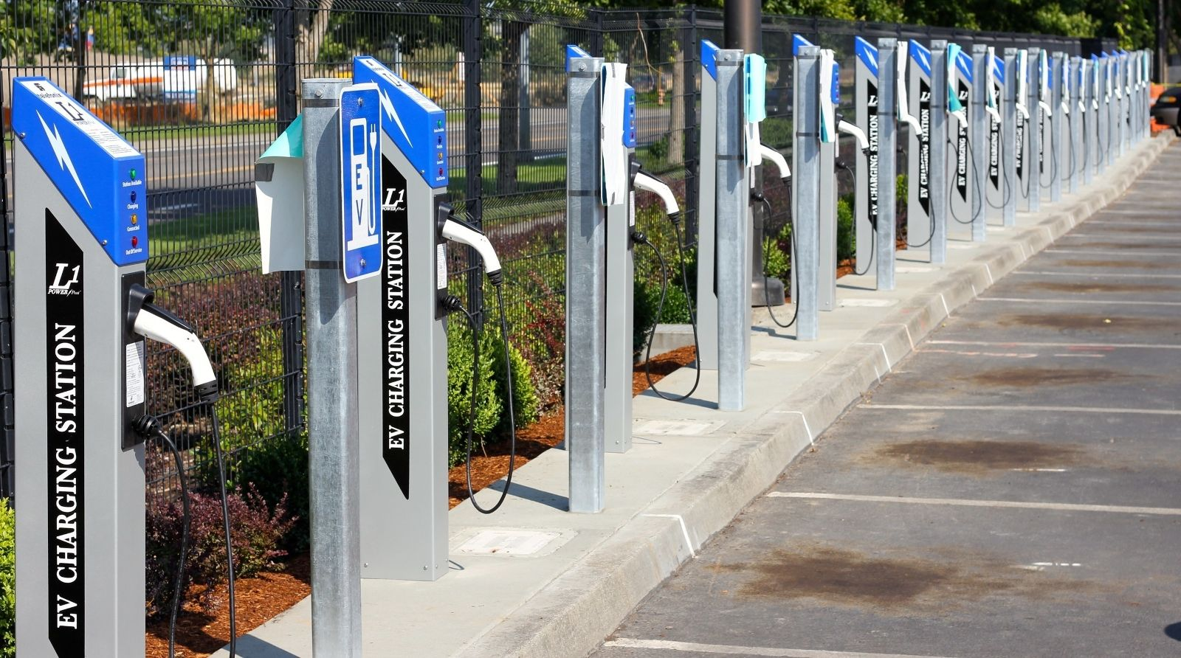
Introduction
We are only now beginning to understand how much AMI has changed and is continuing to change our world.
This presentation will touch on the power of this AMI data, new tools we can create and the challenges we are facing to use this data
We will look at just a few of the new opportunities already being presented to us that we can use this data to take advantage of
With some AMI systems and AMI meters approaching 15 years of age, many utilities are also beginning to consider what is next
As DERs continue to penetrate the grid, EVs increase in presence, and electrification progresses, utilities are on the verge of change
Notes:
AMI 2.0

Slide 3
The Promise of AMI
The introduction 10-15 years ago and the continued development of an Advanced Meter Infrastructure (AMI) system promised more effective and more efficient Meter Service Operations
This was to be accomplished in a variety of ways starting with:
No need to read meters (if AMR had not previously been deployed)
No need to roll a truck to perform a disconnect or a reconnect
Better ability to detect and respond to outages
Better ability to detect theft
Better ability to detect (and eventually capture) unbilled energy
Better understanding of customer usage and ability to make better energy usage decisions
And with all of this came a promise of “Additional Capabilities and additional Operating data.”

Slide 4
A Flood of Data: The Promise and the Curse of AMI
And so, the data started coming in
Once the investment in gathering this data was made the problem quickly moved from the collection of this data to developing the tools and infrastructure to analyze this voluminous data
There was far more data than could be analyzed or even utilized at first

Slide 5
Moving Into The Future
Utilities now collect hundreds of millions of events and readings every day from sources such as the following:
Meters (status, manufacturer, purchase date, events such as reprogramming notifications and tamper alerts)
Transformers (ID, circuit section, circuit ID)
Service points
Customer accounts (type, status, billing cycle)

Slide 6
What Data Are We Getting & How Are We Using It?
Meter quality assurance: Focusing on meter reading performance enables utilities to ensure AMI reliability
For instance, when meter readings are expected but not delivered, the system takes note, and calculates overall performance statistics for the AMI system
Utilities are made privy to problems they never would have been able to identify in the past
Good Start

Slide 7
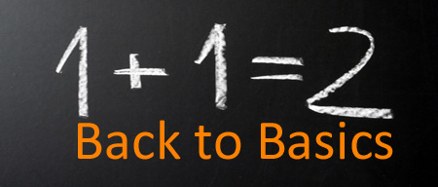
The Basics
Outage event analysis and prevention:
Integration enables real-time, accurate, and complete outage event analysis that helps identify nested outages and optimize field crew dispatch – all to support efficient response and restoration
We can often determine the exact piece of equipment causing a problem, along with the customers directly impacted by it
We can use outage information that is delivered along with meter readings to identify and track outages
These outage event reports help us to understand the overall impact of outages, then drill down to find the problem areas in the distribution network
We can then isolate areas of high impact and work to understand how to address them

Slide 8
And of Course…Report!
We can filter planned outages and momentary from this data for reporting purposes and provide meaningful customer satisfaction and performance measures and trend
Average interruption durations
Number of interruptions
Number of customers impacted
These system performance indexes, and information can be shared with management, regulators, customers, media, and other stakeholders

Slide 9
What Else?
Gain a better understanding of events, as well as what they mean:
For instance, we can correlate power outage events or voltage alarms with the transformers involved to identify faulty or aging infrastructure
We can roll trucks between 8 AM and 4 PM, Monday to Friday on non-storm days
Generate new customer insights
Size distribution assets
Implement preventive maintenance techniques
Forecast and build predictive models for demand program planning
Develop new rate plans and services for customers
Address Line Loss in a meaningful and impactful way

Slide 10
Line Loss
Network energy inventory balancing
You can accurately compare feeder energy to aggregated meter data to track down unbilled energy
Some may be energy theft.
Some is not but is actionable once the cause is determined
Meter events and usage information can help paint an overall picture of what’s happening with a customer’s energy usage over time as well as the usage from an entire sub station
This unified view can help detect energy theft, meter tampering or a host of equipment problems that may be affecting service levels
Some typical filters for theft:
Customers can be identified who have active accounts but no recorded usage, or the converse – energy usage but no account
Customers with gas usage but no electrical usage over months or even years, indicate a very likely candidate for investigation, voltage issues for one customer and not others on the same transformer.

Slide 11
What Else?
Potentially bad metering
Non metering of certain usage
Failing equipment and bad connections
Bad GIS integration and information
To make any of this work we need an up to date and integrated geographic information system (GIS) geodatabase
We need to be able to link our meters accurately to the rest of the system along with every other piece of equipment between the sub station and the meter
The initial investigative work will uncover not system errors but GIS errors and holes
Once corrected this work will begin to uncover correctible losses.

Slide 12
Longer Term Planning
Load profiling
You have accurate and highly granular transformer load profiles, especially significant for effective distribution planning when electric vehicle (EV) charging and distributed generation are involved
What will the impact on your system be as isolated pockets of users influence each other and purchase electric vehicles; adopt home level energy storage and renewable energy solutions
Pricing analysis
Perform ‘what if’ rate and load shift analysis
Compare current tariffs with alternative pricing scenarios
Estimate energy costs for a new rate at different load levels

Slide 13
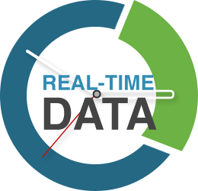
What are Some of the Challenges in Analyzing this “Flood of Data?”
The first issue is that currently data required for complete meter data analytics solution does not reside in the same database
While there is tremendous real time data being collected the information required to complete many types of analysis may reside in other data bases (IE system mapping data)
Another challenge is that while the MDM is configured as a “Fast Write” data base, since it needs to quickly record large volumes of real-time meter information, a useful analytics tool needs to be normalized for “Fast Reads,” since it needs to provide fast access to data for users looking for real-time insights

Slide 14
Additional Challenges?
No impact on billing:
Making sure that you can analyze the data in the MDM system (the “system of truth”) without impacting basic billing operations in any way
As important as meter data analytics is, this capability cannot interrupt billing and other operational systems in terms of performance, data corruption or functionality
Bottom line: The analytics capability cannot threaten the utility’s ability to collect revenues

Slide 15
Additional Challenges?
Near real-time:
Lastly, in order to retain its value to executives, engineers and operational staff, data analytics need to be performed in as near real-time as possible
The ultimate goal:
To establish a repeatable data analytics discipline and infrastructure to reduce the time, cost and complexity of each incremental capability, and with the lowest risk possible to the existing MDM functionality

Slide 16
Business Use Cases for this big data
Now what can we do with this information?
Isolate and determine where we have voltage issues, correct them, and bring an entire line to the same level
This not only works better for our customers but also allows the utility to pursue voltage reduction in a meaningful and controlled way
Determine what transformers should be used in any location
Determine when new loads are present and which transformers are in jeopardy
Locate Bad connections & Undersized lines
For Transformer Rated Services determine which ones are operating for a substantial amount of time below 10% of the rated current
Find and remediate theft
Find and remediate remote outages before the user knows they exist
Find and address Power Factor issues
Notes:
Waveform generation

Slide 17
New Skill Sets
Utilities also need new skill sets to be able to perform this analysis. To use this data, we need
Database Experts
Metering Experts
Business Analysts
Data Scientists
In a perfect world all of these characteristics are rolled up into one
In a less perfect world into two
And is an even less perfect world – three individual groups or people
Too many utilities are missing one or more of these groups or people even after completing their AMI deployment

Slide 18
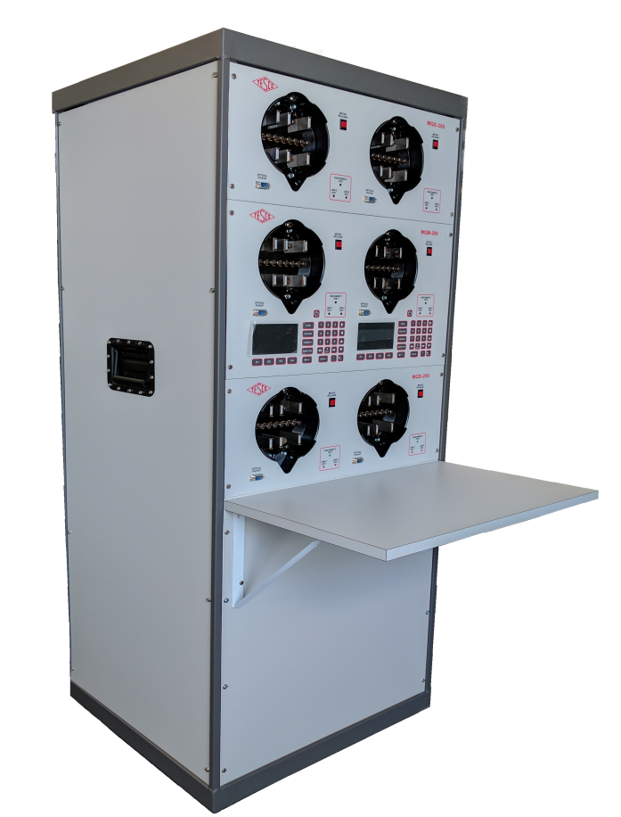
New Tools for the Meter Shop / Field
Advanced functional test boards
Automated firmware and setting comparison tools
Site Verification equipment, procedures and data
…….and data
…….and data
…….and data

Slide 19
And now we want MORE……
More data
Greater frequency
Whatever bandwidth you thought you needed, now you need more
Edge Computing & Distributed Intelligence
Notes:
Waveform generation

Slide 20
AMI 2.0
Can we use our existing infrastructure?
Do we have to rip out and replace with a new infrastructure?
What about LTL back haul or a Private Network?
What about Power Line Carrier?
Is there life there for my most remote service areas?
Has there been form standardization?
Did any of our equipment go EOL?
Notes:
Waveform generation

Slide 21
AMI 2.0 Infrastructure
Second Generation AMI and potentially new communication paradigms as LTL data becomes less and less expensive and reaches larger and larger areas – without new infrastructure
Research in Power Line Carrier Technology may provide expanded bandwidth to allow for greater data transfer more frequently without as much new infrastructure
Mesh networks continue to improve, and AMI 2.0 is anticipating leveraging the infrastructure installed in AMI 1.0

Slide 22
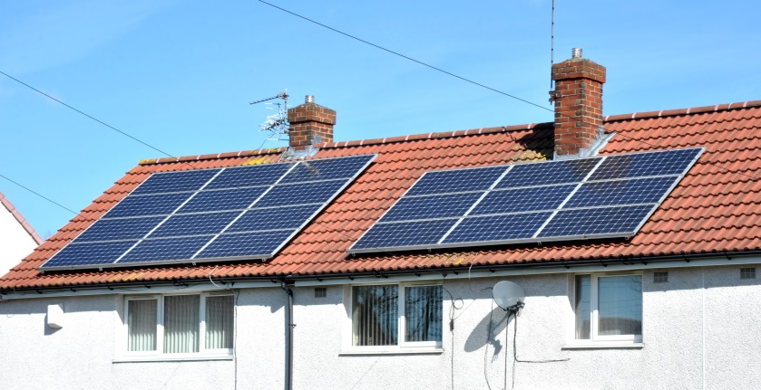
2023 and beyond
On the distribution side customers will be encouraged to put in more and more renewable energy and they will also add more and more energy storage
Larger customer-based energy production and solutions will lead to expanded micro grids
Second Generation AMI and potentially new communication paradigms as LTL data becomes less and less expensive and reaches larger and larger areas

Slide 23
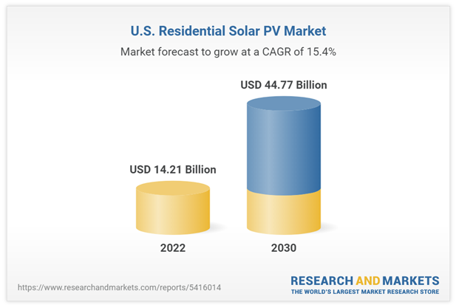
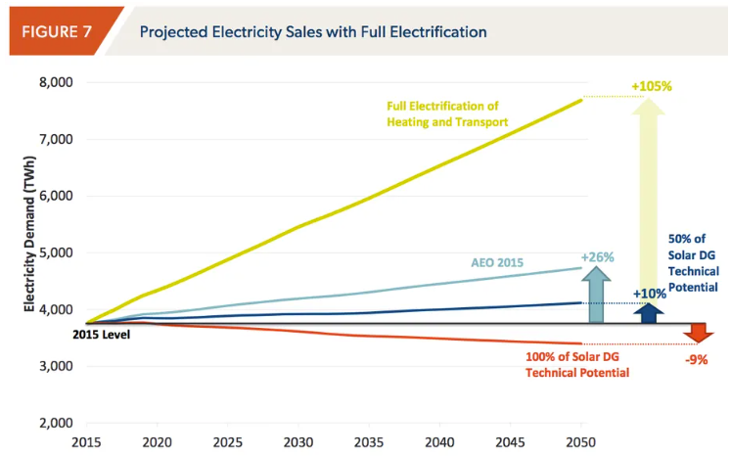
While PV Solar continues to grow - Electrification is on the rise and surpassing forecasts!
Reference: Research & Markets & AEO / NREL https://www.brattle.com/wp-content/uploads/2017/10/7298_electrification_emerging_opportunities_for_utility_growth.pdf
Notes:
Solar continues to grow at a healthy rate with much more market share to go,

Slide 24
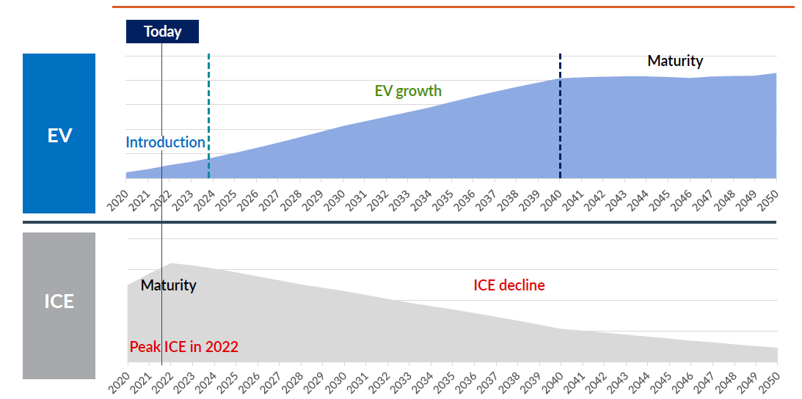
EV Growth and Disruption will be unprecedented!
- 14% of all new Vehicle Sales in 2022 were from EVs!
- Up from 9% in 2021 and 5% in 2020
Reference: plantemoran.com/futureofmobility & EIA Data Sources
Notes:
50% of new vehicles as Evs in next decade!
EV Charger integration alone is expected to grow 390%+ over the next several years and is planned to exceed $16B by 2026

Slide 25
The US EV Market
Where is the Market Going? Upwards – in a big way

Slide 26
The EV Market
Manufacturers have announced over 100 EV models to be introduced by 2024

Slide 27
US ELECTRIC ENERGY CONSUMPTION
Americans drove 3.23 trillion miles in 2021
If this was all done in electric vehicles getting 3 mi/kWh, then we would need 1.1 GWh of energy just to charge cars
Average household uses 10.7 MWh/yr (2021)
Charging our cars could use an additional 8.8 MWh/yr
Charging at home is a potential market worth $145 billion per year in added revenue to electric utilities (Average residential cost in the US for 2021 was $0.1375 per kWh)
This is approximately an extra $1,000 per year per residential customer who charges at home

Slide 28
Electrification for the Consumer will be costly!
For residential buildings and the end consumer, electrification may propose the following strategies among others:
ASHP – Air Source Heat Pump in place of gas / oil heat
Electric hot water – on demand, tank, via heat pump
EVSE – Electric Vehicle Supply Equipment – EV Chargers
BESS - Battery Energy Storage Systems
PV Solar – residential PV solar systems
Many of these technologies have added cost for home wiring, service panel upgrades, and challenges with physical location of assets and availability of 120/240V circuits.
The global market here in the US exceeds $100 billion!
tescometering.com
Reference: Pecan Street & Juniper Research
28
Notes:
cost sheet for EV or Solar install with and without MSA?

Slide 29
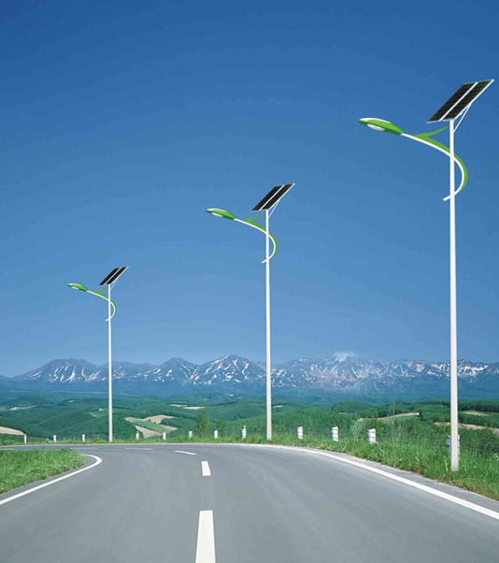
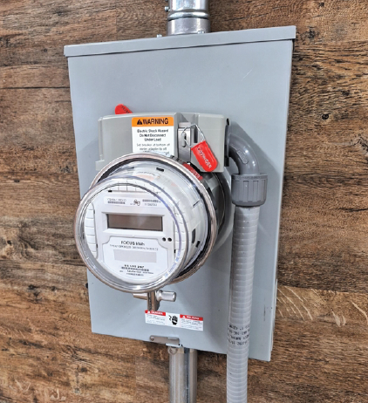
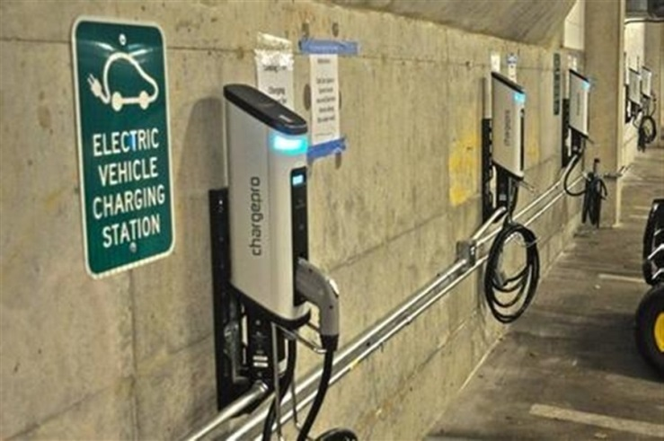
The shape of metering to come: 2023 and beyond
Planning for electrification will start with
the AMI data each of you is now gathering
Streetlights
Smart Poles
Electric vehicle chargers
Sub meters & embedded meters – which may become “utility” meters
New & Prior Technology as tools for enabling electrification
Adapters
29

Slide 30
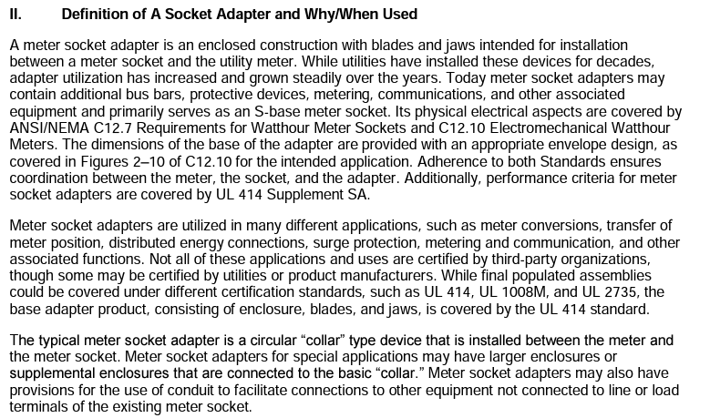
Meter Socket Adapters (MSA)
What is a MSA? And How is it Tested / Certified?
https://www.nema.org/docs/default-source/technical-document-library/nema-us-80016-2022-aspublished.pdf?sfvrsn=a4caa6df_3#:~:text=A%20meter%20socket%20adapter%20is,grown%20steadily%20over%20the%20years
30

Slide 31
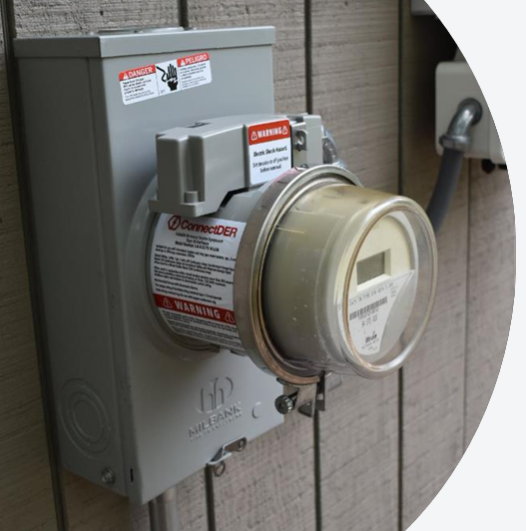
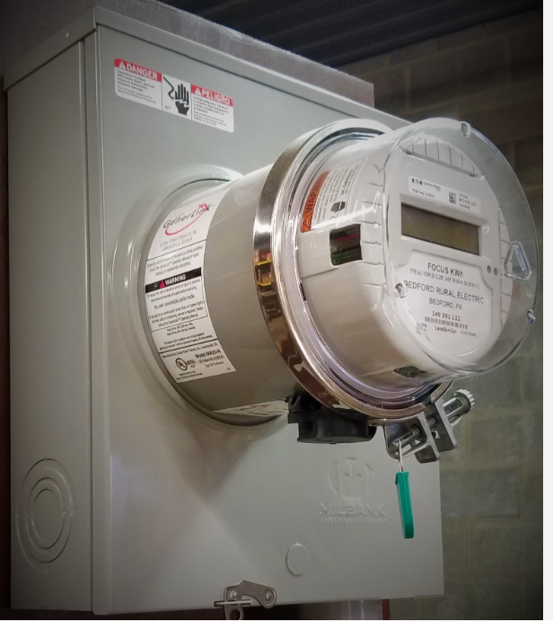
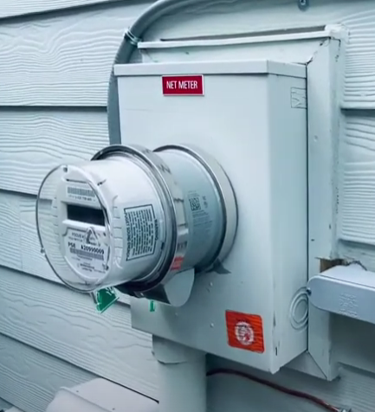
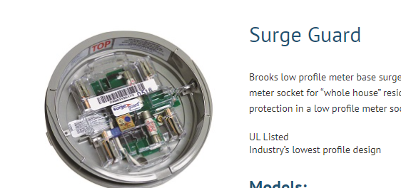
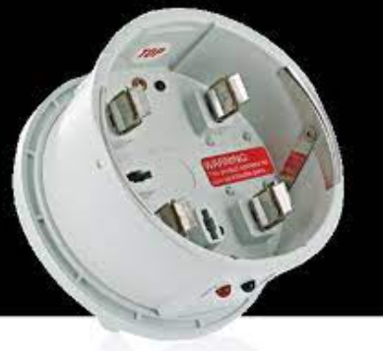
Meter Socket Adapters
Current Market Products
ConnectDER Solar Product, Generlink Product for Backup Generator, & Tesla Product for Backup Switch
Various Surge Protectors
31
Notes:
Generlink has been used by some for almost 15 years, often under lease model

Slide 32
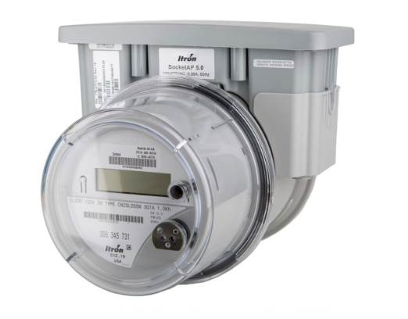
Other Products - Meter Socket Adapters in place
Many utilities use a MSA for various use cases
Socket AP - 2S / 12S or its own dedicated socket
Itron customers and other AMI customers to add a cellular backhaul
2K to 2SE Adapter
Many utilities went EOL on k base meters
Some utilities may have 5k of these installed with plans to install 20-30k+
16k to 9s Adapter
Many utilities went EOL and moved away from higher voltage and current flow bolt in meters
Converts a self-contained bolt-in meter via a MSA to a transformer rated meter
32

Slide 33
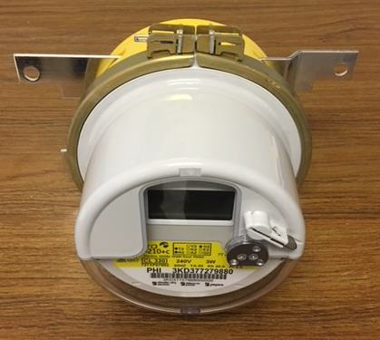
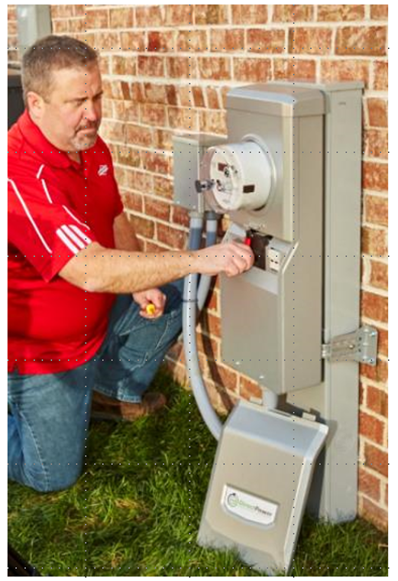
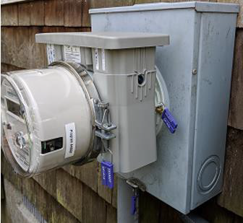
Other Products - Meter Socket Adapters in place
33

Slide 34
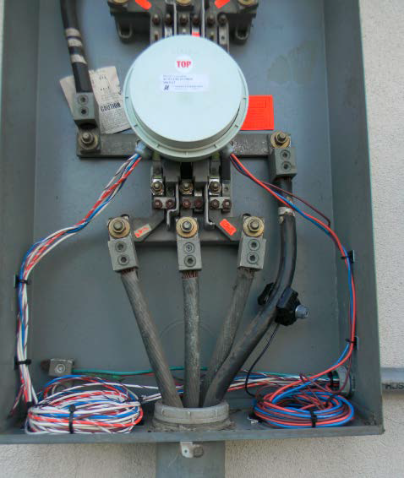
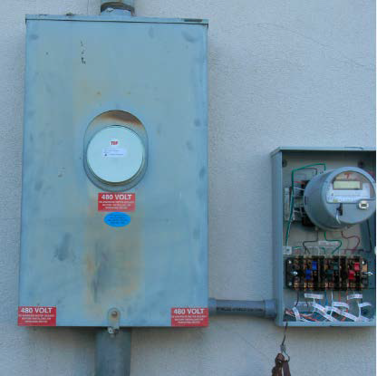
Other Products - Meter Socket Adapters in place
34

Slide 35
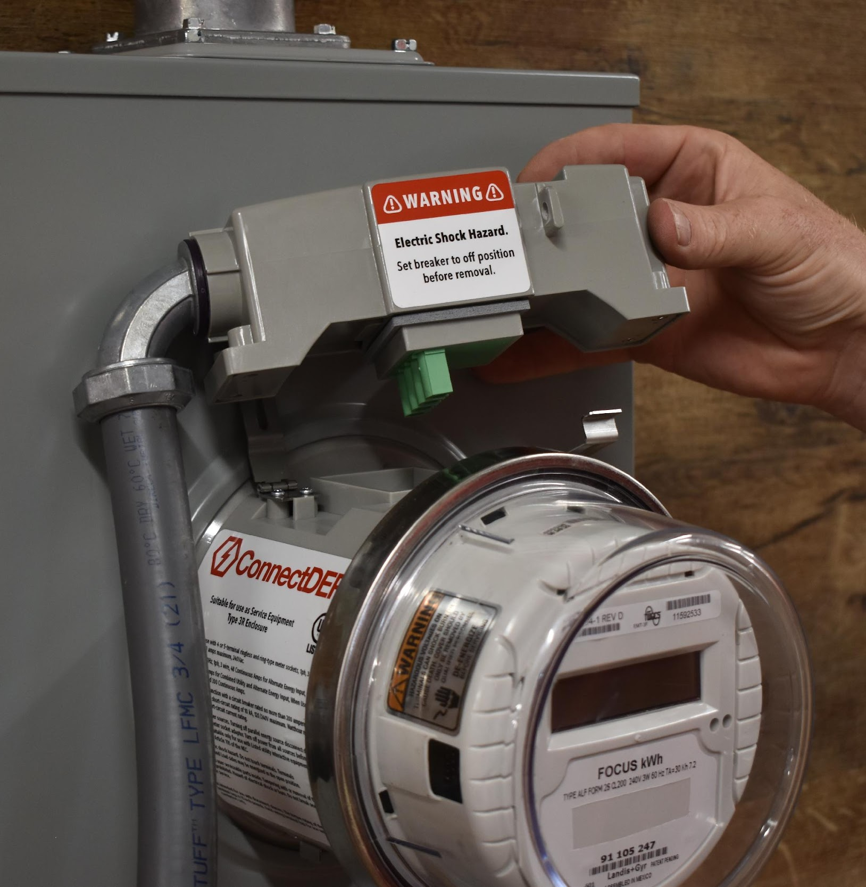
ConnectDER MSA for solar and EV
Solar MSA
EVSE MSA
Launching in 2023
Approved in 20 states – 16,000+ units installed
15-minute installation, 30-minute interconnection
200A continuous rating (utility power); 80A continuous rating (PV input - 15kW)
Integrated PV breaker
UL Listed (414 - Meter Sockets)
15-minute installation, 30-minute interconnection
Initial offer for 100 Amp and 125 Amp services
Future offerings for 200 Amp services
Integrated EV breaker and load management protection
UL Listing pending
Meter socket adapters for ASHP, BESS, and other technologies expected in coming years
tescometering.com
35
Notes:
Air source heat pumps
Battery energy storage systems

Slide 36
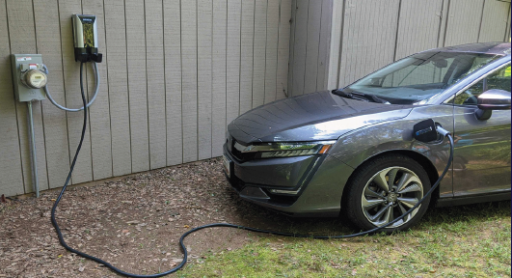
ConnectDER EV MSA
tescometering.com
36
Notes:
Air source heat pumps
Battery energy storage systems

Slide 37
Questions and Discussion
Dan Falcone
Vice President Product
dfalcone@connectder.com
https://connectder.com
302-468-0054
This presentation can also be found under Meter Conferences and Schools on the TESCO website: tescometering.com
ISO 9001:2015 Certified Quality Company
ISO 17025:2017 Accredited Laboratory

