Slide 1
EVSE and Preparing for the Impact on Your Utility
July 12, 2023
11:00 PM – 12:00 PM
Tom Lawton

Slide 2
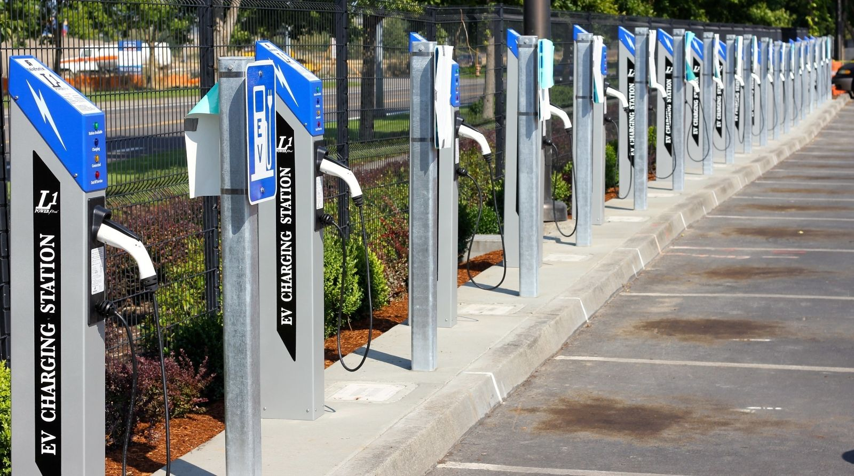
Electric Vehicle Service Equipment - EVSE
What is it all about and why should I care?

Slide 3
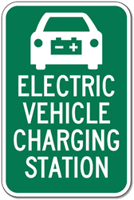
Topic Summary
Overview of Electric Vehicles (EV’s) in 2023
  Who is in the market?
  Who dominates the market?
  How many EV’s are on the road?
  Where is the market going?
Types of Electric Vehicle Supply Equipment (EVSE’s or chargers)
Electric Vehicle Charging Networks
Regulatory environment
Business Segment – revenue opportunities and expectations

Slide 4

Overview of Electric Vehicles in 2023

Slide 5
Who is in the EV Market?
Anyone who is not will be in the near future. The following automobile manufacturers have an Electric Vehicle offering in 2023:
Audi
BMW
Chevrolet
Coda
Fiat
Porsche
Ford
Honda
Hyundai
Kia
Jaguar
Lucid
Mercedes
Mitsubishi
Mini
Nissan
Polestar
Rivian
Smart Car
Tesla
Toyota
VW
Volvo
Fisker

Slide 6




Who are the Market drivers?
2022
TESLA: 66.3%
Ford: 7.6%
Hyundai & Kia: 7.1%
(Motor Intelligence)

Slide 7
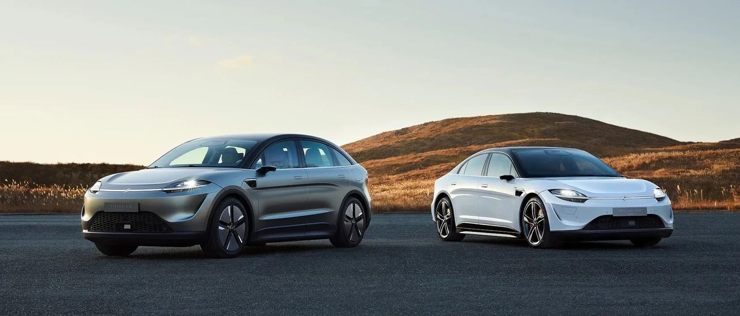
The EV Market
Hyundai Unveils EV Platform, Will Have 23 Global Electric Vehicles by 2025
Toyota Details Six New EV Models Launching for 2020–2025
BMW raises target for EV sales, plans new electric-focused platform
Every major manufacturer has a plan for EV over the next 10+ years

Slide 8
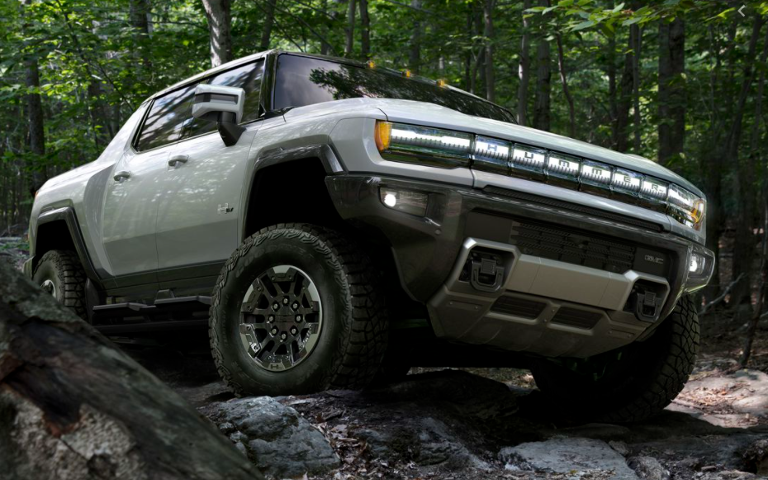
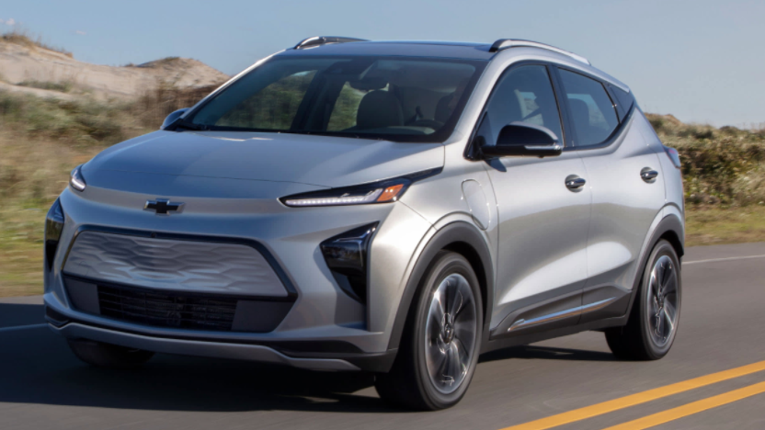
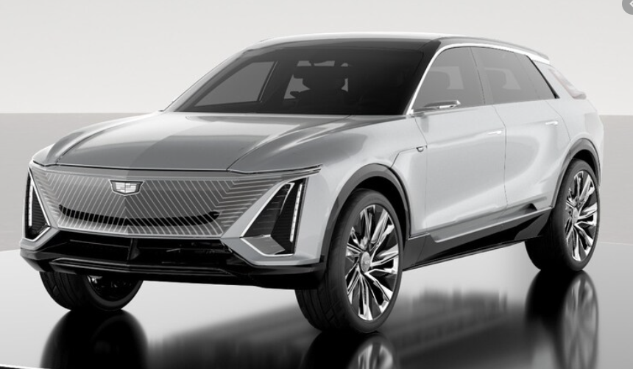
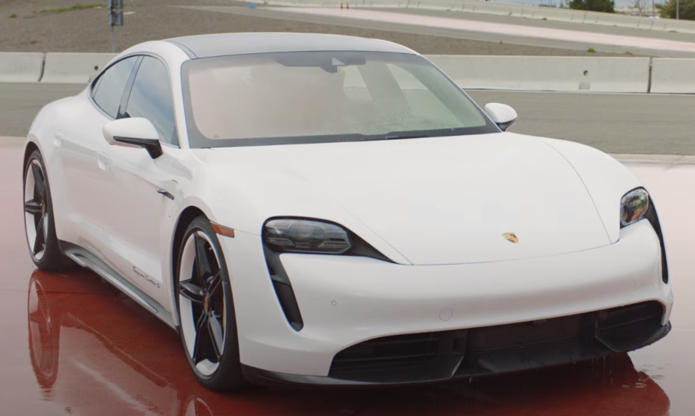
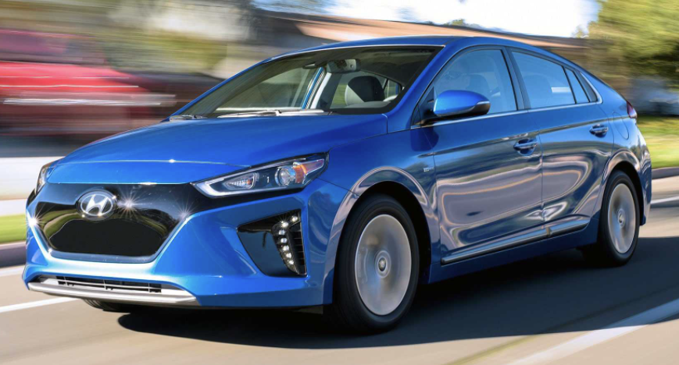
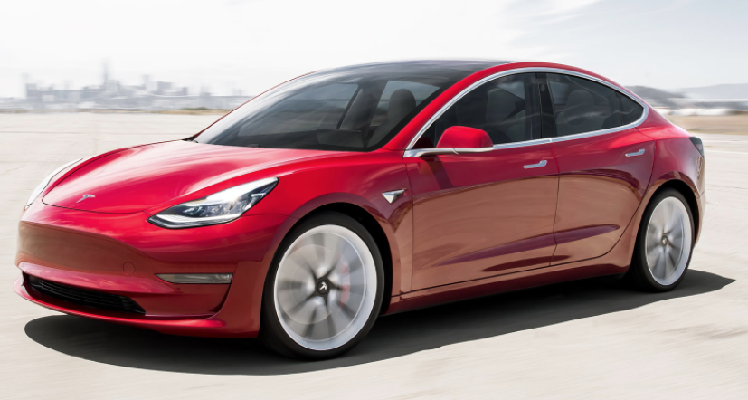
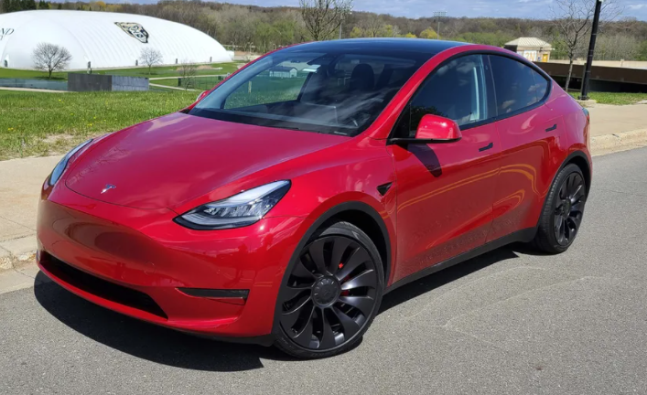
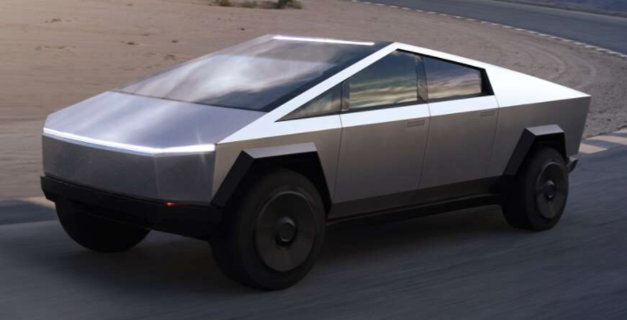
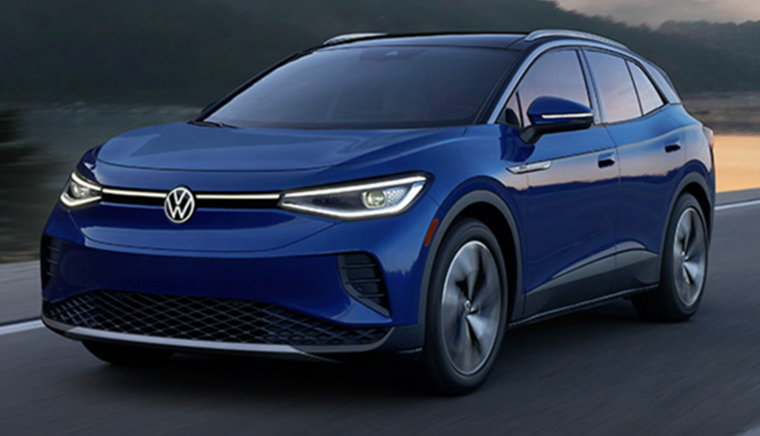
The EV Market
Manufacturers have announced over
100 EV models to be introduced by 2024.

Slide 9

How many
EV’s are on the road in the US?
As of December 31, 2022 there were 2,956,809 Electric Vehicles opera ting in the US
By the end of 2023 there are 4,300,000 forecast to be on the road

Slide 10
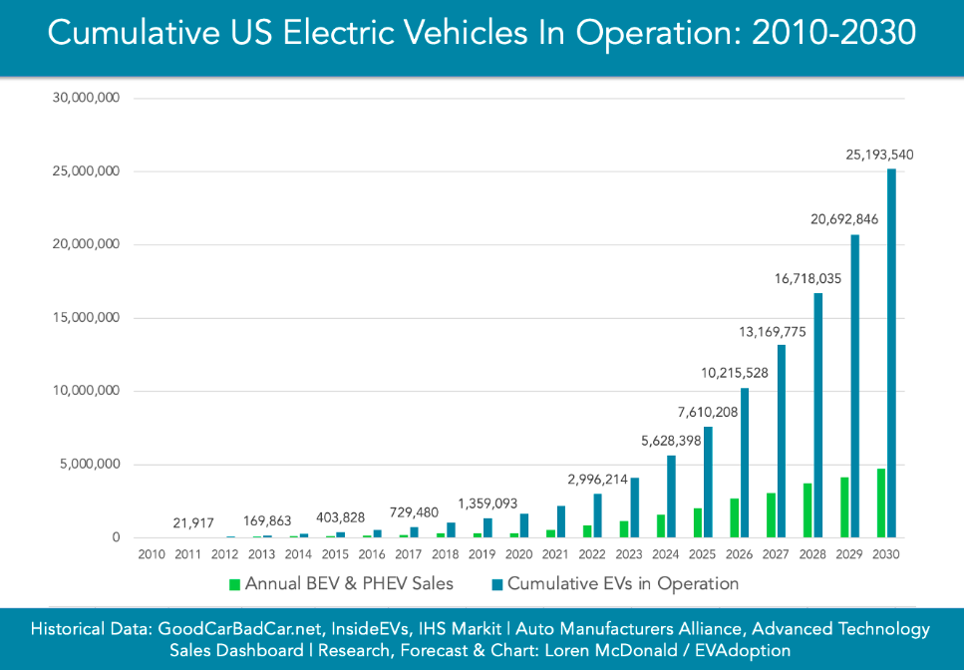
The US EV Market
Where is the Market Going? Upwards – in a big way

Slide 11
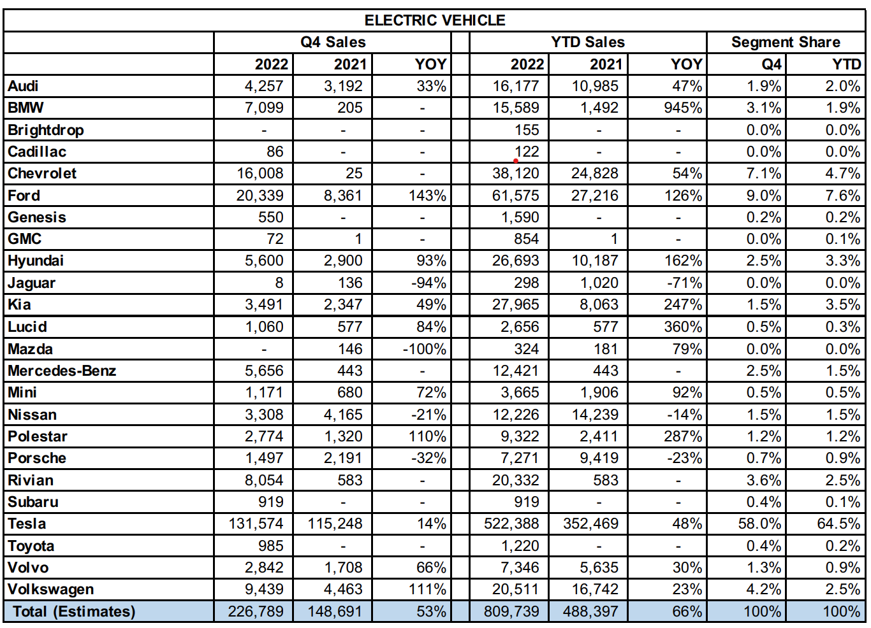
The US EV Market
Source: ELECTRIFIED LIGHT-VEHICLE SALES REPORT Q4 2022 kbb.com

Slide 12
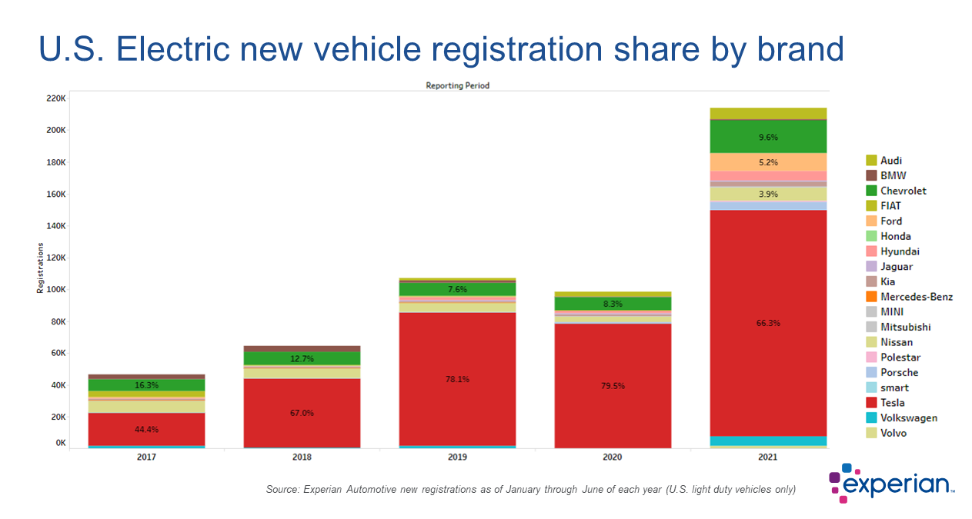
The EV Market

Slide 13
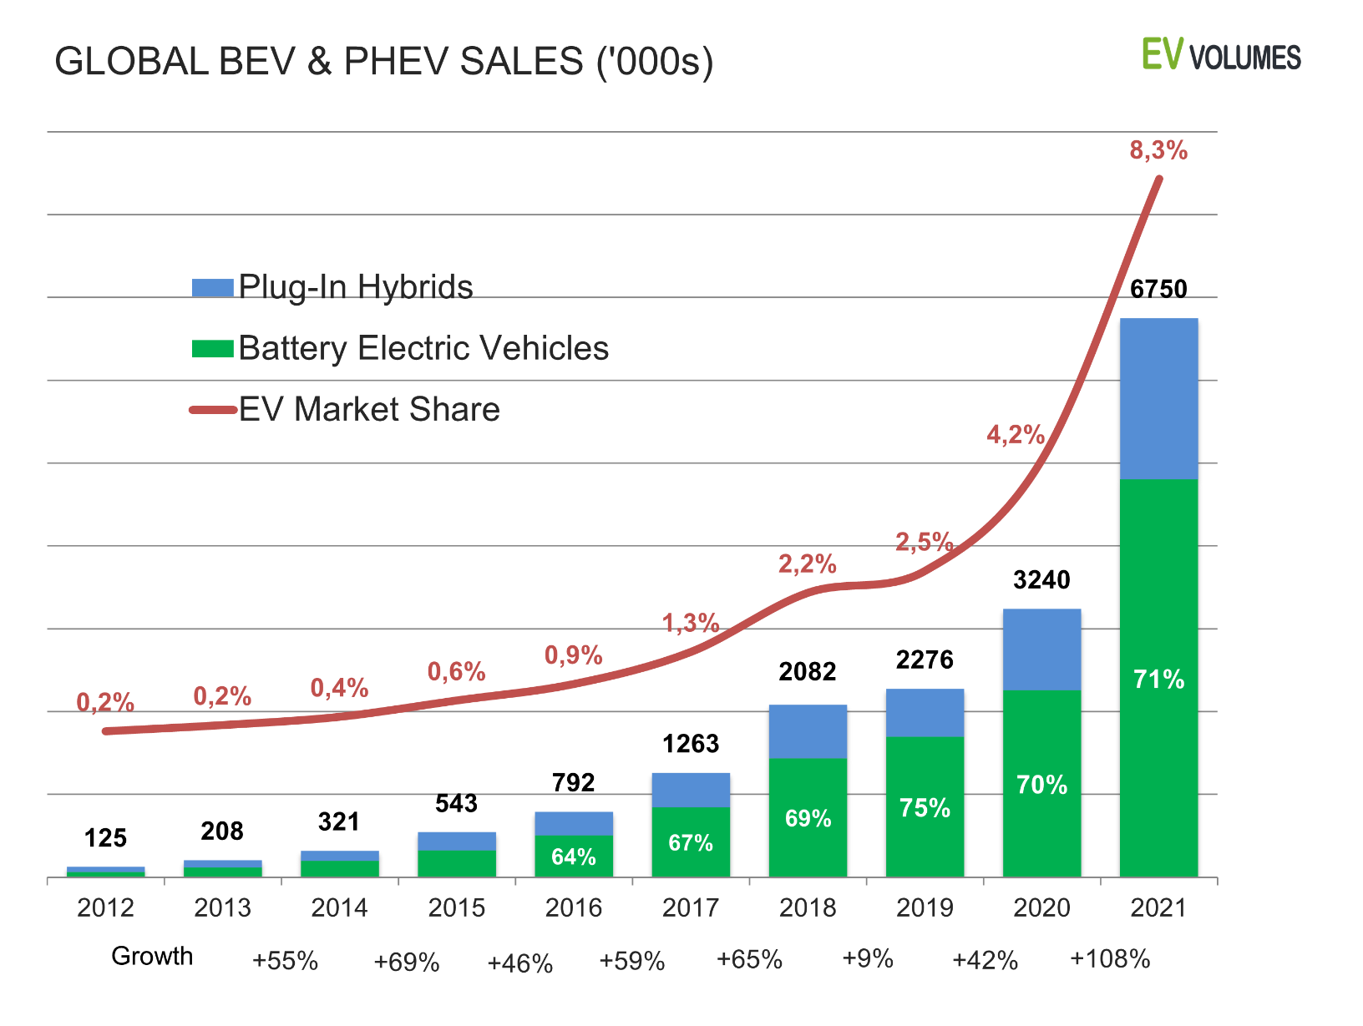
The World EV Market
Source: https://www.ev-volumes.com/

Slide 14
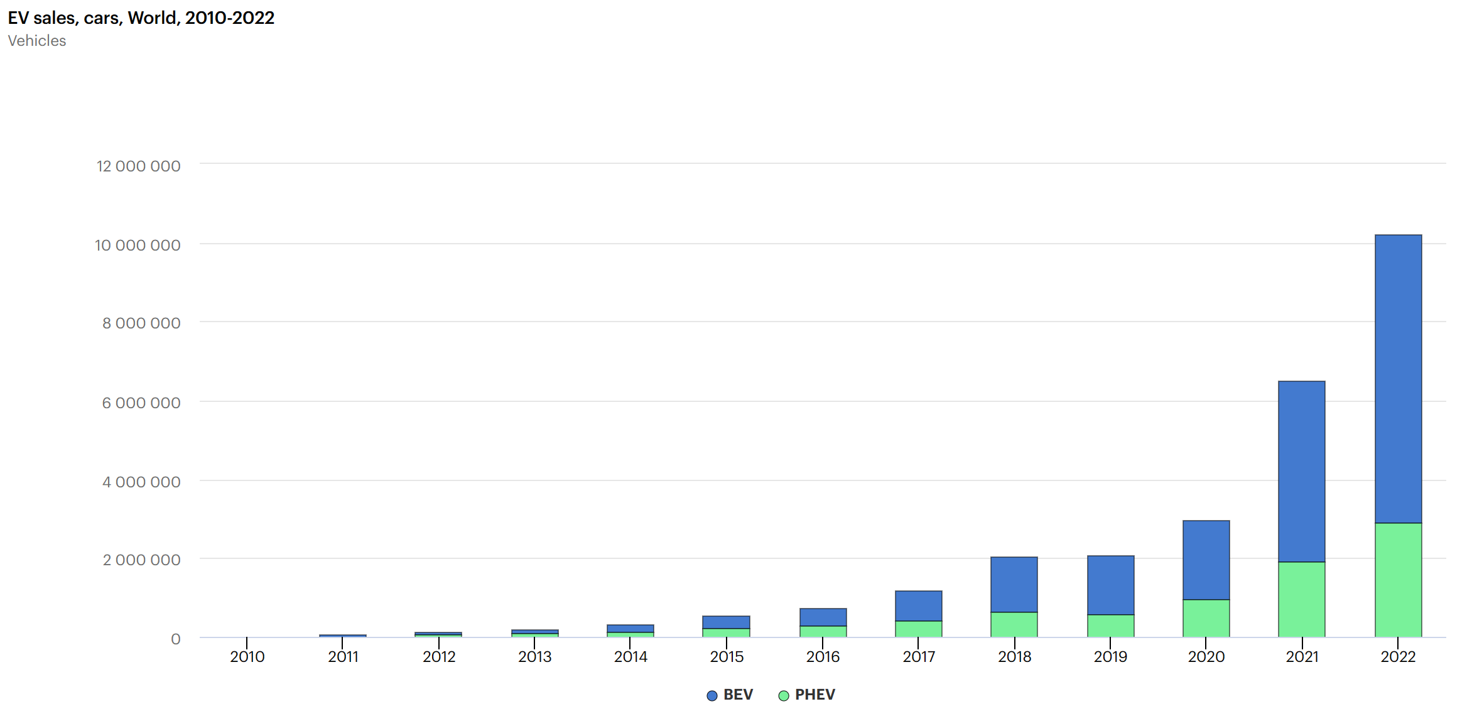
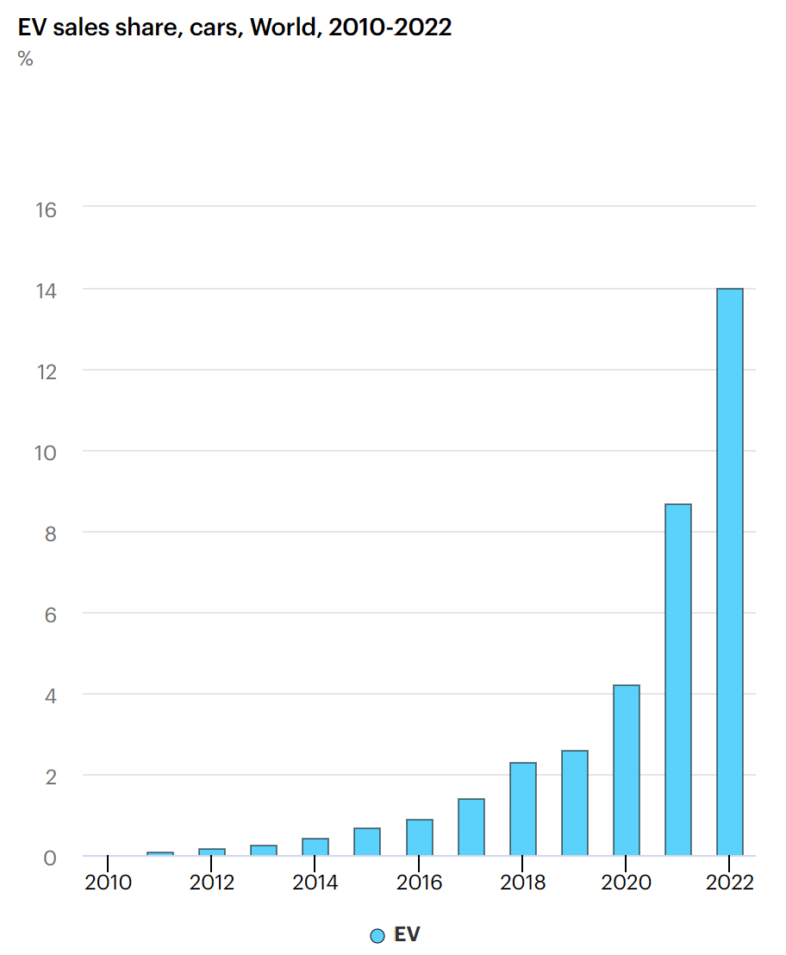
The World EV Market
Source: Global EV Data Explorer – Data Tools - IEA

Slide 15

EV Continues to Boom
Sales for light duty vehicles down YoY for 2022
EV sales increased by 65%
EVs accounted for 5.8% of all new cars sold in the US in 2022, an increase from 3.1% the year before
Motor Intelligence, InsideEvs.com

Slide 16
How much energy and how long to charge?
Mfg | EV Offering | Range (miles) | Battery | Battery Capacity | Battery Charge Time (hours)
Tesla | S / 3 / X / Y | S - 405 3 - 272-358 X - 333-351 Y - 303-330 | S - 407 V lithium-ion 3 - 50-82 kWh 350 V lithium-ion X - 100 kWh 410 V lithium-ion Y - 75 kWh 350 V lithium-ion | S - 103 kWh 3 - 50 to 82 kWh X - 100 kWh Y - 75 kWh | S - 8 -15h at 240V 3 - 8.5 to 10h at 240V X - 10.5h at 240V Y - 10h at 240V
Porsche | Taycan | 199-212 | 79.2-93.4 kWh 723 V lithium-ion | 79.2 to 93.4 kWh | 24 hrs @ 120V 12h @ 240V 15m @ 440V
Kia | EV6 / Niro | EV6 - 232-310 Niro - 258 | EV6 - 58-77.4 kWh 523-697 V lithium polymer Niro - 64 kWh 356V lithium-ion | EV6 - 58 to 77.4 kWh Niro - 64 kWh | EV6 - 51-68h @120V 6.3-8.7h @240V 1.1-1.2h @440V Niro - 9.25 at 240V 1.07h at 440V

Slide 17

Changing the Game - Range
Range – In excess of 400 miles with models announced that will achieve over 600 miles.
However, this is not the effective range. Effective range is rarely more than 70% of this number and in colder, hilly climates, traveling on highways this range may only be 50% of the rating.

Slide 18
Changing the Game - Range
For a 200 mile range car this may only give you 100 miles before needing to charge again in a northern climate in the winter.
For a 650 mile range car this should typically give 400 to 450 miles before needing to stop and charge.

Slide 19
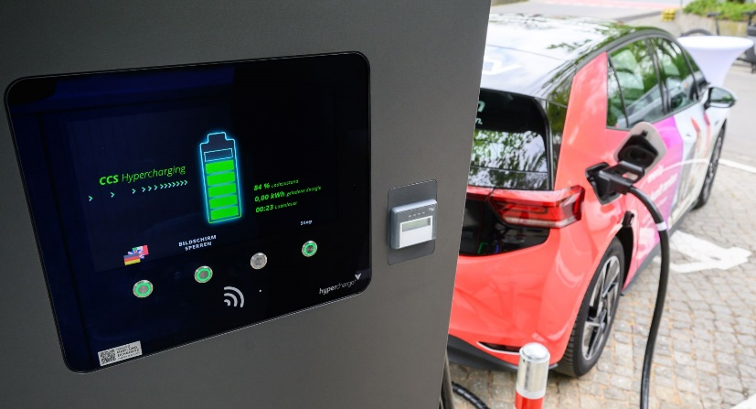
Changing the Game - Time
Charge time – Charging at home is a game changer. You leave every day from home fully charged. This is huge.
We typically are willing to pay for conveniences, but in this case convenience is less expensive.
On the road the DC Superchargers are now capable of getting you on the road in under 10 minutes.
  This is now similar to if not the same as fueling with gas.

Slide 20
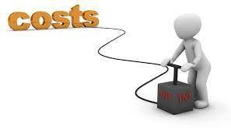
Changing the Game - Cost
Charging even 90% of a 90kwh battery at home for $0.12/kwh is $9.72 and typically will take you 240 miles under typical circumstances for a cost of $0.04/mile.
Assuming you consumed 30 mpg, at a gas price of $4.00/gallon this is roughly a $48.00 fill up and took an extra 10 to 15 minutes out of your life. If you have waited in line at COSTCO you may have spent more time than that and your cost per mile is over $0.13.

Slide 21

Changing the Game – the rest of the world
Small wonder that electric vehicles took off in the rest of the world faster than the US. Gas is significantly more expensive and the distances traveled are typically much less.
On 4/26/23 the average price per gallon in New York State $3.70, in Paris the same gallon of gas was $8.21 or 2.2 times more expensive.
Electricity, on the other hand, is roughly only 1.5 times more expensive. This price advantage coupled with shorter average drive distances makes electric vehicles very attractive to the average driver in Europe.

Slide 22


The EV Market
Ford announced during its fourth-quarter earnings report that it will invest $22 billion in electric vehicles and $7 billion in autonomous vehicles through 2025 and will be “all electric” in Europe by 2030.

Slide 23
Types of Electric Vehicle Supply Equipment (EVSE’s or chargers)

Slide 24
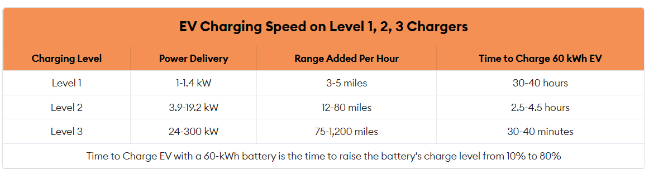
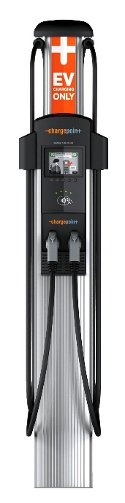
Types of Electric Vehicle Supply Equipment (EVSE)
    At the high end of the Level 3 chargers (350 kw and up) – A 90 kwh battery charging from 10 to 80% and adding 210 miles of range will only take 10.5 minutes
Source: forbes.com

Slide 25
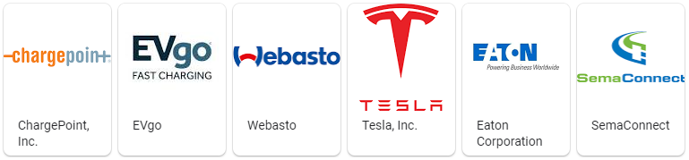
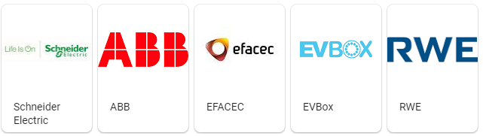
EVSE Manufactures
Major charging system manufacturers

Slide 26
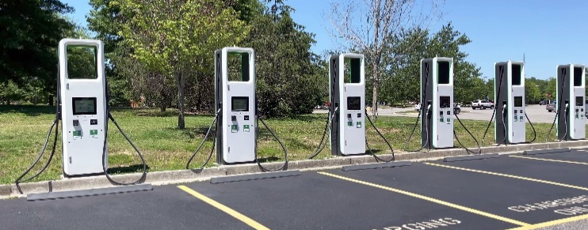
Charging Stations
Deployment is growing rapidly in US
  The current administration has set a goal of having 500,000 charging stations by 2030
Total PUBLIC chargers installed as of April 2023:
  AC Level 1
  AC Level 2
  Level 3 (DC Fast Charger/Superchargers)
  NOTE: As a point of reference, for TESLA Superchargers there
  are an average of 9 charging stations per location.
226 locations
51,508 locations
8,832 locations

Slide 27
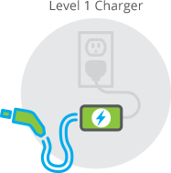

AC EVSE STANDARDS
J1772 AC Level 1
  Home Installation
  120 Volts at between 12 and 16 Amps
  Maximum Power Delivery (1.4 kW)
  Typical time to charge between
  30-40 hours
  3-5 miles per hour of charge @ 16A
  Charging 100% can take 2-3 days for
  most models on a L1 Charger
Source: calevip.org; forbes.com

Slide 28
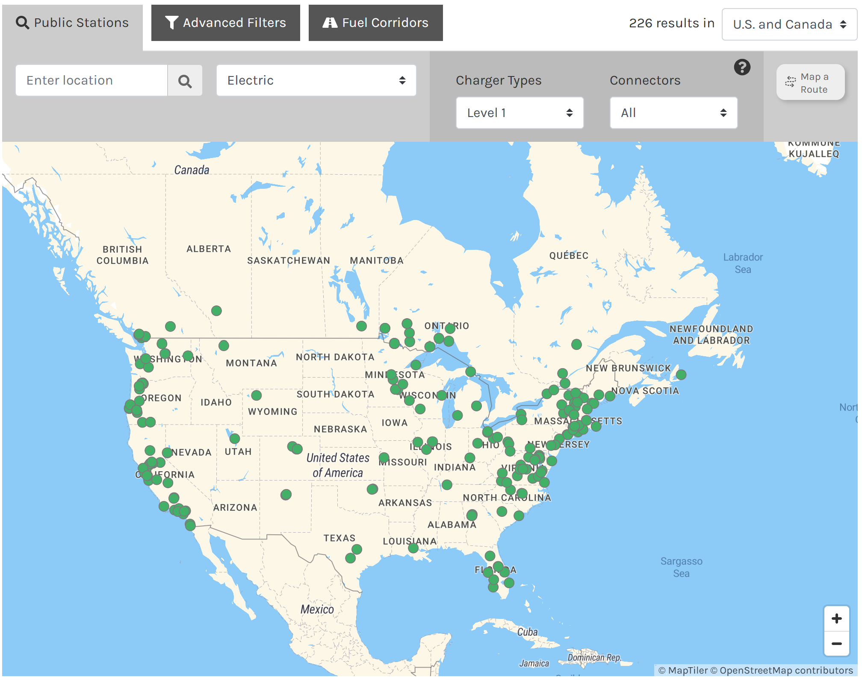
Level 1, AC Chargers
Source: April, 2023 Alternative Fueling Station Data afdc.energy.gov

Slide 29
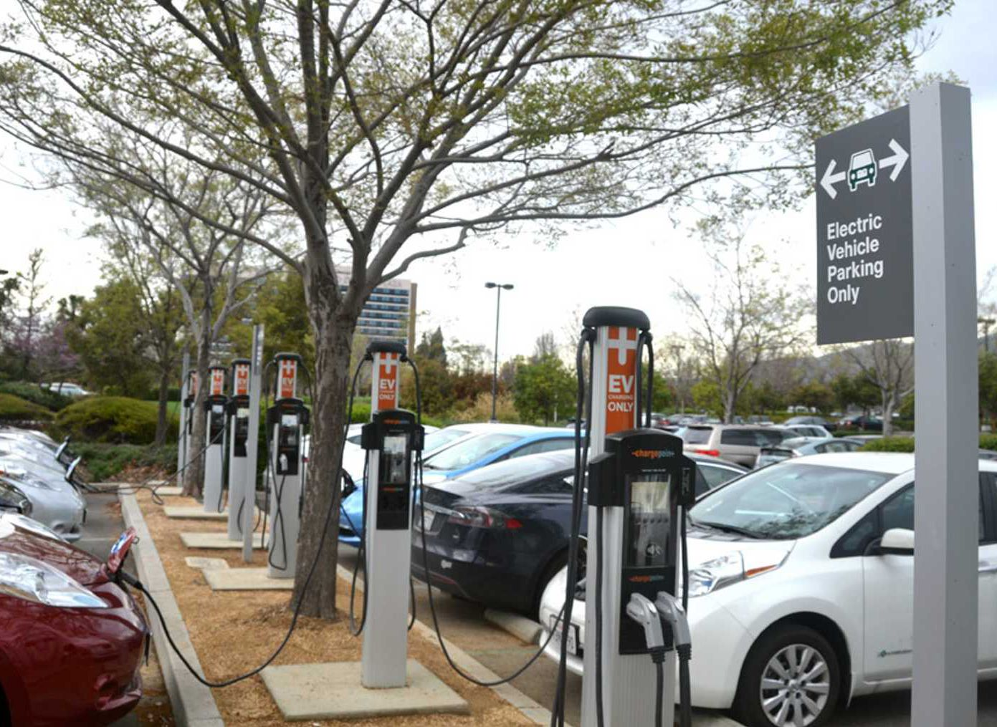
AC EVSE STANDARDS
J1772 AC Level 2
  Over 85% of commercial EVSEs are AC Level 2
  All current EV/PEV in US can use this type though some (Tesla) need adapters
  Stations cost $5K to $8K per port including installation

Slide 30
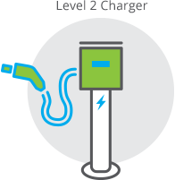
AC EVSE STANDARDS
J1772 AC Level 2
  Home and Commercial Installation
  240 Volts at up to 80 Amps
    30A most common
    Home 30A, Commercial 30A, 50A, 75A
  Maximum Power Delivery (19.2 kW)
    Mostly vehicle limited to 7.2kW
  Typical time to charge
    Pluggable Hybrid ( 0.5 – 1.5 hours, 0% to 90%)
    EV 80 Mile Range (1.5 – 4 hours, 20% to 90%)
    EV200 Mile Range ( 3.2 – 10 hours, 20% to 90%)
  21 miles per hour of charge @ 30A and over 30 mph @48A
  You can virtually always recharge overnight and can typically take advantage of TOU vehicle charging rates where offered.

Slide 31
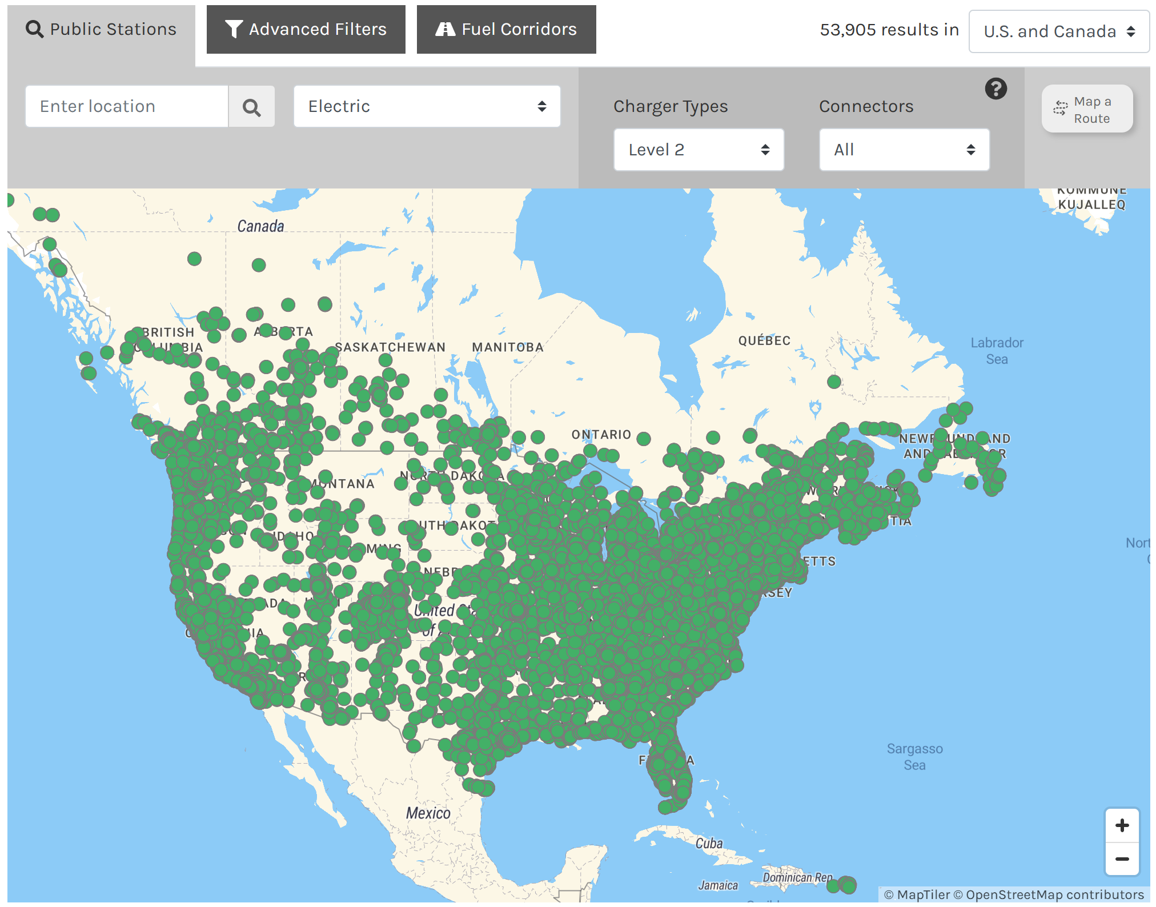
Level 2 Public Stations
2020 Sites:
19,216
2021 Sites:
30,145
2022 Sites:
46,781
2023 Sites:
51,508
Source: April, 2023 Alternative Fueling Station Data afdc.energy.gov
Note: Number of sites, not ports. A site typically has many ports.

Slide 32
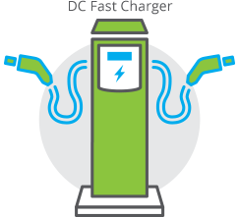
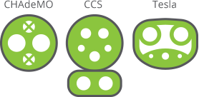
DC EVSE STANDARDS
Standards evolving rapidly
  Combined Charging System
    CCS1 SAE J1772 North America
    CCS2 Europe
  CHadeMO (Only Nissan and Mitsubishi)
  Tesla V1
  Tesla V2/V3 (Introduced in 2019)
  Chaoji (China, Japan, India
    Successor to CHadeMO and GB/T
  >100kW is considered “high end” (400V Systems)
  First US 350kW units installed Dec 10, 2018 (800V)
Source: calevip.org; forbes.com

Slide 33
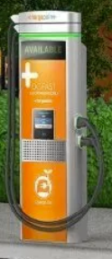
DC EVSE STANDARDS
Market Direction
  DC Generation 1 (less than 150kW)
    Nominal 400-500 VDC
    Up to 300 A max
    All current EV’s except one
  DC Generation 2 (up to 400 kW)
    Nominal 800 VDC (1000VDC max)
    Up to 350A typ, 500 A max
  Expected to be the norm by 2025
  Stations cost roughly $50K per charger

Slide 34
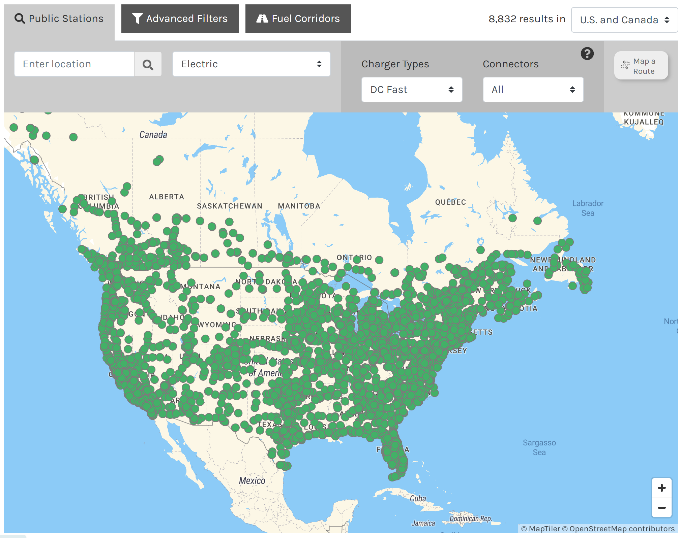
Level 3, DC Superchargers
2022 Sites:
7,219
2023 Sites:
8,832
Source: April, 2023 Alternative Fueling Station Data afdc.energy.gov

Slide 35
Electric Vehicle Charging Networks

Slide 36
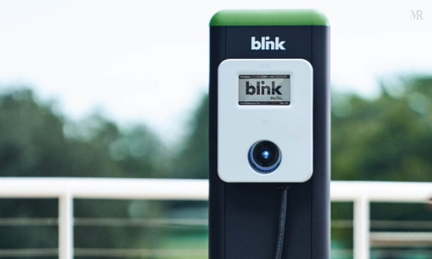
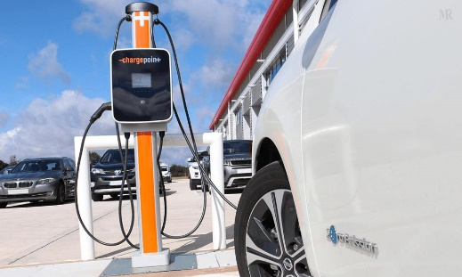
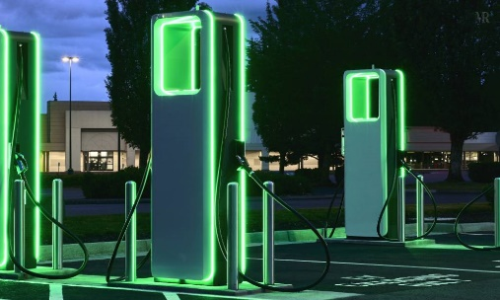
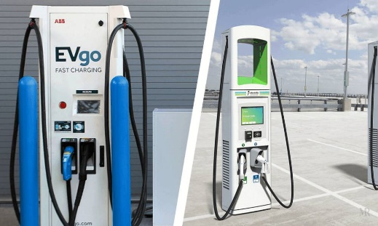
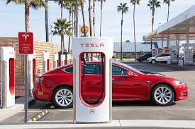
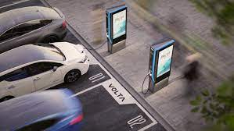
CHARGING NETWORKS
Major charging system networks
  Blink
  Chargepoint
  Electrify America
  EvGo
  National Electric
    Highway Coalition
  SemaConnect
  Tesla
  Volta

Slide 37
Utility Involvement
Many Electric Utilities from small to large offer some electric vehicle charging stations in their service territory. Some are free to promote greater EV adoption, but most charge for the energy.
March 2, 2021 – six electric utilities proposed a network of chargers from Texas to the Carolina’s to be funded by, built by and administered by (i.e. energy sold by) these same utilities.
By December 7, 2021 there were 53 utilities signed up (all Investor owned other than one Coop and TVA) whose footprint covered 120 million of the 150 million connected customers in the US.

Slide 38
Utility Involvement
National Electric Highway Coalition members in New York State;
  Avangrid
  Central Hudson Gas & Electric
  Con Edison
  Orange and Rockland Utilities
  PSE&G
  National Grid
Several of you are already involved with the NY State EV Managed Pilot Project.

Slide 39

Utility Involvement – why?
Utilities can now sell or will be able to sell significantly more electricity
Potentially this power can be sold for
two to three times the cost offered to
the average consumer at home.
This is now infrastructure that the
utility can control and can be placed
both in locations where the market
needs the charging stations and where the Utility infrastructure can best support these charging stations.
  Being able to add 1MW of usage where the utility wants to add this is highly desireable.

Slide 40
Regulatory Environment

Slide 41

Regulatory Background
Sales of electricity as a vehicle fuel are regulated by the Department of Commerce
Like all sales of all things based on quantity sold, EVSE sales are regulated by NIST Handbooks 130 and 44.
HB130 establishes that all sales of electricity as a vehicle fuel must be
based on the quantity delivered.
HB44 sets performance requirements for devices (Electric Vehicle Service Equipment) used to dispense electricity for sale.

Slide 42

HB44 APPLICABILITY
A.1. General. – This code applies to devices, accessories, and systems used for the measurement of electricity dispensed in vehicle fuel applications wherein a quantity determination or statement of measure is used wholly or partially as a basis for sale or upon which a charge for service is based.

Slide 43
HB44 REQUIREMENTS
Metrological Requirements of HB44
  S.3.1. Metrological Components. – An EVSE measuring system shall be designed and constructed so that metrological components are adequately protected from environmental conditions likely to be detrimental to accuracy.
  S.3.5. Temperature Range for System Components. – EVSEs shall be accurate and correct over the temperature range of – 40 °C to + 85 °C (− 40 °F to 185 °F).
  S.8. Minimum Measured Quantity (MMQ). – The minimum measured quantity shall satisfy the conditions of use of the measuring system as follows:
    (a) Measuring systems shall have a minimum measured quantity not exceeding 2.5 MJ or 0.5 kWh.

Slide 44
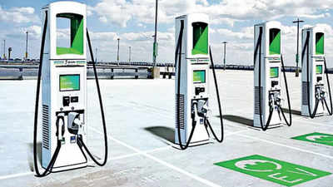
HB44 APPLICABILITY
Use Cases –COVERED
  ANY transaction which is based on the amount of energy delivered
  Examples
    A network of charge stations charges a monthly fee to belong AND a fee based on the amount of energy used
    A EVSE charges for the amount of energy delivered
    A parking lot charges for parking and EVSEs located in it also charge for the amount of energy delivered if used

Slide 45
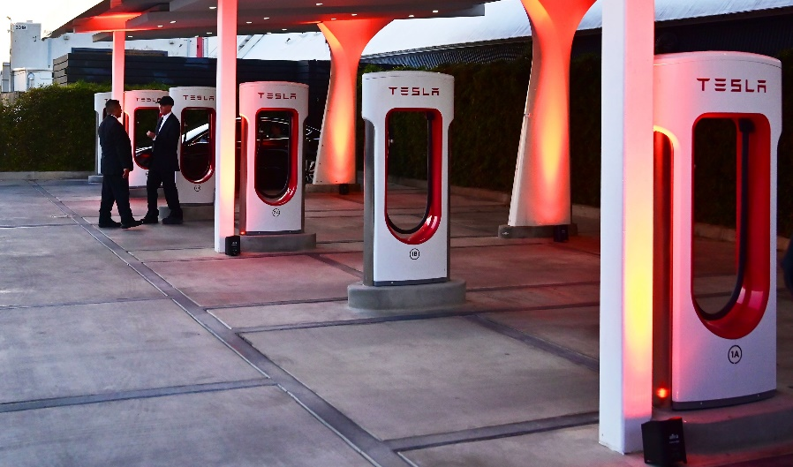
HB44 APPLICABILITY
Use Cases – NOT COVERED
  A store provides a free EVSE in its parking lot
  A paid parking lot provides EVSEs for which there is no charge based on the amount of energy delivered
  Tesla provides free charging services for some owners
  An organization charges a monthly fee for unlimited use of its network of EVSEs.

Slide 46

HB44 APPLICABILITY
Exceptions-This code does not apply to:
  The use of any measure or measuring device owned, maintained, and used by a public utility or municipality only in connection with measuring electricity subject to the authority having jurisdiction such as the Public Utilities Commission.
  Electric Vehicle Supply Equipment used solely for dispensing electrical energy in connection with operations in which the amount dispensed does not affect customer charges or compensation.
  The wholesale delivery of electricity.

Slide 47


Certification and Traceability
None of this means anything if we can not certify and provide traceability for these tests.
Two general approaches – New York approach and California Approach
Traceability through a National Lab to an International Standard
  This requires a DC “Standard”
  Fortunately DC Power = VA
    Need a certifiable voltage source and a certified current source and the ability to measure down to the appropriate levels for both Volts and Amps, then have a National Lab do the same test on the lab equipment
ANSI has also spent a great deal of time creating a new Standard to cover DC Metering – ANSI C12.32. This standard is being updated as quickly as the industry changes and another standard is being prepared for DC Transducers. C12.32 is the DC version of C12.1 for AC metering.

Slide 48
AC vs. DC Chargers and accuracy testing
Effective January 1, 2023: All AC charging stations that charge for power must be tested and certified once per year by the state’s bureau of weights and measures.
Effective January 1, 2028: Current regulations call for DC charging stations that charge for power to be tested once per year as well.
Why the hold up?

Slide 49
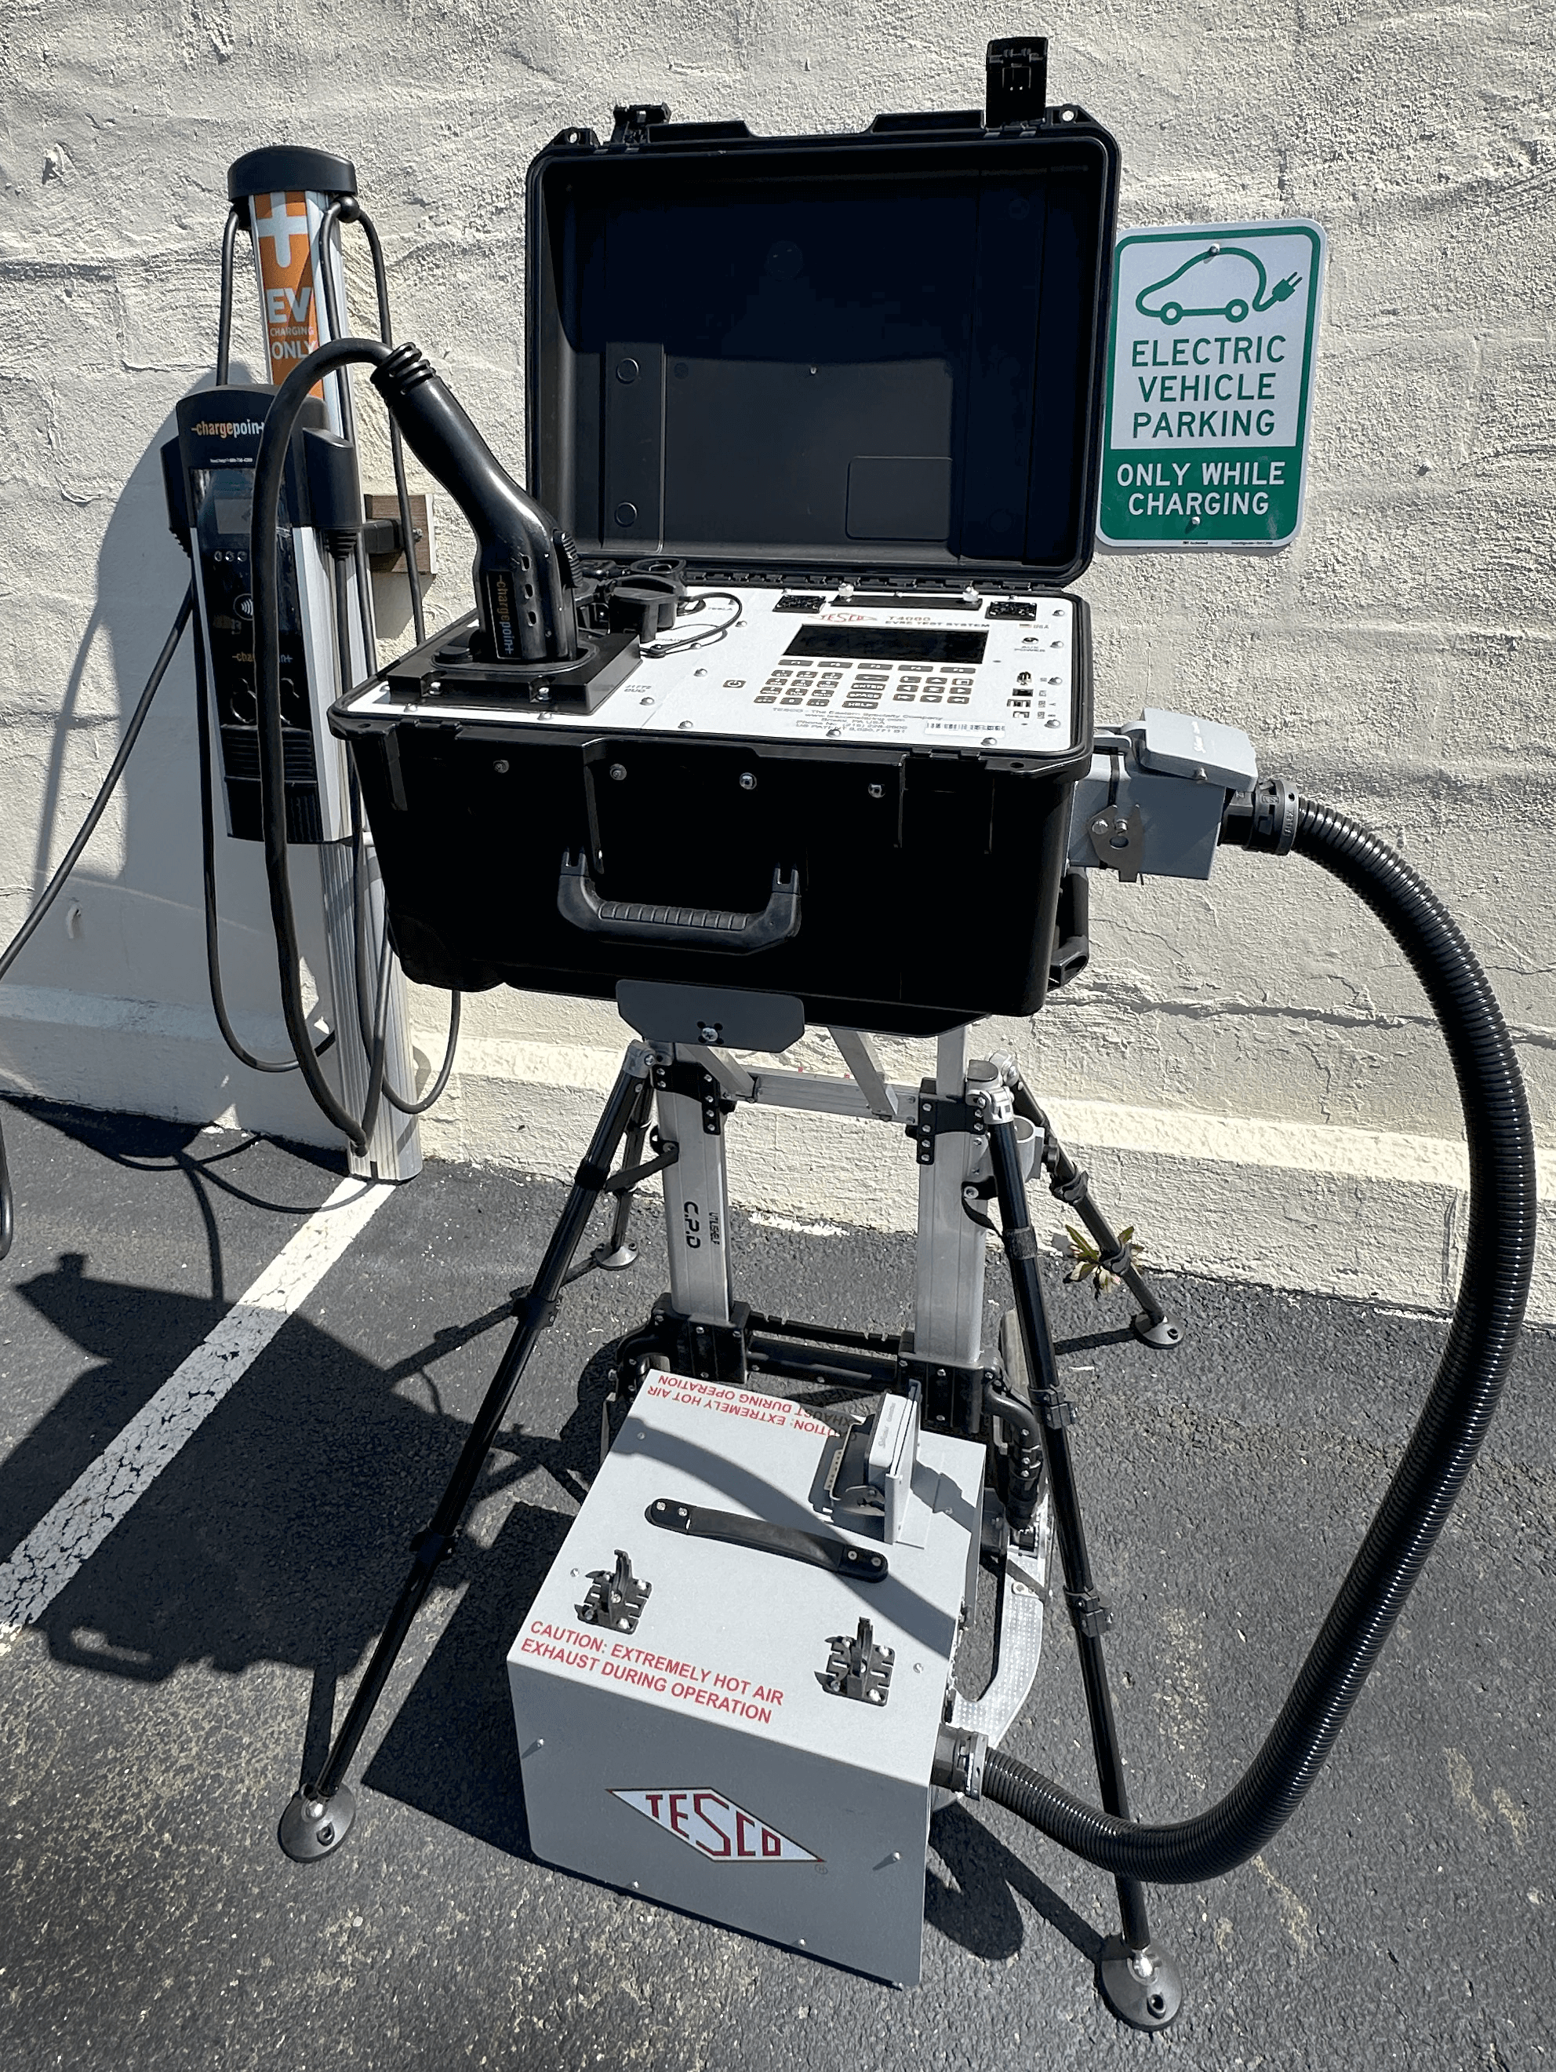
Why the delay?
Electric Vehicle chargers are not like ANSI electric meters. ANSI meters typically do not operate at their rated current limit. Electric vehicle chargers start at this limit and then taper off from there as the battery being charged approaches a full charge.
TESCO TS-400 Test System
We need to find a way to test 400 Kw chargers at 80% of full load and keep the equipment reasonably sized and without obsoleting what was purchased in the past.

Slide 50
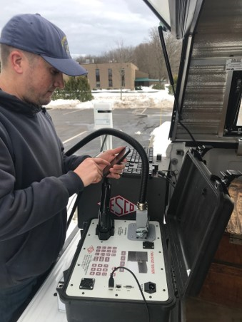
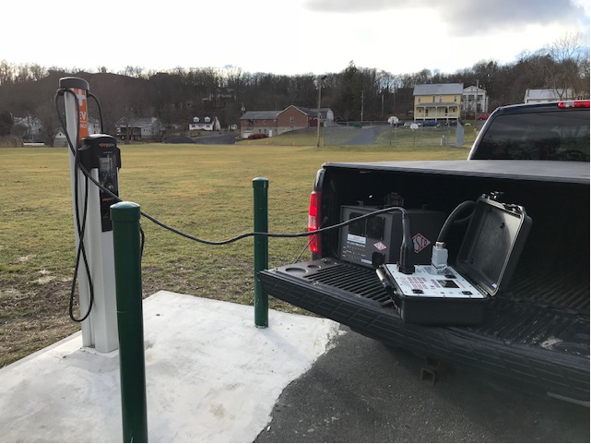
New York State Weights and Measures testing
  Note: This data is courtesy of New York State Weights and Measures NEWMA presentation at the 2022 annual meeting on Electric Vehicle Fueling System and Testing

Slide 51
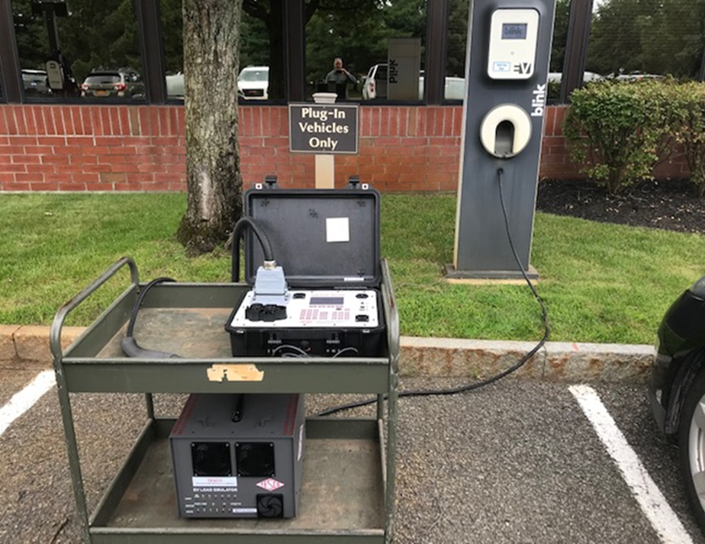
New York State Weights and Measures testing
Prerequisites
  HB 44
  Smart Phone
    Applicable App for testing particular charging platform
    Method of Payment
  Note: This data is courtesy of New York State Weights and Measures NEWMA presentation at the 2022 annual meeting on Electric Vehicle Fueling System and Testing

Slide 52
Results
Number of tests:
  265 total
Out of maintenance tolerance:
  Plus: 37 13.9%
  Minus: 40 15%
  Combo 4 1.5%
Failed transaction/Charger malfunction:
  25 9.4%
  Note: This data is courtesy of New York State Weights and Measures NEWMA presentation at the 2022 annual meeting on Electric Vehicle Fueling System and Testing

Slide 53
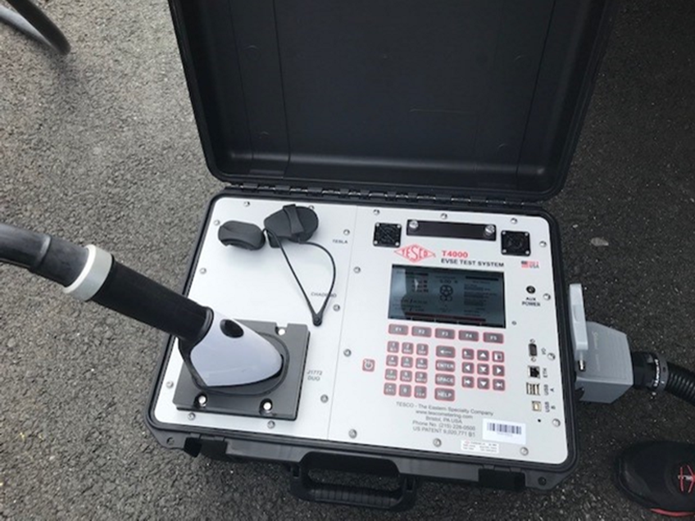
Takeaways
Specific Charging Networks/Manufacturers
  Some had no out of tolerance, others nearly all are out of tolerance
Cold vs Hot Weather Testing
  Very small sample size but no discernible difference in test results
  Note: This data is courtesy of New York State Weights and Measures NEWMA presentation at the 2022 annual meeting on Electric Vehicle Fueling System and Testing

Slide 54
Business Segment – Revenue Opportunities and Expectations

Slide 55
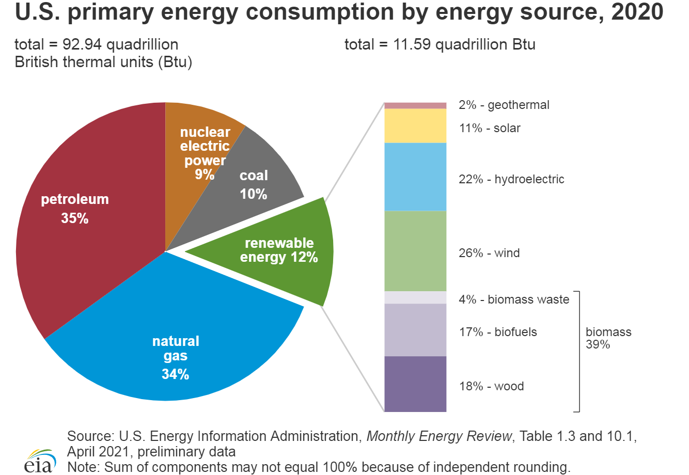
US Primary Energy by Source

Slide 56
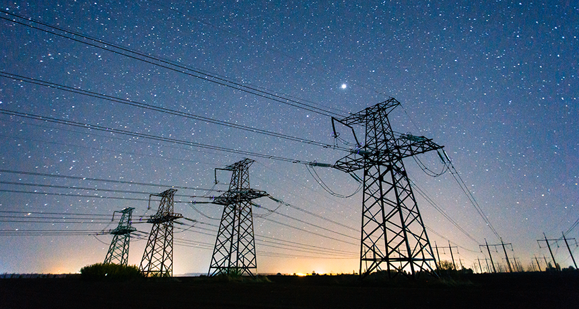
US TOTAL ENERGY CONSUMPTION
January 2023:
Generated 352,140.3 GWh
Average Residential retail price: 13.75* cents/kwh

Slide 57
US ELECTRIC ENERGY CONSUMPTION
Americans drove 3.23 trillion miles in 2021. If this was all done in electric vehicles getting 3 mi/kWh, then we would need 1.1 GWh of energy just to charge cars.
Average household uses 10.7 MWh/yr (2021).
Charging our cars could use an additional 8.8 MWh/yr.
Charging at home is a potential market worth $145 billion per year in added revenue to electric utilities

Slide 58
Topic Summary
Overview of Electric Vehicles (EV’s) in 2023
  Who is in the market?
  Who dominates the market?
  How many EV’s are on the road?
  Where is the market going?
Types of Electric Vehicle Supply Equipment (EVSE’s or chargers)
Electric Vehicle Charging Networks
Regulatory environment
Business Segment – revenue opportunities and expectations

Slide 59
Electric Vehicle Service Equipment - EVSE
What is it all about and why should I care?

Slide 60

Questions and Discussion
Tom Lawton
President
tom.lawton@tescometering.com
TESCO – The Eastern Specialty Company
Bristol, PA
215.228.0500
This presentation can also be found under Meter Conferences and Schools on the TESCO website: tescometering.com
ISO 9001:2015 Certified Quality Company
ISO 17025:2017 Accredited Laboratory

