Slide 1
Test Switch Operation & Transformers
Wednesday, July 12th, 2023
9:00 AM-10:AM
Dan Hollow

Slide 2
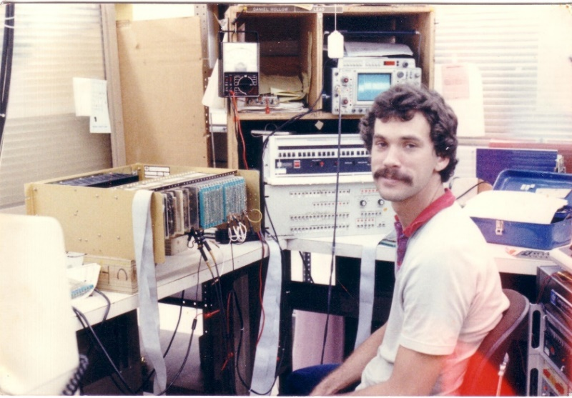
Bio: Dan Hollow Rocky Mountain Regional Sales Manager for TESCO
Background in Micro Electronics. Have worked for TESCO as the Rocky Mountain Regional Sales Manager since 2015. Have worked in the utility industry since 1988. Began career in the utility industry as the Production Test Department Supervisor for Aptech and accepted an outside sales position with Aptech in 1992 and have been in outside sales ever since. Have also worked for companies such as UTS/Itron, Datamatic, and Metrum Technologies/Aclara.
Have worked in the technology industry since 1980 and have worked in other industries prior to working in the utility industry as an Electronics Technician and Test Department Supervisor for companies that manufactured products for Banking Equipment, Industrial CNC Controls, Process Controls and Flight Simulator Equipment.

Slide 3
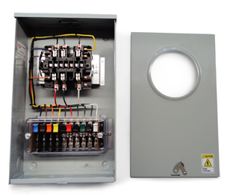
Purpose
To acquaint the attendees with the use and purpose of Meter Test Switches
Course Breakdown of Topics:
Using Test Switches
Meter Test Switch Specifications
Meter Test Switch Configurations
Meter Test Switch Accessories
Pre-Wired Transformer Rated Enclosures

Slide 4
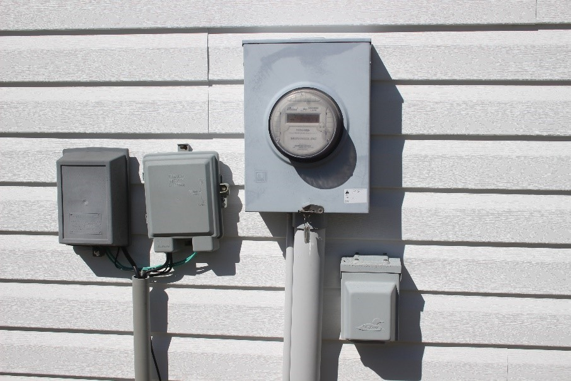
Typical Self-Contained Service
Typically found in residential metering
Meters are capable of handling the direct incoming amperage
Meter is connected directly to the load being measured
Meter is part of the circuit
When the meter is removed from the socket, power to the customer is interrupted

Slide 5
Transformer Rated Service
Meter measures scaled down representation of the load.
Scaling is accomplished with the use of external current transformers (CTs) and sometimes voltage transformers or PTs).
The meter is NOT part of the circuit
When the meter is removed from the socket, the customer does not lose power

Slide 6
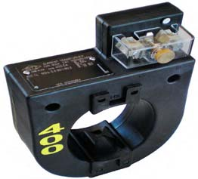
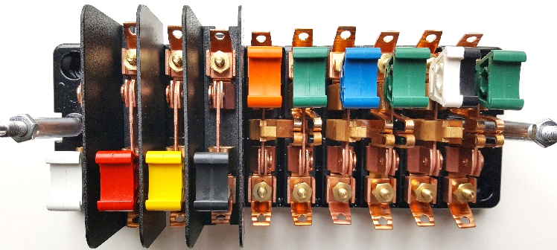
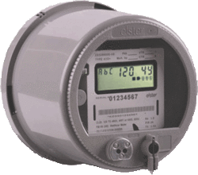
Transformer Rated Service
9S Meter Installation with 400:5 CT’s
SOURCE
PHASE A
400A
PHASE B
400A
LOAD
PHASE C
400A
5A
5A

Slide 7
Safety
Testing current transformers while they are in service can be a dangerous operation if certain safety procedures are not followed. The secondary loop of a current transformer must NEVER BE OPENED when service current is present in the primary. When there is current in the primary, and the secondary of a current transformer is open circuited, the voltage across the secondary can rise to hundreds and even thousands of volts, creating an extremely dangerous situation. The open CT secondary voltage magnitude varies with CT design and primary current flow. The high voltage that is present on the open secondary of an energized current transformer generates two great hazards.

Slide 8
Safety
The first hazard is ELECTRICAL SHOCK TO TESTING PERSONNEL. The second hazard is THE BREAKDOWN OF THE CURRENT TRANSFORMER INSULATION. Both hazards can be avoided provided that the secondary of the current transformer is never opened. The safest current transformer installations for testing are those that have a Test Switch as part of the secondary loop. A Test Switch is a device that will facilitate inserting instrumentation in the current transformer secondary loop without the danger of opening the circuit.

Slide 9
Typical Connections for Common Meter Forms

Slide 10
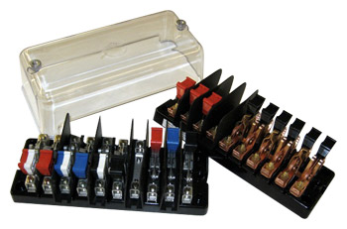
Test Switch Specifications
ANSI C12 Definitions
Test Switch Materials
Plating
Barriers
Wiring Connections
What to look for
Covers

Slide 11
ANSI C12.9 Test Switch Definitions

Slide 12
ANSI C12.9 Test Switches

Slide 13
ANSI C12.9 General Test Switch Specifications

Slide 14
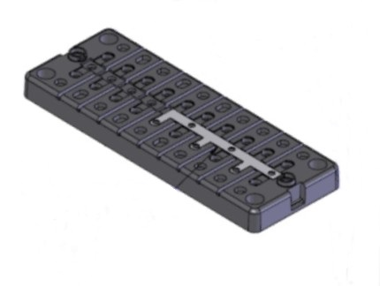
Test Switch Configurations
Layout
Handle Colors
Reversed vs. Normal Potentials
Current Links
Base Sizing
Barrier Locations

Slide 15
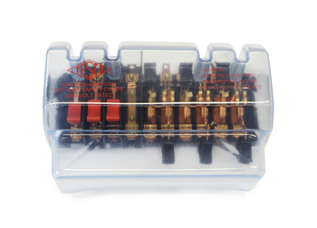
Test Switch Accessories
Test Plugs
Safety Covers
Test Switch Isolators
On installations that contain Test Switches, test leads terminated with a test switch
safety test probe (test plug) should be used for CT testing. This provides a “make-before-break” connection to prevent accidental opening of the current transformer secondary loop.

Slide 16
ANSI C12.9 Test Jack Specifications

Slide 17
ANSI C12.9 Test Plug Specifications

Slide 18
For Utilities not Currently Using Test Switches

Slide 19
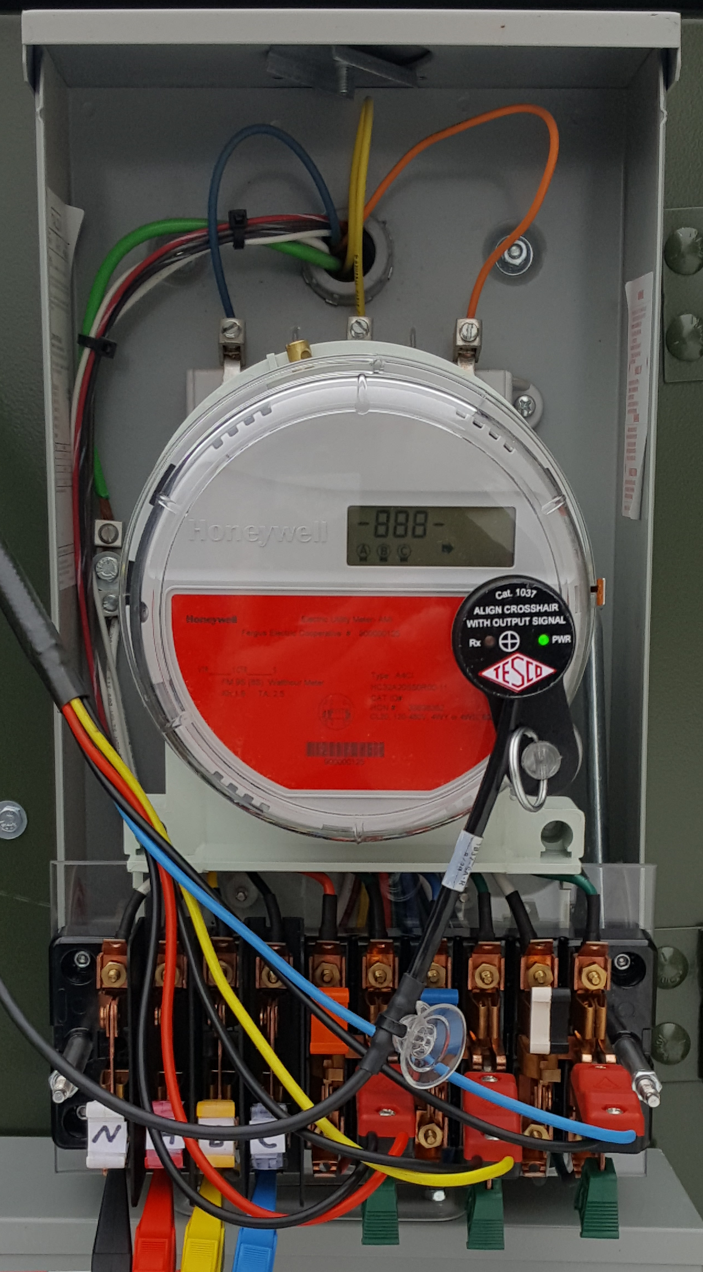
Test Switch Mounted Below Adaptor

Slide 20
Test Switch Wired up and Ready for Test

Slide 21
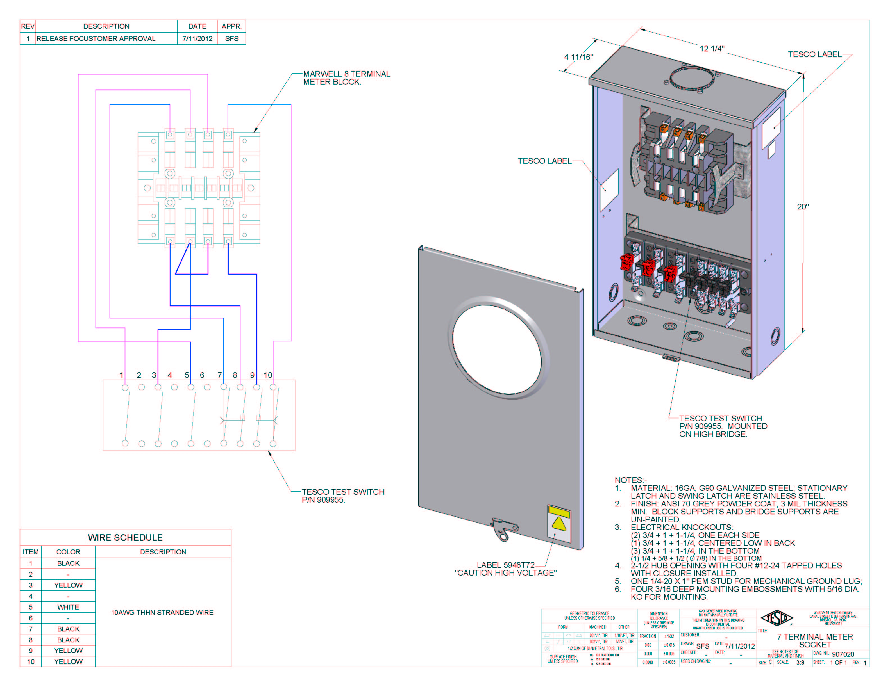
Pre-Wired Transformer Rated Enclosures
Cover Types
Wiring
Sockets

Slide 22
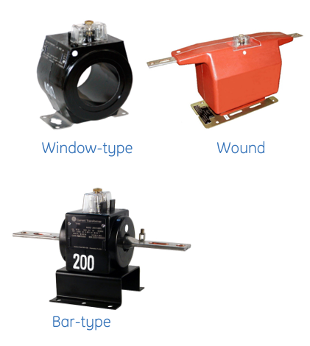
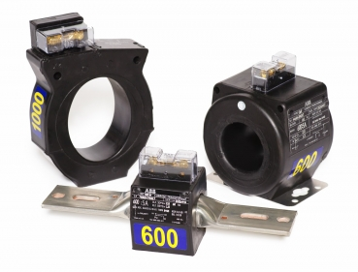
CT Types

Slide 23
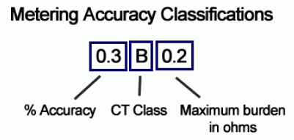
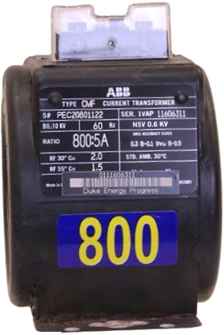
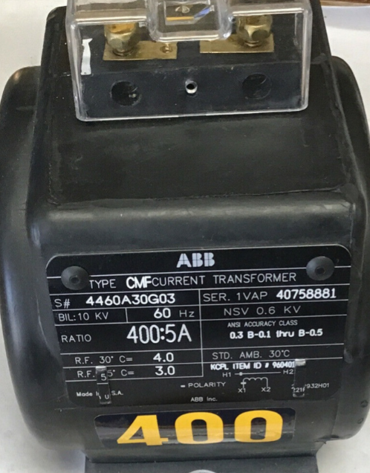
CT Nameplate Information

Slide 24
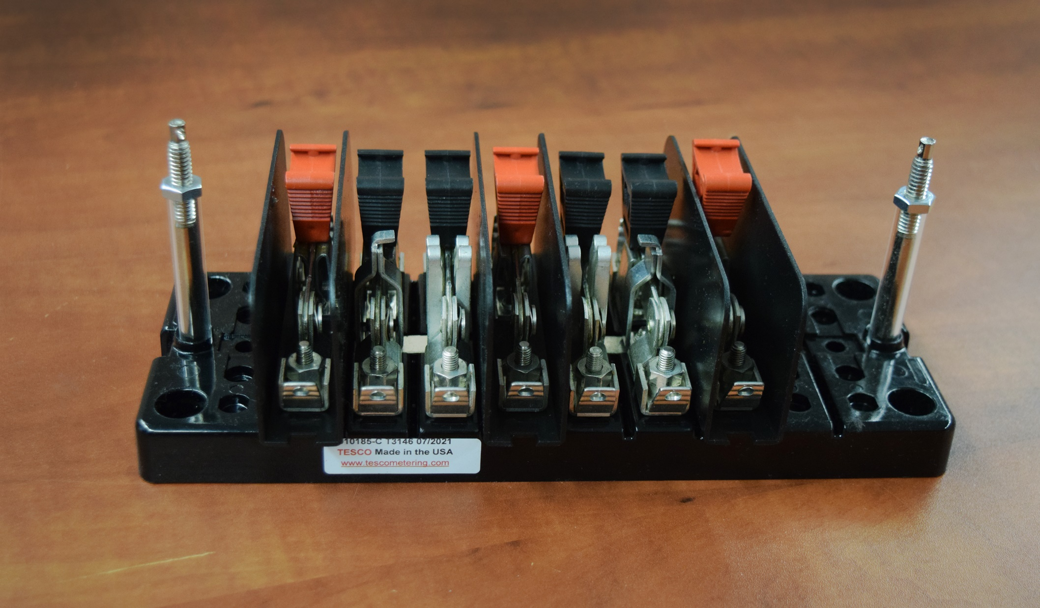
Questions?

Slide 25
3 Quiz Questions Multiple Choice
Why would you not want to open the test jack before opening the shunt/shorting switch first before testing the CTs on a given transformer on a transformer rated metering service?
Because it could cause an arc flash
Because you would power down the meter
Because it would open circuit the secondary of the CT for that phase
None of the above
Which type of metering service would require a test switch?
Self-Contained
Single Phase
Transformer rated service
Net Metered Service
What is the purpose of a test switch?
To add cost to a transformer rated metering service.
To prevent electrical shock
To enable testing of the CTs and meter on a transformer rated service
To cut power to the meter

Slide 26
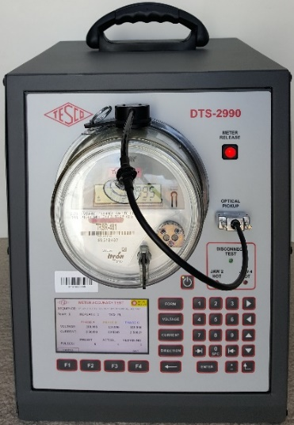
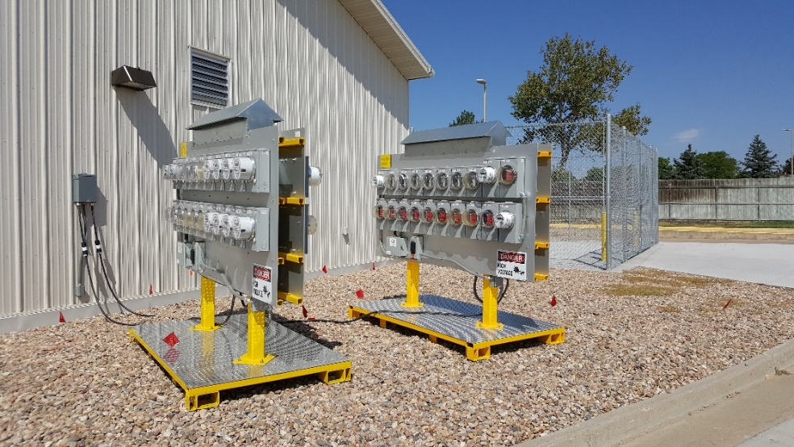
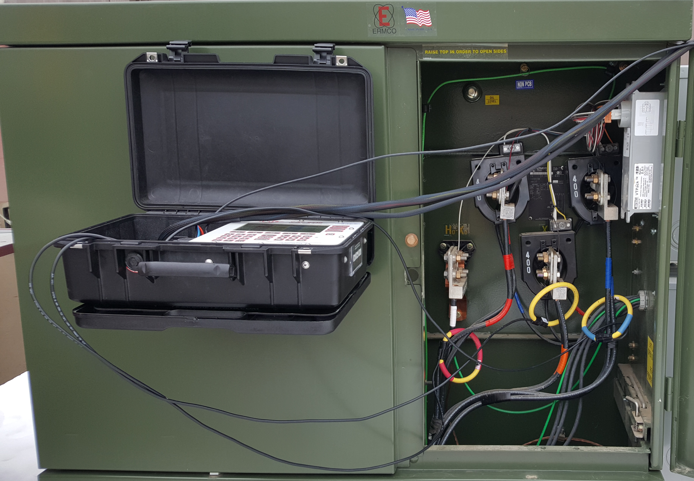
Thank you
Your Source for all Things Metering
Website: www.tescometering.com
Email: dan.hollow@tescometering.com
Main Office Phone: (215) 228-0500
Cell: (303) 810-6528

