Slide 1
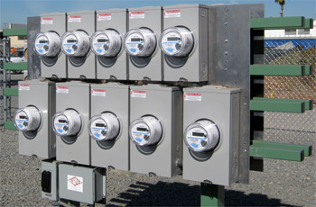


How to Hire and Train the Right Employee for Meters and Metering Technology
Prepared by Tom Lawton, TESCO
The Eastern Specialty Company
For North Carolina Electric Meter School
Management Session
Wednesday, June 27, 2018 at 9:30 a.m.
10/02/2012
Slide 1
Notes:
1

Slide 2

Summary
SORRY
We have them all.
QUESTIONS?
Tom Lawton
TESCO – The Eastern Specialty Company
Bristol, PA
215-785-2338
This presentation can also be found under Meter Conferences and Schools on the TESCO web site: www.tescometering.com

Slide 3
Lack of Workforce
As the U.S. economy has improved in the years after the Great Recession, businesses in all sectors have struggled to hire and retain labor. The national unemployment rate has hovered below 5 percent over the past two years, with local rates at or below 4 percent in half the states, according to the Bureau of Labor Statistics. Meanwhile, the U.S. labor-force participation rate—the share of workers who are employed or searching for work—has steadily declined since 2001. That’s left employers in dozens of states struggling to hire and keep employees, whether they’re in minimum-wage jobs or positions requiring advanced degrees.
The metering work force continues to age with the average age of the field meter technician pushing 50 years old and the meter shop average age exceeding that number.

Slide 4

Competition
Competition for talented, good employees
Business costs and impact of employee turnover can be grouped into four major categories;
  Hiring costs
  Training costs
  Costs resulting from a person leaving
  Lost Productivity Costs
Estimated cost to replace an employee is at least 150% of the person’s base salary

Slide 5

Strong Employer Brand
Employer branding is how your company is perceived by prospective and current employees. Positive employer branding can help you attract and retain the best employees. It can also help reduce hiring costs by attracting more candidates per job opening.
Strong regional/local company with deep local roots
Strong employee base. Employees can help attract prospective employees
Describe your culture – whatever that may be;
  All about the customer
  Most technically progressive
  Best value for the customer in the area
  Most family oriented
Whatever your culture – promote this
Develop a Co-op program with local universities and technical schools
Speak at secondary school career fairs
Sponsor primary and secondary school technology fairs

Slide 6
Strong Industry Brand
Utility work is a unique career
  Stable work
  Constantly evolving technology with tremendous opportunities to grow
  Great upward mobility for the incoming generation of workers
Utility work is a non-competitive environment that relies on high technical skills and individual work ethic
There are electric utilities in every region of the country that you may want to live in or relocate to.
This is an industry with a rapidly aging work force that went too many years without recruiting. Tremendous opportunities for advancement given the gap between new entries into the industry and the retiring employees.
Do not underestimate the comradery of the industry and the wealth regional meter schools to meet and work with other engineers, technicians, and managers in the industry

Slide 7
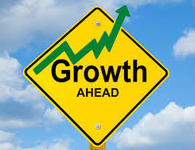
Growth Opportunities for the Metering Sector
People like to be part of something growing and dynamic
  Do not underestimate the appeal of metering in 2018
  Metering is growing
  Metering technology is evolving rapidly
  Metering is where all the information is
  Metering is sexy
New skill sets are necessary and must be coupled with the old skill sets
  New employees have the potential to be a new breed of engineer or technician
    Metering expertise
    Communications expertise
    Big data and analytics expertise
  Again – this new set of skills provides the ability for rapid advancement and success

Slide 8
Good Benefits Package
According to a 2017 study by Harvard Business Review and Fractl, the top 4 benefits workers seek are health benefits, flexible hours, vacation time, and work-from-home options. Newer benefits may include helping employees with their transportation costs.
Utilities have always had one of the strongest benefits packages of any industry sector. Capitalize on this;
  Great health care
  Great vacation and paid time off package
  Increasingly greater work from home opportunities
    Field workers often travel to the field directly from home or return there or both
  Field work allows for more flexible work hours and conditions and typically involves a company vehicle that can be used for all company travel including to and from work

Slide 9

Culture
Culture is important to most employees when deciding whether to stay or leave
Be the employer people want to work for
Monthly Game Nights
Family-like connections with employees
Increase employee involvement and enthusiasm
Inspire employees to do excellent work

Slide 10
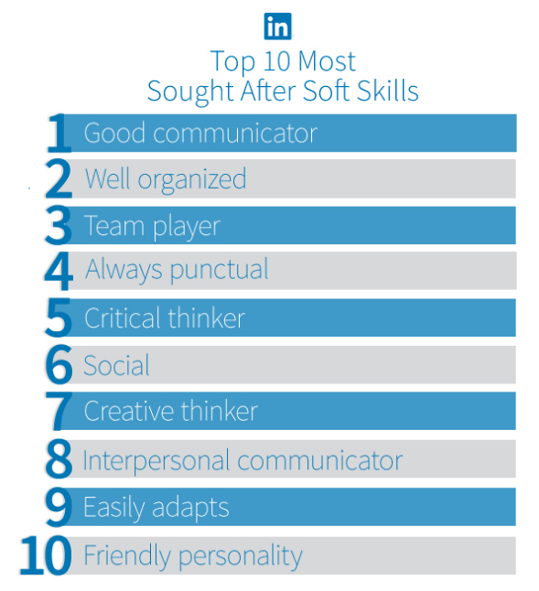
Top 10 Most Sought After Skills

Slide 11

Onboarding Process
Once hired, getting new employees onboard is the first step in making sure they’re successful and more likely to stay.
Make onboarding a priority
Cover the basics
Signed offer letter
Tax forms, e.g. W-2s or W-4s
Identification forms, e.g. I-9
Payment forms, e.g. direct deposit
Signed employment agreement
Signed non-disclosure / confidentiality agreement
Signed non-compete agreement
Policies and procedures employee handbook

Slide 12

Welcoming Them
The basics are good. Go above and beyond. Make sure that they feel they are a priority. They need to feel that you have taken the time to get ready for them and are expecting and wanting them to join the team;
Business cards are ready for them
Their name is on their cubicle or office or locker
Their tools are ready for them
Lap top or desk top is assigned to them, e-mail is set up, security and access to the network is taken care of
And go beyond that
Make time out of your schedule to spend time with them. They may spend more time on their first day with you than they will for the next six months or a year depending how many levels above them you are, but if they know the people above them know they are starting and have taken time to spend with them they will feel a part of the team right from the first day

Slide 13
Training
New employees
Building a positive culture through training and investment in people is good business sense
While training can improve performance and service, It can also improve retention.
Make Sure They’re Well Trained
Employees value relevant, high-quality training. It increases their chances for success and shows that you care about their professional growth.
The key steps for successful training include:
Don’t just train on hard skills. Help new employees acclimate to your small business’ culture and norms. This is especially important in areas such as customer service roles.
Leverage mentors and cohorts. New employees learn best when they have others in the organization they can turn to for tips and help.
Training needs to be a continuous process, not just something you offer in the first few month. Design it as a career-long process.
Have a regular check-in mechanism. Make sure you or your HR folks follow up with new employees on a periodic basis to make sure they are doing well and are happy.
Safety aspect for metering??
Metering schools like NC???

Slide 14

Other
Give employees good feedback
  Everyone likes to know where they stand. There is value in providing personalized feedback to employees on their strengths and areas in need of improvement
  A strong management process or annual performance review will help employees feel more secure and happier in the long run, leading them to stay longer
Let employees know they’re appreciated
  Employee recognition programs
  One thing that can demotivate employees is not being appreciated for their hard work
Make sure employees are engaged and motivated
  More engaged employee is a happier employee
  Learning opportunities for growth
  Culture building team events

Slide 15

Summary
Be the employer people want to work for
Describe the successful person, not job applicant
Get the word out in the right way
Filter candidates to find the best
Set up an efficient onboarding process
Hire slow, fire without surprises
Develop employee retention strategies

Slide 16
Questions?
Tom Lawton
TESCO – The Eastern Specialty Company
Bristol, PA
215-785-2338
This presentation can also be found under Meter Conferences and Schools on the TESCO web site: www.tescometering.com

